Slide 1
News from Dyalog Spring 2025
Morten Kromberg, CTO

Slide 2
Morten Kromberg
CTO of Dyalog since 2005 (20 years + 2 days)
CTO of Adaytum Software (BI vendor) 1995-1999
(20 => 200 employees, sold to Cognos for $160M)
APL Consultant for ~20 years
Focus on interfacing/integration, client/server architectures and developer tools / frameworks
Still writes APL code most days ❤️
Contributor to GUI emulation & Source Code Mgt tools

Slide 3
Agenda
General News from Dyalog
New Tools, Products and Services
Releases
19.0 (Q1'24) and 19.4.1
20.0 (Q2'25 – in Beta Test)
21.0 (Q2'26) – and beyond...

Slide 4
Introducing Dyalog
Dyalog is the ”New Kid” on The APL Block
Only 42 years since release of Dyalog version 1.0 in 1983
Has emerged as the Market Leader for APL
Management Buy-In in 2005
Financed by two clients and an APL distributor / consulting firm

Slide 5
The Last 20 Years
Headcount and Turnover Increased 5x
Headcount now ~29 full time equivalents (+3 from 2024)
Steadily increasing R&D budget
Largest sustained investment in APL technology in the history of the language

Slide 6
Revenue Splits
Very Roughly
USA vs ROW: 40 / 60
UNIX & Linux vs Windows: 25 / 75
UNIX revenue is currently 90% AIX
We expect Linux to grow, replacing both AIX and Windows
USA and UNIX: a smaller number of larger clients
Slowly changing due to migrants from US-based APL vendors

Slide 7
Financial Status
Owners | 2008 | 2018 | Present
SimCorp (Denmark) | 32.33% | 40% | 24%
APL Italiana (Italy) | 32.33%
Management & Employees | 35.33% | 60% | 76%
Ownership Today
24% owned by SimCorp (Deutsche Börse)
76% owned by management and employees
Revenue steadily increasing
Adding 1 or 2 "significant" clients each year
Year | Growth
2024 | 4.7%
2023 | 8.6%

Slide 8
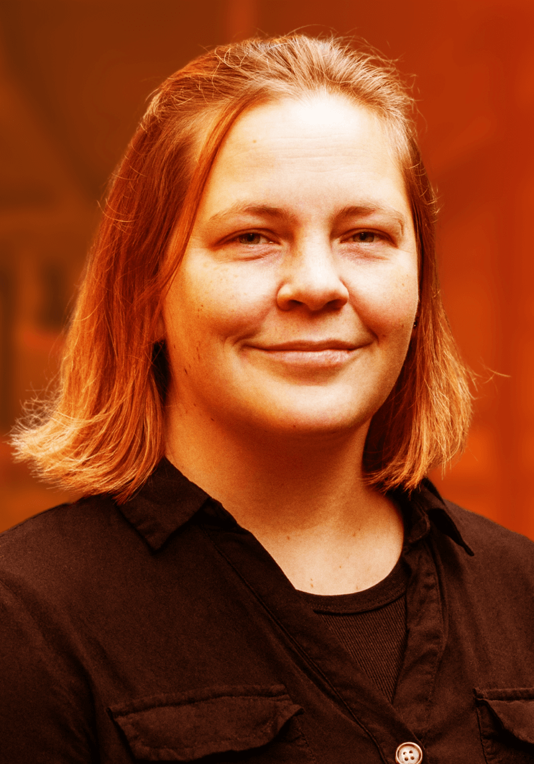
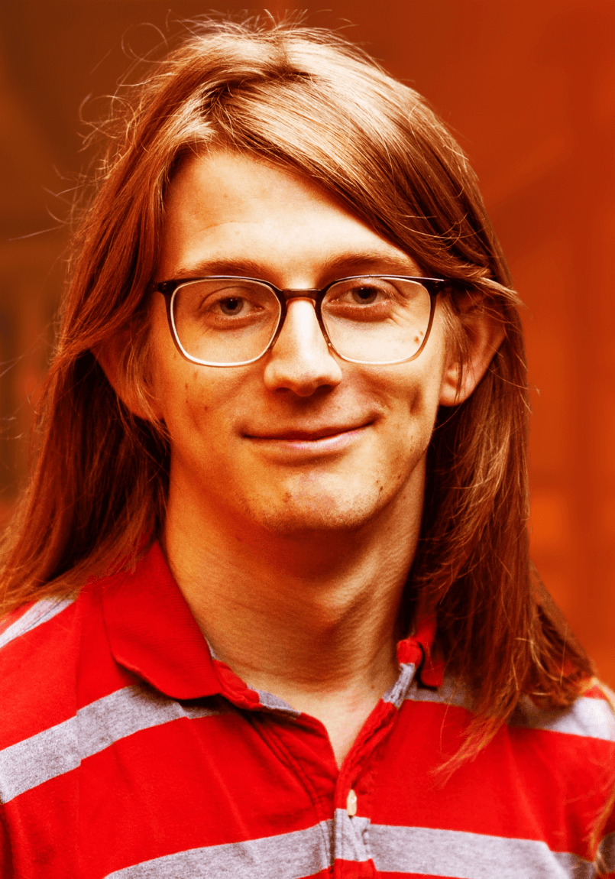
Dyalog – The Next Generation
New CEO
2010-2021
2022
2023
2024
2025

Slide 9
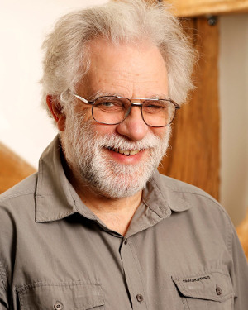
Retirees
Geoff Streeter
Gitte Christensen
Pete Donnelly
Dyalog'24 recording at dyalog.tv: "Let's Put the Future Behind Us"

Slide 10
Dyalog'24 recording at dyalog.tv: "The New Breed Plugs In"

Slide 11
New Tools, Products & Services
Kafka Interface
Static Analysis of APL Code
GUI Emulations
LLM Interfaces
Training & Consulting

Slide 12
Maturing Technologies
But first, a few words about some important "maturing" technologies

Slide 13
The "Jarvis" Web Service Framework
Jarvis is involved in many, many new client projects, and is continuously enhanced. Recent examples:
Support multipart/form-data for file upload and form input
Support for serving static files
Automatic response-type set for 79 common content file types
Support for application/x-www-form-urlencoded content type allows Jarvis to accept HTML form input from a served page
Added zipping response payload if client supports it

Slide 14
Tatin
Package manager for Dyalog APL (A tasty way to package APLs)
2023
2024
]z←tatin.listPackages
{⍺,≢⍵}⌸{(¯1+⍵⍳'-')↑⍵}¨3↓z[;1]
aplteam 42
davin 4
dyalog 2
]z←tatin.listPackages
{⍺,≢⍵}⌸{(¯1+⍵⍳'-')↑⍵}¨3↓z[;1]
aplteam 44
davin 4
dyalog 5 ⍝ 150% growth!
¯2↑z
dyalog-HttpCommand 1
dyalog-Jarvis 1
¯5↑z
dyalog-APLProcess 1
dyalog-HttpCommand 1
dyalog-Jarvis 1
dyalog-NuGet 1 dyalog-OpenAI 1

Slide 15
Link
Link maps the source code of objects in the workspace to text source files
Link enables the use of Git or other Source Code management systems
New users generally start with Link; old dogs are moving slowly

Slide 16
Documentation
We are moving towards open-source markdown-based documentation, produced using MkDocs on GitHub
Anyone (including you) can raise issues
Or even submit pull requests
You CAN also email docs@ or support@dyalog.com

Slide 17
Documentation: Why change?
Easier to contribute
Internally and externally
Open formats, platform agnostic tools
Better search
Provide better training input to Language Models
Human-friendly, predictable URLs

Slide 18
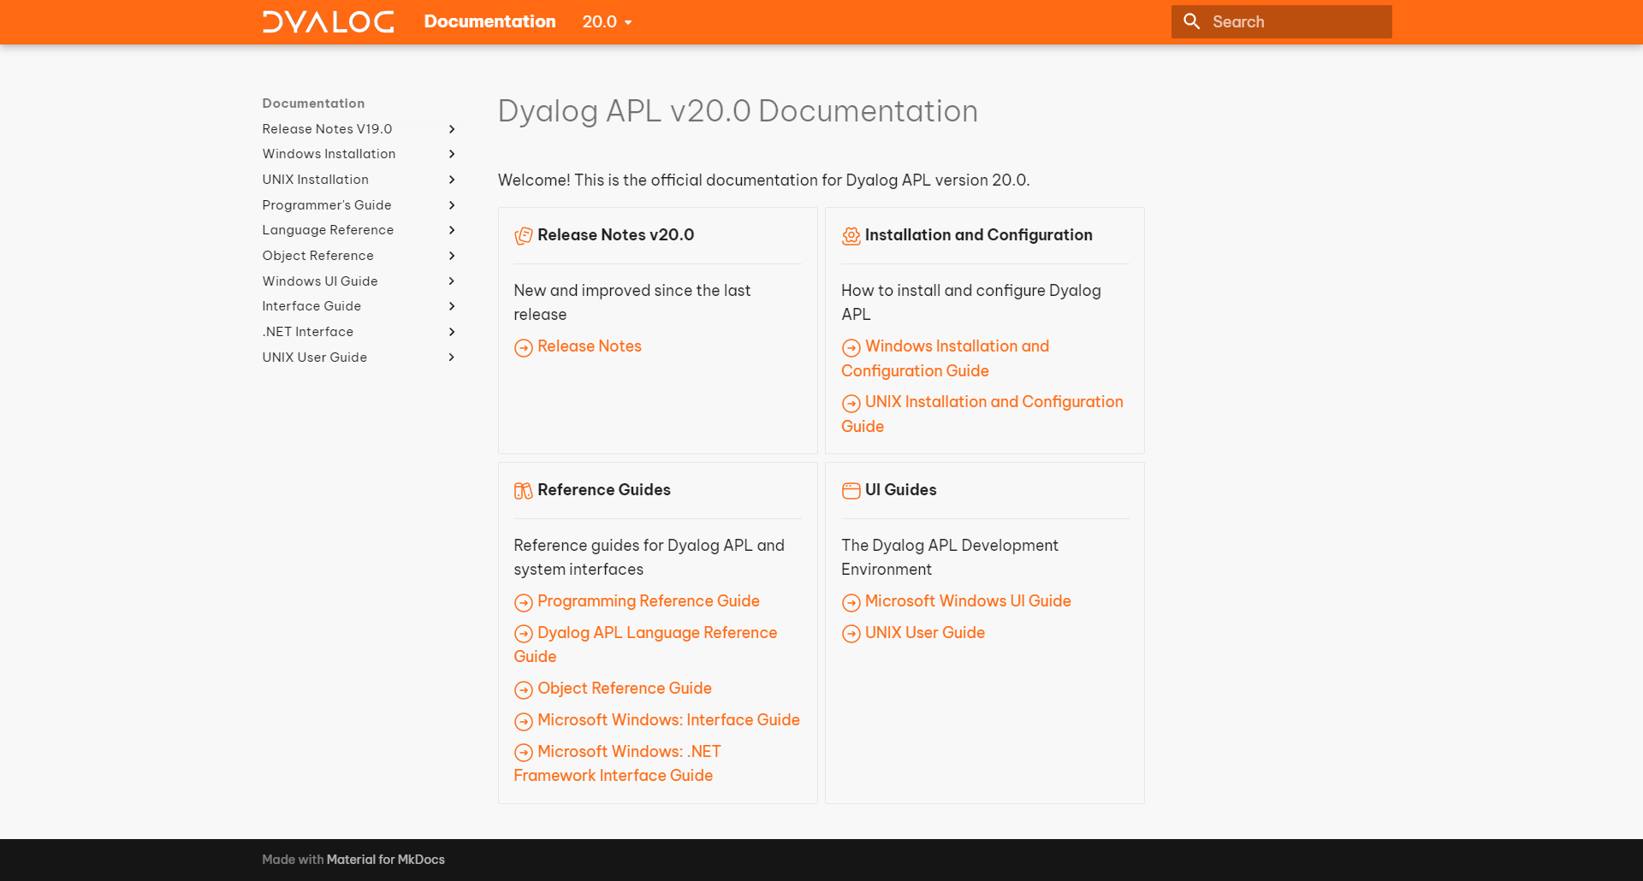

Slide 20
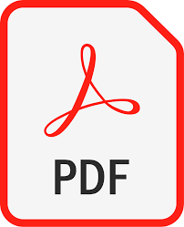
NB: PDF / Print is deprecated
We will continue to produce some PDFs
Will not spend as much energy on formatting them nicely
Offline versions of the documentation WILL be available

Slide 21
New Tools...

Slide 22
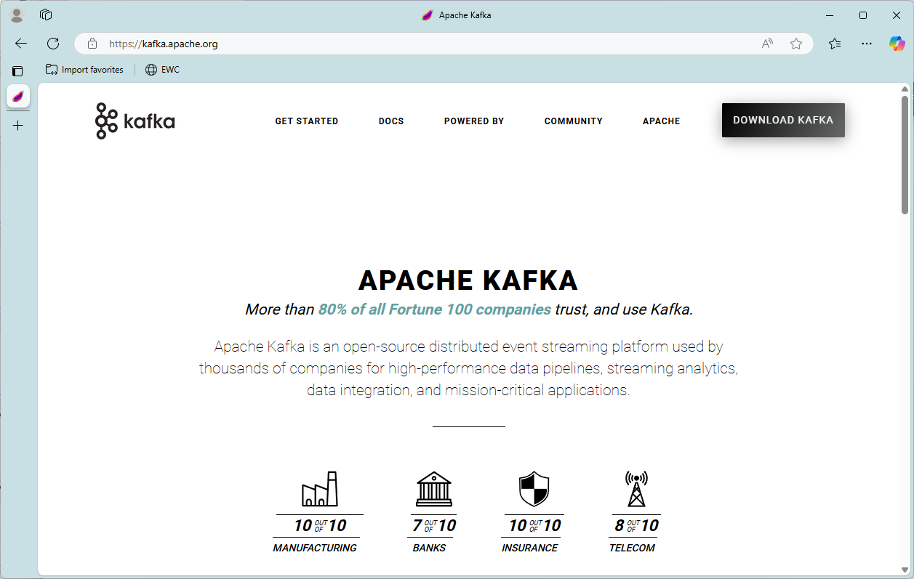
The Dyalog-Kafka interface supports Producer and Consumer, but not "AdminClient"

Slide 23
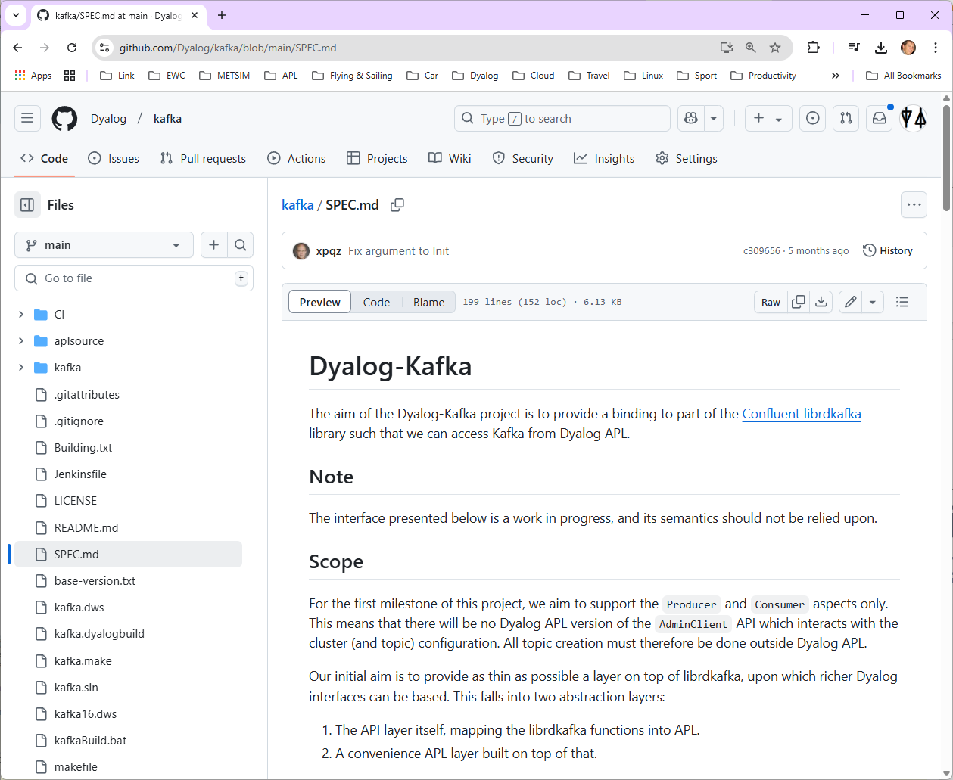

Slide 24
Kafka Support
We're trying a new approach
The interface is FOSS (Free and Open Source)
https://github.com/dyalog/kafka
If you want Dyalog to build and test for you and provide support, you can sign up for paid support
Two customers currently testing the prototype
Meeting another potential user this week

Slide 25
Static Analysis of APL Code
Static Analysis of application code is seen as a required "best practice" by many corporations
We are building a prototype of a tool which will
Detect vulnerabilities and other bad practices
"Lint" APL Code
This tool will initially be licensed separately
A free "community edition" may follow later
Will be tested by first two clients late this year

Slide 26
"Artificial Intelligence"
AI in some form is likely here to stay
Users (or at least their managers) expect us to support AI in a practical way
[New] developers expect some degree of AI support
AI providers are unlikely to prioritise APL improvements without our involvement

Slide 27
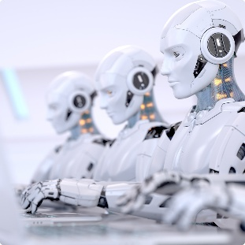
AI – Potential Use Cases
Enabling the use of LLMs "etc" from Dyalog
Improving developer productivity with co-pilots
Improving code quality by identifying common errors and automating boiler plate
Generating test cases and analyzing test logs
Summarizing and explaining existing code
Smart documentation

Slide 28
AI for APL – "Yes But"
Compared to other languages, there is relatively little online training data available
Large APL users are unwilling to make code public
Coding styles and standards vary enormously
Often using domain specific notations unique to each solution
Public code tends to be "modern"
(dfns and tacit functions)
There is less boiler-plate to write, so less of a productivity boost to be had ;)

Slide 29
AI – Dyalog's Action Plan
Implement [free and open source] interfaces
Provide good public training data: Dyalog will put [almost] all the APL code that WE write in the public domain
Experiment with
Using AI for internal testing
Experiment with "smart searching" of our online documentation
Experiment with "co-pilots" at large customer sites, using private source code

Slide 30
Training
We make all our course materials available online
Many different tutorials available, including a revised version of Gary Bergquist's tutorial
We also run training courses and workshops
Inhouse or Online – your choice!
Helping a client produce internal training videos on secure coding practices

Slide 31
Consulting
Traditionally, Dyalog has not offered consulting services
We are now slowly growing a team
In most cases, we will still refer clients to partners

Slide 32
Open-Source
Dyalog APL will remain closed source
Almost everything else we produce is open-source
Documentation and training materials
Almost all tools and interfaces written in APL
The Kafka interface and co-dfns compiler
Some old C components will become open-source
Conga (TCP), HTMLRenderer (CEF), Cryptographic Library

Slide 33
Dyalog Versions Recent, Present and Future

Slide 34
Highlights of Version 19.0 (Q1'24)
For more, see Dyalog'24 Presentations @ https://dyalog.tv
Platform Support / Distribution
64-bit ARM support
New Macs
Enhanced .NET Bridge
Framework vs new .NET versions
Bound executables on all platforms
Building Production Systems
Token range reservation
WS FULL handling
⎕NCOPY/⎕NMOVE callbacks
Developer Productivity / IDE
Source "as typed" by default
Multi-line input on by default
HTMLRenderer updates
Link 4.0: Config files, simple text arrays
HttpCommand client, Jarvis web service
Installing & Managing APL
Multiple session files
Health Monitor

Slide 35
Version 19.4.1
The tools that applications are built upon are changing at an astonishing rate
V19.4.1 re-targets many obsolete system names to modern tools and interfaces

Slide 36
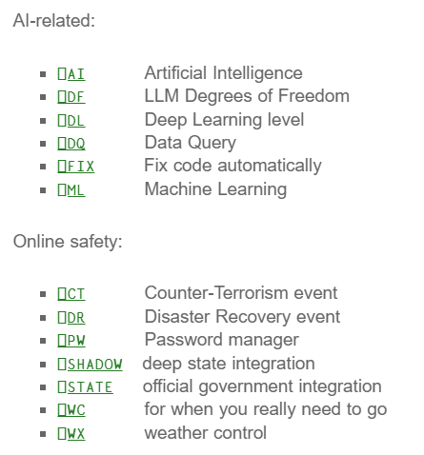
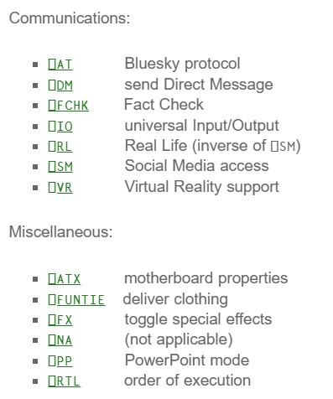
Revised System Names in v19.4.1
Many system functions re-purposed
Read all about it at dyalog.com/blog

Slide 37
Mike Mingard – Brand manager

Slide 39
Highlights of Version 20.0
In Beta, planned release in Q2
Array Notation
Set & Get Variables
Token-by-Token Debugging
Reverse Compose
Shell System Function
.NET Bridge Enhancements
New Platform: ARM64

Slide 40
Array Notation
≡
≡
≡

Slide 41
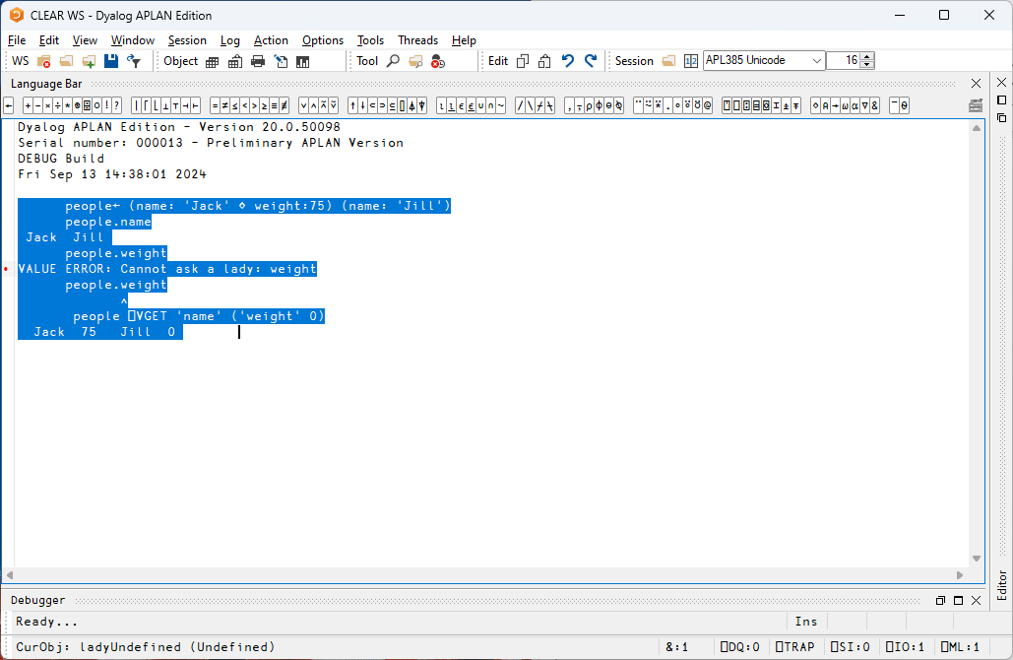
Namespace Notation
⎕VGET and ⎕VSET
people← (name: 'Jack' ⋄ weight:75) (name: 'Jill')
people.name
Jack Jill
people.weight
VALUE ERROR: Undefined name: weight
people.weight
∧
people ⎕VGET 'name' ('weight' 50)
Jack 75 Jill 50
people[1].⎕VGET ¯2
name Jack weight 75

Slide 42
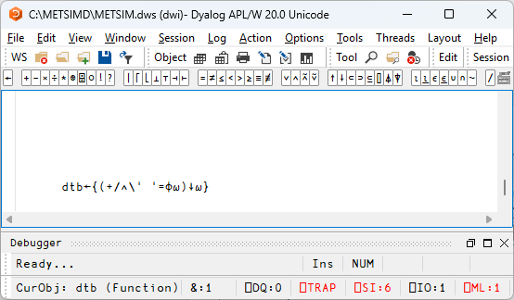
Token by Token Debugging

Slide 43
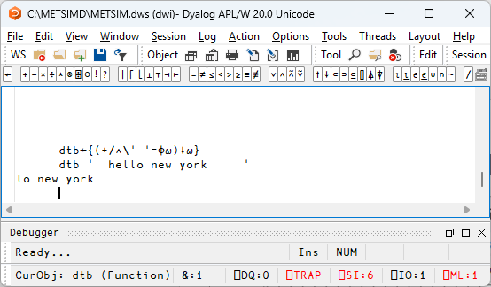
Token by Token Debugging

Slide 44
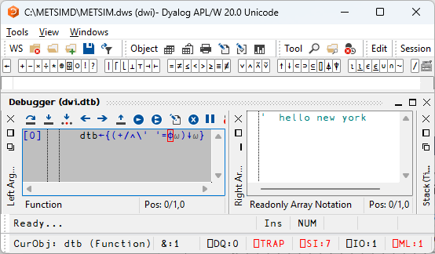
Token by Token Debugging

Slide 45
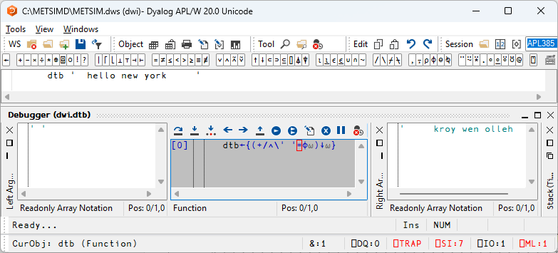
Token by Token Debugging

Slide 46
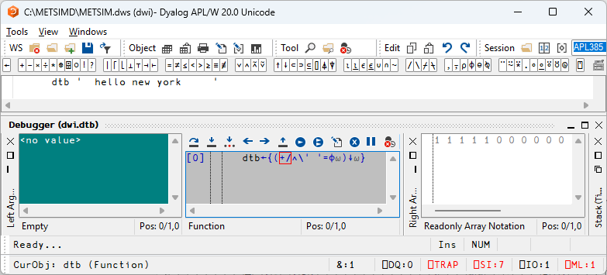
Token by Token Debugging

Slide 47
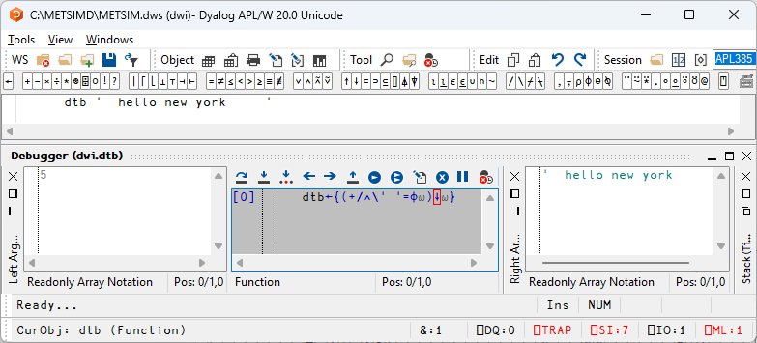
Token by Token Debugging

Slide 48
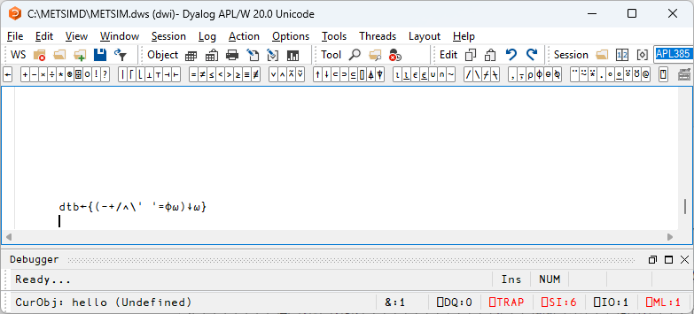
Token by Token Debugging

Slide 49
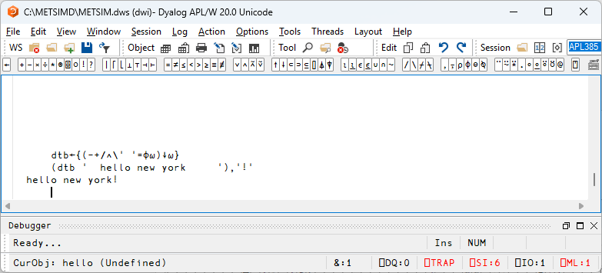
Token by Token Debugging

Slide 50
Behind / Reverse Compose
Dyadic: ⍺ f⍛g ⍵ ⬅➔ (f ⍺) g ⍵
10⍳⍛∊2 3 5 8 ⍝ (⍳10)∊2 3 5 8
0 1 1 0 1 0 0 1 0 0

Slide 51
Behind / Reverse Compose
Monadic: f⍛g ⍵ ⬅➔ (f ⍵) g ⍵
f←5∘< ⍝ Predicate function
f⍛⌿ 2 7 1 8 2 8 ⍝ Filter by f
7 8 8
⌈/⍛= 2 7 1 8 2 8 3 ⍝ Max behind Equal
0 0 0 1 0 1 0

Slide 52
⎕SHELL to replace complement ⎕CMD
Invoke Shell Commands from APL
Interruptible
Optionally return data as an asynchronous stream
Manage stdin, stdout & stderr (& other streams) independently
Handle variety of data encodings
Defaults to PowerShell under MS Windows
Dyalog'24: New Function for Shell Calls (Peter Mikkelsen)

Slide 53
.NET Bridge Enhancements
The v19.0 bridge to .NET 8.0 is on par with the Framework bridge
New features will ONLY target the new .NET versions (8+):
In v20.0: Generic Methods and Classes

Slide 54
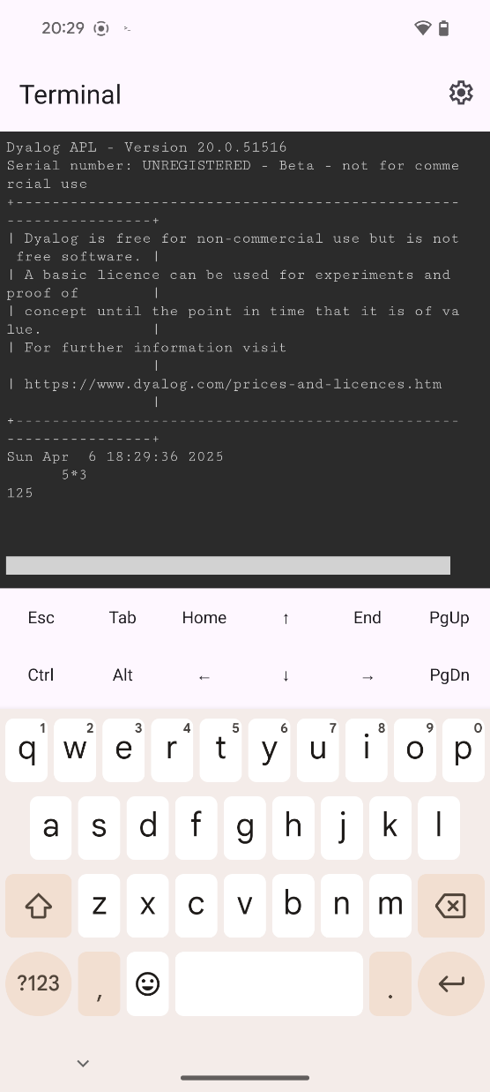
New Platform: ARM64
macOS since v19.0
v20.0: Linux / ARM
Amazon Web Service "Graviton" images
64-bit Raspberry Pi
Seems to work on Android (but no development environment)

Slide 55
Sketch of Version 21.0
Open-Source Components
.NET Generics
Parse date-times
Open Telemetry
Script Support
Language
Enhanced Key Operator
New Selection Primitive
:Disposable, :Finally
Reap dividends of Namespace Notation

Slide 56
Selected v21.0 Features...

Slide 57
Growing use of APL as an engine for services in multi-tier or microservice architectures
Monitoring and debugging these complex systems requires recording telemetry
Version 21.0 will make it easy to emit logs using the OpenTelemetry framework

Slide 58
Open Source Components
Release as open-source "plugins":
HTMLRenderer (CEF)
Conga (TCP/IP)
Cryptographic Library

Slide 59
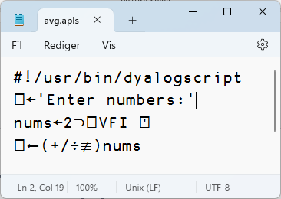
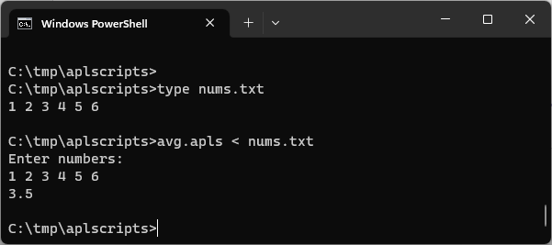
"Script Engine"
#! (hash bang) scripting
Script engine is popular with new users AND "Continuous Integration" engineers
Has been gradually enhanced for several releases
Will be further improved in v21.0
RIDE debugging of scripts

Slide 60
Parse Dates & Times
Version 20.0:
⎕←now←1 ⎕DT 'J' ⍝ current local time
45751.57121
1 ¯1 ⎕DT now ⍝ Convert from Day No (1) to ⎕TS (¯1) format
2025 4 5 13 42 32 632
format←'__es__ hh:mm Dddd DD Mmmm'
format (1200⌶) now
13:42 Sábado 05 Abril
Version 21.0: Absorb 1200⌶ and its inverse into ⎕DT:
1 format ⎕DT now
13:42 Sábado 05 Abril
format ¯1 ⎕DT '13:42 05 Abril' 2025 4 5 13 42 0 0

Slide 61
Dividends of Namespace Notation
⎕SIGNAL (EN:11 ⋄ EM:'USER ERROR' ⋄ Message:'Problem between screen and chair')
⎕NEW 'Timer' (Active:0 ⋄ Interval:500)
.NET & COM named arguments: pop3.Connect (port: 1234 ⋄ SecureSocketOptions: secure) vs pop3.Connect 1234 secure ⎕NULL (to leave CancellationToken as default)

Slide 62
Research – v21.0 or Later
Async
Module System
Pocket Restructuring
External IDE integration
Debug Protocol
Copilots, etc?
Harness AI
"Zero Copy" data sharing using Arrow or similar?
Embed APL in Python?
Integration of co-dfns compiler

Slide 63
Key with Vocabulary
Allow operand to be an array
≢¨('aeiou'⌸)'an elephantine appetizer' 3 5 2 0 0

Slide 64
Last & From (aka "Sane Indexing)
Last ⊇1 2 3 4 4
From 1 2 2 1 ⊇ 'ABCD' ABBA 2 1 ⊇ 3 4⍴⍳12 5 6 7 8 1 2 3 4

Slide 65
Leading Axis Agreement
Allow scalar functions to handle arrays where the shape of one array is the prefix of another
Below, shape of left arg is 2, right is 2 3:
Implemented in J and BQN
10 20 + 2 3⍴⍳6 11 12 13 24 25 26

Slide 66
Selected Features 2006-2025
Web Server and Web Service Frameworks
Run APL as a Windows Service
Public Docker Containers
Remote IDE for debugging services
Health Monitor for monitoring collections of processes
Parallel and Asynchronous Execution
New Data Types:
128-bit Decimal Floating Point
Complex Numbers
Functional Programming (dfns)
New primitives: Key, Stencil, Where, …
Significant steps towards an APL compiler
Many speed-ups of interpreter algorithms
Object Orientation
Microsoft.Net Integration
HTMLRenderer object embeds Chromium Web Browser engine
64-bit: *NO* size limits
Unicode Support; APL Source in Text Files
Secure TCP Sockets w/ IPv6 Support
Encryption Toolkit
Regular Expressions (PCRE) built-in to APL
XML and JSON parsers for fast conversion to (and from) APL structures
Array Notation
Vast majority of features are identical across all platforms

Slide 67
The Real Reason to Pick Dyalog

