Slide 1
Introduction to Link
Morten Kromberg
CTO

Slide 2

Goals
Introduce you to Link
Give you time to practice
  Exporting a workspace to text files
  Working with your new source format
  Being hit by some of the "gotchas"
  Creating a runtime environment / distribution
Demo by Morten of GitHub + VS Code

Slide 3

Workshop Overview
14:00-15:00 Getting Started with Link
What is Link?
Starting a new project
Converting an existing project
15:15-16:15 Configuration, Text Files, "Legacy" Features
Configuration files, Text representations, Saved workspaces with Links
Legacy Features: Case insensitivity, Flat workspaces
16:30-17:30 The Final Touches – Distribution & Code Sharing
Launching from Text Source
Saving workspaces with Active Links
Building & Deploying a real application
Demo: How Morten uses Link

Slide 4
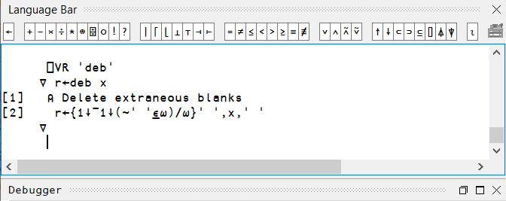
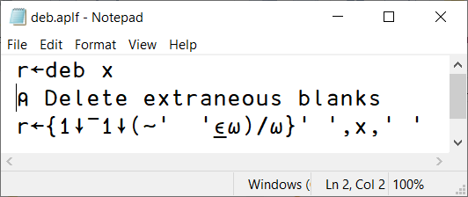

But first - What exactly is Link?
Each code item in the active workspace is linked to a file
  [Unscripted] Namespaces map to a directory structure containing these files
By default, the link is bi-directional:
  If the item is modified using the APL editor, the source file is updated
  If the source file is modified using an external tool, the workspace is updated

Slide 5
File System Watcher
External source changes are detected using a
"File System Watcher" - .NET is required
Works fine for synchronising the WS with changes made in an external editor
NOT appropriate for handling "bulk" changes
  DO NOT unzip or copy lots of files into a watched folder
  DO NOT do a large checkout/revert which changes many files
DO NOT use live links to deploy code changes via shared drives to your production server!

Slide 6



Why is Link ?
Important
With source code in text files we can use extremely attractive tools developed outside the APL community
  Tools for editing, comparing, mergeing, refactoring, sharing, building, testing, computing statistics, …
… in addition to all our own tools
… without losing any of what is good about interactive development

Slide 7










Why is Link ?
Important

Slide 8
And now also "AI" / LLMs ...

Slide 10
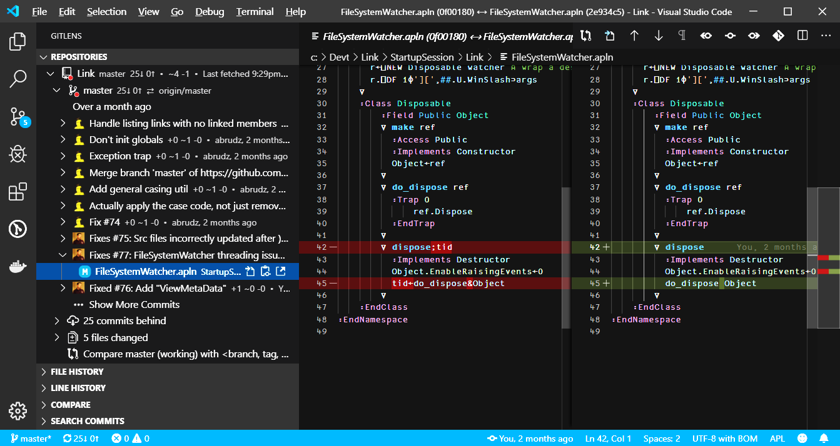
Screen Shot from Mortens SA1 Slides
Showing VS Code with Git History and a diff

Slide 11
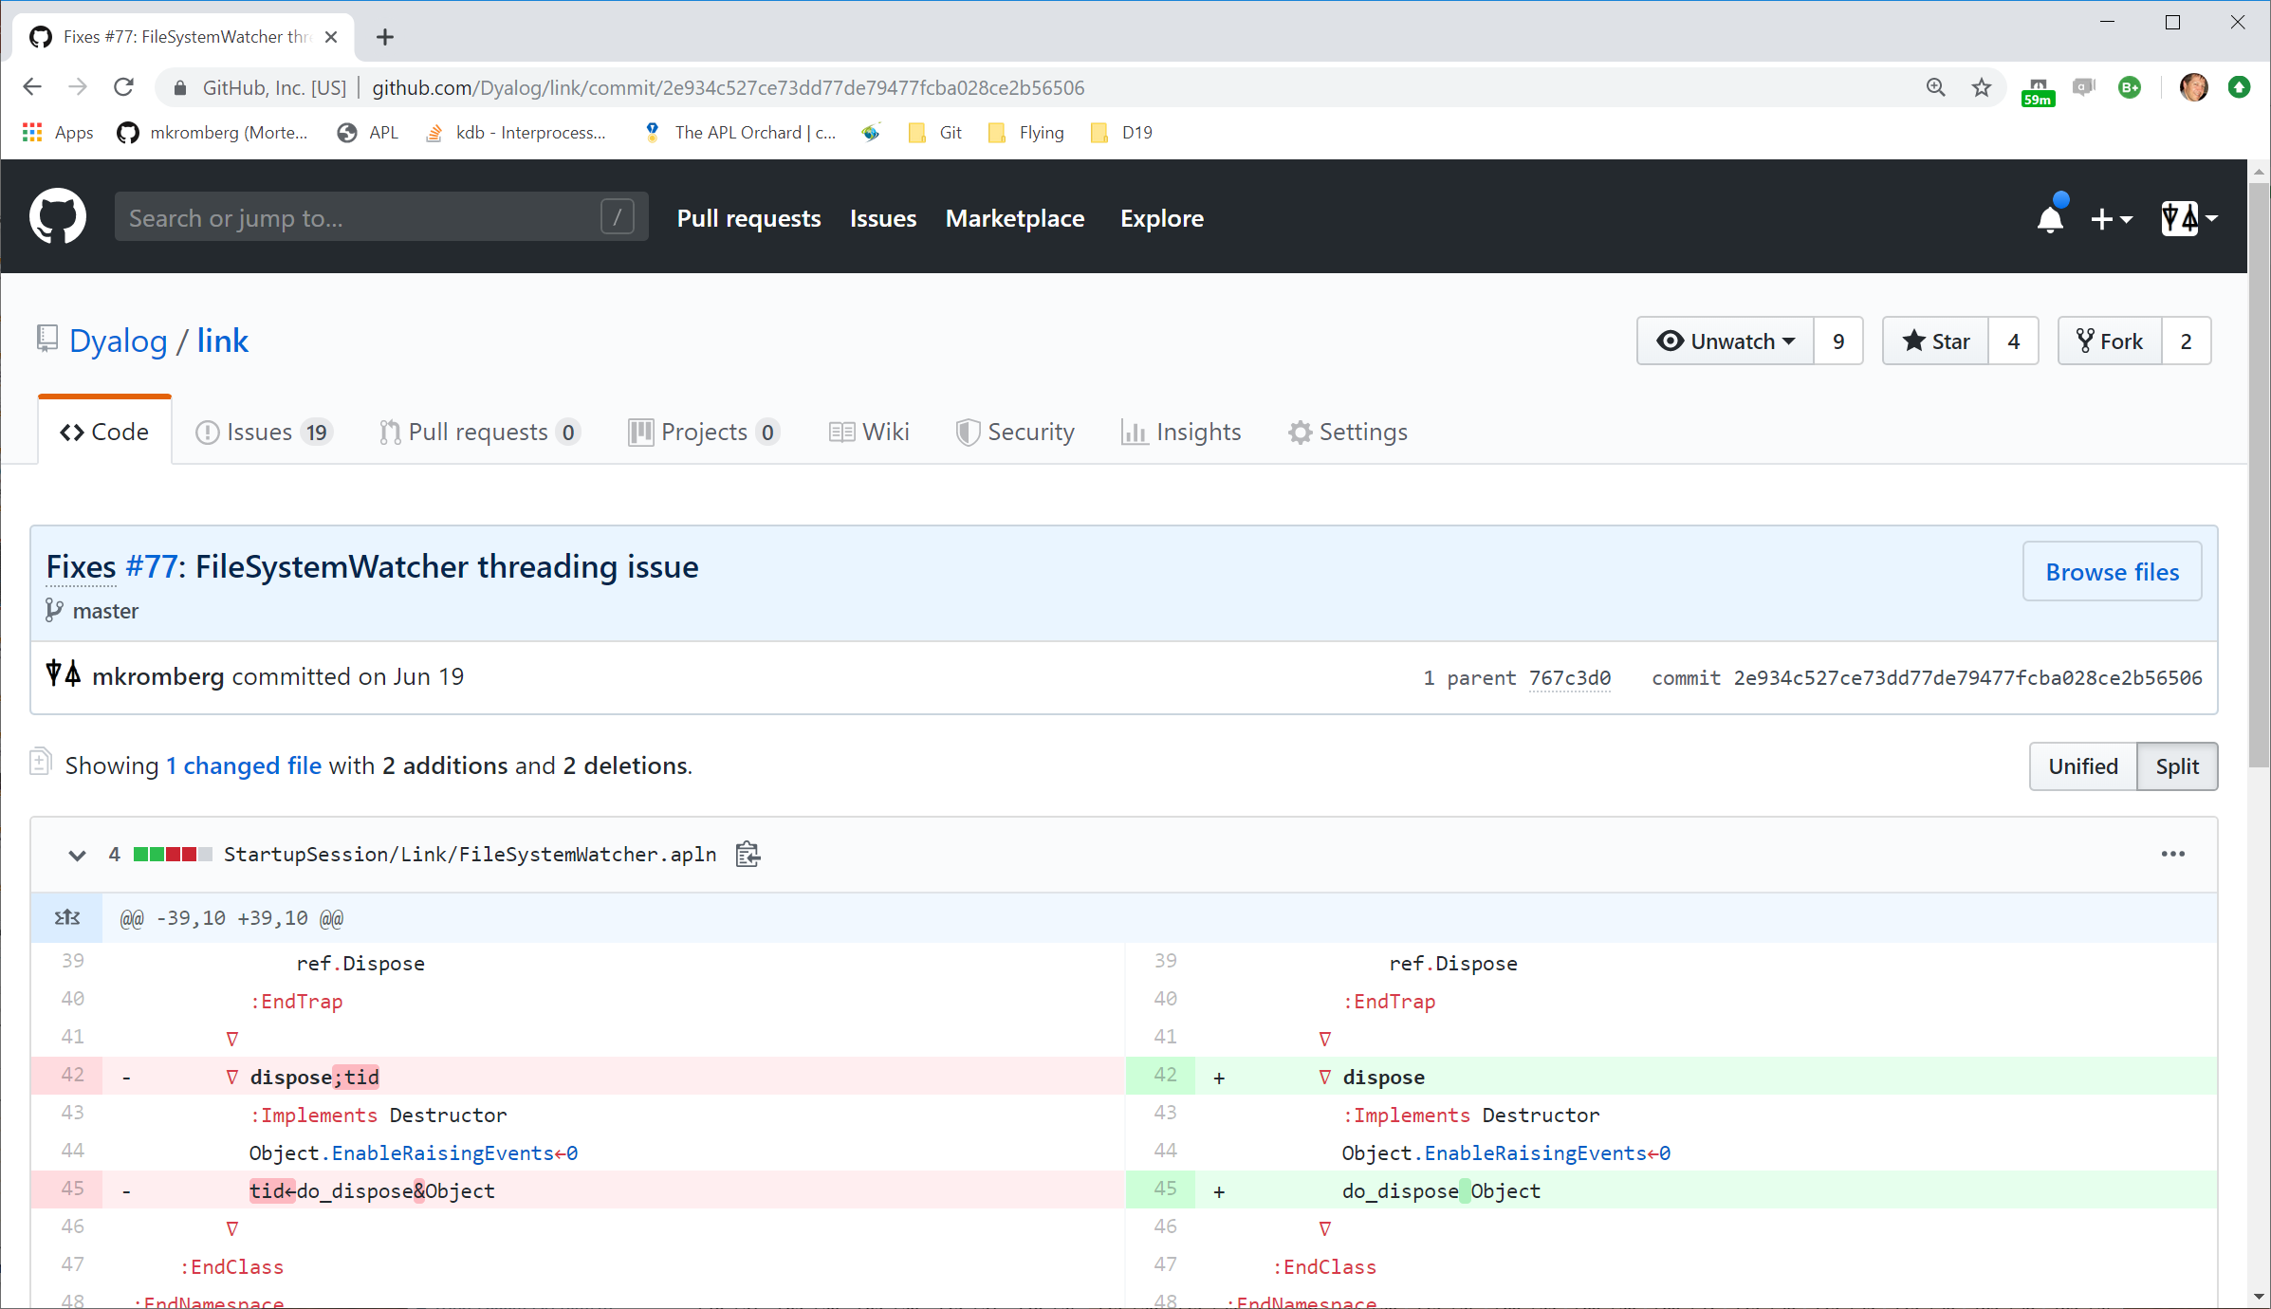

Slide 12
Other Benefits of Text Source
Easily share code between APL versions
  Text files are backwards and forwards compatible
Not be distressed by crashes
Drawbacks of Text Source
This space intentionally left blank

Slide 13
Current Link Versions
Link Version | Shipped with | Also supported on
4.1 | 20.0 | 19.0
4.0 | 19.0 | 18.2
Earlier | Never Mind
Since 4.0, Link is stable and well documented
Move on from earlier versions as soon as possible

Slide 14
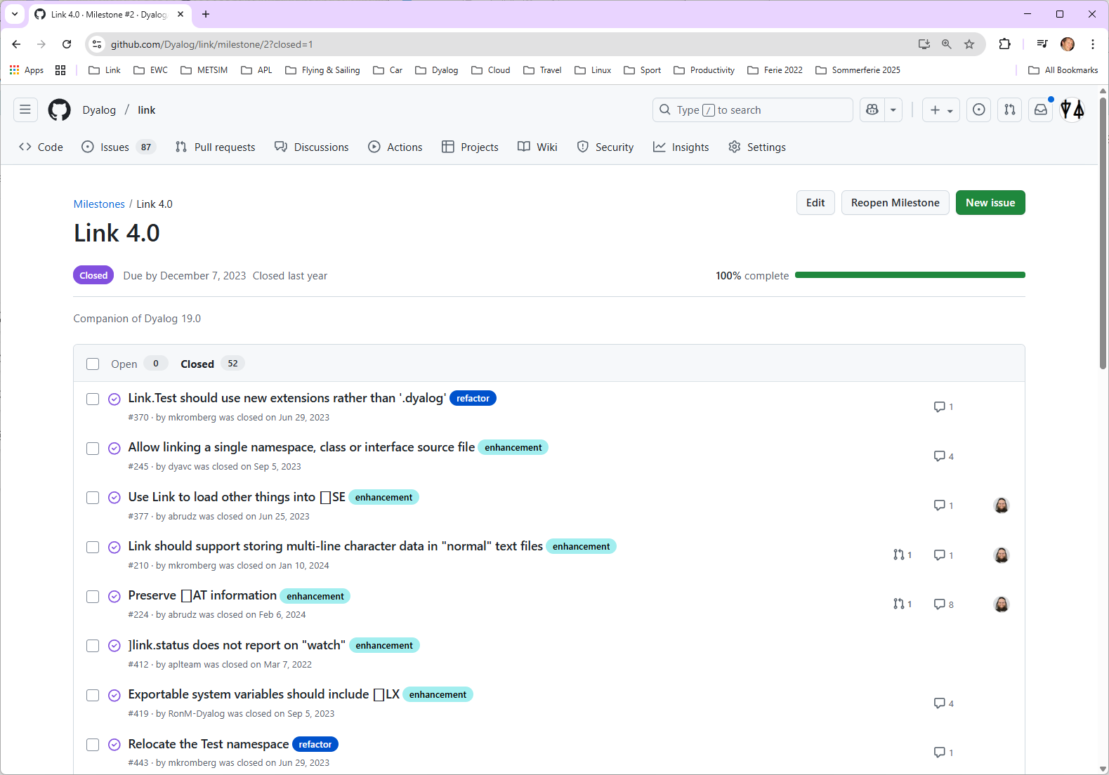
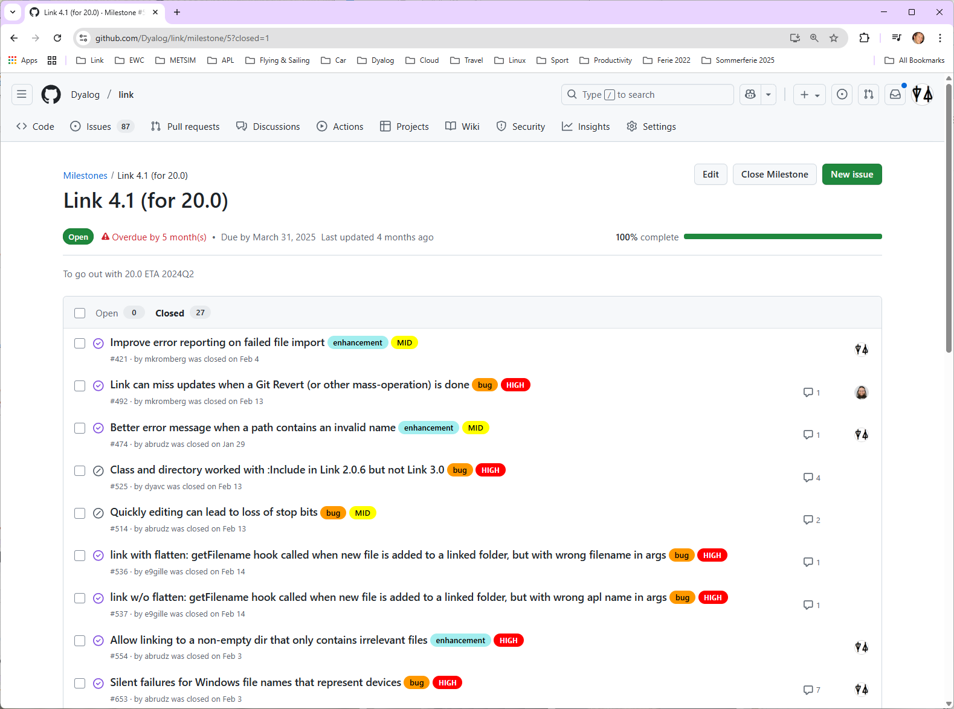

Slide 15
Exercise 0 - Documentation
Open the documentation in a browser:
https://dyalog.github.io/link/4.1/
or
Use -? or -?? with user commands
]link.create -?
... Look at the last line of output

Slide 16
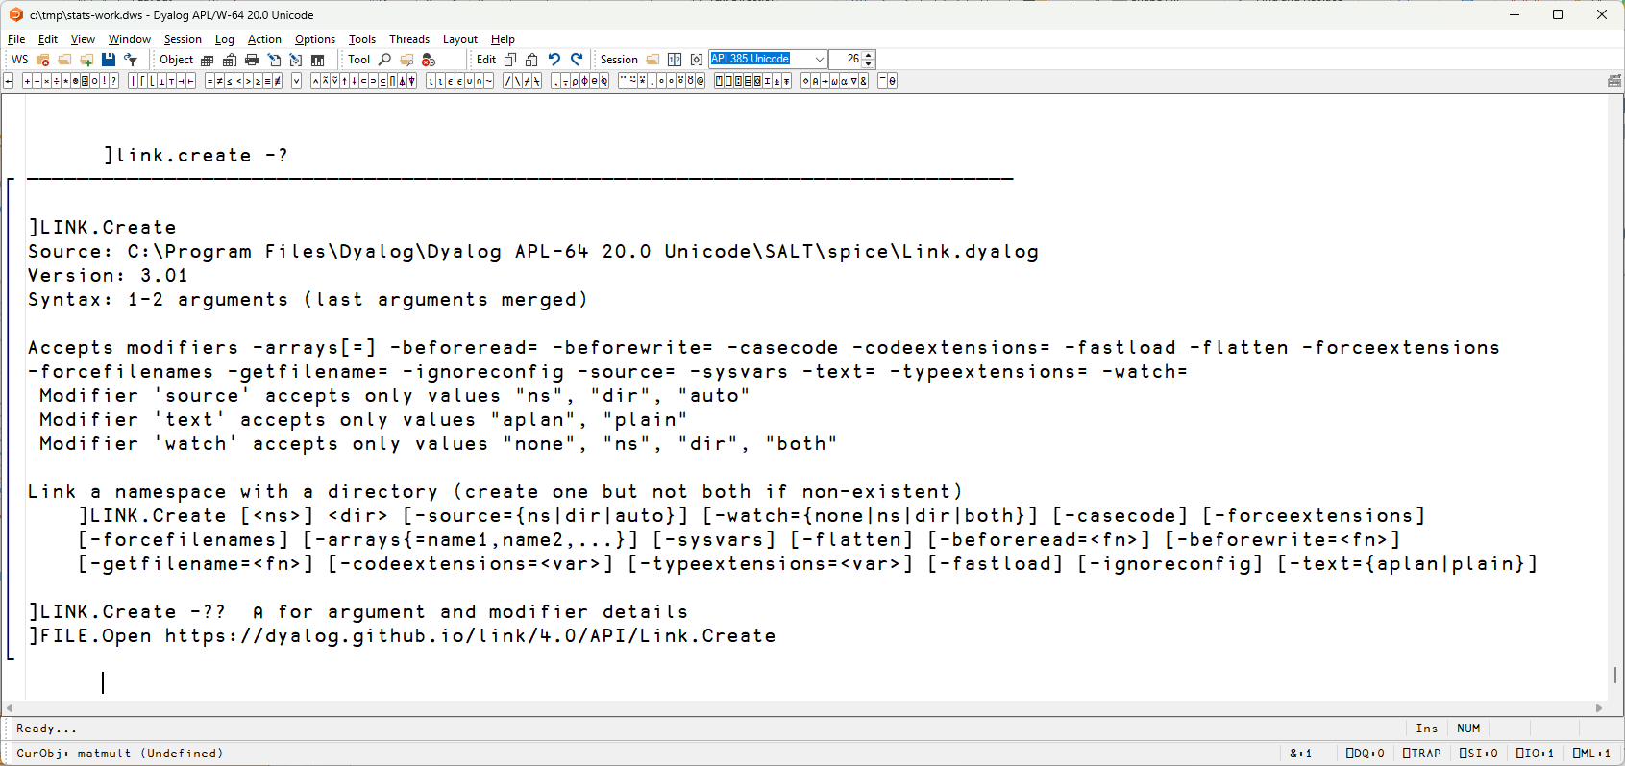
Documentation

Slide 17
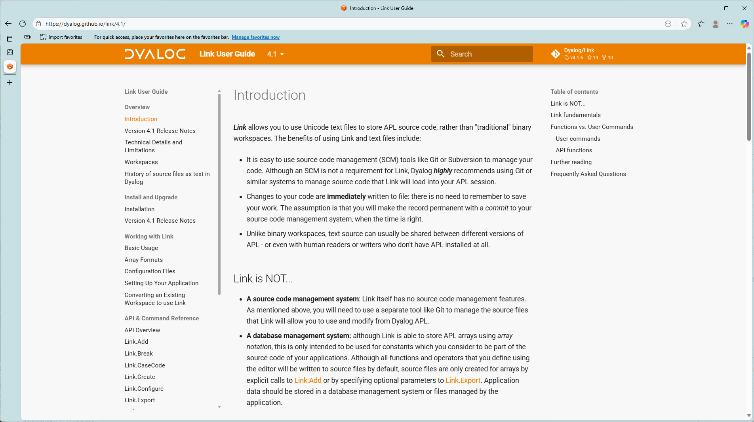

Slide 18
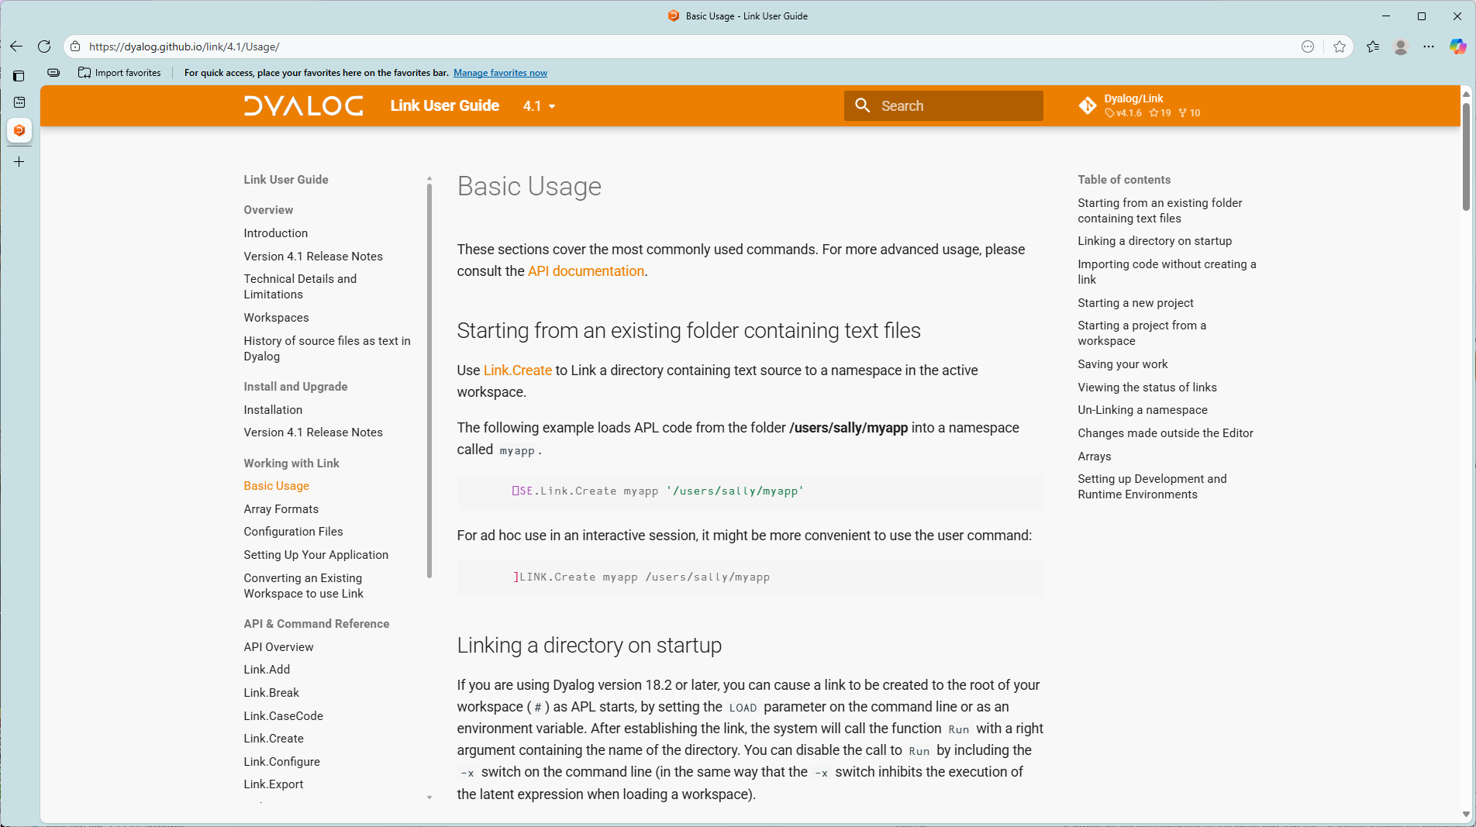

Slide 19
Starting a New Project
To start a new project
)ns myns
]link.create myns /my/dir
At least one of myns (the namespace) or /my/dir (the directory) must exist
If both exist, only one may be populated
You can also create a Link to #
]link.create # /my/dir

Slide 20
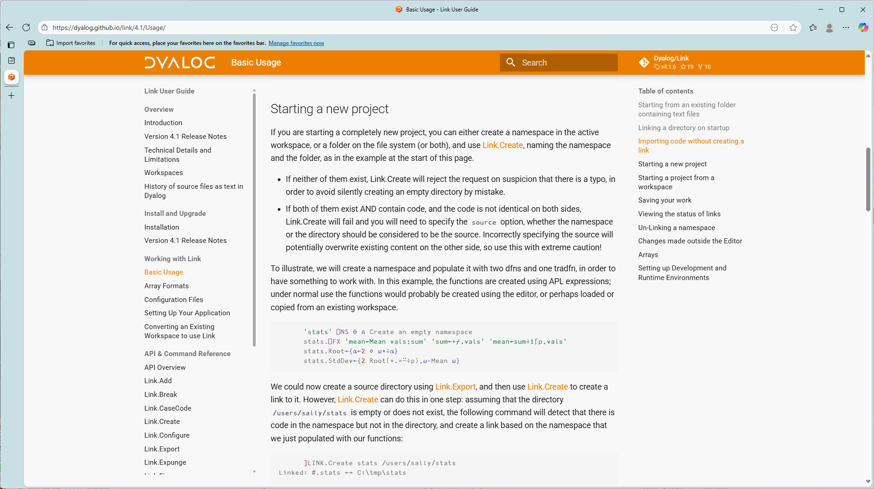

Slide 21
Source File Extensions
Link creates files with extensions that identify the type of APL item exported
  .aplf and .aplo for functions and operators
  .apla for arrays
  .aplc and .apli for classes and interfaces
  .apln for namespaces that have source
    namespaces w/out source become directories

Slide 22

Exercise 1 – Your first Link
Create a namespace with at least one function in it
Create a link between the namespace and a new or empty directory
Verify that source files were created in the directory
Edit a function and verify that the source file is updated
Edit a source file using notepad or another external editor
  Verify that the function is updated in the WS
)CLEAR and re-create the link
Verify that your code is loaded into the workspace

Slide 23
Variables
By default, variables are NOT linked
  Most variables are not part of the "source code"
The –arrays switch will cause ALL arrays to be exported on Link.Create
Once a source file exists for an array, Link will respond to source changes
Link.Add can be used to create a source file, or update it

Slide 24
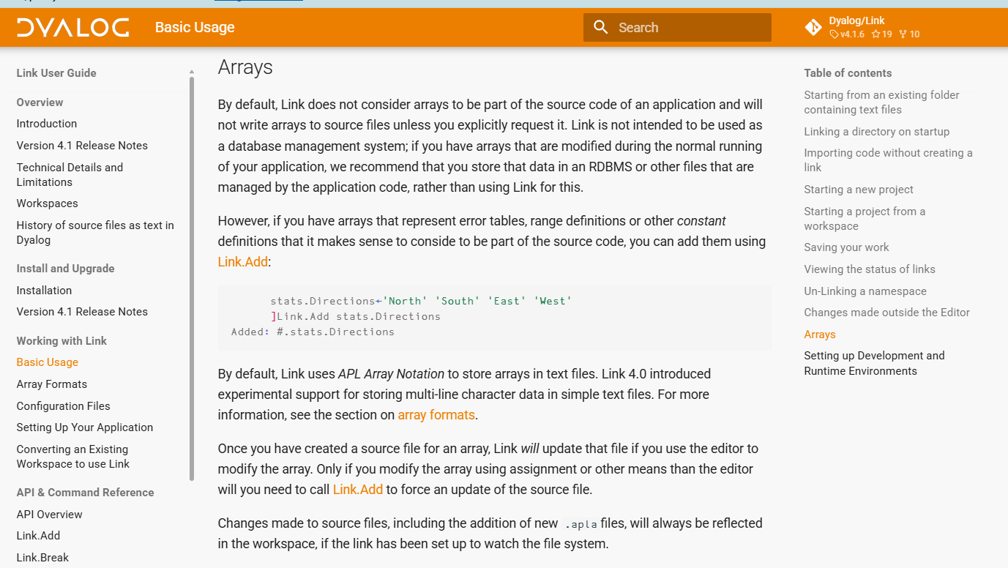
Variables

Slide 25
Assignment
Link will create or update source files for functions, operators and variables if they are EDITED
  For variables, existing source files will be updated
Assigning new values to functions or variables using ← will NOT update the source file
  The same is true for ⎕NS, ⎕CY, ⎕FX or any system function that modifies or creates definitions
Use Link.Add to cause files to be created or updated

Slide 26
Exercise 2 - Variables
Create a variable containing a constant that your application needs
Write it to file using ]Link.Add
Inspect the file, edit it, and verify that the new value appears in the workspace
Change the value in the workspace
  Note that the file is NOT updated
  Update it using ]Link.Add
Q: Can you write system variables to file?
  (check the docs)

Slide 27
Link.Create - Recap
Link.Create creates a "live" link between a namespace and a directory
One end of the link must be empty, code is replicated at the empty end of the link
By default, changes made on either side are immediately replicated on the other
  You can set –watch=ns|dir if you only want changes "watched for" on one side of the link
Variables are not exported by default
Only the editor (or Link.Add) will trigger file updates

Slide 28
Import and Export
If you do not want a live link after the operation:
Import brings objects into a namespace from a directory
Export "saves" the contents of a namespace to files
Most of the switches/options that apply to Create also apply to Import and Export

Slide 29
Namespace = Directory
Each function, operator or array is linked to a file
Namespaces which are defined using source text are also linked to a single file with extension .apln
  If such a namespace contains "free"
  functions or variables, Link will ignore them
Namespaces without source map to directories
If an exported namespace contains sub-namespaces
  Each one becomes a subdirectory
If an imported directory contains subdirectories
  Each one becomes a namespace
myns.apln
:Namespace myns
...
:EndNamespace

Slide 30
Exercise 3 - Subdirectories
Create a subdirectory in your source structure
  The name must be a valid APL namespace name
Verify that a corresponding namespace is created in the workspace
)ED a function in the namespace
Rename the subdirectory
Verify the effect in the workspace

Slide 31
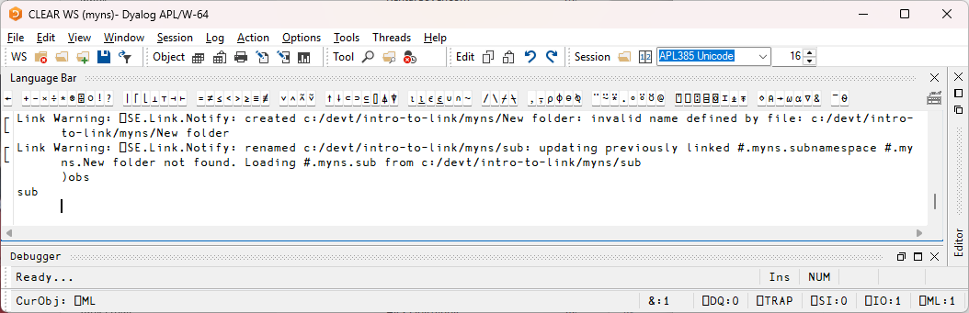
Ugh
If you started creating "New folder", Link will complain

Slide 32
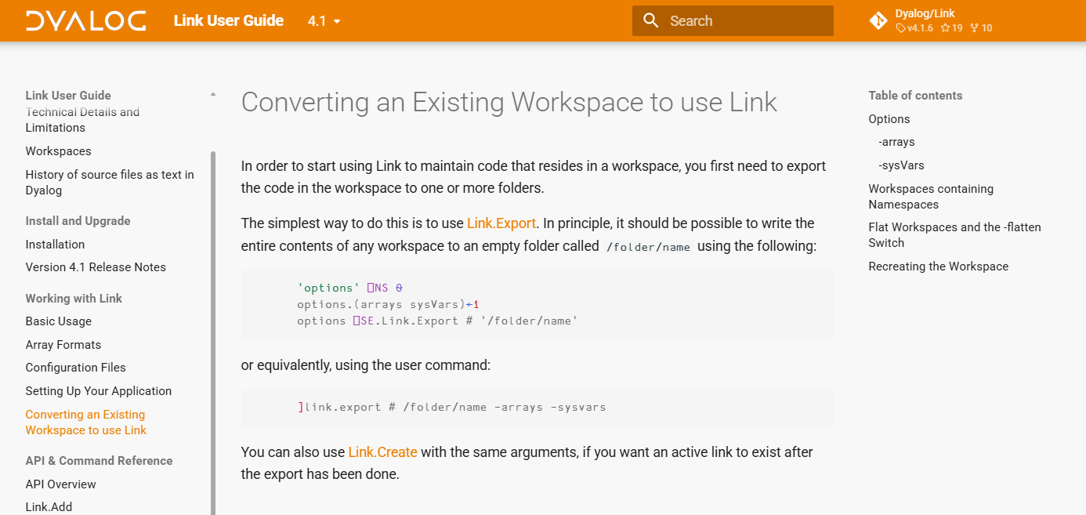

Slide 33
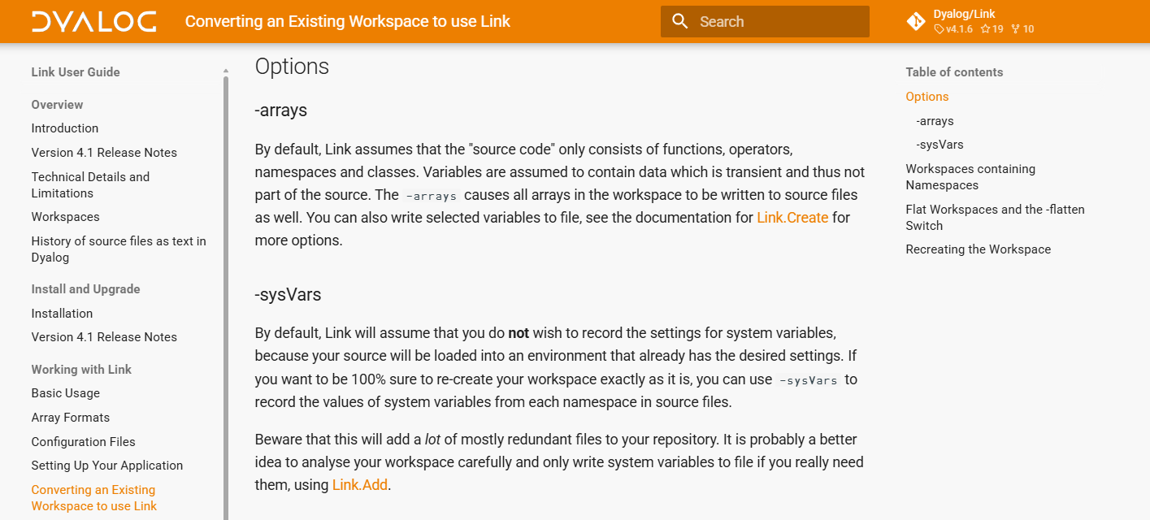

Slide 34
Case Coding
Case-insensitive file systems (like Windows) do not distinguish between FOO.aplf and Foo.aplf
Link avoids this issue using "case coding"

Slide 35
Case Coding
∇foo
[1] 2+2
∇
∇FOO
[1] 3+3
∇
Avoid file name clashes in case-insensitive file systems by adding an octal representation of the case
to the file name:
]link.create # c:\tmp\foos
ERRORS ENCOUNTERED: ⎕SE.Link.Create: File name case clash - try using caseCode←1:
#.FOO
#.foo
]link.create # c:\tmp\foos -casecode
Linked: # ←→ "c:\tmp\foos"
0 (⎕NINFO⍠1) 'c:\tmp\foos\*.aplf'
c:/tmp/foos/foo-0.aplf c:/tmp/foos/FOO-7.aplf

Slide 36
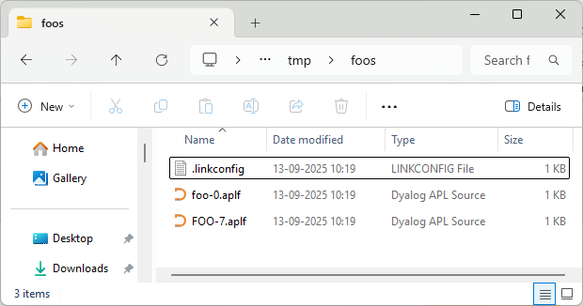
Case Coding
∇foo
[1] 2+2
∇
∇FOO
[1] 3+3
∇
Avoid file name clashes in case-insensitive file systems by adding an octal representation of the case
to the file name:
]link.create # c:\tmp\foos
ERRORS ENCOUNTERED: ⎕SE.Link.Create: File name case clash - try using caseCode←1:
#.FOO
#.foo
]link.create # c:\tmp\foos -casecode
Linked: # ←→ "c:\tmp\foos"
0 (⎕NINFO⍠1) 'c:\tmp\foos\*.aplf'
c:/tmp/foos/foo-0.aplf c:/tmp/foos/FOO-7.aplf

Slide 37
API vs User Commands?
All user commands have an API equivalent. Or as Adám would put it, most API functions have a user command for interactive use.
]link.export # whatever –casecode
(caseCode:1) ⎕SE.Link.Export # 'whatever'
When you automate Link operations, PLEASE DO NOT:
⎕UCMD 'link.export # whatever –casecode'
NB: that all user command switches are lowercase (casecode), while option namespace names are camelcase (caseCode).

Slide 38
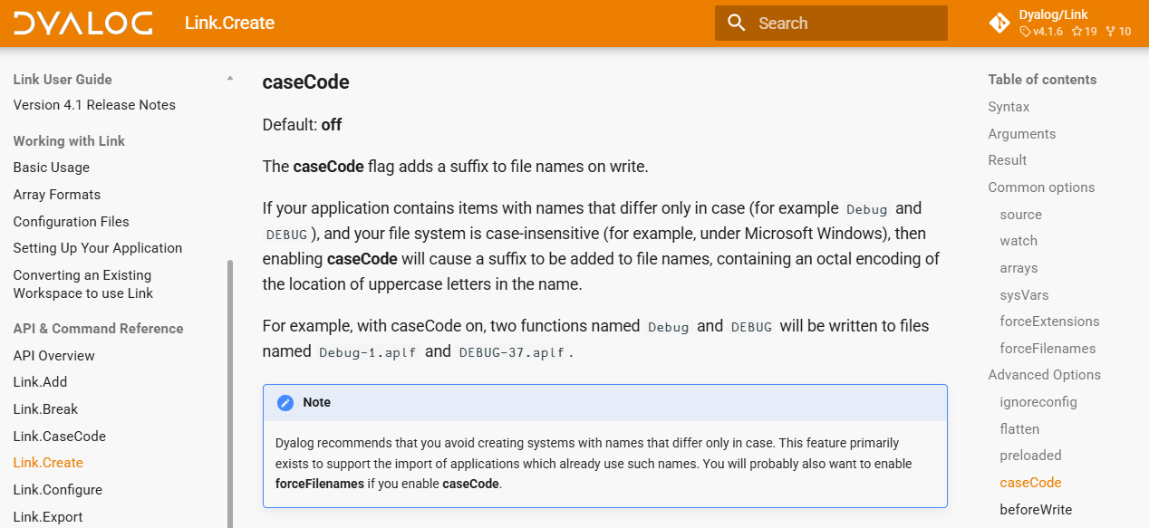
Documentation is for the API

Slide 39
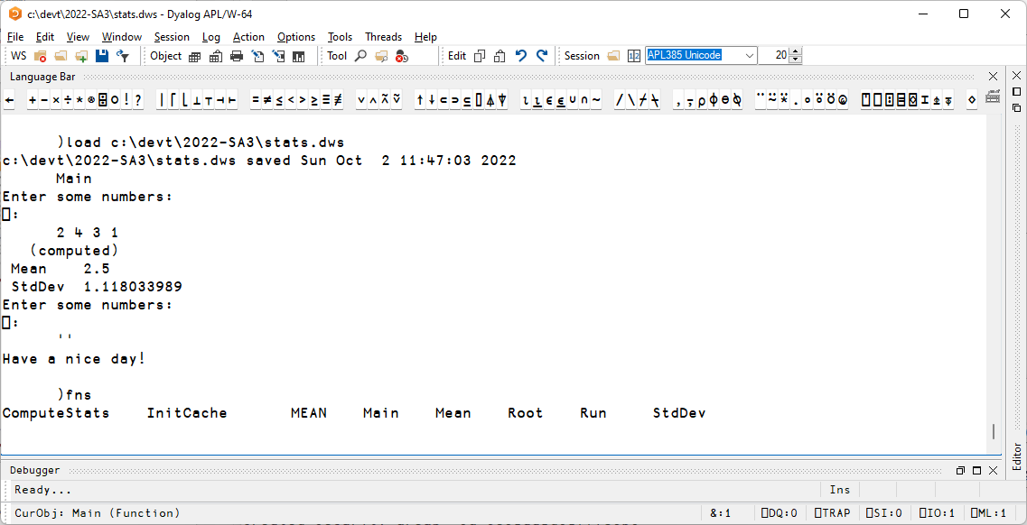

Slide 40
Exercise 4
Export the workspace stats.dws to a directory
Note that
  It contains two variables
  Has a non-default ⎕ML
  Has two names which differ only in case

Slide 41
Exercise 4 - Discussion
Use -casecode or rename?
Which variables should be considered "source"
  STATFNS ?
  RESULTS ?
⎕ML=3:
  Use –sysvars switch, ]link.add ⎕ML
  ... or refactor to use ⎕ML←1

Slide 42
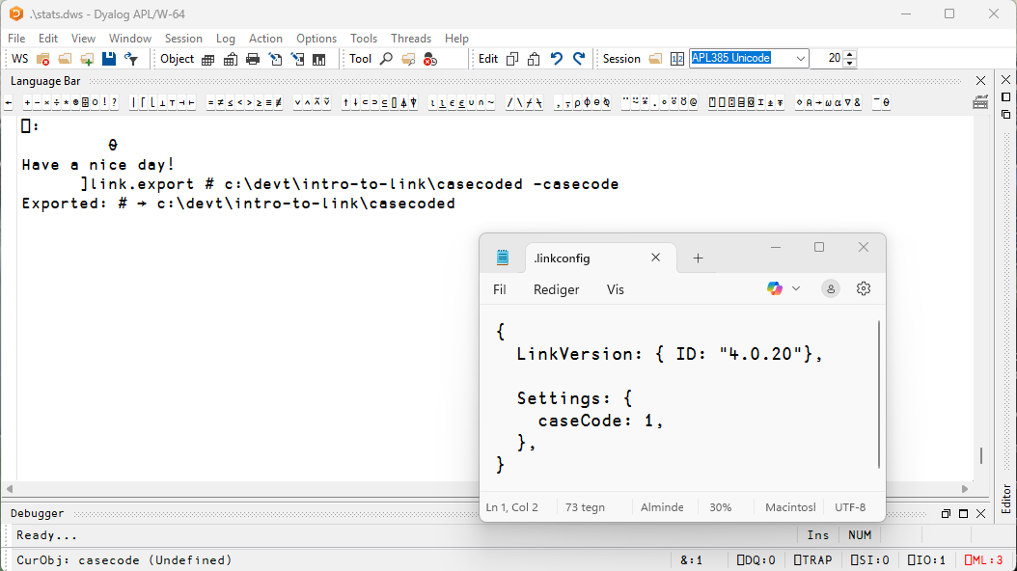
If you used –casecode, a .linkconfig file is created

Slide 43
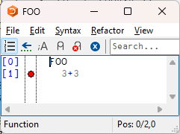
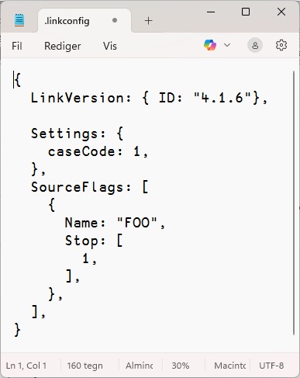
The .linkconfig file
Introduced in Link 4.0
Records non-default link options
  So you don't need to say –casecode each time you create a link to that folder
Tracks - and reinstates - Stop+Trace flags on Create
]link.stop FOO 1
  "Automatic" registration of stop bits in a file in the application direction is a bit controversial, may become an option
  NB: A bit experimental; flags are not recorded if no other change is made to the source ☹

Slide 44
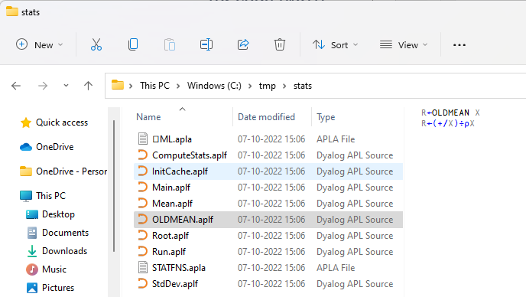
Exercise 4 – Morten's Solution
)load c:\devt\intro-to-link\stats
c:\devt\intro-to-link\stats.dws saved Tue Oct 4 22:59:08 2022
)fns
ComputeStats InitCache MEAN Main Mean Root Run StdDev
)ed MEAN ⍝ rename to OLDMEAN
)erase MEAN
)vars
RESULTS STATFNS
]link.export # c:\tmp\stats
Exported: # → c:\tmp\stats
]link.export ⎕ML c:\tmp\stats
Exported: #.⎕ML → c:/tmp/stats/⎕ML.apla
]link.export STATFNS c:\tmp\stats
Exported: #.STATFNS → c:/tmp/stats/STATFNS.apla

Slide 45
Issues with old applications
Link & Dyalog APL offer some help:
-casecode for names that differ only in case
-flatten for workspaces that are not divided into namespaces
Underscores: "do not exist" in Unicode
You're on your own:
Objects that have no text representation
Derived functions

Slide 46

The –flatten switch
Even if everything in your old workspace is in #, it might benefit from being organised into separate directories (utilities, etc)
-flatten allows you to load the contents of multiple directories into a flat workspace
The link between individual functions and files is maintained

Slide 47
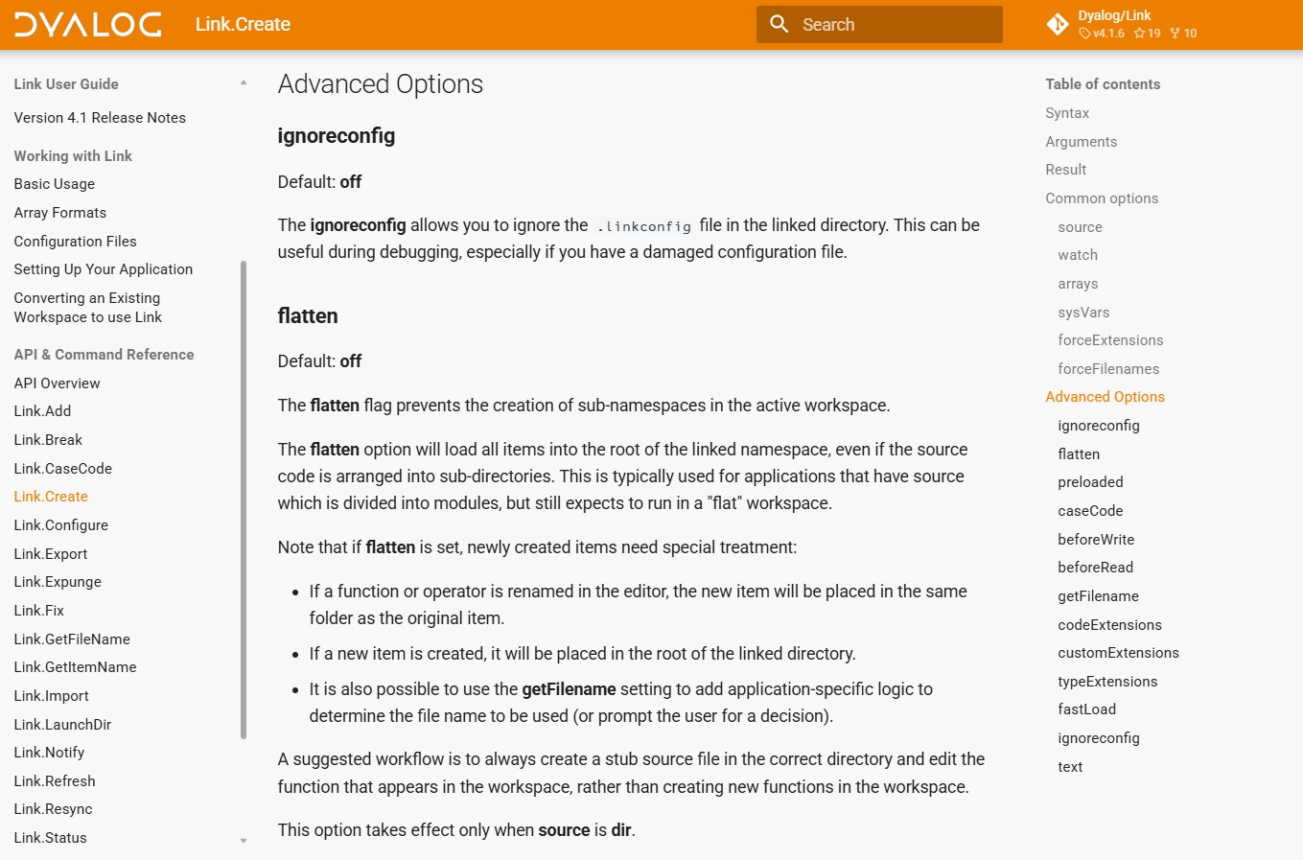

Slide 48
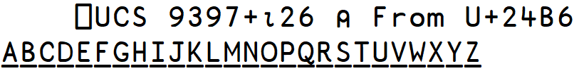
Underscores
There are no Underscored characters in Unicode
  Underlining is seen as a style, like bold or italic
The APL385 Unicode Font tells little white lies:
Using a normal Unicode font, these display as:
Dyalog recommends that you try to eliminate these characters from your applications ASAP.
The "font trick" is a temporary measure.

Slide 49
Non-Representable Objects
Some objects that CAN be saved in a Dyalog workspace have no meaningful textual representation
  GUI & COM objects
You need to write code which creates these objects at run or build time
Such "binary" objects are also non-transferrable between 32/64 or classic/unicode; they can only be loaded by the same architecture

Slide 50
Example: OLE Server…
Example of explicit creation of an otherwise un-representable object:
∇ R←MakeOLEServer;ns;spec
[1] ⍝ Recreate the OLE Server before WS is built
[2] ns←#.StatsServer
[3] ns.⎕WC'OleServer'('ClassID' '{395E64DF-6B44-4515-B409-6A0A2E1ACD9B}')
('RunMode' 'SingleUse')
[4] spec←⊂'This function returns the mean' 'VT_VARIANT'
[5] spec,←⊂'InputNumbers' 'VT_VARIANT'
[6] ns.SetFnInfo'Mean'spec
[7] R←0
∇

Slide 51
Derived Functions
Derived functions are currently not supported:
matmult←+.×
]link.add matmult
ERRORS ENCOUNTERED: ⎕SE.Link.Add:
Cannot get source of #.myns.matmult: Invalid name class (3.3)
Solutions:
Define a dfn or tradfn, e.g matmult←{⍺+.×⍵}
Define a Namespace Script (or an APL Script) which creates your little dervs:
:Namespace Utils
matmult←+.×
:EndNamespace

Slide 52
Exercise 5: flatten (or do not)
Create a subdirectory called "statfns"
Move the source files for the statistical functions (Mean, StdDev, Root) into it
Get the application to run again

Slide 53
Exercise 5 - Discussion
-flatten or refactor?

Slide 54
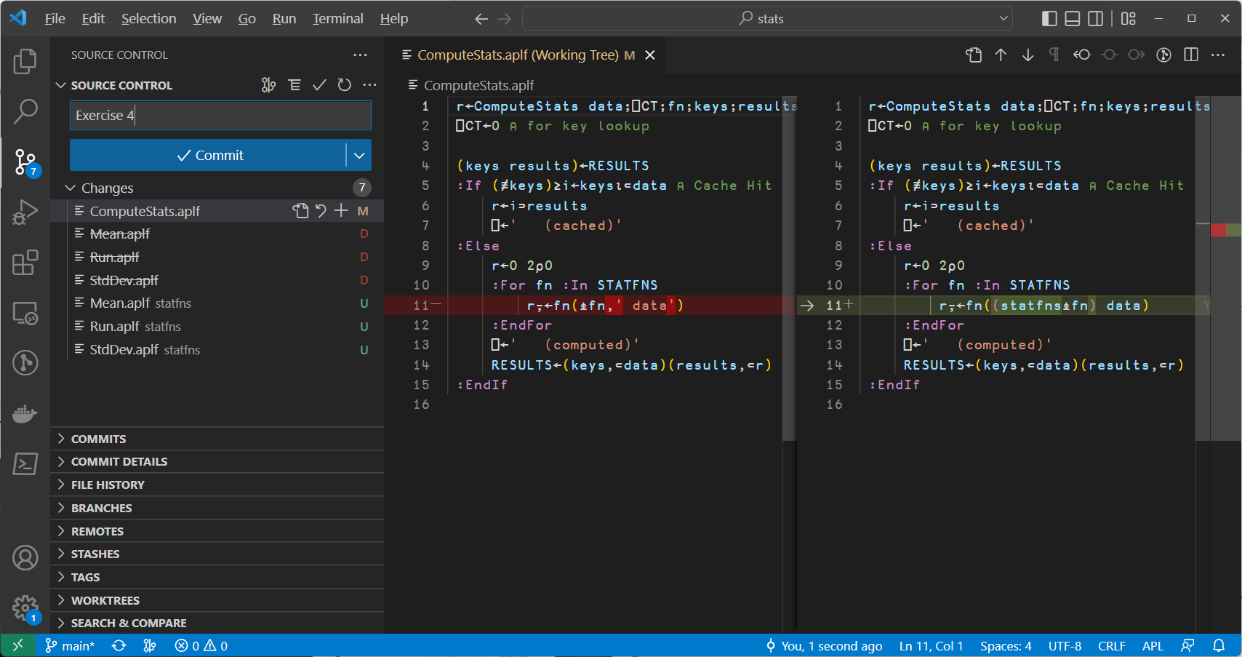

Slide 55
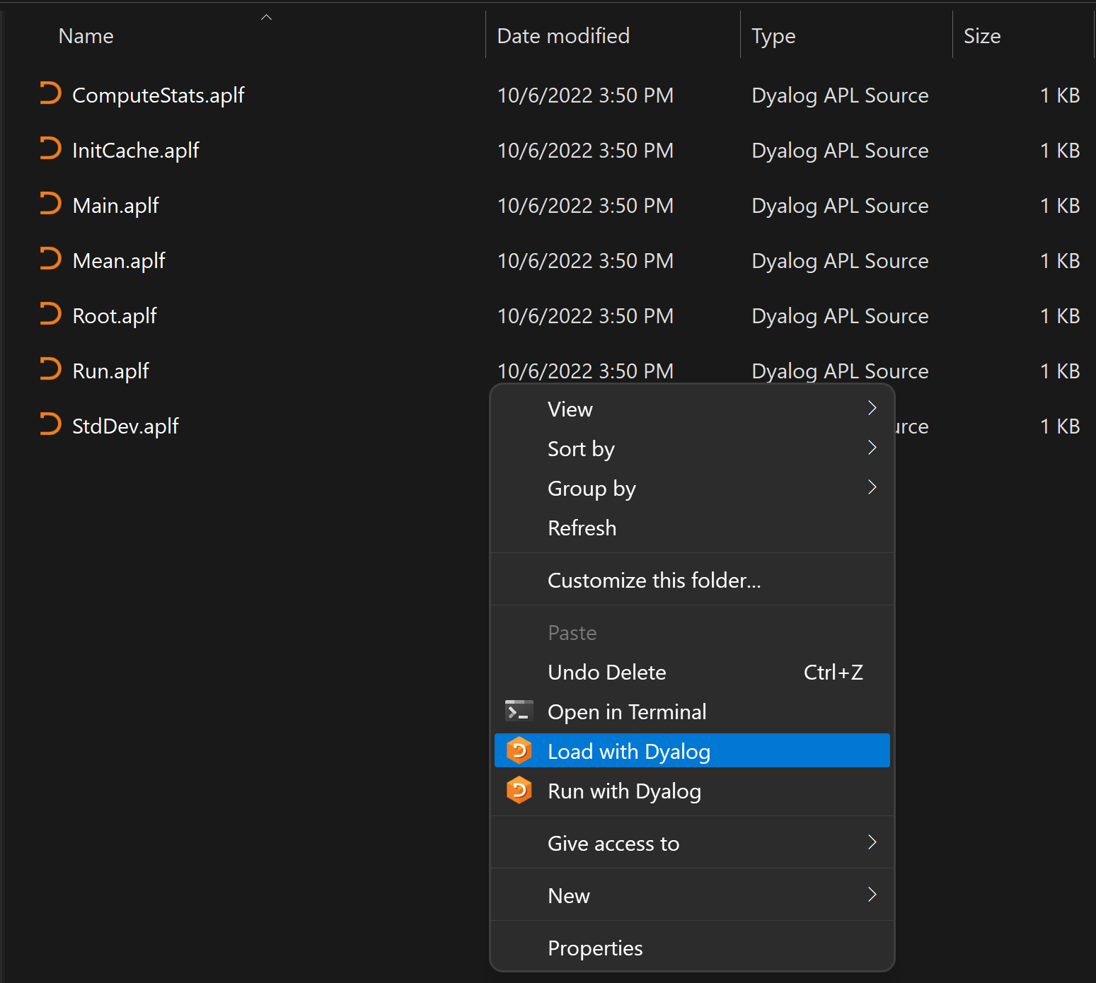
"Boot" from Source
Right click in the file explorer
  "Load with Dyalog" will do a Link.Create on a selected folder, or import a selected file
  "Run with Dyalog" will look for a function called Run and invoke it if it exists after the link has been created.
]FileAssociations can be used to select APL version

Slide 56
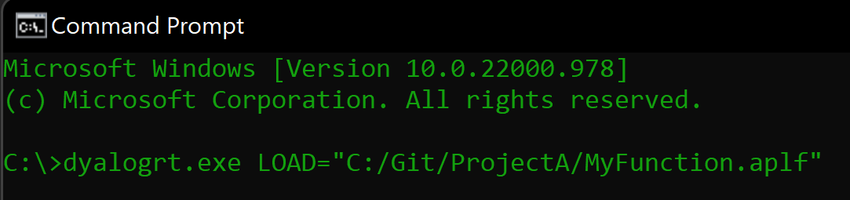
LOAD= parameter
Example .dcfg file:
{
Settings: {
AutoPW: 1,
MaxWS: "512M",
DadoProjectsFolder: "C:/Git",
PropertyExposeRoot: 1,
LOAD: "C:/Git/stats"
}
}
Point to a file, or a directory
Can be specified on the command line, or in a .dcfg file
Add –x to disable startup (just setting LOAD is actually equivalent to "Run with Dyalog")
Notes:
When LOAD points to a directory, it will run “Run ,⊂<Load>”
When LOAD points to a single file name, it will run “filename 0⍴⊂’’ or filename.Run 0⍴⊂’’ for classes/namespaces

Slide 57
The Run function
The stats workspace contains a function Run:
∇ Run dir
[1] Main
∇
When launched by LOAD, the right argument will be the name of the folder that was loaded. Also:
⎕SE.Link.LaunchDir
C:/devt/intro-to-link/old-export

Slide 58
Is the Workspace Dead?
With Link, you no longer need to save workspaces (?)
Well, except for distribution of your application
Or saving WIP including live data that is not stored in Link, in order to resume work later
Or saving "crash workspaces"
Anything else?

Slide 59
Saved Workspaces with Links
From v4.0, Link handles workspaces with "live" links kinda OK
This is not a very well tested feature
Do NOT rely on this as a way to manage multiple variations over your source code.
The correct way to manage branches of your source code is to use something like Git[Hub], we'll look at that soon.

Slide 60
Saved Links
]link.create # c:\devt\intro-to-link\export
Linked: # ←→ c:\devt\intro-to-link\export
data←?100⍴100
Lunch time!
)save c:\tmp\stats-work.dws
c:\tmp\stats-work.dws ⍝ saved Tue Sep 23 18:20:43 2025
Back from lunch!
)load c:\tmp\stats-work.dws
c:\tmp\stats-work.dws ⍝ saved Tue Sep 23 18:20:43 2025
Link Warning: 1 link restored: #
IF source files match WS contents, the link is just restored. If not, see next slide.

Slide 61
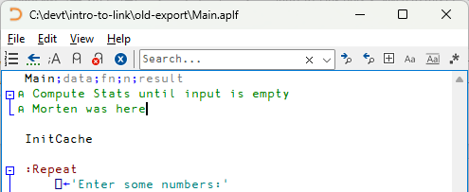
If source does not match WS
)load c:\tmp\stats-work.dws
c:\tmp\stats-work.dws ⍝ saved Tue Sep 23 18:20:43 2025
Link Warning: IMPORTANT: 1 namespaces linked in this workspace:
Link Warning: IMPORTANT: Link.Resync is required
]link.resync
1 update required: use -proceed option to synchronise
Name Direction File Comments
#.Main ← c:/devt/intro-to-link/old-export/Main.aplf File is dated 1 minute ago, WS copy is dated 23 Sep 2025
]link.resync -proceed
1 file read
IF you do not agree with the recommended "Direction", you must manually resolve the differences by copy/pasting source etc.

Slide 62
Exercise 6 – Saved Links
Save a workspace with a Link in it
Edit a function source file using the editor of your choice
Reload the workspace and sort things out

Slide 63
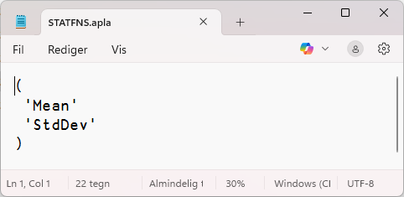
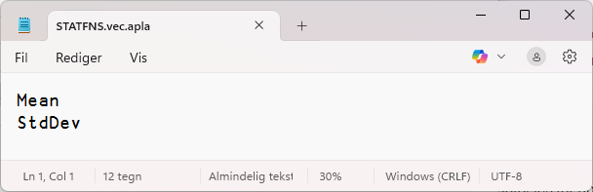
"Simple" Text Arrays
By default, APL Array Notation is used to store all arrays
This is not always the best format if your data is
  A character vector with completely regular line endings
    CR (UCS 13) , LF (10) or CRLF (13 10)
  A vector of character vectors with no line endings (like STATFNS)
  A character matrix

Slide 64
-text=plain|aplan
The –text switch allows you to select "plain" text formats
  The default is APL Array Notation: –text=aplan
]link.export STATFNS c:\tmp\stats –text=plain
Note that the penultimate segment of the name controls the form of the APL array that will be created from the file.
  In this case, .vec. tells Link that the
  file should be loaded into a vector of vectors

Slide 65
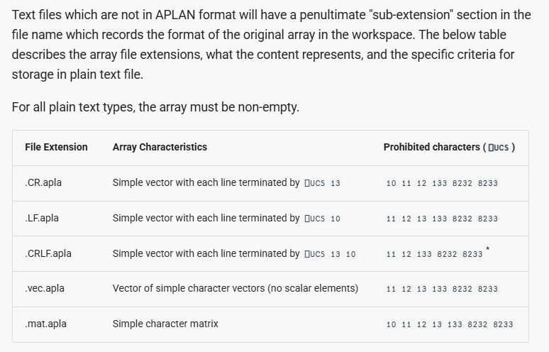

Slide 66
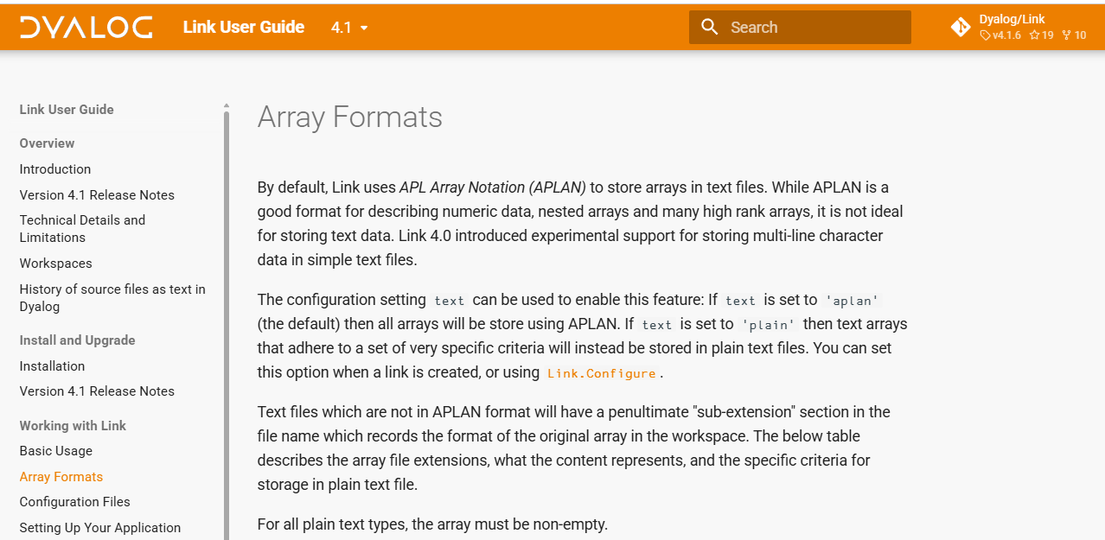

Slide 67
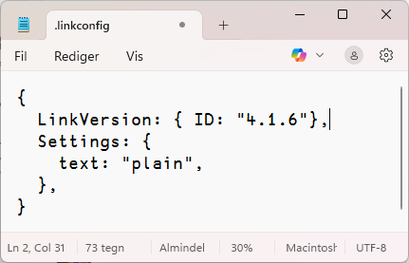
The middle segment of the name
Declares the form of the APL array, NOT the file
  The file will have the separator decided by ⎕NPUT
Once a file has e.g. .vec. in the name, the array format is fixed.
  You need to delete the file if you want to change the format
    Or rename it and re-create the link
  NB: If you delete the file while watch=both,
  the variable will be expunged!
You can set the default for future files
]link.configure myns text:plain

Slide 68
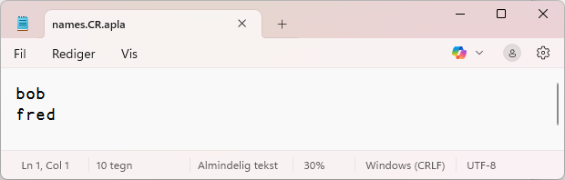
text:plain, continued
Once the default is set to "plain":
NL←⎕UCS 13 ⍝ "Carriage Return"
names←'bob',NL,'fred',NL
]link.add names
Added: #.myns.names

Slide 69
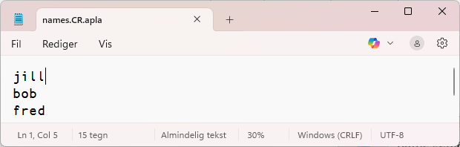
Text:plain, continued
If watching the directory, then after saving the edited file:
↑('.'@(NL∘=)names)(⎕UCS names)
j i l l . b o b . f r e d .
106 105 108 108 13 98 111 98 13 102 114 101 100 13

Slide 70
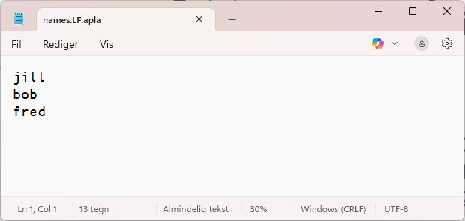
Text:plain, continued
Renaming the file to *.LF.apla gives a nasty warning:
Link Warning: ⎕SE.Link.Notify:
renamed c:/devt/intro-to-link/myns/names.LF.apla:
ignoring attempt to redefine #.myns.names
However, if you re-create the Link, note that the line endings are LF's:
↑('.'@(=∘(⎕UCS 10))names)(⎕UCS names)
j i l l . b o b . f r e d .
106 105 108 108 10 98 111 98 10 102 114 101 100 10

Slide 71
Final words about "Data"
As a general rule, Link is not for saving "data"
  It is for "source code"
However, this is a grey area
  Are mortality tables or other assumptions code or data?
  If they need to be tracked and audited, using text source brings many useful tools to bear
  One persons data is another ones code

Slide 72
Oh, and ...
Did I say "text:plain" is not very well tested ...
]Link.Resync doesn't work with text:plain
  Hopefully fixed before v20.0 is shipped
Otherwise, Link 4.1.7 will be in a DSS update (and on GitHub)

Slide 73
Exercise 7 – text:plain
Switch to using text:plain in the stats app
Use ]link.configure to change the default to text:plain
Verify the contents of the .linkconfig file
Replace STATFNS.apla with STATFNS.vec.apla
Verify that the application still works

Slide 74
Boot or Build?
It is fine (even encouraged!) to dynamically load text source during development
For small or open-source applications, it is also fine for distribution / runtime if performance is not an issue
It is NOT recommended to dynamically load source from large numbers of text files in production environments

Slide 75
Exercise 8 - Distribution
Write a "BuildWS" function which
  Load the source into the workspace
  If source is already Linked, see Link.Break
  Uses ⎕SAVE to create a workspace that will run when loaded

Slide 76
Exercise 8 - Solution
∇ BuildStats;home;wsid
[1] :If 0=≢home←1⊃⎕NPARTS 4⊃5179⌶⊃⎕SI
[2] →0⊣⎕←'Unable to determine source directory!'
[3] :EndIf
[4] ⎕SE.Link.Import #(home,'/export')
[5] ⎕LX←'Main'
[6] 0 ⎕SAVE wsid←home,'/runstats.dws'
[7] ⎕←'Saved: ',wsid
∇
dyalog.exe LOAD=C:\devt\intro-to-link\BuildStats.aplf

Slide 77
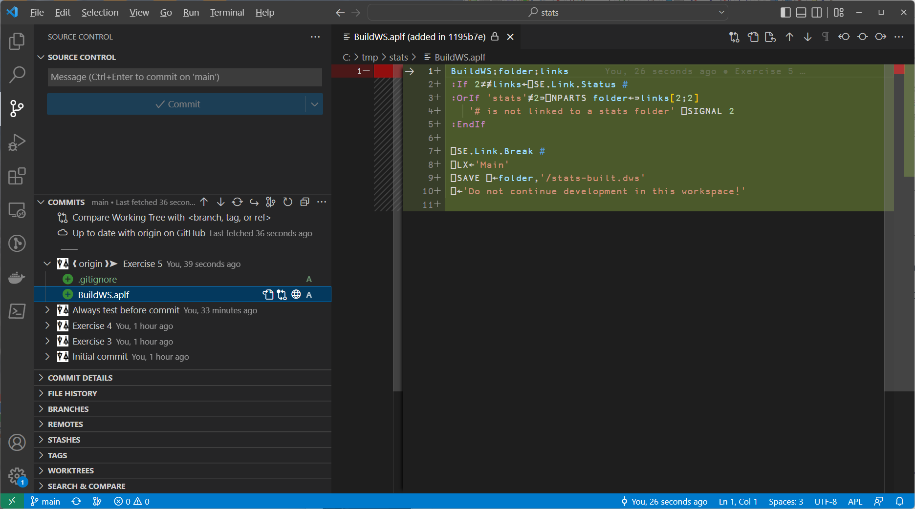

Slide 78
A Day in the Life ...
... Of a text-based APL developer
Create GitHub repo
Clone it locally
Populate it
Make a change, roll back
Roll forward,
Make branch, commit, pull request
Finally, look at METSIM Build & Run
Talk about -preload

Slide 79
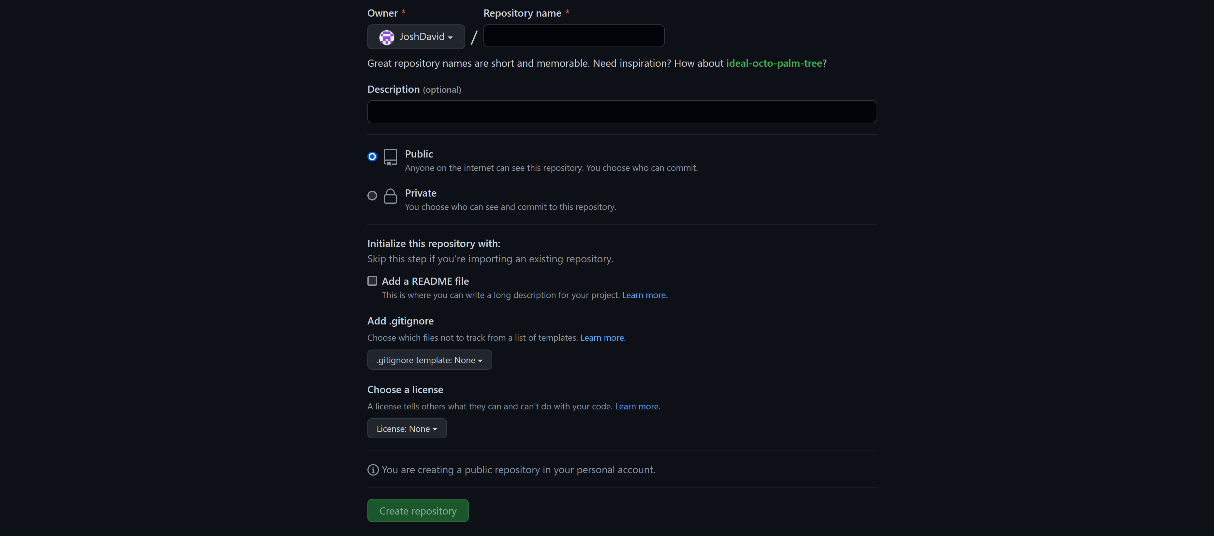
Creating a GitHub Repository
Notes:
https://github.com/new
Talk about: Owner, Repo name
Visibility (Public vs Private)
.gitignore

Slide 80
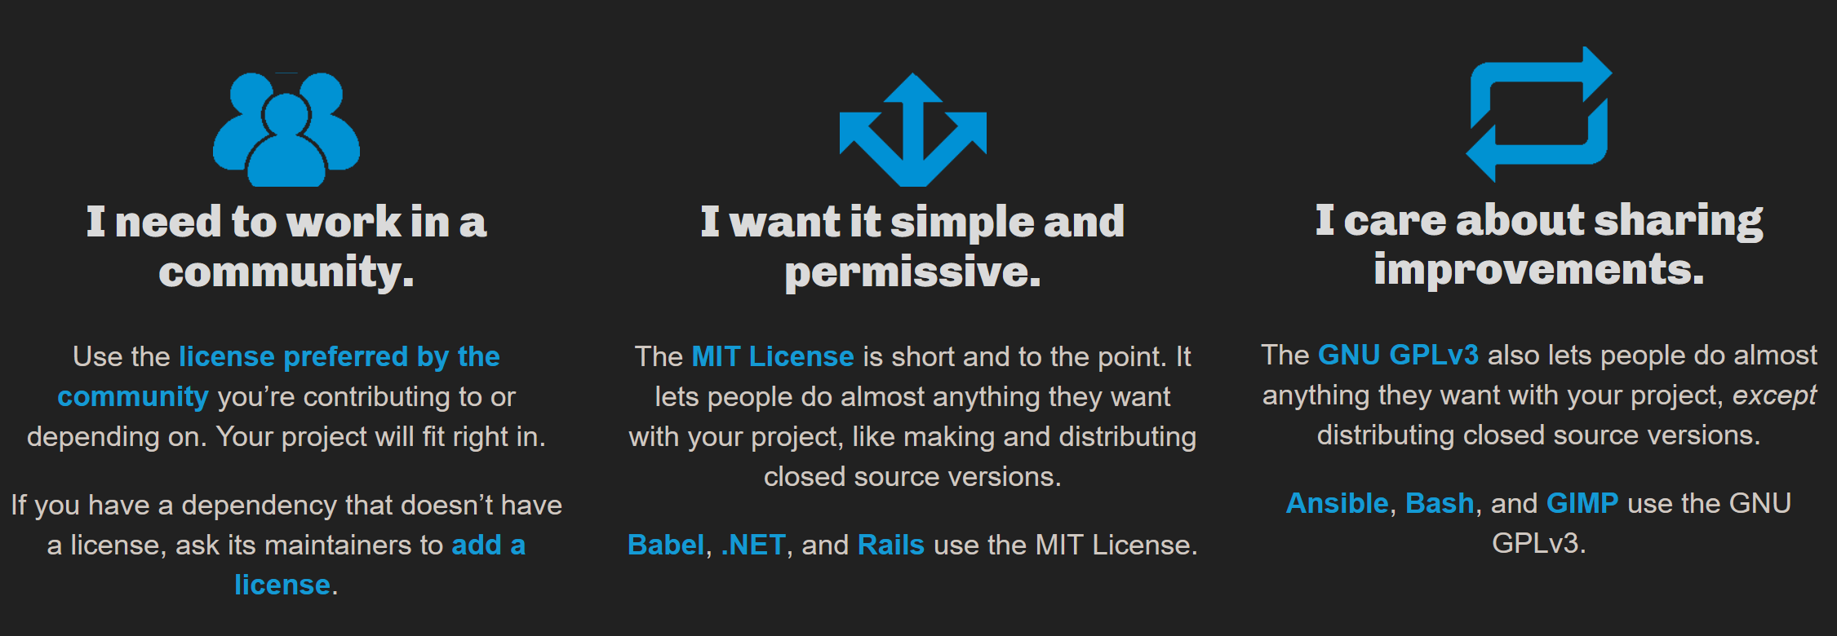
Picking a License
Notes:
https://choosealicense.com/
MIT is simple and permissive

Slide 81
Cloning your repo
You can set your Git client up to communicate via HTTPS or SSH
HTTPS is easier to setup, and with Personal Access Tokens (PAT) and 2FA (Two-factor Authentication) it probably satisfies your security needs
Once set up, try cloning your new "repo", or:
git clone https://github.com/dialog-training/2022-SA3 /some/folder
Notes:
Some firewalls may block SSH over port 22 – you can try using SSH with port 443 (not with GH enterprise though)
You need to generate public and private keys before using SSH
GitHub has gone back and forth on recommending SSH vs HTTPS..

Slide 82
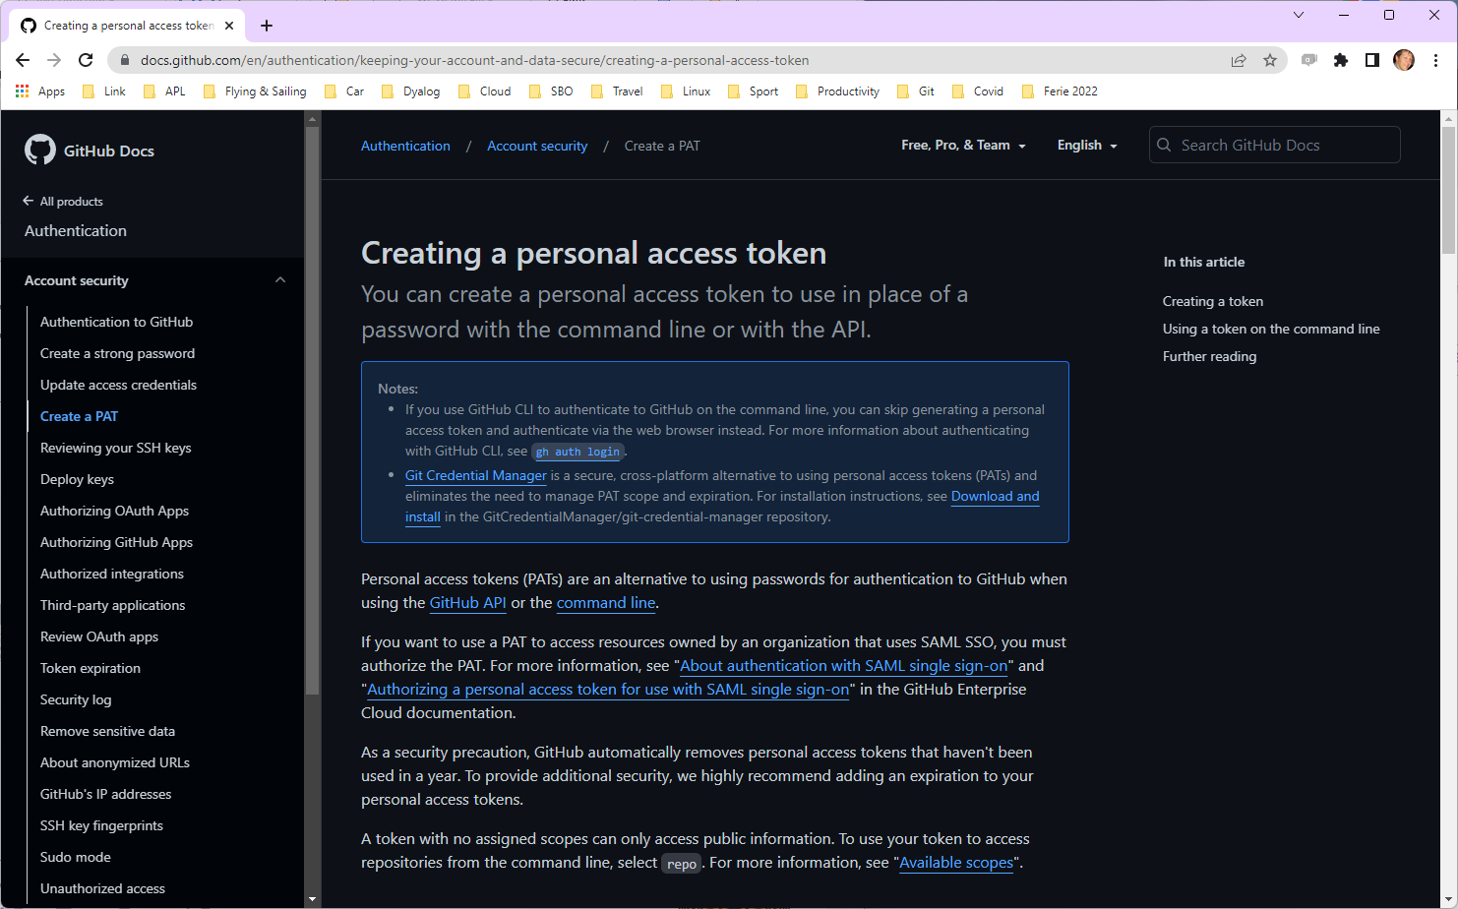

Slide 83
How Morten Works – Live Demo
VS Code & Git Lens
METSIM build

Slide 84
∇ Build;GITPATH;gitrepos;warn;ai3;dirs;nss;ns;dir;z;type;filename;flags;resource;icon;cmdline;details;DEV;m;PULL;pull
[1] DEV←∨/'yY1'∊2 ⎕NQ'.' 'GetEnvironment' 'DEV'
[2] PULL←∨/'pull'⍷⎕C 2 ⎕NQ'.' 'GetCommandLine'
[3]
[4] ⎕←'Building METSIM ',((DEV+1)⊃'runtime' 'development'),' workspace...'
[5] :If 0=≢GITPATH←1⊃⎕NPARTS ¯1↓1⊃1 ⎕NPARTS 4⊃5179⌶1⊃⎕SI
[6] GITPATH←∊1 ⎕NPARTS{⍵,'/'/⍨~(¯1↑⍵)∊'/\'}{0=≢⍵:'c:\devt\' ⋄ ⍵}2 ⎕NQ'.' 'GetEnvironment' 'GITPATH'
[7] :EndIf
[8] :If ~∧/m←⎕NEXISTS dirs←GITPATH∘,¨'metsim/dyalog' 'AtfIn/APLSource/A2K' 'deltawi/code/DWI'
[9] ⎕←'Unable to build METSIM® for Dyalog APL, cannot find:'
[10] ⎕←⍪' '∘,¨(~m)/dirs
[11] →0
[12] :EndIf
[13] nss←'#' 'A2K' 'dwi'
[14]
[15] :For (ns dir) :InEach nss dirs
[16] ai3←⎕AI[3]
[17] ⍞←'Processing ',dir,'... '
[18] :If PULL
[19] ⎕←dir(1⊃pull←⎕SHELL'git' '-C'dir'pull')
[20] :EndIf
[21] :If DEV
[22] z←(fastLoad:1 ⋄ flatten:∨/'metsim'⍷dir)⎕SE.Link.Create ns dir
[23] :Else
[24] z←(fastLoad:1 ⋄ flatten:∨/'metsim'⍷dir)⎕SE.Link.Import ns dir
[25] :EndIf
[26] ⎕←(1⍕0.001×(3⊃⎕AI)-ai3),' seconds'
[27] :EndFor

Slide 85
[29] ⎕←'Verifying git status...'⊣warn←0
[30] gitrepos←GitStatus¨GITPATH∘,¨{(¯1+⍵⍳'/')↑⍵}¨(≢GITPATH)↓¨dirs
[31] ⎕←⍪gitrepos
[32]
[33] :If ∨/~gitrepos.branch∊'main' 'main...origin/main'
[34] ⎕←'** Warning: not building exclusively from main branches'⊣warn←1
[35] :EndIf
[36] :If ~∧/gitrepos.clean
[37] ⎕←'** Warning: repos contain uncommited changes: ',(≢GITPATH)↓¨(~gitrepos.clean)/gitrepos.path⊣warn←1
[38] :EndIf
[39]
[40] :If 0≠≢RIDE←2 ⎕NQ'.' 'GetEnvironment' 'RIDE' ⍝ LEAVE THIS AS GLOBAL for Run to inspect!
[41] ⎕←'*** NB NB RIDE is set: ',RIDE,' ***'
[42] :EndIf
[43]
[44] :If warn
[45] ⎕←'Proceed (Y/N)?'
[46] →(∨/'yY'∊⍞)↓0
[47] :EndIf
[48]
[49] ⎕←'Copying SQAPL and Conga'
[50] 'Conga'⎕CY'conga'
[51] 'SQA'⎕CY'sqapl'
[52]
[53] A2K.∆WI←dwi.WI
[54] GITREPOS←gitrepos
[55]
[56] ⎕WSID←'C:\METSIMD\METSIM'
[57] ⎕LX←'Run'

Slide 86
[59] :If DEV
[60] 0 ⎕SAVE ⎕WSID
[61] ⎕←'Saved: ',⎕WSID
[62]
[63] :Else ⍝ Build a stand-alone executable
[64] ∆RTS←1
[65] filename←'C:\METSIMD\METSIM.exe'
[66] type←'StandaloneNativeExe'
[67] flags←8 ⍝ Runtime
[68] resource←''
[69] icon←'c:\METSIMD\METSIM.ico'
[70] cmdline←'METSIM.exe MAXWS=512M METSIM_FORMSIZE="1000 1600"'
[71] details←['Comments' 'METSIM® for Dyalog APL'
[72] 'CompanyName' 'MSI Inc.'
[73] 'FileDescription' 'METSIM® executable for Dyalog APL'
[74] 'FileVersion'(↑'Mmm YYYY'(1200⌶)1 ⎕DT'J')
[75] 'ProductVersion'(↑'Mmm YYYY'(1200⌶)1 ⎕DT'J')
[76] 'LegalCopyright'('Copyright MSI Inc. ',⍕1⊃⎕TS)
[77] 'ProductName' 'METSIM® for Dyalog APL']
[78]
[79] :If 1=2 ⎕NQ'.' 'bind'filename type flags resource icon cmdline details
[80] ⎕←'Created executable with command line ',cmdline
[81] :If ⎕NEXISTS buildfile←GITPATH,'metsim/installer/METSIM/METSIM.exe'
[82] buildfile(⎕NCOPY⍠'IfExists' 'Replace')filename
[83] ⎕←'Also updated ',buildfile
[84] :EndIf
[85] :Else
[86] ...
[87] :EndIf
[88] :EndIf
∇

Slide 87
∇ Run;GITPATH;dirs;nss;z;ns;dir;repo;changed;files;prefix;names;parts;m;file;ext;name;path;build;loadsrc;⎕TRAP;silent
[1] ⍝ Start Dyalog METSIM
[2] ⎕TRAP←0 'C' '→ERROR'
[3]
[4] config←ReadConfig
[5] loadsrc←4⊃5179⌶1⊃⎕SI
[6]
[7] :If config.DEV ⍝ In developer mode, patch changes since last Build
[8] ⎕←'Setting up development environment - Patching and Linking'
[9] :If 0=≢GITPATH←{(¯1+1⍳⍨'metsim/dyalog'⍷⎕C ⍵)↑⍵}∊1 ⎕NPARTS loadsrc
[10] GITPATH←∊1 ⎕NPARTS{⍵,'/'/⍨~(¯1↑⍵)∊'/\'}{0=≢⍵:'c:\devt\' ⋄ ⍵}config.GITPATH
[11] :EndIf
[12] dirs←GITPATH∘,¨'metsim/dyalog' 'AtfIn/APLSource/A2K' 'deltawi/code/DWI'
[13] nss←'#' 'A2K' 'dwi'
[14]
[15] :For (ns dir) :InEach nss dirs
[16] path←GITPATH,{(¯1+⍵⍳'/')↑⍵}(≢GITPATH)↓dir
[17] build←(GITREPOS.path⍳⊂path)⊃GITREPOS
[18] ⎕←repo←build.hash GitStatus path
[19] :If build.branch≢repo.branch
[20] ⎕←'*** Unable to patch - this workspace was built from branch [',build.branch,'] - rebuild required.'
[21] :Continue
[22] :EndIf
[23] saved←13 ⎕NINFO ⎕WSID,'.dws'
[24] (names times)←0 13 ⎕NINFO⍠('Wildcard' 1)('Recurse' 1)⊢dir,'/*'
[25] parts←⎕NPARTS(times>saved)/names
[26] names←(m←((3⊃¨parts)∊⊂'.dyalog')∨(4↑¨3⊃¨parts)∊⊂'.apl')/2⊃¨parts
[27] ⎕EX names~⊂'Run

Slide 88
[27] ⎕EX names~⊂'Run'
[28] :For (path name ext) :In m/parts
[29] ⎕←'Patching ',path,name,ext
[30] :If ext≡'.apla'
[31] ns ⎕SE.Link.Fix 1⊃⎕NGET(path,name,ext)1
[32] :Else
[33] 2(⍎ns).⎕FIX'file://',path,name,ext
[34] :EndIf
[35] :EndFor
[36] z←(fastLoad:1 ⋄ preloaded:1 ⋄ flatten:∨/'metsim'⍷dir)⎕SE.Link.Create ns dir
[37] :EndFor
[38] :If ∨/m←~⎕NEXISTS ⎕SE.Link.Links.dir
[39] ⎕←'*** WARNING: source folder(s) not found: ',⍕m/⎕SE.Link.Links.dir
[40] :EndIf
[41] :If 0=≢loadsrc
[42] ⎕←'*** WARNING: this is not a development workspace - no file links ***'
[43] :EndIf
[44] ⎕←'Config:'
[45] ⎕JSON⍠'Compact' 0⊢config
[46] :ElseIf 0≠≢loadsrc
[47] ⎕←'*** WARNING: development workspace - file links exist ***'
[48] :EndIf

Slide 89
[50] A2K.∆WI←dwi.WI
[51] dwi.Init #
[52] dwi.DEBUG←~config.TRAP_DWI_ERRORS
[53]
[54] ⎕WSID←'C:\METSIMD\METSIM'
[55] A2K.DEBUG_INTERRUPTS←'#.DEBUG_INTERRUPTS'
[56] A2K.DISPLAY_ERRORS←config.DISPLAY_TRAPPED_ERRORS/'#.DISPLAY_ERRORS'
[57] ∆DEBUG←isRuntime
[58] silent←∨/'1yY'∊2 ⎕NQ'.' 'GetEnvironment' 'SIL'
[59]
[60] :If config.DEV∧~isRuntime∨silent
[61] ⎕←' LOAD'
[62] :Else
[63] :If 0≠≢RIDE
[64] 3502⌶RIDE ⋄ 3502⌶1
[65] Wmsg'RIDE enabled - disable before shipping!' 48
[66] :EndIf
[67] LOAD
[68] ⎕OFF
[69] :EndIf
[70] →0
[71]
[72] ERROR:
[73] ⎕TRAP←0 'S'
[74] 'EF'⎕WC'Form' 'METSIM® Startup Error'('Size' 300 1000)('Coord' 'Pixel')
[75] 'EF.TXT'⎕WC'Text'(⊂⍕⍪⎕DMX.DM)(10 10)('Font' 'APL385 Unicode')
[76] ⎕DQ'EF'
∇

