Slide 1
Namespaces in Dyalog
Josh David
Morten Kromberg
Notes:
Workshop, not lecture — interrupt and ask!

Slide 2
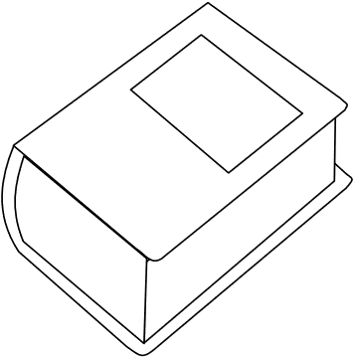
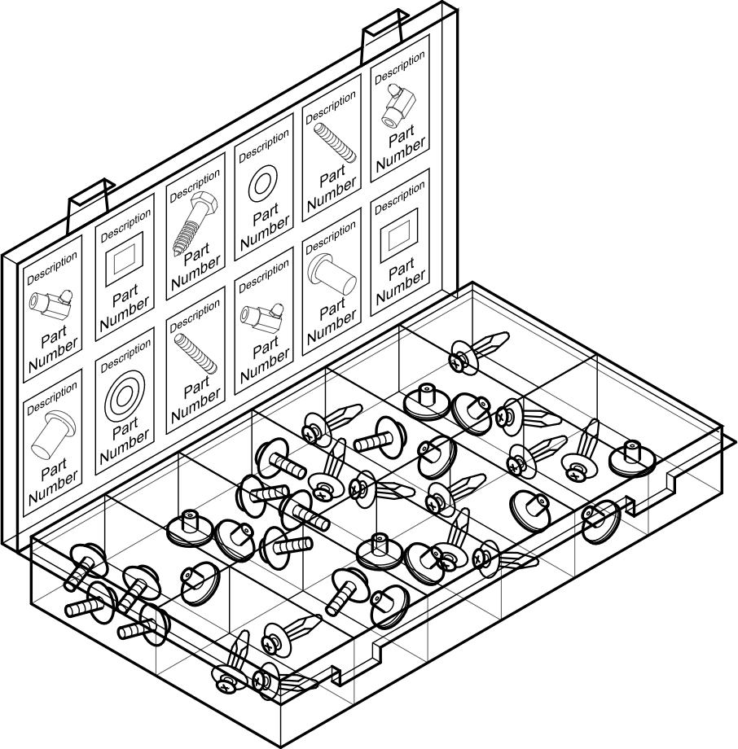
Overview
A–Z
Self-contained dictionary of name-value pairs
Structured container to organise your code
Display form and scripted namespaces
Notes:
Workshop, not lecture — interrupt and ask!

Slide 3
_{The namespace as a}
self-contained dictionary
^{of name-value pairs}
A–Z

Slide 4
Dictionary
ns←⎕NS⍬ create a namespace
≡ns it’s a kind of simple scalar
0
]display ns (2 2⍴ns) used like any other scalar
┌→───────────────────────────────────────────────┐
│ ┌→─────────────────────────────┐ │
│ #.[Namespace] ↓ #.[Namespace] #.[Namespace] │ │
│ │ #.[Namespace] #.[Namespace] │ │
│ └#─────────────────────────────┘ │
└∊───────────────────────────────────────────────┘

Slide 5
Dictionary
Value accessed with dot:
dictionary.name ← value set value
value ← dictionary.name get value
ns←⎕NS⍬ create a namespace
ns.foo←1 2 3 populate it
10×ns.foo use the value
10 20 30

Slide 6
Dictionary: Dotted expressions
Left side of the dot must be an array of namespace(s).
(ns1 ns2)←(⎕NS⍬)(⎕NS⍬)
ns1.num←77
ns2.num←99
ns1.num ns2.num
77 99

Slide 7
Dictionary: Dotted expressions
Left side of the dot must be an array of namespace(s):
(ns1 ns2).num
77 99
(2 3⍴ns1 ns2).num
77 99 77
99 77 99
Notes:
Errors if array is empty

Slide 8
Dictionary: Dotted expressions
Scalar extension:
(a b)←55
(a b)
55 55
(ns1 ns2).num←55
(ns1 ns2).num
55 55

Slide 9
Dictionary: Dotted expressions
Scalar extension:
(a b)←55
(a b)
55 55
(ns1 ns2).num←55
(ns1 ns2).num ≡ (ns1.num ns2.num)
55 55

Slide 10
Dictionary: Dotted expressions
Right side of the dot can be any expression (that is, without ⋄) executed in the namespace(s) on the left side.
(ns1 ns2)←(⎕NS⍬)(⎕NS⍬)
ns1.(a b)←'Hello' 'World'
ns1.(a,b)
HelloWorld

Slide 11
Dictionary: Dotted expressions
Right side of the dot can be any expression (that is, without ⋄) executed in the namespace(s) on the left side.
ns2.a←{2/⍵}
ns2.b←2 2⍴6 7 8 9
ns2.(a,b)
6 6 7 7 8 8 9 9

Slide 12
Dictionary: Dotted expressions
Right side of the dot can be any expression (that is, without ⋄)
executed in the namespace(s) on the left side.
(2 3⍴ns1 ns2).(a,b)
┌───────────────┬───────────────┬───────────────┐
│HelloWorld │6 6 7 7 8 8 9 9│HelloWorld │
├───────────────┼───────────────┼───────────────┤
│6 6 7 7 8 8 9 9│HelloWorld │6 6 7 7 8 8 9 9│
└───────────────┴───────────────┴───────────────┘
Notes:
What happens if we move ? Outside ()

Slide 13
Exercise 1a: Creation ^{Easy}
Create a namespace req where status is 200 and Method is {4+2×⍵} .
your ⋄ expressions
req.status
200
req.Method 200
404
Notes:
req←⎕NS⍬
req.status←200
req.Method←{4+2×⍵}

Slide 14
Exercise 1b: Updating ^{Easy}
Within req, apply Method to status, and update status with the result.
req.status
200
your_expression
req.status
404
Notes:
req.status←req.Method req.status
req.status←req.(Method status)
req.(status←Method status)

Slide 15
Exercise 1c: Importing a workspace ^{Medium}
Write a function Into that copies a workspace into a namespace (using ⎕CY).
dfns←⎕NS⍬
'dfns.dws' Into dfns
dfns.disp dfns.morse'SOS'
┌───┬───┬───┐
│...│---│...│
└───┴───┴───┘
Notes:
Into←{⍵.(⎕CY ⍺)}
Into←{⍵.⎕CY ⍺}

Slide 16
“By-value” versus “by-reference”
Non-namespaces have value semantics:
A←1 2 3
B←A
A B arrays have the same value
1 2 3 1 2 3
A←4 5 6
A B B not affected
4 5 6 1 2 3

Slide 17
“By-value” versus “by-reference”
Non-namespaces have value semantics:
A←1 2 3
B←A
A B arrays have the same value
1 2 3 1 2 3
A[3]←9
A B B not affected
1 2 9 1 2 3

Slide 18
“By-value” versus “by-reference”
Non-namespaces have value semantics:
A←3

Slide 19
“By-value” versus “by-reference”
Non-namespaces have value semantics:
A←3 ⋄ f←A∘+
f 100
103
A←4
f 100 A was passed by value – f hasn’t changed
103
f←A∘+
f 100 f has changed – not A
104

Slide 20
“By-value” versus “by-reference”
Non-namespaces have value semantics:
∇ {A}←foo A arguments are implicitly local
A[2]←9
∇
A←1 2 3
foo A
A A hasn’t changed
1 2 3

Slide 21
“By-value” versus “by-reference”
Non-namespaces have value semantics:
∇ {A}←foo A arguments are implicitly local
A[2]←9
∇
A←1 2 3
A←foo A reassigns A
A
1 9 3

Slide 22
Discussion: By-value versus by-reference
Should there be a difference between
(⎕NS⍬)(⎕NS⍬) and (2⍴⎕NS⍬)?
No: there is only one empty namespace,
compare to (⍬ ⍬) ≡ 2⍴⊂⍬ that’s by-value!
Yes: yes, in the first case we create two entities,
in the second case only one that’s by-reference!

Slide 23
Discussion: By-value versus by-reference
When should two namespaces compare equal?
By-value:
when they happen to have the exact same content (slow)
By-reference:
when they originate from the same call to ⎕NS (fast)

Slide 24
“By-value” versus “by-reference”
Namespaces have reference semantics
Arrays are pure values, irrespective of the actual instance
Except any namespace, which is a container
In the context of Dyalog APL:
namespaces are called references or refs
Name class: 2 is array, 3 is function, 9 is scalar reference

Slide 25
“By-value” versus “by-reference”
Namespaces have reference semantics
ns1←⎕NS⍬
ns2←ns1 both names designate the same ns
ns2.vec name vec undefined in ns2
VALUE ERROR
ns1.vec←7 8 9
ns2.vec name vec defined in ns2
7 8 9

Slide 26
“By-value” versus “by-reference”
Namespaces have reference semantics
ns1←⎕NS⍬
ns2←ns1 both names designate the same ns
ns1.vec←7 8 9
ns2.vec[2]←10
ns1.vec value in ns1 has changed
7 10 9

Slide 27
“By-value” versus “by-reference”
Namespaces have reference semantics
ns1←⎕NS⍬
ns1.vec←7 8 9
∇ ns SetVec2 value
ns.vec[2]←value
∇
ns1 SetVec2 10
ns1.vec ns1 has been modified
7 10 9

Slide 28
“By-value” versus “by-reference”
27
Namespaces have reference semantics
ns1←⎕NS⍬
ns1.vec←7 8 9
∇ ns SetVec2 value
ns.vec[2]←value
∇
ns1 SetVec2 10
ns1.vec ns1 has been modified
7 10 9
ns2←ns1
ns1 SetVec2 100
ns2.vec ns2 has been modified
7 100 9
ns3←⎕NS⍬ new, unrelated namespace
ns3 SetVec2 1000
VALUE ERROR: Undefined name: vec

Slide 29
“By-value” versus “by-reference”
Namespaces have reference semantics
ns1←⎕NS⍬
ns1.vec←7 8 9
∇ SetVec3 vec takes array
vec[3]←10
∇
SetVec3 ns1.vec
ns1.vec an array: passed by value
7 8 9

Slide 30
“By-value” versus “by-reference”
How to achieve “by-value” semantics with namespaces:
ns1←⎕NS⍬
ns1.vec←7 8 9
ns3←⎕NS ns1 clone: make “deep” copy
ns3.vec[2]←10
]disp (ns1 ns3).vec only new copy changed
┌→────┬──────┐
│7 8 9│7 10 9│
└~───→┴~────→┘

Slide 31
“By-value” versus “by-reference”
Namespaces have reference semantics
Allows you to:
Track individual entities independently of their content
Pass modifiable arguments to functions (use with care!)
Notes:
E.g. GUI

Slide 32
“By-value” versus “by-reference”
Namespaces have reference semantics
Note the name class (40⎕ATX):
depth-0 refs: 9
other arrays: 2 (even if consisting entirely of refs)

Slide 33
“By-value” versus “by-reference”
Namespaces have reference semantics
Naming convention tip:
Due to the different semantics, it may be worth naming “dottable” names in a recognisable way, for example: name_

Slide 34
Exercise 2a: Swap names ^{Easy}
Write an expression that swaps the values of variables x and y in a namespace ns .
ns←⎕NS⍬
ns.x←10 ⋄ ns.y←20
your_expression
ns.x ns.y
20 10
ns
x
y
Notes:
(ns.x ns.y)←ns.y ns.x
ns.(x y)←ns.(y x)

Slide 35
Exercise 2b: Swap namespaces ^{Easy}
Write an expression that swaps the values of the variables named x in the namespaces ns1 and ns2 .
ns1←⎕NS⍬ ⋄ ns2←⎕NS⍬
ns1.x←10 ⋄ ns2.x←20
ns1.y←30 ⋄ ns2.y←40
your_expression
ns1.x ns1.y ns2.x ns2.y
20 30 10 40
ns1
x
y
ns2
x
y
Notes:
(ns1.x ns2.x)←ns2.x ns1.x
(ns1 ns2).x←(ns2 ns1).x
Cannot do (ns1 ns2).x⌽⍨←1 because of implied ¨

Slide 36
Exercise 2c: Testing if reference ^{Medium}
Write a function ScalarRef that returns a scalar Boolean value indicating whether its argument is a scalar namespace.
ns←⎕NS⍬ ⋄ ns.a←10
vec←ns.a 'abc' (ns ns) ns (⎕NS⍬) 42 ⍬ #
ScalarRef¨ vec
0 0 0 1 1 0 0 1
Use one or more of these scalar namespace properties:
40⎕ATX is 9  Depth (≡) is 0 (simple scalar)
⎕DR is 326  Allows dot syntax (ns.name)
Notes:
ScalarRef←(0=≡)∧(326=⎕DR)
ScalarRef←0 326≡≡,⎕DR
ScalarRef←{9=40⎕ATX'⍵'}
ScalarRef←{9∊⎕NC'⍵'} ⍝ note the ∊

Slide 37
Exercise 2d: Indicate references ^{Hard}
Write a function RefMask that returns an array of the same structure as its argument, but with bits indicating any ns refs.
]disp RefMask (⊂⊂⊂⊂1 2 ns) 3 ns (2 2⍴'abc',⎕NS⍬)
┌→────────────┬─┬─┬───┐
│┌───────────┐│0│1│0 0│
││┌─────────┐││ │ │0 1│
│││┌───────┐│││ │ │ │
││││┌─────┐││││ │ │ │
│││││0 0 1│││││ │ │ │
││││└~───→┘││││ │ │ │
│││└───────┘│││ │ │ │
││└─────────┘││ │ │ │
Notes:
RefMask←{0=≡⍵:40⎕ATX'⍵' ⋄ ∇¨⍵}
RefMask←{b⊣(∊b)←{40⎕ATX'⍵'}¨∊b←⍵}
RefMask←{0=≡⍵:326=⎕DR ⍵ ⋄ ∇¨⍵}
RefMask←{b⊣(∊b)←326=⎕DR¨∊b←⍵}

Slide 38
Dictionary access under program control
value ← dictionary.name get value
But how do we do this when the name can vary?
ns←⎕NS⍬
ns.foo←1 2 3
name←'foo'
10×ns⍎name
10 20 30

Slide 39
Dictionary access under program control
dictionary.name ← value set value
But how do we do this when the name can vary?
ns←⎕NS⍬
name←'foo'
ns⍎name,'←1 2 3'
10×ns.foo
10 20 30

Slide 40
Exercise 3a: Get multiple values ^{Medium}
Write a function Get that takes a namespace as left argument and a vector of names as right argument and returns the corresponding values from the namespace.
ns←⎕NS⍬
ns.(foo bar baz)←(1 2 3) 'Hello' 42
names←'foo' 'bar' 'foo' 'baz'
ns Get names
1 2 3 Hello 1 2 3 42
Notes:
Get←{⍺⍎⍕⍵} or ⍎∘⍕ ⍝ inconsistent depth with single enclosed name
Get←{⍺⍎¨⍵} or ⍎¨ ⍝ requires nested argument
Get←{⍺⍎¨⊆⍵} or ⍎¨ ∘⊆ ⍝ inconsistent depth with single simple name
Get←{1≥|≡⍵:⍺⍎⍵ ⋄ ⍺⍎¨⍵}

Slide 41
Exercise 3b: Set a value ^{Medium}
Write a function Set that takes a two-element (name value) vector as right argument, then does the corresponding assignment.
Set 'my' (⍳5)
10×my
10 20 30 40 50

Slide 42
Exercise 3c: Set in a namespace ^{Medium}
Improve Set so that it takes a namespace as left argument and does the corresponding assignment in that namespace.
ns←⎕NS⍬
ns Set 'my' (⍳5)
10×ns.my
10 20 30 40 50
Notes:
{⍺.{⍎⍺,'←⍵'}/⍵}
{⍺.⍎(⊃⍵),'←⊃⍬⍴⍵'} ⍝ beware of ⎕ML and ⎕IO: {⍺.⍎(⊃⍵),'←⊃⌽⍵'} and {⍺.⍎(1⊃⍵),'←2⊃⍵'}
∇{v}←ns Set(n v)
n ns.{⍎⍺,'←⍵'}v
∇

Slide 43
Exercise 3d: Set multiple values ^{Hard}
Improve Set so that it handles multiple two-element
(name value) vectors as right argument.
ns←⎕NS⍬
ns Set ('yours' 'Hello')('mine' 'World')
ns.(yours mine)
Hello World
Notes:
Set←{⍺.{⍎⍺,'←⍵'}/¨⍵}
Set←{⍺.{⍎⍺,'←⍵'}/↑⍵}

Slide 44
Dictionary access under program control
Beware: ⍎ is potentially dangerous.
ns←⎕NS⍬
name←'⎕OFF⋄' !!!
value←1 2 3
ns {⍺.{⍎⍺,'←⍵'}/⍵} name value
Solution: In production, validate your arguments (¯1≠40⎕ATX).
— Look forward to ⎕VGET and ⎕VSET in version 20.0…

Slide 45
Dictionary access in version 20.0
Exercise 3a: Get multiple values
Get←⎕VGET
Exercise 3b: Set a value
Set←{⎕VSET⊂⍵} or Get←⎕VSET⊂
Exercise 3c: Set in a namespace
Set←{⍺⎕VSET⊂⍵} or Set←⎕VSET∘⊂
Exercise 3d: Set multiple values
Set←⎕VSET

Slide 46
_{The namespace as a}
structured container
^{to organise your code}

Slide 47
Structured container
workspace.dws
workspace1.dws
Run
data
workspace2.dws
Go
data

Slide 48
Structured container
workspace.dws
(workspace1.dws)
Run
data
(workspace2.dws)
Go
data

Slide 49
Structured container
workspace.dws
(workspace1.dws)
Run
data .
(workspace2.dws)
Go
data .
⎕IO←1
⎕IO←0

Slide 50
Structured container
workspace.dws
(workspace1.dws)
Run
ws1_data
(workspace2.dws)
Go
ws2_data

Slide 51
Structured container
workspace.dws
(workspace1.dws)
ws1_Run
ws1_data
(workspace2.dws)
ws2_Go
ws2_data

Slide 52
Structured container
workspace.dws
ws1 namespace
ws1.Run
ws1.data
ws2 namespace
ws2.Go
ws2.data

Slide 53
Structured container
workspace.dws
ws1.namespace
Run
data
ws2.namespace
Go
data
⎕IO←1
⎕IO←0

Slide 54
Structured container: notation
Tree Workspace File system
Node Namespace Directory
Leaf Name File
unix windows
Roots # ⎕SE / C:\ D:\
Separator . / \
Parent node ## .. ..
Access current node ⎕THIS . .
Report current node ⎕THIS pwd cd

Slide 55
Structured container: actions
Tree Workspace File system
Node Namespace Directory
Leaf Name File
unix windows
Create node ⎕NS mkdir md
Copy node ⎕NS cp copy
Change current node ⎕CS cd cd
List node contents ⎕NL ls dir
⋮ ⋮ ⋮ ⋮

Slide 56
Structured container
data←7 8 9
ns←⎕NS⍬
ns.data←'hello'
(data)(ns.data)
┌─────┬─────┐
│7 8 9│hello│
└─────┴─────┘
⎕CS ns Change Space
⎕THIS
#.[Namespace]
data
hello
⎕CS ## Return to parent
⎕THIS
#
data
7 8 9

Slide 57
Structured container
data←7 8 9
ns←⎕NS⍬
ns.data←'hello'
(data)(ns.data)
┌─────┬─────┐
│7 8 9│hello│
└─────┴─────┘
ns.(sub←⎕NS⍬)
ns.sub.data←'x'
⎕CS ns Change Space
data
hello
##.data
7 8 9
⎕CS sub Change Space
data
x
##.data
hello

Slide 58
Structured container
data←7 8 9
ns←⎕NS⍬
ns.data←'hello'
(data)(ns.data)
┌─────┬─────┐
│7 8 9│hello│
└─────┴─────┘
ns.(sub←⎕NS⍬)
ns.sub.data←'x'
⎕CS ns Change Space
sub.(data #.data)
┌─┬─────┐
│x│7 8 9│
└─┴─────┘

Slide 59
Exercise 4a: Is argument a root? ^{Easy}
Write a function IsRoot that takes a namespace as argument that tells you whether that namespace is a root namespace.
IsRoot ⎕SE.Dyalog.Utils
0
IsRoot #
1
IsRoot ⎕SE
1
Notes:
IsRoot←{⍵=⍵.##}

Slide 60
Exercise 4b: What is my root? ^{Medium}
Write a function FindRoot that takes a namespace as argument and returns its root.
FindRoot ⎕SE.Dyalog.Utils
⎕SE
FindRoot #
#
FindRoot ⎕NS⍬
#
Notes:
FindRoot←{⍵.##}⍣=

Slide 61
Exercise 4c: Our roots? ^{Easy ― based on FindRoot}
Write a function FindRoots that takes an arbitrary array of namespaces and finds the root for each namespace.
FindRoots ⍪⎕SE.Dyalog.Utils(#,⎕NS⍬)⎕SE
┌──────┐
│⎕SE │
├──────┤
│ # # │
├──────┤
│⎕SE │
└──────┘
Notes:
FindRoots←{⍵.##}⍣≡

Slide 62
Exercise 4d: Namespace lineage ^{Hard}
Write a function Line that takes a single namespace and returns its lineage (as a vector of refs) from root to leaf.
Line ⎕SE.Dyalog.Utils
⎕SE ⎕SE.Dyalog ⎕SE.Dyalog.Utils
Line ⎕SE.cbbot.bandsb2.sb.io
⎕SE ⎕SE.cbbot ⎕SE.cbbot.bandsb2 ⎕SE.cbbot.bandsb2.sb ⎕SE.cbbot.bandsb2.sb.io
Notes:
Line←{⍺←⍬ ⋄ ⍵≡p←⍵.##:⍵,⍺ ⋄ p∇⍨⍵,⍺}
Line←{1↓r⊣{r,⍨←⍵.##}⍣≡r←⍵}

Slide 63
Parent hierarchy
Namespaces have a single immutable parent (fixed at creation time) which is the namespace where ⎕NS was called.
ns←⎕NS⍬
#=ns.## created in #
1
ns.sub1←ns.⎕NS⍬
ns=ns.sub1.## created in #.ns
1

Slide 64
Parent hierarchy
Namespaces have a single immutable parent (fixed at creation time) which is the namespace where ⎕NS was called.
ns.sub1.(sub2←⎕NS⍬)
ns.sub1=ns.sub1.sub2.## created in #.ns.sub1
1
ns.sub1.sub2.##.##.##
#

Slide 65
Parent hierarchy
ns0←⎕NS⍬
ns1←⎕NS⍬
ns1.ns2←ns0
Names in a namespace are not (necessarily) its children:
ns1=ns1.ns2.##
0
Note: ns1.ns2 ≡ ns0 which was created in #

Slide 66
Parent hierarchy
ns0←⎕NS⍬
ns1←⎕NS⍬
ns1.ns2←ns0
Children are not (necessarily) named from their parent:
ns3←ns1.ns2.⎕NS⍬
Note: there exists no name such that ns3 ≡ ns3.##⍎name:
ns1.ns2.ns3
VALUE ERROR: Undefined name: ns3

Slide 67
Two approaches to namespaces:
Purpose: Code structure Data dictionary
Usage: rooted self-contained
Creation: named unnamed
Display: full path description
Hierarchy: tree flat
Each approach is easy, mixing them is tough ― don’t try!

Slide 68
Array Notation (v20)
Matrix, Vector: ['a' ⋄ 'b'] ('aye' ⋄ 'bee')
Namespace: (a:'aye' ⋄ b:'bee') ()
Merge Namespace: ns1 ⎕NS ns2 ⎕NS ns1 ns2
Value Get: ⎕VGET names ⎕VGET nameMat
⎕VGET ¯2 ⎕VGET 2
⎕VGET nv1 nv2 ⎕VGET nameMat values
Value Set: ⎕VSET nv1 nv2 ⎕VSET nameMat values
defaults

Slide 69
Merging Namespaces (v20)
defaults←(
name: '<no name>'
age: '<no age>'
phone: '<no phone>'
email: '<no email>'
)
jack←(
name: 'Jack'
email: 'jack@ex.com'
)
show ⎕NS defaults jack
{
"age": "<no age>",
"email": "jack@ex.com",
"name": "Jack",
"phone": "<no phone>"
}
Notes:
show←⎕JSON⍠'Compact' 0

Slide 70
JSON (JavaScript Object Notation)
{
"CaseCode": false,
"Dependencies": [
{
"URL": "https://github.com/JoshDavid/VegaLite",
"Version": "0.0.7"
},
{
"URL": "https://github.com/JoshDavid/SQL-Browser",
"Version": "0.0.4"
}
],
"Version": "0.0.0"
}

Slide 71
JSON Exercise
Create an error in your APL session
Investigate ⎕DMX
  What are you seeing when you enter ⎕DMX into the session?
Write a function that displays a Namespace using ⎕JSON
  Hint: Look into the variant operator ⍠
Notes:
⎕JSON ⍠ 'Compact' 0 ⊢ ⎕DMX

Slide 72
JSON Exercise continued
What happens if you have a higher rank array in the namespace?
  How do you fix this?
What happens if you have a function in the namespace?
  How do you only run this on variables in the namespace?

