Slide 1

US
Diane Hymas & Mark Wolfson
Monday September 29, 2025
Presentation at Fall DYNA 2025
Notes:
Thank you for the kind introduction.
I know it’s been a very long day and this is the last presentation.
How is everyone doing?
CLICK

Slide 2
Remember the day You discovered APL
Power
Possibilities
Passion
Profits
Notes:
Many of you might be feeling like this. Completely wiped out and empty.
I have some exciting news that I hope will bring energy to the room.
CLICK
To set the stage, I would like you to take a moment to “Remember the day You discovered APL”. “..the day you discovered APL”. Pause 10 seconds. CLICK
What did you see? Powerful primitives and operators? N-dimensional arrays, Implicit looping and vectorization. Conciseness, easy to map mathematical expressions directly to a line of code. You each probably have a favorite thing that made you say Wow. CLICK
You began to see Possibilities. Problems that previously seemed impossible now became Possible and faster to solve. The language constructs enabled your mind to fundamentally shift your approach to problems and algorithmic solutions. You thought differently. CLICK
APL became a joy to use, and so I’m guessing you might have developed an endearing PASSION. CLICK
And as a result of this journey, maybe your careers have been both intellectually and financially profitable.
Does this describe any of you?

Slide 3
What If…
○
○
}
{
⍵
/
|
¨
N
∘
APL
∘
∧
|
/
\
/
\
/\
/\
Science
Technology
Engineering
Mathematics
Bioinformatics
Medicine
Finance
AI …..
Notes:
What If…
CLICK
more Men . CLICK
and Women .CLICK
Could encounter APL CLICK
And the experiences that we had with APL could be replicated in their lives.
CLICK
And as they became proficient in APL CLICK
They began to apply it in Each of the disciplines of their expertise.
What transformations would be possible?

Slide 4




How?
Donate
Request
Learn
Apply
Receive
Non-Profit Charity
Dedicated to promoting APL for the benefit of Education and Science
Create
Amazing
Showcases APL as a Powerful Tool of Thought
Notes:
But How could we do this? CLICK
What if. some individuals who were successful using APL, donated funds and created a non-profit APL scientific charity. . CLICK
Then individuals or teams with great ideas could write grant applications and . CLICK Request funds from the charity. The charity would evaluate requests and . CLICK grant funds to projects in align with its mission of promoting APL. Those individuals would then . CLICK Learn APL if they didn’t already know it, and would Apply APL as per the proposals in their grant application. The result would be . CLICK the creation of some amazing Projects – which would highlight the power and potential of APL.
Very exciting ideas. This was the vision of Gitte Christenson and Bob Smith.
I first learned about this at Dyalog ‘22 in Portugal and Gitte talked more about it at Dyalog 23 in Denmark. When I attended Dyalog 24 in Scotland I was eager to know how these ideas were progressing.
CLICK

Slide 5
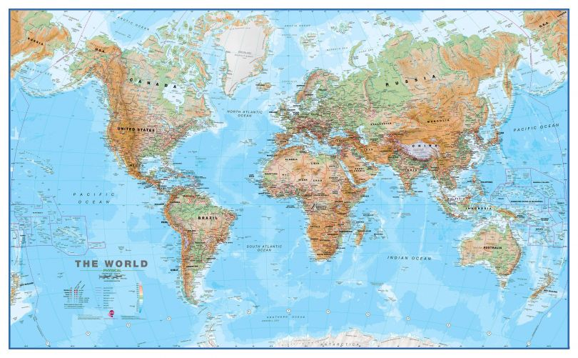
Vision Refactoring …
X
Original Idea:
One Global Charity
Registered in UK
Revised Idea:
Multiple Charities
US, UK, EU….
Notes:
CLICK
The original idea was to create one global charity registered in the UK. Funds could be donated from any country and the charity could sponsor projects in any country.
But.. Short answer - this turned out not to be legally feasible. CLICK
So this vision needed some refactoring. CLICK
The revised idea was to create multiple charities, each governed by the laws of the individual country or groups of countries abiding by similar laws in relation to charities.
For example there could be a charity in the US, another in the UK and another for the EU countries. Charities in other countries could be created if there were donors and directors interested.
CLICK

Slide 6
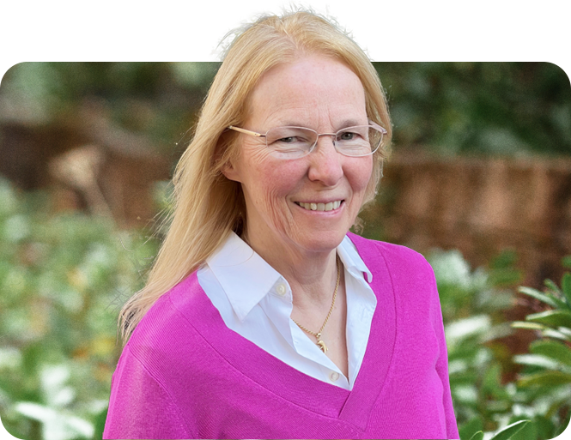
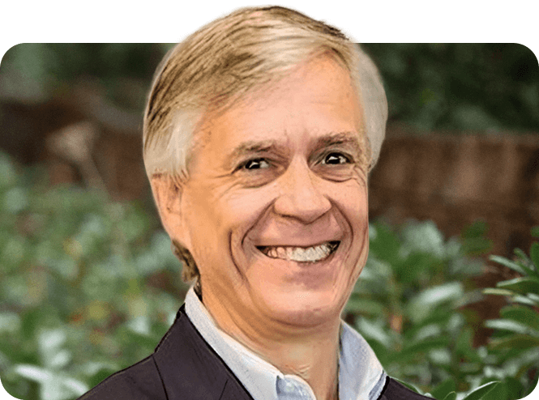
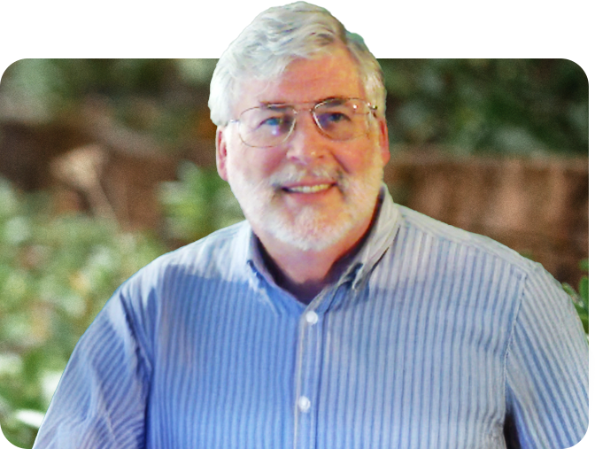


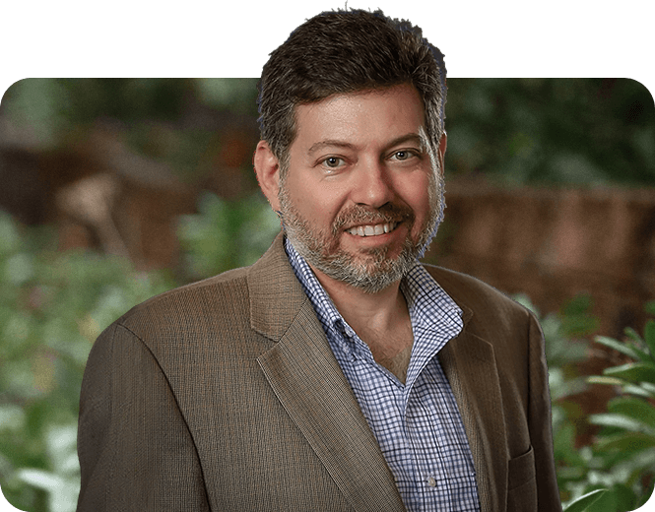
Who?
Board of Directors
Knights of the Zoom Table
US
Diane Hymas
Jay Whipple
Bob Smith
Brian Becker
Mark Wolfson
Notes:
So who will create the first APL Charity? CLICK
I would like to introduce you to
Bob Smith, Mark Wolfson, Brian Becker, Jay Whipple, and myself. CLICK who are the Founding Directors of the APL Trust US. Collectively, we probably represent 200 years of APL programming experience.
This is a group of individuals who are passionate about APL and about the vision empowering the next generations of APLers.
We have been working diligently since October 2024 to turn this vision into a reality.
My codename for our group which they will hear for the first time today, CLICK I have dubbed us the Knights of the Zoom Table.
Bob Smith definitely deserves to be knighted Sir Bob for his role in battling the paperwork dragons to get us fully incorporated. CLICK

Slide 7
The APL Trust US
Non-Profit Charity - IRS 501(c)(3)
Mission:
We are a non-profit dedicated to promoting the global awareness and use of the APL programming language.
By funding an array of APL based projects, particularly in the fields of science, engineering, and mathematics we aim to showcase the genuine utility of APL as a tool of thought to improve the capabilities of people and computers alike using concise code.
Notes:
The APL Trust US is - a fully registered US non-profit Charity.
Read mission statement.
CLICK

Slide 8
Current Status?
The APL Trust US is an Incorporated Charitable Entity
We received IRS approval of Tax-Exempt Status
  On September 24, 2025. Donations Tax Deductible!
We have Donation Pledges and Funds Received
We are launching a Letter of Intent Grant Application Process – deadline December 31, 2025
Notes:
Our current status is:

Slide 9
📢 Announcement: APL Education, Innovation and Impact Grants
The APL Trust US is excited to announce the upcoming launch of the APL Education, Innovation and Impact Grants. We plan to award grants of up to $25,000 each to projects that advance the use and understanding of the APL programming language.
We encourage proposals from experienced APL practitioners as well as from applicants with strong domain expertise who demonstrate a clear plan to learn and apply APL within their project. In this inaugural cycle, priority will be given to projects that show both feasibility and strong alignment with our mission. While APL is especially powerful for mathematically intensive problems, potential applications extend across many domains — including artificial intelligence, bioinformatics, medicine, finance, supply chain, aviation, engineering, and education.
We invite interested applicants to submit a Letter of Intent (LOI) through our online form. The LOI should be a brief summary outlining the project idea, its relevance to APL, anticipated impact, budget estimate, and key personnel.
👉 Submit your LOI here: [Google Form link – coming soon]
📅 Deadline for first round of applications: December 31, 2025
Applicants will be notified within 45 days of LOI submission to indicate if they are invited to submit a full proposal.

Slide 10
Project Ideas?
Mark’s Moment
to share some
project ideas
Notes:
What type of Projects might the charity sponsor?
CLICK
This is Mark’s Moment to share some potential ideas with you.
Thank you so much Mark.
This is by no means the limit to ideas – these are just some examples to start you thinking.
CLICK

Slide 11
What’s Your Role?
Idea Generator
Educator
Mentor
Donor
We want to hear from you!
Notes:
What role would you like to have in this vision? CLICK
Are you a person with ideas for Projects? CLICK
Are you an educator who would be interesting in generating APL teaching material or in teaching APL? CLICK
Would you be interested in mentoring individuals or teams in projects? CLICK
Are you a person who would like to contribute financially to this vision? CLICK
We want to hear from all of you! CLICK

Slide 12
Donation Details
Mail Checks:
The APL Trust Inc
PO 151
Lake Forest, Illinois 60045
Wire transfers to The Apl Trust Inc's Fidelity account:
Wire to: J.P. Morgan Chase, NY
ABA/routing number: 021000021
For credit to: National Financial Services LLC Account number: 066196-221
For benefit of: The Apl Trust Inc
For final credit to: Z32576718
Address: 383 Madison Avenue, New York, NY 10017
Stock transfers to The Apl Trust Inc's Fidelity Account via DTC:
Fidelity’s DTC number: 0226
Fidelity Account Name: The Apl Trust Inc
Fidelity Account Number: (Michael in the finance office at ‭+1 (312) 282-6543‬ for full wiring/DTC instructions)

Slide 13
Questions?
Thank You!
Notes:
Thank you all for engaging in this vision today.
And now I would like to open the floor to any questions that you might have.
Again, I want to thank you all for listening. If you have any additional questions or comments please reach out to any of the directors.

Slide 14
Information Sources
https://theapltrust.org/ - register here
https://aplwiki.com/wiki/APL_Trust https://www.linkedin.com/company/theapltrust

