Slide 1
The Data Science Journey
Josh David

Slide 2
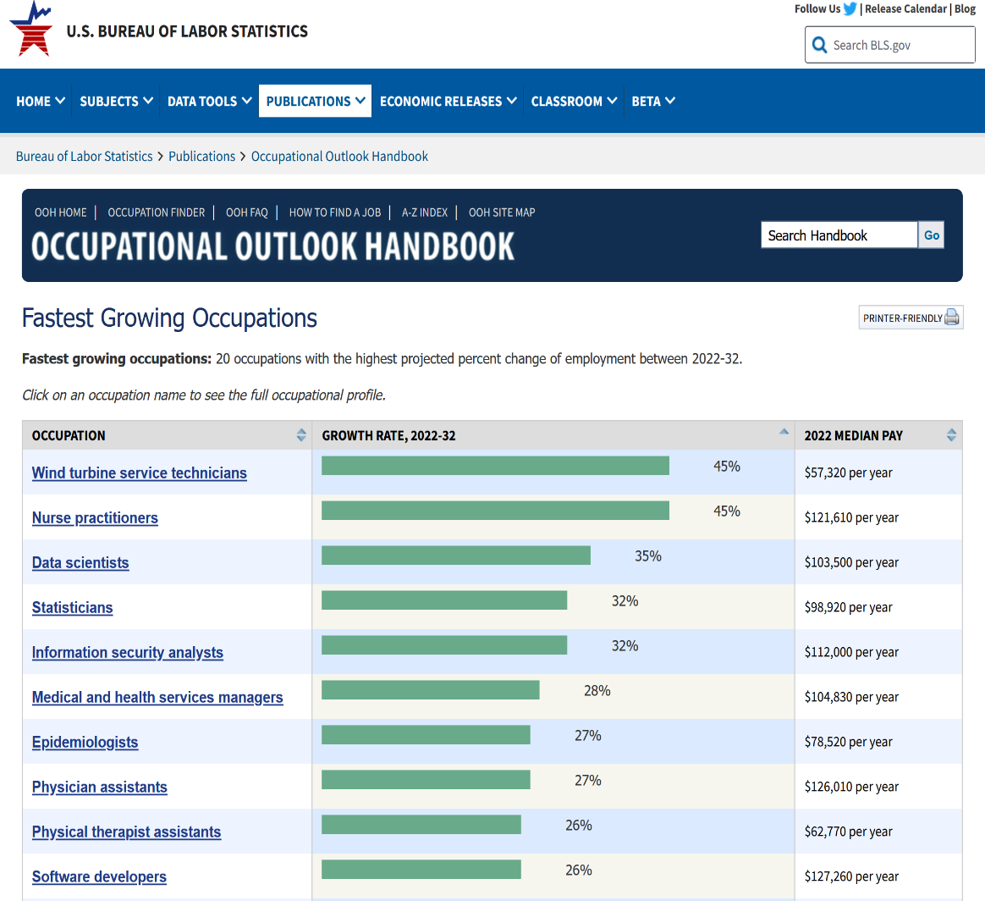
Why the need
Heavily used in rising fields
  Data Science
  Machine Learning
Shift in Company Cultures
  Data driven
Opportunity for APL
Figure 1

Slide 3
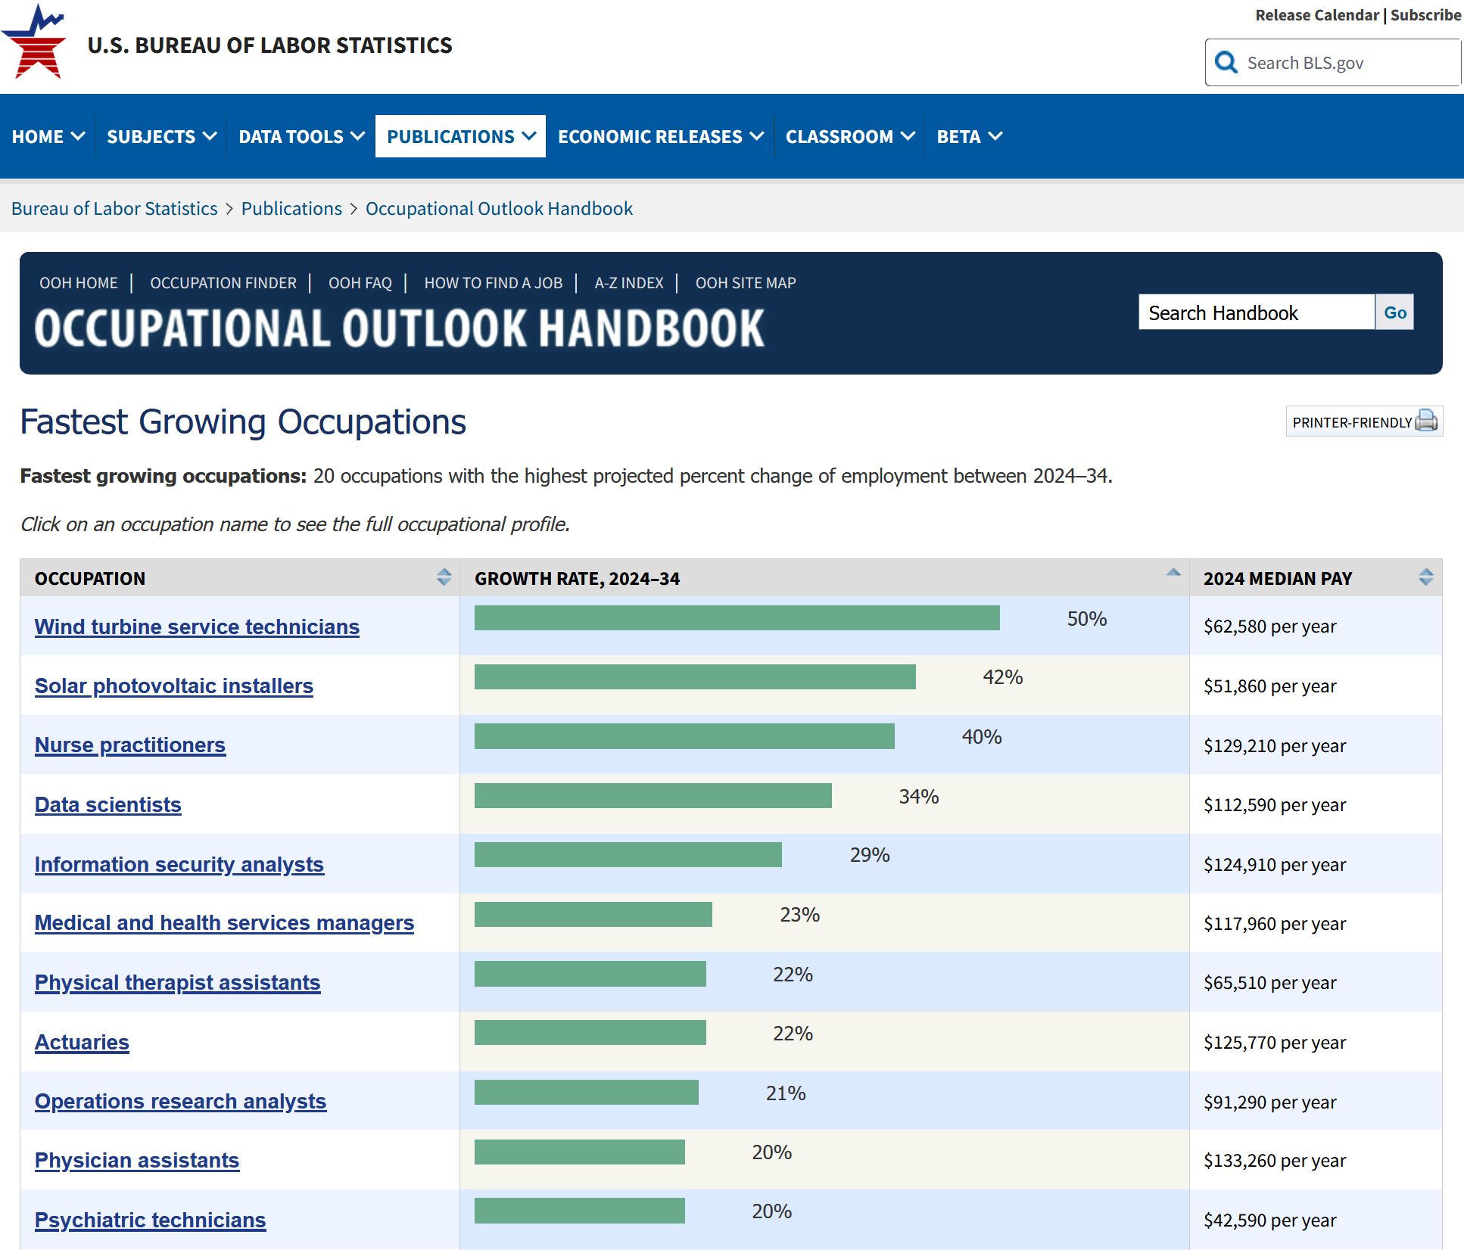
2022
2024

Slide 4
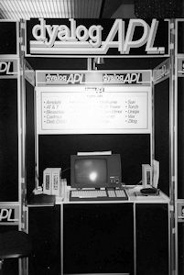
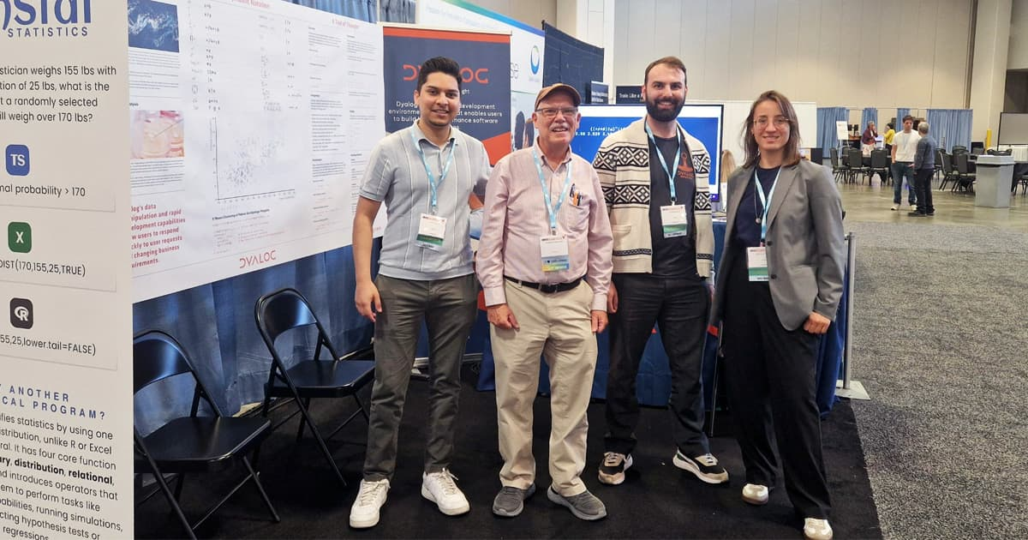
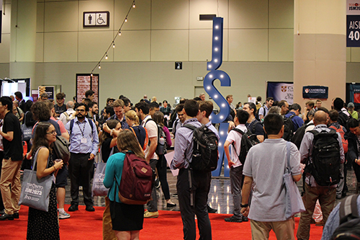
JSM
Figure 2

Slide 5
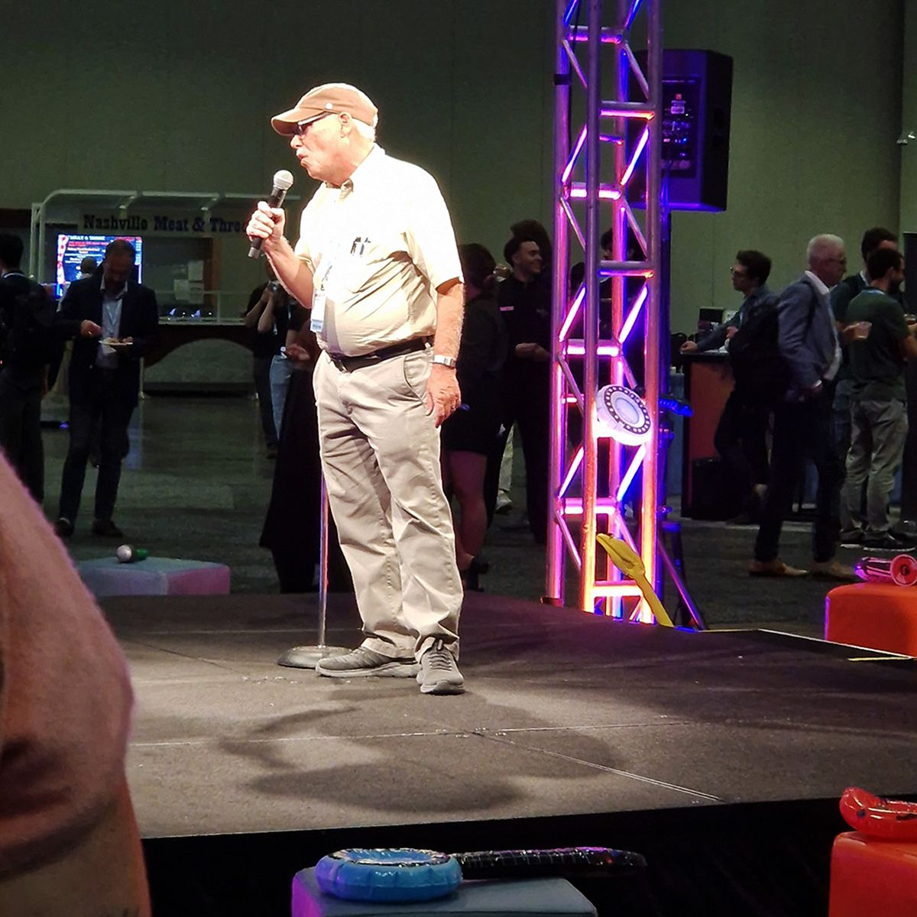
JSM

Slide 6
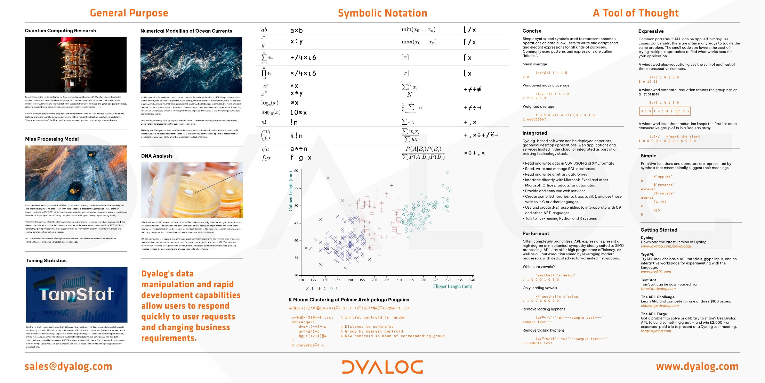
JSM

Slide 7
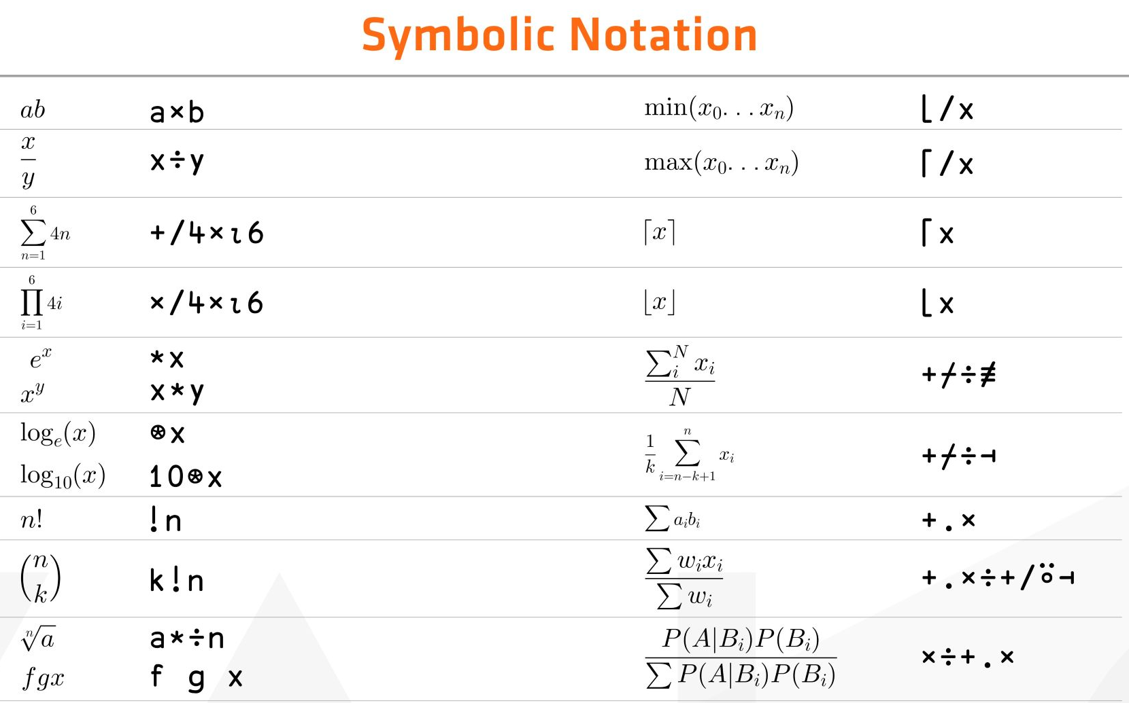

Slide 8
K Means Clustering
m{⍉g⊢∘(+⌿÷≢)⌸⍺⊣g←⊃∘⍋⍤1⊢⍺+.(*2⍨)⍵}⍣≡⍉m⌷⍨⊂3?≢m←fl,⍪cl

Slide 9
K Means Clustering
c←⍉m⌷⍨⊂3?≢m←fl,⍪cl
Converge←{
d←⍺+.(-*2⍨)⍵
g←⊃∘⍋⍤1⊢d
⍉g⊢∘(+⌿÷≢)⌸⍺
}
m Converge⍣≡c
⍝ Initial centroid is random
⍝ Distance to centroids
⍝ Group by nearest centroid
⍝ New centroid is mean of
⍝ corresponding group

Slide 10
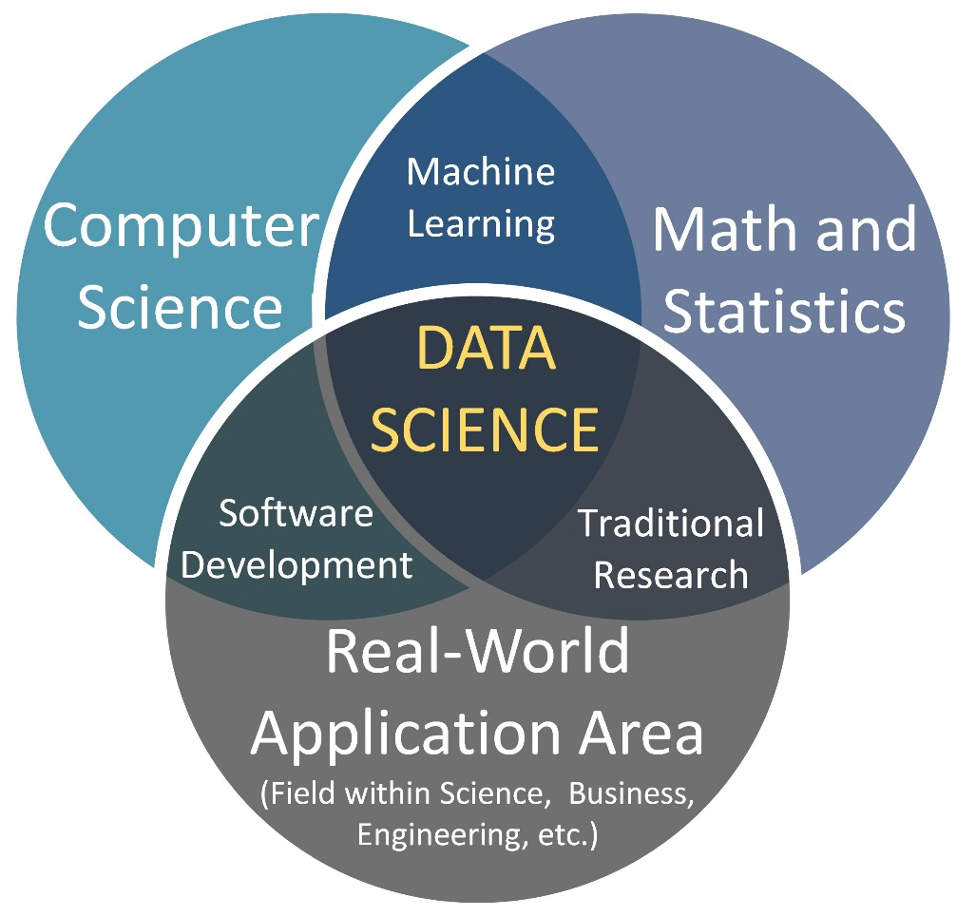
What is Data Science?
Figure 3

Slide 11


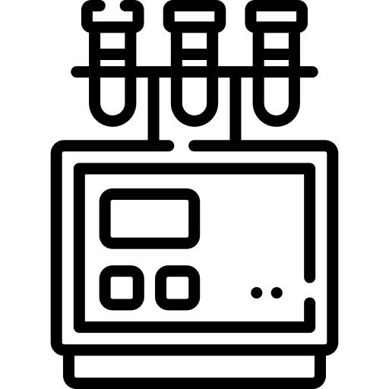


Data Science is the Collection of Data

Slide 12




Data Science is the Structuring of Data
Databases
APIs
Files
⎕CSV
⎕JSON
⎕XML
]load HttpCommand
)load sqapl
workspace

Slide 13
Data Science is the Structuring of Data
t1,(t2⍪¯1)[t2Pkey⍳t1Fkey;]
id1 100
id2 102
id3 101
id4 177
id1 100 100 2.718
id2 102 102 1.618
id3 101 101 3.142
id4 177 ¯1 ¯1
100 2.718
101 3.142
102 1.618

Slide 14
Data Science is the Cleansing of Data
x~⎕NULL ⍝ X without nulls
x/⍨(x>0)∧(x≤100) ⍝ Keep values between (0,100]
∪x ⍝ Remove duplicates
tlb←{(∨\' '≠⍵)/⍵} ⍝ Trim leading blanks
tlb∘⌽⍣2 ⍝ Trim trailing and leading blanks

Slide 15
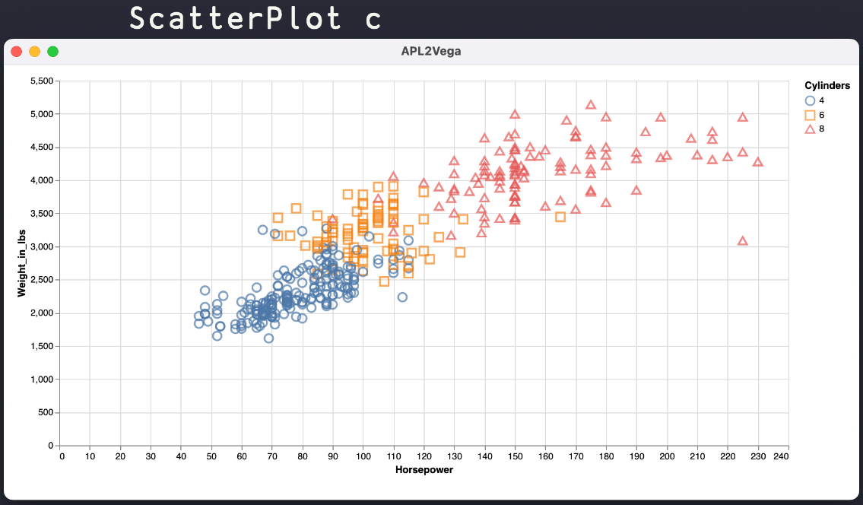
Data Science is the Visualization of Data
https://vega.github.io/vega-lite/examples

Slide 16
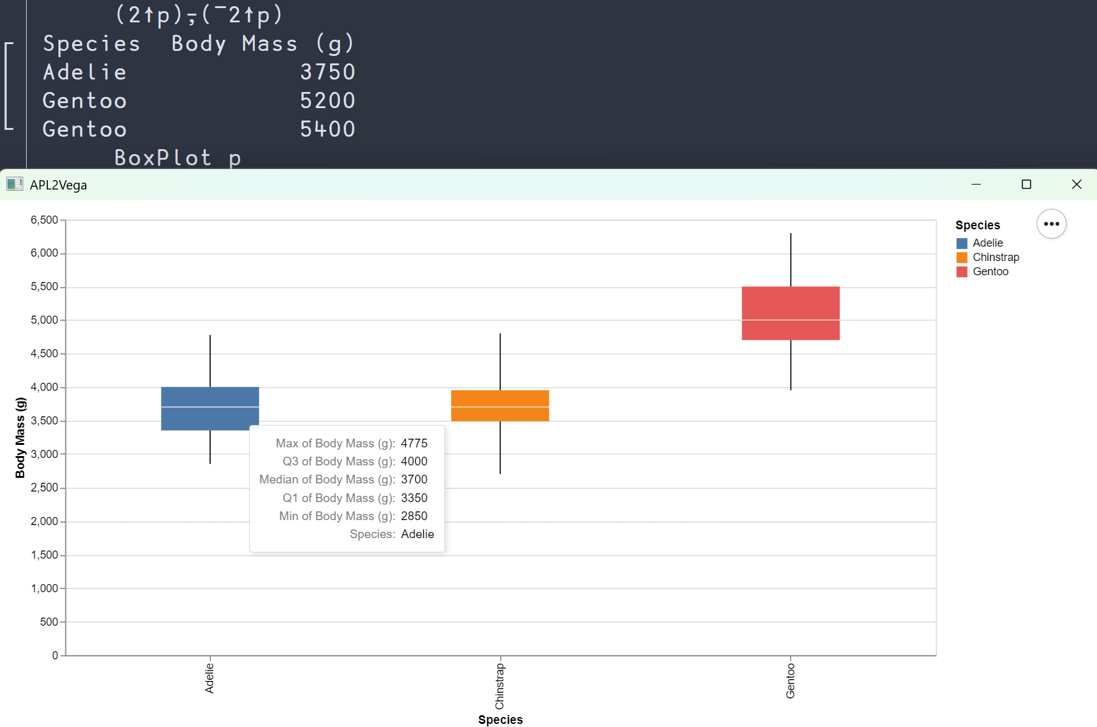
Data Science is the Visualization of Data

Slide 17
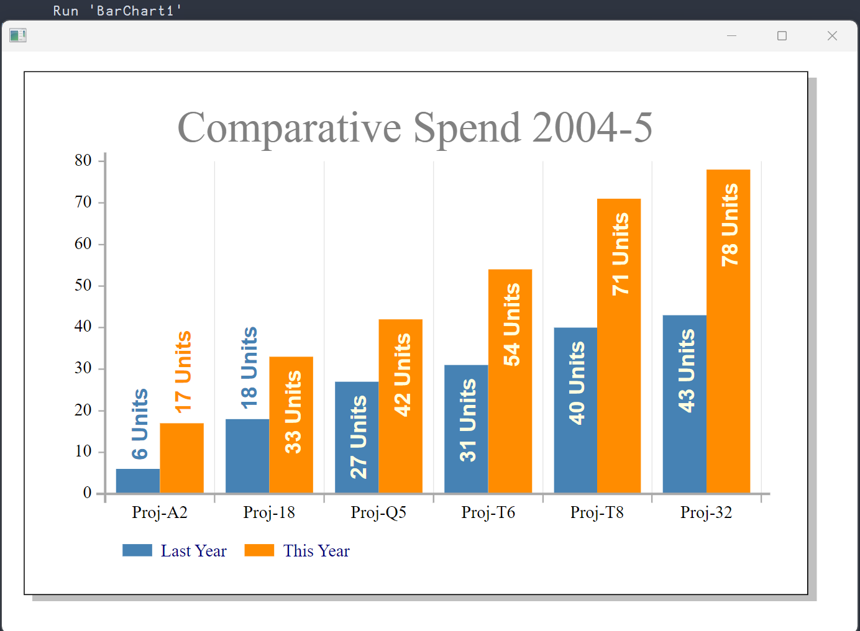
Data Science is the Visualization of Data

Slide 18
Data Science is the Summarization of Data
+/ ⍝ sum
×/ ⍝ product
⌈/ ⍝ max
⌊/ ⍝ min
(⌈/-⌊/) ⍝ range
(+/÷≢) ⍝ mean

Slide 19
Data Science is
Data Science is an exploratory discipline, combining fields of Mathematics, Statistics & Computing
Sounds perfect for APL?

Slide 20
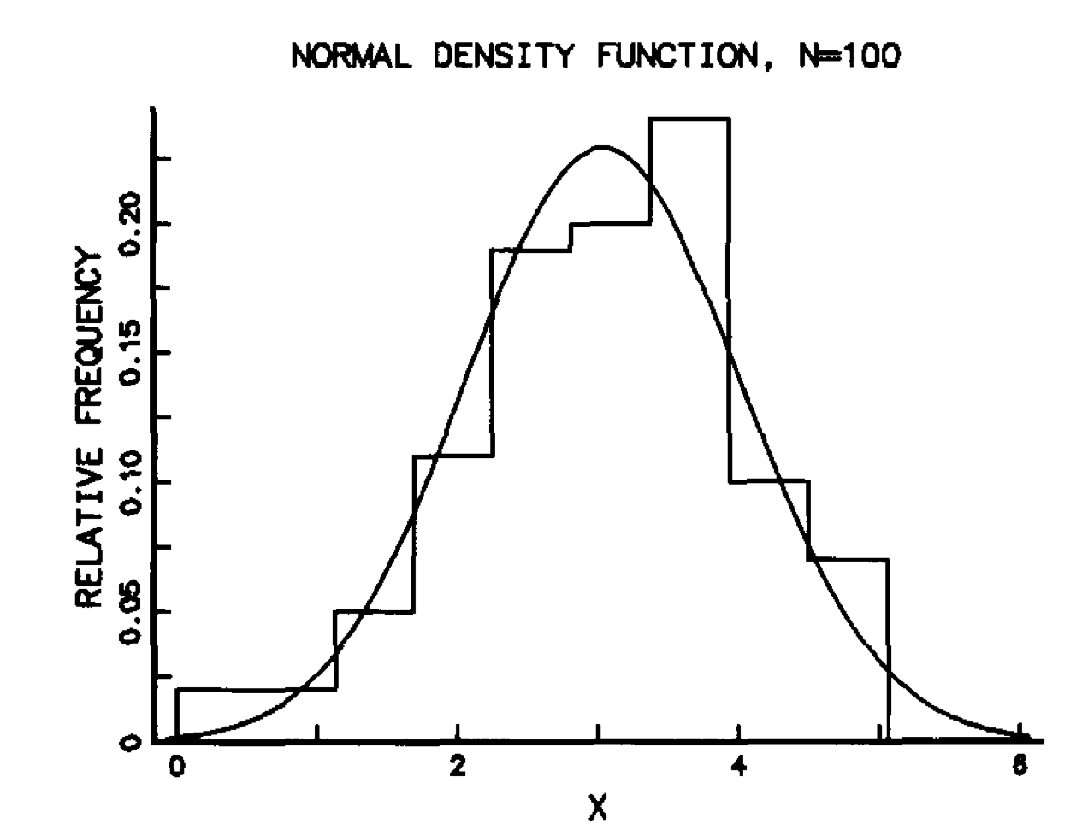
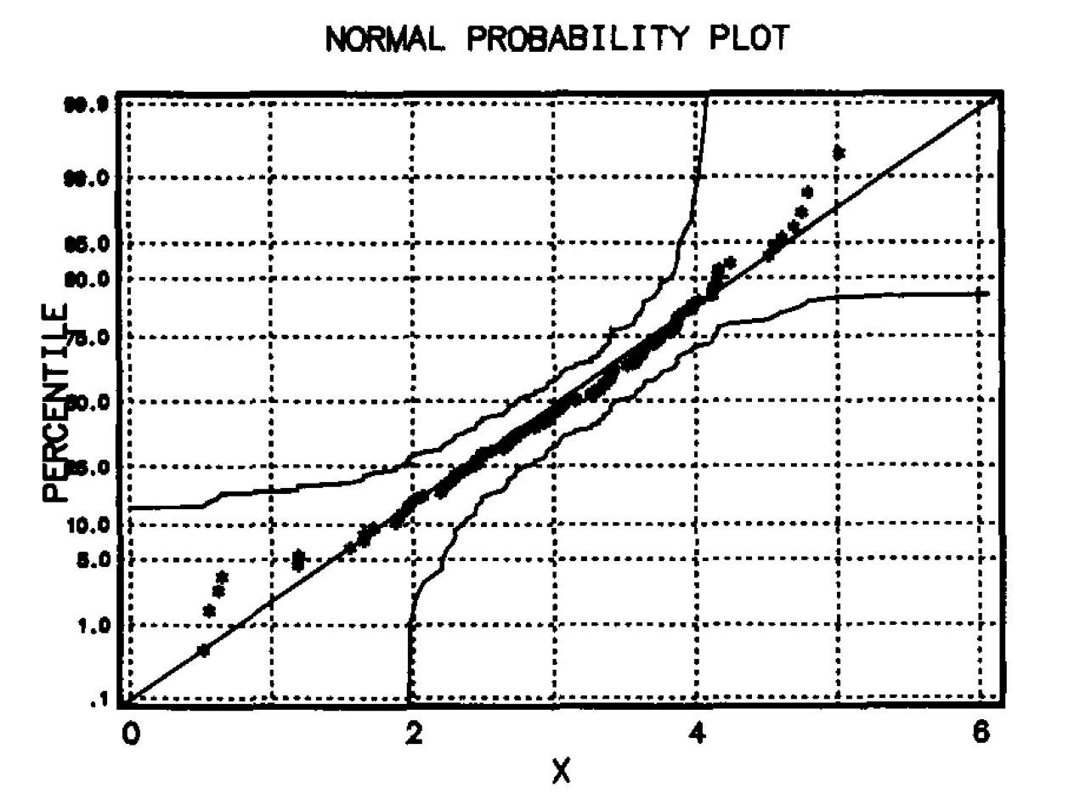
History – GRAFSTAT (1984)
Figure 4

Slide 21
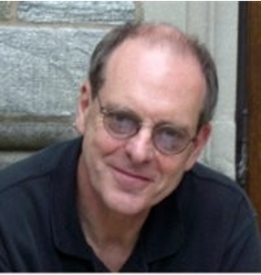

Open Source Libraries
KokoStats
TamStat

Slide 22

Open Source Libraries
KokoStats
APLearn
TamStat

Slide 23
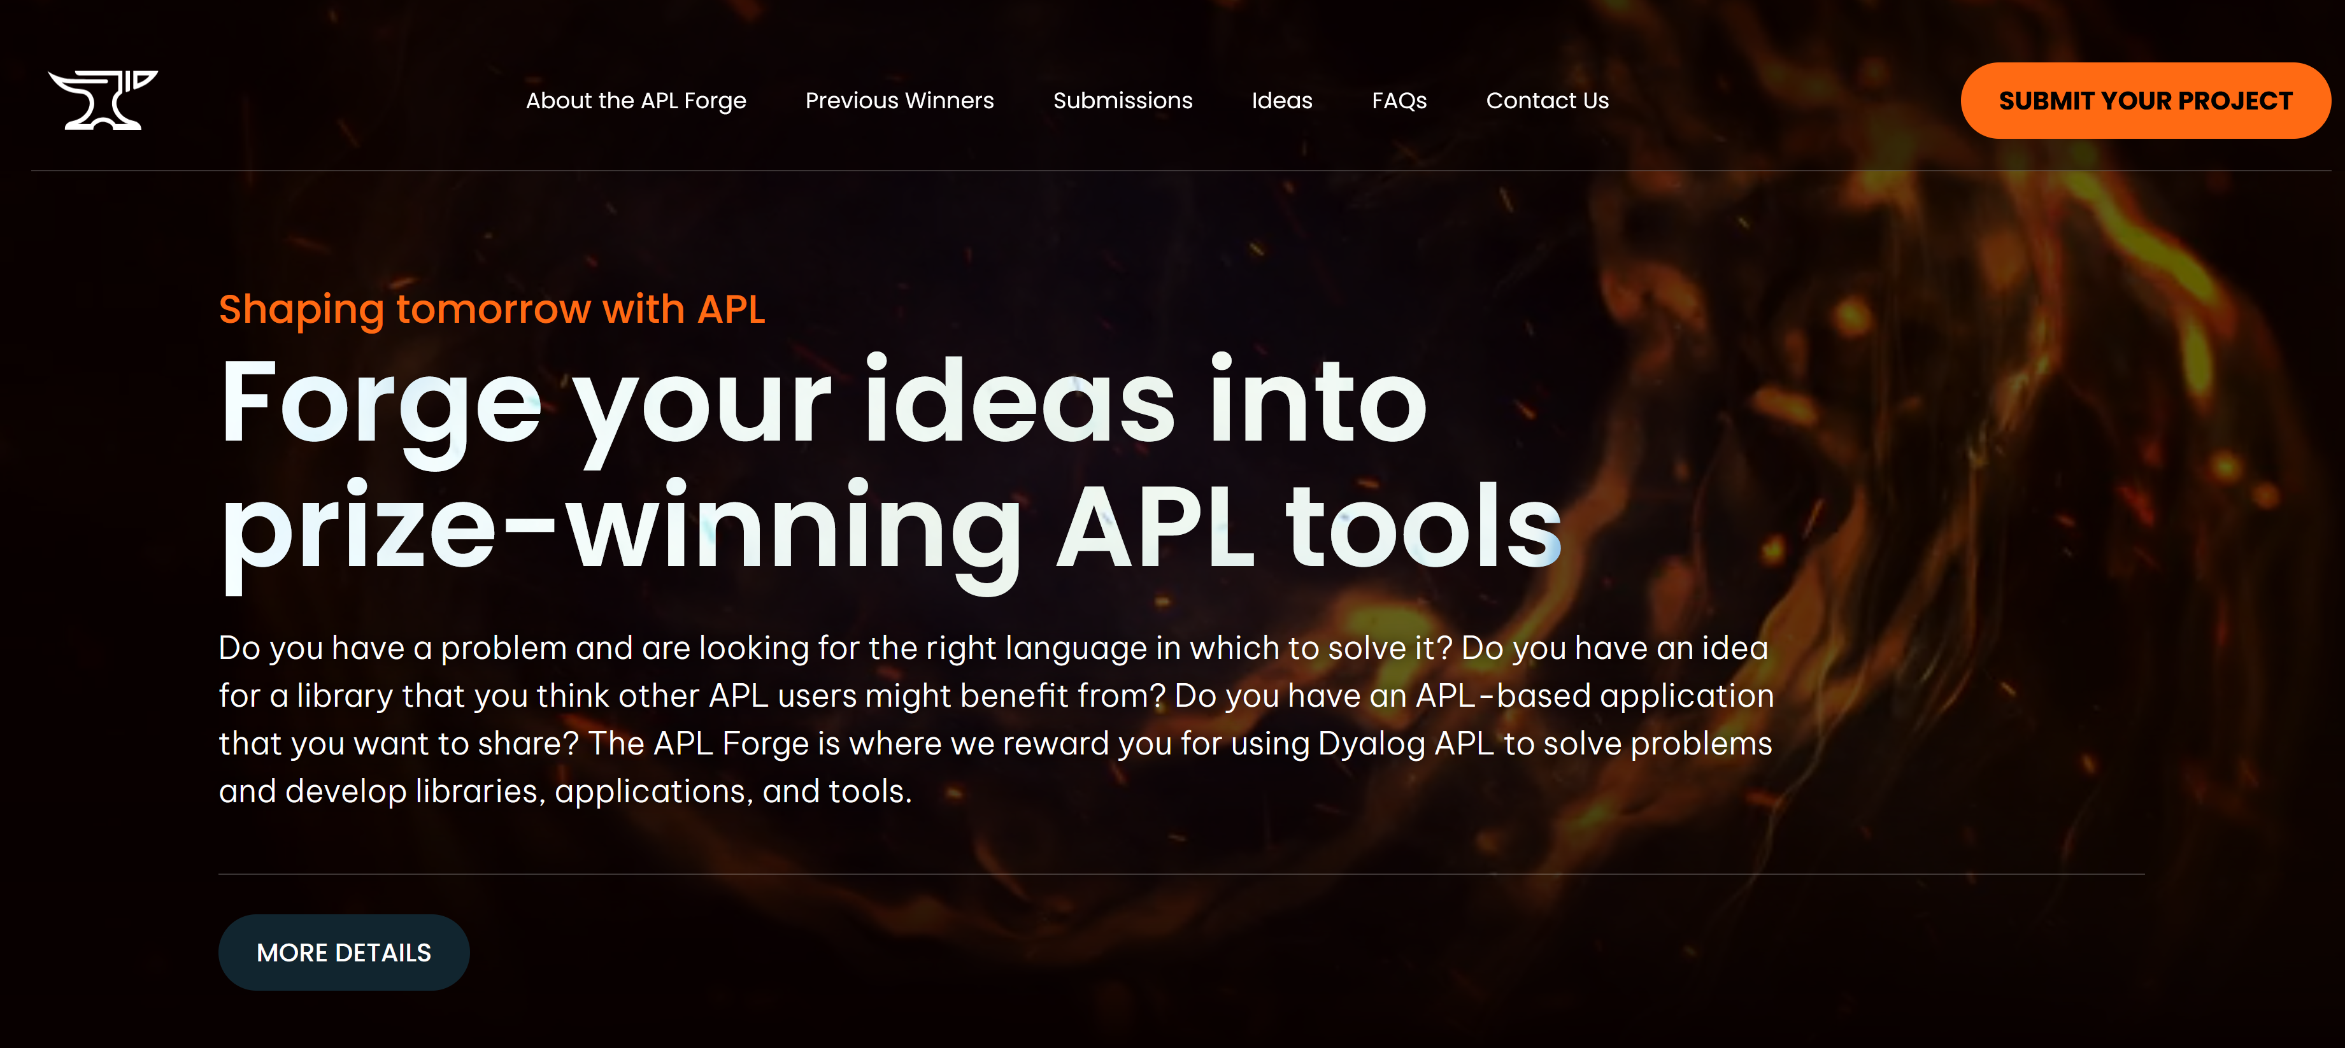

Slide 24
KokoStats
github.com/JoshDavid/KokoStats
Anova, AnovaPool
RegressMultipleLinear
RegressPolynomial
RegressForsythe
RegressChebyshev
RegressFourier
PrincipleComponents
Statistics
CorrelMatrix
AutoCorr
CrossCor
CrossTabs
DFT
FFT
IDFT
IFFT
TukeyWindow
LeadLag

Slide 25
TamStat
A full-stack application with a functional DSL for statistical operations

Slide 26



TamStat
github.com/steveman7/TamStatCore
tamstat.dyalog.com
Probability that a person weighs over 150 lbs given a population mean of 120 and a standard deviation of 25 lbs?
pnorm(150,120,25,lower.tail=FALSE)
=1-NORM.DIST(150,120,25,TRUE)
120 25 normal probability > 150

Slide 27

TamStat
What is the probability of at least 4 heads in 5 tosses?
pbinom(4-1,5,0.5,lower.tail=FALSE)
=1-BINOM.DIST(4-1,5,0.5,TRUE)
5 0.5 binomial probability ≥ 4
0.1875

Slide 28
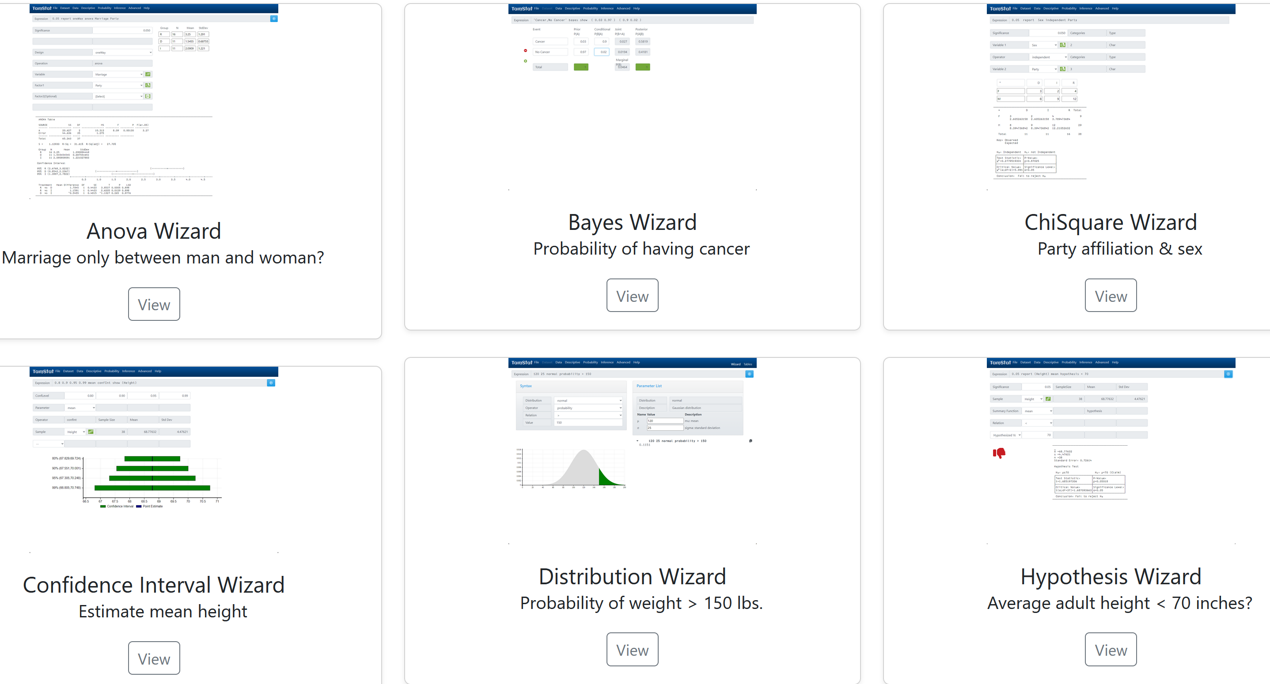

Slide 29
TamStat - Demo

Slide 30
Issues with ML Libraries
High level libraries that abstract away the central logic of a program
Low-level code that obfuscate the core definition of an algorithm

Slide 31





Slide 32
APLearn - Demo
Sci-kit learn, written in APL

Slide 33
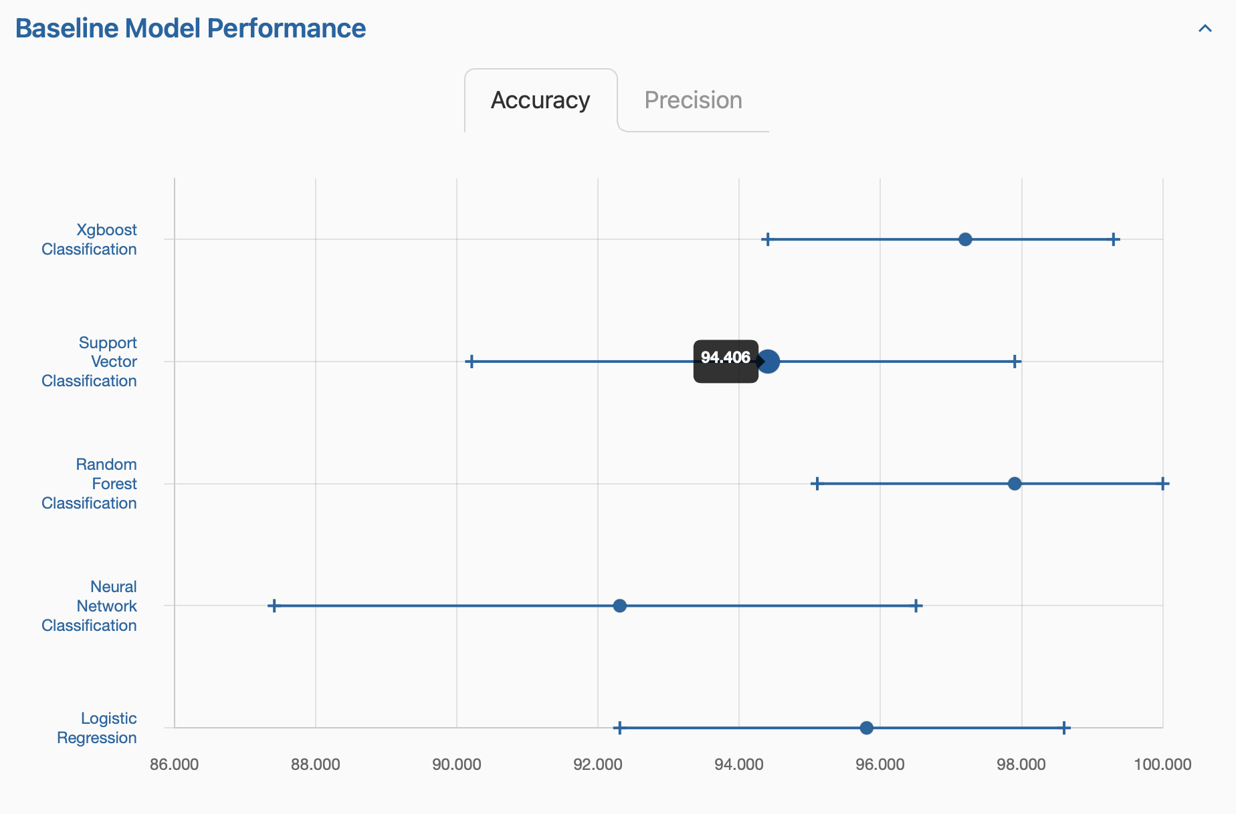
Figure 5

Slide 34
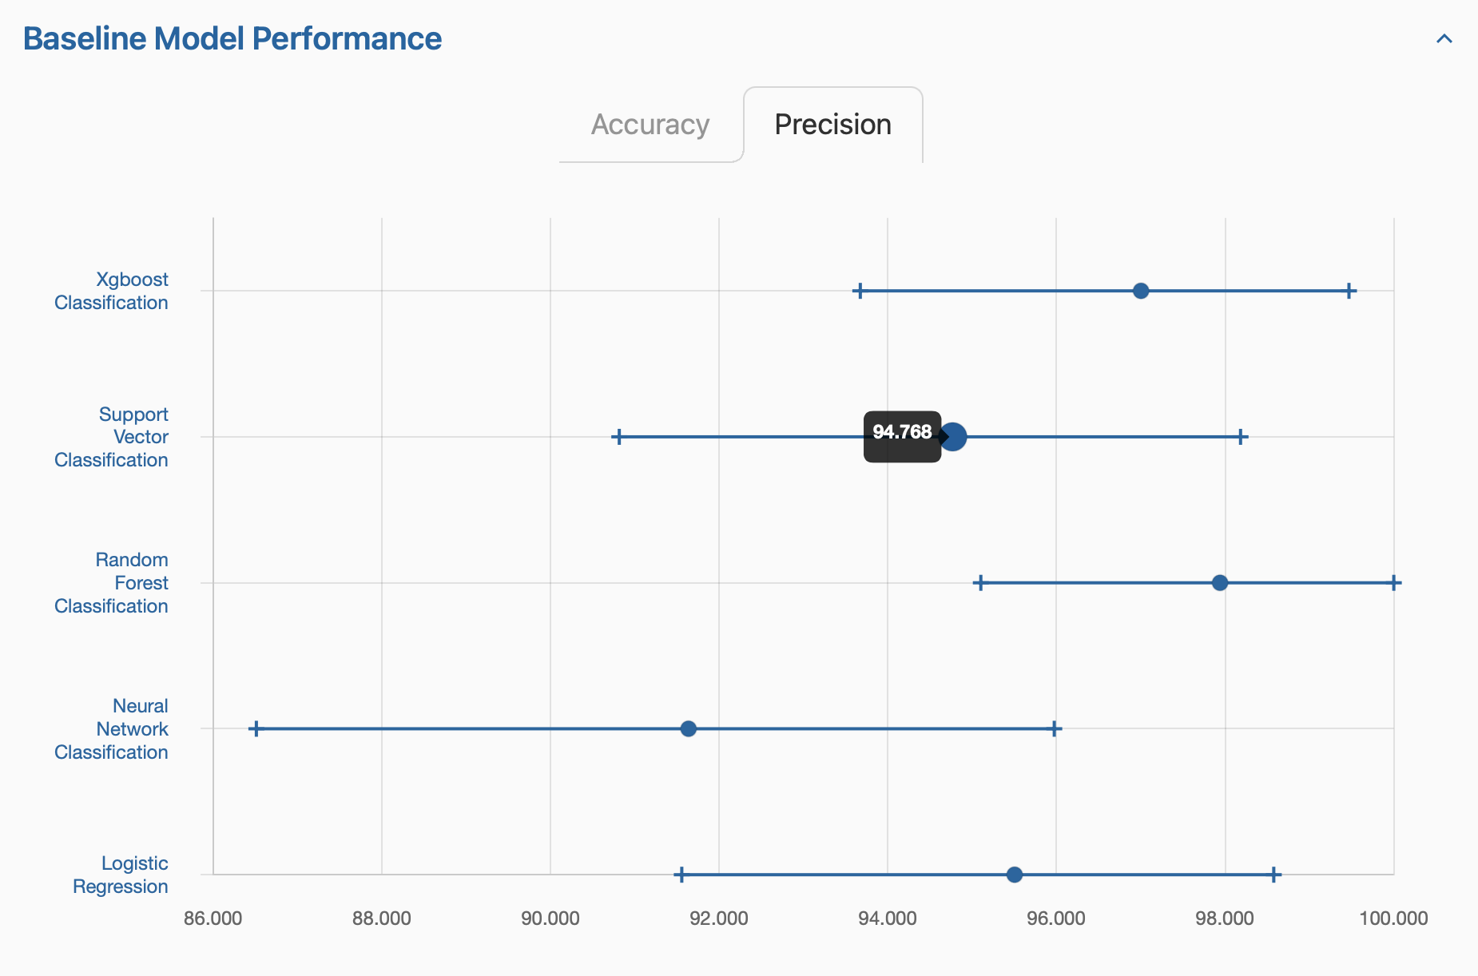
Figure 6

Slide 35
Key ⌸ (v16+)
{(3↑⍵)⍪(¯3↑⍵)}borough,⍪status
Queens Alive
Queens Alive
Brooklyn Alive
Staten Island Alive
Bronx Alive
Queens Alive

Slide 36
Key ⌸ (v16+)
{⍺,≢⍵}⌸¨borough status
Queens 250551 Alive 652173
Brooklyn 177293 Stump 17654
Manhattan 65423 Dead 13961
Staten Island 105318
Bronx 85203

Slide 37
Key ⌸ (v16+)
borough{c←≢⍵ ⋄ ⍺,⊂{⍺,100×c÷⍨≢⍵}⌸⍵}⌸status
Brooklyn Alive 95.74207668
Dead 1.872042325
Stump 2.385880999
Manhattan Alive 95.42057075
Dead 2.754383015
Stump 1.825046238
…

Slide 38
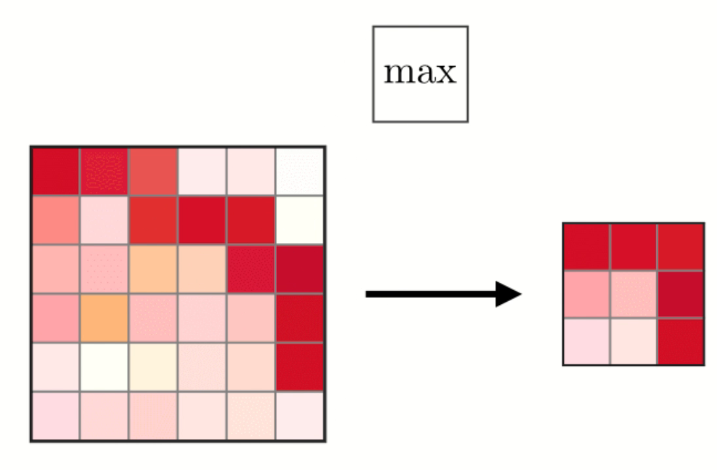
Stencil ⌺ (v16+)
{⌈⌿,⍵}⌺(2 2⍴2)⊢m
Figure 7

Slide 39
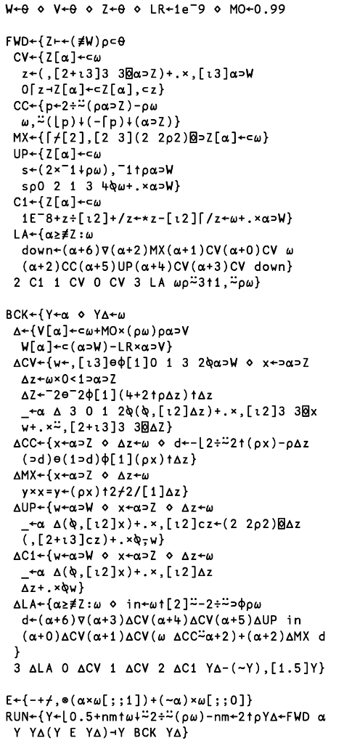
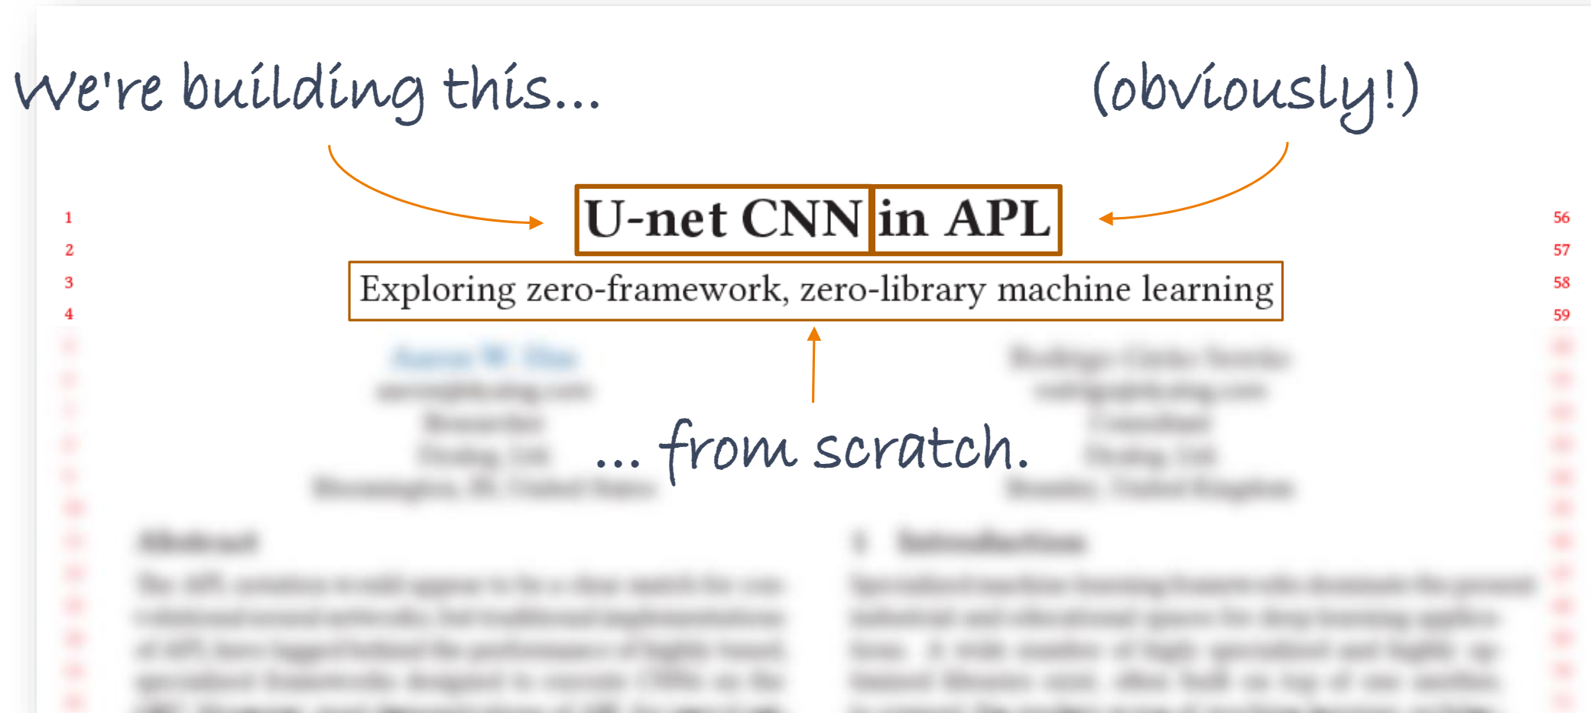
U-net CNN
Figure 8

Slide 40
Conclusion
APL’s notation is ripe for tasks in Data Science and Machine Learning
Data Science and Machine Learning give a new perspective and influence core language design
Work on co-dfns & GPU is critical

Slide 41
References
Figure 1
  https://www.bls.gov/ooh/fastest-growing.htm
Figure 2
  https://ww2.amstat.org/meetings/jsm/2025/spotlight.cfm
Figure 3
  https://artsci.usu.edu/math-stats/datascience/

Slide 42
References
Figure 4
  https://dl.acm.org/doi/pdf/10.1145/800058.801082
Figure 5,6
  https://archive.ics.uci.edu/dataset/17/breast+cancer+wisconsin+diagnostic
Figure 7
  https://dl.acm.org/doi/10.1145/3589246.3595371
Figure 8
  https://stanford.edu/~shervine/teaching/cs-230/cheatsheet-convolutional-neural-networks

Slide 43
References
Icons
  Lab <a href="https://www.flaticon.com/free-icons/equipment" title="equipment icons">Equipment icons created by Freepik - Flaticon</a>
  Survey <a href="https://www.flaticon.com/free-icons/survey" title="survey icons">Survey icons created by Freepik - Flaticon</a>
  Watch <a href="https://www.flaticon.com/free-icons/smart-watch" title="smart watch icons">Smart watch icons created by RIkas Dzihab - Flaticon</a>
  Fridge <a href="https://www.flaticon.com/free-icons/smart-fridge" title="smart fridge icons">Smart fridge icons created by logisstudio - Flaticon</a>
  Shopping <a href="https://www.flaticon.com/free-icons/shopping-cart" title="shopping cart icons">Shopping cart icons created by Freepik - Flaticon</a>

