Slide 1

Streamlining a complex development environment using Dyalog
DYNA ’25 – 09/29/2025
Mark I.Wolfson

Slide 2
Who is BIG?
  Who is BIG and why is it a perfect use-case for APL
  Technology stack – where does APL/Dyalog fit in?
  New capabilities after migrating to Dyalog
  New frontier: Analytics and AI
  New frontier: UI
Notes:
Prequel: What we’re doing with APL and how it has helped us disrupt our industry, increasing collaboration, creating efficiencies and improving overall performance.

Slide 3
Who is BIG?
Who is BIG and why is it a perfect use-case for APL
Service consultancy in the jewelry industry
  Customers:
    Retail Jewelers
    Jewelry Manufacturers (vendors)
    Jewelry industry service companies
  Services:
    Inventory analysis & merchandising consulting
    Jewelry sales/inventory data aggregation
  We provide these services by collecting accurate, timely data from 1600 retail jewelry stores using 40 different software systems, and 120 vendors.
Notes:
Prequel: What we’re doing with APL and how it has helped us disrupt our industry, increasing collaboration, creating efficiencies and improving overall performance.

Slide 4
Big Business – Disrupting the Jewelry Industry
Prior to BIG - 2005
  Independent Jewelers – family-owned businesses
  No POS/Inventory Management
    Wrong inventory mix
    Too much non-performing inventory
Balance to Buy - 2007
  Improve performance by using data
    Analyze prior consumer behavior
    Strategies to reduce aged inventory
    Budget/Plan/Buy/Manage
Notes:
Mall stores/free standing stores
Branded stores/ generic stores
Ham story
Single stores / small chains
$1M stores / 5-10-20-50 M Stores

Slide 5
Upload Service
Retailers
Vendors
MS SQL Database
Balance to Buy
Integrations

Slide 6
How to get data from retailers?
Retailers with no technical capabilities
  Direct user upload
  Emailed reports
  Monthly data
Direct POS Integration
  Daily transmissions
  With and without cooperation from software companies
  The Applet – a big ask

Slide 7
Retailer Data – A HOT MESS
Integration with dozens of systems
  Varying number of files even for the same system
  Different formats
    Flavors of CSV
    Text files
    Excel
    XML
    JSON
  Different content
    Variations in content between retailers using the same system
    Variations within a retailer depending on who’s entering the data
    Changes over time

Slide 8
Upload Service
Retailers
Vendors
MS SQL Database
Balance to Buy
Integrations

Slide 9
Upload Service
Retailers
Vendors
MS SQL Database
APL Process
Balance to Buy
Integrations

Slide 10
Retailer
APL Process
Upload Service
Retailer
APL Process
MS SQL Database
Retailer
APL Process
Balance to Buy
Integrations
Vendor
APL Process
Notes:
STOP after this slide to explain how the system is complicated and
LOT of Moving parts
EVERYTHING IS C# except Black Boxes

Slide 11
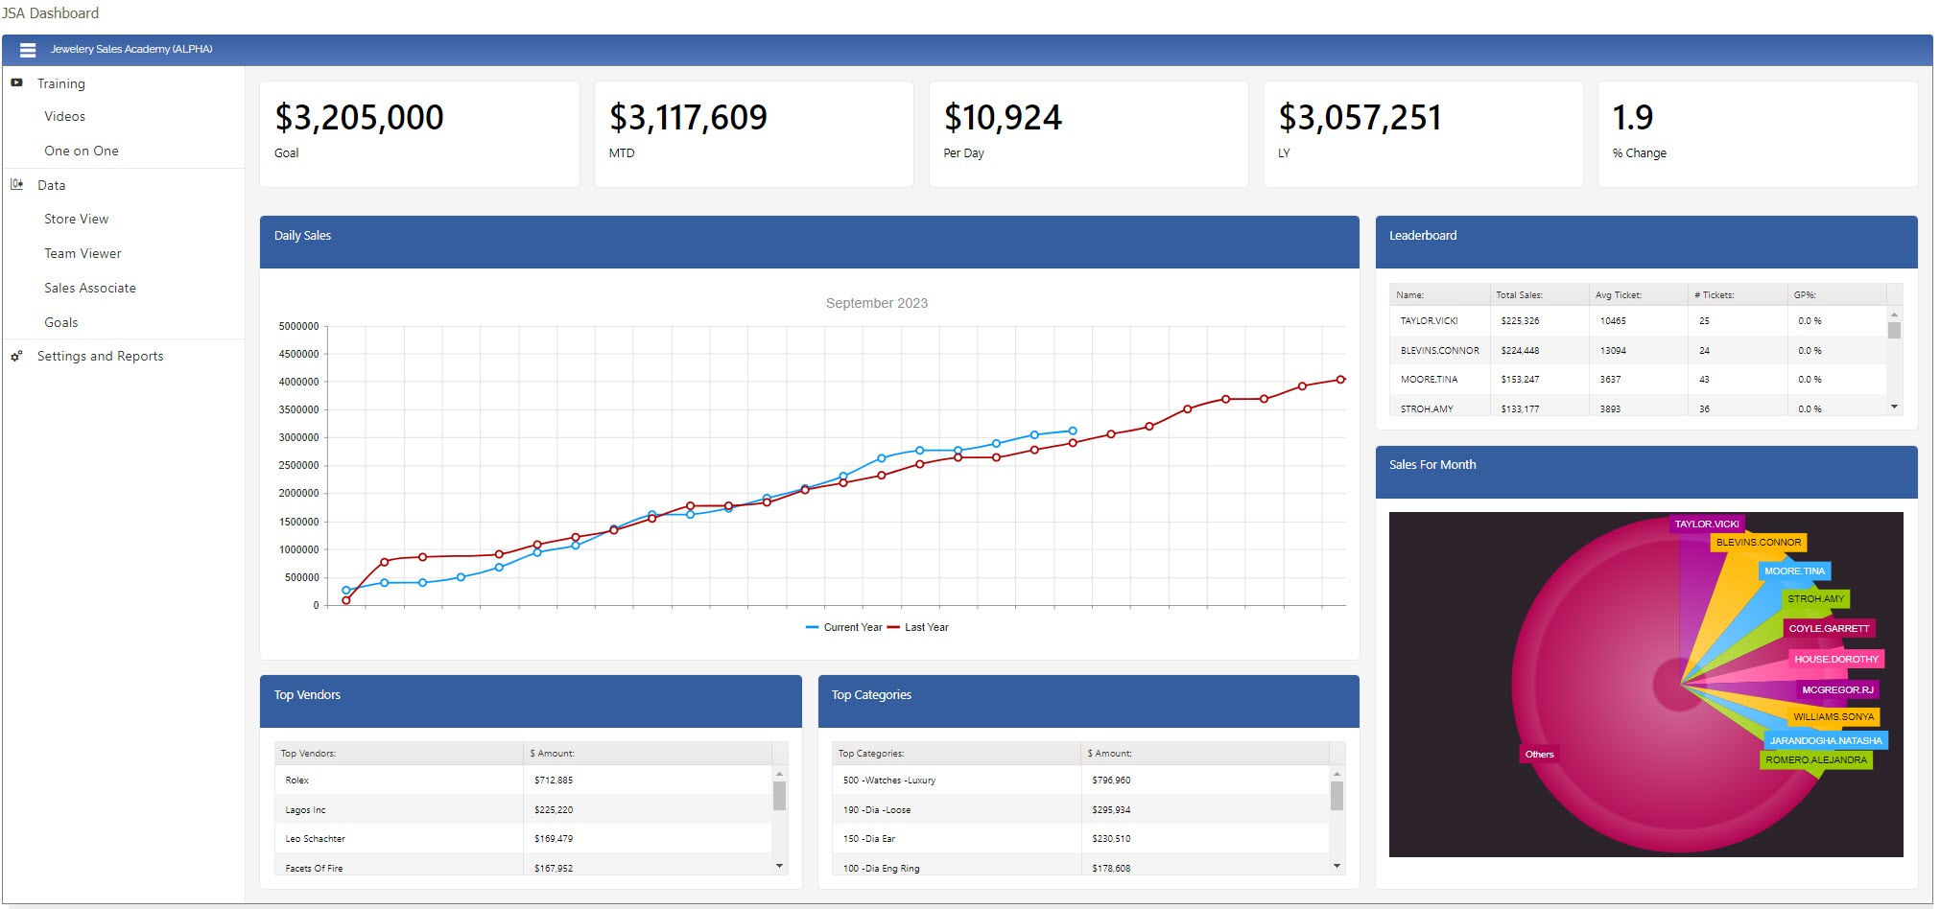
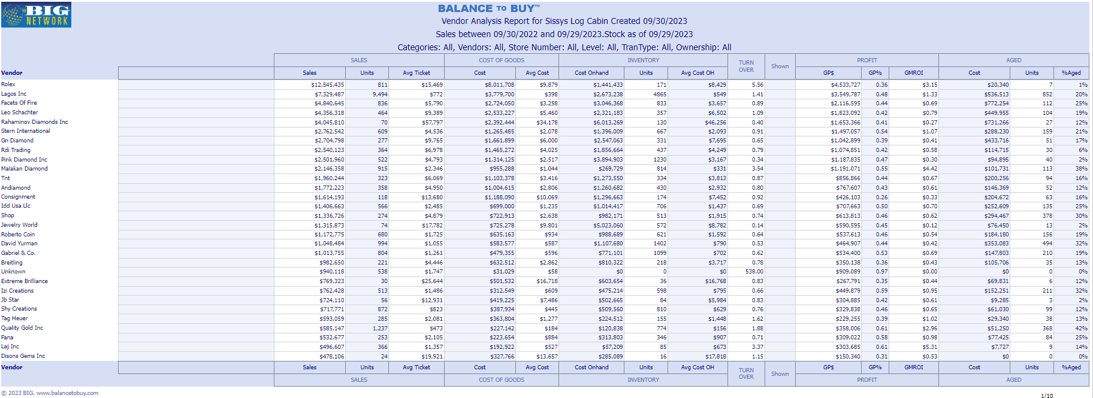
Retailer
.CSV
Black Box Process
MS SQL DB
Retailer
Retailer
Applet
15 POS Systems
Retailer
Black Box Process
Retailer
Retailer
Black Box Process
Retailer
.csv
API
Black Box Process
.txt
Retailer
API
Black Box Process
.xls
Raw Data Store
Retailer
API
Black Box Process
.xlsx
Custom Reporting
Retailer
API
Black Box Process
Vendor
.xml
API
Black Box Process
.json
Black Box Process
Vendor
API
Outbound Integrations
Black Box Process
Retailer
FTP
Black Box Process
Retailer
Vendor
Black Box Process
Outbound Datafeeds
Vendor
Retailer
Black Box Process
Retailer
Notes:
STOP before to explain APL is just tranche in the middle – application is all C#
STOP after to explain using Dyalog with standard tools – APL=GLUE
2 60-somethings doing black boxes, now 2 20-somethings

Slide 12
Big Business – Disrupting the Jewelry Industry
Issues to fix
    Wrong inventory mix (buying the old way)
    Too much non-performing inventory
      $100B Industry, $100B non-performing inventory
Improve performance by using data
    Use prior consumer behavior to
      Plan inventory
      Inform buying decisions
    Partner with vendors
    Strategies to reduce aged inventory
Notes:
Mall stores/free standing stores
Branded stores/ generic stores
Single stores / small chains
$1M stores / 5-10-20-50 M Stores

Slide 13
Using Math to Solve these issues
  New frontier: Math and AI and Machine Learning
    Training users to use data/reports to make decisions
    Figuring out the answers for them
Notes:
Prequel: What we’re doing with APL and how it has helped us disrupt our industry, increasing collaboration, creating efficiencies and improving overall performance.

Slide 14
Using Math to Solve these issues
  Examples of problems to solve:
    Weekly reorder list organized by vendor
    Transfer list to move aged from non-performing stores to performing stores
    Determining more accurate values for aged/fast sellers
    Find holes in inventory mix (Inventory Planning)
    Use peer stores to recommend adding/removing vendors
    Model/ideal inventory for a brand
    Parse attributes out of technical descriptions
Notes:
Prequel: What we’re doing with APL and how it has helped us disrupt our industry, increasing collaboration, creating efficiencies and improving overall performance.

Slide 15
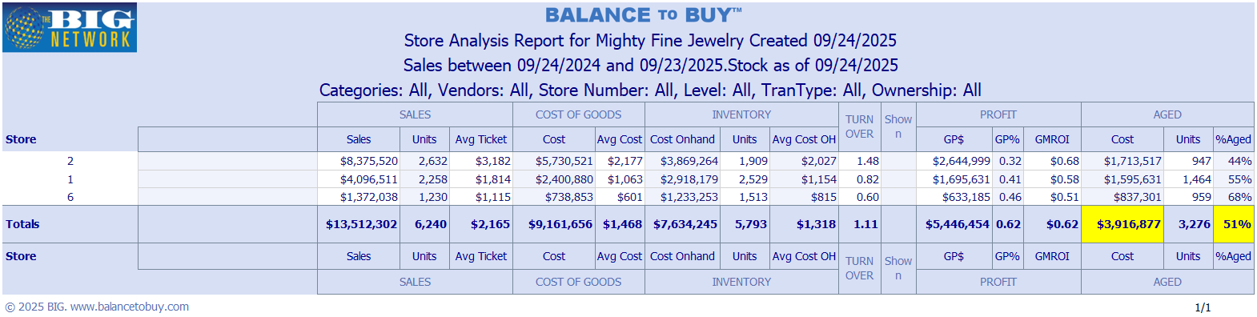
Example of the problem to solve
Notes:
Mall stores/free standing stores
Branded stores/ generic stores
Single stores / small chains
$1M stores / 5-10-20-50 M Stores

Slide 16
Using Math to Solve these issues
  Creating a store-to-store transfer list
    Batch items in different ways using keytypes
    Concentrate on aged inventory – could vary depending on keytype
    Using Kaplan-Meier curves – survival analysis
    Why can’t we just send the data off to ChatGPT?
      Special Orders
      Samples
      Programs
      Dynamically adjusting aged thresholds
Notes:
Prequel: What we’re doing with APL and how it has helped us disrupt our industry, increasing collaboration, creating efficiencies and improving overall performance.

Slide 17
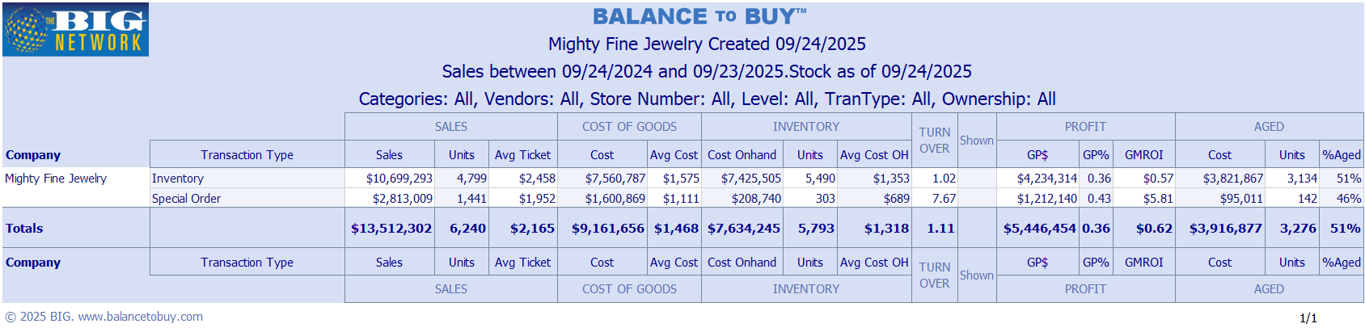
Example of the problem to solve
Notes:
Mall stores/free standing stores
Branded stores/ generic stores
Single stores / small chains
$1M stores / 5-10-20-50 M Stores

Slide 18
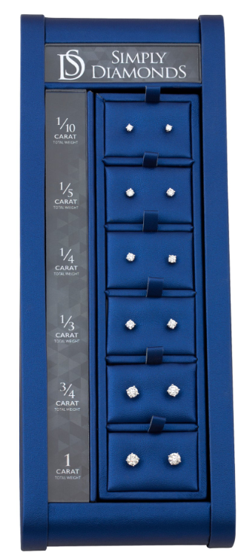


Using Math to Solve these issues
Notes:
Prequel: What we’re doing with APL and how it has helped us disrupt our industry, increasing collaboration, creating efficiencies and improving overall performance.

Slide 19
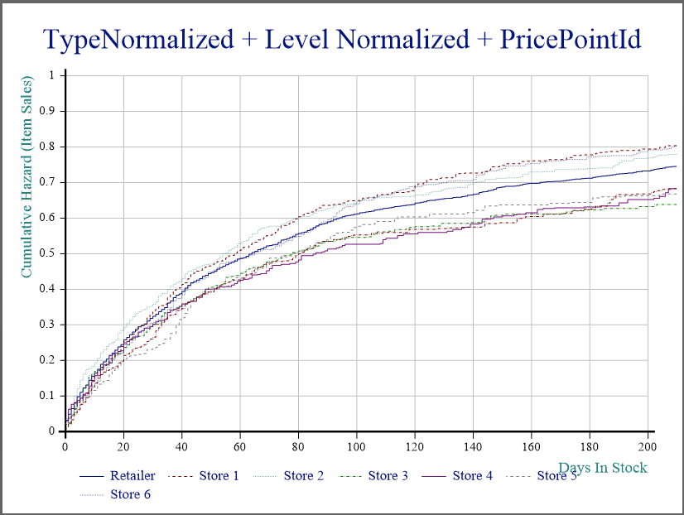
Using Math to Solve these issues
Notes:
Prequel: What we’re doing with APL and how it has helped us disrupt our industry, increasing collaboration, creating efficiencies and improving overall performance.

Slide 20
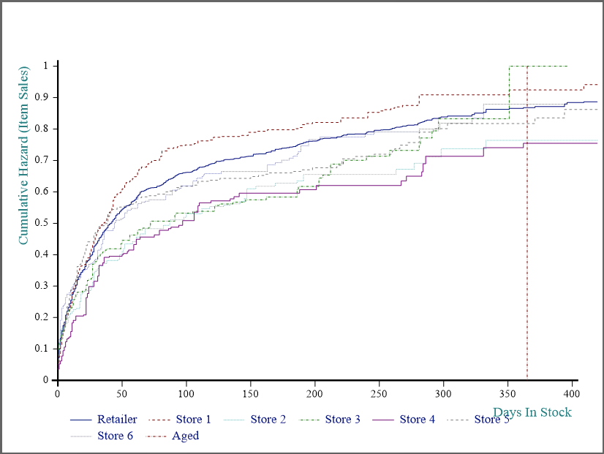
Using Math to Solve these issues
Notes:
Prequel: What we’re doing with APL and how it has helped us disrupt our industry, increasing collaboration, creating efficiencies and improving overall performance.

Slide 21
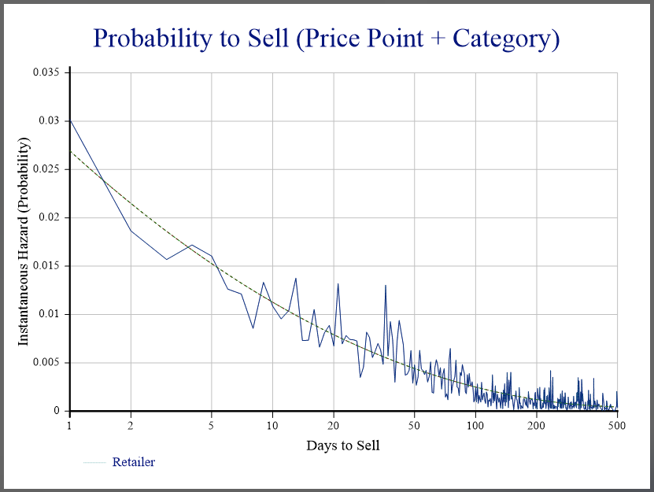
Using Math to Solve these issues
Notes:
Prequel: What we’re doing with APL and how it has helped us disrupt our industry, increasing collaboration, creating efficiencies and improving overall performance.

Slide 22
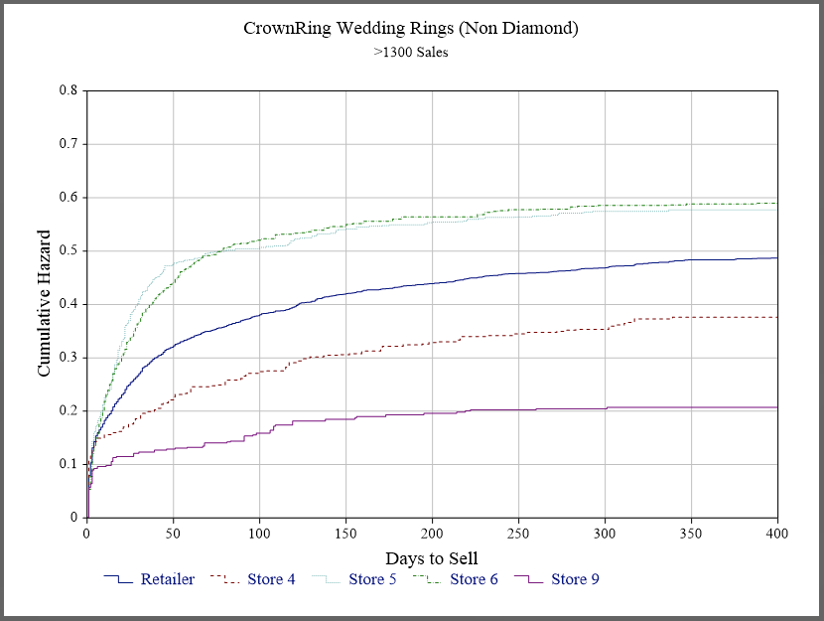
Using Math to Solve these issues
Notes:
Prequel: What we’re doing with APL and how it has helped us disrupt our industry, increasing collaboration, creating efficiencies and improving overall performance.

Slide 23
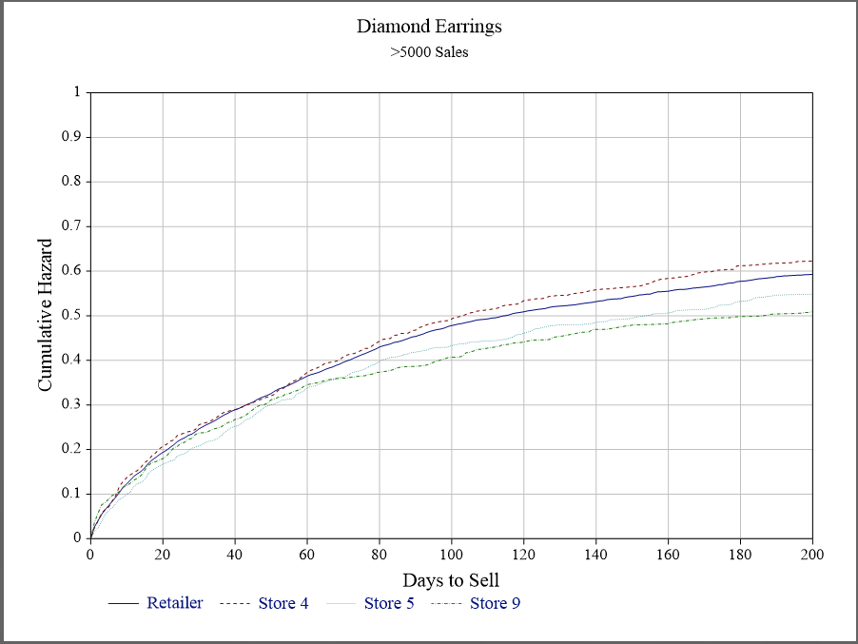
Using Math to Solve these issues
Notes:
Prequel: What we’re doing with APL and how it has helped us disrupt our industry, increasing collaboration, creating efficiencies and improving overall performance.

Slide 24
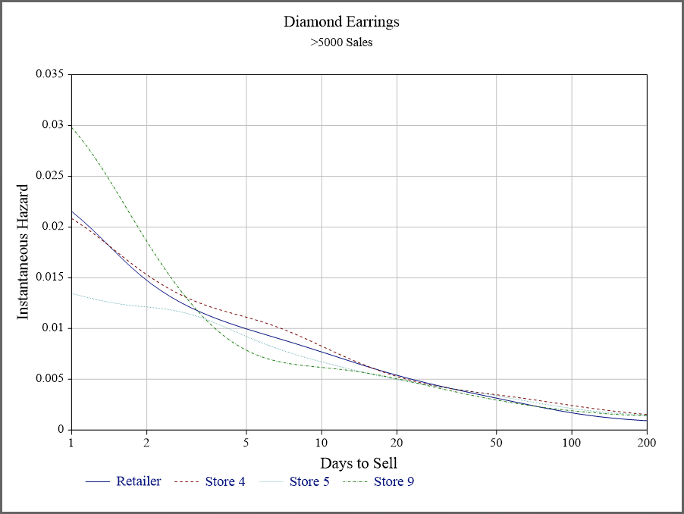
Using Math to Solve these issues
Notes:
Prequel: What we’re doing with APL and how it has helped us disrupt our industry, increasing collaboration, creating efficiencies and improving overall performance.

Slide 25
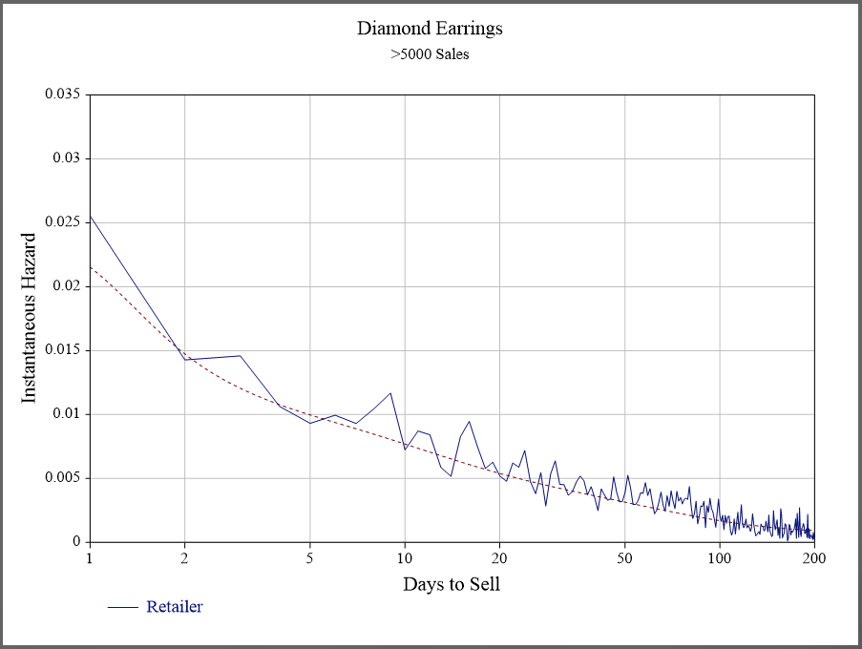
Using Math to Solve these issues
Notes:
Prequel: What we’re doing with APL and how it has helped us disrupt our industry, increasing collaboration, creating efficiencies and improving overall performance.

Slide 26
How to create great web pages fast!
  New frontier: UI
    Using Javascript/KendoUI and C#
    Using Javascript/KendoUI and Jarvis
    Using EWC
      Standard EWC controls
      Integrating KendoUI
Notes:
Prequel: What we’re doing with APL and how it has helped us disrupt our industry, increasing collaboration, creating efficiencies and improving overall performance.

Slide 27
Creating web pages:
  The OLD way: everything all together in one code block
Notes:
Prequel: What we’re doing with APL and how it has helped us disrupt our industry, increasing collaboration, creating efficiencies and improving overall performance.

Slide 28
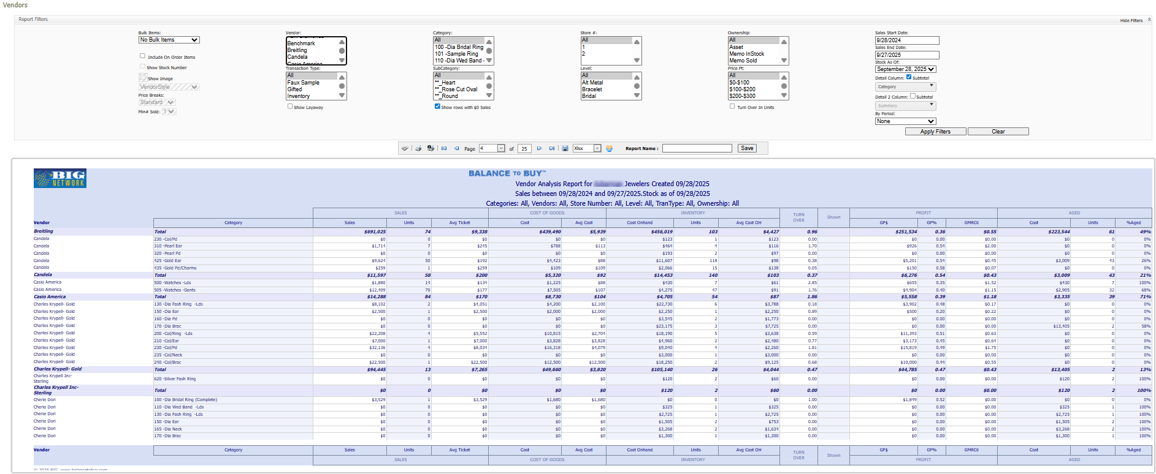
Notes:
Still IIS / HTML / JavaScript / KENDO
CUT dev time 80 % -- MAPS example

Slide 29
Creating web pages better:
  The NEW way: Javascript front end
  C# backend endpoints
Notes:
Prequel: What we’re doing with APL and how it has helped us disrupt our industry, increasing collaboration, creating efficiencies and improving overall performance.

Slide 30
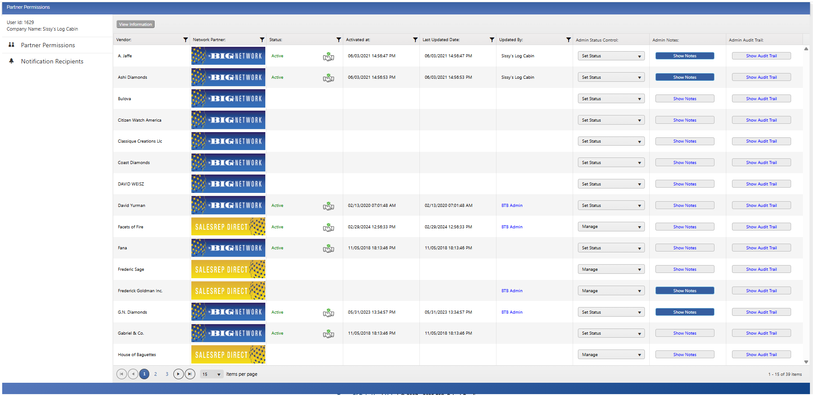
Notes:
Still IIS / HTML / JavaScript / KENDO
CUT dev time 80 % -- MAPS example

Slide 31
How to create great web pages fast!
  Even Better: Javascript front end
  Jarvis APL backend endpoints
Notes:
Prequel: What we’re doing with APL and how it has helped us disrupt our industry, increasing collaboration, creating efficiencies and improving overall performance.

Slide 32
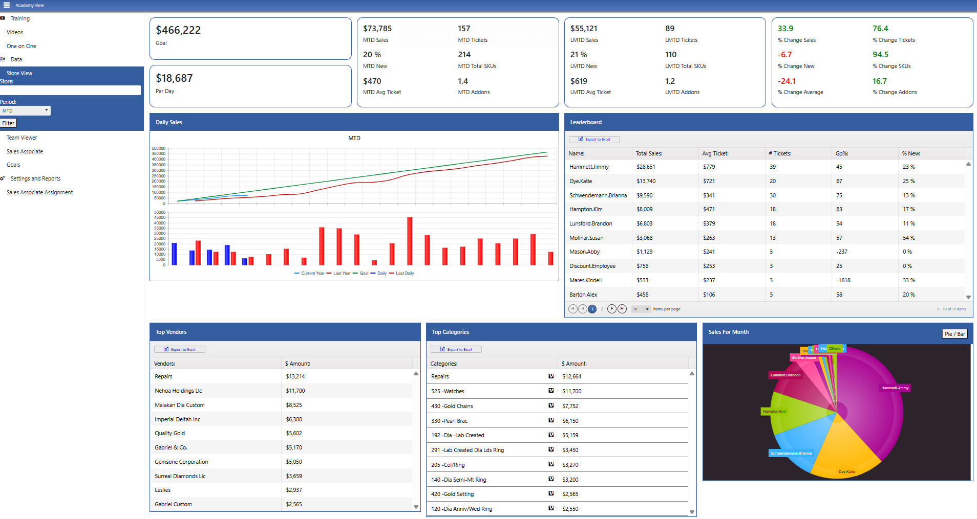
Notes:
Still IIS / HTML / JavaScript / KENDO
CUT dev time 80 % -- MAPS example

Slide 33
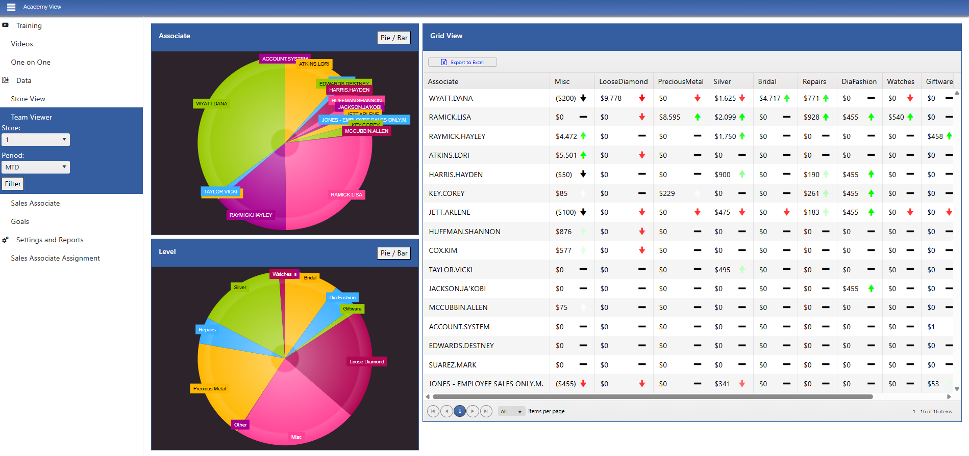
Notes:
Still IIS / HTML / JavaScript / KENDO
CUT dev time 80 % -- MAPS example

Slide 34
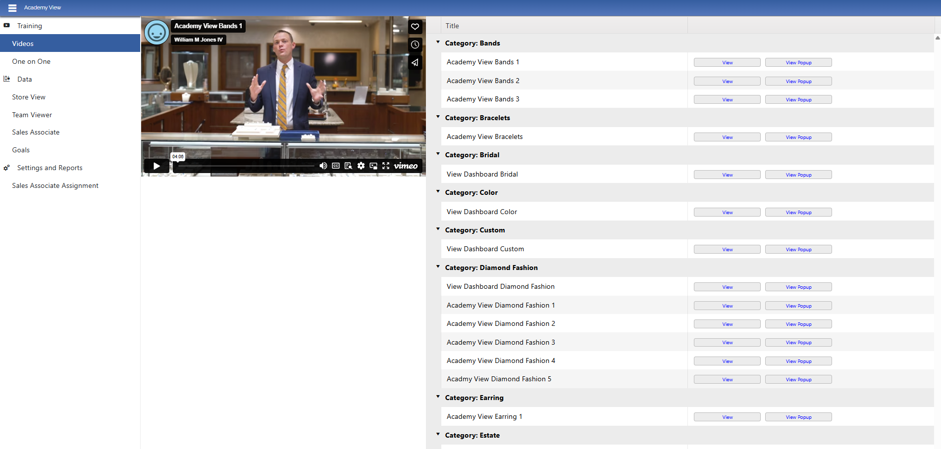
Notes:
Still IIS / HTML / JavaScript / KENDO
CUT dev time 80 % -- MAPS example

Slide 35
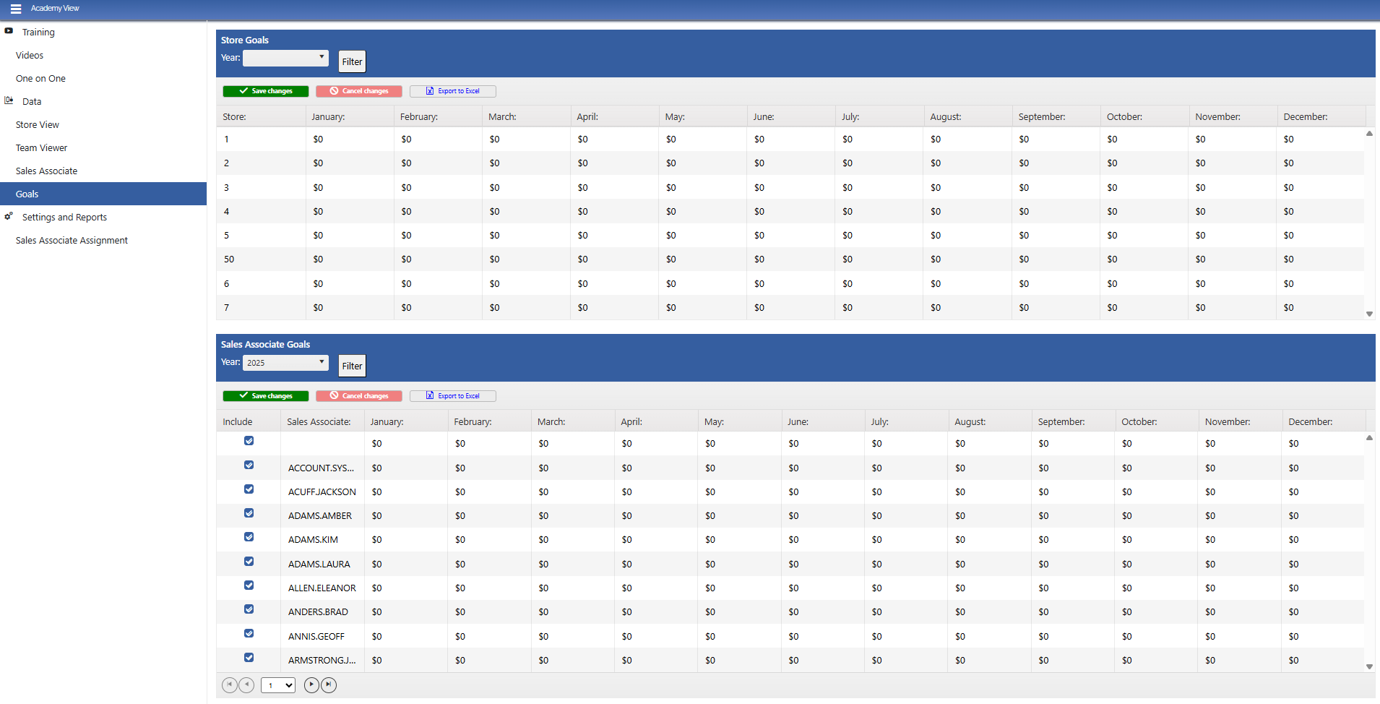
Notes:
Still IIS / HTML / JavaScript / KENDO
CUT dev time 80 % -- MAPS example

Slide 36
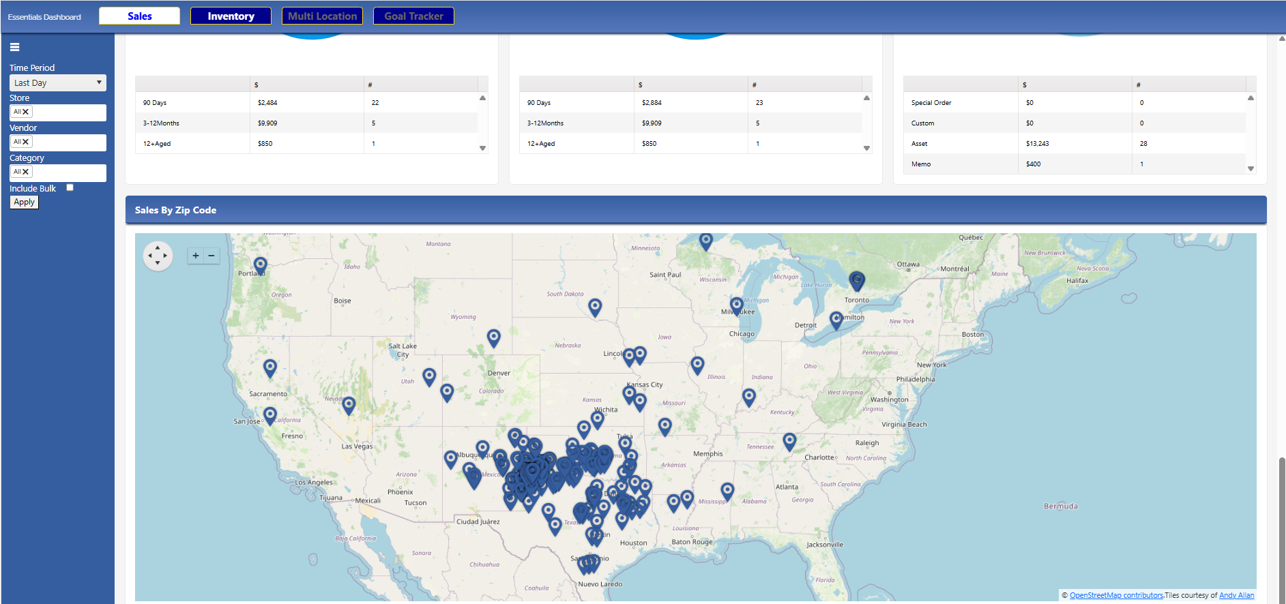
Notes:
Still IIS / HTML / JavaScript / KENDO
CUT dev time 80 % -- MAPS example

Slide 37
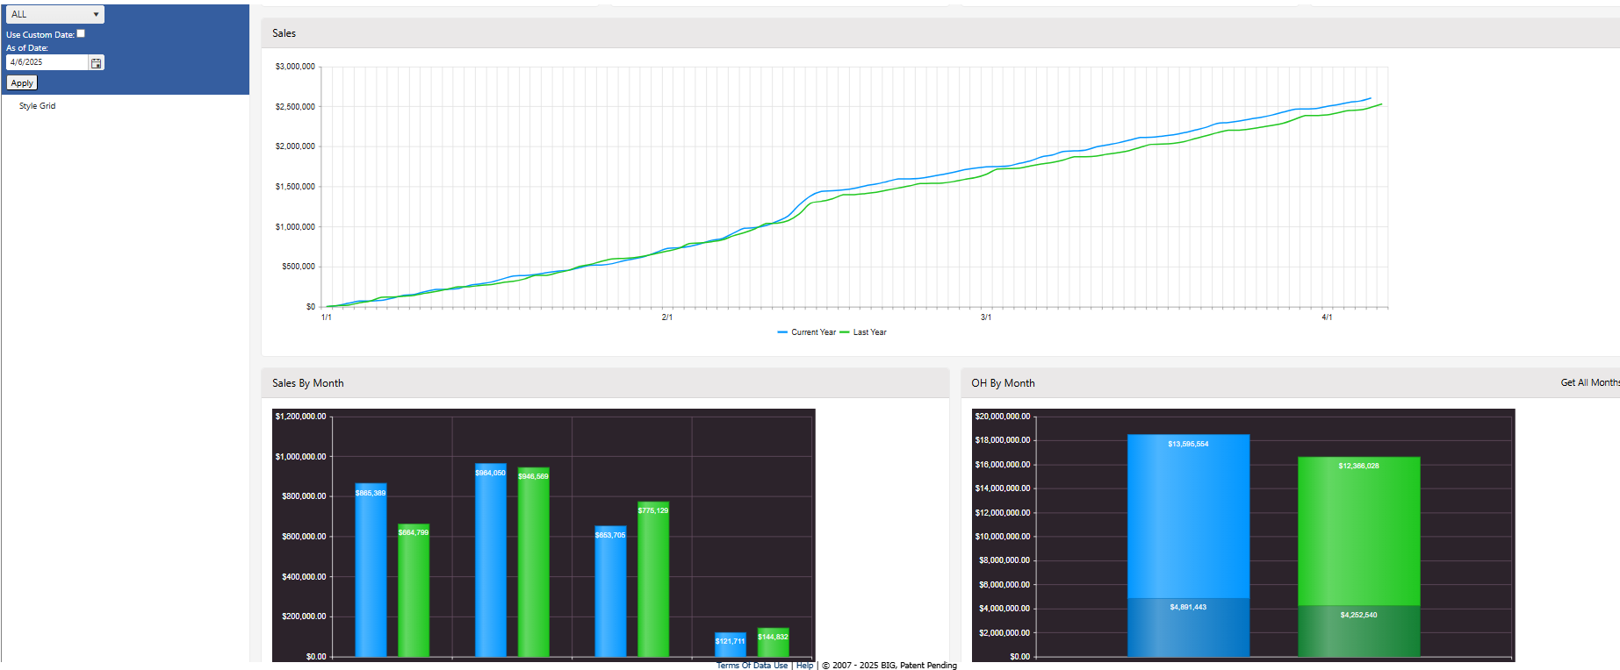
Notes:
Still IIS / HTML / JavaScript / KENDO
CUT dev time 80 % -- MAPS example

Slide 38
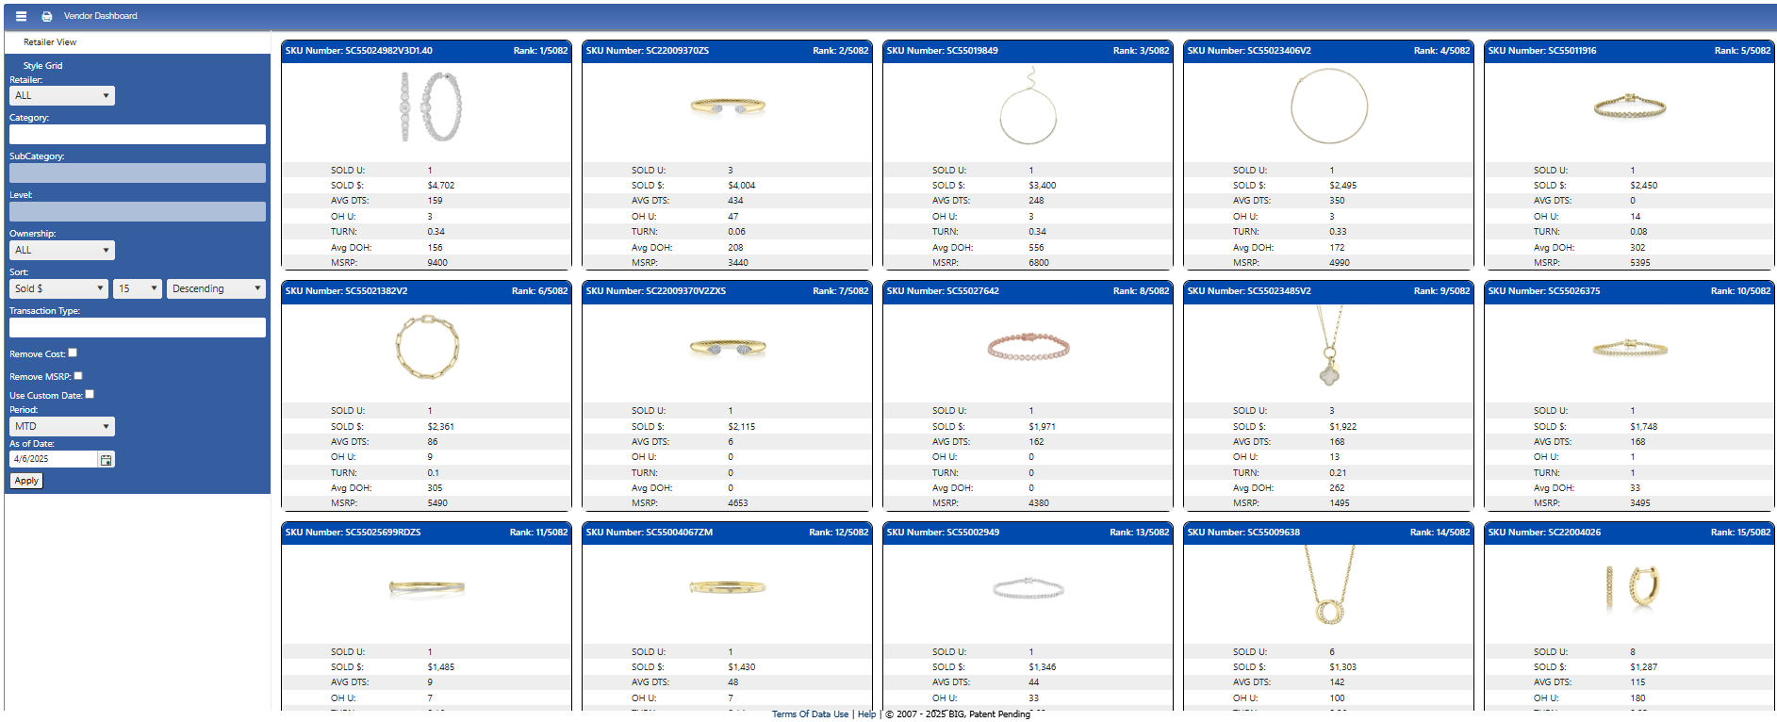
Notes:
Still IIS / HTML / JavaScript / KENDO
CUT dev time 80 % -- MAPS example

Slide 39
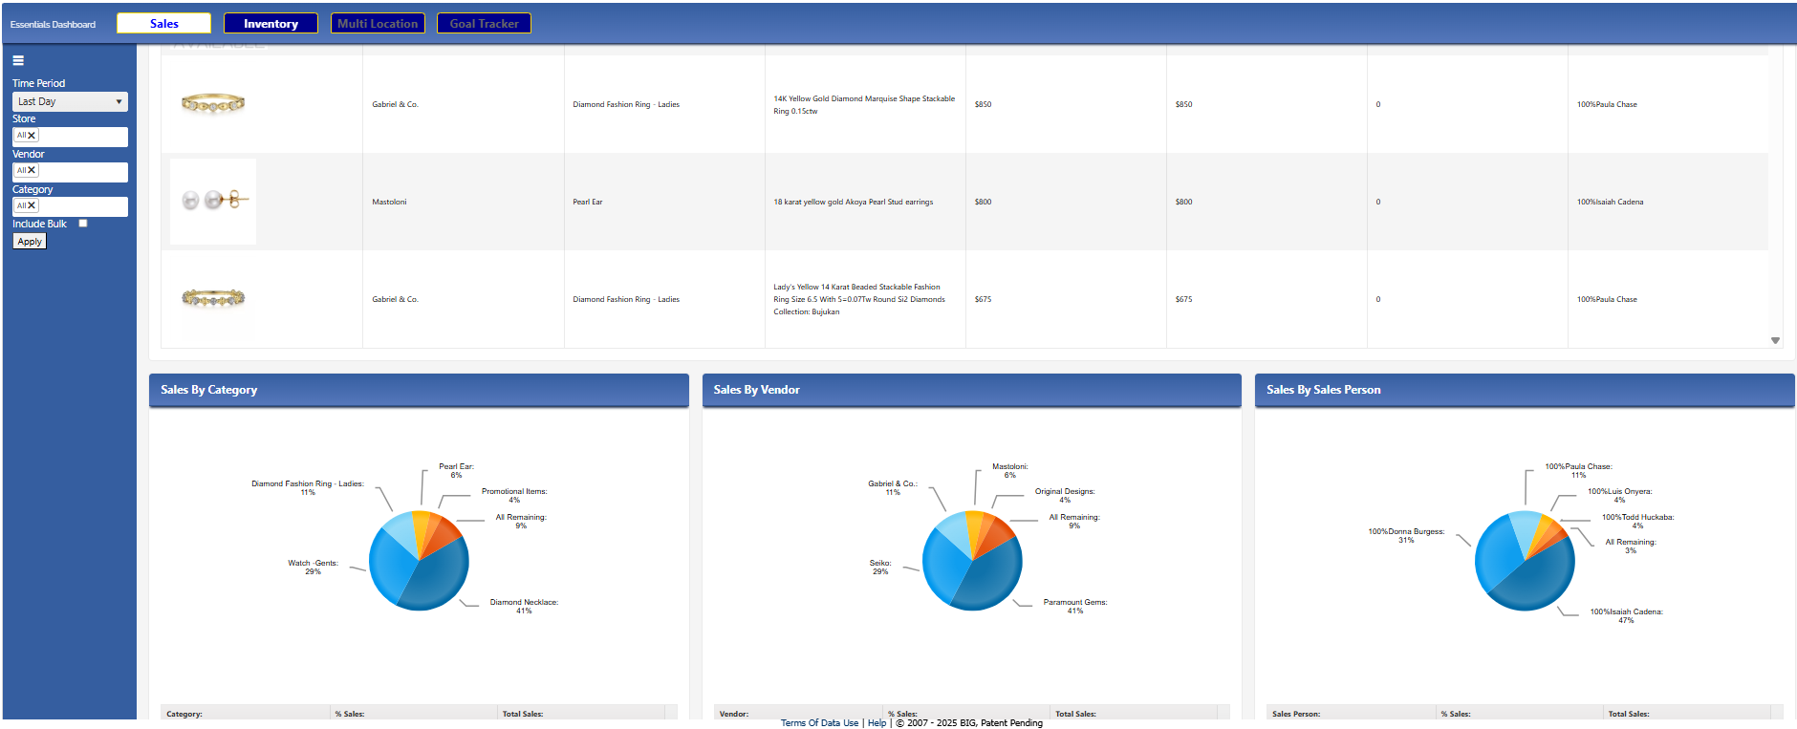
Notes:
Still IIS / HTML / JavaScript / KENDO
CUT dev time 80 % -- MAPS example

Slide 40
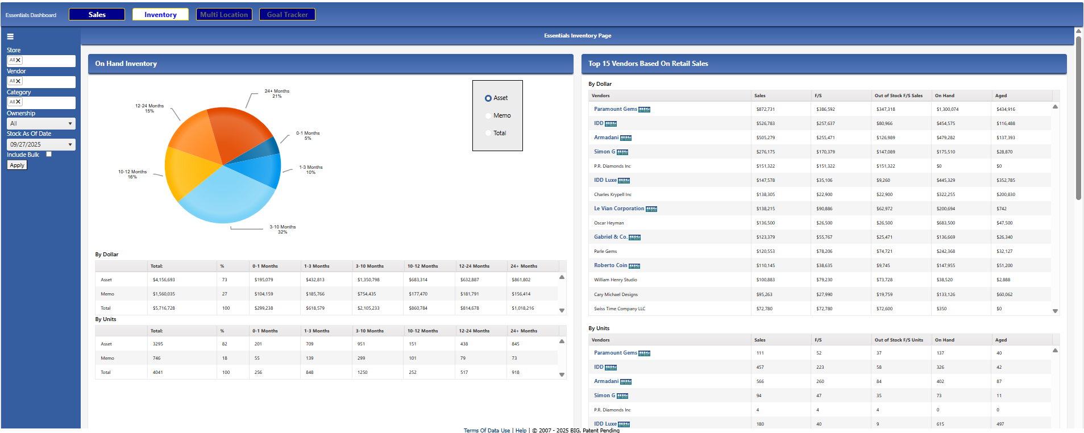
Notes:
Still IIS / HTML / JavaScript / KENDO
CUT dev time 80 % -- MAPS example

Slide 41
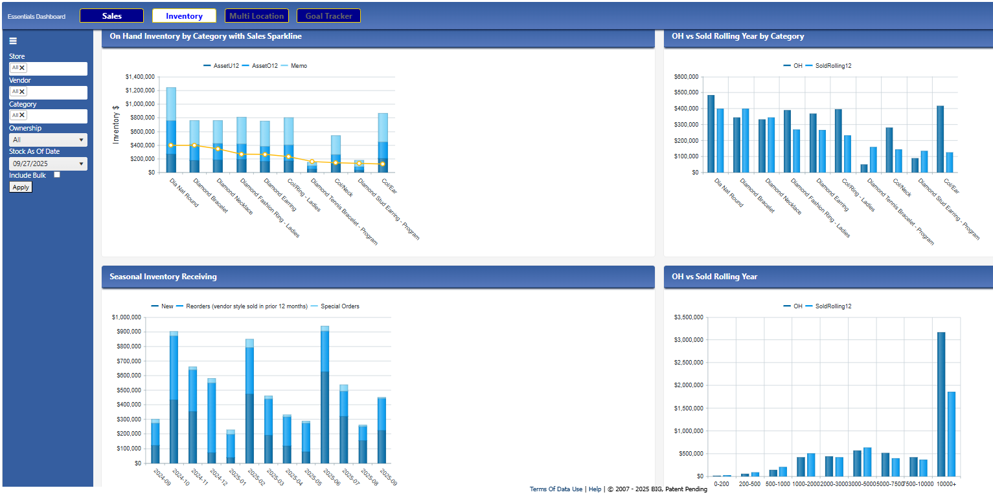
Notes:
Still IIS / HTML / JavaScript / KENDO
CUT dev time 80 % -- MAPS example

Slide 42
How to create great web pages fast!
  Another new way: EWC
Notes:
Prequel: What we’re doing with APL and how it has helped us disrupt our industry, increasing collaboration, creating efficiencies and improving overall performance.

Slide 43
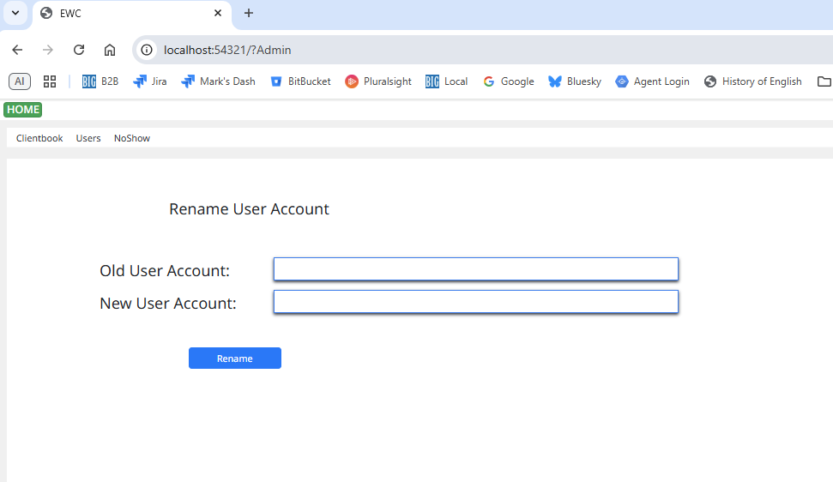
Notes:
Still IIS / HTML / JavaScript / KENDO
CUT dev time 80 % -- MAPS example

Slide 44
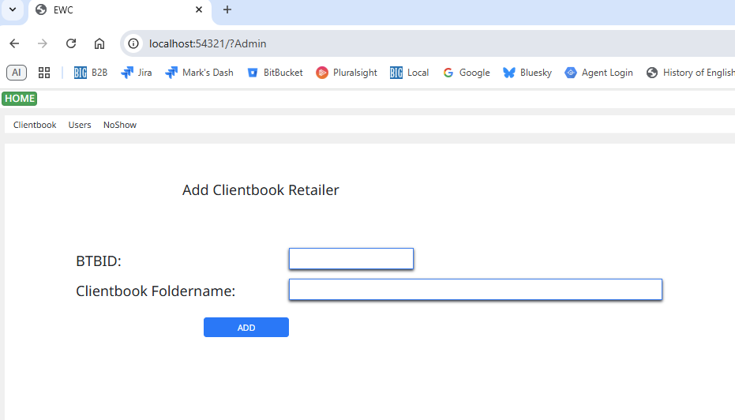
Notes:
Still IIS / HTML / JavaScript / KENDO
CUT dev time 80 % -- MAPS example

Slide 45
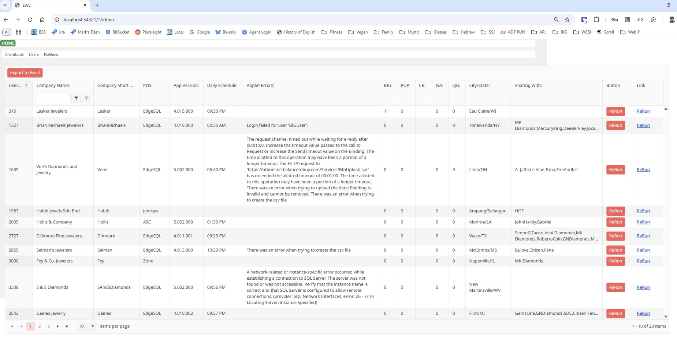
Notes:
Still IIS / HTML / JavaScript / KENDO
CUT dev time 80 % -- MAPS example

Slide 46
New Production Environment
Windows Service
Code in text files
Full Source Control
Global file handling
Global error handling

Slide 47
Thank you!
DYNA ’25 – 09/29/2025
Mark I.Wolfson

