Slide 1
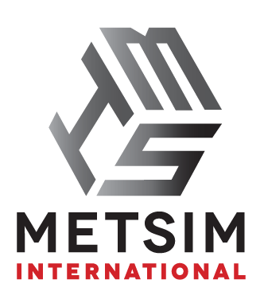
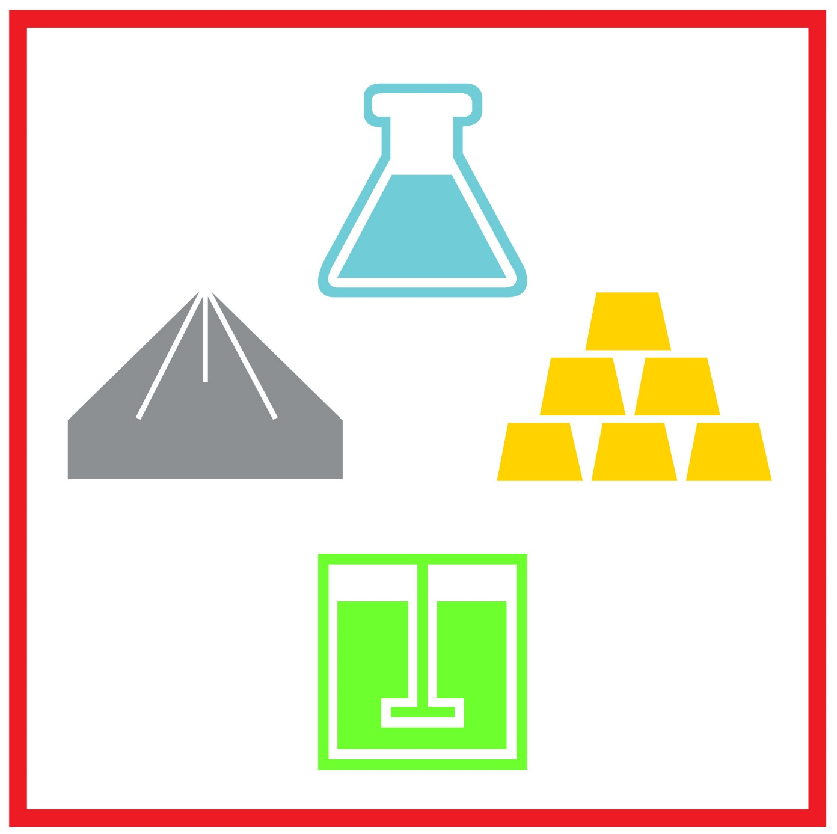
Converting to Dyalog APL
Lessons Learned
Alex Holtzapple, President, Metsim International

Slide 2

Acknowledgements & Introduction

Slide 3
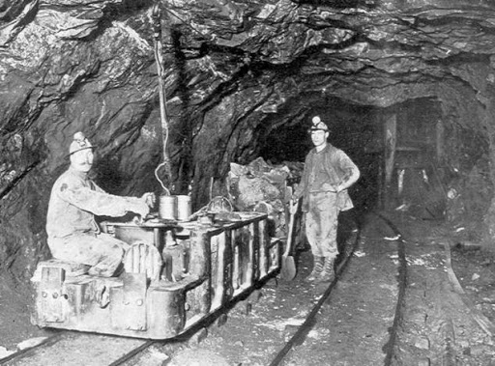
Brief History of METSIM®
Started in the late 1970’s by John Bartlett to serve as a mass balancing tool mineral processing engineering
First registered as a commercial product in 1982
Conversion to a graphical interface in the late 1990’s to all for process flowsheet development
Licensed to over 700 companies and 250 universities worldwide
Converted from APL+Win to Dyalog APL in 2025

Slide 4
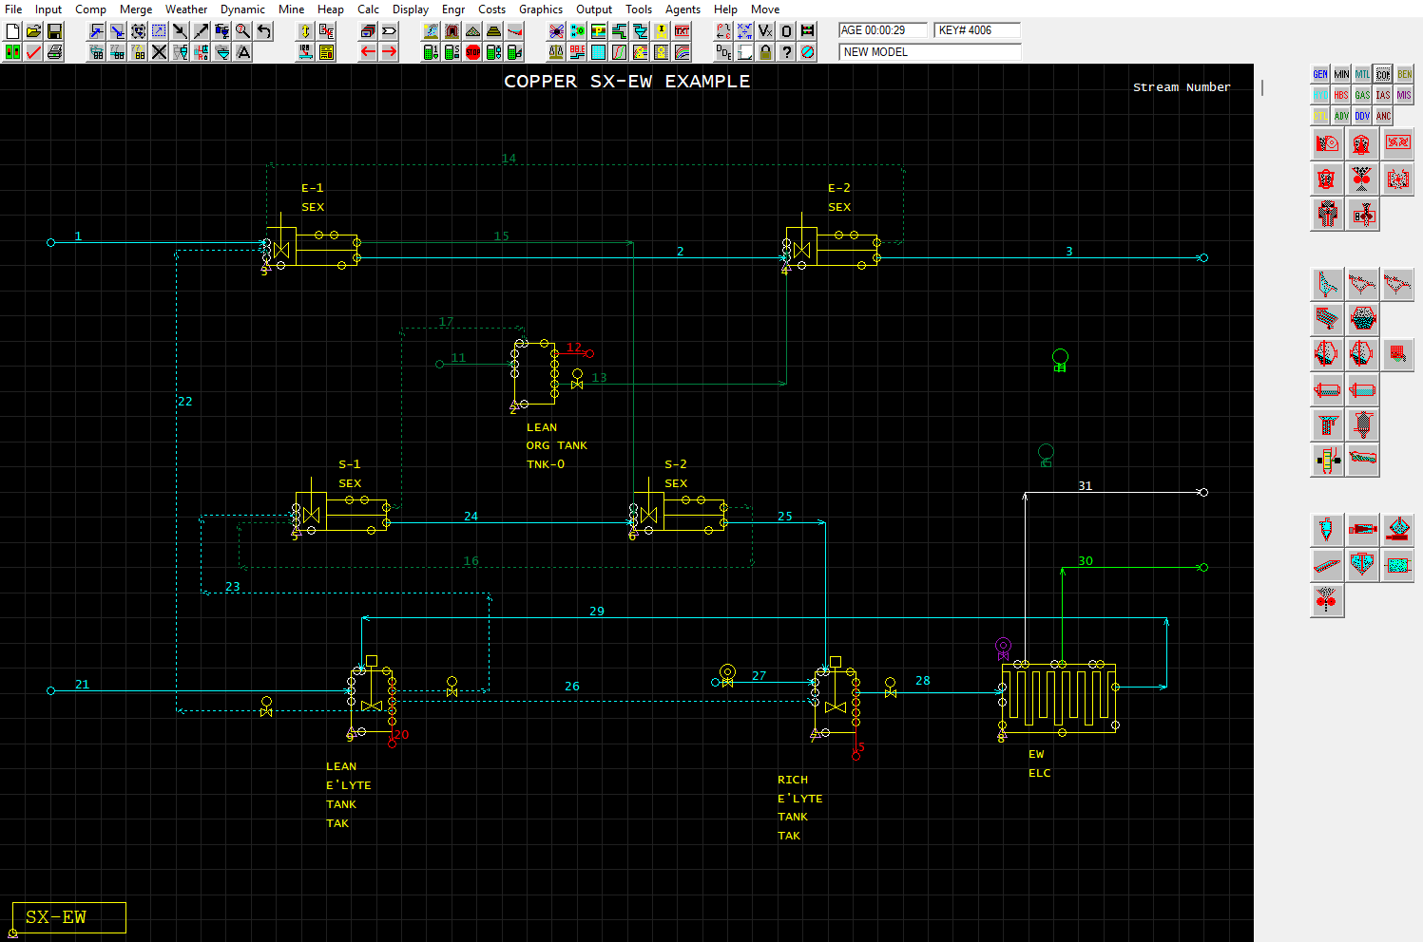
METSIM® GUI – APL+Win

Slide 5
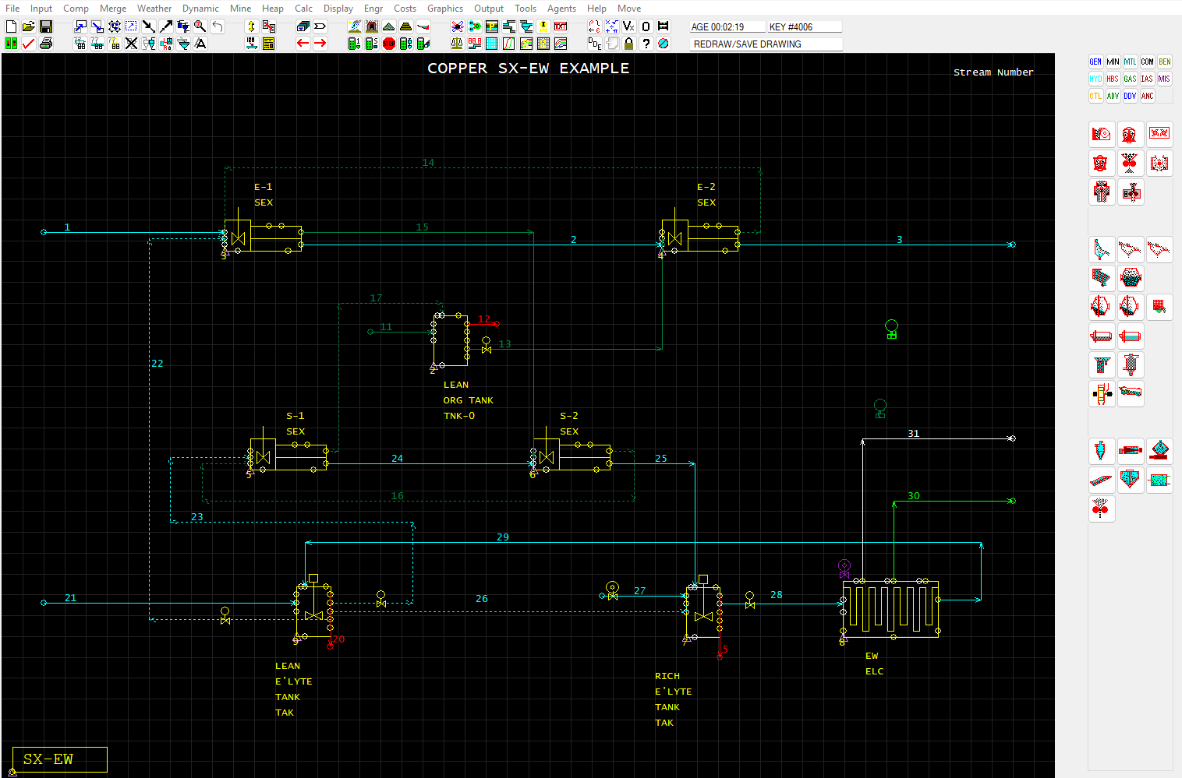
METSIM® GUI – Dyalog APL

Slide 6
18 Months for Conversion Project
MSI contracted Dyalog APL directly to manage conversion of 100% of METSIM® source code in February 2024
Established an online repository utilizing GitHub
  Created by Dyalog team
  MSI uploaded all associated workspaces and component files
  Allowed for cross-team collaboration and easy “check system”
Dyalog team got to work…
  Direct conversion (easy)
  Dyalog emulators for APL+Win (less easy)
  Where improvements could be made, they were (very easy)
MSI included throughout the entire process

Slide 7
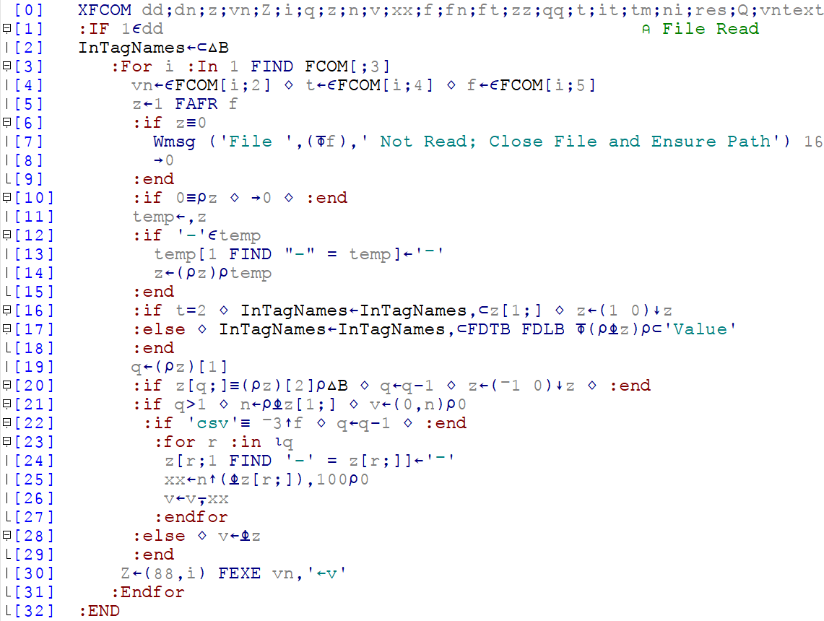
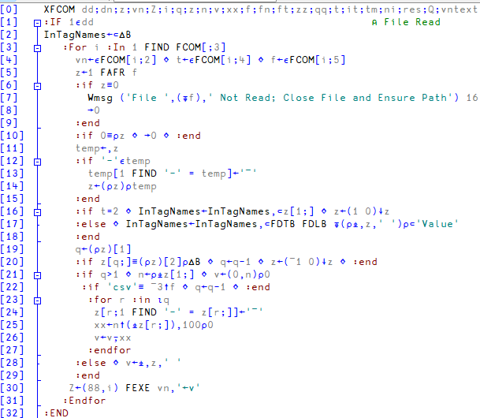
Comparable?

Slide 8
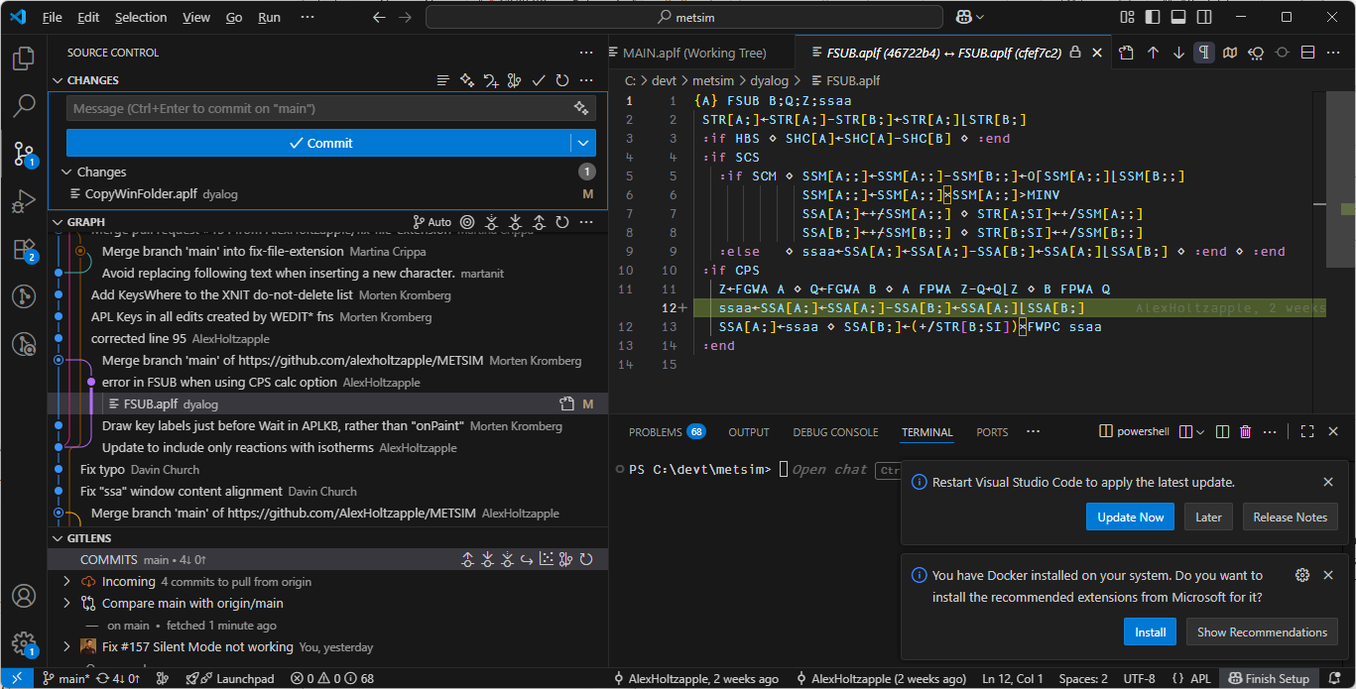
Visual Studio Code (part of the workflow)

Slide 9
Dyalog Emulators for Windows
METSIM® has relied on several APL+Windows commands for functionality over the years, limiting its ability to run on other operating systems.
No more…

Slide 10
Why?
MSI exists in the mining sector, but is a technology and software provider so must stay current:
APIs with external systems
Calculation speeds
Program development techniques
Directly working with Dyalog APL team ensures latest tools and techniques are included within METSIM®

Slide 11
Thank You

