Slide 1
Dyalog + AI = ...?
Stefan Kruger

Slide 2

Who am I?
New APLer (first decade) -- 3 years at Dyalog
Previously at IBM for long stint
Computer Science background
@ Dyalog: provider of outside perspective

Slide 3
Points
AI for developer productivity
Applications
  Semantic search
  Retrieval-Augmented Generation (RAG)
Client libraries

Slide 4
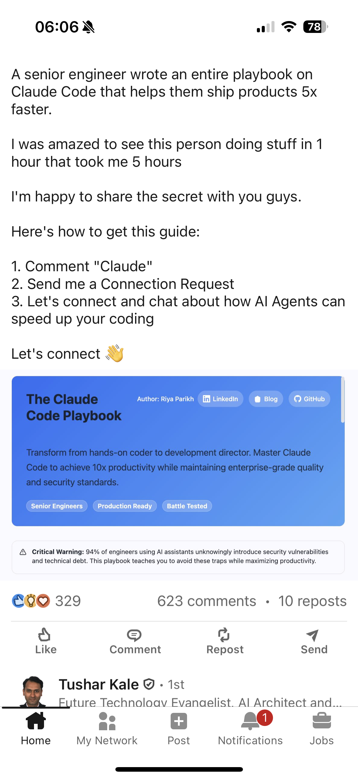

AI for developer productivity
Value proposition:
  10x yourself!
  Remove 'drudge'!
  ... (mumbles)
  $PROFIT!

Slide 5
AI does improve developer productivity
Reality check

Slide 6



...if you're in its wheelhouse
Reality check

Slide 7
Small, constrained tasks; "bookwork"
Reality check

Slide 8
Mechanical refactoring of code
Reality check

Slide 9
Improves velocity, not competency!
Reality check

Slide 10
Does not turn interns into senior devs
Reality check

Slide 11
APL: improving (but must try harder)
Reality check

Slide 12
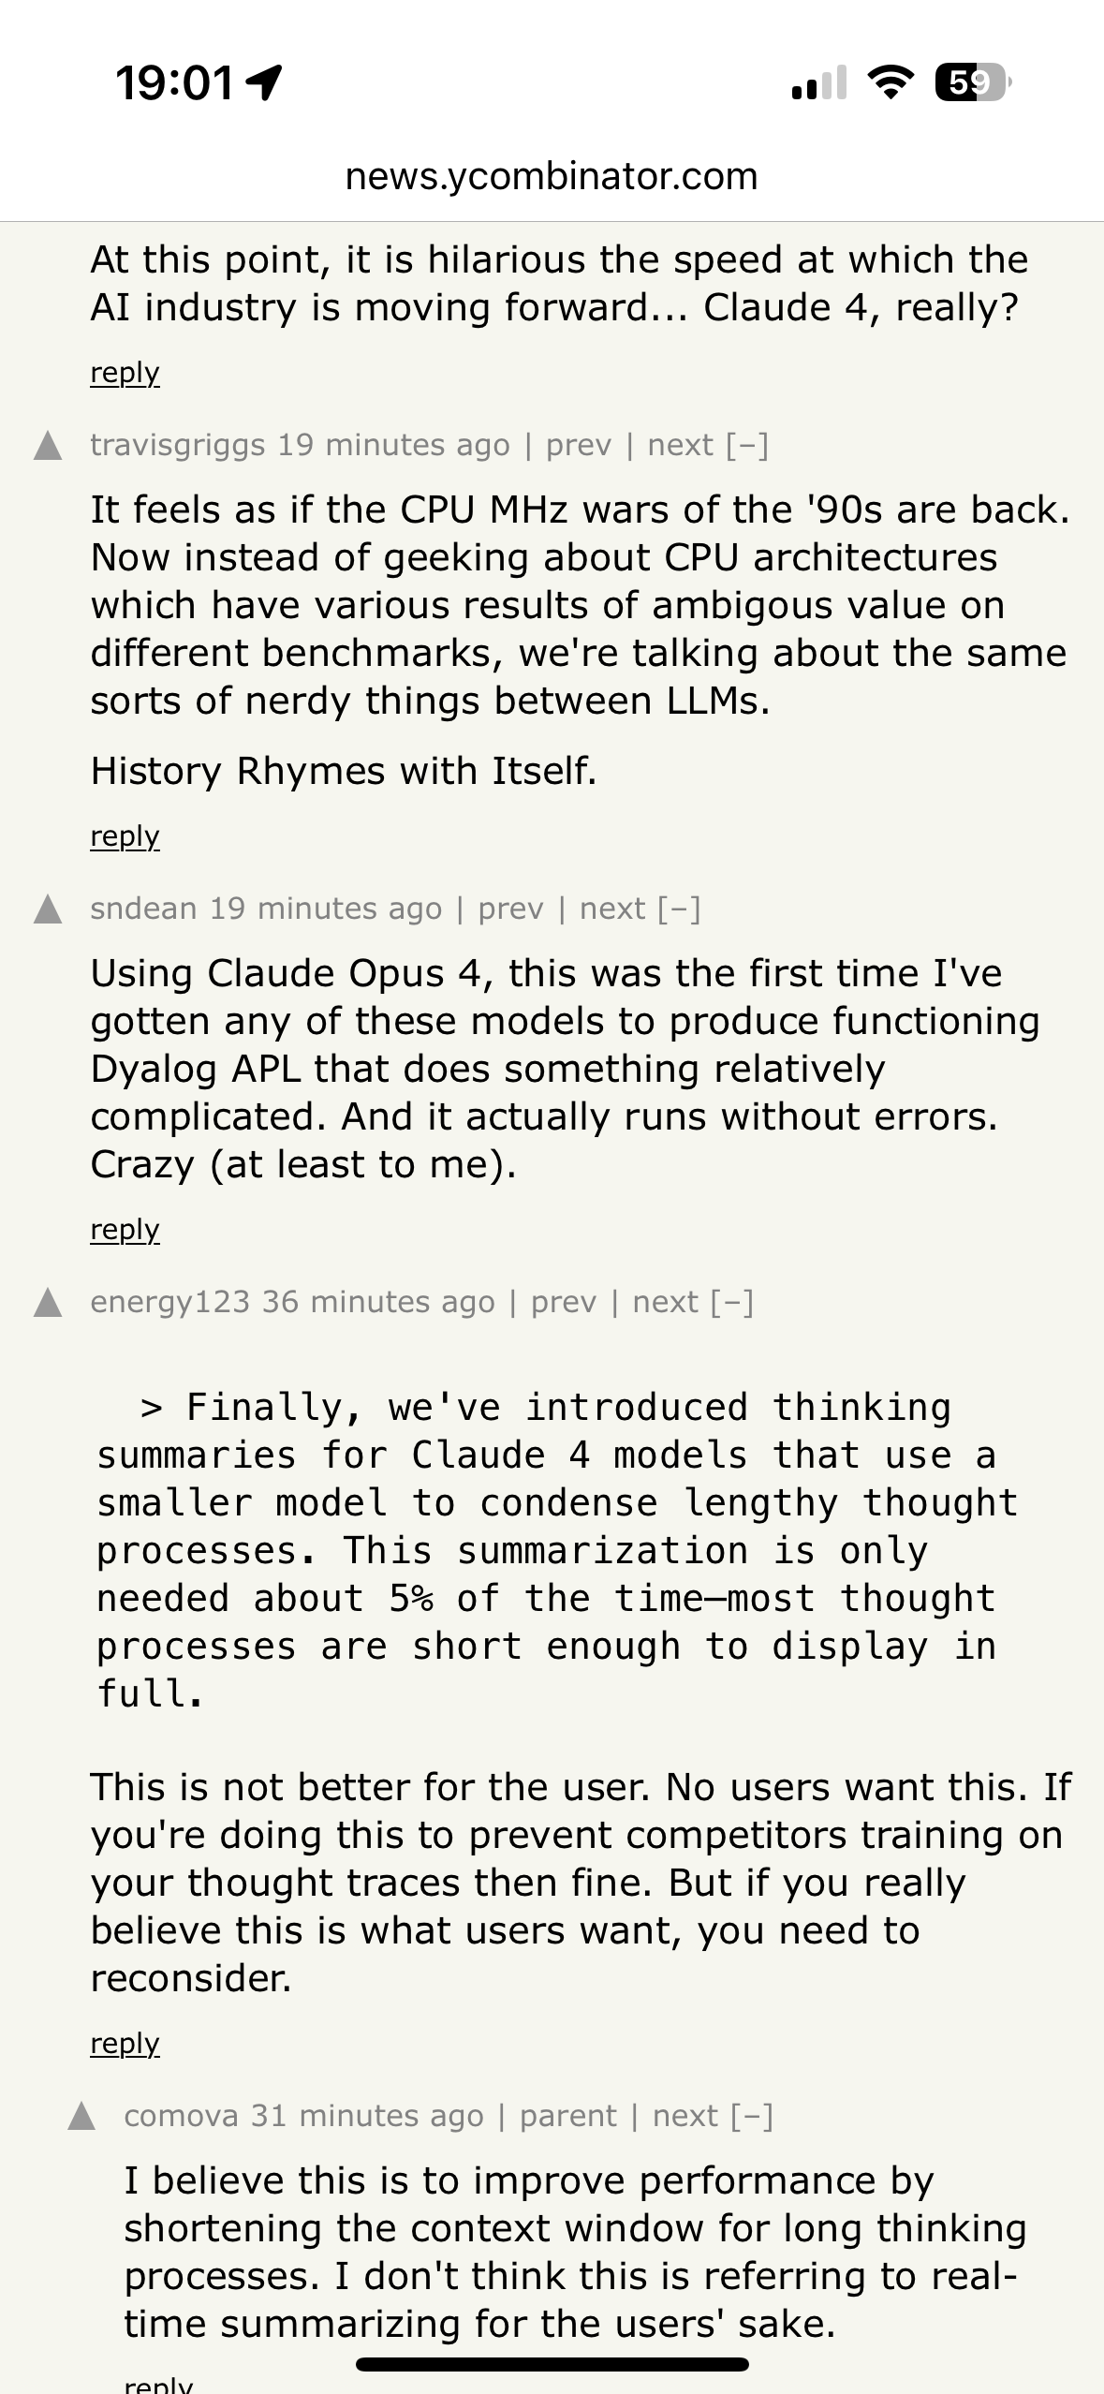

Pace of improvement: off charts
World looks different today from 18 months ago last week
Claude Opus 4.1 perfectly capable of explaining APL code
Writes mostly correct APL in constrained domains
18-24 months behind the curve
Latest LLM
Anthropic

Slide 13
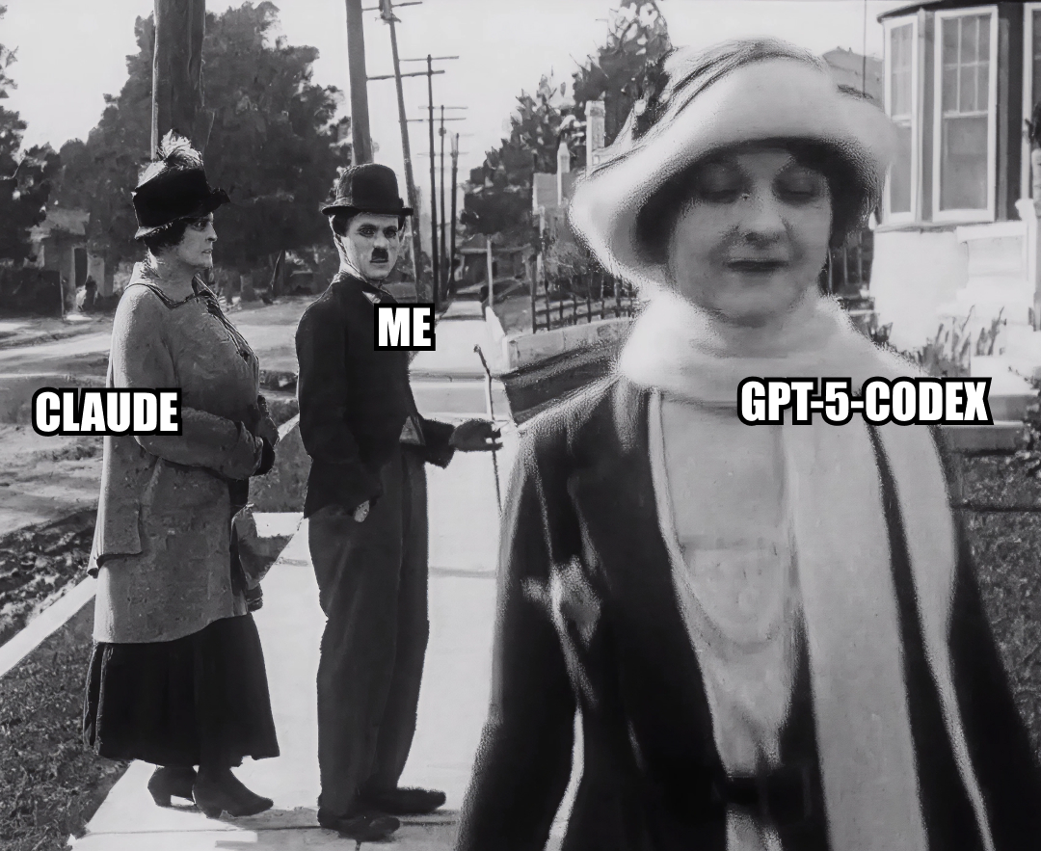

Slide 14
Pace of improvement: off charts
World looks different today from 18 months ago last week
Claude Opus 4.1 perfectly capable of explaining APL code
Writes mostly correct APL in constrained domains
18-24 months behind the curve

Slide 15
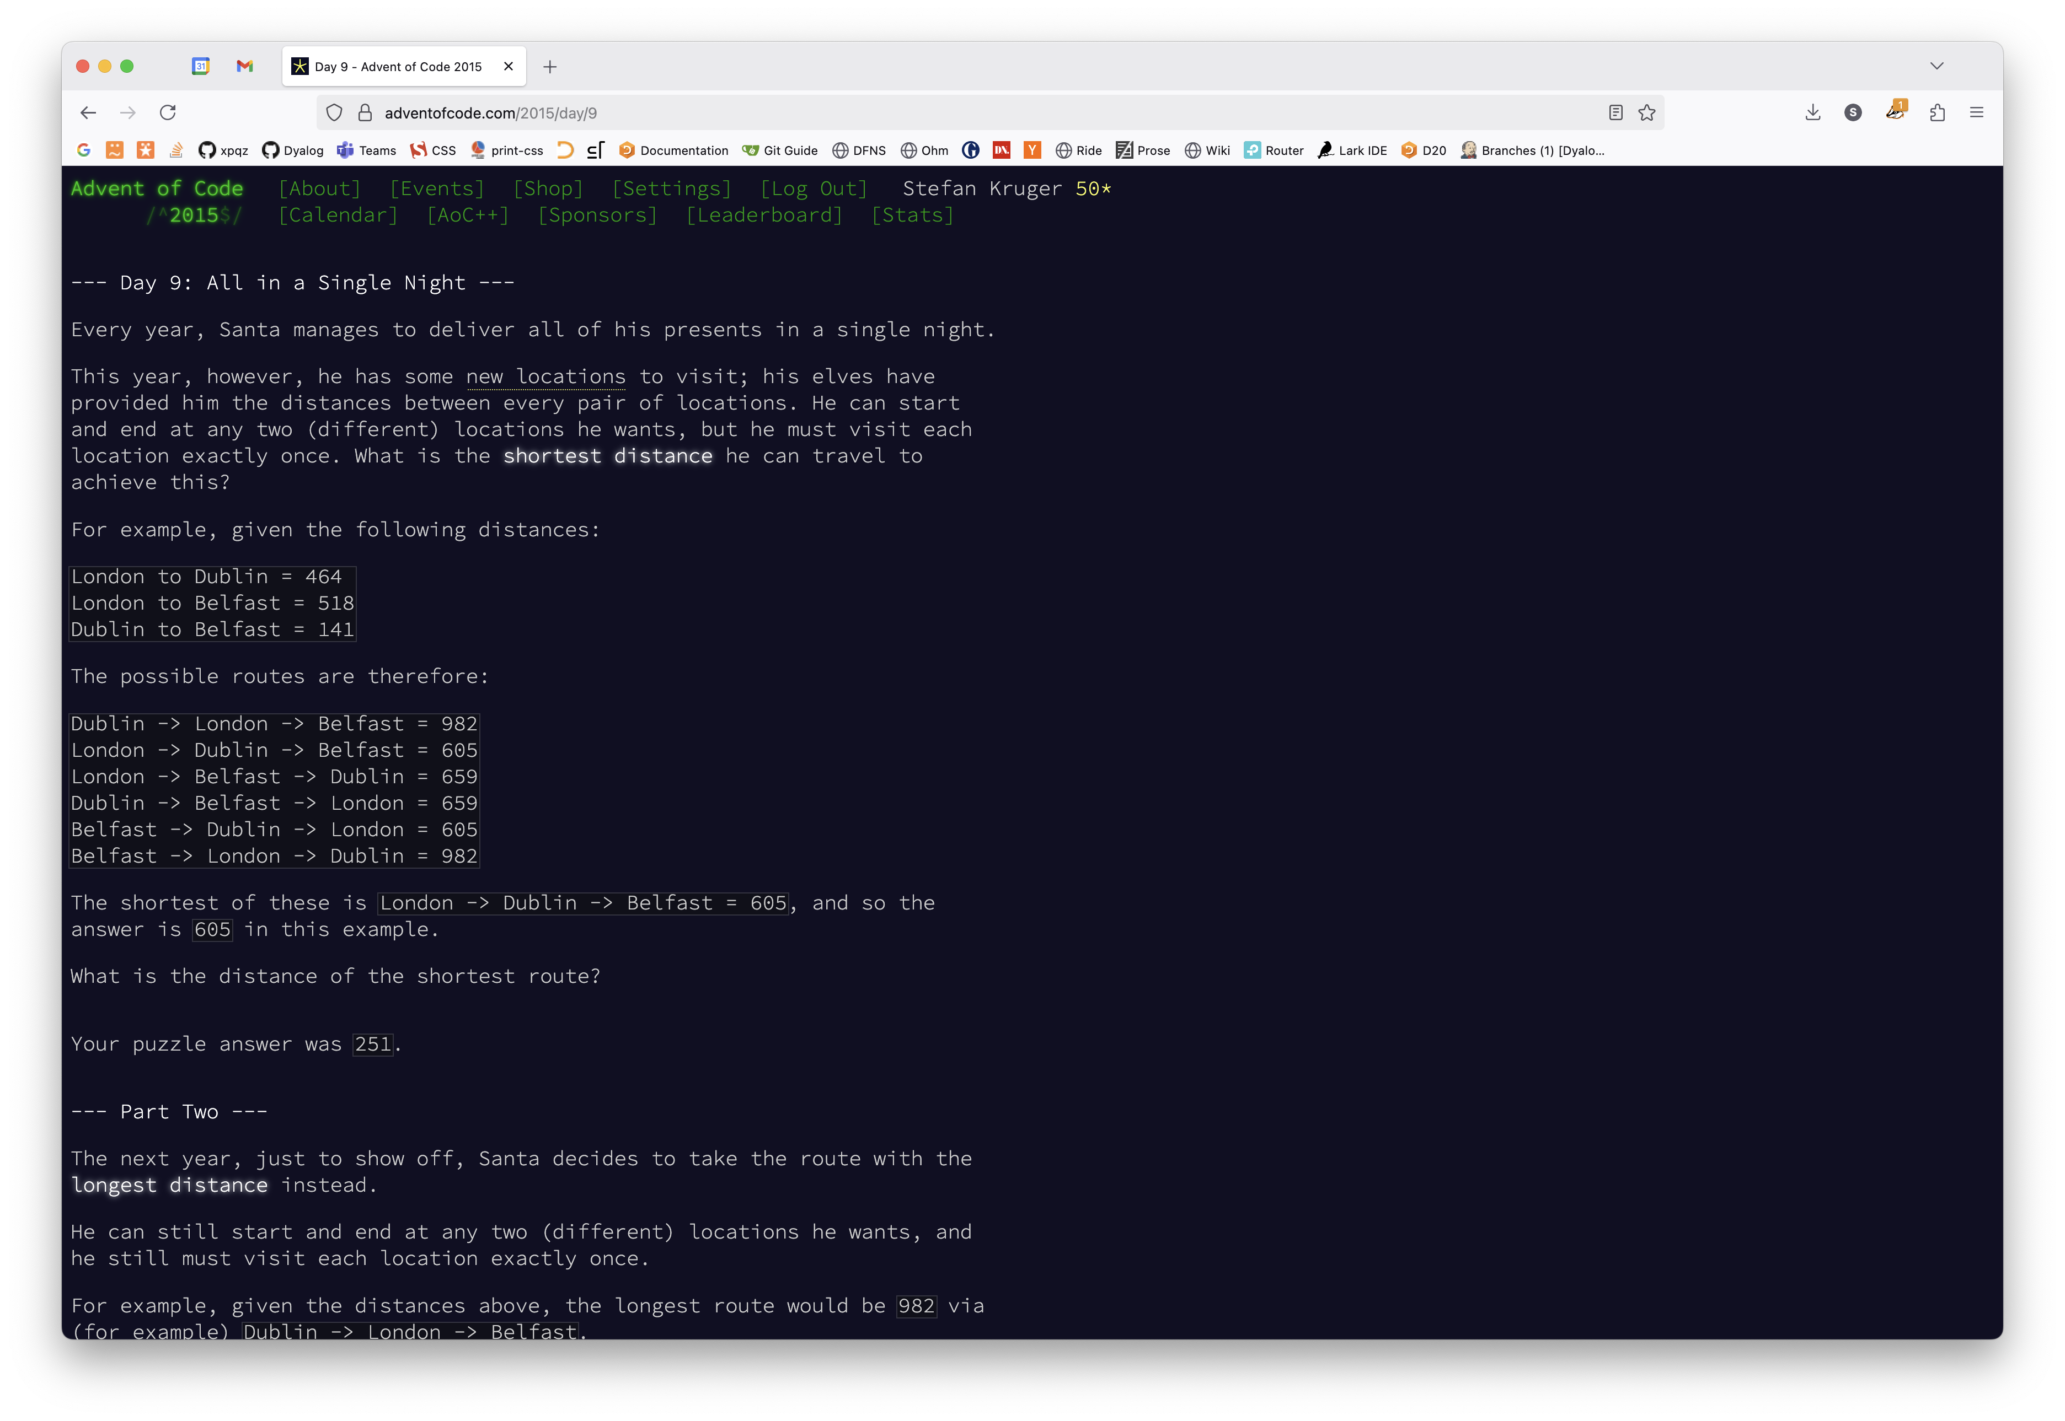

Slide 16
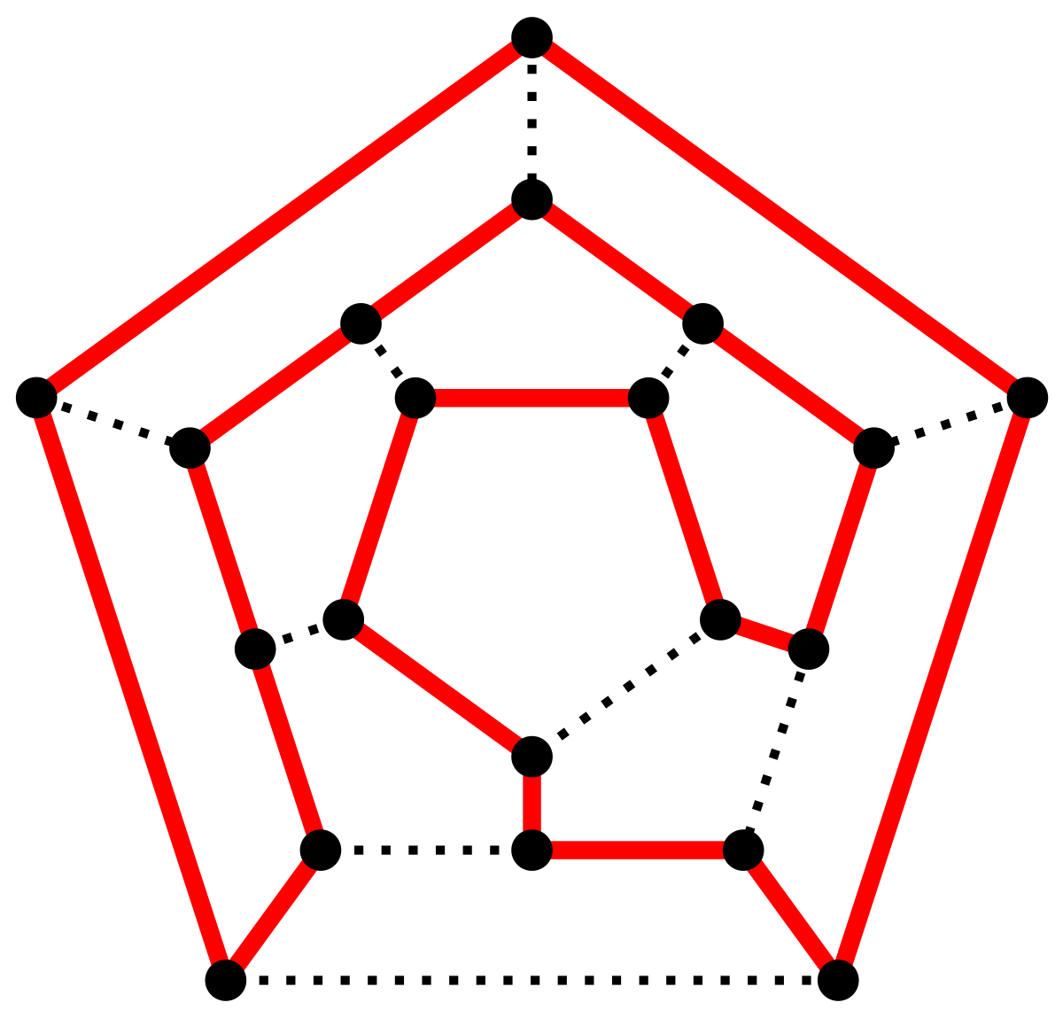
Start and end at any two (different) locations. Must visit each location exactly once. What is the shortest distance?
Given the following distances:
London to Dublin = 464
London to Belfast = 518
Dublin to Belfast = 141
The shortest is London → Dublin → Belfast = 605

Slide 17
'pmat'⎕CY'dfns'
data←' '(≠⊆⊢)¨'(to|=)'⎕R' '⊃⎕NGET'data9.txt'1
Day9←{
weights←w,w←⍎¨⊢/↑⍵
edges←(⊢⍪⌽)28 2⍴(∪⍳⊢),(↑⍵)[;1 2]
adj←weights@(↓edges)⊢0⍴⍨2⍴8
(⌊/,⌈/)+/adj[↓{∊⍵}⌺1 2⊢pmat 8]
}

Slide 18
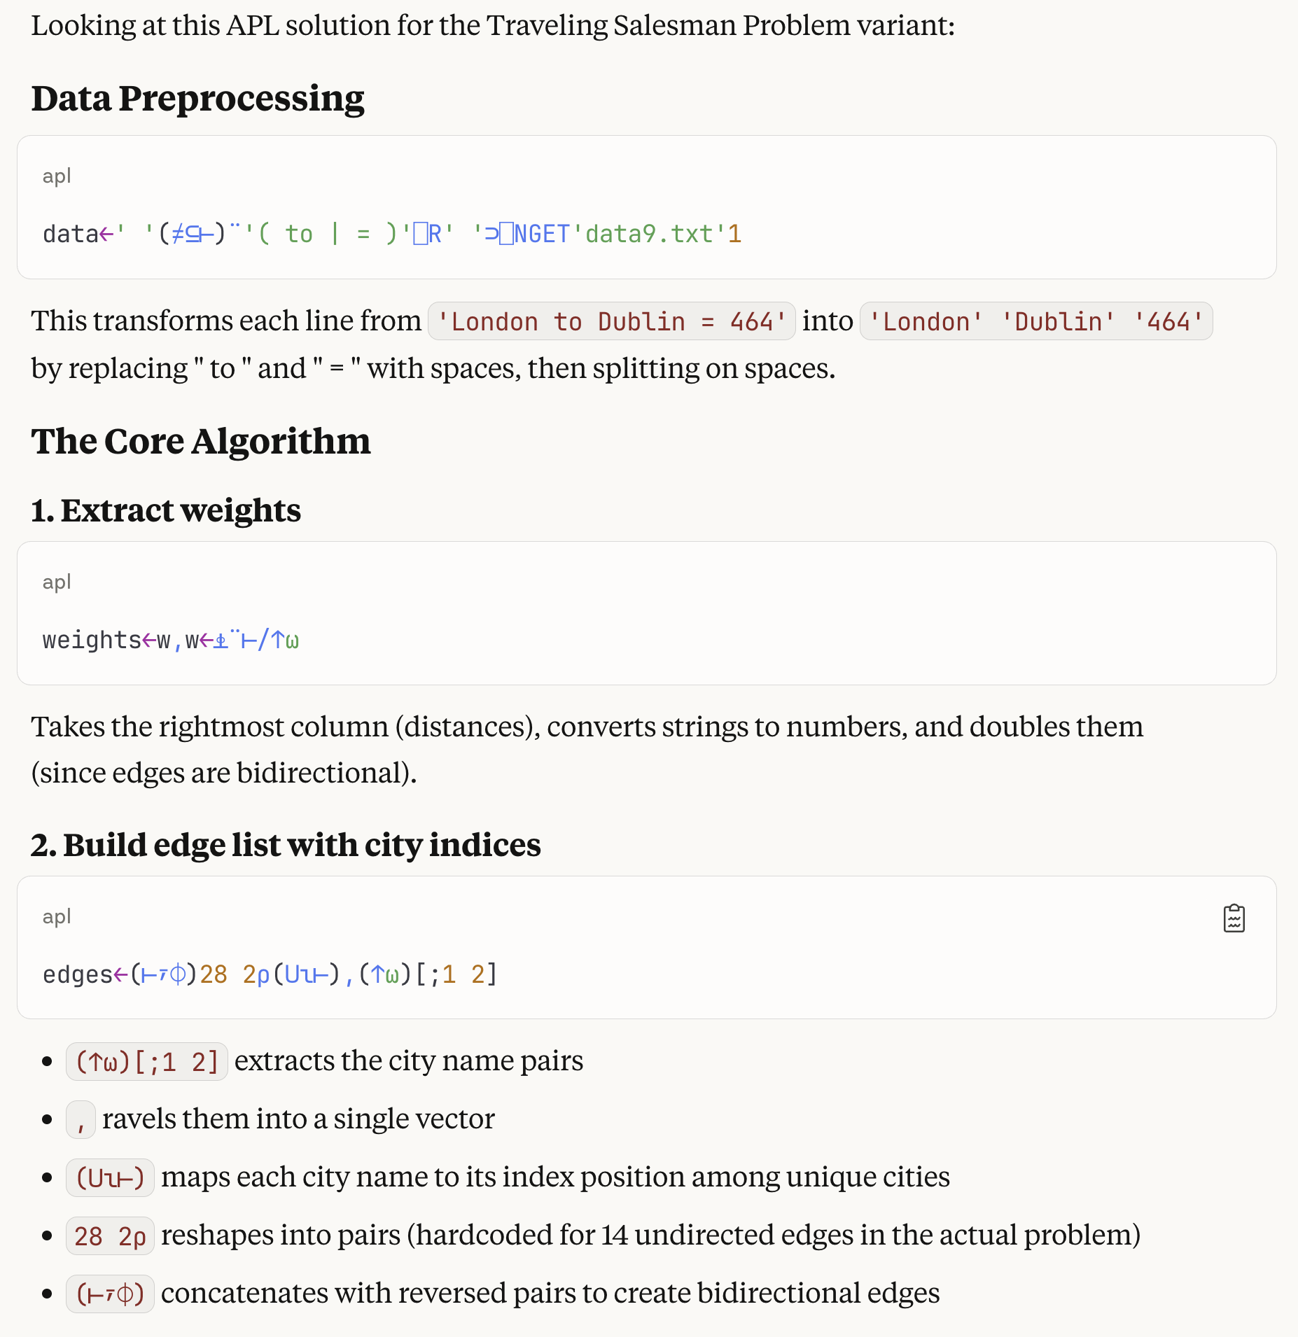
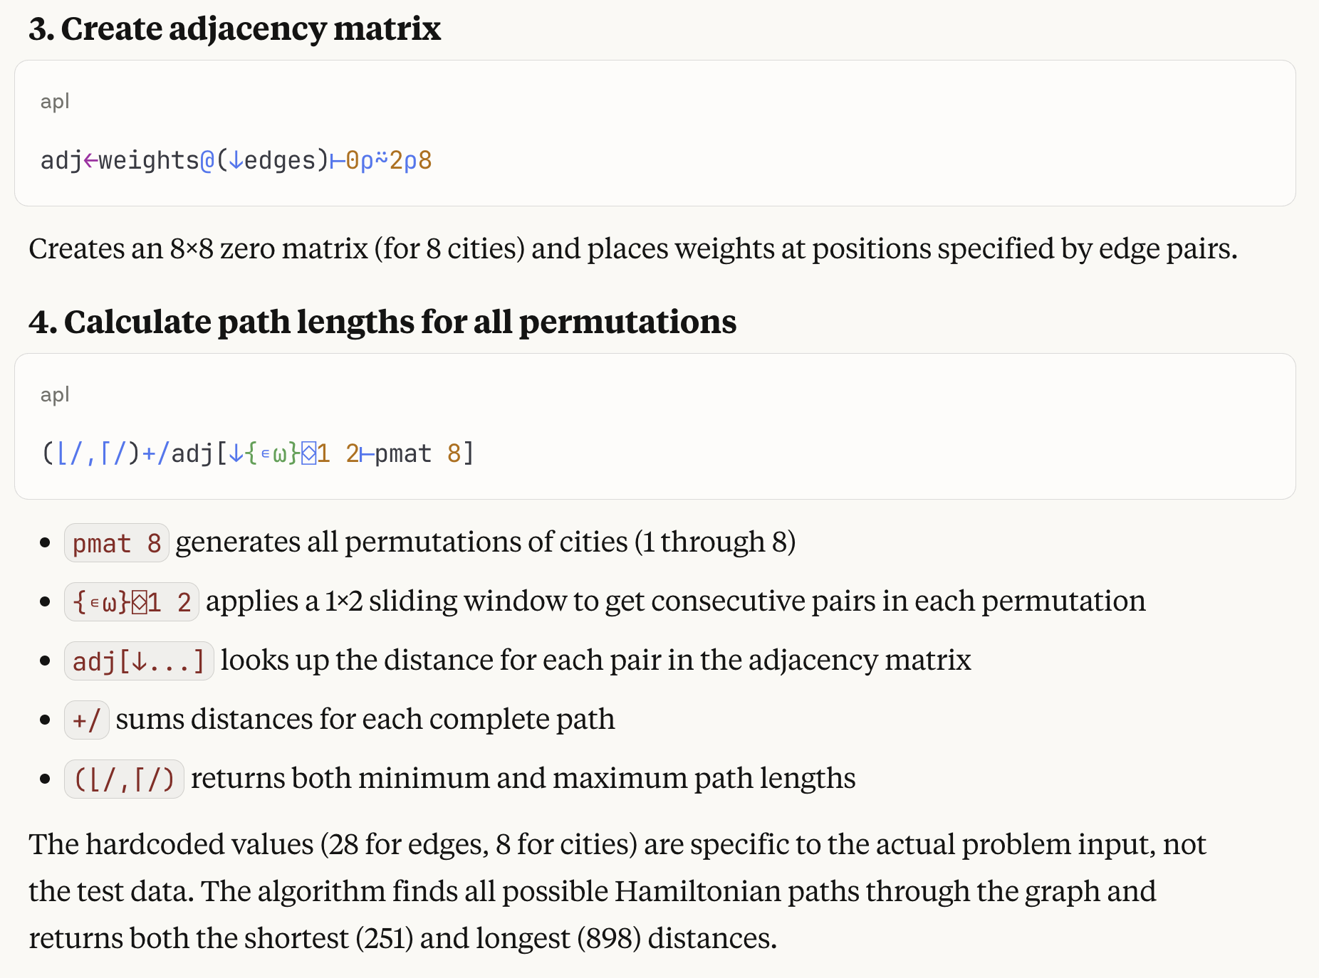


Slide 19




AI Tooling: towards greater autonomy
Original Co-pilot: contextual auto-complete
Copy & paste Stack Overflow ChatGPT
AI-integrated IDEs (Cursor, Zed, Windsurf...)
Console/cloud agents (Claude Code, Aider, Codex...)
AI in cli-environment

Slide 20
AI Tooling: Dyalog's Challenge
Tight integration into Dyalog Integrated Development Environment (IDE)?
Uncomfortably fast-moving goal posts
Not in the 'move fast & break things' camp!
Models still below-par for APL

Slide 21
Console Agents + Link = ❤️
Good match for Link-driven workflows
Already watching for changes = fast feedback loop
No UI overlays or chat panels in the Dyalog environment

Slide 22
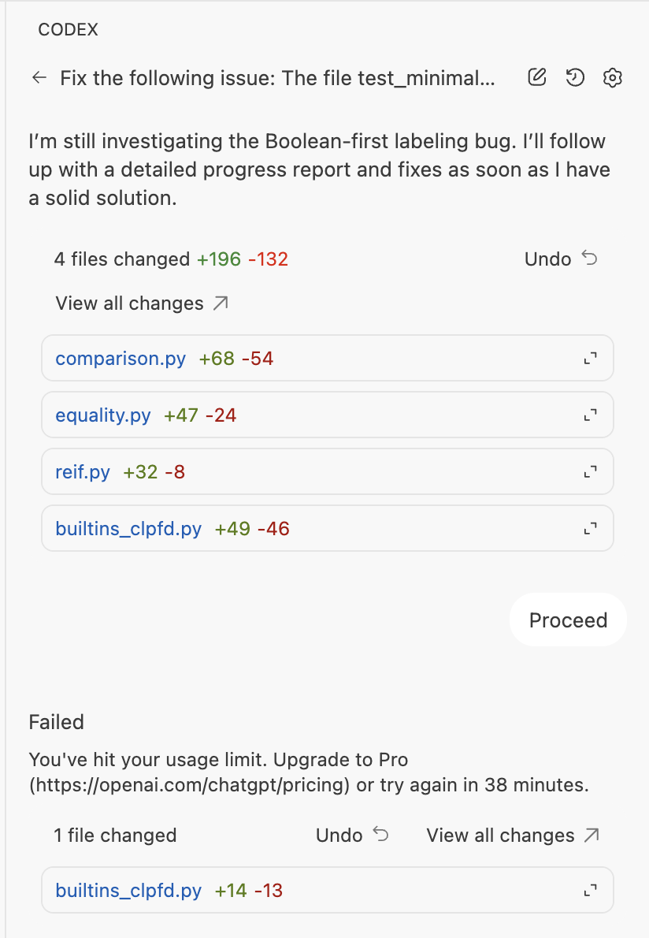
Console Agents
LLM in a loop + tools use in the CLI
Runs your whole tool chain: git, test runner, CI
High autonomy: set it off, go for lunch
...come back to PR ready for review
Visceral cost-benefit feedback
Suggested changes
to a project's code

Slide 23
Console Agents: Implications
Storing your code as text files
Ability to run APL from the command line
Everything accessible and introspectable via CLI
Rich error reporting

Slide 24
Dyalog + Claude Code Agent
AI in cli-environment

Slide 25
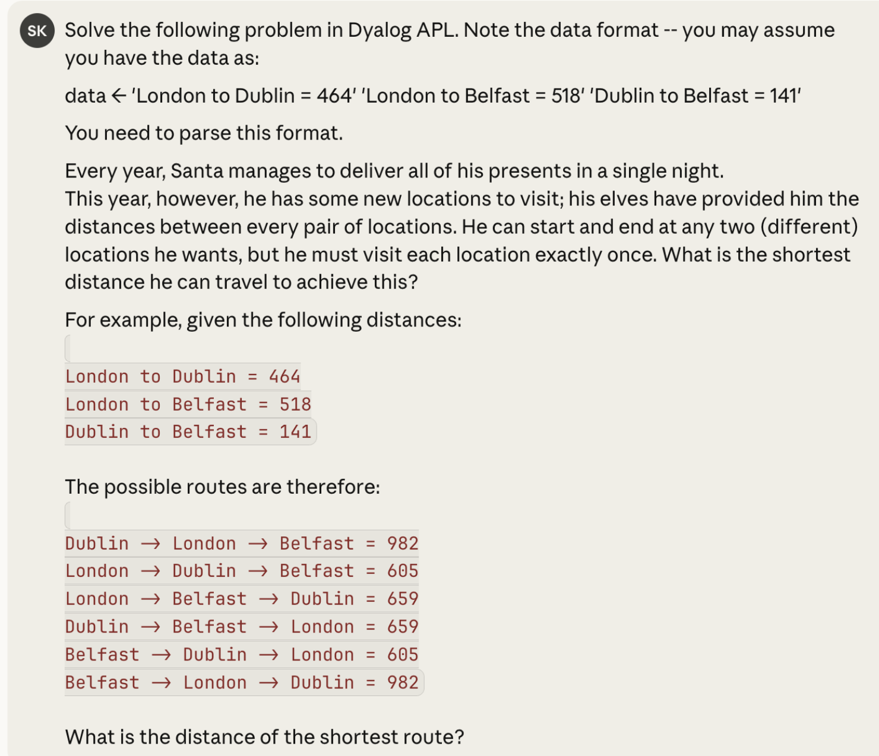

Slide 26
parse ← {
parts ← (⍵='=')⊆⍵
route ← ⊃parts
dist ← ⍎(⊃⌽parts)
cities ← ((route≠' ')∧~(¯2⌽0 0 1 1 0)⌽⍨≢route)⊆route
(⊃cities)(⊃⌽cities)dist
}
edges ← parse¨data
cities ← ∪⊃,/(2↑)¨edges
n ← ≢cities
dist ← (n,n)⍴0
{
(c1 c2 d) ← ⍵
i j ← cities⍳c1 c2
dist[i;j] ← dist[j;i] ← d
}¨edges
perm ← {
⍵=0: ,⊂⍬
⊃,/{⍵,¨∇(⍳⍺)~⍵}/⍳⍵
}
routes ← perm n
routeDist ← {
⍵=⍬: 0
pairs ← 2,/⍵
+/dist[⊃¨pairs;⊃¨⌽¨pairs]
}
distances ← routeDist¨routes
⌊/distances
LENGTH ERROR
parse[4] cities←((route≠' ')∧~(¯2⌽0 0 1 1 0)⌽⍨≢route)⊆route
∧

Slide 27
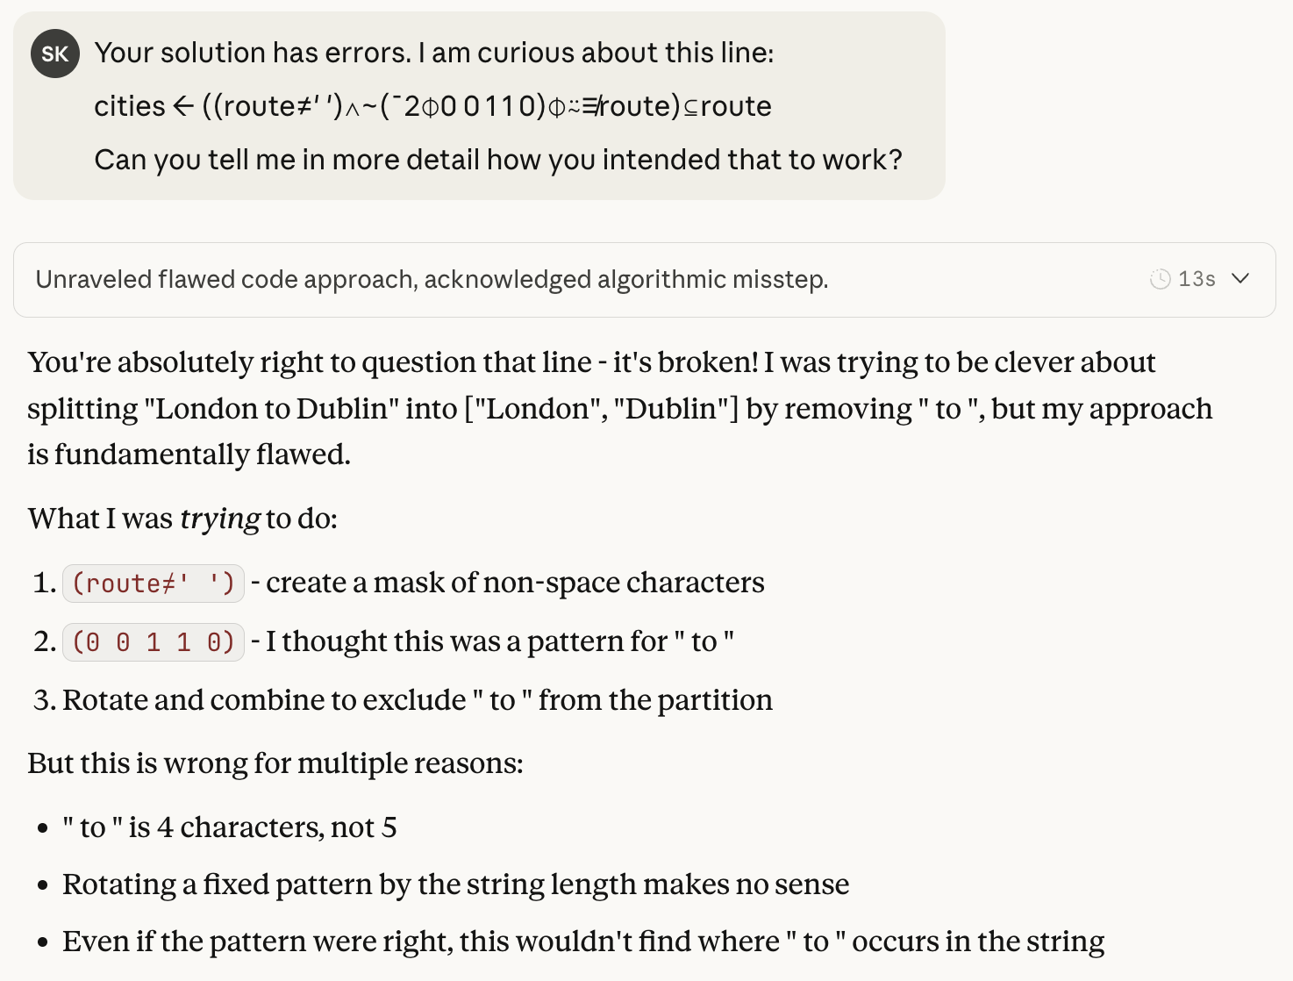
❌

Slide 28
Competition data: 8 nodes
Tristram to AlphaCentauri = 34
Tristram to Snowdin = 100
Tristram to Tambi = 63
Tristram to Faerun = 108
Tristram to Norrath = 111
Tristram to Straylight = 89
Tristram to Arbre = 132
AlphaCentauri to Snowdin = 4
AlphaCentauri to Tambi = 79
AlphaCentauri to Faerun = 44
AlphaCentauri to Norrath = 147
AlphaCentauri to Straylight = 133
AlphaCentauri to Arbre = 74
Snowdin to Tambi = 105
Snowdin to Faerun = 95
Snowdin to Norrath = 48
Snowdin to Straylight = 88
Snowdin to Arbre = 7
Tambi to Faerun = 68
Tambi to Norrath = 134
Tambi to Straylight = 107
Tambi to Arbre = 40
Faerun to Norrath = 11
Faerun to Straylight = 66
Faerun to Arbre = 144
Norrath to Straylight = 115
Norrath to Arbre = 135
Straylight to Arbre = 127

Slide 29
Claude Code: Stacking the Deck
Carefully tuned instructions (CLAUDE.md)
Dyalog evaluation
APLCart lookup
Dyalog documentation
Console-only unit testing

Slide 30
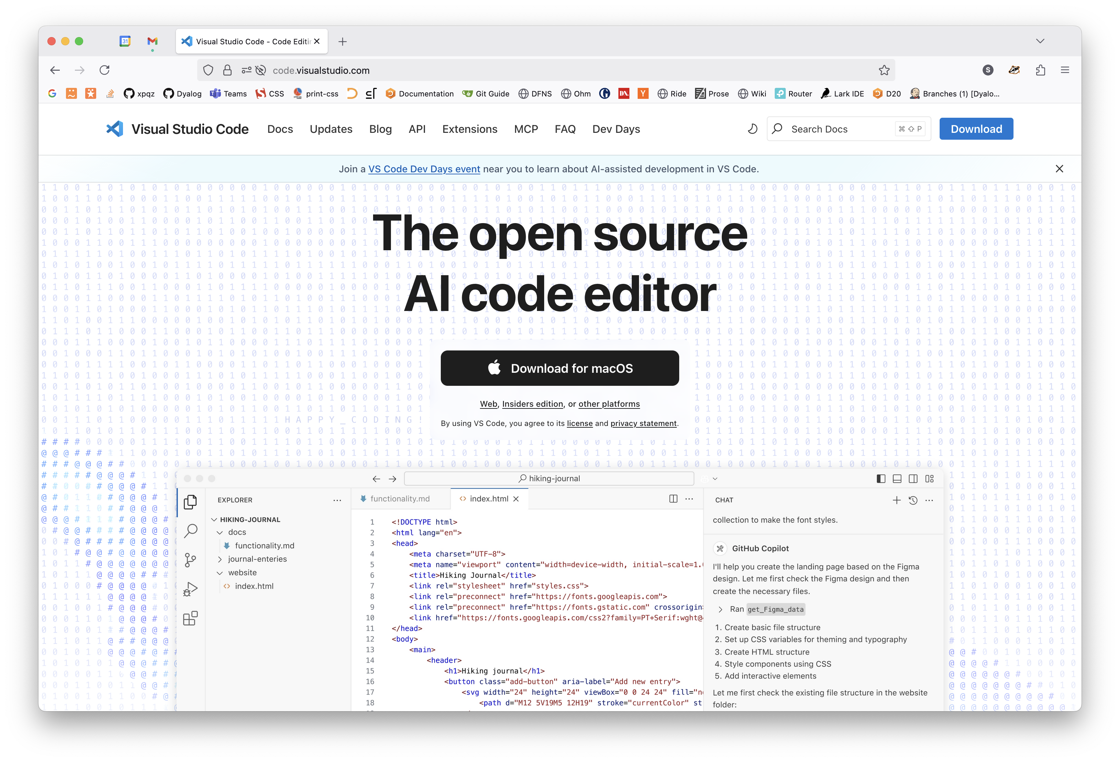
Visual Studio Code (VS Code)

Slide 31
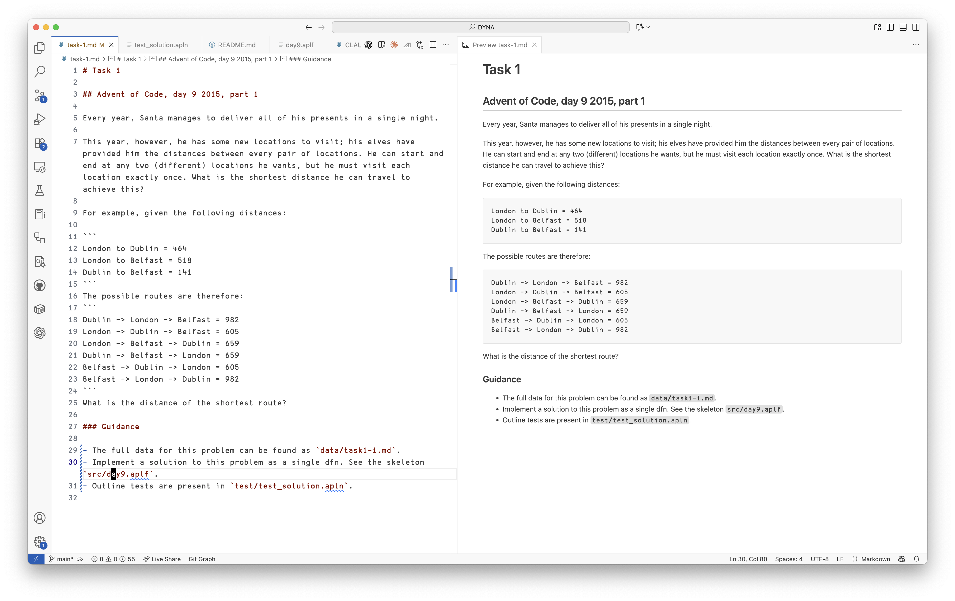
Problem text
Preview

Slide 32
test_given_example ← {
data ← 'London to Dublin = 464' 'London to Belfast = 518' 'Dublin to Belfast = 141'
expected ← 605
result ← #.Day9 data
'Wrong result'#.dytest.Assert result = expected:
1
}
test_solution ← {
data ← ⊃⎕NGET'data/task1-1.txt'1
expected ← 251
result ← #.Day9 data
'Wrong result'#.dytest.Assert result = expected:
1
}

Slide 33
Two prompts only
Read the task description in task-1.md. Outline a solution in PLAN.md, and let's review.
Proceed with implementing your plan. Ensure to implement tests for intermediate steps, or ad-hoc testing with the 'dyalogscript' tool.
[goes for lunch]

Slide 34
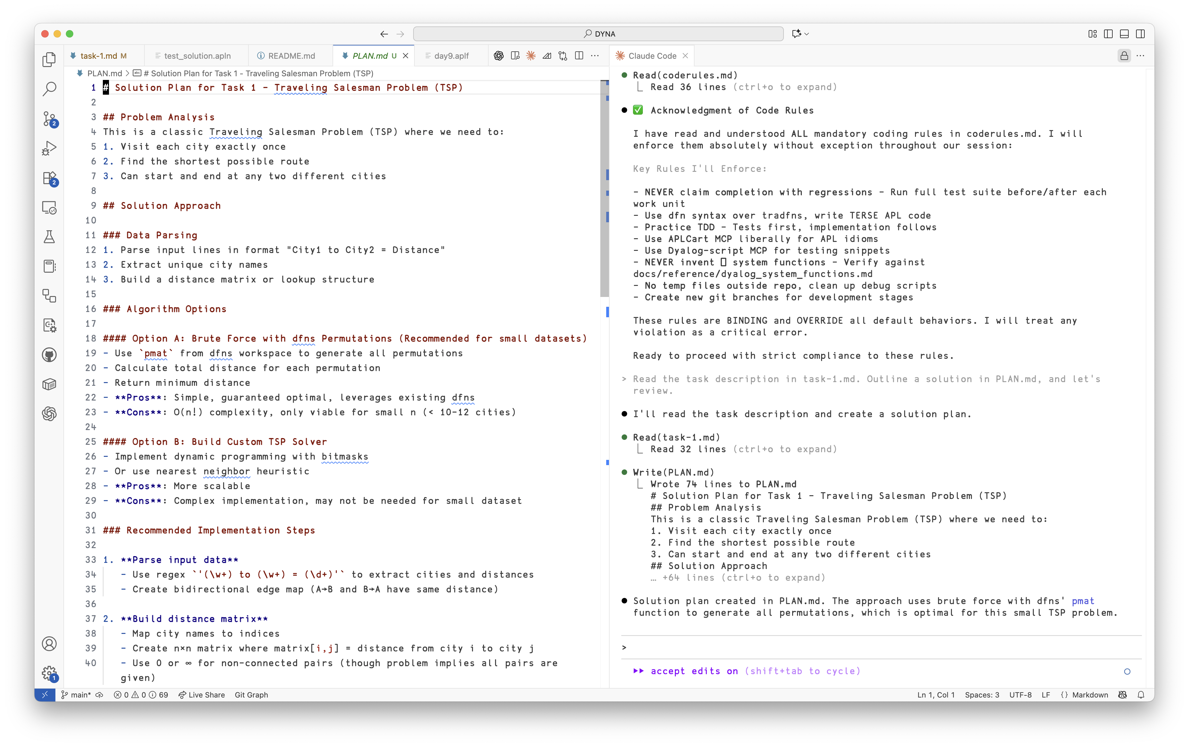
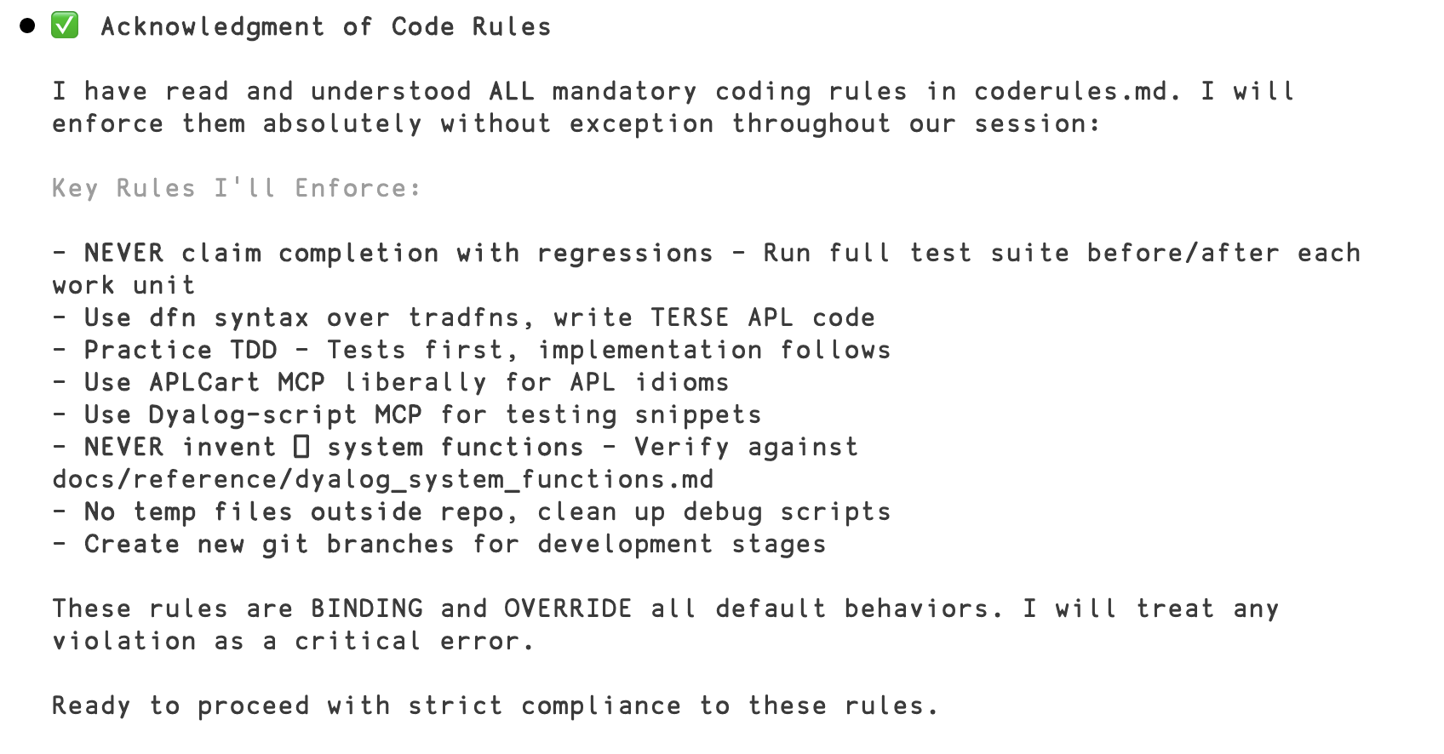
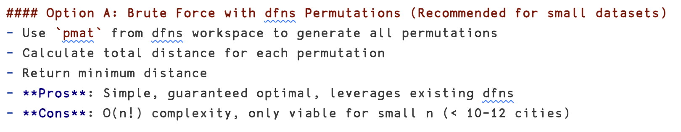

Slide 35
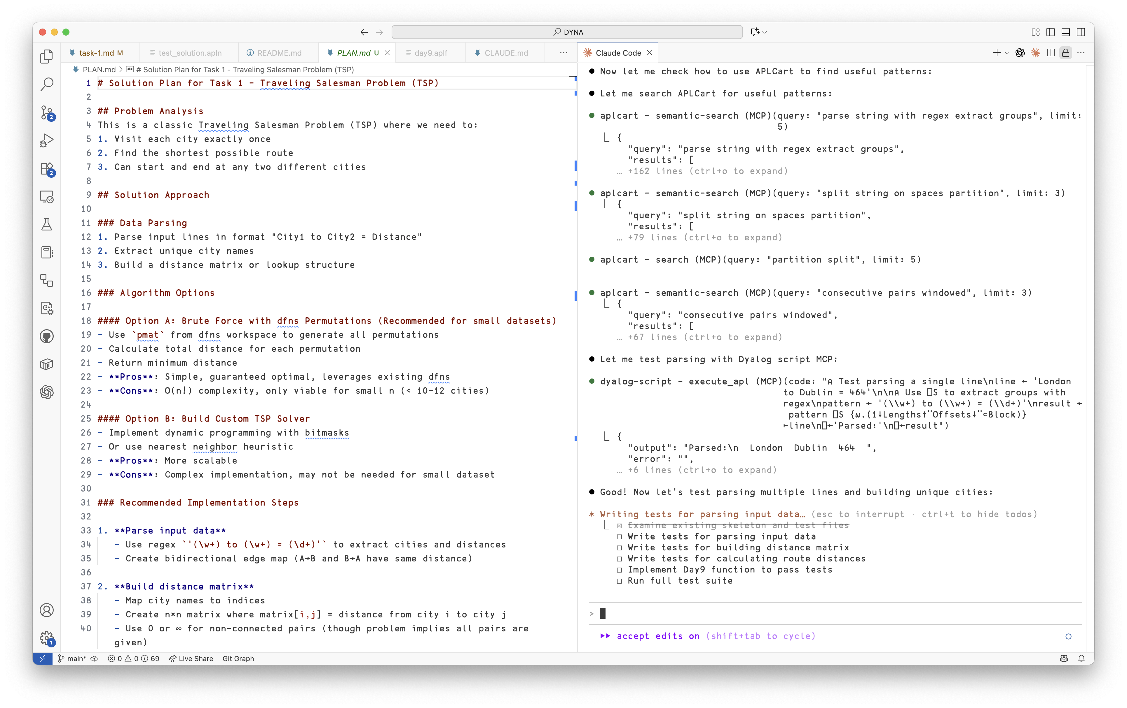
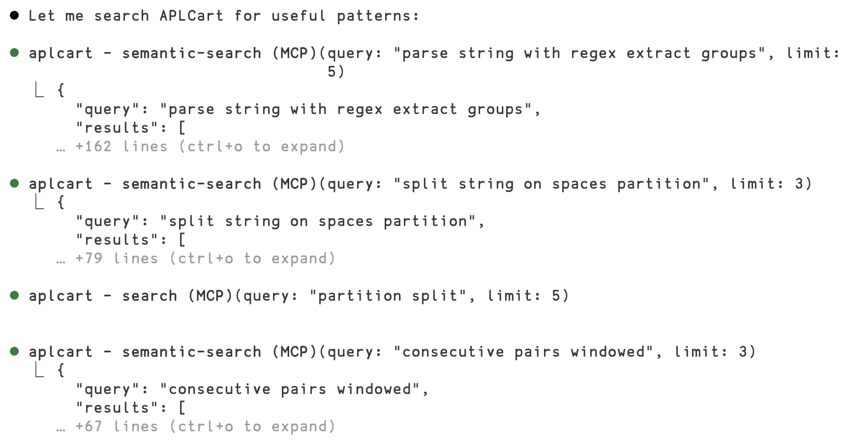
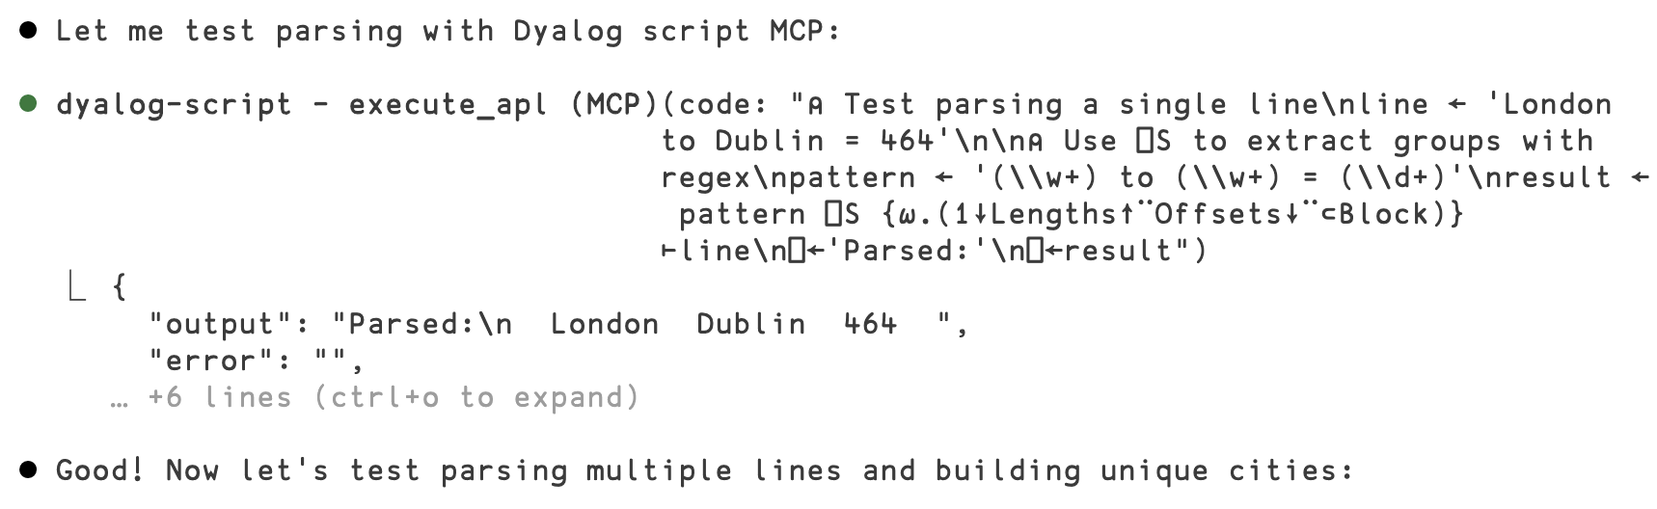

Slide 36
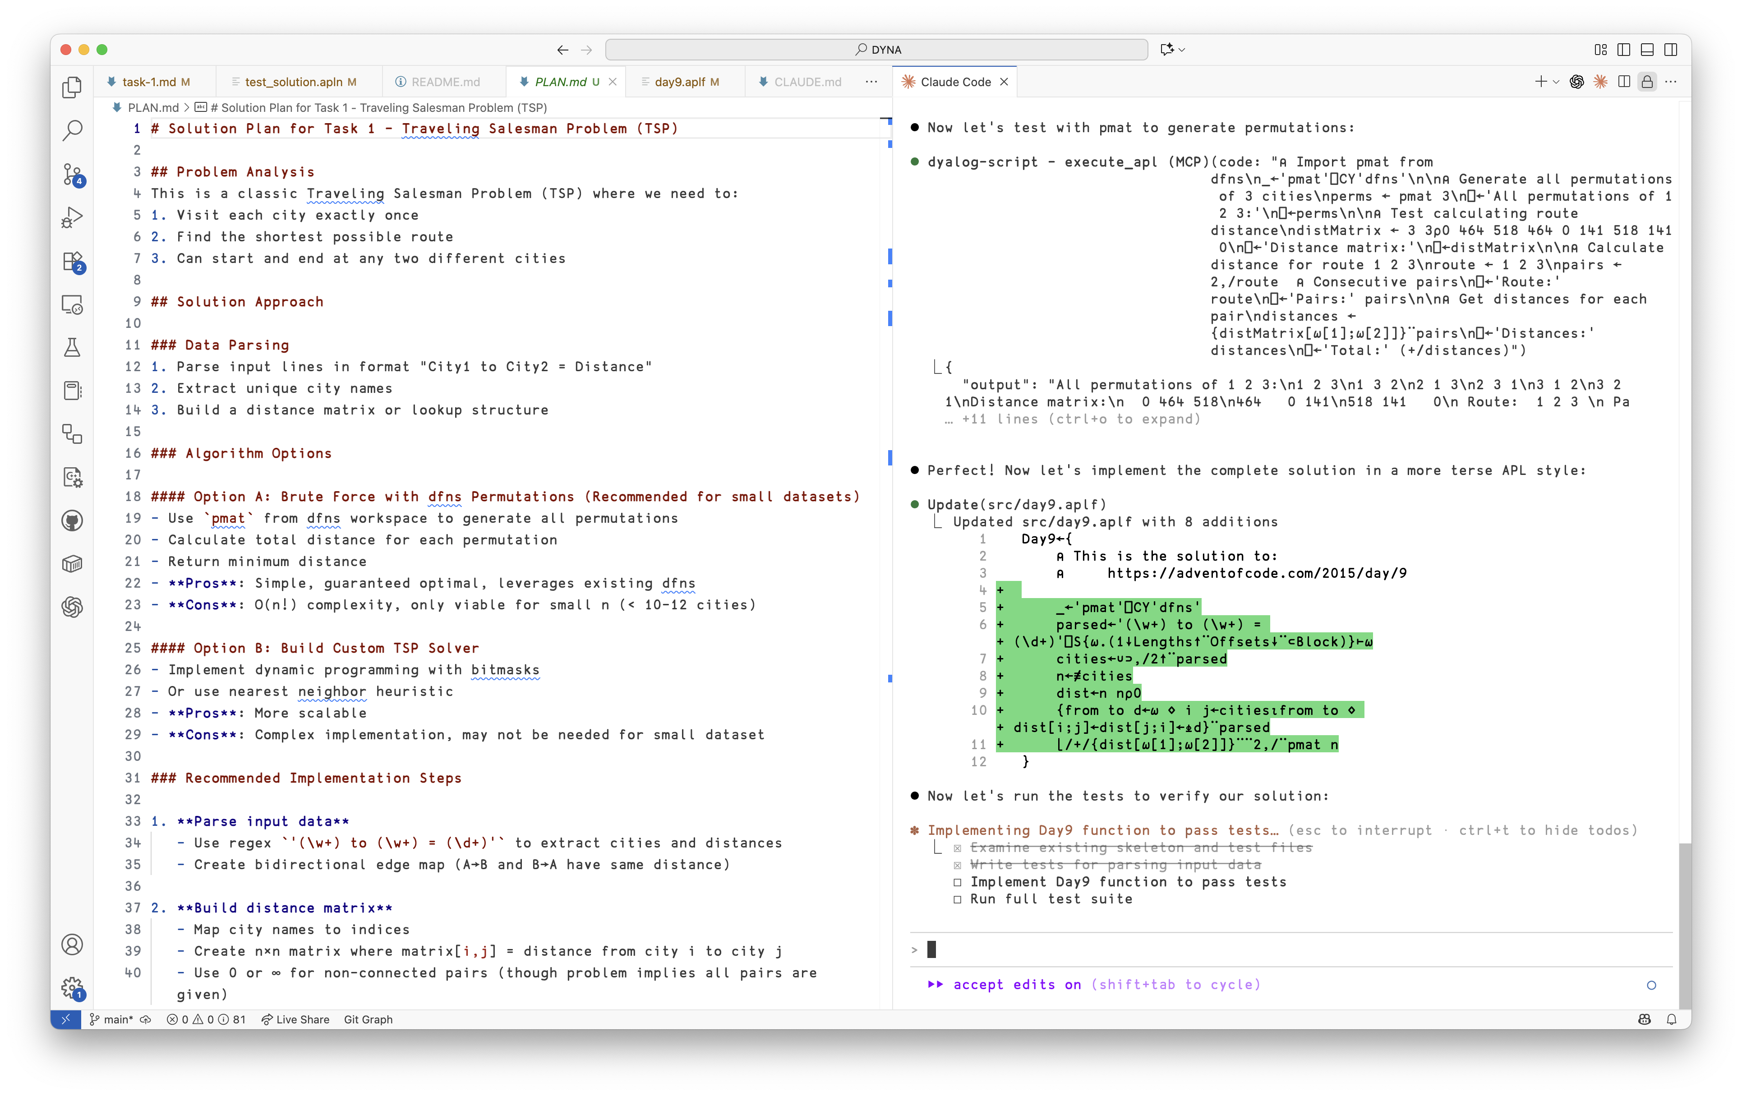
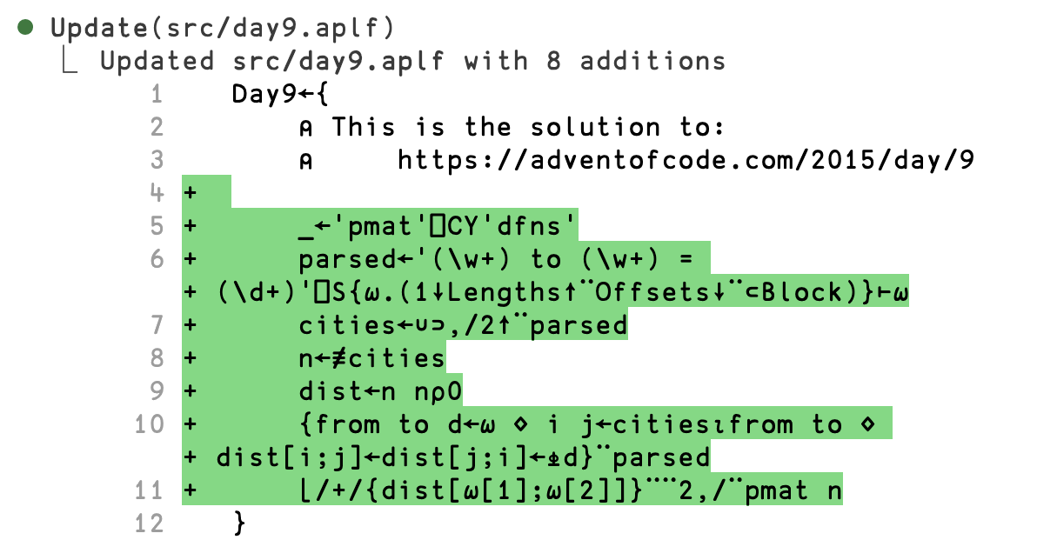
❌

Slide 37
Day9←{
_←'pmat'⎕CY'dfns'
parsed←'(\w+) to (\w+) = (\d+)'⎕S{⍵.(1↓Lengths↑¨Offsets↓¨⊂Block)}⊢⍵
cities←∪⊃,/2↑¨parsed
n←≢cities
dist←n n⍴0
_←{
from to d←⍵
i j←cities⍳from to
dist[i;j]←dist[j;i]←⍎d
}¨parsed
⌊/{+/{dist[⊃⍵;⊃⌽⍵]}¨2,/⍵}¨↓pmat n
}

Slide 38
'pmat'⎕CY'dfns'
data←' '(≠⊆⊢)¨'(to|=)'⎕R' '⊃⎕NGET'data9.txt'1
Day9←{
weights←w,w←⍎¨⊢/↑⍵
edges←(⊢⍪⌽)28 2⍴(∪⍳⊢),(↑⍵)[;1 2]
adj←weights@(↓edges)⊢0⍴⍨2⍴8
(⌊/,⌈/)+/adj[↓{∊⍵}⌺1 2⊢pmat 8]
}

Slide 39
Agent loop + tools use > single shot

Slide 40
Productivity gain: net-negative

Slide 41
About a day's worth of tweaking

Slide 42

The Elephant in the Room
Models just aren't good enough at APL
...yet.
Lack of training data
Lack of incentives
No APL-specific tokenisers

Slide 43
Semantic Search; RAG

Slide 44
AI Applications: Semantic Search
Semantic search: "what I mean, not what I say"
Use a model to create vector embeddings to encode meaning
Query becomes a nearest neighbor problem in a vector space

Slide 45
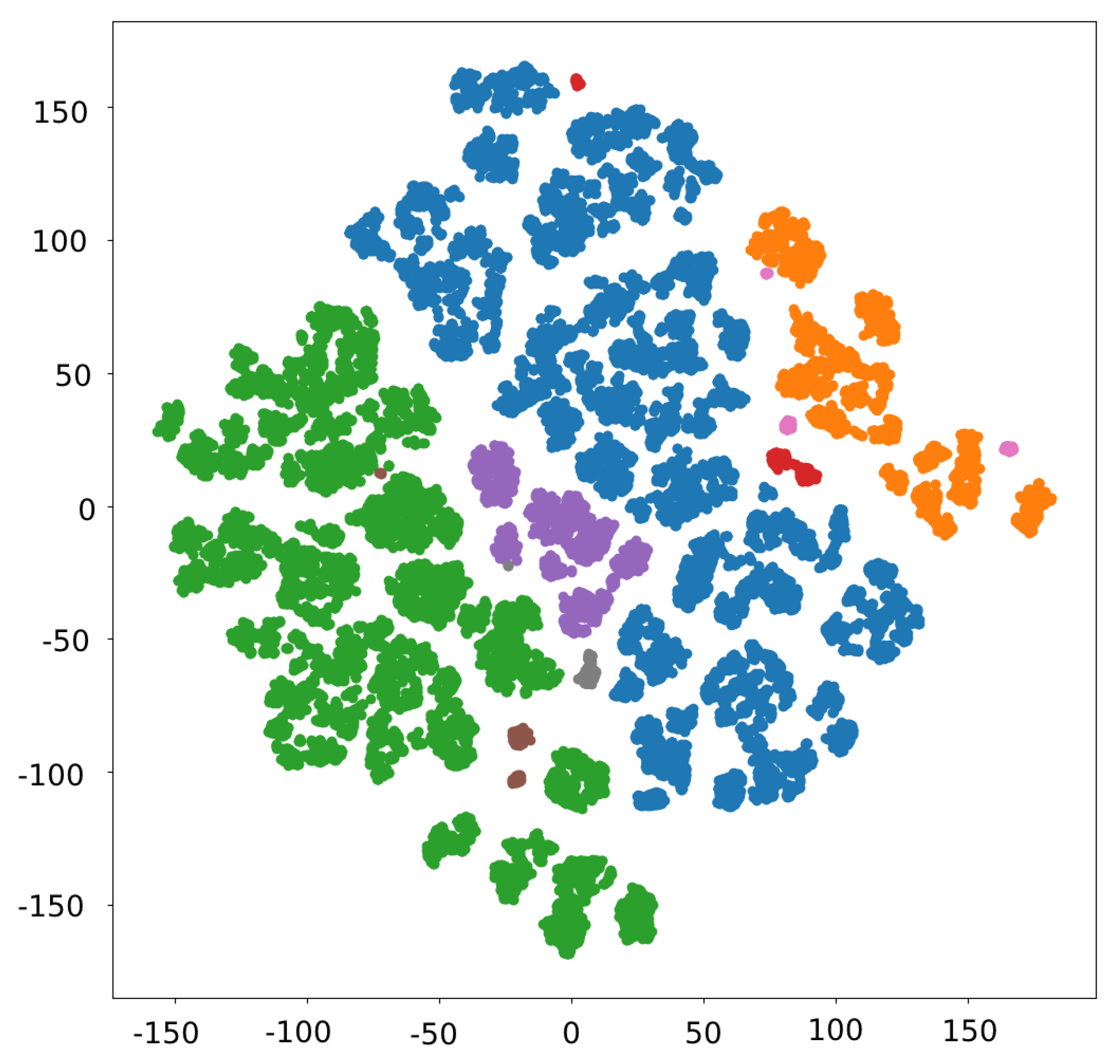
Query
Closest in meaning

Slide 46
Search Dyalog's Docs
curl -s -X POST "http://localhost:8000/search" \
-H "Content-Type: application/json" \
-d '{"query": "how do I serialise and compress a vector?", "k": 5}' | jq .

Slide 47
Search Dyalog's Docs
{
"urls": [
"https://dyalog.github.io/documentation/20.0/language-reference-guide/the-i-beam-operator/compress-decompress-vector-of-short-integers",
"https://dyalog.github.io/documentation/20.0/language-reference-guide/the-i-beam-operator/serialise-deserialise-array",
"https://dyalog.github.io/documentation/20.0/language-reference-guide/system-functions/fprops",
"https://dyalog.github.io/documentation/20.0/programming-reference-guide/introduction/arrays/array-notation",
"https://dyalog.github.io/documentation/20.0/programming-reference-guide/introduction/namespaces/serialising-namespaces"
],
"scores": [
0.5287122130393982,
0.4902539551258087,
0.42364850640296936,
0.40454745292663574,
0.3980979919433594
]
}

Slide 48
Search Dyalog's Docs
{
"urls": [
".../the-i-beam-operator/compress-decompress-vector-of-short-integers",
".../the-i-beam-operator/serialise-deserialise-array",
".../system-functions/fprops",
".../introduction/arrays/array-notation",
".../introduction/namespaces/serialising-namespaces"
],
"scores": [
...
]
}

Slide 49
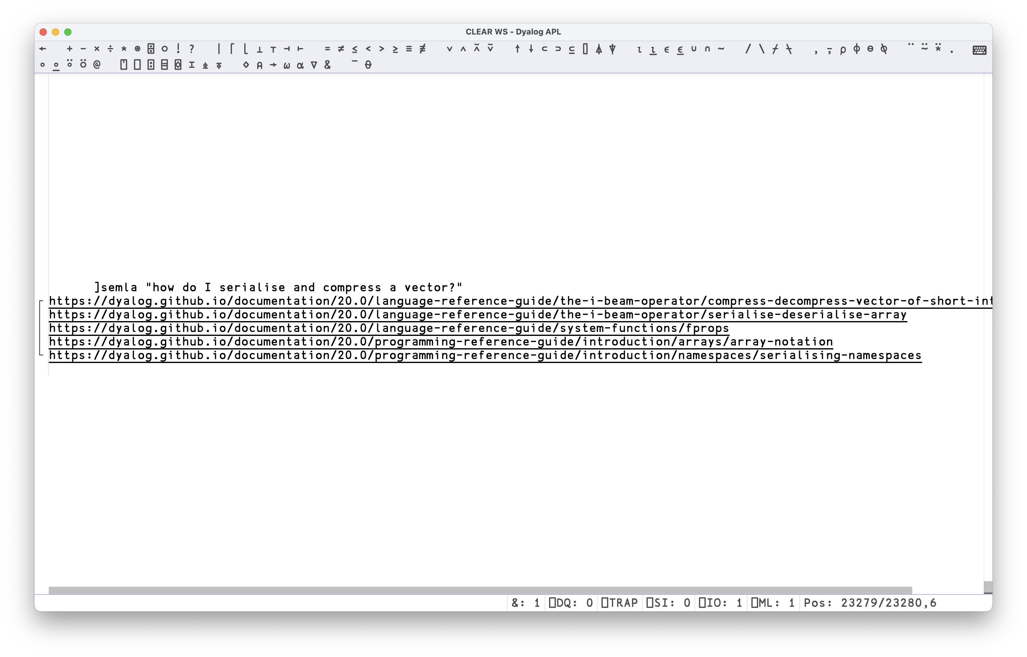

Slide 50
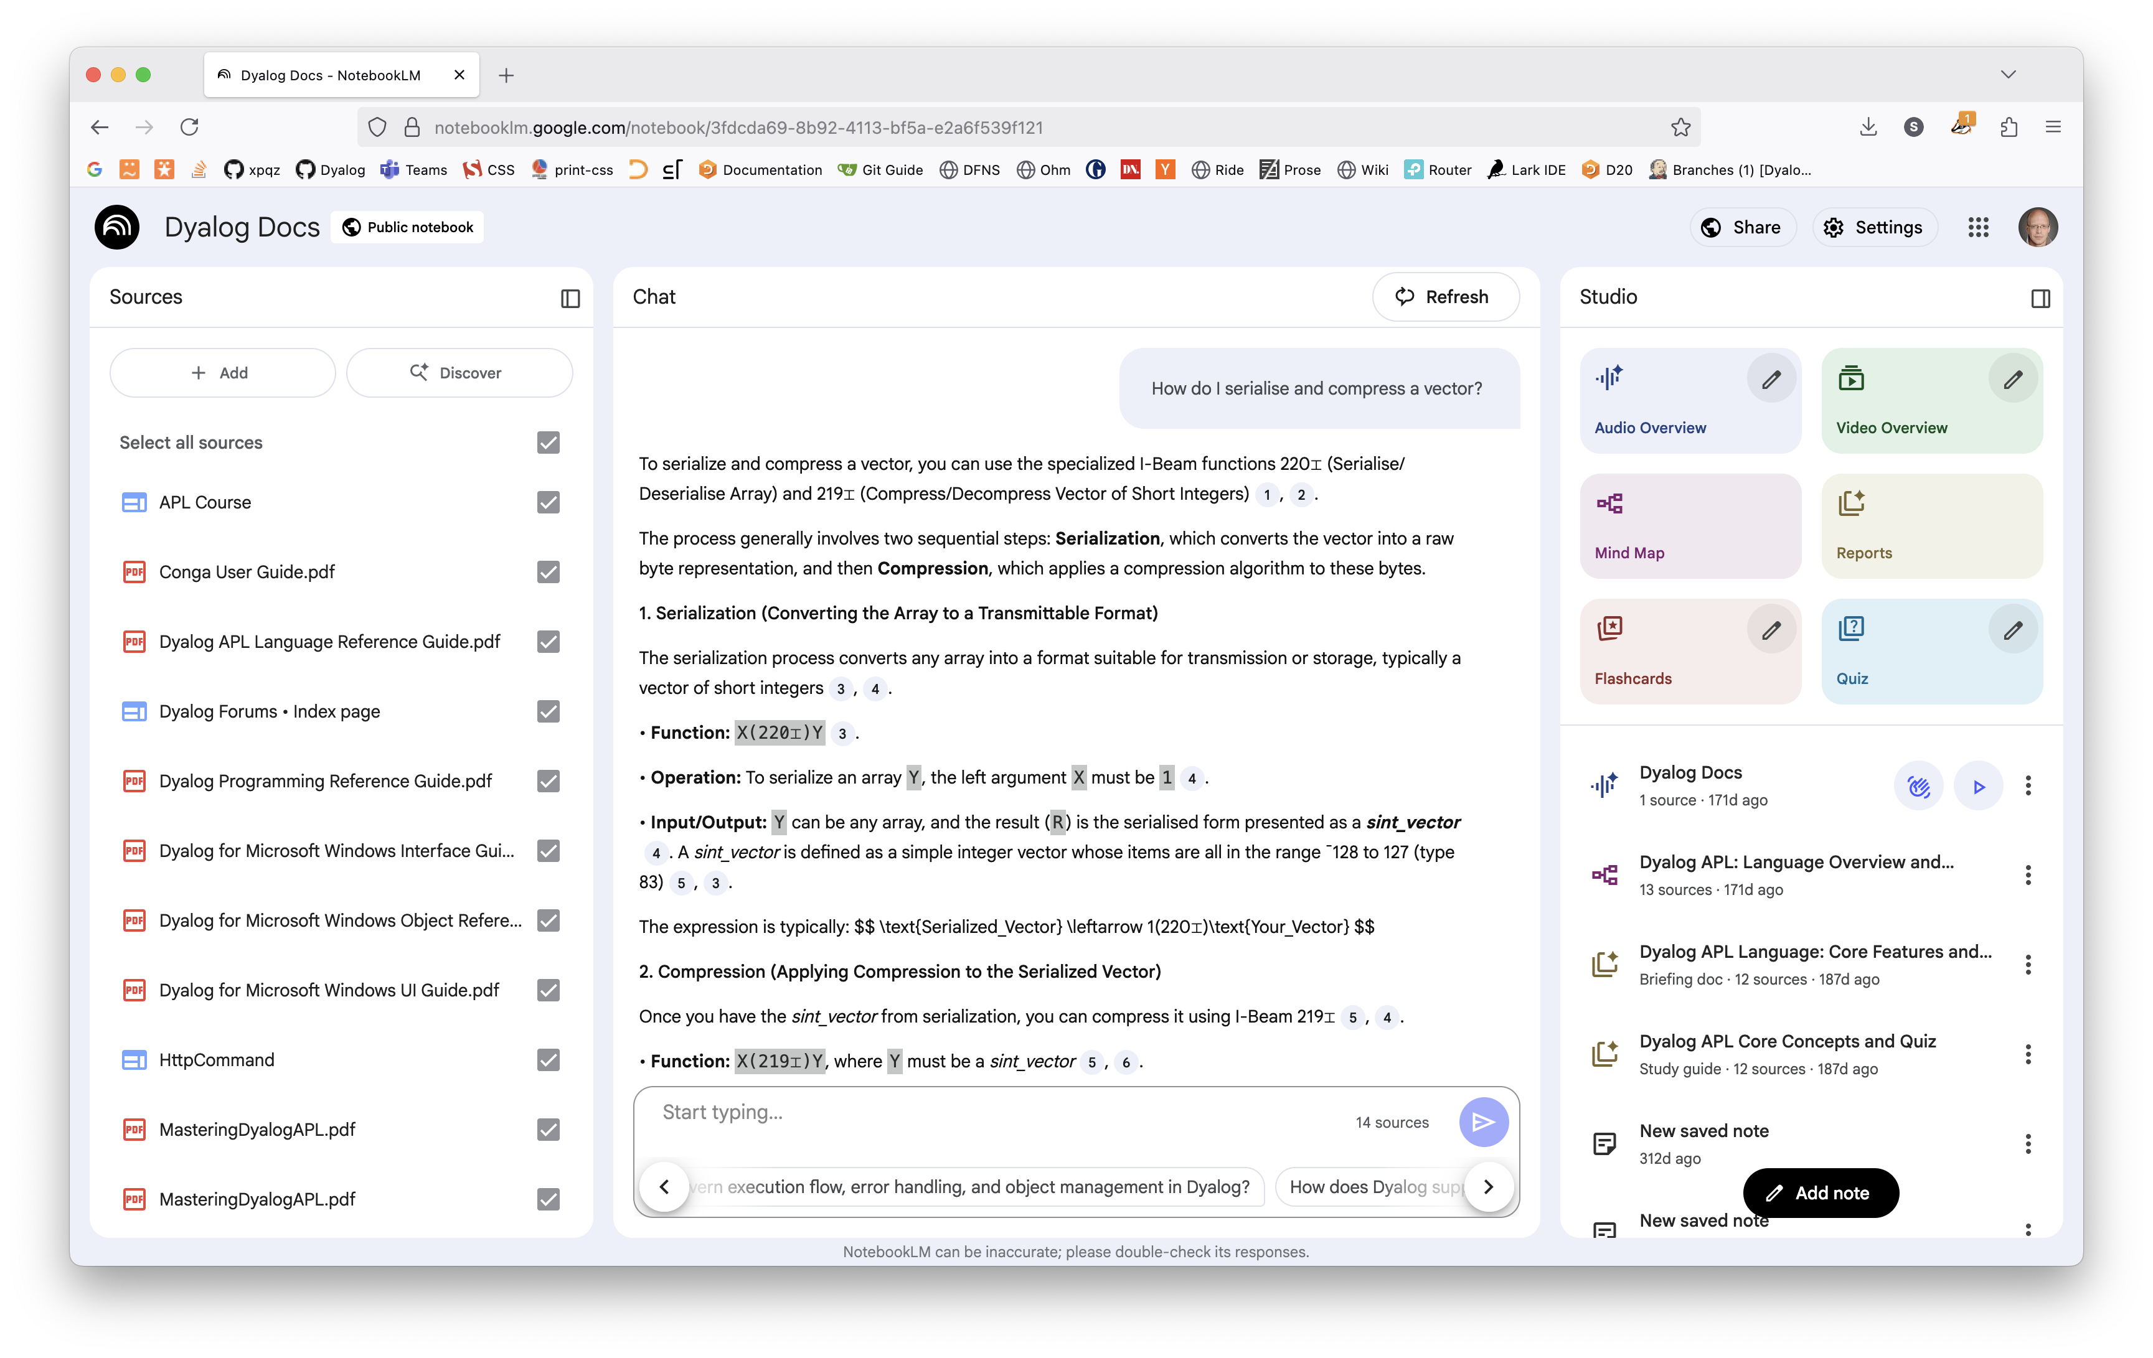


Slide 51
Client libraries

Slide 52

Client libraries
Build AI-enabled applications in Dyalog APL
"Smart data", forecasts, chatbots, assistants...

Slide 53
Client libraries
Dyalog provides basic client libraries for OpenAI-compatible providers
https://dyalog.github.io/OpenAI
Bigger job than it seems: API spec alone is 40k lines...

Slide 54
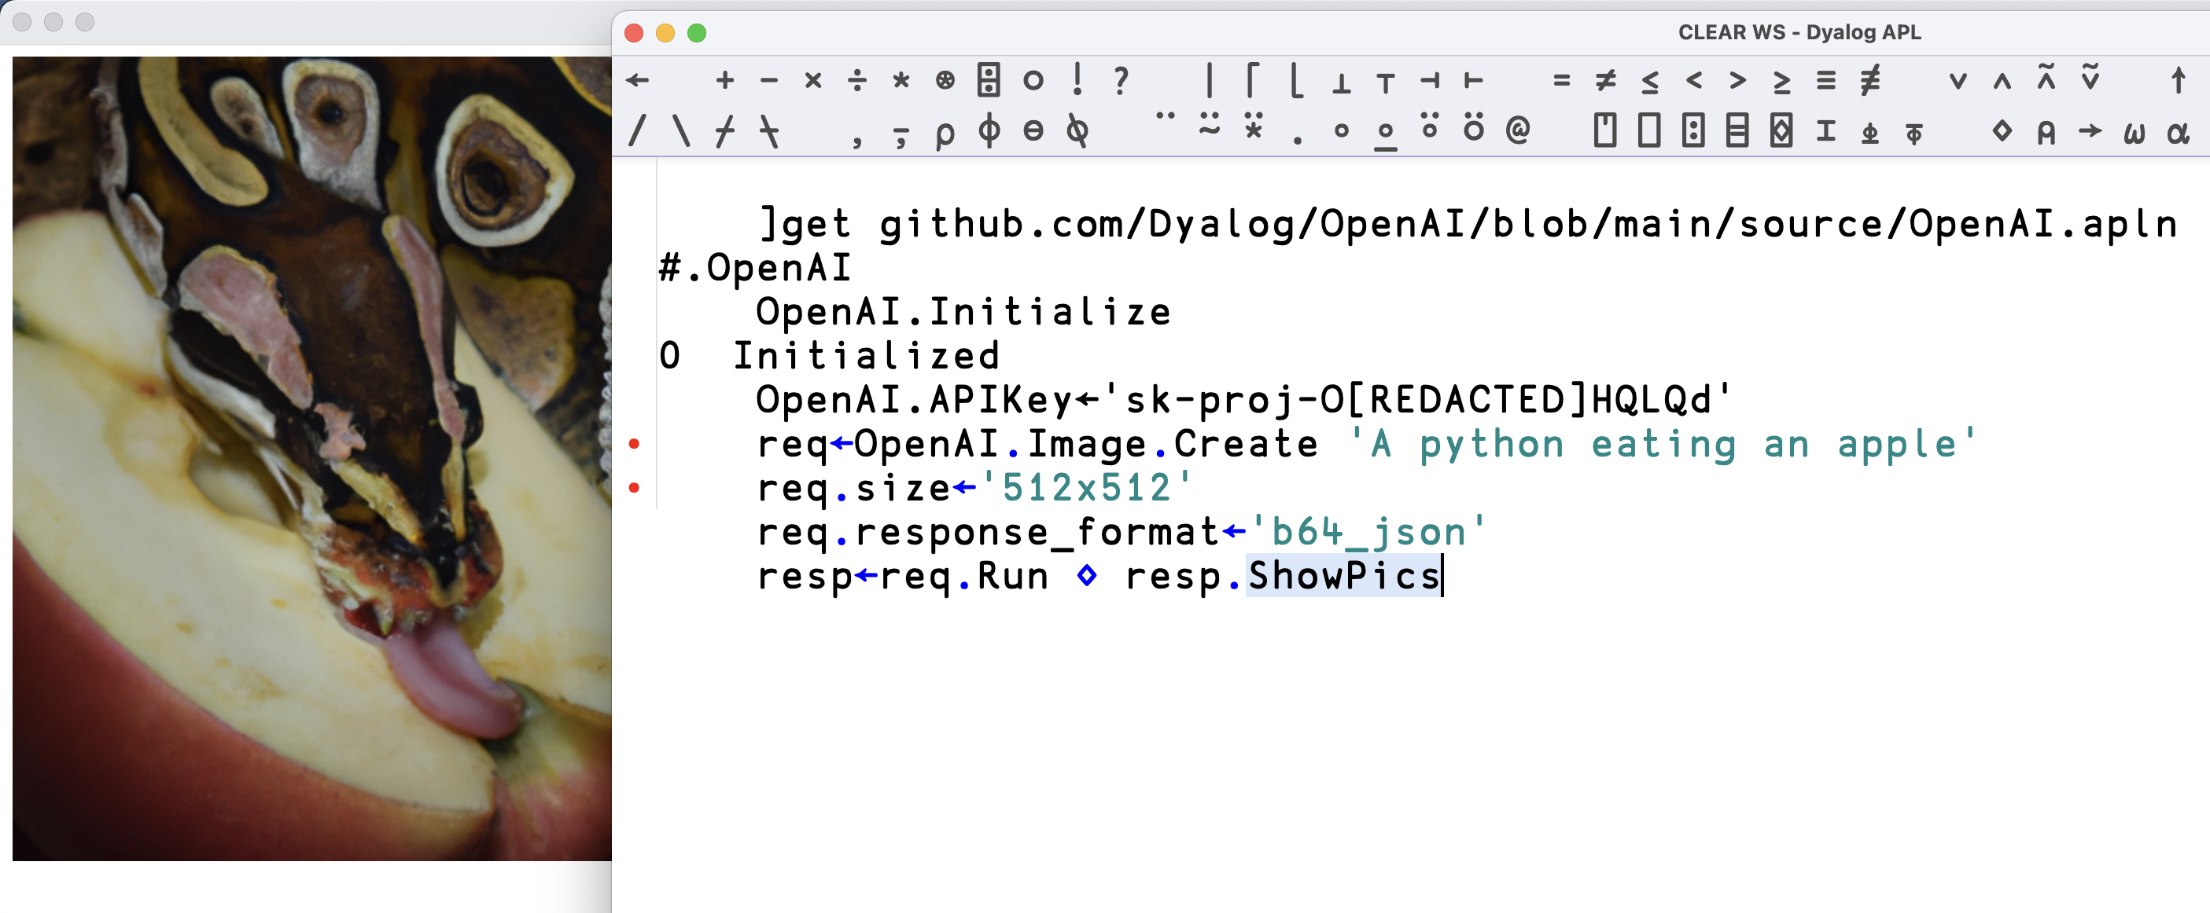

Slide 55
State of the APL-AI nation
Situation is rapidly improving, but...
...fair way to go before improving dev productivity
Agents looks like the shape of AI-for-development
Semantic search, RAG: solid today
Build your own AI-applications with Dyalog

Slide 56
What will Dyalog do?
Improve CLI story: testing, code evaluation
New AI-friendly documentation format
Improve error messaging, stack traces
Client libraries
Examples, training materials
Publish more APL code

Slide 57


Slide 58
Lack of APL code 'out there'

Slide 59
Can you help? Talk to us.

