Slide 1

Dyalog
Road Map
Morten Kromberg
CTO, Dyalog
(20 years 5 months)

Slide 2
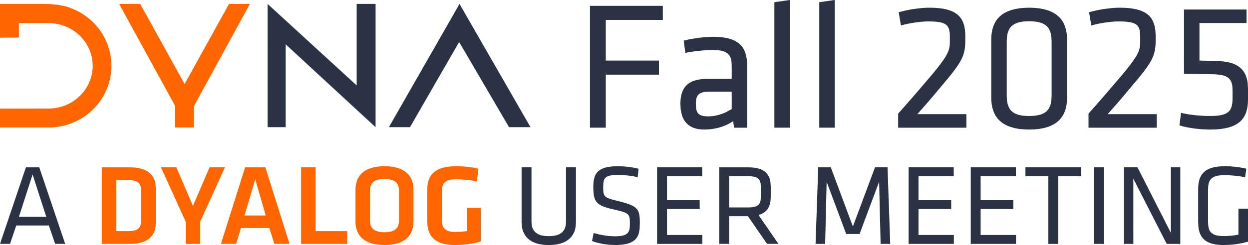
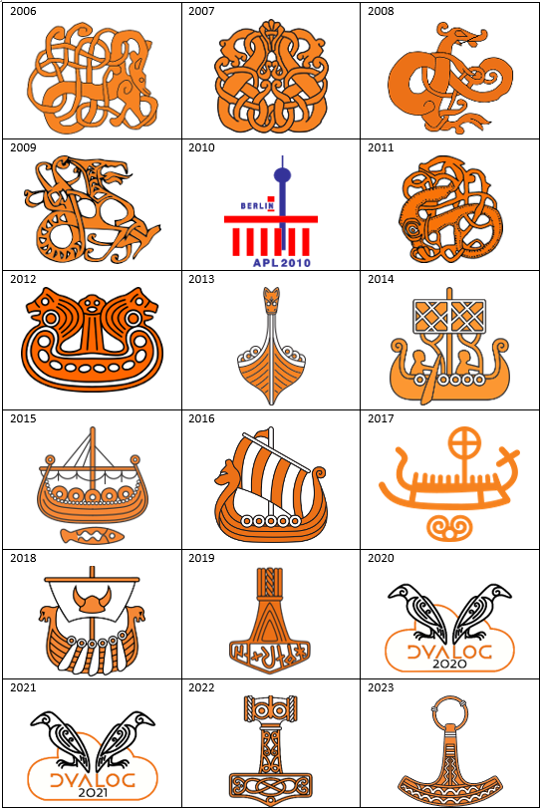
Welcome to
Current Event Schedule
Global Dyalog User Meeting in even years
  2026: Eastbourne, UK (return to Dyalog'14 venue)
DYNA Fall in odd years (~September, 2 days)
DYNA Spring every year (April, 1 day)
  Looking at Monday 4/13/26
What about the "Dyalog NYC Meetup"?

Slide 3
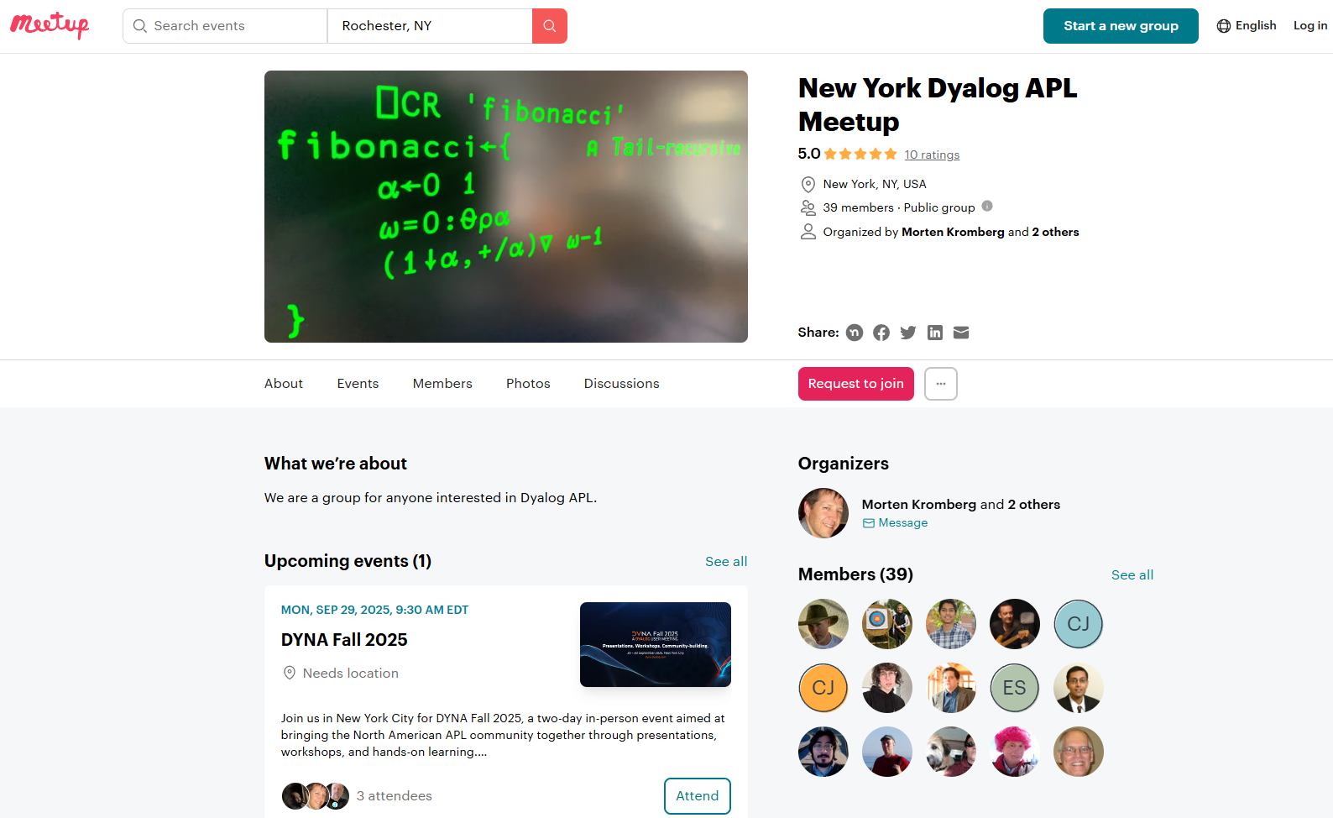

Slide 4
Start | Mins | Title | Presenter
9:30 AM | 45 | The Dyalog Road Map | Morten Kromberg
10:15 AM | 45 | Dyalog and AI | Stefan Kruger
11:00 AM | 15 | Break
11:15 AM | 30 | JAWS – Jarvis And Web Sockets | Brian Becker
11:45 AM | 30 | An Interface to Kafka | Martina Crippa
12:15 PM | 30 | Static Analysis of APL | Aaron Hsu and Brandon Wilson
12:45 PM | 45 | Lunch
1:30 PM | 30 | Converting from APL+Win to Dyalog APL | Alex Holtzapple
2:00 PM | 60 | Dyalog APL: Our (Not So) Secret Ingredient | Mark Wolfson
3:00 PM | 30 | Break
3:30 PM | 30 | The Data Science Journey | Josh David
4:00 PM | 30 | What Can Vectorised Trees Do For You? | Asher Harvey-Smith
4:30 PM | 30 | ArrayLab: Building a 3D APL Game | Holden Hoover
5:00 PM | 30 | The APL Trust US | Diane Hymas

Slide 5
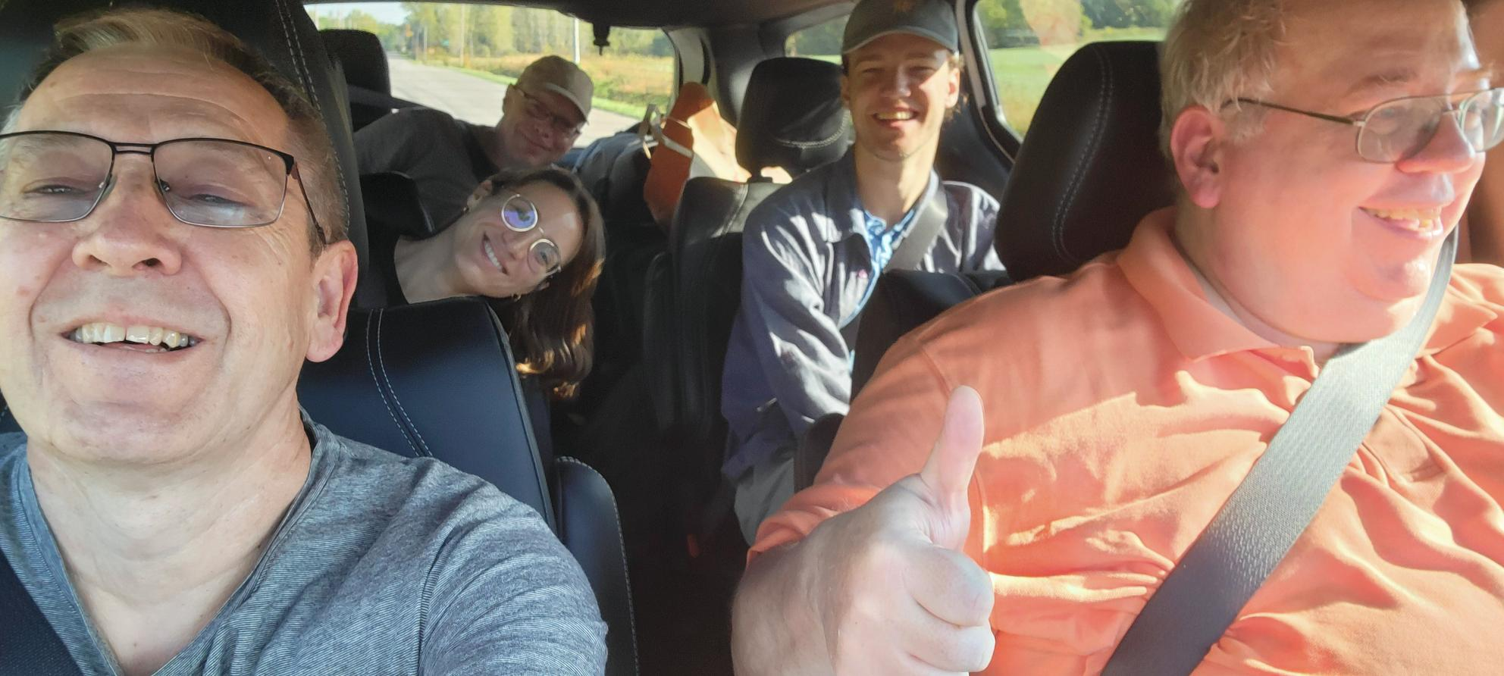

Slide 7

The Plan is Unchanged
Continue to grow the revenue base
Customers use of APL is growing
Migrants keep arriving
Grow and replenish the team
Hire new people in good time before old-timers retire
Hunt the new generation of users
Get back into data science & education
Continue to position APL in the functional community

Slide 8

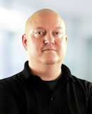
Business as Usual
Thanks, Mike!

Slide 9

Migration Tools
deltaWI: Migrate ⎕WI (APL+Win / MicroAPL) GUI to ⎕WC (Dyalog APL)

Slide 10
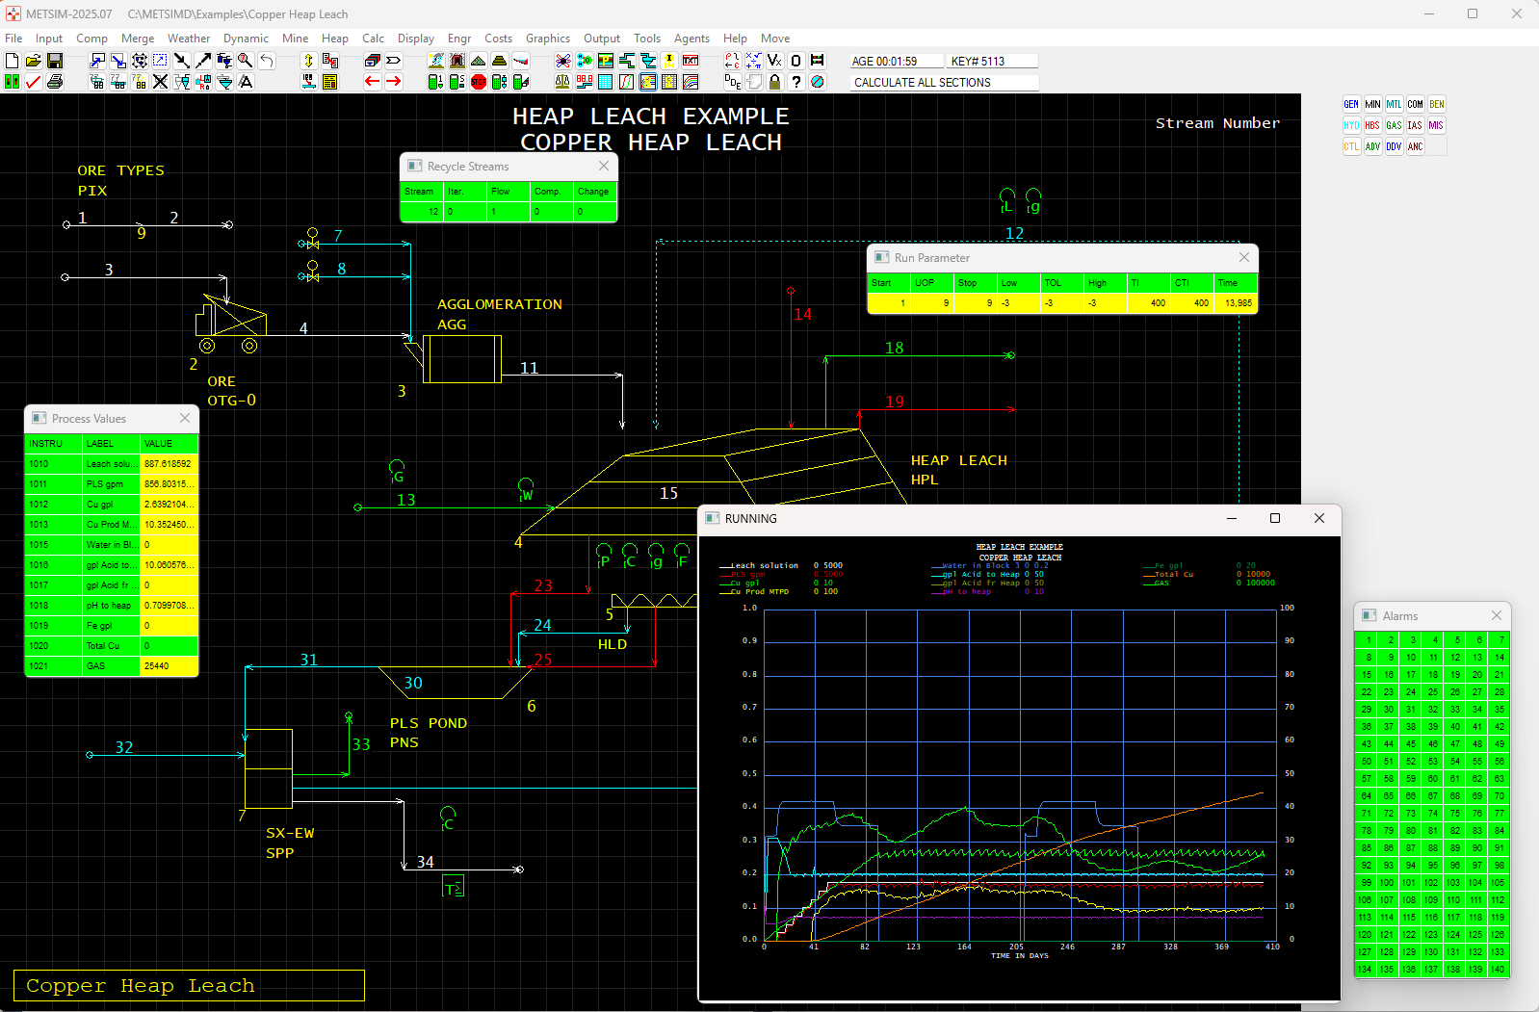

Slide 11
Migration Tools
deltaWI: Migrate ⎕WI (APL+Win / MicroAPL) GUI to ⎕WC (Dyalog APL)
EWC: Migrate ⎕WC (Windows) to Linux, macOS,
and the Web

Slide 12
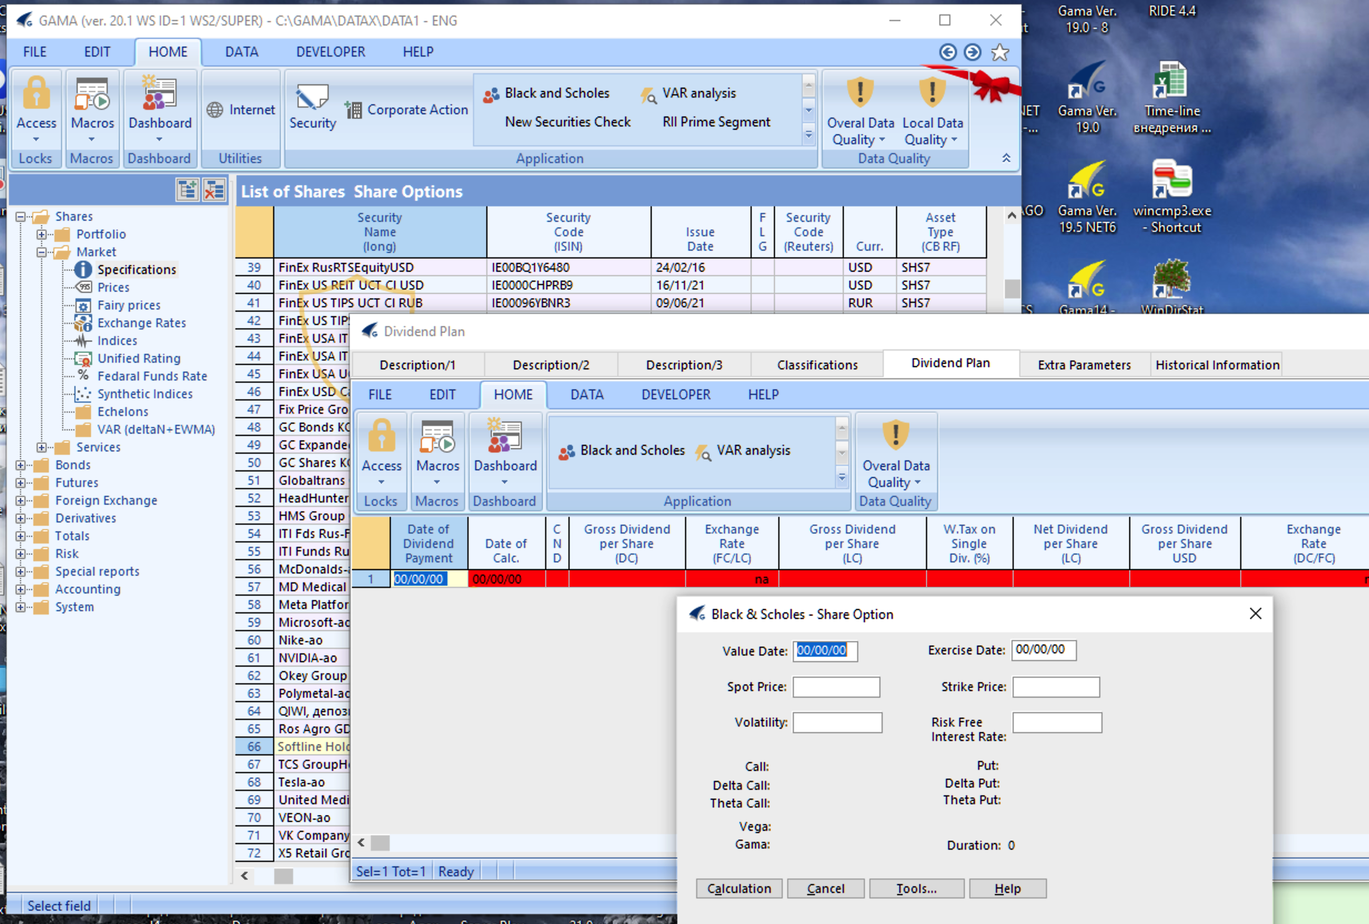
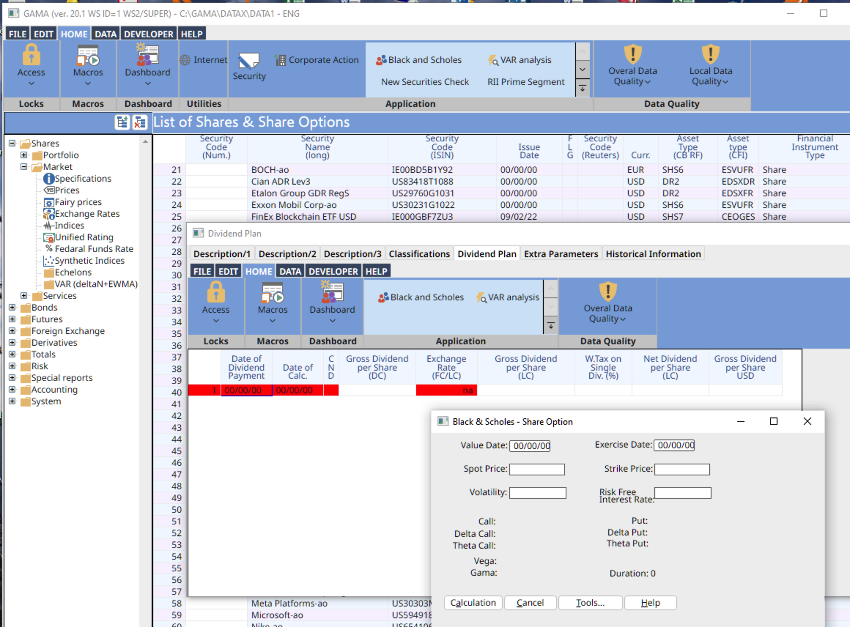

Slide 13
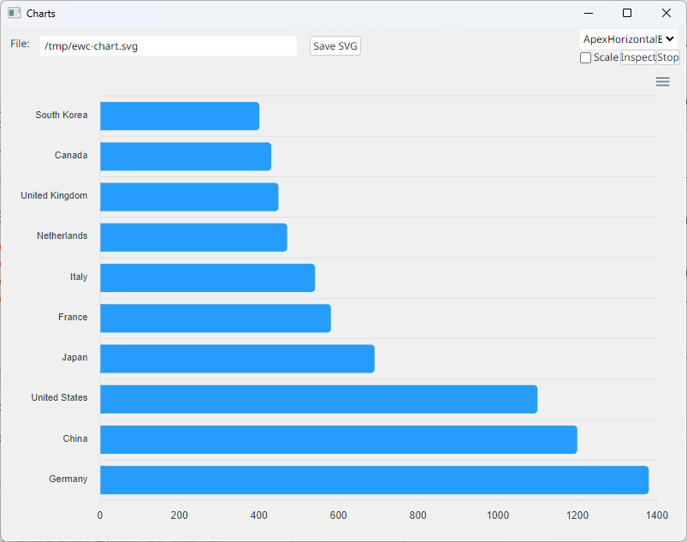
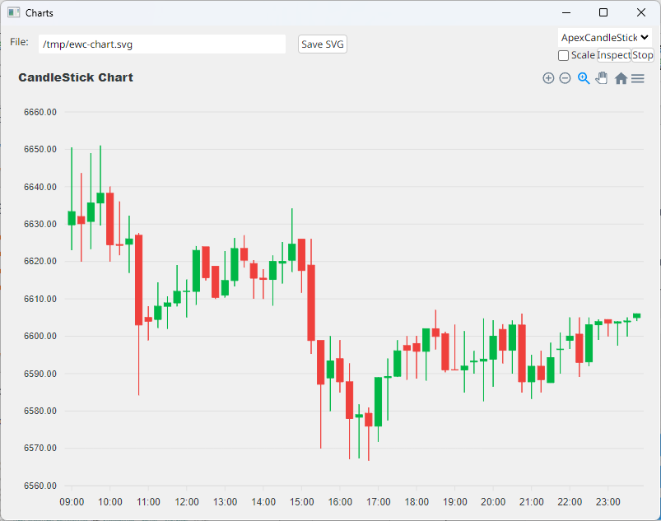
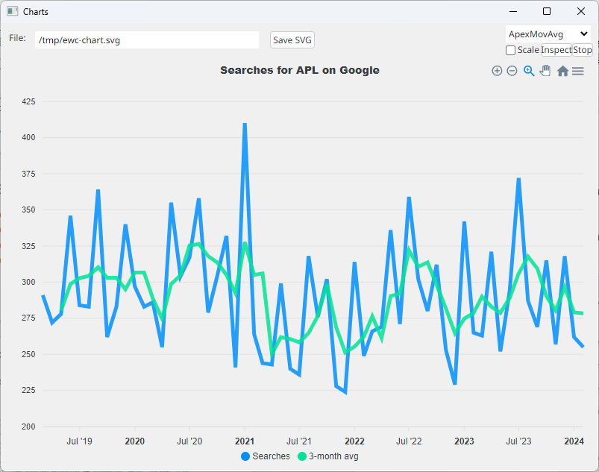
Additional Classes in EWC (ApexCharts)

Slide 14
Migration Tools
deltaWI: Migrate ⎕WI (APL+Win / MicroAPL) GUI to ⎕WC (Dyalog APL)
EWC: Migrate ⎕WC (Windows) to Linux, macOS,
and the Web
ATFIN: Read APL Transfer Format files and perform translation to DyalogAPL
  Includes emulation of many APL+Win system functions
Focus has been on working with launch customers, rather than publishing the tools – we will do that now.
Davin Church will rewrite the ⎕WI emulator this Winter

Slide 15

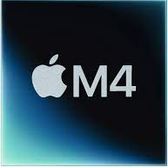
Rise of the ARM64
v19.0 Raspberry Pi & "New" Apple Macs
v20.0 ARM64 Linux w/ Docker containers
v21.0 Possible Experiments
  ARM64 Windows
  Maybe even Android
  Not "supported", but available for experimentation

Slide 16
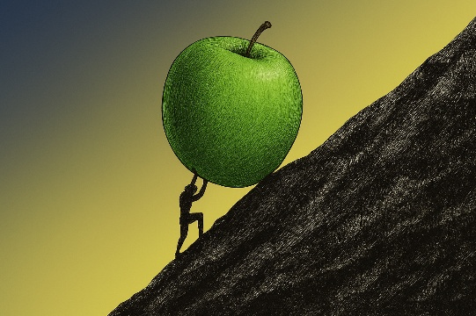
.NET Generics
The use of generic classes and methods in .NET
libraries is spreading like wildfire.
v20.0
⎕NEW GenericClass (43⌶632) T1 T2
(GenericClass (43⌶632) T1 T2).StaticMember args
v21.0
⎕NEW GenericClass[T1 T2]
GenericClass[T1 T2].StaticMember args
+ Export APL code with generic signatures

Slide 17
⎕SHELL to replace complement ⎕CMD
Execute External Programs from APL
Interruptible
Manage stdin, stdout & stderr (& other streams) independently
Handle variety of data encodings
Optionally return data as an asynchronous stream
Select which shell to use
  Defaults to PowerShell under MS Windows and /bin/sh elsewhere
  Can also invoke programs directly, bypassing shell overhead

Slide 18
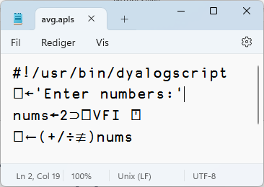
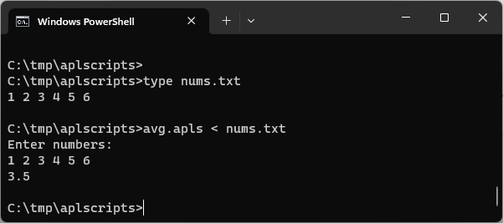
"Script Engine"
#! (hash bang) scripting
Script engine is popular with new users
AND "Continuous Integration" engineers
Has been gradually enhanced for
several releases
Will be further improved in v21.0
  RIDE debugging of scripts

Slide 19

Link Enhancements
Recent Highlights:
-text=plain
  Simple representations of character data
-preloaded
  Create links to pre-loaded workspace content
  Useful when you have thousands of source files
To come:
The "crawler"
  To find things the File System Watcher will miss

Slide 20
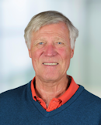
Miscellaneous
New Open-Source Documentation Format
Pete Donnelly
(finally retired)

Slide 21
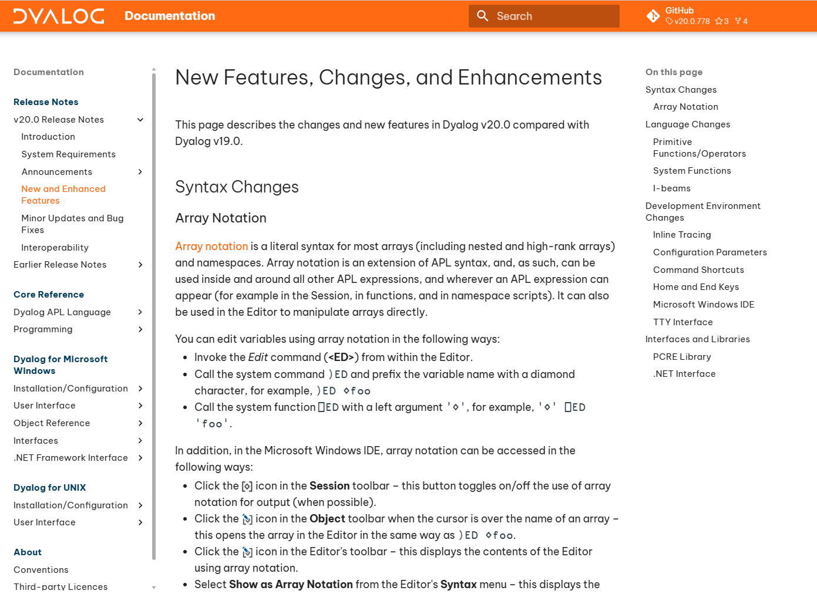
docs.dyalog.com/20.0

Slide 22
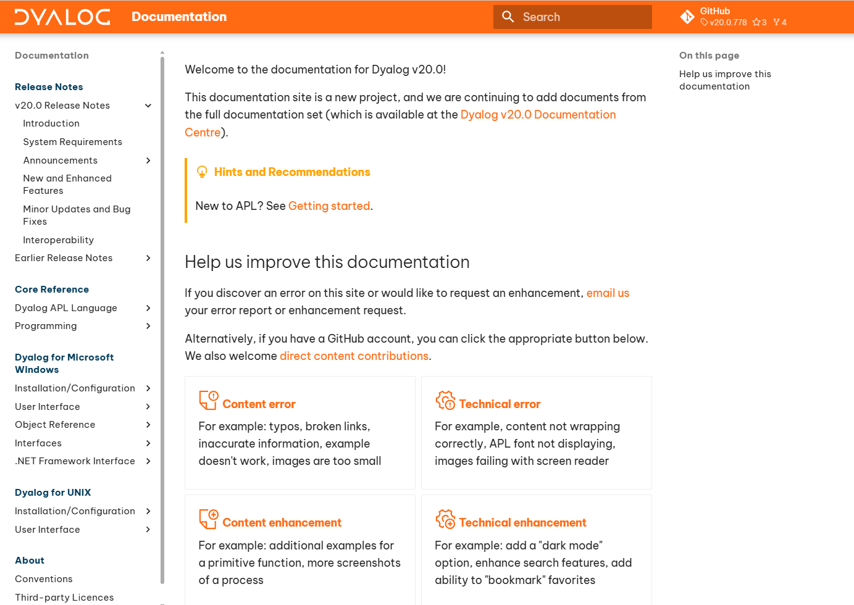
Open-Source!

Slide 23
Miscellaneous
New Documentation Format
Kafka Interface
⎕NINFO
  Set File Attributes
  Progress Callbacks for long-running moves & copies
Platform Features
Pete Donnelly
(finally retired)

Slide 24
Platform Features: 4075⌶⍬
(undocumented – future ⎕PLATFORM)
(⎕JSON⍠'Compact' 0) 4075⌶⍬
{
"CommandLine": {
"Args": ["C:\\...\\Dyalog APL-64 20.0 Unicode\\dyalog.exe",
"CONFIGFILE=C:\\tmp\\dcfg\\200U64.dcfg"],
"CodeArgs": ["C:\\...\\Dyalog APL-64 20.0 Unicode\\dyalog.exe",
"CONFIGFILE=C:\\tmp\\dcfg\\200U64.dcfg"],
"Full": "\"C:\\...\\Dyalog APL-64 20.0 Unicode\\dyalog.exe\"
CONFIGFILE=\"C:\\tmp\\dcfg\\200U64.dcfg},
"CurrentDirectory": "C:\\Users\\mkrom\\Desktop",
"DirectorySeparator": "\\",
"Executable": {
"Bits": 64,
"BuildTarget": "win",
"BuildType": "opt",
"Path": "C:\\...\\Dyalog APL-64 20.0 Unicode\\dyalog.exe",
"RideConnected": 0,
"Runtime": 0,
"Unicode": 1,
"Version": [20, 0, 51721],
"VersionMoniker": "200U64",
"VersionNumber": 20},
"Features": {
"DDE": 1,
"DotNet": [4, 0, 30319],
"Interactive": 1,
"OLE": 1,
"PCRE": [10, 44]},
"Host": {
"ComputerName": "MKROM-LENOVOE16",
"DNSDomainName": "dyalog.bramley",
"EffectiveUserId": -1,
"EffectiveUserName": "",
"FQDN": "MKrom-LenovoE16.dyalog.bramley",
"GroupId": "S-1-5-21-3838592348-3279234526-3710572232",
"GroupName": "",
"NetBIOSDomainName": "MKROM-LENOVOE16",
"UserId": "1110",
"UserName": "mkrom"},
"OS": {
"Bits": 64,
"Description": "Windows",
"DirectorySeparator": "\\",
"Family": "Windows",
"LibcPath": "",
"Newline": [13, 10],
"NullDevice": "nul",
"PathSeparator": ";",
"SharedLibraryExtension": ".dll",
"TempDirectory": "C:/Users/mkrom/AppData/Local/Temp",
"UTCOffset": 2,
"Version": [10, 0, 26100],
"VolumeSeparator": ":"},
"Process": {
"CurrentDirectory": "C:\\Users\\mkrom\\Desktop",
"Id": 10024,
"InitialDirectory": "C:\\Users\\mkrom\\Desktop",
"LaunchTarget": "",
"ParentId": -1},
"Runtime": 0,
"Unicode": 1,
"VersionNumber": 20}

Slide 25
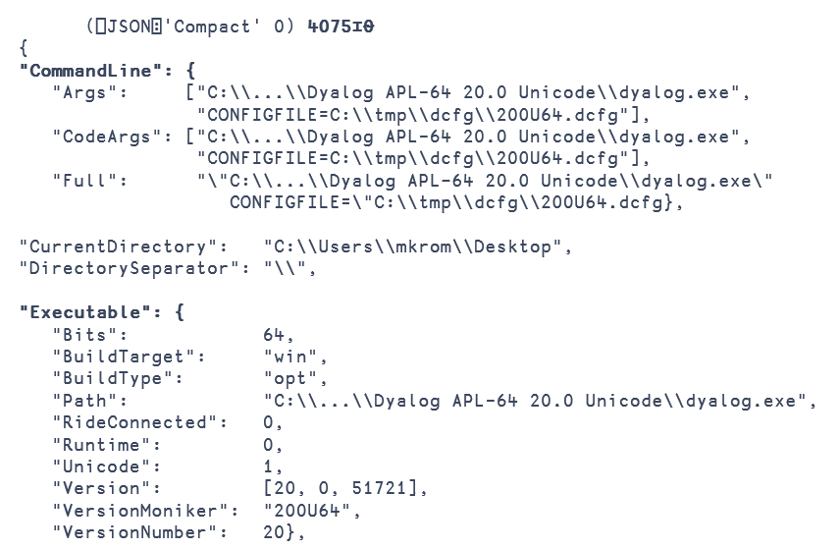

Slide 26

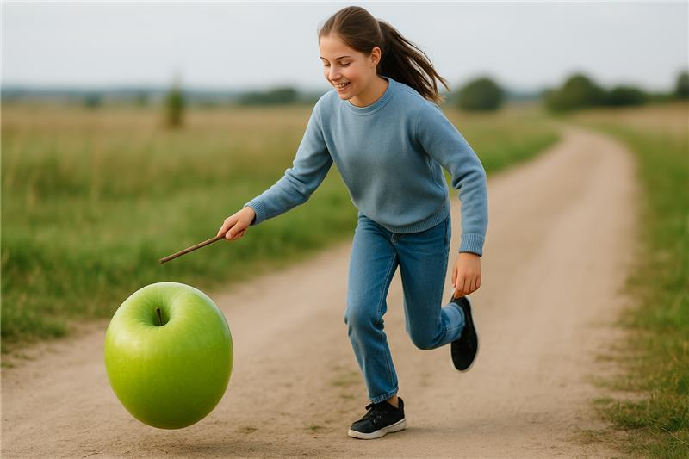
Less Usual Business
Language enhancements
  Array Notation
  VGET & VPUT
  Reverse Compose
Inline Tracing

Slide 27
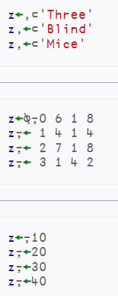
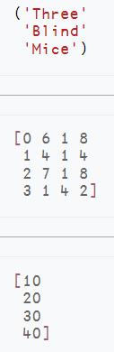
Array Notation
≡
≡
≡

Slide 28
Namespace Notation
⎕VGET and ⎕VSET
people← (name: 'Jack' ⋄ weight:75) (name: 'Jill')
people.name
Jack Jill
people.weight
VALUE ERROR: Undefined name: weight
people.weight
∧
people ⎕VGET 'name' ('weight' 50) ⍝ Default weight to 50
Jack 75 Jill 50
people[1].⎕VGET ¯2 ⍝ Get all class 2 names
name Jack weight 75

Slide 29
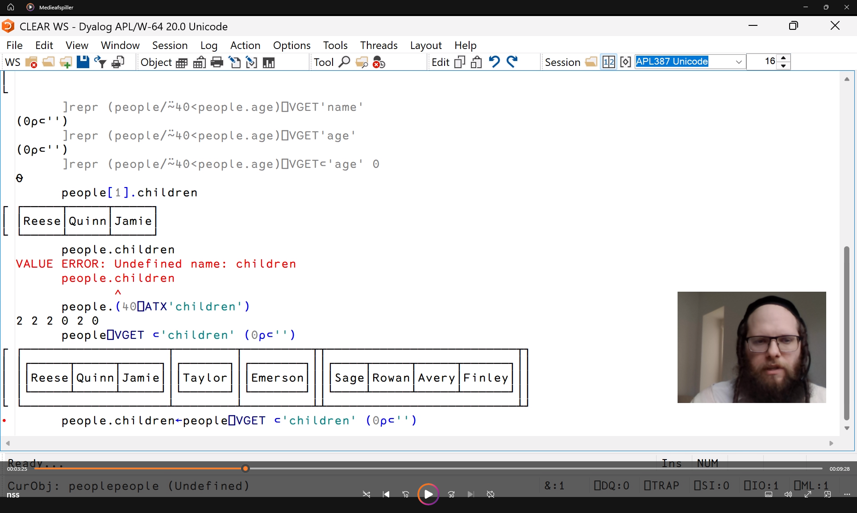
Insert screen shot of Adam here
Adam Brudzewsky
v20.0 Videos

Slide 30
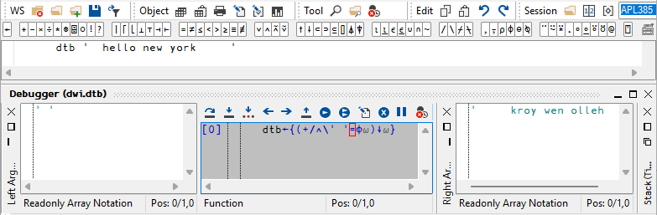
Inline Tracing

Slide 31
Behind / Reverse Compose
(the "missing combinator")
Monadic: f⍛g ⍵ ⬅➔ (f ⍵) g ⍵
f←5∘< ⍝ Predicate function
f⍛⌿ 2 7 1 8 2 8 ⍝ Filter by f
7 8 8
⌈/⍛= 2 7 1 8 2 8 3 ⍝ Max behind Equal
0 0 0 1 0 1 0

Slide 32

The Longer Perspective

Slide 33
Data Science
AI / LLMs
Async / Parallel
Static Analysis
APL Libraries
Compilation

Slide 34
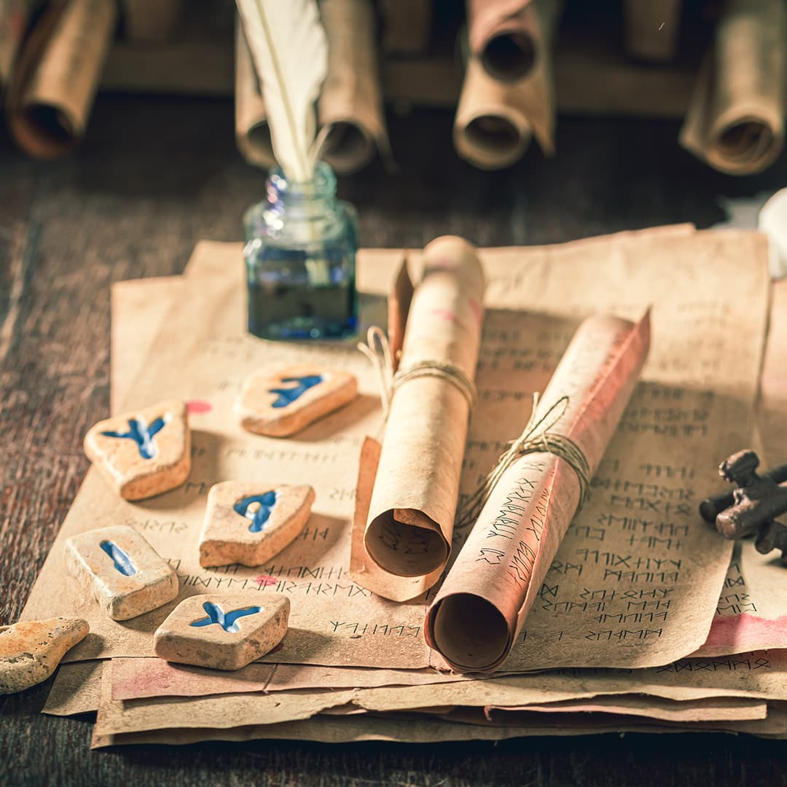
APL Source Code as Text
Foundation for much modern tooling
Link 4.1 with v20.0 is "mature"
v21.0 interpreter to load text source w/out Link
  Create foundation for loading modules or libraries
Link will be enhanced & maintained
  To support features required by applications that started out with binary code structures

Slide 35
⎕IMPORT and :Insert
myns.apln
part1.apls
part2.apls
:Module
Export: 'foo'
Init: 'Setup'
:EndModule
:Include goo
∇foo
goo
∇
∇goo
∇
:Namespace myns
:Insert part1
:Insert part2
calc←{foo goo hoo ⍵}
:EndNamespace
∇foo
⎕←⎕NL ¯3
∇
∇goo
...
∇
∇hoo
...
∇
myns←⎕IMPORT 'myns.apln'
myns.foo
calc foo goo hoo
NB This syntax is
not confirmed!

Slide 36

APL Libraries
Work on the package manager for APL (Tatin)
Command-line interface to install packages
Language support for loading modules will simplify implementation of Tatin
Write more packages
  Statistics libraries
  General utilities
  Other stuff

Slide 37
Open-Source Interfaces
We cannot open-source the language engine
Most tools written in APL are free & open
  And destined for the Package Manager
We will now open-source some C code
This will allow
  Community Contribution
  Inspection & Verification
  Easier compliance with open-source licencing
Done
Kafka Interface
Planned for v21.0
HTMLRenderer (Chromium)
Conga (TCP / UDP)
"Later"
Cryptographic Library

Slide 38
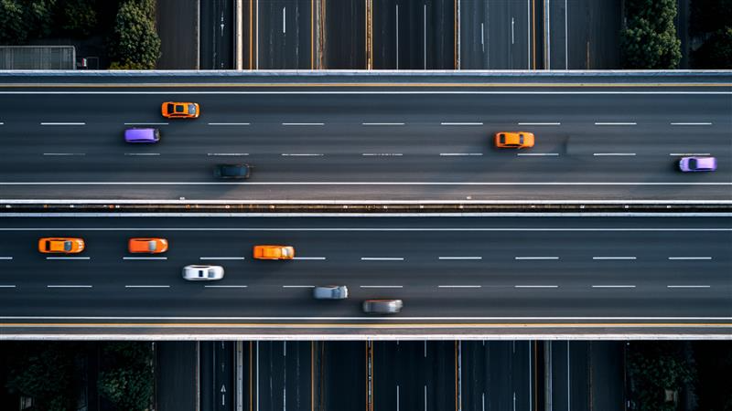
Async / Parallel

Slide 39
Parallel / Async Operator ∥
Implement a primitive operator ∥ which can invoke functions asynchronously
  A future is immediately returned (as with isolates today)
  The interpreter will block automatically if the value is used and has not materialised.
Multiple architectures will be supported simultaneously
  Isolates (remote processes w/TCP sockets)
  "Green threads" (as the existing & operator)
  Multiple interpreters running on separate O/S threads within the same process

Slide 40


Compilation
The ∥ operator will support parallelism using multiple interpreters
Effective use of GPUs
requires a compiler
Enter co-dfns
Or is it cod-fns ?

Slide 41

Static Analysis of APL Code
Static Analysis of application code is seen as a required "best practice" by many corporations
We are building a prototype of a tool which will
  Detect vulnerabilities and other bad practices
  "Lint" APL Code
This tool will initially be licensed separately
  A free "community edition" may follow later
Will be tested by first two clients at the end of this year

Slide 42

Large Language Models / AI
No presentation can be complete without mention of Artificial Intelligence

Slide 43

Large Language Models / AI
No presentation can be complete without mention of Artificial Intelligence
Mark Wolfson will talk about how they can be used to add functionality to APL systems
Stefan Kruger is up next to talk about his journey, investigating the potential of current LLMs to help us develop APL code

Slide 44
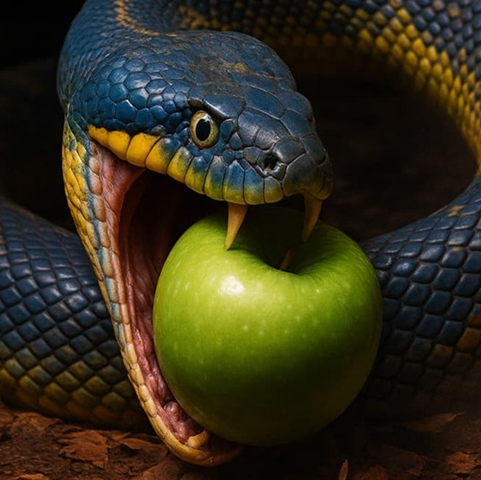


Data Science
APL used to be the best tool for DS
Today, Python has more, better libraries
We are building a team to understand
  Where the opportunities are for APL
  How to make ourselves more visible
  Where we need to improve to be competitive
  How to share tools & data with Python

Slide 45
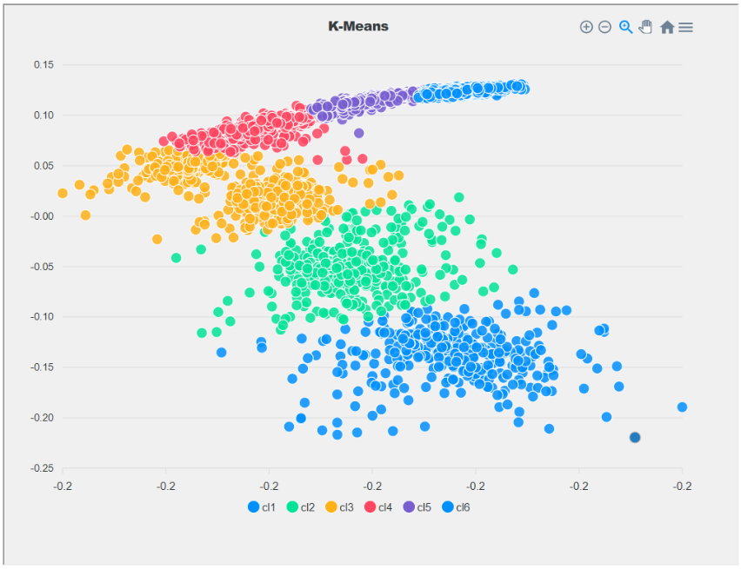
Data Science Findings
We need to work on:
Faster Data Loading
Faster Matrix Multiplication
Easy access to LLMs
New Visualisation Tools
Arrow & Parquet Data Formats
Python Integration
  Use Python packages from APL
  Use APL as a package from Python

Slide 46
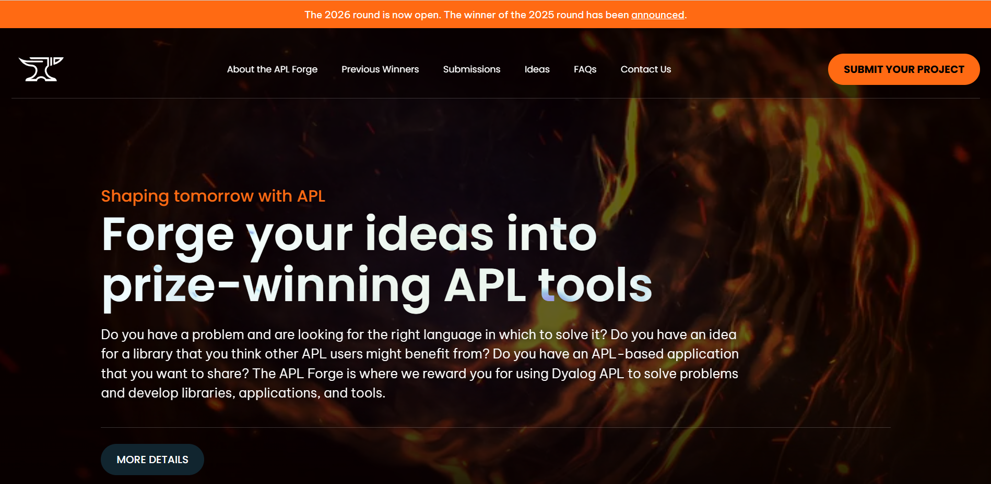
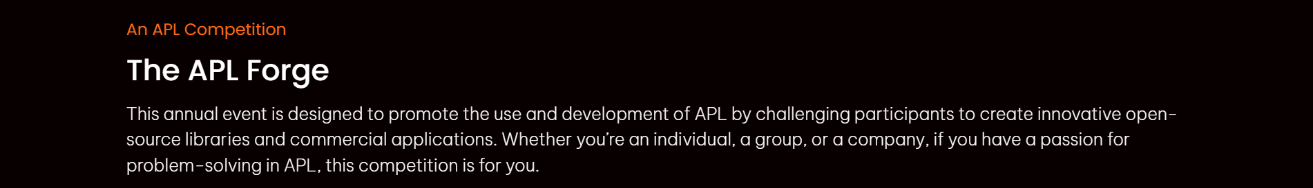

Slide 47

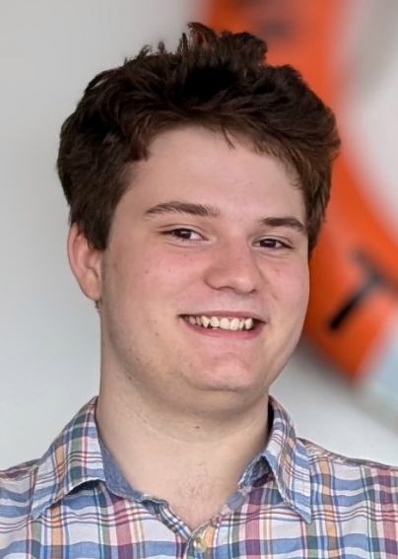
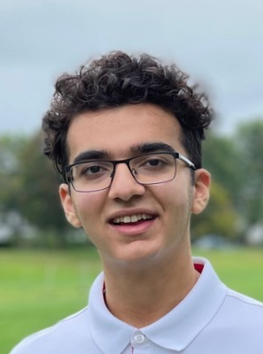
Winners
2024 Holden Hoover
Radar Ingest System
2025 Borna Ahmadzadeh
APLearn – Machine Learning

Slide 48
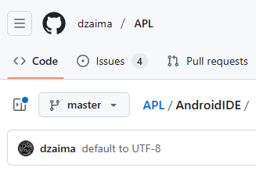
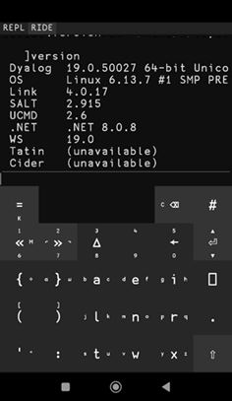
Open-Source helps
Drive Engagement
The Remote IDE (Ride)
and the Ride protocol are open
"dzaima" is a former
Problem-Solving Contest winner and has his own APL interpreter
Suddenly one day …

Slide 49

Building the Team
Recruit in good time
  New recruits provide much-needed inspiration to go after new business
  But need to learn from the experienced crew
Offer Consulting & Training
  Stay in close contact with existing users
  Help new users build modern APL systems

Slide 50
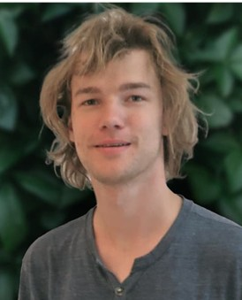
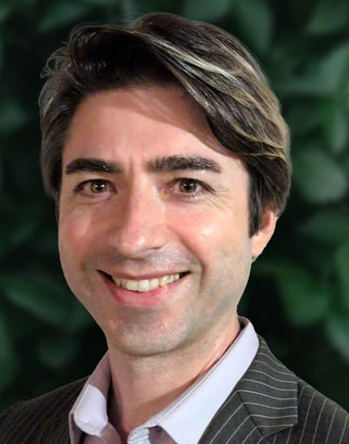
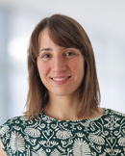
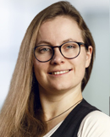
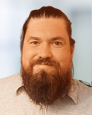
Recent Hires
Asher
APL+C
UK Oct 25
(Intern in 23 & 24)
Brandon
APL
Japan Jan 25
Martina
APL+C
Denmark Aug 24
Andrea
CEO Assist.
Denmark Oct 24
Neil
JS+APL
Germany Sep 24

Slide 51
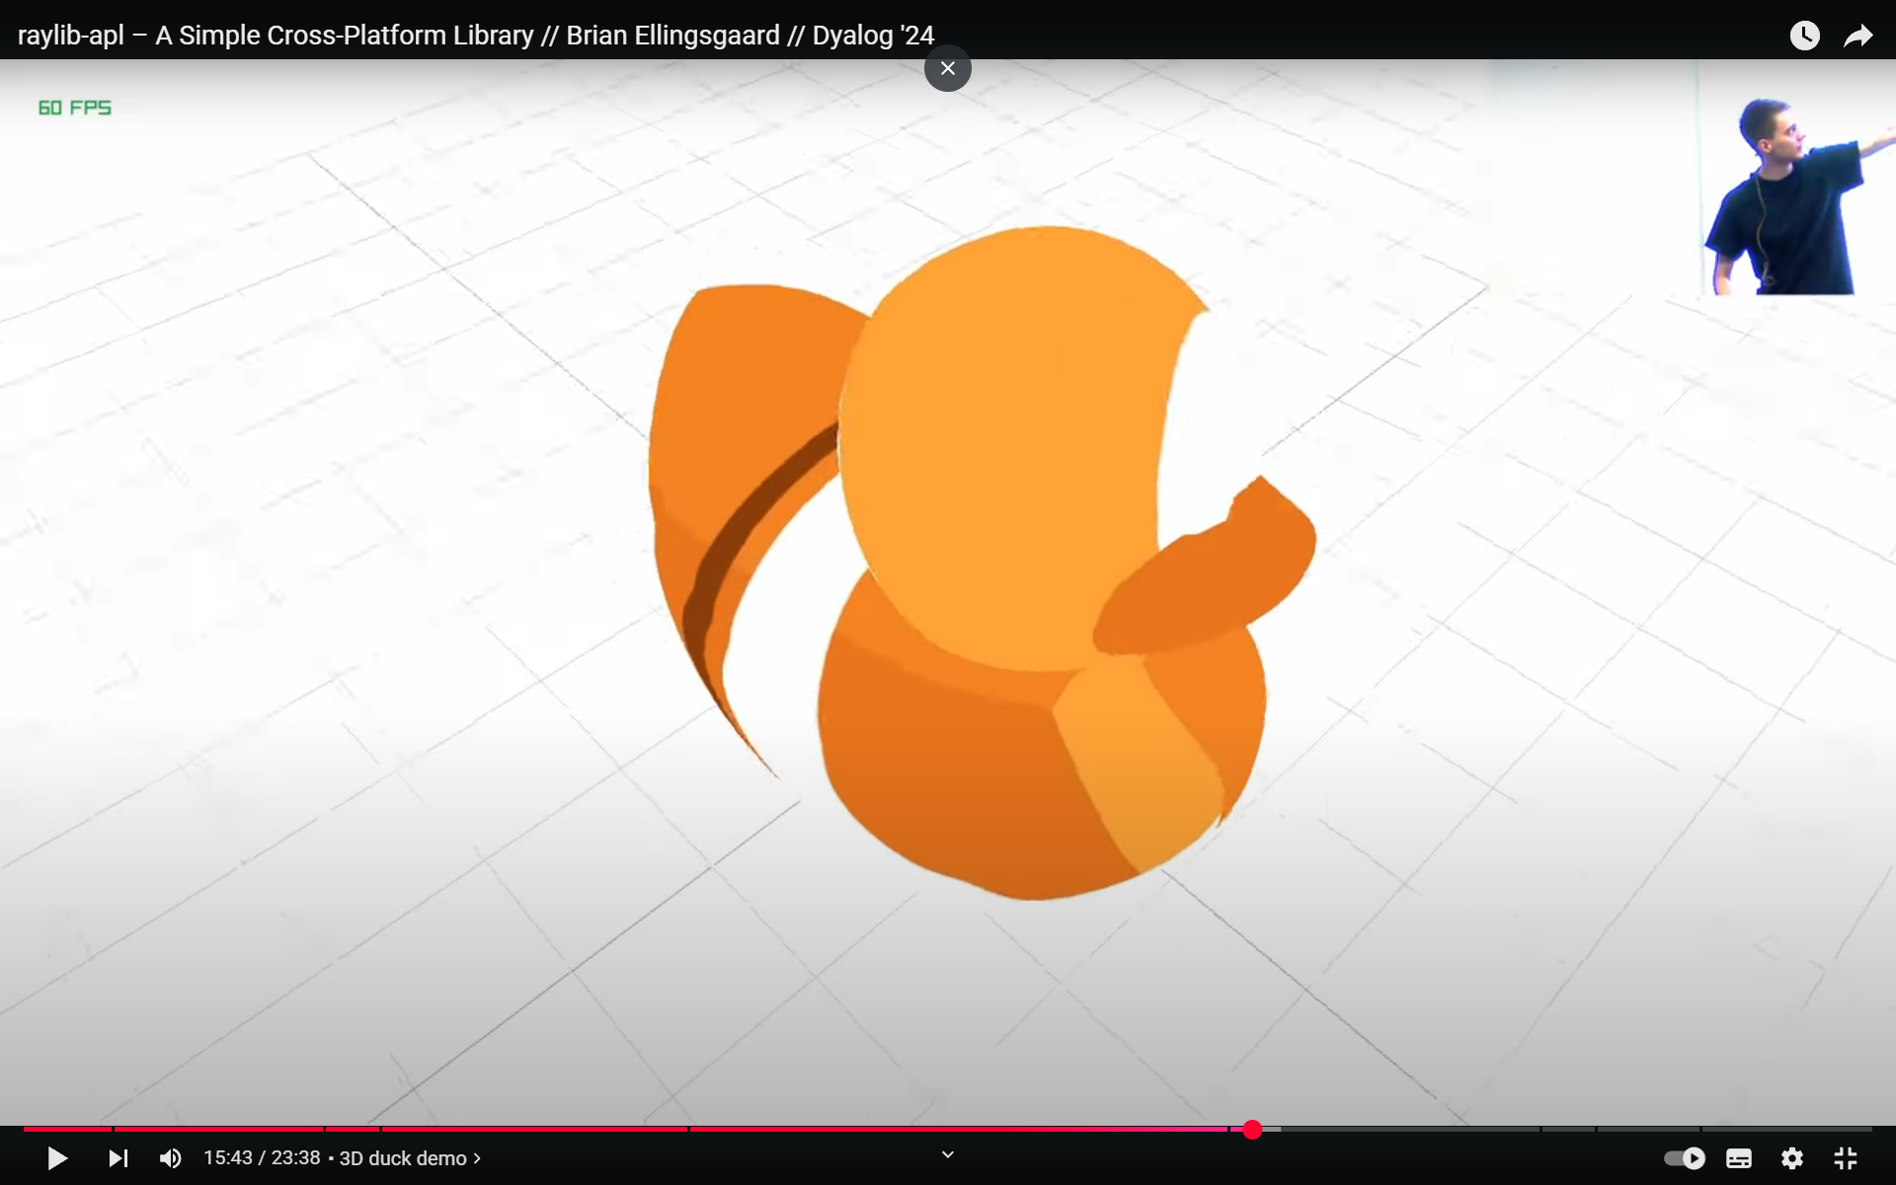
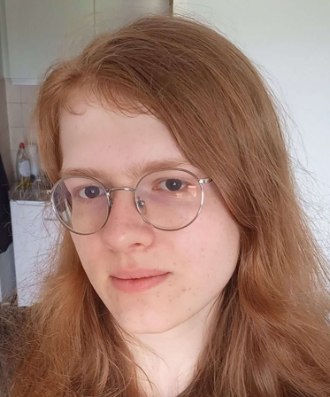
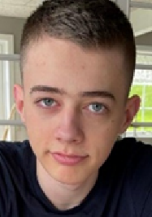
Interns!
Asher
Kamila
Brian
raylibAPL

Slide 52
The Plan is Unchanged
Continue to grow the revenue base
Customers use of APL is growing
Migrants keep arriving
Grow and replenish the team
Hire new people in good time before old-timers retire
Hunt the new generation of users
Get back into data science & education
Continue to position APL in the functional community

Slide 53
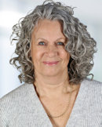

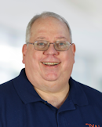
A big THANK YOU to ...
Mike Mingard provided invaluable help with the images.
A ton of Admin work behind the scenes by
Karen Shaw and Jada Andrade
Behind and on
the scene:
Brian Becker

