Slide 1

AVG - A Voxel Game
Exploring Dyalog APL and Game Programming
Kyle Croarkin — croarkin.kyle@gmail.com

Slide 2
Quick Warning
Fair amount of APL
Fair amount of game/graphics concepts
Don’t worry about understanding both — enjoy the ride.
Notes:
Stumbled upon APL and found notation fascinating
Aplers make interesting claims and want to verify for self
Most examples online centered around AoC/code snippets/short problems
Or yaml/codfns
- Get an experience doing APL for bigger problems

Slide 3
Overview
Overview
Demo
Code example
Positives
Difficulties
Conclusion
Notes:
Stumbled upon APL and found notation fascinating
Aplers make interesting claims and want to verify for self
Most examples online centered around AoC/code snippets/short problems
Or yaml/codfns
- Get an experience doing APL for bigger problems

Slide 4
Using APL for a larger project?
Got fascinated by APL
APLers make interesting claims
Notes:
- APLers make a lot of interesting claims about how using APL is substantially different from traditional programming

Slide 5
Using APL for a larger project?
Got fascinated by APL
APLers make interesting claims
Most examples online:
  Short code snippets/Problem solving competition
  High barrier of entry (Co-dfns/YAML parser)
Notes:
- Most examples online “problem solving code”
- Better examples have high barrier of entry

Slide 6
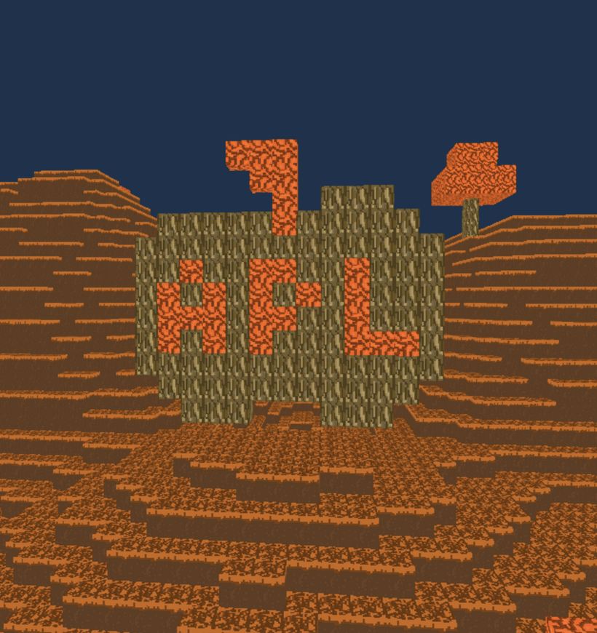
Using APL for a larger project?
Got fascinated by APL
APLers make interesting claims
Most examples online:
  Short code snippets/Problem solving competition
  High barrier of entry (Co-dfns/YAML parser)
Want to experiment APL in a domain I’m familiar with
Notes:
- Goal: experiment with APL in domain im familiar with (graphics programming)

Slide 7
What to do?
People who got into programming cause of video games usually..
Notes:
I got into programning to make video games or mod them — people who got into programming due to this usually…

Slide 8
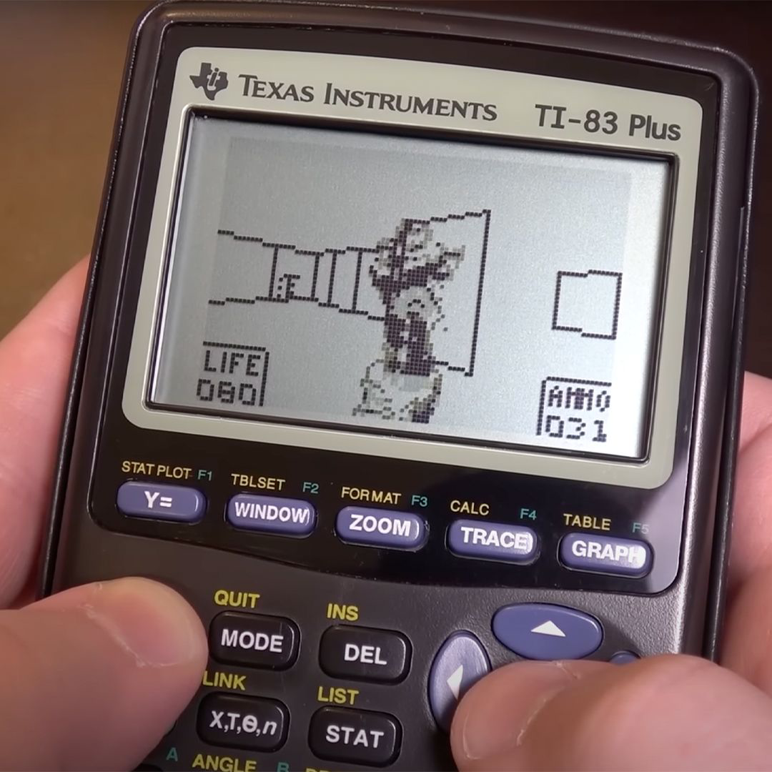
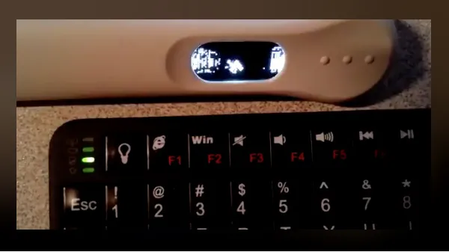
What to do?
People who got into programming cause of video games usually..
Make Doom run on it

Slide 9

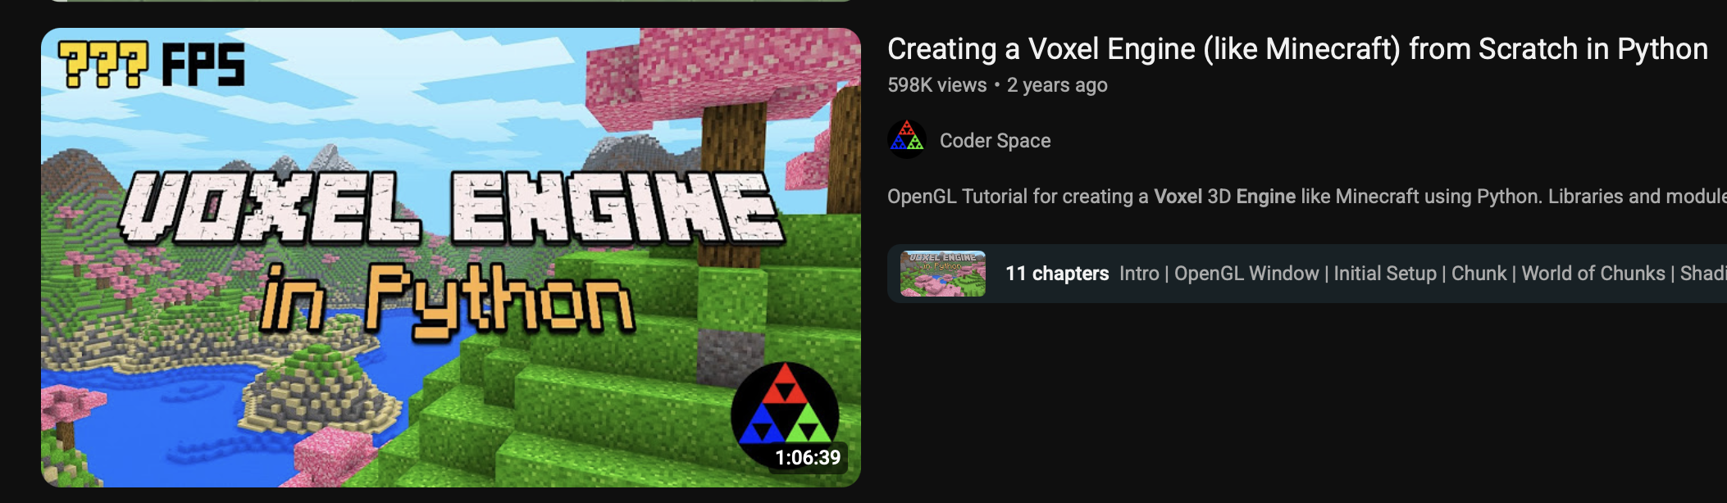
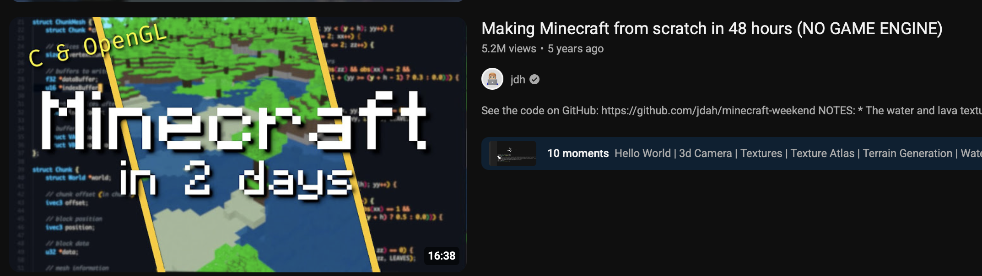
What to do?
People who got into programming cause of video games usually..
Make Doom run on it
Write a Voxel game on it
Notes:
In a foreign environment…

Slide 10
What to do?
People who got into programming cause of video games usually..
Make Doom run on it
Write a Voxel game on it
Notes:
Works well with APL notation

Slide 11
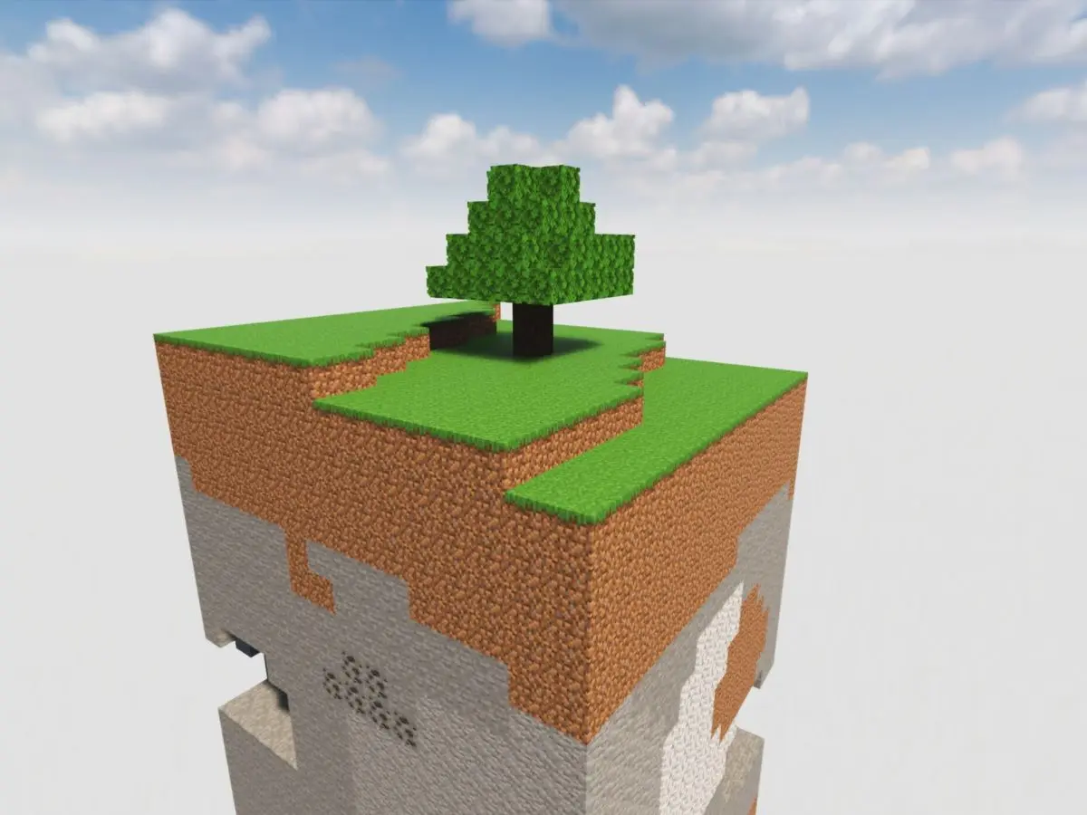
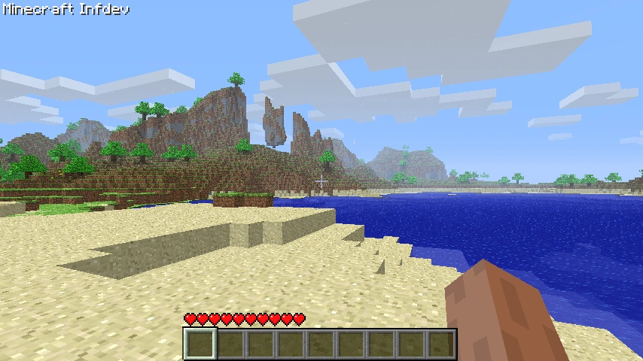
A Voxel Game?
Famous Example: Minecraft
World of 3d blocks that can be placed or destroyed
Blocks subdivided into chunks
Need to see if language is expressive enough to handle game programming
  And if I can handle writing APL…
Notes:
World of 3d blocks that goes for near-infinite distances with worlds that are generated
Player can move around and place and destroy different blocks
Architecturally, blocks are grouped into chunks, (16, 384, 16)

Slide 12
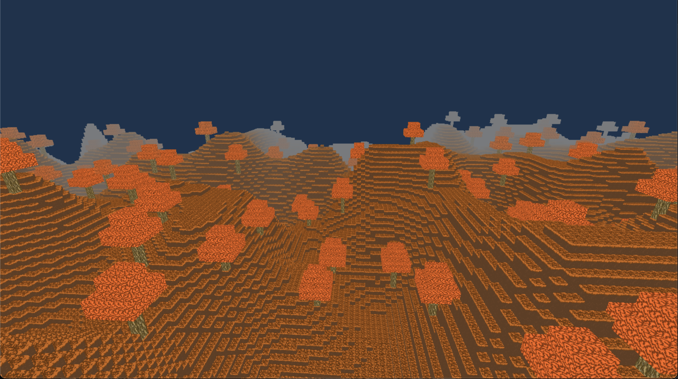
Showcase
Well..?

Slide 13

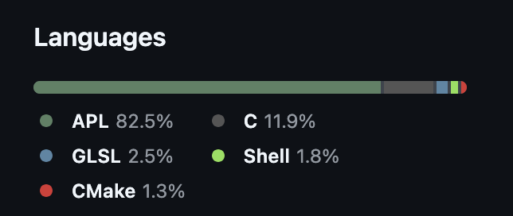
Broad Project Structure
Cross-platform library for windowing and event handling
New low level wrapper over modern graphics apis
Other goodies
Notes:
SDL3
Provides windowing and event handling with a c library
Low level wrapper over modern directx/vulkan/metal
Why I chose it over raylib
- Image handling, font handling

Slide 14
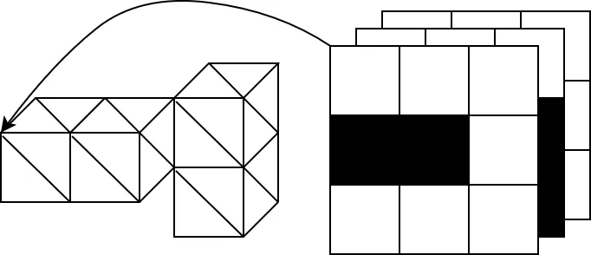
Snippet Example
l ← 16 128 16
box ← ⊃∘.∨/1@0¨l-⍛↑¨1
faces ← [
0 1 0 ⋄ 0 1 1 ⋄ 0 0 1 ⋄ 0 0 0 ⍝ Left
1 1 1 ⋄ 1 1 0 ⋄ 1 0 0 ⋄ 1 0 1 ⍝ Right
1 0 0 ⋄ 0 0 0 ⋄ 0 0 1 ⋄ 1 0 1 ⍝ Bottom
0 1 0 ⋄ 1 1 0 ⋄ 1 1 1 ⋄ 0 1 1 ⍝ Top
1 1 0 ⋄ 0 1 0 ⋄ 0 0 0 ⋄ 1 0 0 ⍝ Back
0 1 1 ⋄ 1 1 1 ⋄ 1 0 1 ⋄ 0 0 1 ⍝ Front
]
vertices←,[⍳2]faces+⍤1⍤2 1⊢⍉l⊤⍳×/l
indices←,0 1 2 0 2 3∘.+⍨4×⍳4÷⍨≢vertices
∇ info←Copy_chunk(chunk ptr offset);flat;solid;edges;exposed;m;vert
flat←∊chunk
solid←chunk≠0
edges←solid∧box
exposed←↑[0]{edges∨solid>⍵}¨0 1 2∘.{⍵⌽[⍺]solid}¯1 1
vert←vertices⌿⍨4/m←∊exposed
...
Converting chunk data to vertex data
Need to convert a 3d array of block types to geometry to be rendered.
Notes:
We store chunks as 3d arrays where 0 indicates air, other numbers indicate solid blocks
Need to convert it to a geometrical representation to pass to the GPU to be rendered
Example snippet that shows how positions of a geometries are generated

Slide 15
Intuition
Have one data structure representing the possible amount of faces of the chunk that can be rendered and have chunks select the faces they need when converting them
Let’s go through it with a 3-by-3-by-3 chunk.
×/3 3 3
27
Possible number of blocks in a chunk
Notes:
Broad idea:
Have one data structure representing all the possible faces of a chunk
Chunks that need to be converted to geometrical representation select relevant faces
Example with a 3-3-3 instead of 3-128-3

Slide 16
Intuition
Have one data structure representing the possible amount of faces of the chunk that can be rendered and have chunks select the faces they need when converting them
Let’s go through it with a 3-by-3-by-3 chunk.
⍳×/3 3 3
0 1 2 ... 24 25 26
Indices of blocks in a chunk

Slide 17
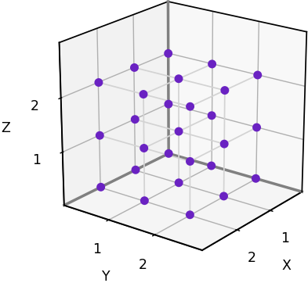
Intuition
3 3 3⊤⍳×/3 3 3
0 0 0 . . . 2 2 2
0 0 0 . . . 2 2 2
0 1 2 . . . 0 1 2
Convert indices into “chunk size” numbering system
Notes:
I like to think of it as “base chunk shape”

Slide 18
Intuition
⍉3 3 3⊤⍳×/3 3 3
0 0 0
0 0 1
0 0 2
. . .
2 2 0
2 2 1
2 2 2
Transpose so each row is a position
Notes:
Want each row to be a position instead of column

Slide 19
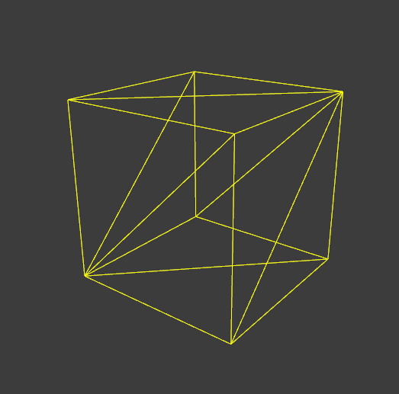
Intuition
faces←[
0 1 0 ⋄ 0 1 1 ⋄ 0 0 1 ⋄ 0 0 0 ⍝ Left
1 1 1 ⋄ 1 1 0 ⋄ 1 0 0 ⋄ 1 0 1 ⍝ Right
1 0 0 ⋄ 0 0 0 ⋄ 0 0 1 ⋄ 1 0 1 ⍝ Bottom
0 1 0 ⋄ 1 1 0 ⋄ 1 1 1 ⋄ 0 1 1 ⍝ Top
1 1 0 ⋄ 0 1 0 ⋄ 0 0 0 ⋄ 1 0 0 ⍝ Back
0 1 1 ⋄ 1 1 1 ⋄ 1 0 1 ⋄ 0 0 1 ⍝ Front
]
l←3 3 3
A←faces+⍤1⍤2 1⊢⍉l⊤⍳×/l
⍴A ⍝ Test getting shape
27 24 3
Add vertices of a cube to each position
Notes:
To render a cube takes 24 vertices. GPU renders triangles
4 vertices for each face
Can think of each face as having 2 right angled triangles sharing 4 edges
We use the rank operator twice to add cube positions as a 2d array row-by-row onto each row of the possible positions
We get a shape of 27 24 3, so each possible block is now its position plus vertices

Slide 20
Intuition
faces←[
0 1 0 ⋄ 0 1 1 ⋄ 0 0 1 ⋄ 0 0 0 ⍝ Left
1 1 1 ⋄ 1 1 0 ⋄ 1 0 0 ⋄ 1 0 1 ⍝ Right
1 0 0 ⋄ 0 0 0 ⋄ 0 0 1 ⋄ 1 0 1 ⍝ Bottom
0 1 0 ⋄ 1 1 0 ⋄ 1 1 1 ⋄ 0 1 1 ⍝ Top
1 1 0 ⋄ 0 1 0 ⋄ 0 0 0 ⋄ 1 0 0 ⍝ Back
0 1 1 ⋄ 1 1 1 ⋄ 1 0 1 ⋄ 0 0 1 ⍝ Front
]
l←3 3 3
A←faces+⍤1⍤2 1⊢⍉l⊤⍳×/l
⍴A ⍝ Test getting shape
27 24 3
⊢A←3 2⍴⎕A
AB
CD
EF
⊢B←2 2⍴⎕D
01
23
B {⎕←⍺ ⍵}⍤2 1 ⊢ A
01 AB
23
01 CD
23
01 EF
23
B {⎕←⍺ ⍵}⍤1⍤2 1 ⊢ A
01 AB
23 AB
01 CD
23 CD
01 EF
23 EF
Add vertices of a cube to each position
Notes:
Good visual example to understand how rank works

Slide 21
Intuition
faces←[
0 1 0 ⋄ 0 1 1 ⋄ 0 0 1 ⋄ 0 0 0 ⍝ Left
1 1 1 ⋄ 1 1 0 ⋄ 1 0 0 ⋄ 1 0 1 ⍝ Right
1 0 0 ⋄ 0 0 0 ⋄ 0 0 1 ⋄ 1 0 1 ⍝ Bottom
0 1 0 ⋄ 1 1 0 ⋄ 1 1 1 ⋄ 0 1 1 ⍝ Top
1 1 0 ⋄ 0 1 0 ⋄ 0 0 0 ⋄ 1 0 0 ⍝ Back
0 1 1 ⋄ 1 1 1 ⋄ 1 0 1 ⋄ 0 0 1 ⍝ Front
]
l←3 3 3
A←,[⍳2]faces+⍤1⍤2 1⊢⍉l⊤⍳×/l
⍴A ⍝ Test getting shape
648 3
Collapse it in 2d form
Notes:
Collapse it into 2d form since I want all possible vertices of a chunk in that form

Slide 22
What to do with that?
27 ↑4 8 ⍝ Take 27 from 2, 0 rest
4 8 0 0 0 0 0 0 0 0 0 0 …
3 3 3⍴27 ↑4 8 ⍝ Form of a 3d array
4 8 0
0 0 0
0 0 0
0 0 0
0 0 0
0 0 0
0 0 0
0 0 0
0 0 0
We can select relevant faces from A relatively easily by doing the following.
Example mock data
Notes:
Example of a chunk with block types of 4 and 8 next to each other in form of 3-3-3 array

Slide 23
What to do with that?
What’s the size if we flatten and duplicate each element by 24?

Slide 24
What to do with that?
What’s the size if we flatten and duplicate each element by 24?
⍴24/27 ↑4 8
648
Notes:
Same as all possible amount of vertices

Slide 25
What to do with that?
What’s the size if we flatten and duplicate each element by 24?
⍴24/27 ↑4 8
648
Can’t we just select along rows where they’re not 0?

Slide 26
What to do with that?
What’s the size if we flatten and duplicate each element by 24?
⍴24/27 ↑4 8
648
(24/0≠27 ↑4 8)⌿A
0 1 0
0 1 1
0 0 1
0 0 0
...
0 1 2
1 1 2
1 0 2
0 0 2
Can’t we just select along rows where they’re not 0?
Yeah.
Notes:
Gives us all the positions needed to render 2 cubes

Slide 27
What to do with that?
What’s the size if we flatten and duplicate each element by 24?
What if I wanted to add color or something?
⍴24/27 ↑4 8
648
(24/0≠27 ↑4 8)⌿A
0 1 0
0 1 1
0 0 1
0 0 0
...
0 1 2
1 1 2
1 0 2
0 0 2
Can’t we just select along rows where they’re not 0?
Yeah.

Slide 28
What to do with that?
What’s the size if we flatten and duplicate each element by 24?
What if I wanted to add color or something?
⍴24/27 ↑4 8
648
No problem!
B←(24/0≠27 ↑4 8)⌿A
B(,⍤1)255 0 0
0 1 0 255 0 0
0 1 1 255 0 0
0 0 1 255 0 0
0 0 0 255 0 0
...
0 1 2 255 0 0
1 1 2 255 0 0
1 0 2 255 0 0
0 0 2 255 0 0
(24/0≠27 ↑4 8)⌿A
0 1 0
0 1 1
0 0 1
0 0 0
...
0 1 2
1 1 2
1 0 2
0 0 2
Can’t we just select along rows where they’re not 0?
Yeah.
Notes:
Vertex attributes are interleaved
Simple catenate colors
Can ravel to get flattened data to pass

Slide 29
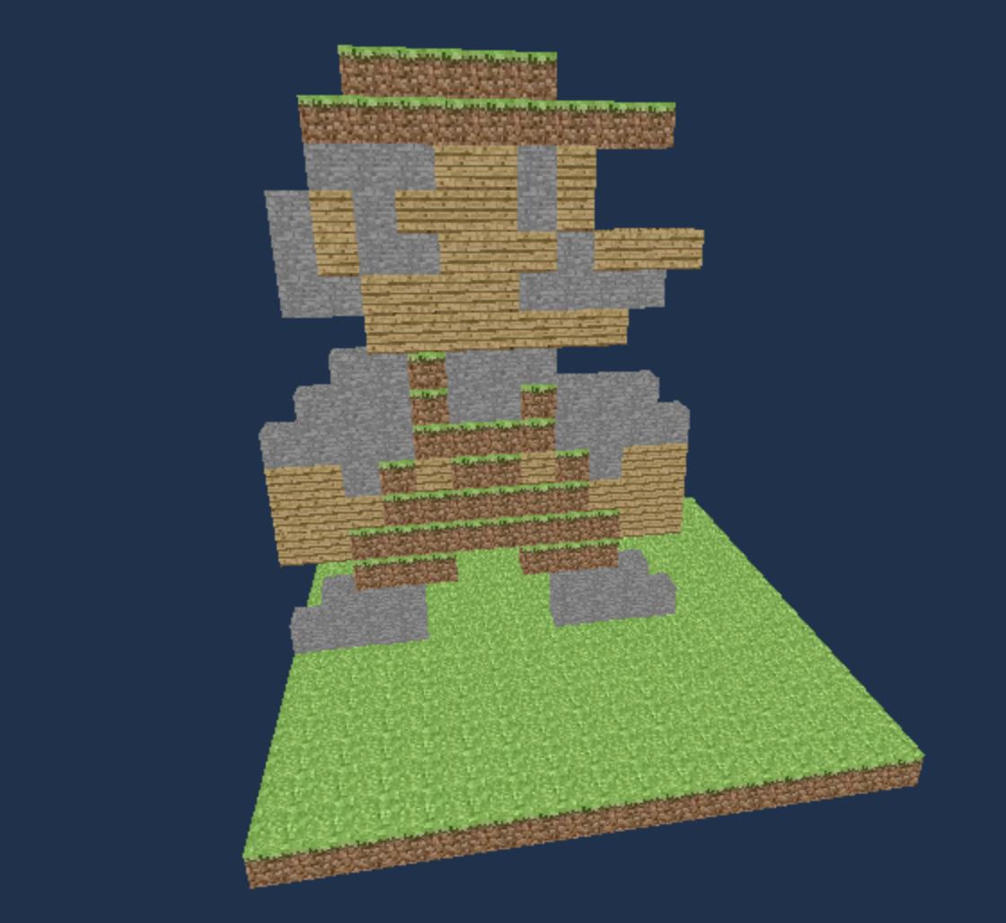
What to do with that?
blocks ← world.l⍴0
mario_stencil ← [
0 0 0 1 1 1 1 1 0 0 0 0
0 0 1 1 1 1 1 1 1 1 1 0
0 0 2 2 2 3 3 2 3 0 0 0
0 2 3 2 3 3 3 2 3 0 0 0
0 2 3 2 2 3 3 3 2 3 3 3
0 2 2 3 3 3 3 2 2 2 2 0
0 0 0 3 3 3 3 3 3 3 0 0
⍝ Head Stops here
0 0 2 2 1 2 2 2 0 0 0 0
0 2 2 2 1 2 2 1 2 2 2 0
2 2 2 2 1 1 1 1 2 2 2 2
3 3 2 1 3 1 1 3 1 2 3 3
3 3 3 1 1 1 1 1 1 3 3 3
3 3 1 1 1 1 1 1 1 1 3 3
0 0 1 1 1 0 0 1 1 1 0 0
0 2 2 2 0 0 0 0 2 2 2 0
2 2 2 2 0 0 0 0 2 2 2 2
0 0 0 0 0 0 0 0 0 0 0 0
]
blocks[8;;] ← 17 16↑⊖mario_stencil
blocks[;1;] ← 1
What’s the size if we flatten and duplicate each element by 24?
What if I wanted to add color or something?
⍴24/27 ↑4 8
648
No problem!
B←(24/0≠27 ↑4 8)⌿A
B, [255 0 0⋄]⍴⍨3,⍨≢B
0 1 0 255 0 0
0 1 1 255 0 0
0 0 1 255 0 0
0 0 0 255 0 0
...
0 1 2 255 0 0
1 1 2 255 0 0
1 0 2 255 0 0
0 0 2 255 0 0
(24/0≠27 ↑4 8)⌿A
0 1 0
0 1 1
0 0 1
0 0 0
...
0 1 2
1 1 2
1 0 2
0 0 2
Can’t we just select along rows where they’re not 0?
Yeah.
Notes:
Mario—one of first things tested
Experience amazed me. Made me realize power of APL.
Equivalent done in other languages would take significantly more long lines of code

Slide 30
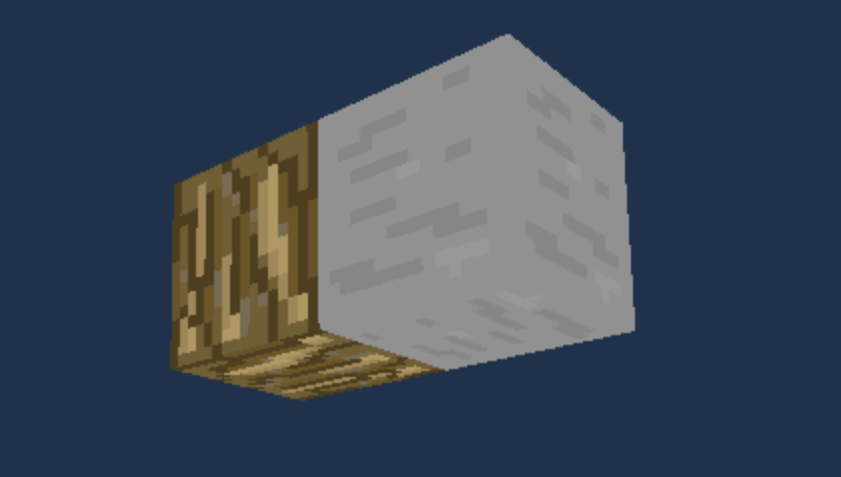
This renders occluded faces!
True!
Rotate the chunk in each of the 6 directions and compare it with itself to see if the face is visible (ignoring edges)
[1] solid←chunk≠0
[2] edges←solid∧box
[3] exposed←↑[0]{edges∨solid>⍵}¨0 1 2∘.{⍵⌽[⍺]solid}¯1 1
[4] vert←vertices⌿⍨4/m←∊exposed
Notes:
4 8 and would include faces that touch each other that would be sent to gpu and drawn - inefficient
Solve this by rotating each chunk in 6 directions and comparing rotated chunks with original to see which faces are visible, ignoring edges
Done here. Won’t go into details but line 3 is where the logic is at

Slide 31
[1] solid←chunk≠0
[2] edges←solid∧box
[3] exposed←↑[0]{edges∨solid>⍵}¨0 1 2∘.{⍵⌽[⍺]solid}¯1 1
[4] vert←vertices⌿⍨4/m←∊exposed
Does this look familiar?
Notes:
Broad idea: rotate data across cardinal and vertical directions in space and perform computation on that

Slide 32
[1] solid←chunk≠0
[2] edges←solid∧box
[3] exposed←↑[0]{edges∨solid>⍵}¨0 1 2∘.{⍵⌽[⍺]solid}¯1 1
[4] vert←vertices⌿⍨4/m←∊exposed
Does this look familiar?
life ← {⊃1 ⍵ ∨.∧ 3 4 = +/ +⌿ ¯1 0 1 ∘.⊖ ¯1 0 1 ⌽¨ ⊂⍵}

Slide 33
[1] solid←chunk≠0
[2] edges←solid∧box
[3] exposed←↑[0]{edges∨solid>⍵}¨0 1 2∘.{⍵⌽[⍺]solid}¯1 1
[4] vert←vertices⌿⍨4/m←∊exposed
Does this look familiar?
life ← {⊃1 ⍵ ∨.∧ 3 4 = +/ +⌿ ¯1 0 1 ∘.⊖ ¯1 0 1 ⌽¨ ⊂⍵}
Broad pattern: Move around in the directions and perform computation on movements

Slide 34
[1] solid←chunk≠0
[2] edges←solid∧box
[3] exposed←↑[0]{edges∨solid>⍵}¨0 1 2∘.{⍵⌽[⍺]solid}¯1 1
[4] vert←vertices⌿⍨4/m←∊exposed
Does this look familiar?
life ← {⊃1 ⍵ ∨.∧ 3 4 = +/ +⌿ ¯1 0 1 ∘.⊖ ¯1 0 1 ⌽¨ ⊂⍵}
Broad pattern: Move around in the directions and perform computation on movements
Good example of Suggestivity
“A notation will be said to be suggestive if the forms of the expressions arising
in one set of problems suggest related expressions which find application in other problems” (Notation as a Tool of Thought).

Slide 35
Major Positives
APL puts data in your face
APL is ridiculously fast to iterate on
APL is malleable

Slide 36
Major Positives
Entire data structure for world data
and some helper functions
chunks ← 0⍴⍨0,l
cnames ← 'cx' 'cz' 'vb' 'vb_kind' 'idx_cnt' 'ready'
chunk_info ← (≢cnames)⍴⊂⍬
Ci ← cnames∘⍳∘⊆
Cg←{
⍵≡'xz':↓⍉↑chunk_info⌷⍨⊂Ci'cx' 'cz'
⍵≡'enc_xz':(,⍨2*16)⊥⍉⊃,/⍪¨chunk_info⌷⍨⊂Ci'cx' 'cz'
chunk_info⊃⍨Ci ⍵
}
APL puts data in your face
APL is ridiculously fast to iterate on
APL is malleable
Notes:
Emphasis on concise code and primitives handling data transformation shifts focus away from abstraction and allows more directly working with the problem instead of figuring out how all its components link together
Concept -> reality requires breaking down problem while APL allows for direct translation
- 4d array and inverted table
Helper function converts x z to list of vectors or in encoded format
If I wanted to act on them (i.e., placing blocks or removing chunks I just select according to correct index

Slide 37
Major Positives
Entire data structure for world data
and some helper functions
chunks ← 0⍴⍨0,l
cnames ← 'cx' 'cz' 'vb' 'vb_kind' 'idx_cnt' 'ready'
chunk_info ← (≢cnames)⍴⊂⍬
Ci ← cnames∘⍳∘⊆
Cg←{
⍵≡'xz':↓⍉↑chunk_info⌷⍨⊂Ci'cx' 'cz'
⍵≡'enc_xz':(,⍨2*16)⊥⍉⊃,/⍪¨chunk_info⌷⍨⊂Ci'cx' 'cz'
chunk_info⊃⍨Ci ⍵
}
APL puts data in your face
APL is ridiculously fast to iterate on
APL is malleable
Unloading chunks out of memory
range←(ax az ⋄ )+,∘.,⍨(⍳1+2×view_distance)-view_distance
old←range~⍨Cg'xz'
chunks⌿⍨←m←~old∊⍨Cg'xz'
set_m←(0≠Cg'vb')∧~m
vb_fenced⍪←¯1,'vb_kind'{⍉↑⍺ ⍵}⍥{⍵/⍨set_m}⍥Cg'vb'
chunk_info←m∘/¨chunk_info
Notes:
old chunks not found in range are removed from memory
Inverted table and chunks modified
Vertex buffers used are queued to be re-used once gpu is finished
Can easily be modified to account for saving to disk

Slide 38
Major Positives
With saving to disk :)
range←(ax az ⋄ )+,∘.,⍨(⍳1+2×view_distance)-view_distance
old←range~⍨Cg'xz'
m←~old∊⍨Cg'xz'
{ ⍝ (major cell index ⋄ index into chunk hash array)
(packR chunks⌷⍨⊃⍵)⎕FREPLACE(map ⋄ 2+1⊃⍵)
}{⍺⍺¨∘↓⍣(~0∊⍴⍵)⊢⍵}(~m)⌿⍉[⍳≢chunks ⋄ mapi⍳Cg'enc_xz']
chunks⌿⍨←m
set_m←(0≠Cg'vb')∧~m ⍝ unload only those with vbs on GPU
vb_fenced⍪←¯1,'vb_kind'{⍉↑⍺ ⍵}⍥{⍵/⍨set_m}⍥Cg'vb'
chunk_info←m∘/¨chunk_info
APL puts data in your face
APL is ridiculously fast to iterate on
APL is malleable
Notes:
- did this while working on the presentation

Slide 39
Major Positives
Everything world related fits into a ~500 line of code namespace file!!!
Low level rendering and GPU buffer management
Frustum culling
Saving and loading world to disk
Terrain generation with perlin noise
No need to abstract all the components when they’re right there.
APL puts data in your face
APL is ridiculously fast to iterate on
APL is malleable

Slide 40
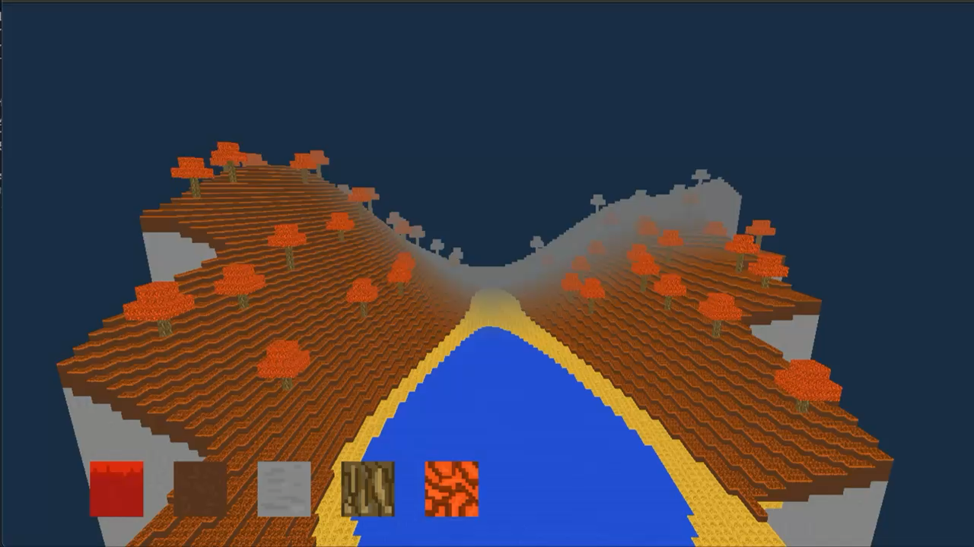
Major Positives
APL puts data in your face
APL is ridiculously fast to iterate on
APL is malleable
Notes:
Frustum culling, seeing if chunks are viewable by the camera so that they can be rendered
Example with lower field of vision

Slide 41
Major Positives
vec←[0 0 ⋄ w 0 ⋄ 0 w ⋄ w w](+⍤2)4/[1],[0.5]↑(⊂px pz-lx lz×w×0.25)-⍨(w←⊃l)×Cg'xz'
dist←0.5*⍨+/[2]vec*2
num←(lx lz)(+.×⍤1)↑vec
den←dist×0.5*⍨+/(lx lz)*2
m←(Cg'ready')∧∨/(○70÷180)>¯2○num(⎕DIV:1).÷den
⍝ Chance that distance could be 0
frs←##.player.Get_frustum (○70÷180⋄1280÷720⋄0.1⋄500.0)
n←3↑[1]frs
d←,3↓[1]frs
(w h)←(⊃l ⋄ 1⊃l)
box←[
0 0 0 ⋄ w 0 0 ⋄ 0 0 w ⋄ w 0 w
0 h 0 ⋄ w h 0 ⋄ 0 h w ⋄ w h w
]
vec←box(+⍤2)8/[1],[0.5]⌽2⌽0,(w←⊃l)×↑Cg'xz'
t←~(∧/⍤1)(∨/⍤1)0>d(-⍤1)⍨ n(+.×⍤2 1)vec
t2 ← (2×w)>({0.5*⍨+/⍵*2}⍤1)↑(⊂px pz)-⍨w×Cg'xz'
m←(t2∨t)∧(Cg'ready')
APL puts data in your face
APL is ridiculously fast to iterate on
APL is malleable
frs←##.player.Get_frustum(○70÷180 ⋄ 1280÷720 ⋄ 0.1 ⋄ 500)
n←3↑[1]frs
d←,3↓[1]frs
centers←(w÷2 ⋄ 2÷⍨h←1⊃l ⋄ w÷2)(+⍤1)⌽2⌽0,(w←⊃l)×↑Cg'xz'
r←+/(|n)(×⍤1)(w ⋄ h ⋄ w)÷2
m←(Cg'ready')∧∧/(-r)(≤⍤1)d(-⍤1)⍨n(+.×⍤2 1)centers
Notes:
3 different iterations working on this — don’t worry about code, just to show what it looks like
Previous ones had cases I didn’t consider I had to improvise on
Was able to modify them relatively quickly to work

Slide 42
Major Positives
vec←[0 0 ⋄ w 0 ⋄ 0 w ⋄ w w](+⍤2)4/[1],[0.5]↑(⊂px pz-lx lz×w×0.25)-⍨(w←⊃l)×Cg'xz'
dist←0.5*⍨+/[2]vec*2
num←(lx lz)(+.×⍤1)↑vec
den←dist×0.5*⍨+/(lx lz)*2
m←(Cg'ready')∧∨/(○70÷180)>¯2○num(⎕DIV:1).÷den
⍝ Chance that distance could be 0
frs←##.player.Get_frustum (○70÷180⋄1280÷720⋄0.1⋄500.0)
n←3↑[1]frs
d←,3↓[1]frs
(w h)←(⊃l ⋄ 1⊃l)
box←[
0 0 0 ⋄ w 0 0 ⋄ 0 0 w ⋄ w 0 w
0 h 0 ⋄ w h 0 ⋄ 0 h w ⋄ w h w
]
vec←box(+⍤2)8/[1],[0.5]⌽2⌽0,(w←⊃l)×↑Cg'xz'
t←~(∧/⍤1)(∨/⍤1)0>d(-⍤1)⍨ n(+.×⍤2 1)vec
t2 ← (2×w)>({0.5*⍨+/⍵*2}⍤1)↑(⊂px pz)-⍨w×Cg'xz'
m←(t2∨t)∧(Cg'ready')
APL puts data in your face
APL is ridiculously fast to iterate on
APL is malleable
frs←##.player.Get_frustum(○70÷180 ⋄ 1280÷720 ⋄ 0.1 ⋄ 500)
n←3↑[1]frs
d←,3↓[1]frs
centers←(w÷2 ⋄ 2÷⍨h←1⊃l ⋄ w÷2)(+⍤1)⌽2⌽0,(w←⊃l)×↑Cg'xz'
r←+/(|n)(×⍤1)(w ⋄ h ⋄ w)÷2
m←(Cg'ready')∧∧/(-r)(≤⍤1)d(-⍤1)⍨n(+.×⍤2 1)centers
Each took ~30mins-1hour and was usually done while I was half-asleep before going to bed
Notes:
I work in research full time so impressive I can knock them out before going to bed. Usually think of answer while working out or at lunch

Slide 43
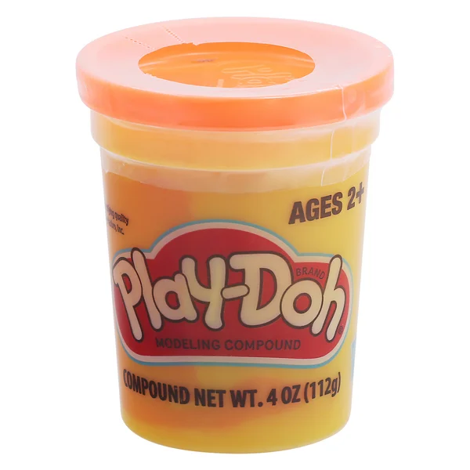
Major Positives
APL puts data in your face
APL is ridiculously fast to iterate on
APL is malleable
Notes:
Previous points and experience with APL make playing with your data fun and engaging
Very easy to experiment around and figure out what’s right and zero-cost behind trying
Like playdoh

Slide 44
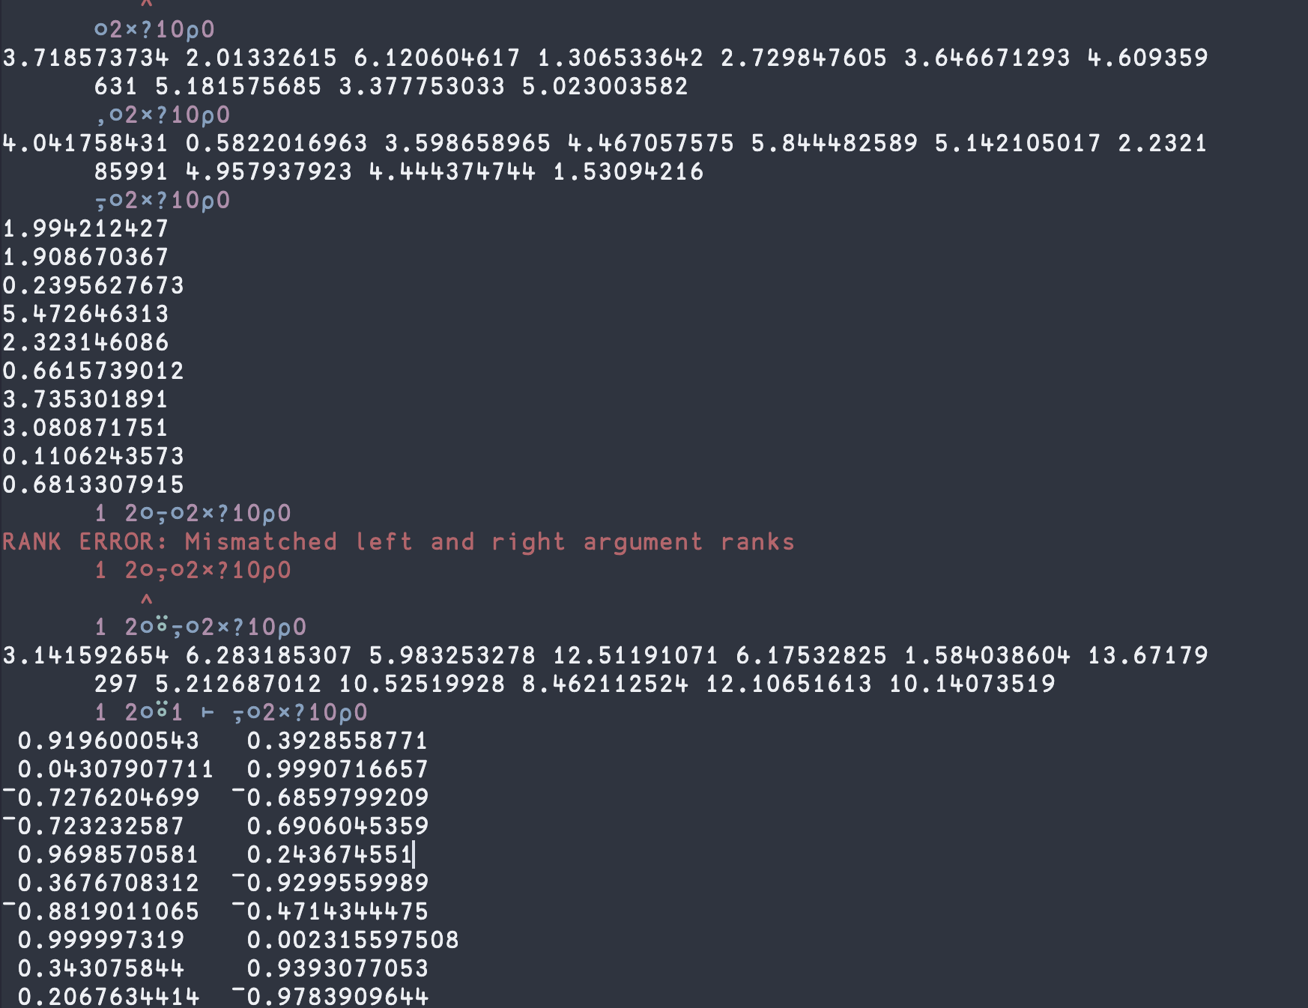
Major Positives
APL puts data in your face
APL is ridiculously fast to iterate on
APL is malleable

Slide 45
Major Difficulties
The learning curve is a cliff
Domain knowledge needed
Not all problems seem to fit well in APL

Slide 46
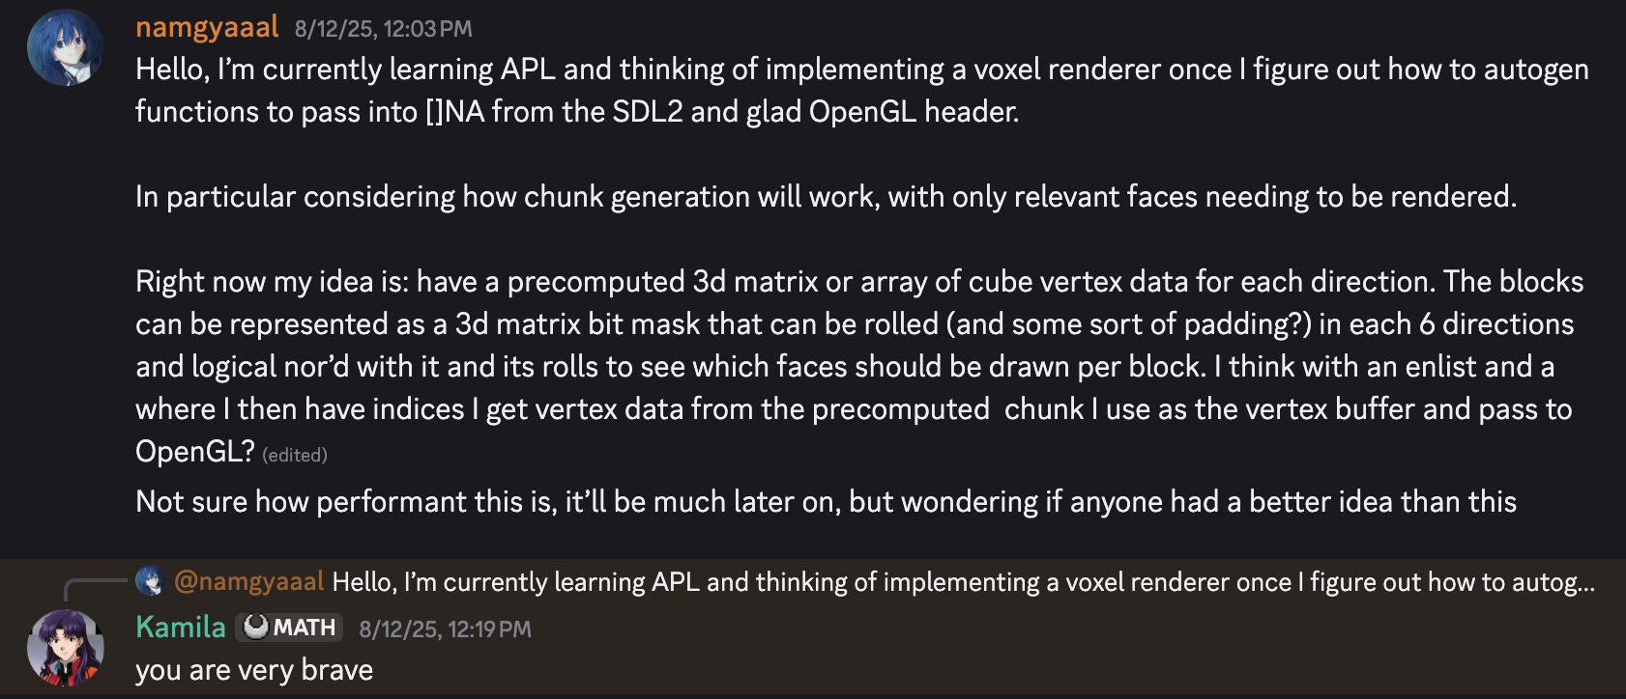

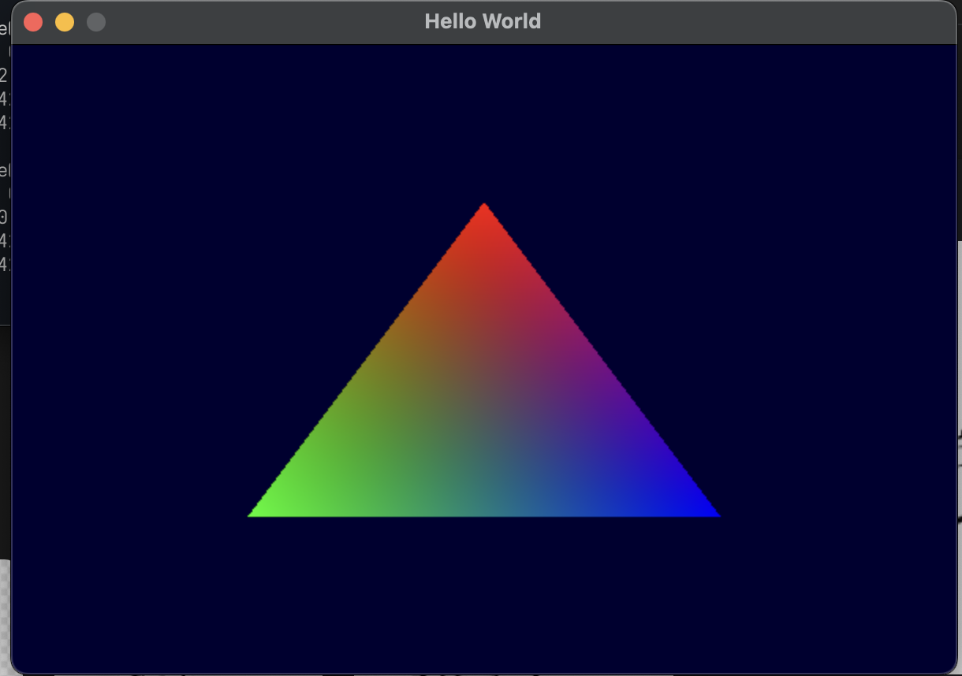
Major Difficulties
The learning curve is a cliff
Domain knowledge needed
Not all problems seem to fit well in APL
3 month time lapse…
Notes:
Started learning August 2025
Began November 2025
Took months until I was confident I could express what I wanted in APL.
Big paradigm shift from ALGOL-influenced languages to APL even with surface understandings of Numpy and pytorch

Slide 47
Major Difficulties
proj_mat←##.math.Ortho(0 0 600 900 0.1 100)
rot←↑{
ul←1 ¯1 1 1×2 1 1 2○⍵ ⍝ Rotate on XY plane
4 4⍴(ul,1,1)@(0 1 4 5 10 15)⊢16⍴0
}¨scope⊃⍨Si'rotation'
trans←↑{(⊃⍵ ⋄ 1⊃⍵ ⋄ 0 ⋄ 1)@3⊢∘.=⍨⍳4}¨↓⍉↑x y
scale←↑{1@(⊂3 3)⊢⍵×∘.=⍨⍳4}¨scope⊃⍨Si'scale'
mp←proj_mat+.×⍨⊃(+.×⍤2 2)/origin rot scale trans
The learning curve is a cliff
Domain knowledge needed
Not all problems seem to fit well in APL
∆CV←{
x←⊃⍺⊃Z ⋄ a←1⊃⍺⊃Z ⋄ k←⍺⊃W
w←,[⍳3]⊖⌽[1]0 1 3 2⍉k
∆z←⍵×0<a
∆Z←¯2⊖¯2⌽[1](4+2↑⍴∆z)↑∆z
∆w←⍺ ∆ 3 0 1 2⍉(⍉,[⍳2]∆z)+.×,[⍳2]3 3⌺x
∆x←w+.×⍨,[2+⍳3]3 3 SF ∆Z
}
Notes:
Problem domain knowledge vs no problem domain knowledge greatly exacerbates in APL
Gestalt of code (way code appears in its whole) that subordinates detail requires a good understanding of the domain the code is working on to succeed
Not much room for busywork or glueing together oblique components, so you have to have a proper understanding
Issue when implementing things based off of books/papers

Slide 48
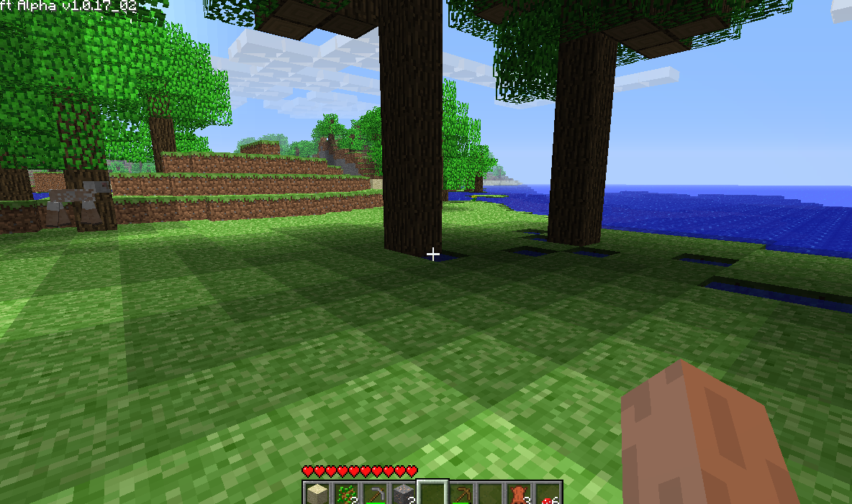
Major Difficulties
The learning curve is a cliff
Domain knowledge needed
Not all problems seem to fit well in APL
Notes:
Wanted to do light map Minecraft style
Seems to require breadth first search from points
Not amenable to apl without power-stencil
Water also has this problem
Show example with water
Can do compute shaders or write in c but ruins point

Slide 49
Conclusion
Definitely understand the value of APL’s notation
Want to experiment more with data structures and problems that are less amenable to APL
Want to experiment with reading other codebases (e.g., dfns, AoC, Co-dfns)
Made me curious on an actual full game in APL
Notes:
Quadtrees/problems I mentioned
- Only getting one part of the picture with a solo project

Slide 50
Questions?
See outdated blogpost here:
https://homewithinnowhere.com/blog/voxel_game/
All APL code open-sourced here:
https://github.com/namgyaaal/avoxelgame

