Slide 1
Jarvis and AI
Brian Becker
APL Tools Architect, Dyalog LTD

Slide 2
Jarvis (JSON and REST Service)
Dyalog’s open-source web service framework that lets you expose APL functions and data as modern web services over HTTP.
  JSON mode - each endpoint maps directly to an APL function
  REST mode - endpoints represent resources managed through standard HTTP methods like GET, POST, PUT, and DELETE.

Slide 3
Jarvis (JSON and REST Service)
Jarvis handles all the underlying details:
  parsing requests
  converting between JSON and APL data structures
  formatting responses
You can focus on writing APL while making your work accessible to any HTTP client, regardless of whether the consumer knows APL.

Slide 4
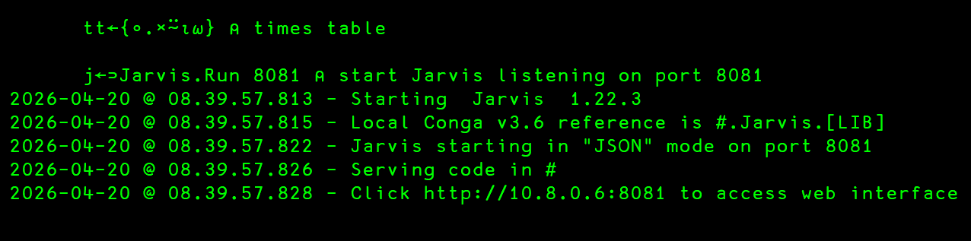
Jarvis

Slide 5
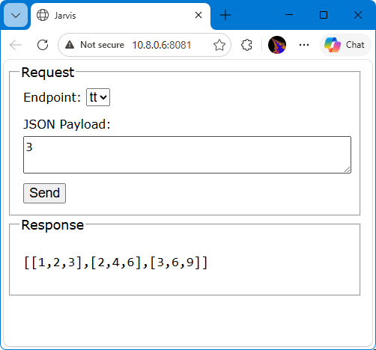
Built-in Web Client

Slide 6
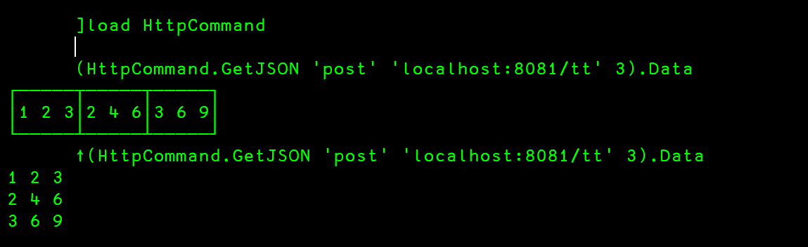
APL Client

Slide 7
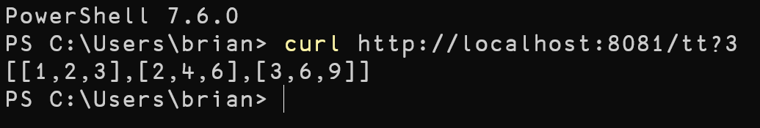
Other clients

Slide 8

AI…

Slide 9
LLMs and APL
Exponential Improvement
  Understanding/Explaining APL
  Generating APL
Context is Important
  The more context, the better the result (generally)
Development Environment Integration
  Using Claude with VS Code and DyalogScript
Notes:
Understanding – not only individual lines, but the code taken as a whole

Slide 10
Motivation
I know APL…
  and I enjoy writing APL
I (sort of) know HTML/CSS/JavaScript
  and I find it tedious and error-prone to write partly due to my own limitations
LLMs are good at generating HTML/CSS/JavaScript
  but not as good (yet) at generating APL
How close can I quickly get to a working web service using Jarvis and an LLM?

Slide 11
AI Goals
Responsibly use AI internally
  Automated testing / Generating tests
  Assist development and documentation
  Ownership doesn't transfer
Help our customers responsibly use AI should they choose to
  Learn/develop/demonstrate best practices
  Provide tools and techniques – e.g. OpenAI OpenAPI

Slide 12
The Project
Use an LLM to create a Wordle™-like web application
  Use Jarvis as its server
  Make it multi-user
  I will supply the list of candidate words
  Provide a "New Game" button
  Congratulate the user if they guess the secret word
  Console the user and tell them the secret word if they fail to guess it
  Make it responsive to different form factors
  Use a color scheme compatible with the dyalog.com website

Slide 13
The Prompt
create a Wordle™-like web application
  Use Jarvis as its server
  Make it multi-user
  I will supply the list of candidate words
  Provide a "New Game" button
  Congratulate the user if they guess the secret word
  Console the user and tell them the secret word if they fail to guess it
  Make it responsive to different form factors
  Use a color scheme compatible with the dyalog.com website

Slide 14
LIVE DEMO TIME!

Slide 15
Why We're Not Doing a Live Demo
Life is like a box of chocolates…
You never know what you're gonna get.
(Forrest Gump in Forrest Gump, 1994)
You want another answer, ask another girl.
(Tess McGill in Working Girl, 1988)

Slide 16
Why We're Not Doing a Live Demo
LLMs are like a box of chocolates…
You never know what you're gonna get.
You want another answer, ask the LLM the same question.

Slide 17


Slide 18
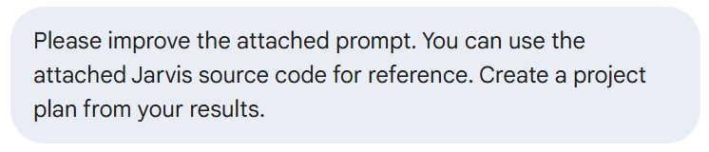
Prompting the Prompt

Slide 19
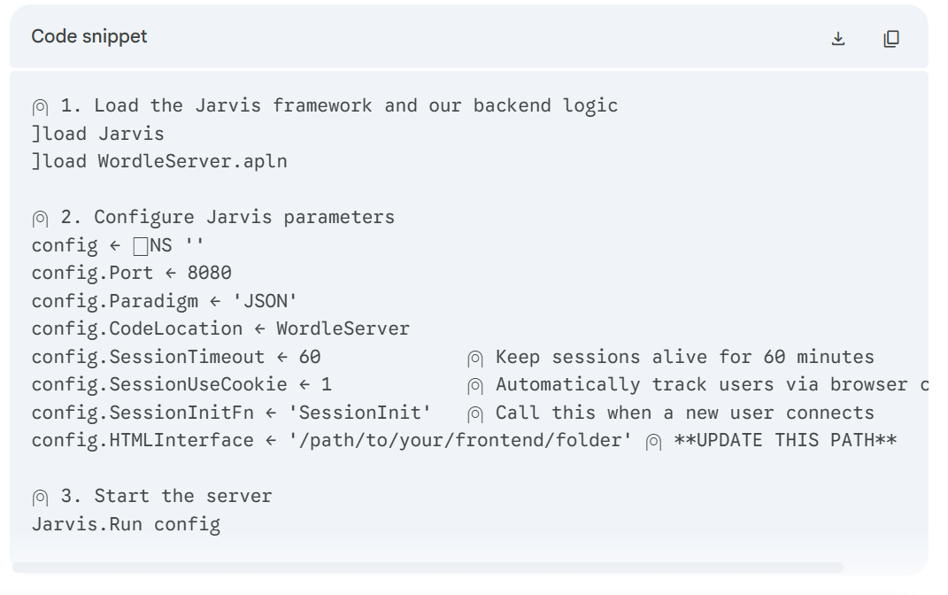
Hiccup 1 - Start.apls

Slide 20
Hiccup 1 - Start.apls
DyalogScript (.apls) files run in TTY (terminal mode) and don't have a session by default
Without a session the ]load user command isn't available
Jarvis isn't directly ]load-able
Where is WordleServer.apln?
DyalogScripts exit after execution

Slide 21

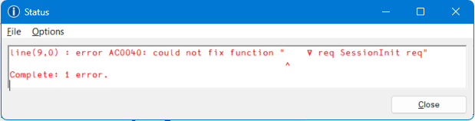
Hiccup 2

Slide 22
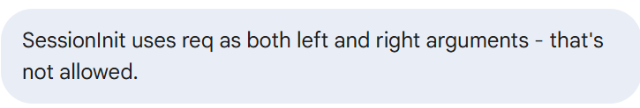
Hiccup 2 - SessionInit

Slide 23
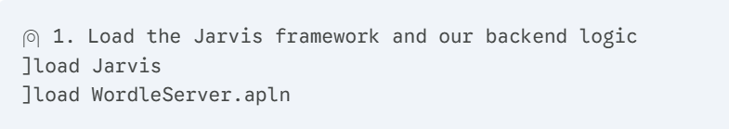
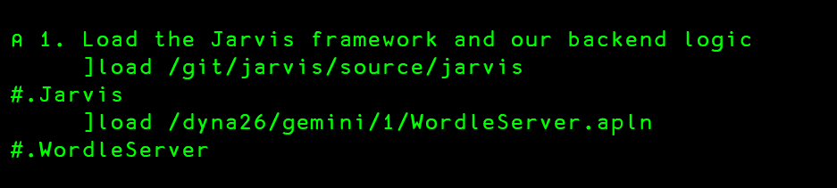
Loading…

Slide 24
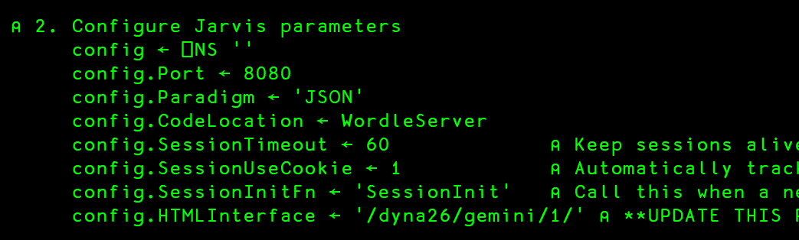
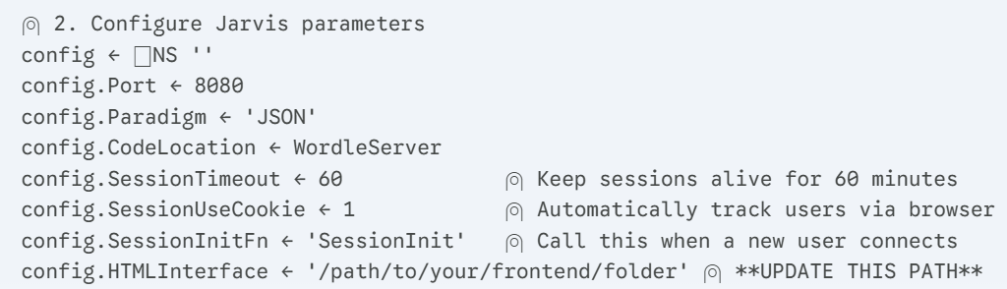
Configure

Slide 25
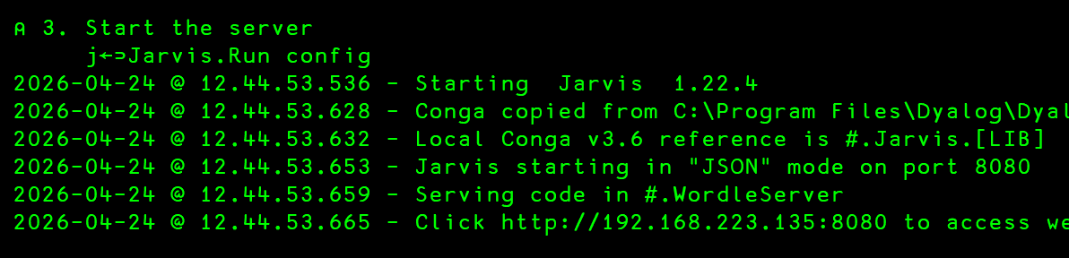
Start your engines…

Slide 26
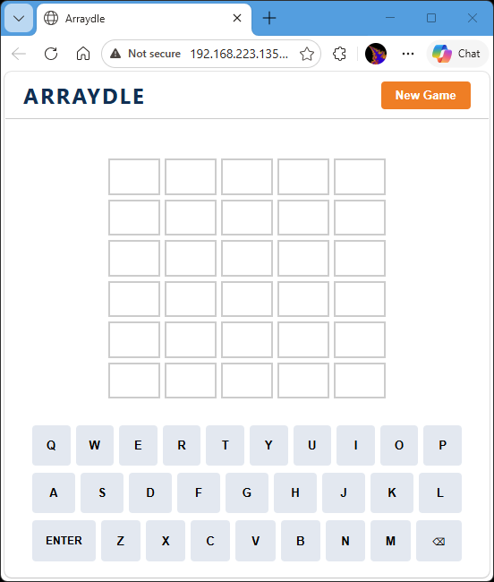

Slide 27
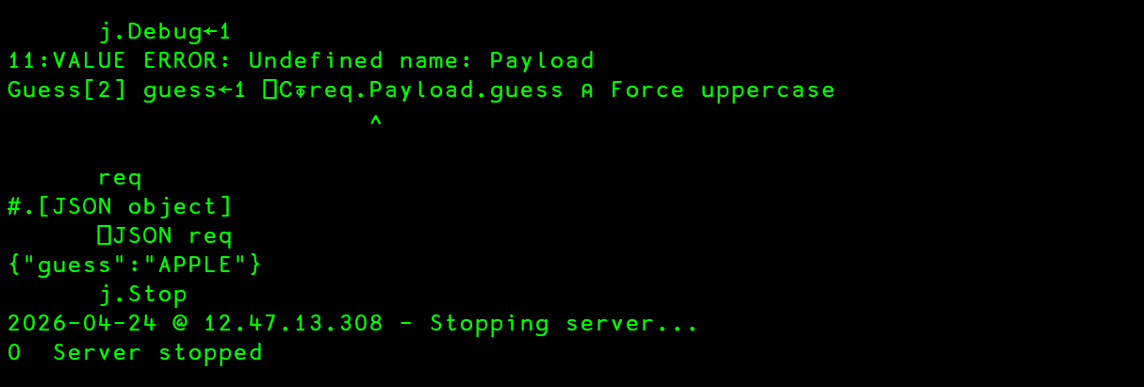
Hiccup 3

Slide 28
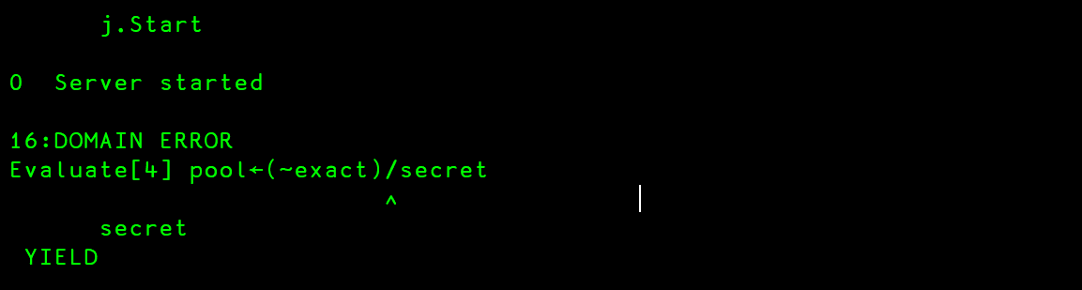
Hiccup 4

Slide 29
Hiccup 4

Slide 30
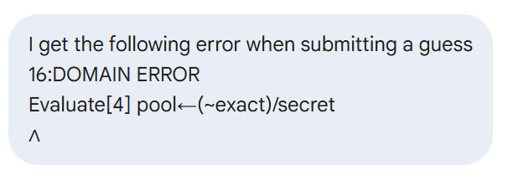
Hiccup 4
And then Gemini lost its mind…

Slide 31
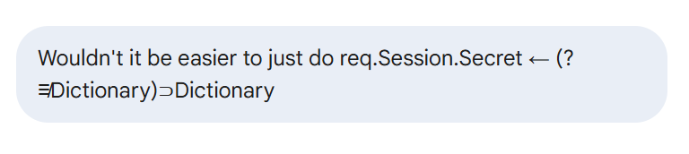
Hiccup 4

Slide 32
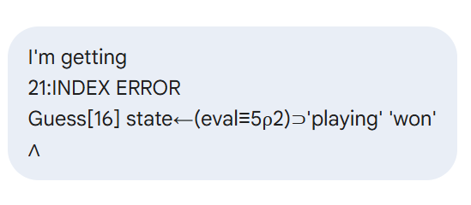
Hiccup 5

Slide 33
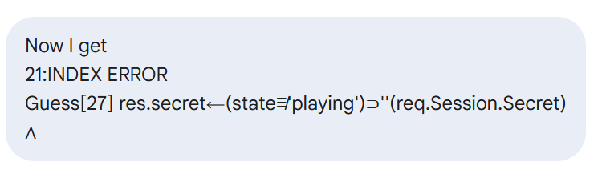
Hiccup 6

Slide 34
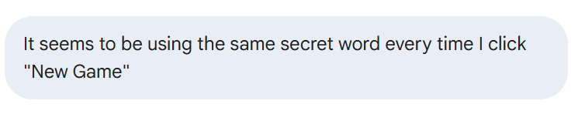
Hiccup 7

Slide 35
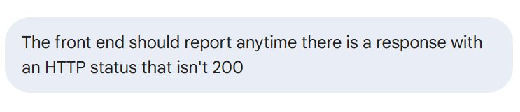
Enhancement 1

Slide 36
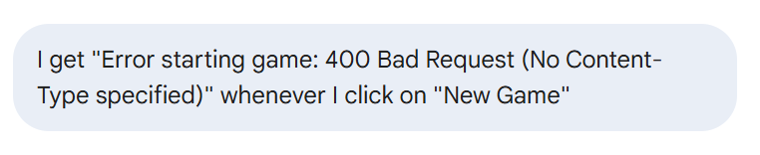
Hiccup 8

Slide 37
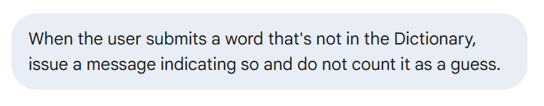
Enhancement 2

Slide 38
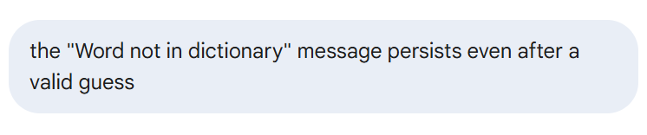
Hiccup 9

Slide 39
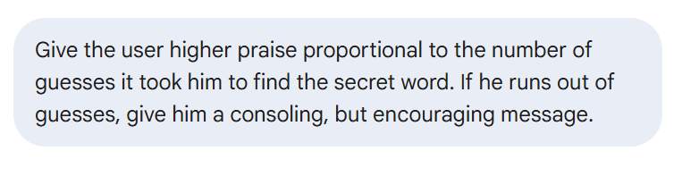
Enhancement 2

Slide 40
Takeaways
Worthwhile?
  I didn't modify a single line of HTML/CSS/JS myself
  The APL framework it started with would have been easy to modify
Trust but Verify
  Test the results
LLMs will benefit from being able to execute APL
  VS Code/Claude/DyalogScript

Slide 41

Questions?

