Slide 1
Migration to
Dyalog APL
Morten Kromberg, CTO

Slide 3
We are creating
Tools to easily import source code and data from APL+Win and APL2
Emulation of non-Dyalog language features
  In particular, GUI

Slide 4
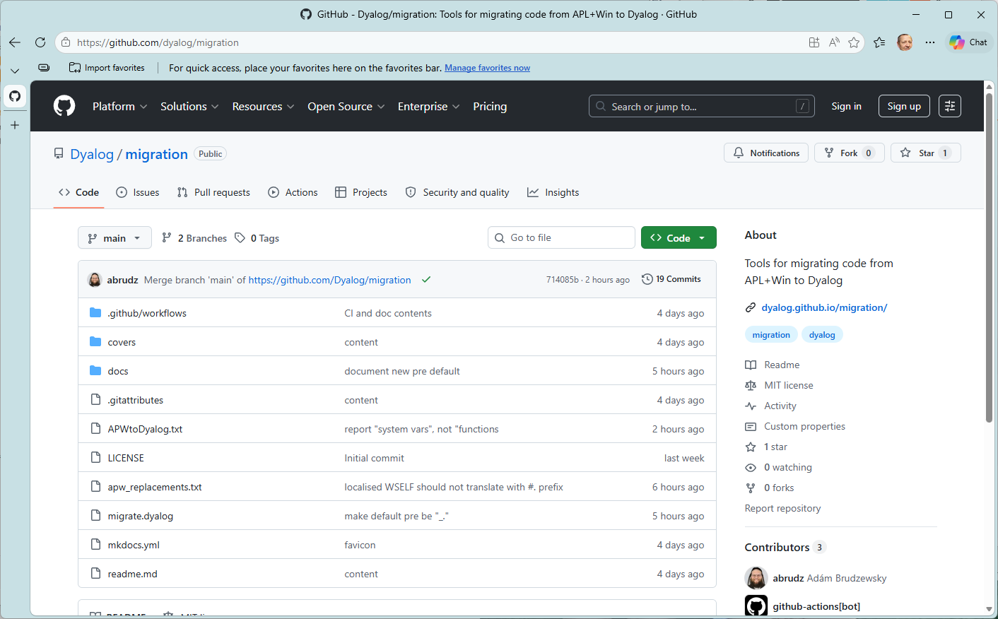

Slide 5
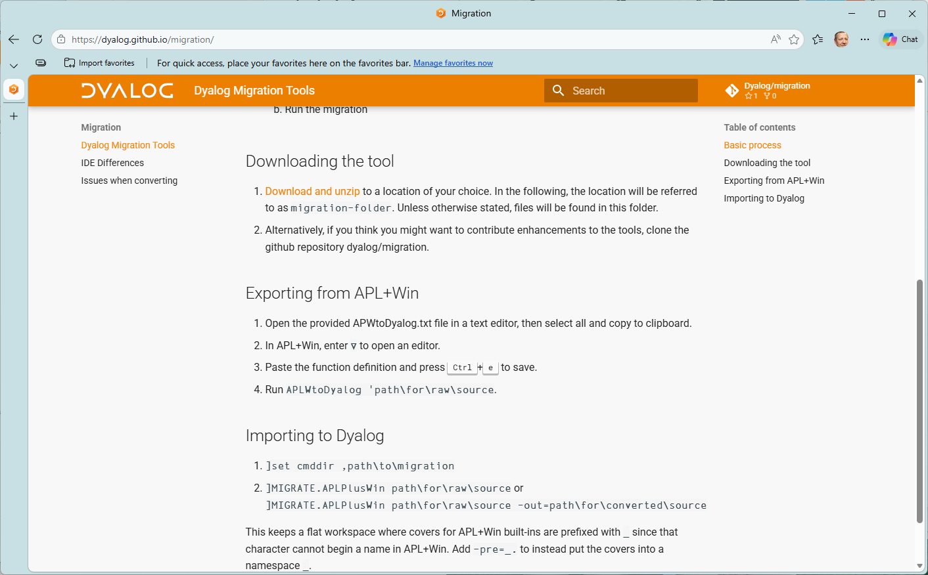

Slide 6
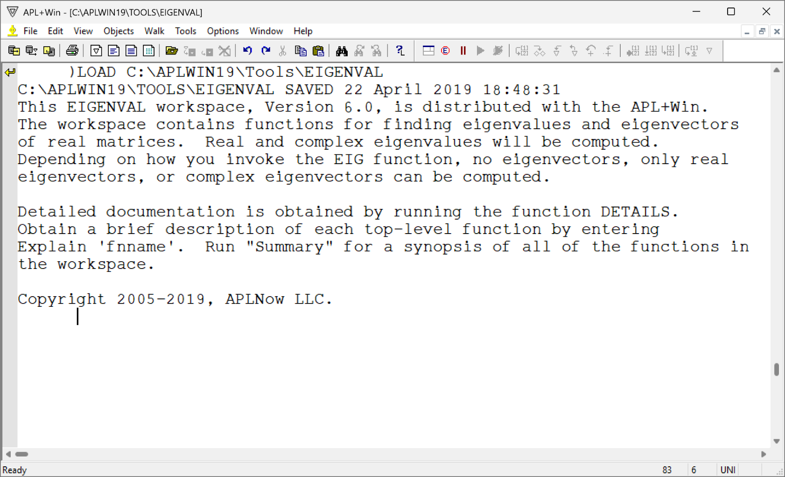

Slide 7
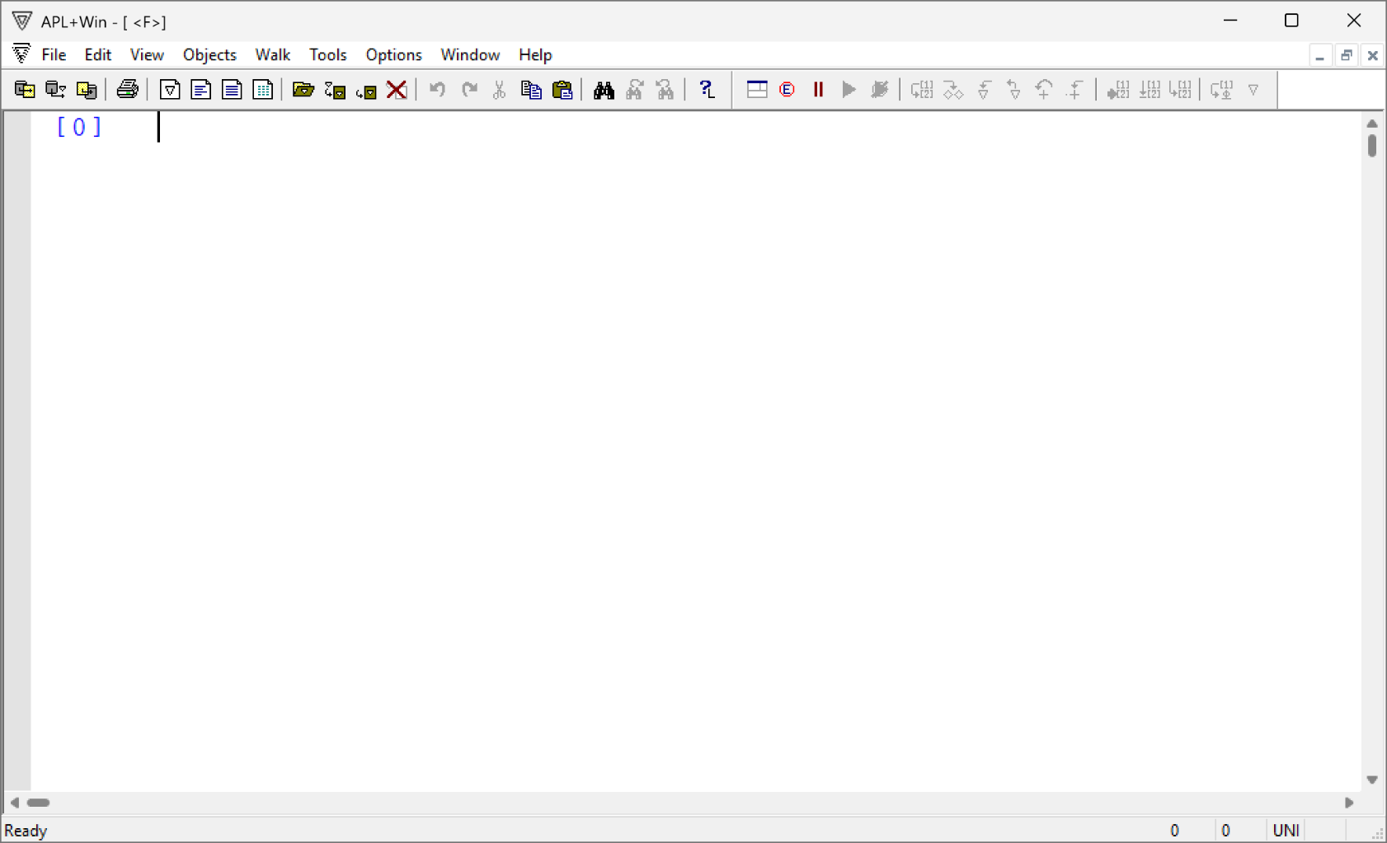

Slide 8
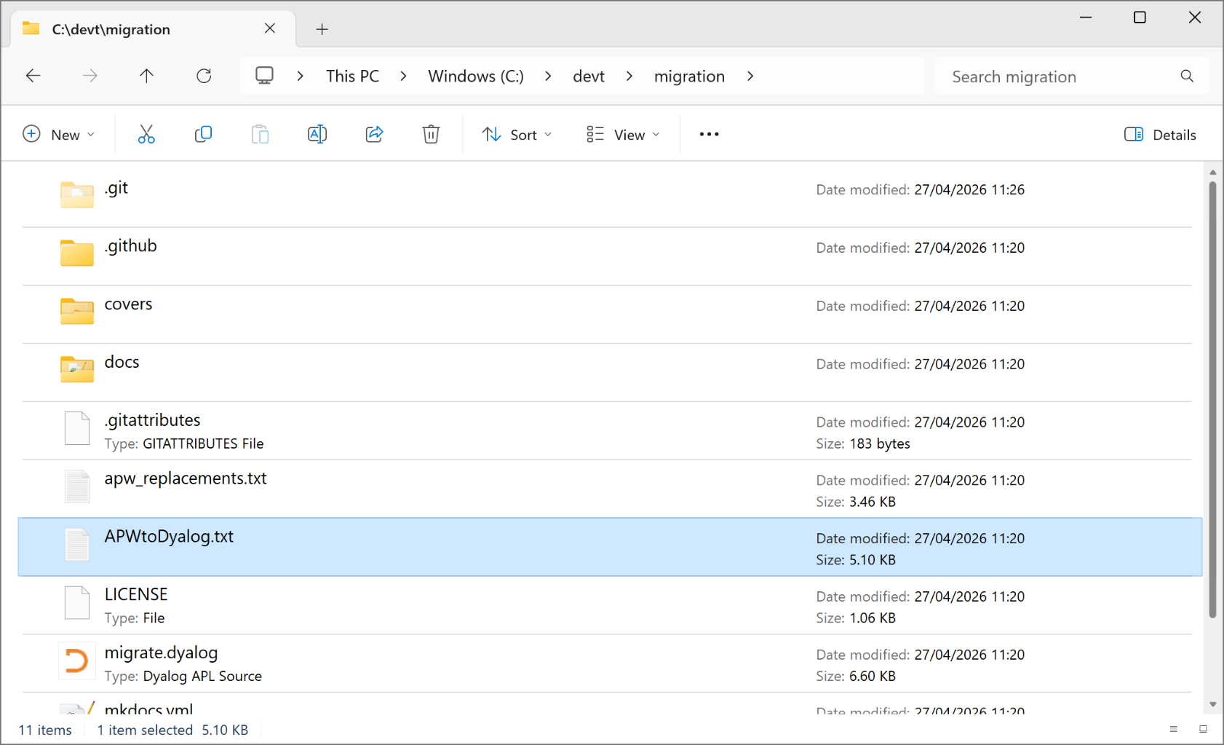

Slide 9
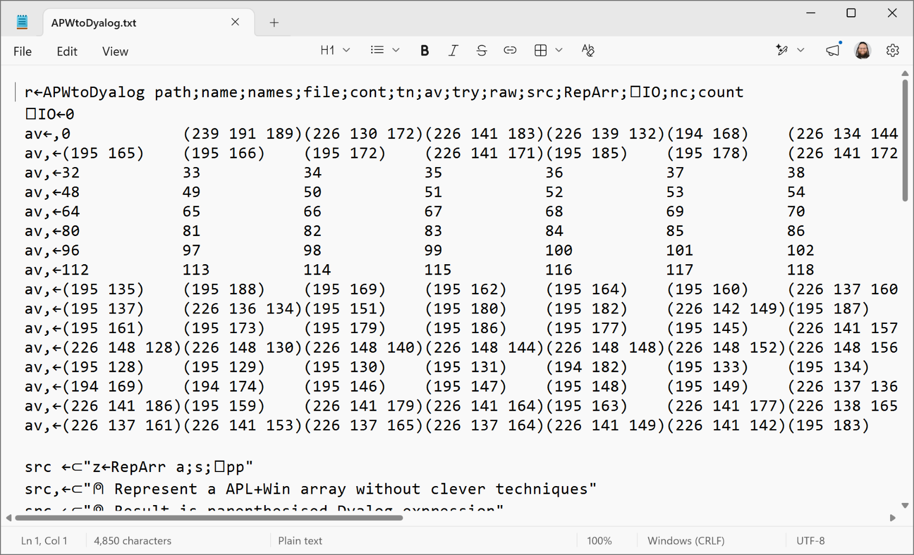

Slide 10
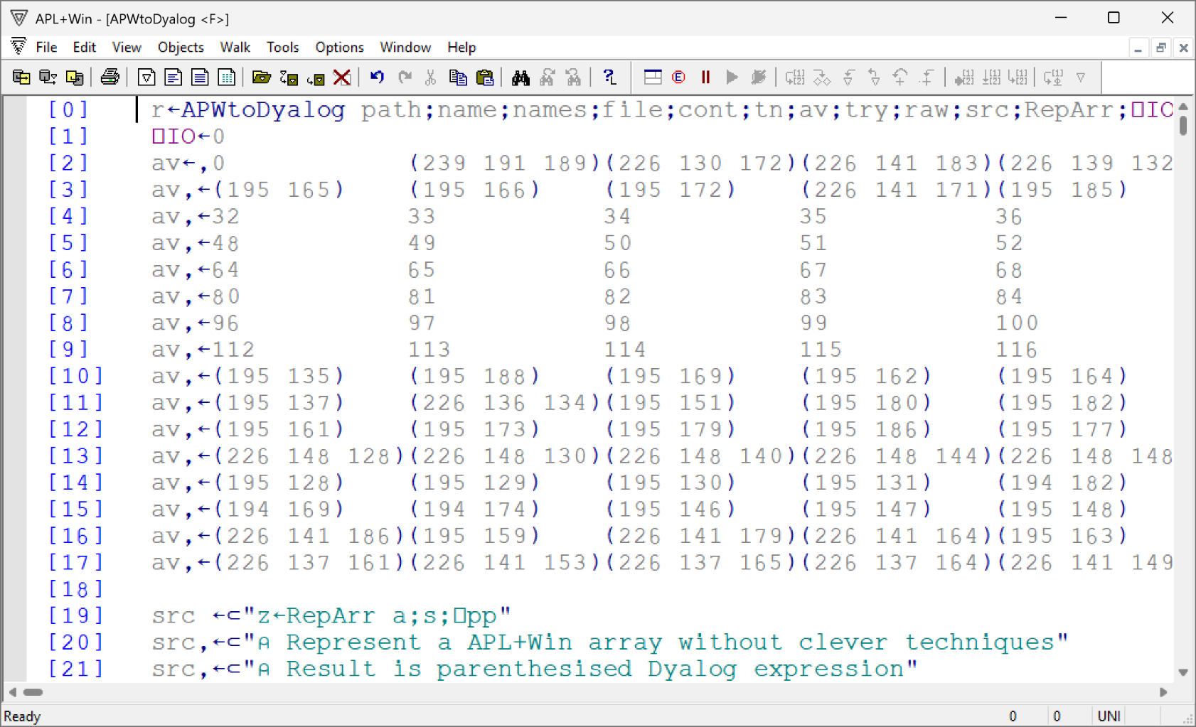

Slide 11
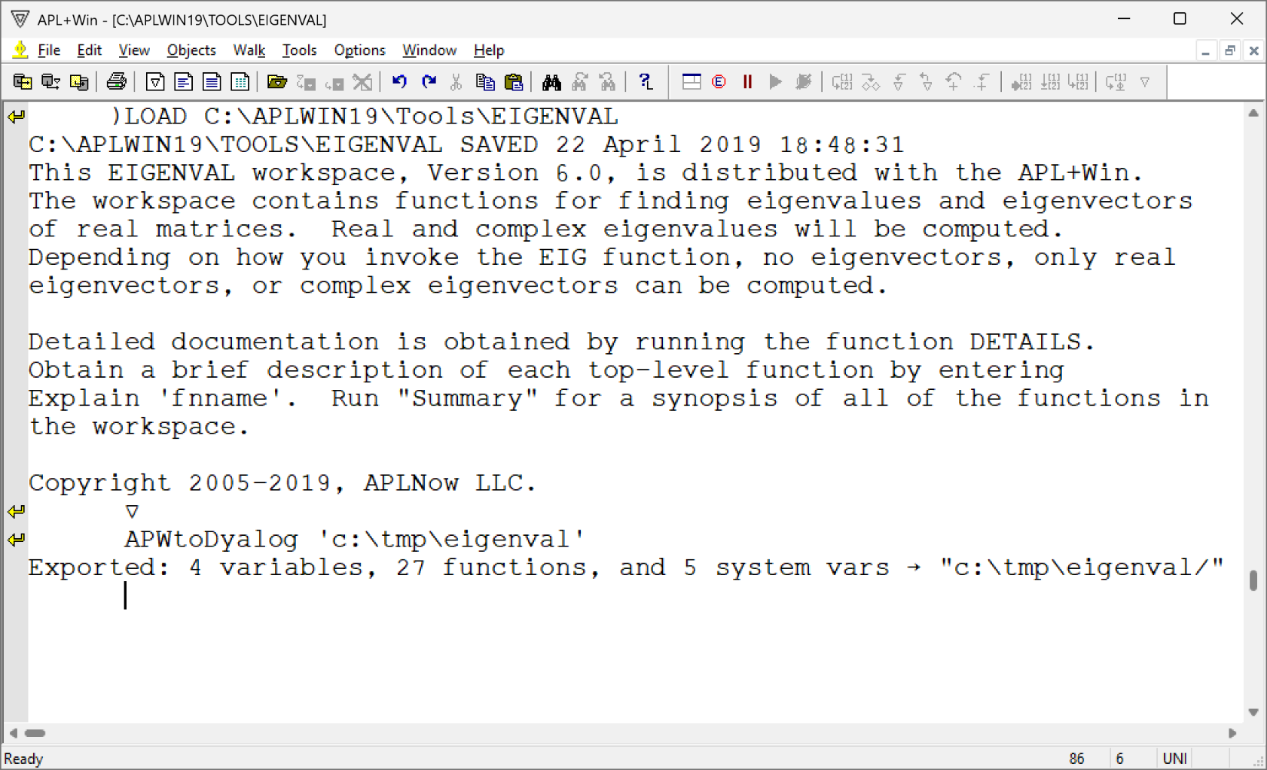

Slide 12
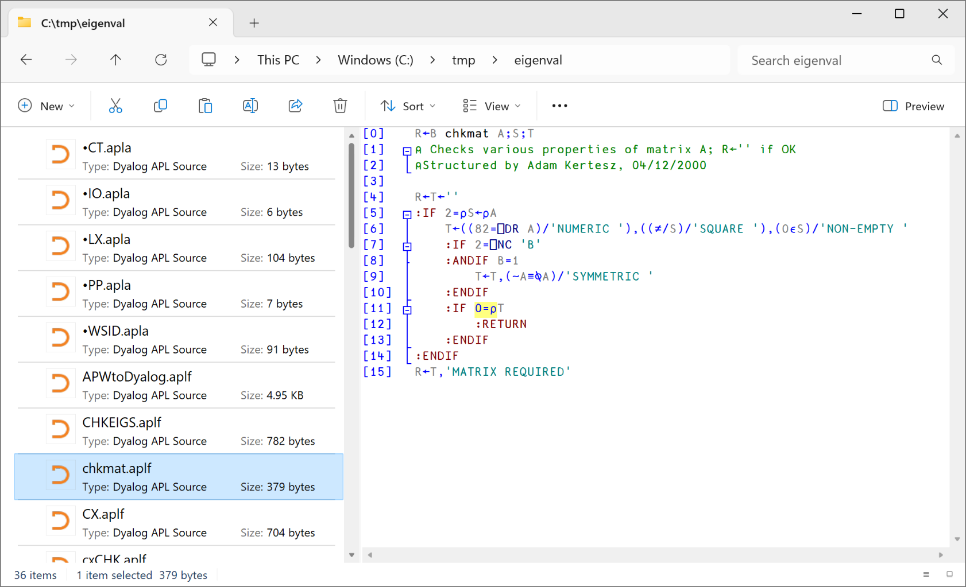

Slide 13
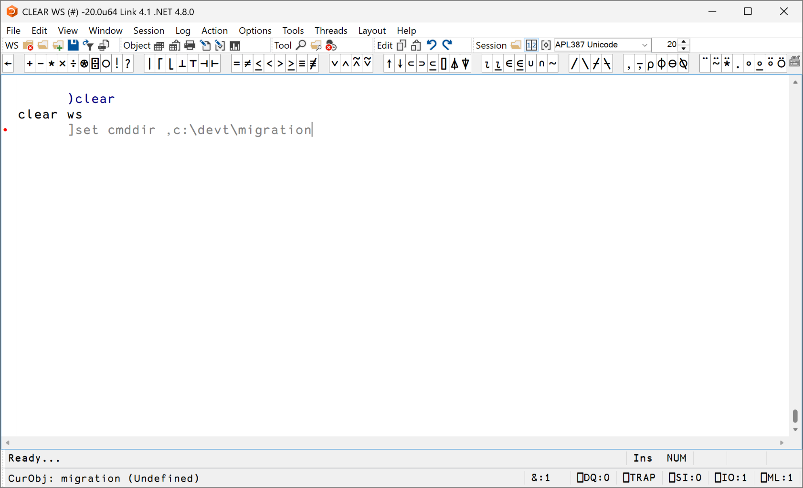

Slide 14
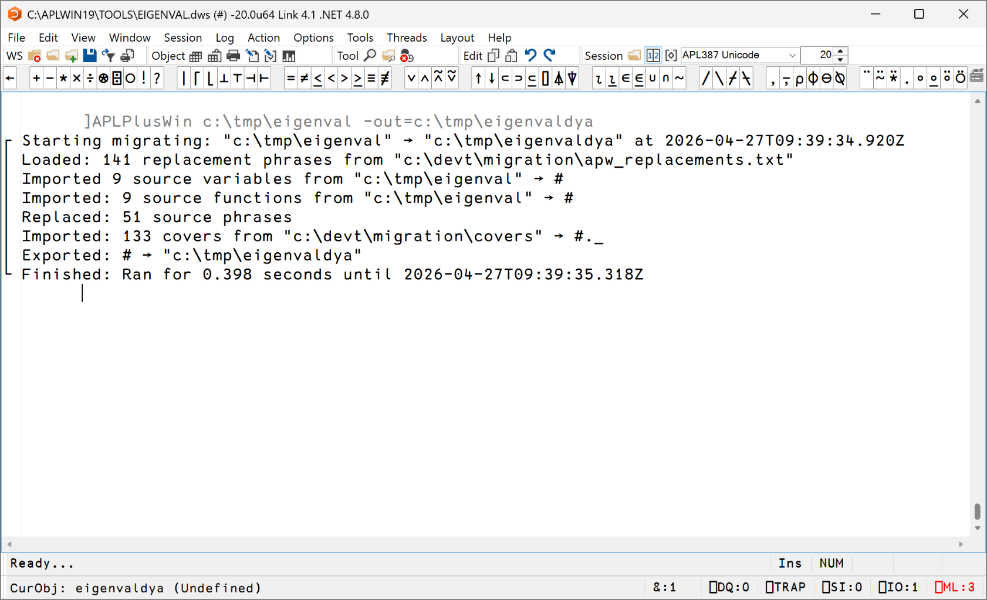

Slide 15
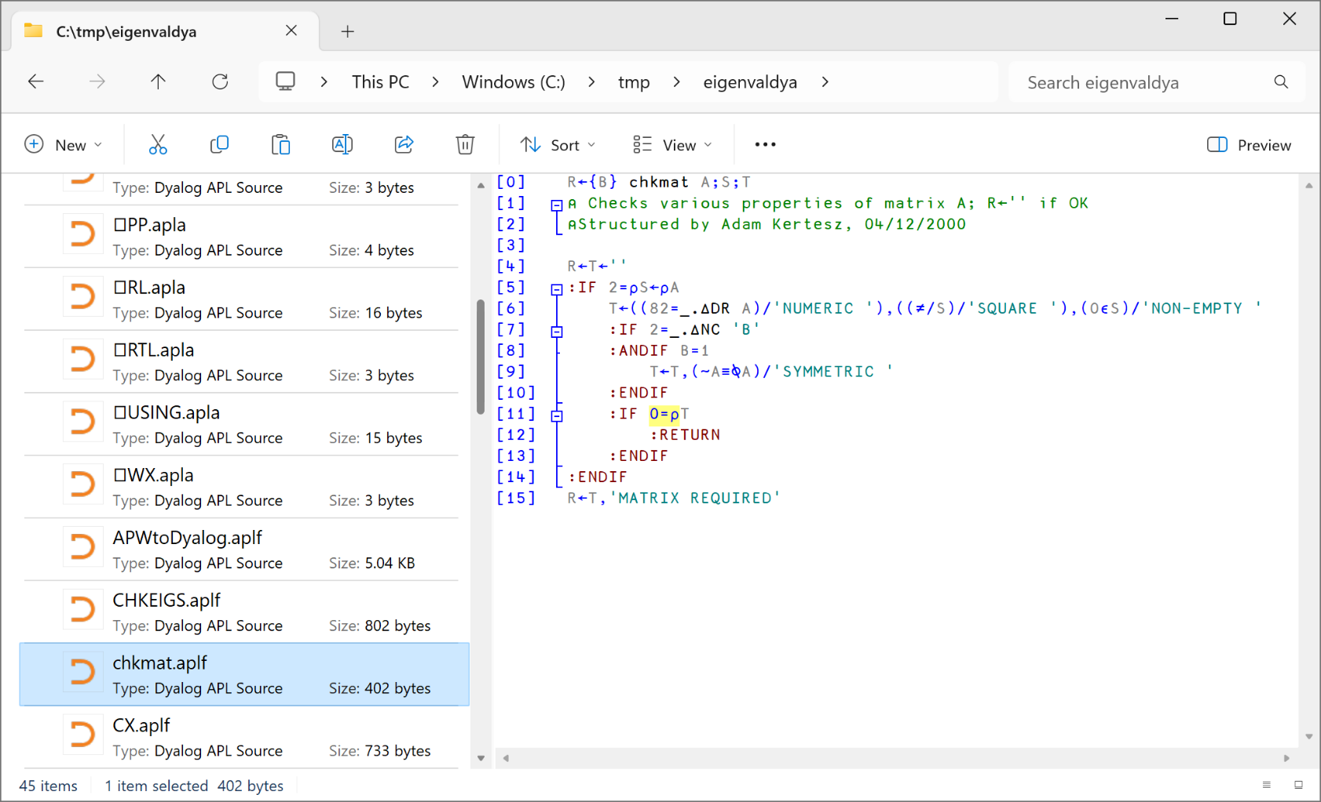

Slide 16
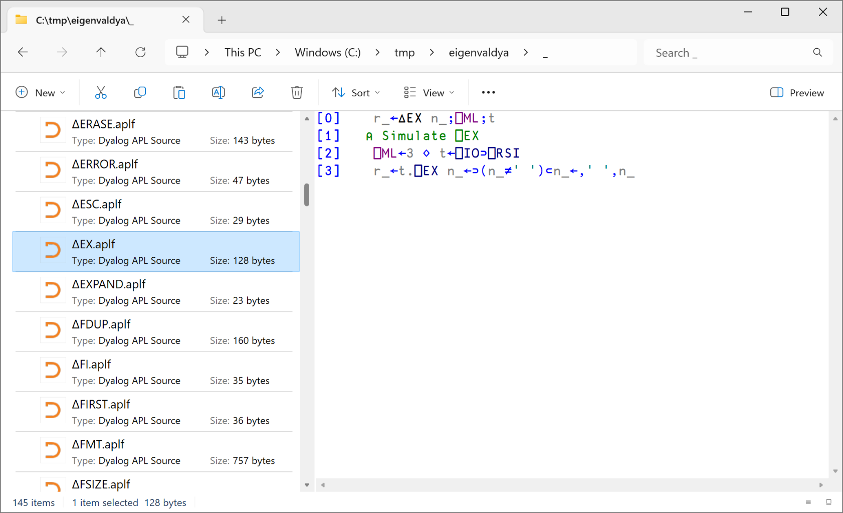

Slide 17
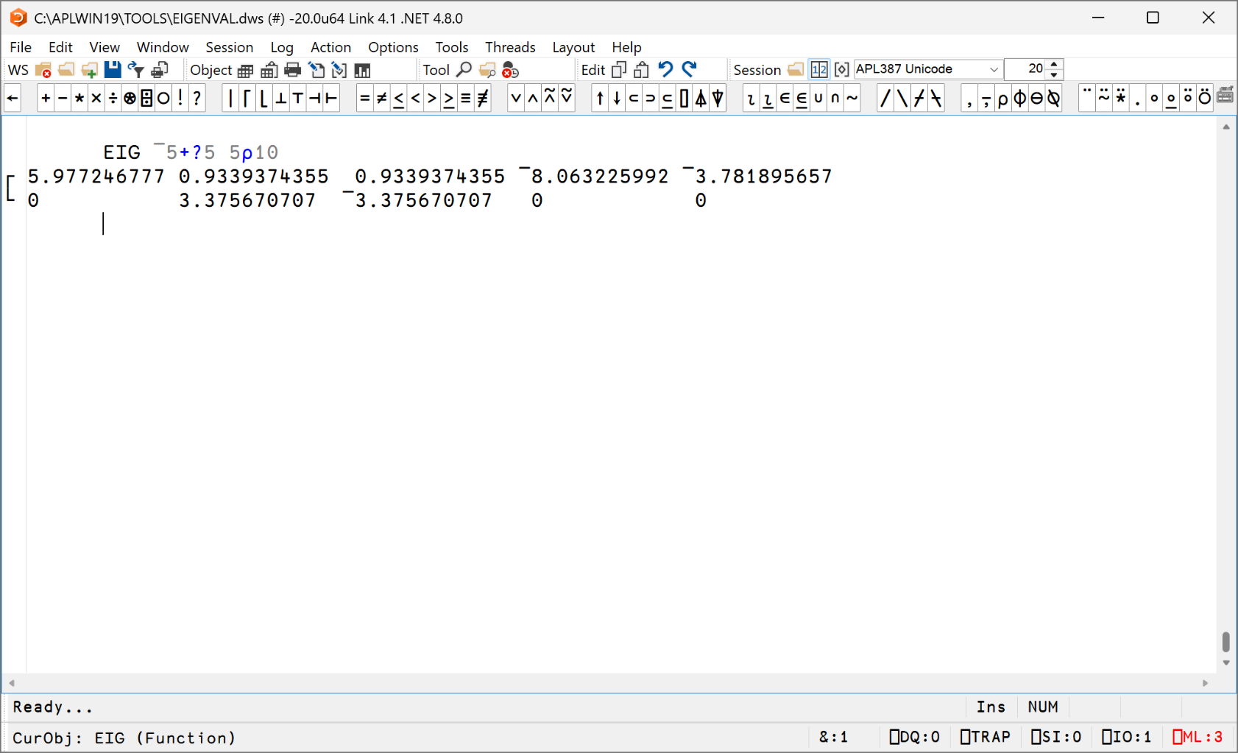

Slide 18
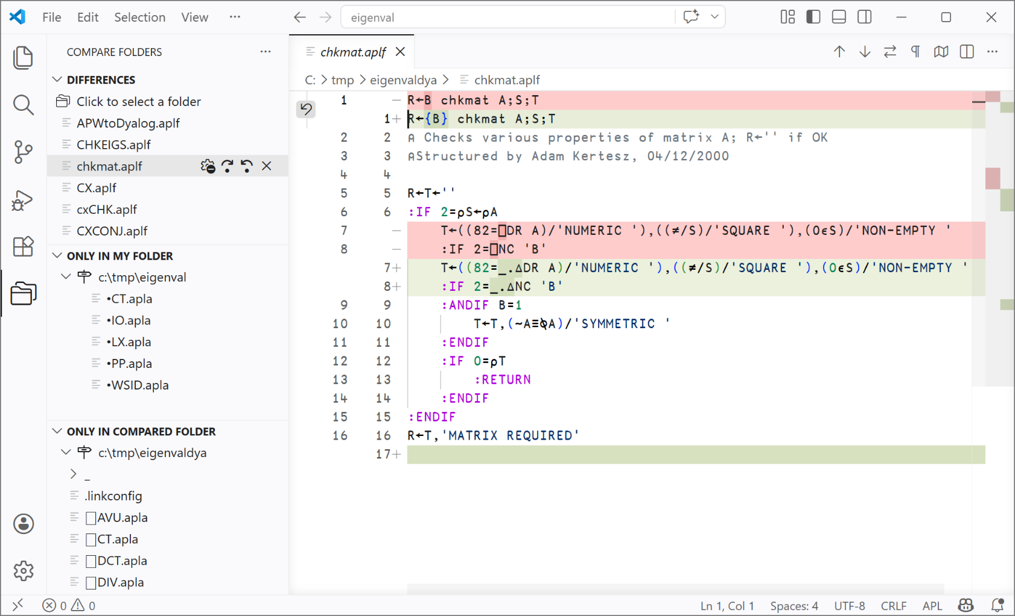

Slide 19
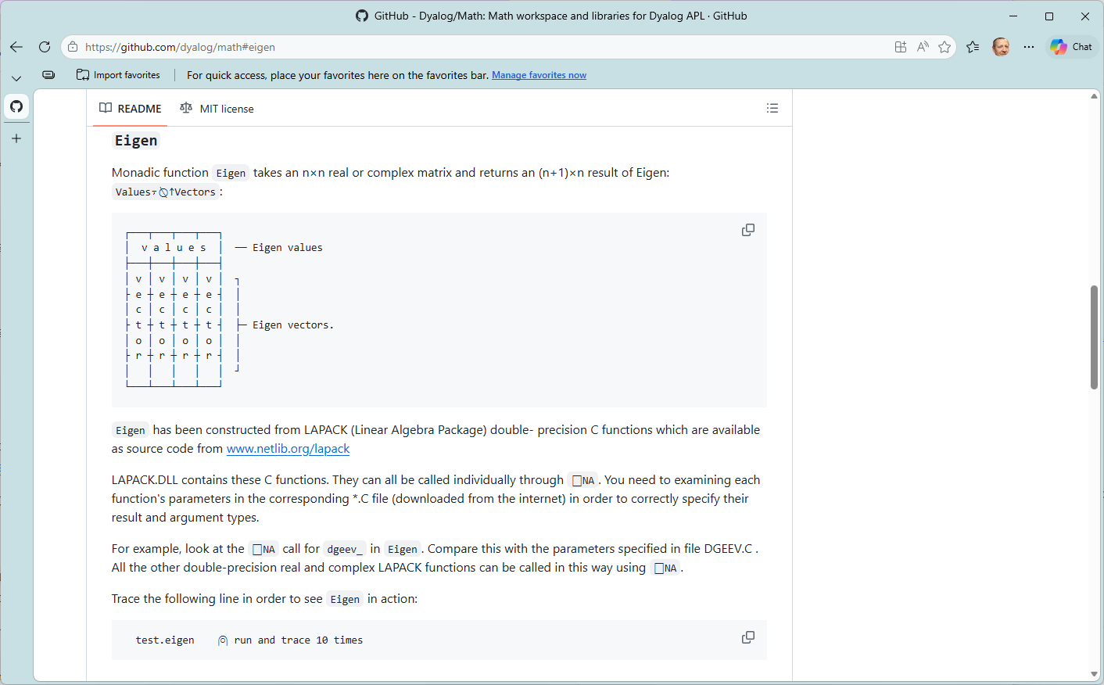

Slide 20
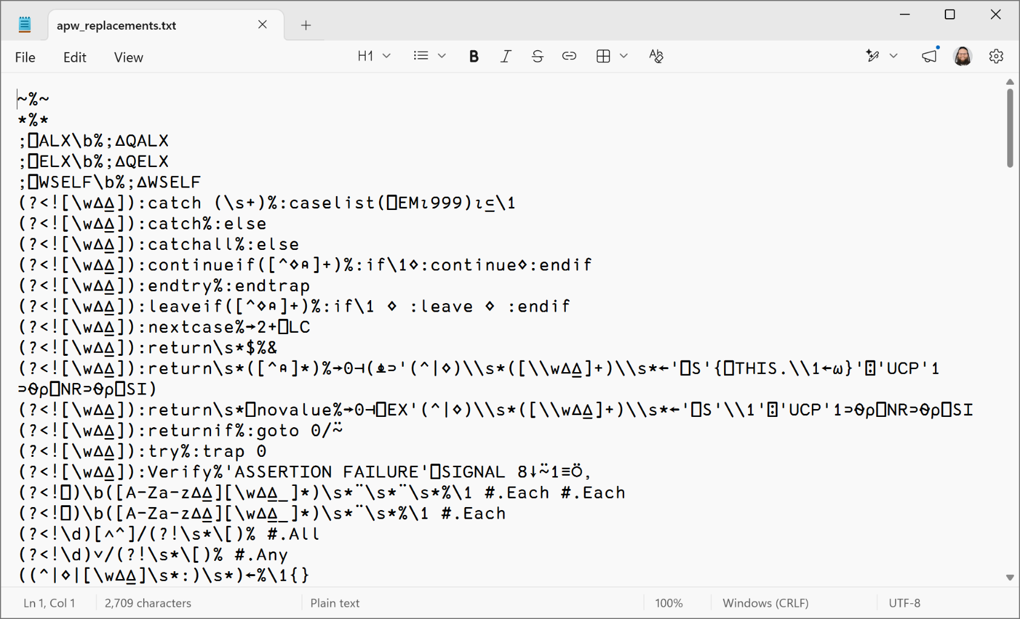

Slide 21
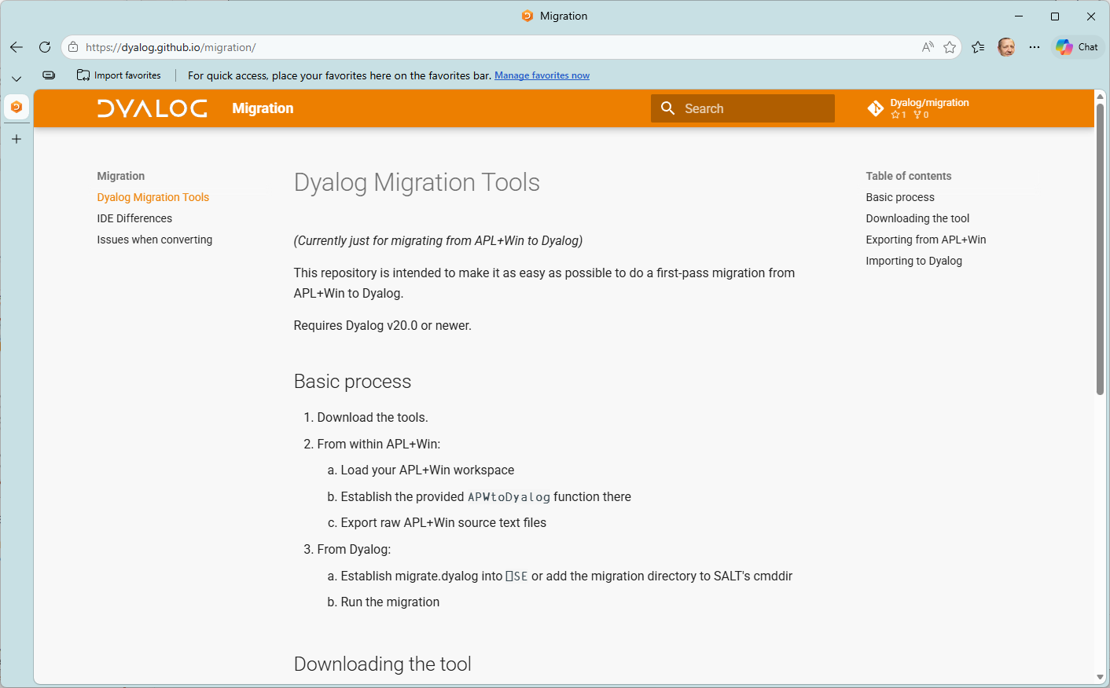

Slide 22
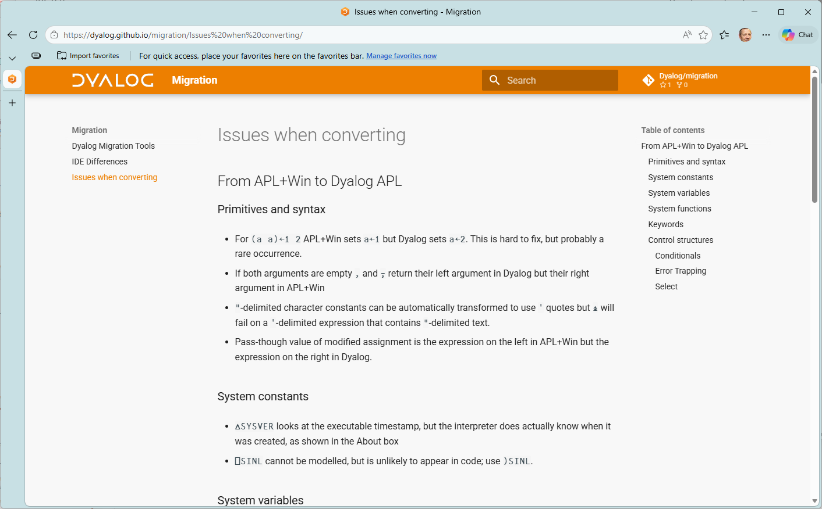

Slide 23
Status of Code Migration Tool
Open-source GitHub repo dyalog/migration
Still a prototype, much more work to follow
  Only support for APL+Win – APL2 to come
Pull Requests welcome!

Slide 24
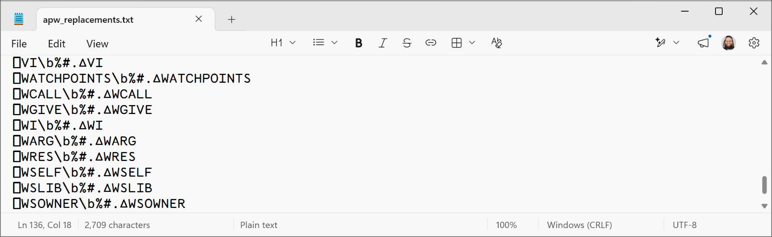
Graphical User Interfaces
We have an emulator for GDDM / AP126
  Generates HTML/svg
And a "∆WI" emulator for APL+Win GUI

Slide 25
Graphical User Interfaces
We have an emulator for GDDM / AP126
  Generates HTML/svg
And a "∆WI" emulator for APL+Win GUI
  A prototype, successfully used for METSIM®

Slide 26
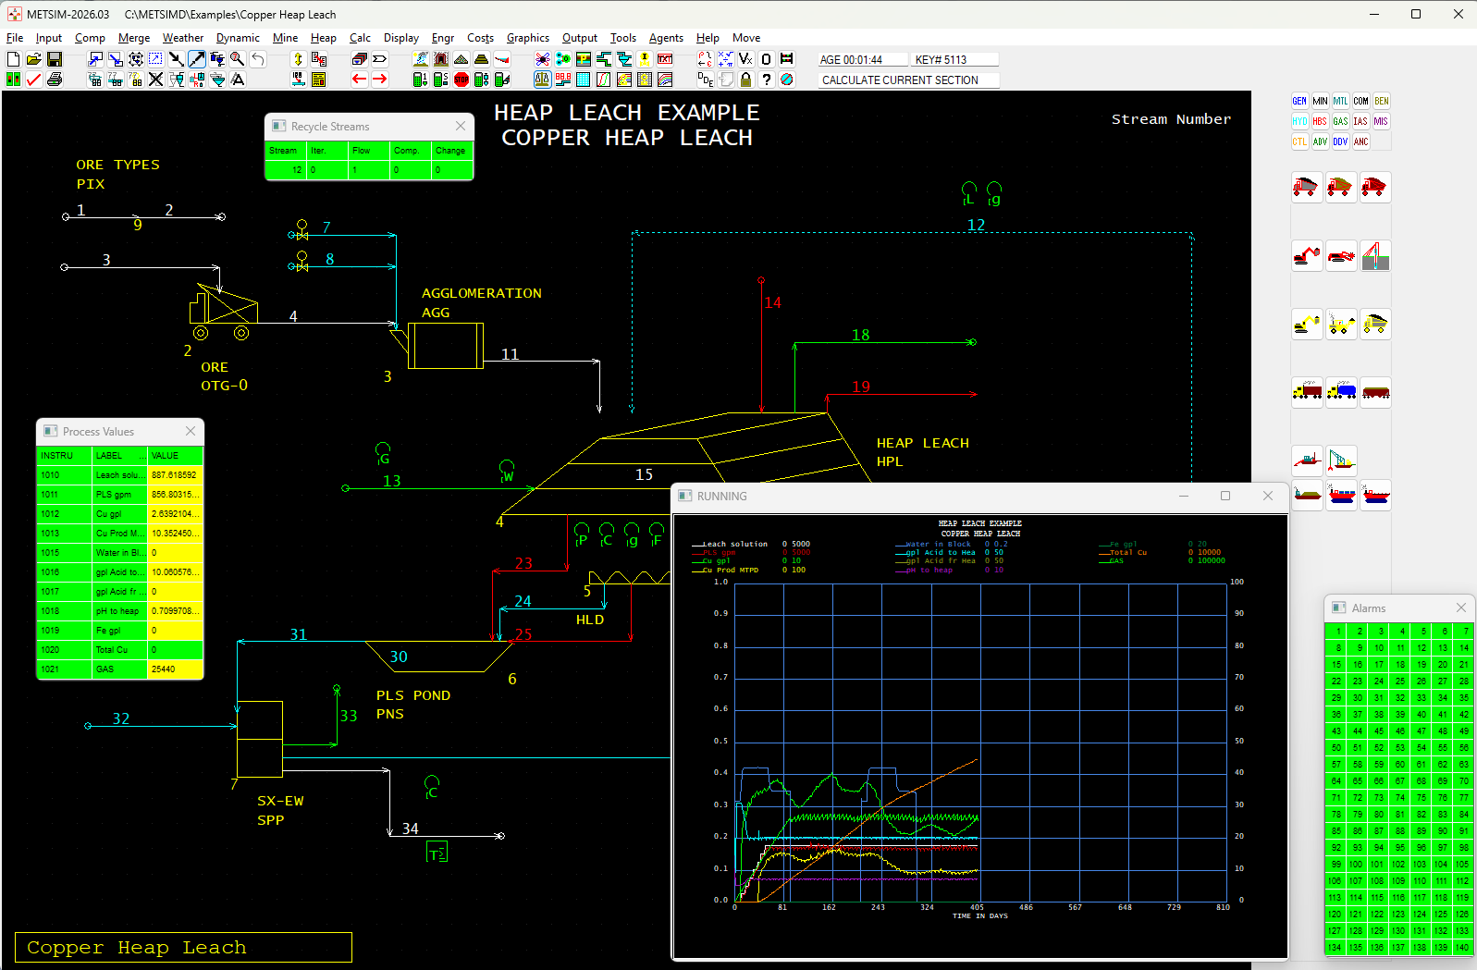

Slide 27
Graphical User Interfaces
We have an emulator for GDDM / AP126
  Generates HTML/svg
And a "∆WI" emulator for APL+Win GUI
  A prototype, successfully used for METSIM®

Slide 28
Graphical User Interfaces
We have an emulator for GDDM / AP126
  Generates HTML/svg
And a "∆WI" emulator for APL+Win GUI
  A prototype, successfully used for METSIM®
  A re-implementation by Davin Church – known as "deltaWI".

Slide 29
DeltaWI Goals
Same syntax and usage as ⎕WI with behavior matching APL+Win (and APLX)
Allow maintaining applications in the APL+Win style after porting
Many extensions, including Dyalog controls, are being considered
Windows-only, but portability planned for future

Slide 30
DeltaWI Progress
16 classes supported:
"Simple Applications"
Expected this year:
"Meaningful Applications"
System (#)
Button
Check
Combo
Edit
Form
Frame
Label
List
Listview
Option
Page
RichEdit
Selector
Tree
Spinner
CommandBar
DateTime
MDIForm
Menu
Progress
Scroll
Status
TrackBar
ImageList
Picture
Printer
Timer
So far:
244 Methods
516 Properties
236 Events
996 Total
(Some uncommonly used features are not yet implemented)

Slide 31
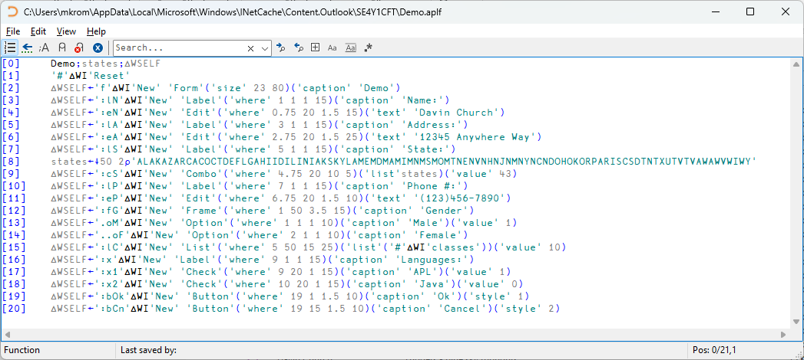

Slide 32
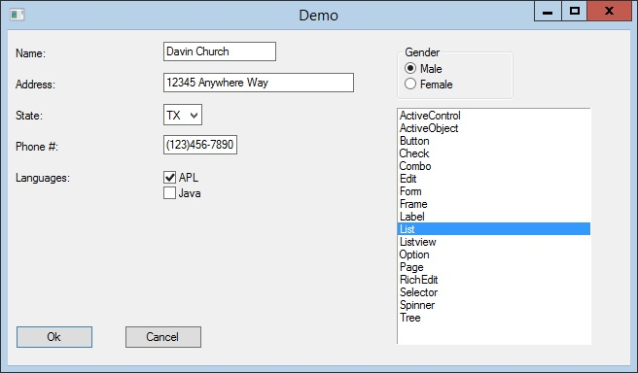

Slide 33
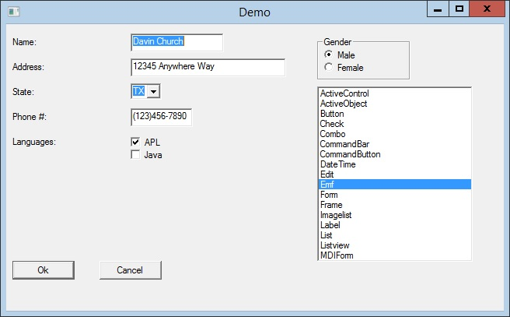
Original
Emulation
(NB: XPLookAndFeel=1)

Slide 34
DeltaWI Implementation
Source code is currently on GitHub at:
https://github.com/DavinChurch/DeltaWI
  Feel free to review code or submit contributions
Design document available upon request
All free and open source (but will be supported)

Slide 35
Data
We have tools to support binary transfer of data in batch or real time between APL systems
Will be published, also free and open-source
  (will require a valid APL+Win licence)

Slide 36
Summary
dyalog/migration available now from GitHub
  Will be bundled with future Dyalog versions
deltaWI rewrite available from yearend
  Testers welcome
  An EWC-based version (possibly with more restrictions) is possible but not currently scheduled
More work to do on documenting and resolving language differences
  Static Analysis may come in handy for the really tricky (but fortunately really rare) bits

