Slide 1
An APL App End-to-End
Rich Park
APL Evangelist, Dyalog Ltd
Notes:
Give a showcase of tools available to help you build and deploy APL applications

Slide 2
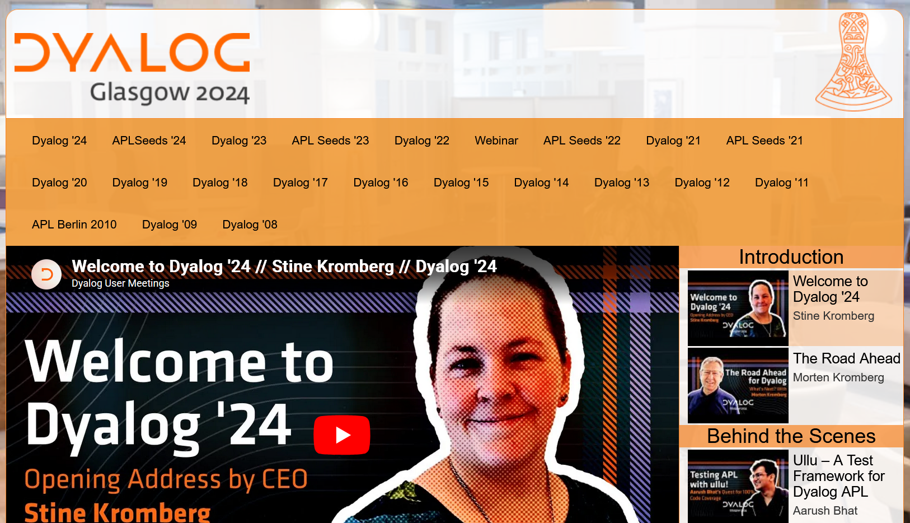
https://dyalog.tv

Slide 3
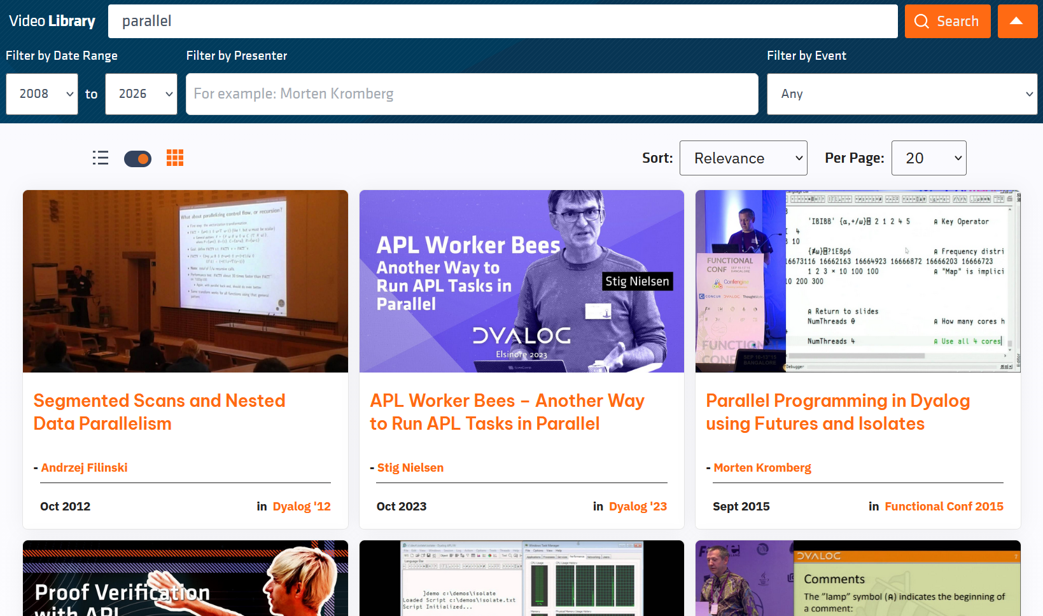

Slide 4
Coming Up…
Architecture Overview
Development Setup
Component Details
  Database
  HTTP Server
  Search and Recommendation

Slide 5
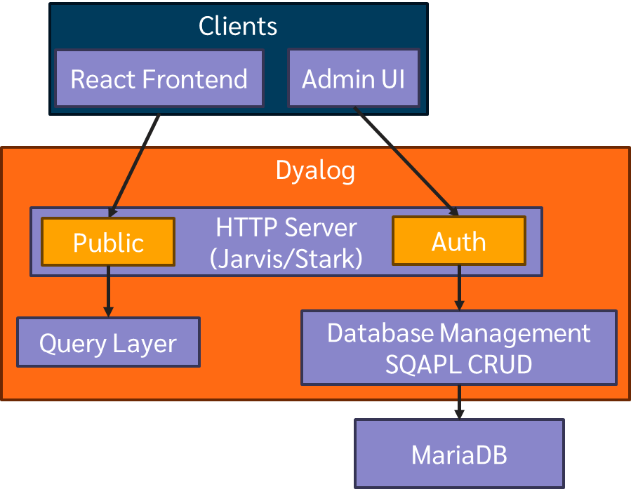
Dyalog Content Management System
(DCMS)

Slide 6
Development & Deployment
Develop in Docker (write once, work anywhere)
Mirror Production in Development
Jenkins Automation for Deployment
Testing
  In APL session
  In local Docker
  In continuous deployment pipeline
Reduce "works on my machine" issues

Slide 7

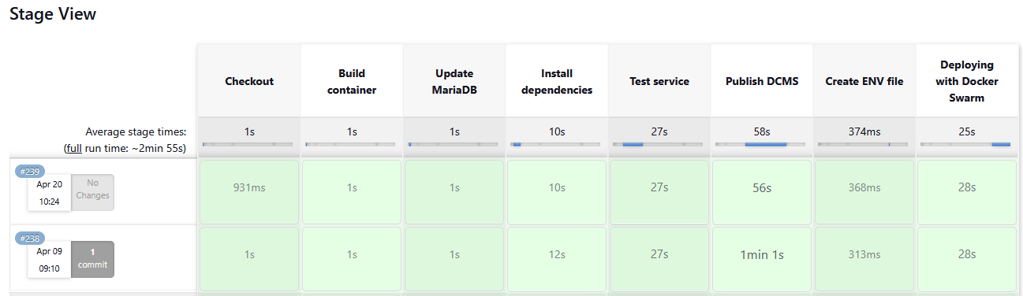
Development & Deployment

Slide 8
Tatin & NuGet Packages
apl-dependencies.txt
dyalog-HttpCommand-5.9.3
dyalog-Jarvis-1.20.5
dyalog-NuGet-0.2.5
bkaw-Stark-0.1.10 (not yet public)

Slide 9
Tatin & NuGet Packages
]tatin.listpackages
Registry: https://tatin.dev ≢ 70
Group & Name # major versions
------------ ----------------
abrudz-ColSchemes 1
abrudz-sort 1
··············································
sjt-translate 1
tiamatica-Mutsu 1
tiamatica-Notela 1

Slide 10
Tatin & NuGet Packages
NuGet: library of .NET tools
Can use from APL with ⎕USING
Porter2Stemmer NuGet package
Stem¨(
'analytic'
'analytics'
'analytically'
)
analyt analyt analyt

Slide 11
Tatin & NuGet Packages
NuGet.Setup'/app/nuget-packages'
NuGet.Add 'Porter2Stemmer'
DCMS.⎕USING←NuGet.Using'/app/nuget-packages'
,/app/nuget-packages/published/Porter2Stemmer.dll
,/app/nuget-packages/published/_nuget-packages.dll
Stem¨(
'analytic'
'analytics'
'analytically'
)
analyt analyt analyt

Slide 12
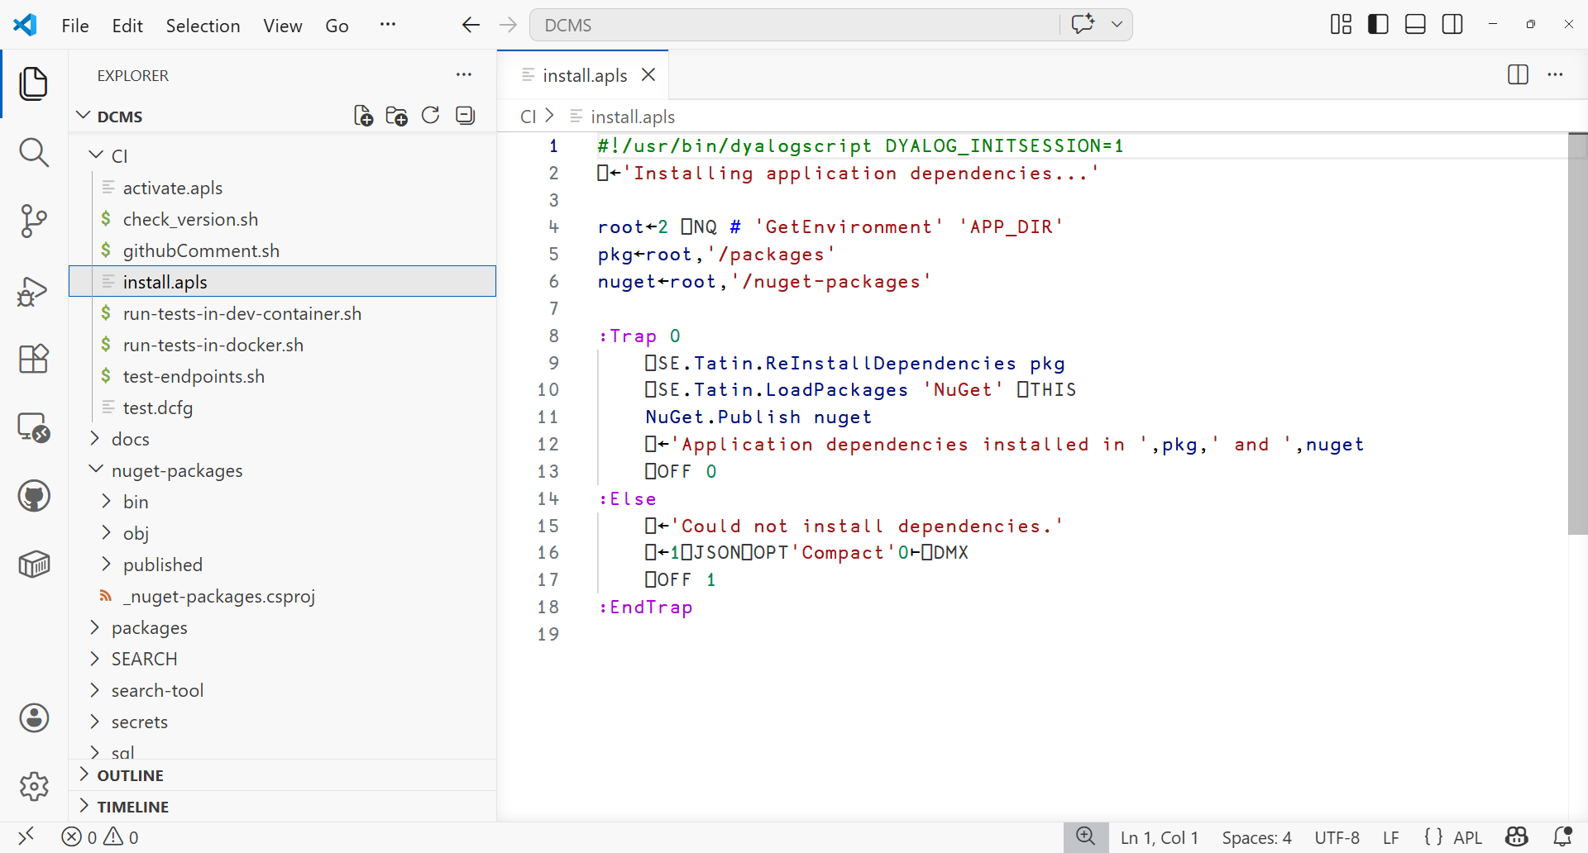


Slide 13
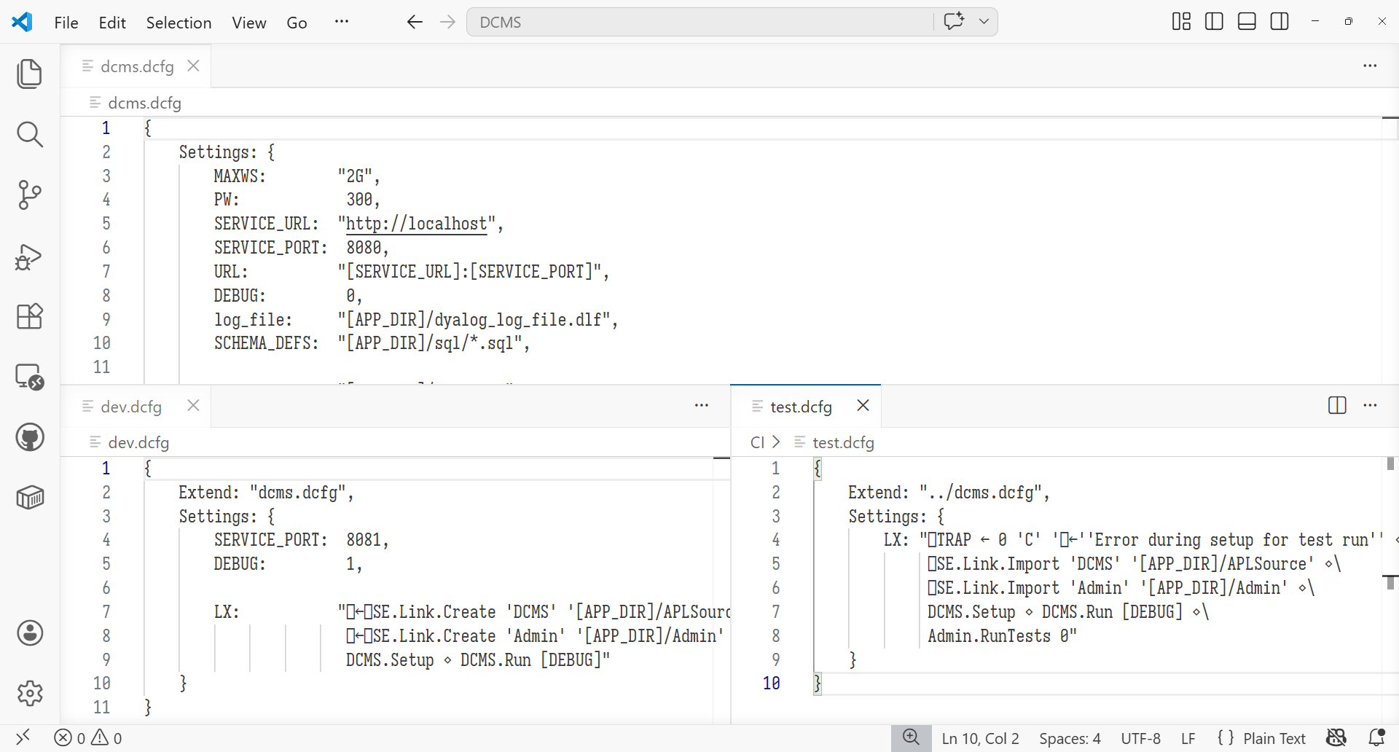

Slide 14
demo.dcfg
{
Settings: {
MAXWS: "2G",
LX: "⎕←'Hi, I was launched from [CONFIGFILE]!'"
}
}

Slide 15
demo.dcfg
{
Settings: {
MAXWS: "2G",
LX: "⎕←'Hi, I was launched from [CONFIGFILE]!'"
}
}
> .\dyalog.exe CONFIGFILE=\tmp\demo.dcfg

Slide 16
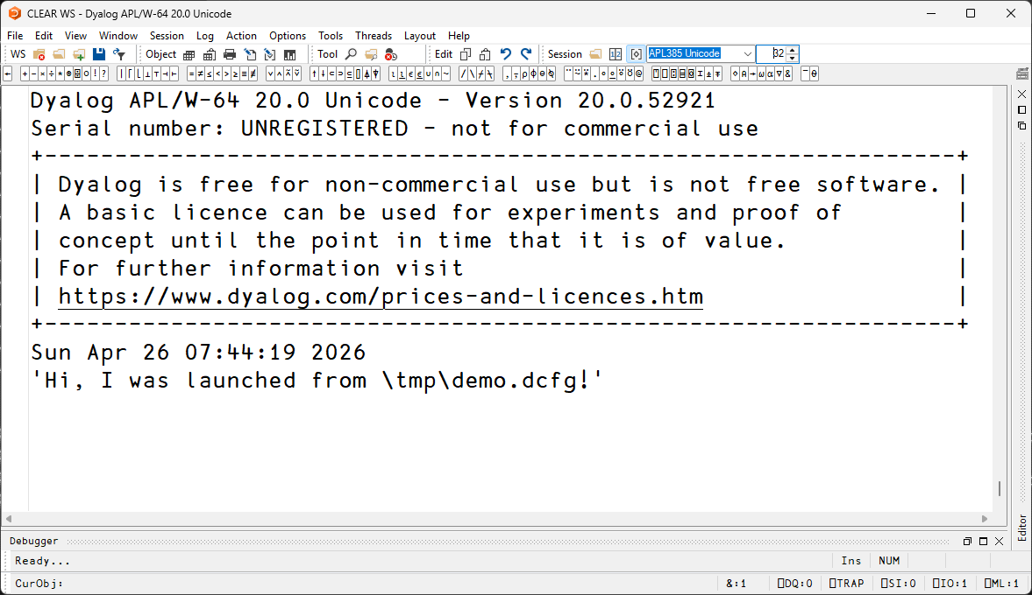
demo.dcfg
{
Settings: {
MAXWS: "2G",
LX: "⎕←'Hi, I was launched from [CONFIGFILE]!'"
}
}
> .\dyalog.exe CONFIGFILE=\tmp\demo.dcfg

Slide 17
Clients
React Frontend
Admin UI
Dyalog
HTTP Server
(Jarvis/Stark)
Public
Auth
Query Layer
Database Management
SQAPL CRUD
MariaDB

Slide 18
MariaDB

Slide 19
MariaDB

Slide 21
MariaDB
Data integrity
  Database normalization
  Foreign key constraints
Share data source with other apps

Slide 22
Clients
React Frontend
Admin UI
Dyalog
HTTP Server
(Jarvis/Stark)
Public
Auth
Query Layer
Database Management
SQAPL CRUD
MariaDB

Slide 23
CRUD
API: Create, Read, Update, Delete
SQL: INSERT, SELECT, UPDATE/SET, DELETE
sql←'SELECT col1,col2 FROM table :>type1,type2:'
SQA.Prepare cursor
SQA.Exec cursor
data←2⊃SQA.Fetch cursor

Slide 24
CRUD
API: Create, Read, Update, Delete
SQL: INSERT, SELECT, UPDATE/SET, DELETE
SQL.Select(table:table_name ⋄ columns:fields)

Slide 25
CRUD

Slide 26
Clients
React Frontend
Admin UI
Dyalog
HTTP Server
(Jarvis/Stark)
Public
Auth
Query Layer
Database Management
SQAPL CRUD
MariaDB

Slide 27
HTTP Server
Jarvis REST mode
REST: Principles for resource management
HTTP: POST GET PATCH DELETE
API: Create Read Update Delete
Stark REST router (experimental)
'/crud/{table}' router.Get 'CRUD.Read'
+ OpenAPI spec generator!

Slide 28
OpenAPI
Standardized framework for REST API specification
Well supported tooling and interoperation

Slide 29
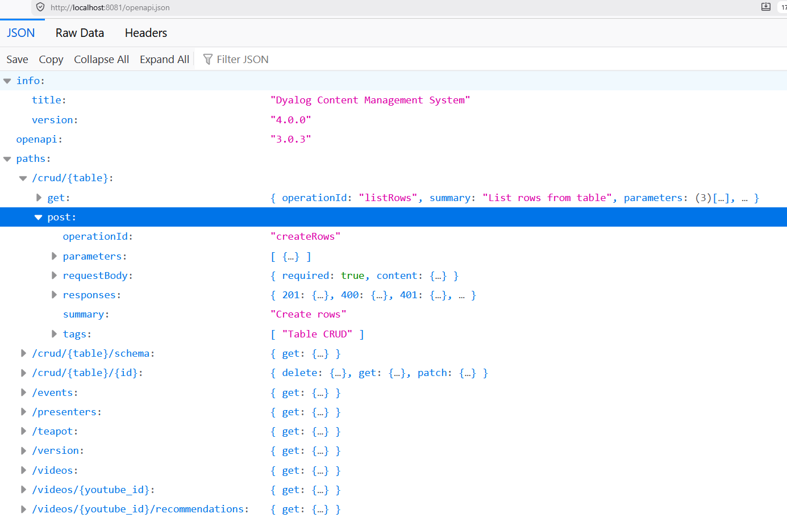

Slide 30
SQL Tables to JSON Objects
APL matrix/table from SQL database
REST service provides JSON
⎕JSON wrappers!

Slide 31
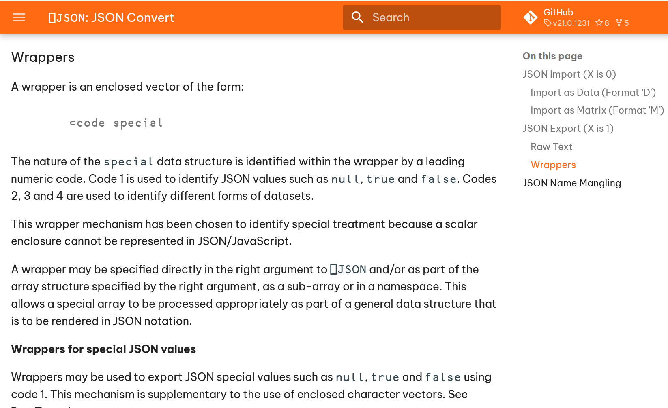
SQL Tables to JSON Objects
Get back matrix/table from SQL database
REST service gives JSON
⎕JSON has wrappers

Slide 32
Table2JSON←{
1 ⎕JSON⊂2,⊂⍵
}
[{
age: 42,
is_cool: false,
name: "Tom",
},
{
age: 56,
is_cool: true,
name: "Dick",
},
{
age: 37,
is_cool: true,
name: "Asher",
}]
┌─────┬───┬───────┐
│name │age│is_cool│
├─────┼───┼───────┤
│Tom │42 │┌─────┐│
│ │ ││false││
│ │ │└─────┘│
├─────┼───┼───────┤
│Dick │56 │┌────┐ │
│ │ ││true│ │
│ │ │└────┘ │
├─────┼───┼───────┤
│Asher│37 │┌────┐ │
│ │ ││true│ │
│ │ │└────┘ │
└─────┴───┴───────┘
json←Table2JSON matrix

Slide 33
Table2JSON←{
1 ⎕JSON⊂2,⊂⍵
}

Slide 34
CRUD/Create.aplf
our_values←↑req.Payload ⎕VGET column_names
inserted←SQL.Insert(
table:table_name ⋄ columns:column_names
values:our_values ⋄ returning:our_cols
)
r←Table2JSON our_cols⍪inserted

Slide 35
CRUD

Slide 36
Clients
React Frontend
Admin UI
Dyalog
HTTP Server
(Jarvis/Stark)
Public
Auth
Query Layer
Database Management
SQAPL CRUD
MariaDB

Slide 37
Query Layer
Search
Filter
Recommendations

Slide 38
Search
Term-frequency inverse-document-frequency
Common words count less towards results
term_count←⍉↑(+/⍷∘docs)¨terms
relevant_vids←⍸∨/0<term_count
tf←term_count[relevant_vids;]
df←+⌿tf
tf_idf←tf+.÷df
relevant_vids[⍒tf_idf]

Slide 39
Search
term_count←⍉↑(+/⍷∘docs)¨terms
relevant_vids←⍸∨/0<term_count
tf←term_count[relevant_vids;]
df←+⌿tf
tf_idf←tf+.÷df
relevant_vids[⍒tf_idf]

Slide 40
Query Layer
Search
Filter
Recommendations

Slide 41
Filter Date Range
⎕←ddn←DT2DDN '2026-04-27 09:30:00'
46138.39583
(from∘≤∧≤∘to)ddn

Slide 42
Filter Date Range
DT2DDN←{1 ⎕DT 2⊃¨'- :'∘⎕VFI¨⊆⍵}
FormatDateTime←{⍺(1200⌶)⍵}
⎕←ddn←DT2DDN '2026-04-27 09:30:00'
46138.39583
'YYYY-DD-MM hh:mm:ss' FormatDateTime ddn
2026-27-04 09:30:00

Slide 43
Filter Date Range
DT2DDN←{'YYYY-MM-DD hh:mm:ss' 1 ⎕DT⊆⍵}
FormatDateTime←⎕DT
⎕←ddn←DT2DDN '2026-04-27 09:30:00'
46138.39583
'YYYY-DD-MM hh:mm:ss' FormatDateTime ddn
2026-27-04 09:30:00
v21.0

Slide 44
Filter Date Range
DT2DDN←{'%ISO%' 1 ⎕DT⊆⍵}
FormatDateTime←⎕DT
⎕←ddn←DT2DDN '2026-04-27T09:30:00'
46138.39583
'%ISO%' FormatDateTime ddn
2026-27-04T09:30:00
v21.0

Slide 45
Query Layer
Search
Filter
Recommendations

Slide 46
Recommendations

Slide 47
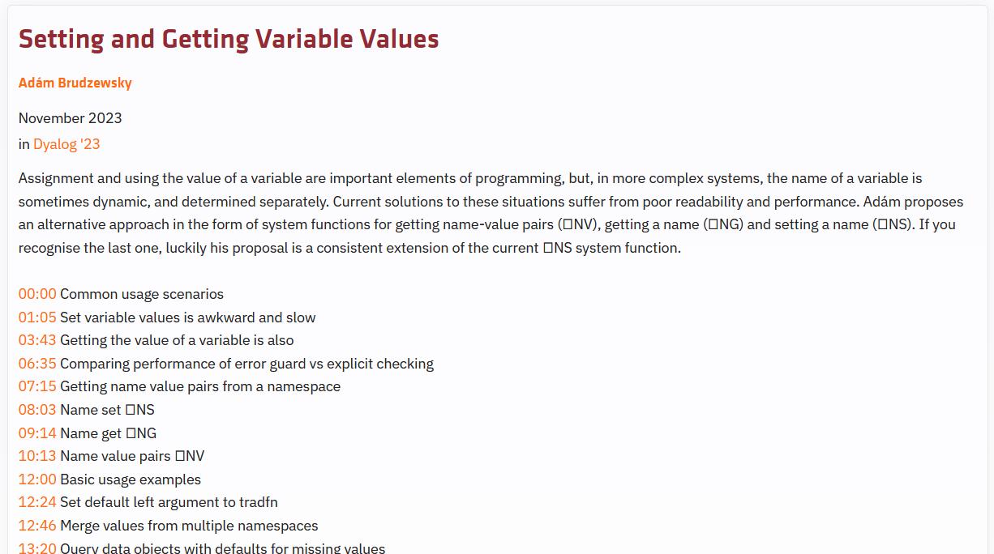

Slide 48
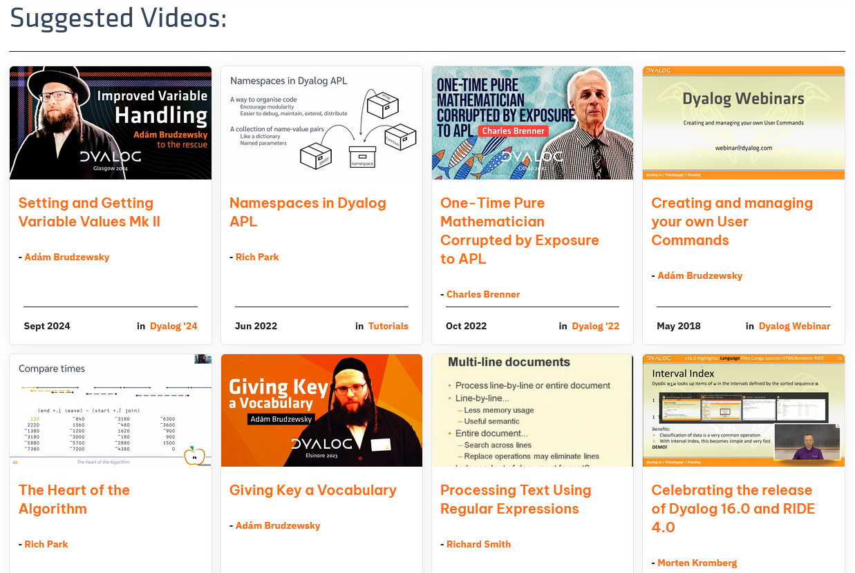

Slide 49
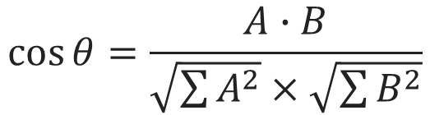

Cosine Similarity
$$A∙B=\left|A\right|\left|B\right|\cos{θ}$$
$$\cos{θ}=\frac{A∙B}{\sqrt{\sum{A^{2}}}×\sqrt{\sum{B^{2}}}}$$
θ
(c+.×⍉c)÷∘.×⍨0.5*⍨+/c*2

Slide 50
Cosine Similarity
Isn't that expensive?
Yes
Isolates

Slide 51
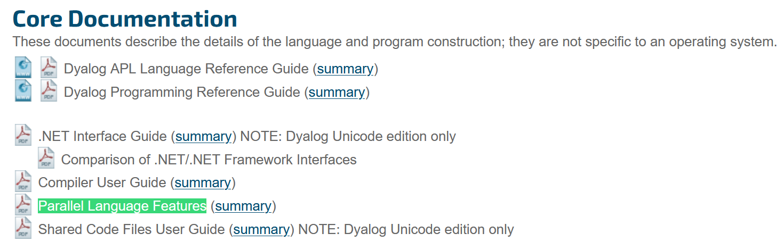
Isolates
Expensive computations in-process block incoming requests
https://www.dyalog.com/documentation_200.htm

Slide 52
Isolates
#.⎕CY'isolate'
II←#.II ⋄ Values←#.isolate.Values
vids←CACHE.videos
data←vids.index_cols⌷⍨⊂vids.fields⍳⊆'title' 'description' 'presenter'
recommendations←videos.ComputeRecommendations II data
:If 0=⎕NC'vids.recommendations'
vids.recommendations←1⍴⍨s,0⌈¯1+s←≢vids.values
:EndIf

Slide 53
Meanwhile…
… in the Recommendations endpoint function
Values←#.isolate.Values
⍝ Use existing values unless the ComputeRecommended
⍝ isolate has finished processing
vids.recommendations←⊃vids.recommendations Values'##.recommendations'

Slide 54
Clients
React Frontend
Admin UI
Dyalog
HTTP Server
(Jarvis/Stark)
Public
Auth
Query Layer
Database Management
SQAPL CRUD
MariaDB

Slide 55
github.com/Dyalog/DCMS
dyalog.com/tools/tools-and-code-libraries.htm

