Slide 1

The Dyalog
Road Map
Morten Kromberg
CTO

Slide 2

The Dyalog
Road Map
Morten Kromberg
CTO

Slide 3
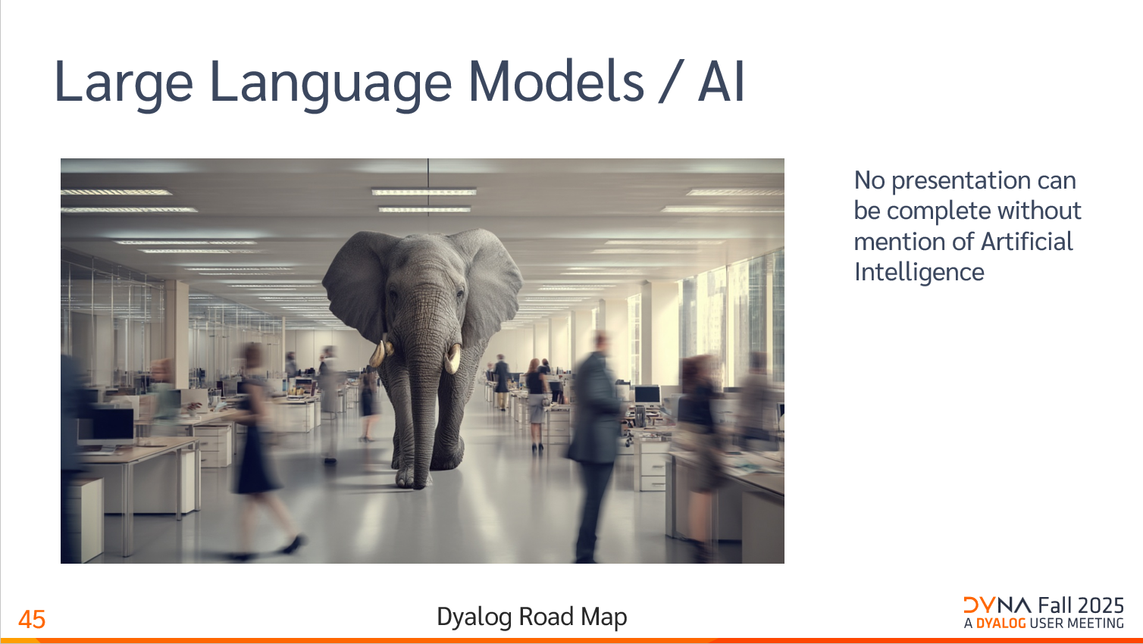

Slide 4
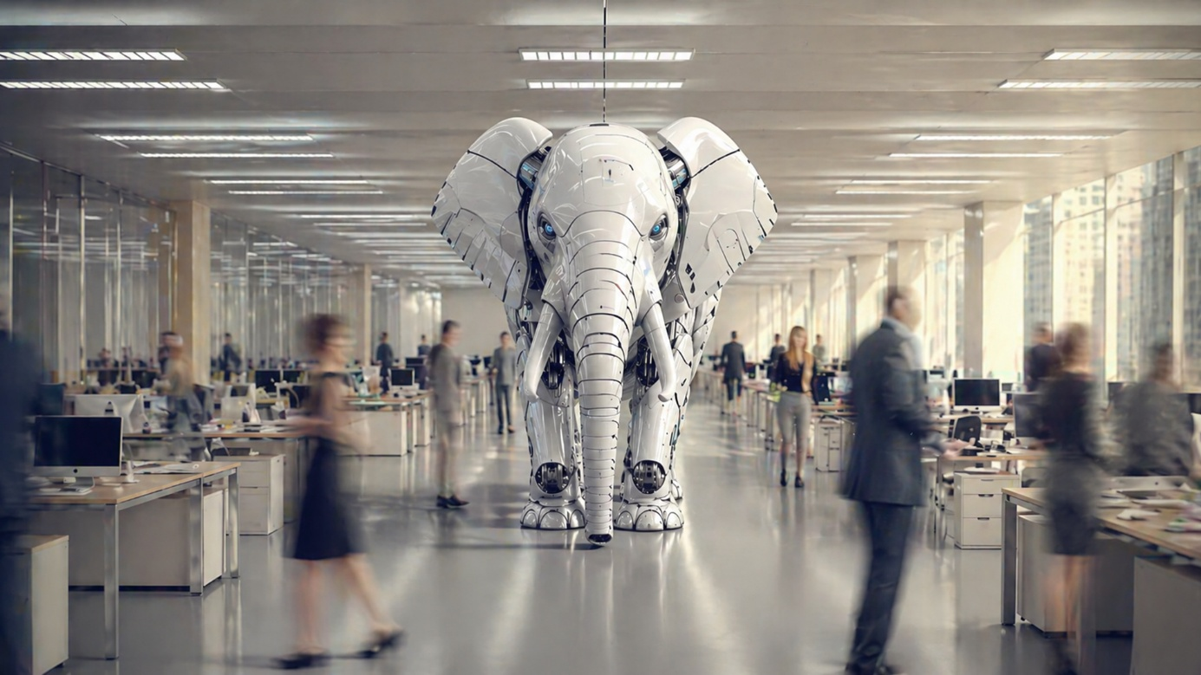
Large Language Models / AI
Nobody can afford to ignore LLMs.

Slide 5
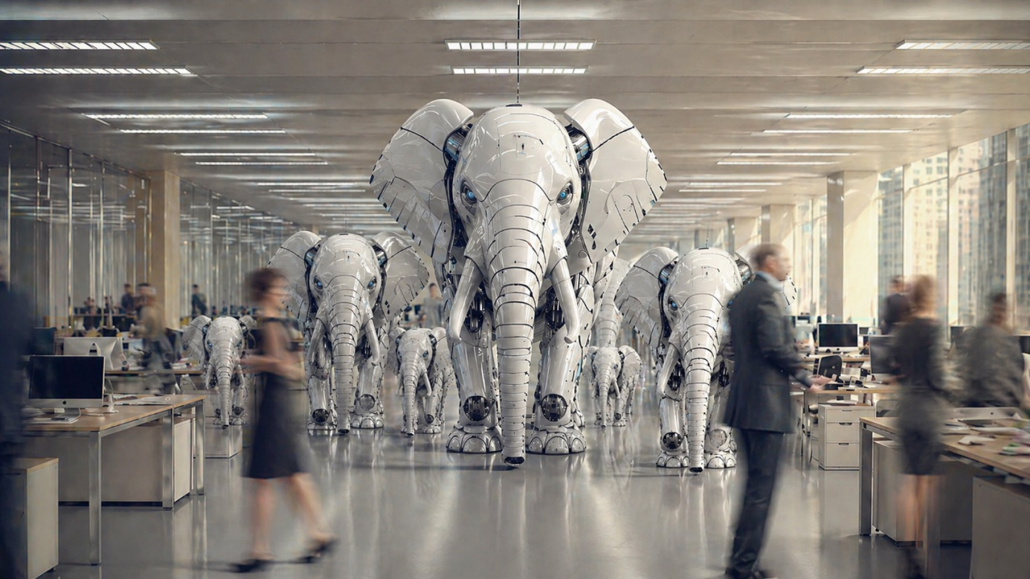

Large Language Models / AI
Nobody can afford to ignore LLMs.
Mike Mingard

Slide 6

Model improvements
Smarter, not bigger
Significant improvement in coding performance
Console agents are capable of hours' of unsupervised work
In your terminal, in the cloud, in your GitHub, on your phone
In skilled hands, capable of producing production-grade code in sweet spot languages

Slide 7
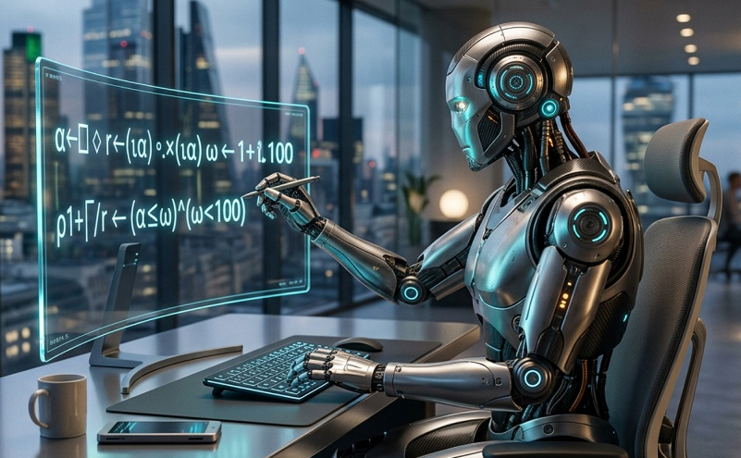
APL Improvements
Last year, models could kinda explain moderately complex APL
...but not reliably write it
A year later, they're assisting in writing more complex APL applications
...in the hands of a capable practitioner!
...and with one or two tooling injections

Slide 8
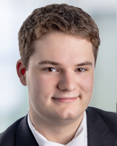

"Claude is the new Quad"
(Stephen Taylor)
Turn your application into a service with good documentation
  (Holden will show you one way to do that later)
Let Claude write the GUI
  Claude is really good at JavaScript
  (Brian will show an example of this later)
But guess what…
Holden Hoover
Brian Becker

Slide 9
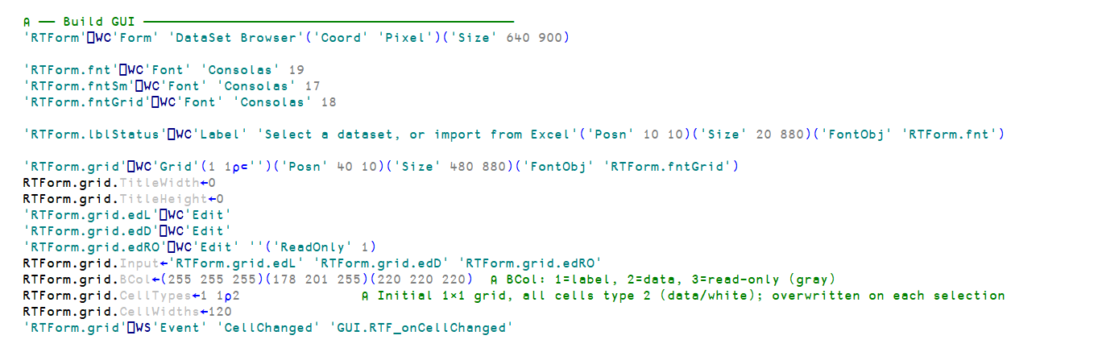
Claude can do ⎕WC too

Slide 10
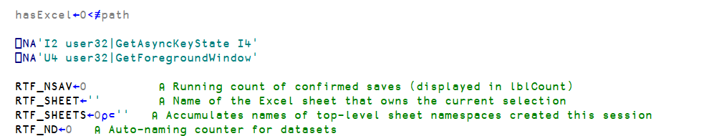
Building GUI in APL with Claude

Slide 11
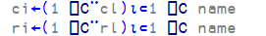
Building GUI in APL with Claude
Less impressive is…

Slide 12
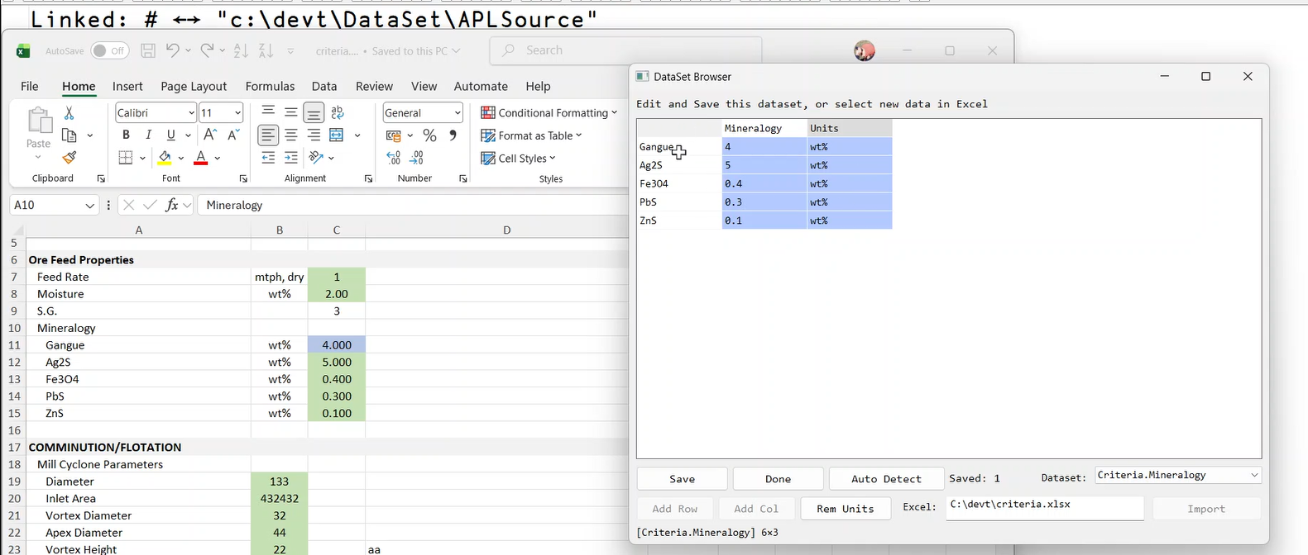
Building GUI in APL with Claude
Less impressive is…

Slide 13
Building GUI in APL with Claude
… and some “mistakes”

Slide 14
OK, so Claude can do ⎕WC
What about cross-platform GUI in APL?

Slide 15
EWC (Everywhere WC)
Cross-platform emulation of ⎕WC
  Reproduce legacy GUI in the cloud
  Also support CSS and Flex to allow modernization
Prototype implementation by external consultant was extremely poor
Being rebuilt by internal resource [will be re-launched later this year]
With some help from Claude …

Slide 16


EWC Tests and Tutorial
Created by Claude based on documentation and a few code samples
... guided by ...
Neil Kirsopp
Aarush Bhat

Slide 17
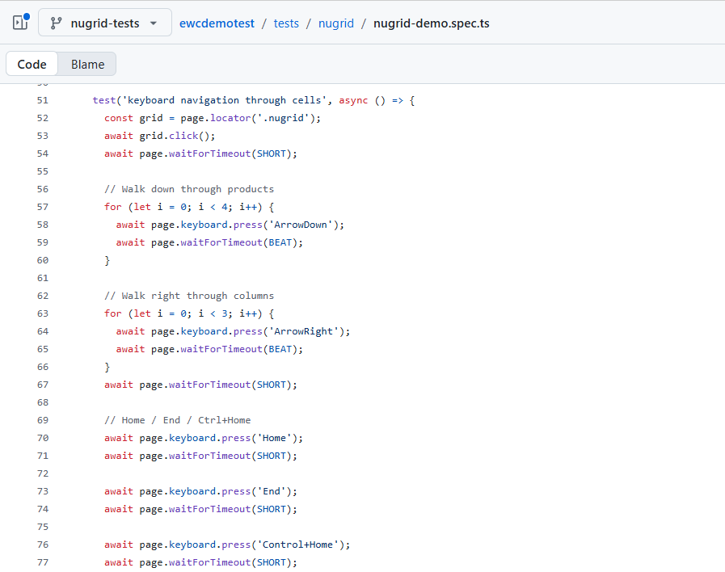

Slide 18
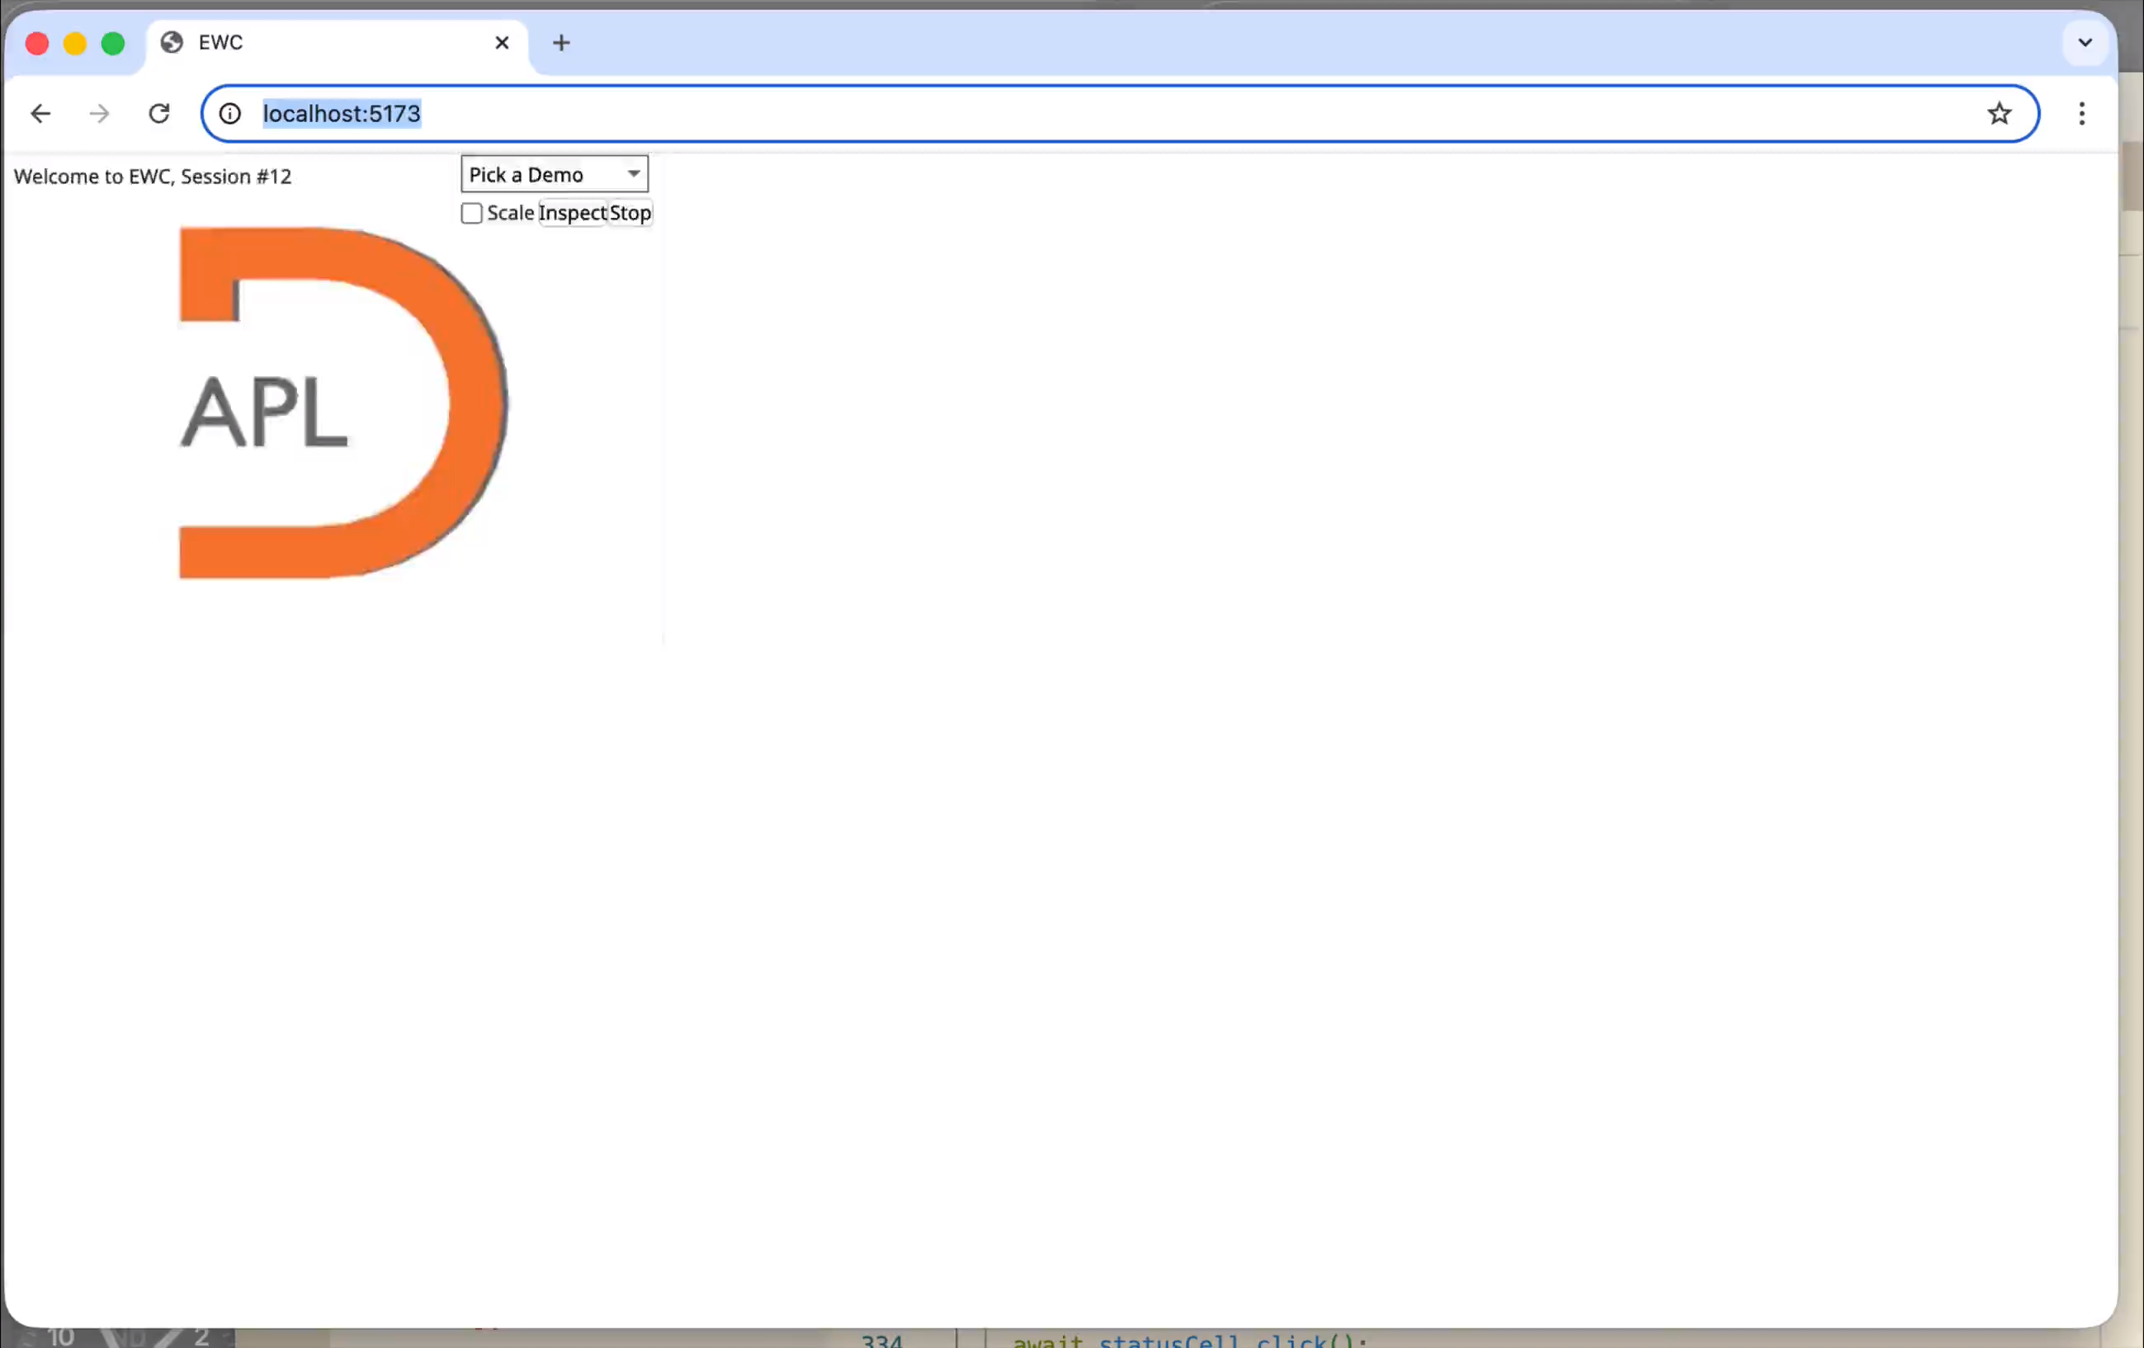

Slide 19
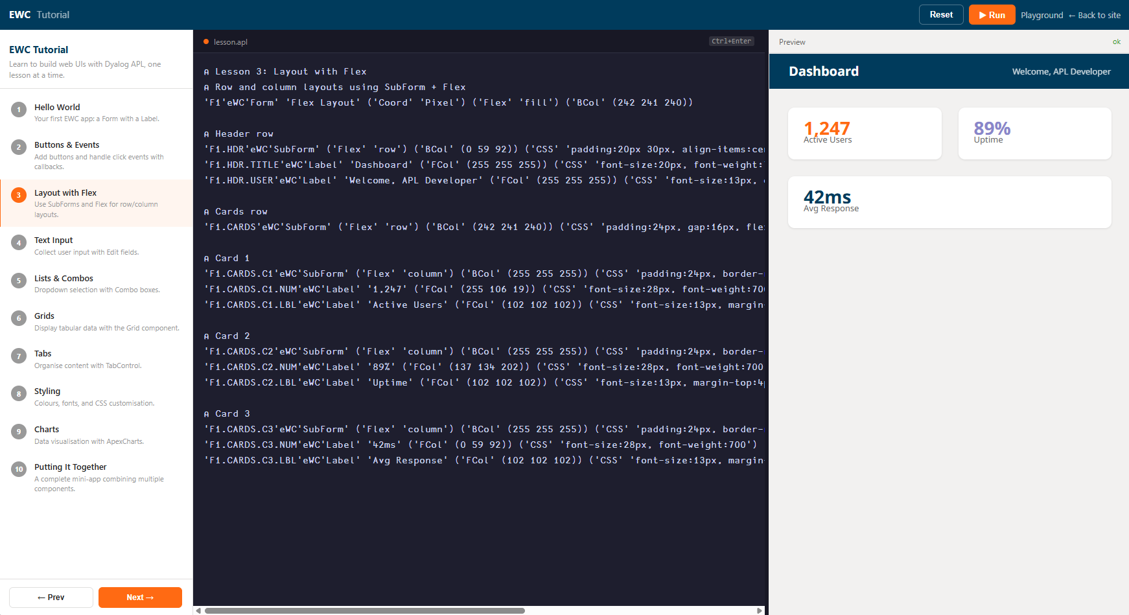

Slide 20
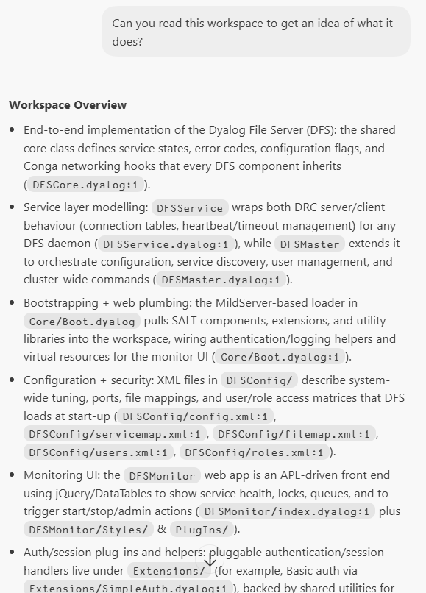
LLMs write documentation

Slide 21
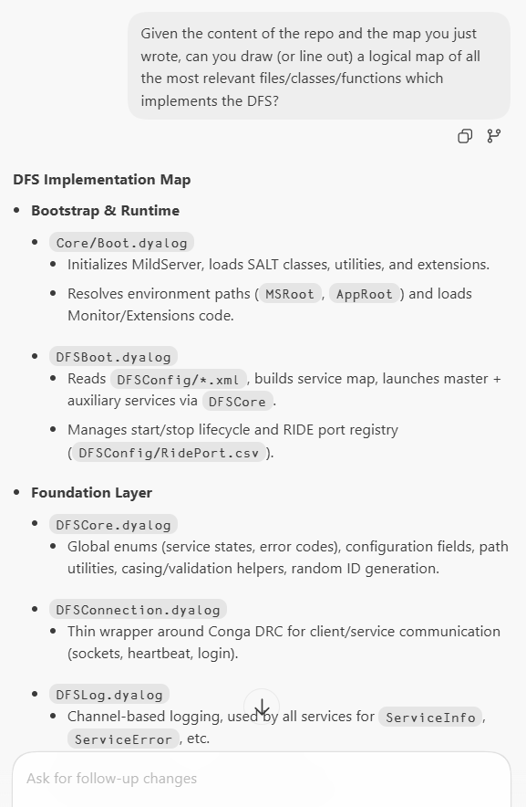
LLMs write documentation

Slide 22
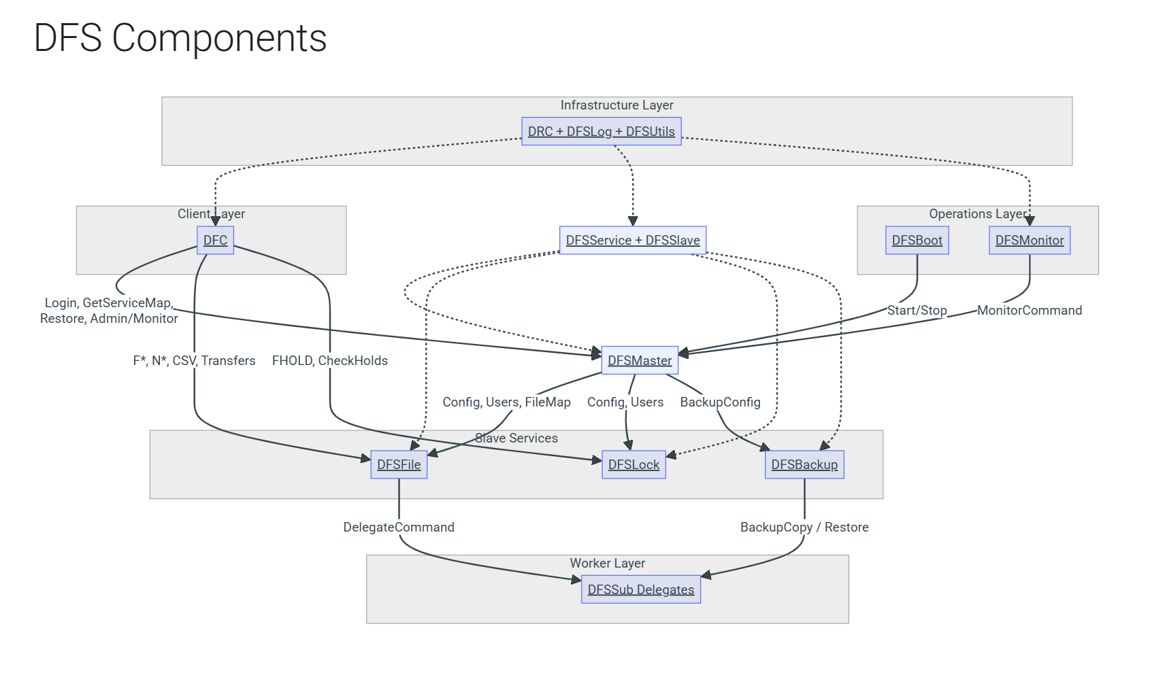
LLMs write documentation

Slide 23
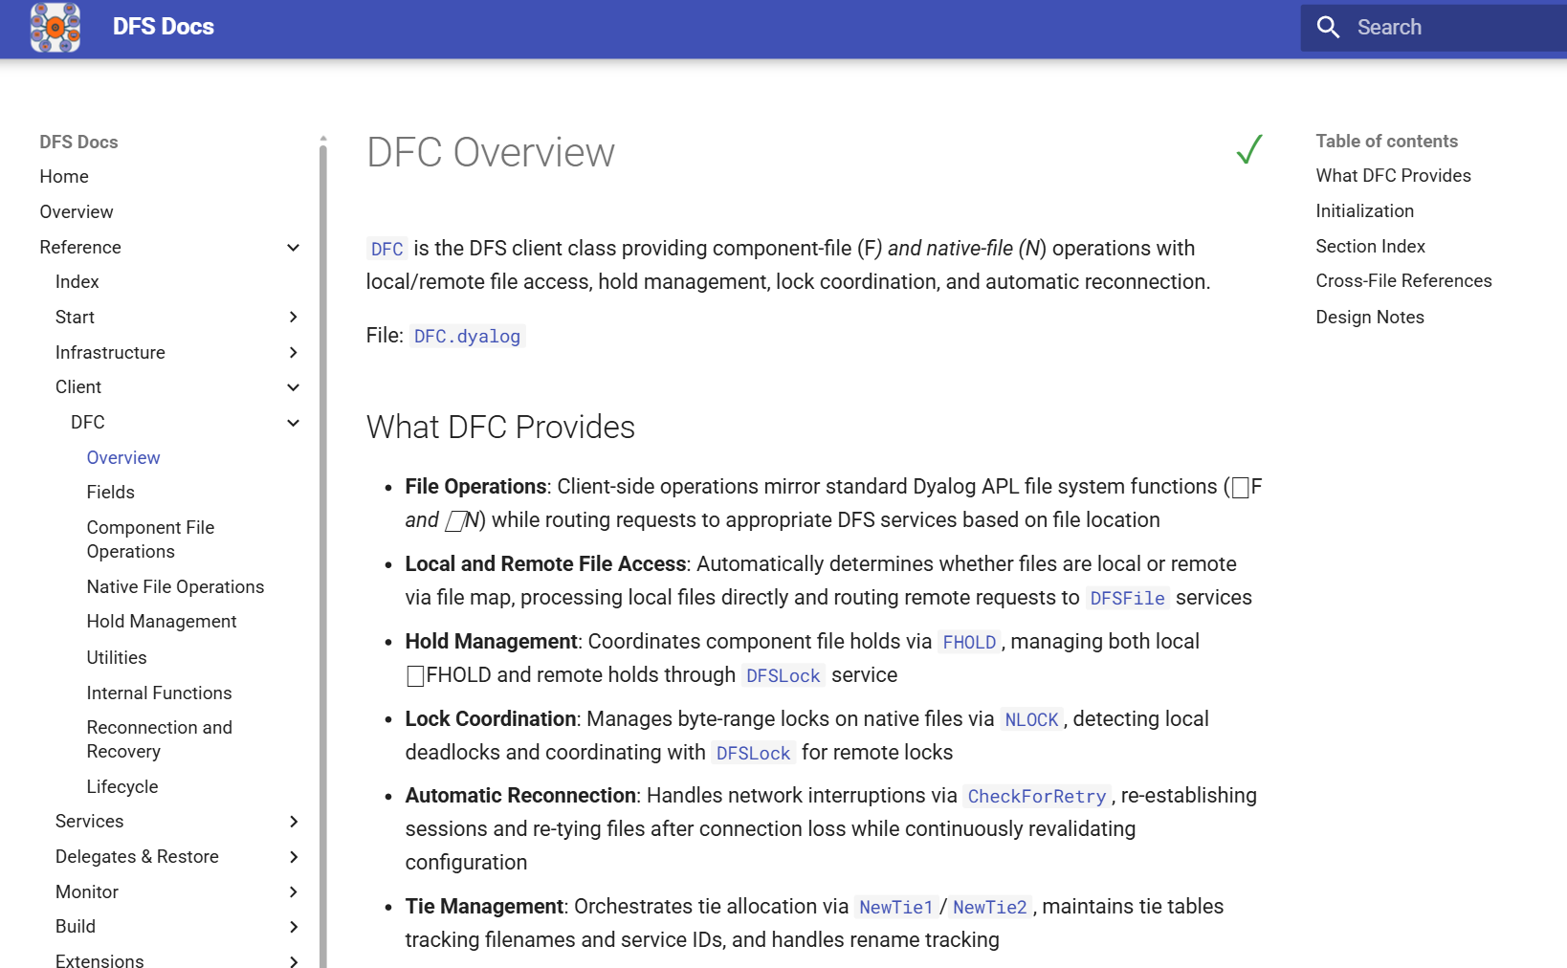
LLMs write documentation
Scan the codebase
Obtain a map
Write the documentation for each file in a .md file
Build mkdocs and populate it
NB A developer MUST review ALL the generated text!!!

Slide 24

Building Prototypes
LLMs are extremely good at building UI on top of well-documented APIs
Dyalog's RIDE protocol is open source
Gilgamesh Athoraya once created a VS Code debug adapter communicating with the interpreter via the RIDE protocol
Why not ask Claude to create a VS Code plugin that "mashes that up"?
Gilgamesh Athoraya

Slide 25
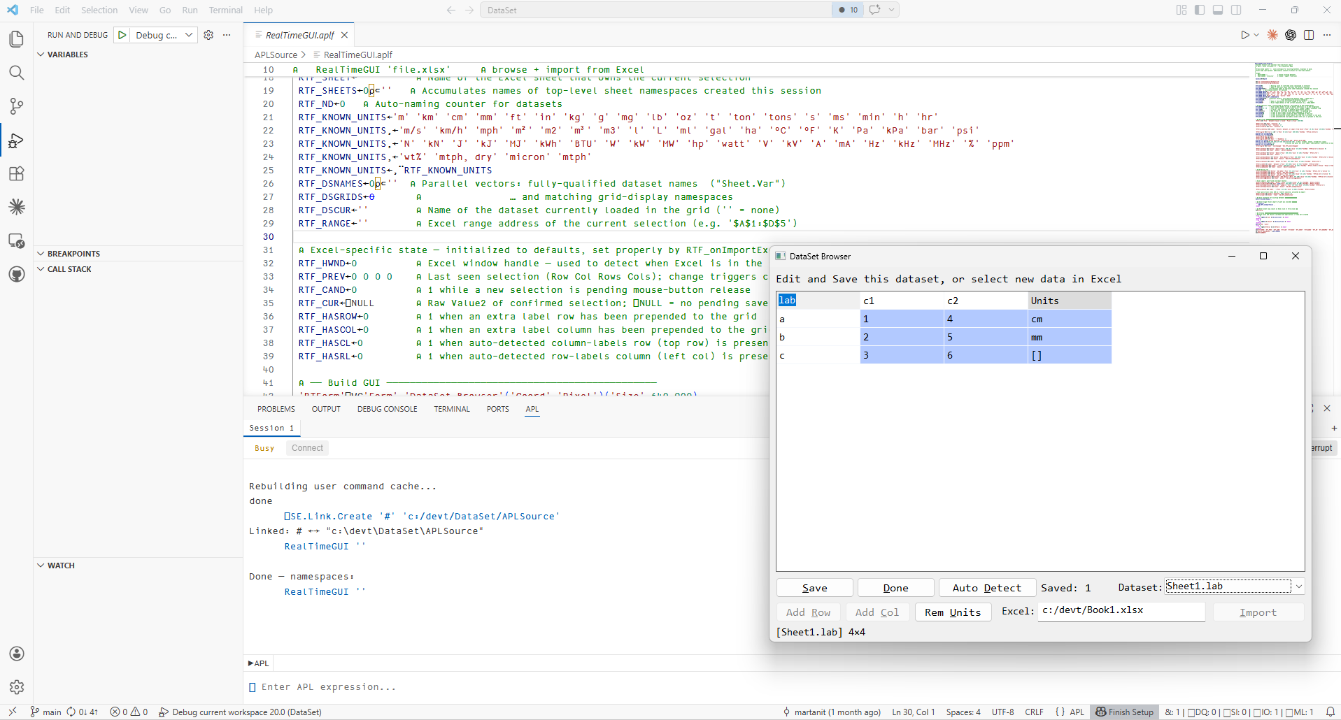
VSC Plugin – Interactive APL Session

Slide 26
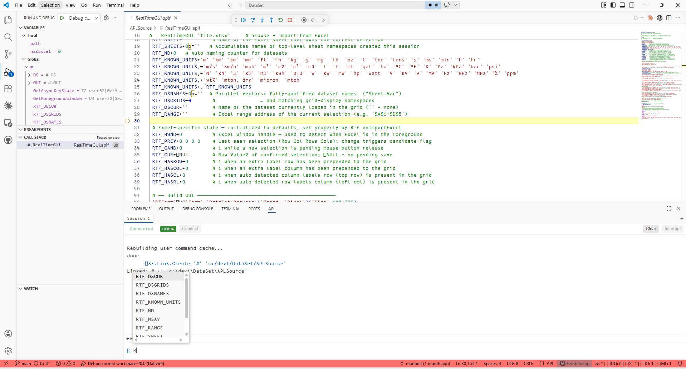
VSC Plugin – Debugging

Slide 27
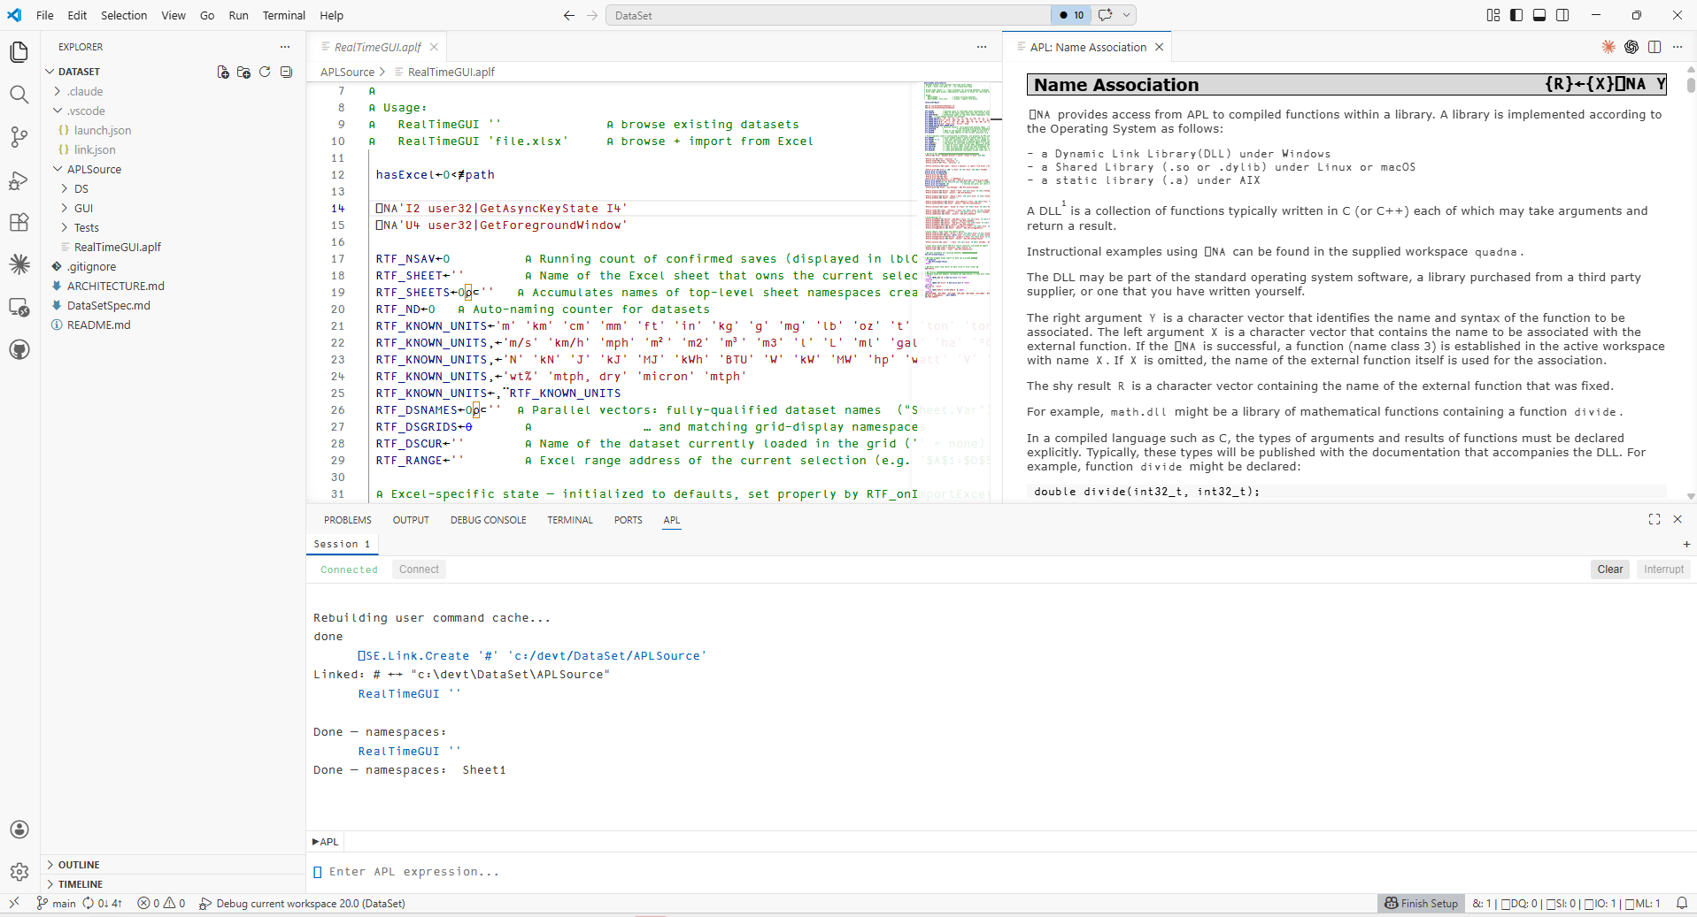
VSC Plugin – Documentation

Slide 28
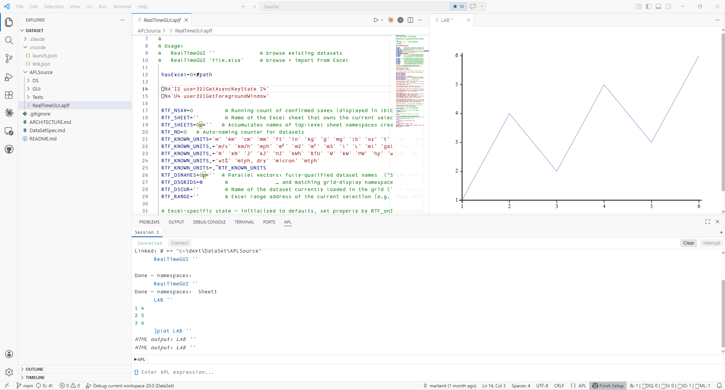
VSC Plugin – HTML Graphics

Slide 29
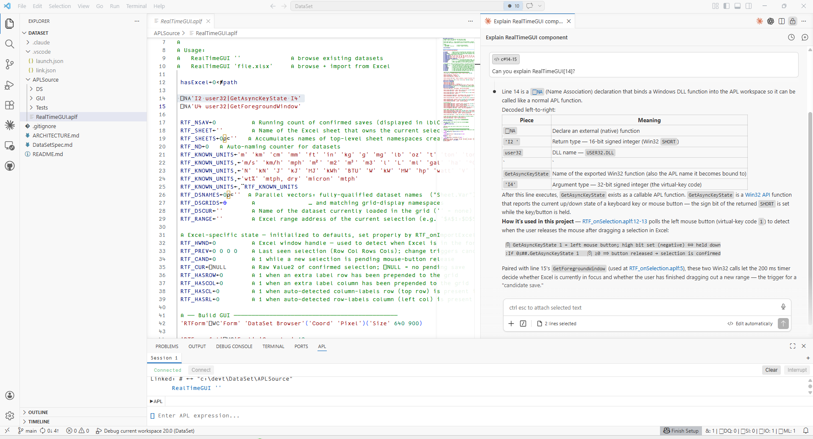
VSC Plugin – Claude Code

Slide 30
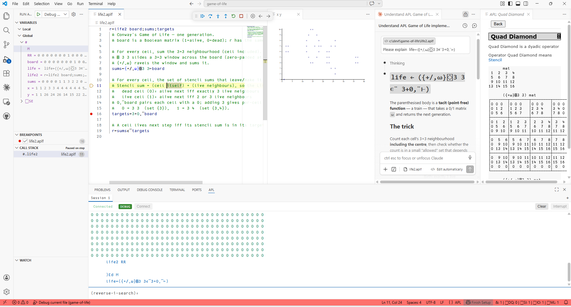
VS Code extension

Slide 31

VS Code Plugin - Summary
About one week of work by a gifted developer working with Claude
Code has been reviewed
Not ready to be supported by Dyalog
Rumor has it at least half a dozen similar projects exist at client sites
Martina Crippa

Slide 32
Summary – AI Productivity Gains
Biggest gains still in the "APL adjacent" areas -- curiously good at .NET, ⎕NA, ⎕WC and EWC (!)
Great at writing C# and APL interfaces to this
Great at writing Web UIs for a Jarvis service
Good at following the style of existing code, including trad, OO or dfns
Good at generating -- and running -- unit tests and writing documentation
Good at finding bugs and flaws in designs and code

Slide 33
Dyalog Internal AI Policy
Anyone wishing to publish or make long-term use of LLM generated materials must take FULL responsibility for the content
  The AI might disappear or change its behaviour
  The AI might become very much more expensive
No personal or customer data may be exposed to an AI without explicit permission
Free AI tools without protections are prohibited, except for experimentation with formal approval

Slide 34

Dyalog's AI Strategy
Experimenting a lot with LLMs
Exposing documentation and code to help train LLMs
Making APL easy for an LLM to call via the command line in order to
  Pair programme with you
  Verify generated code
EVEN more focus on APL source in text files
Stefan Kruger

Slide 35
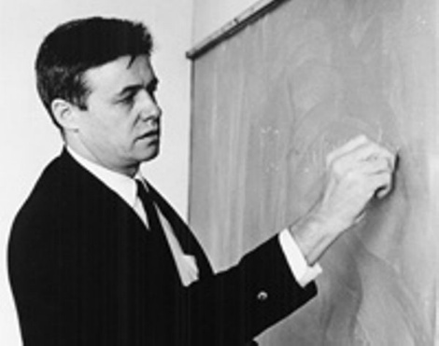
Future of APL in an AI World
If nobody wants to think any more, does anyone need a "Tool of Thought"?
Can one imagine…
APL as an efficient tool of "thought" for LLMs?
  The cost of running LLMs will soon matter
APL as a better way to write some "prompts"?
  English works well if you can refer to pre-existing, well-understood solutions
APL as a way to write easily comprehensible, modifiable and verifiable specifications?
Ken Iverson

Slide 36
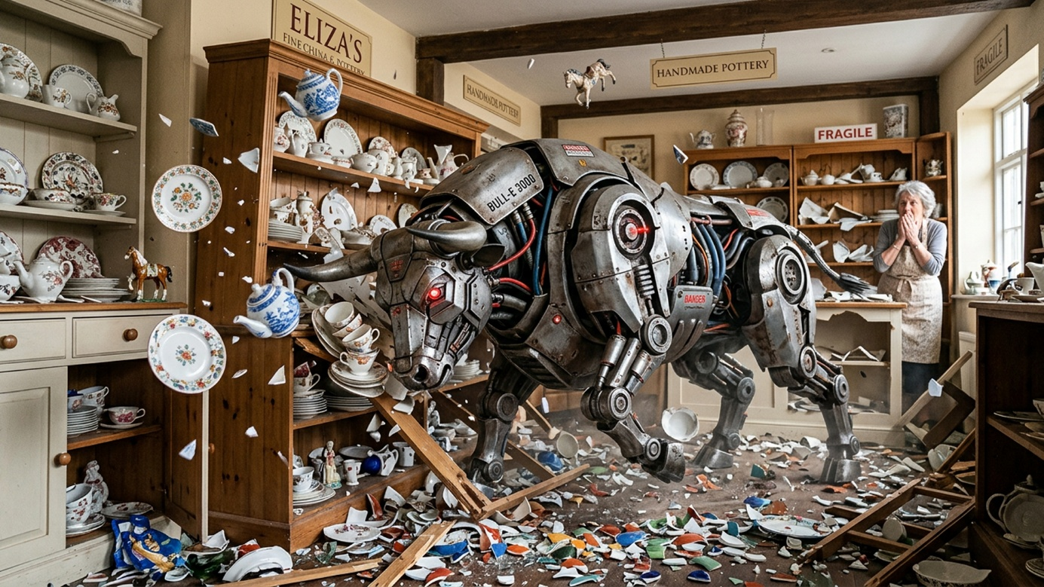
Other Dangerous Wildlife
Security requirements potentially make life much harder for the domain expert.

Slide 37




What we do well
CEO-led SSG with security at every stage of development • Continuous fuzz testing, SAST on all C/C++ code • Formal open-source approval and CVE monitoring • All staff trained twice per year
Software Security
at Dyalog
The honest bit
BSIMM16 Assessment
We are doing more than we are getting credit for — but several real gaps remain. Good practices exist across the organization; not all of them are visible, documented, or repeatable enough for an external assessor to verify.
Independent assessment by
Black Duck Software
March 2026
30
What we are fixing
Centralizing security policies and metrics into a single reportable framework
Commissioning third-party penetration testing of our core product and external services
Extending static analysis to APL code — C/C++ is covered, APL is next
Introducing Static Code Analysis tooling and SBOM generation for customers who need full supply chain transparency
OF 128 ACTIVITIES OBSERVED
Top of our peer group
in Strategy & Metrics
We assess, we measure, and we improve — next independent assessment planned for 2029

Slide 38

Software Security @ Dyalog
What we are fixing
Centralizing security policies and metrics into a single reportable framework
Commissioning third-party penetration testing of our core product and external services
Extending static analysis to APL code — C/C++ is covered, APL is next
Introducing Static Code Analysis tooling and SBOM generation for customers who need full supply chain transparency
CEO Stine Kromberg
(with Claude)

Slide 39

Software Bill of Materials - SBOM
A growing requirement for clients distributing Dyalog APL as a component
We will include an SBOM with future Dyalog APL distributions
Richard Smith

Slide 40
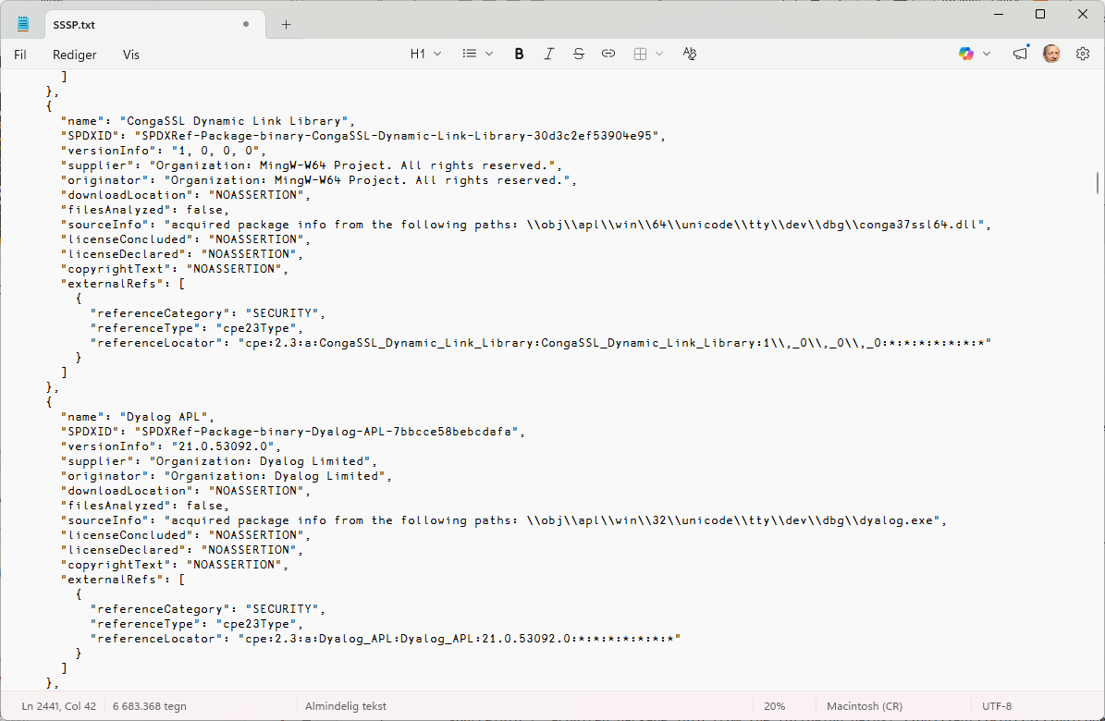
Software Bill of Materials - SBOM
A documentation requirement for clients distributing Dyalog APL as a component
Will be included with from Dyalog APL version 21.0

Slide 41


Static Code Analysis
Search APL code for known vulnerabilities and "code smells"
Prototype delivered to launch customer this month
  Several large clients seem interested
Initially delivered as a consulting project
  Considering a free community version
Output formats:
  JSON format ingestible by SonarQube
  CSV
  In-workspace arrays
Brandon Wilson
Aaron Hsu

Slide 42
Some Implemented Rules
Id | Name | Description | Quality | Severity
SAST-0001 | Syntax Errors | Code that intentionally induces a SYNTAX ERROR should be expicitly marked with an ignore directive. | RELIABILITY | LOW
SAST-0002 | Insecure connections | Clear text protocols are insecure. Use TLS versions instead. | SECURITY | MEDIUM
SAST-0003 | Fixed Random Seed | Setting ⎕RL to a static value may break Roll and Deal. | SECURITY | MEDIUM
SAST-0004 | Hard-Coded Secrets | Suspicious constant detected. Ensure this isn't a hard-coded secret. | SECURITY | HIGH
SAST-0005 | Code Injection | Detected execution of potentially dangerous user-controlled data. | SECURITY | HIGH
SAST-0006 | Leaked Locals | Semi-globals that might be forgotten localizations. | RELIABILITY | LOW
SAST-0007 | Duplicate Functions | Candidate duplicate functions may want to be unified. | RELIABILITY | LOW
SAST-0008 | Shadow after usage | Shadowing a variable after usage may cause confusion | RELIABILITY | MEDIUM
SAST-0009 | Naked strand assignments | Unparenthesized stranded assignments might be confused as modified assignment. Consider enclosing in parentheses. | RELIABILITY | MEDIUM
SAST-0010 | Unbound variables | These names might trigger a VALUE ERROR. | RELIABILITY | HIGH

Slide 43
In-Workspace Analytics
SUMMARY
10 SAST-0001 Syntax Errors
0 SAST-0002 Insecure connections
3 SAST-0003 Fixed Random Seed
1 SAST-0004 Hard-Coded Secrets
5 SAST-0005 Code Injection
37 SAST-0006 Leaked Locals
2 SAST-0007 Duplicate Functions
0 SAST-0008 Shadow after usage
99 SAST-0009 Naked strand assignments
0 SAST-0010 Unbound variables
2↑VIEW 'SAST-0005'
#.doThing[7] :If readFlag
#.doThing[8] r←⍎someData
#.doThing[9] :EndIf
#.ns.anotherFun[42] args←'--verbose' '--output' out
#.ns.anotherFun[43] exit←4⊃⎕SHELL (⊂'curl')⍪args
#.ns.anotherFun[44] :If exit≠0
'#.entryPoint1' '#.entryPoint2' CALLGRAPH '#.ns.anotherFun'
#.entryPoint1[17] #.combobulate[7 11 13] #.ns.fizzle[7] #.ns.greet[1] #.ns.anotherFun
#.entryPoint2[12] #.ns.anotherFun
'#.entryPoint1' GLOBALS '#.ns.anotherFun'
#.entryPoint1 someVar globalThing setupParam
#.combobulate anotherVar
#.ns.fizzle
#.ns.greet greetingMsg
#.ns.anotherFun

Slide 44

Co-dfns update
Greatly enhanced parser to support Static Analysis project
Coming soon:
"Lexical" Trad-fns with Branch and Labels
Performance enhancements and fixes for C backend / Embedded C backend
Initial Python and JS backends (by End of Year)
Potential Java backend (Next year, depending on demand)
Aaron Hsu

Slide 45
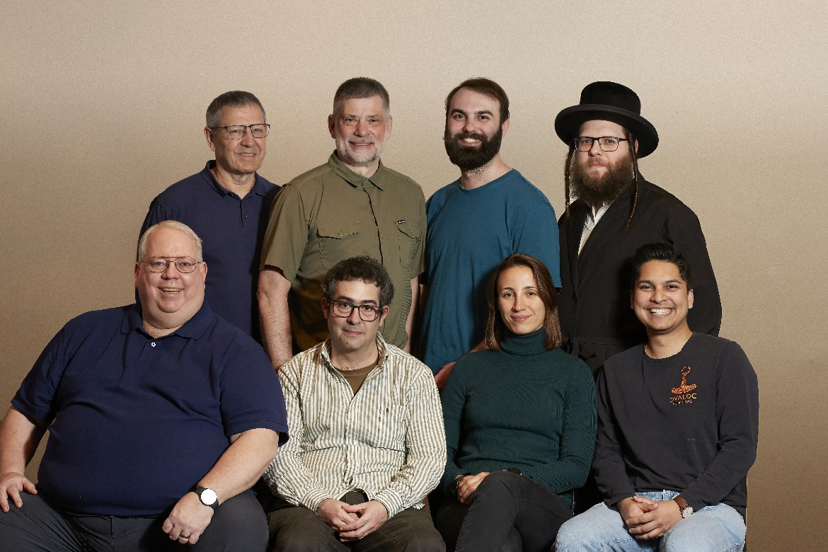
Humans
We continue to employ an increasing number of "Ape Coders".
This is the "Consulting, Tools and Data Science" team.

Slide 46
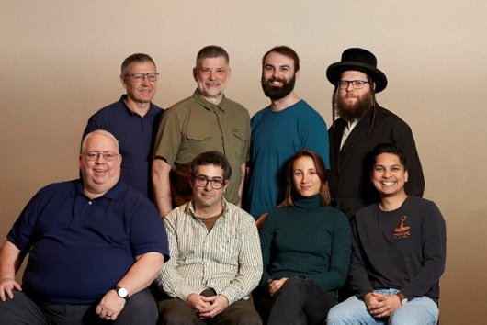
Consulting, Tools, Data Science
When there is no consulting to do
Develop productivity tools for APL application development – in APL
Do research into the Data Science market

Slide 47
Consulting
We specialize in:
Migrations to Dyalog APL
Migrations to new platforms, e.g. Cloud
  Dockerization, Continuous Integration
Using AI with APL
Architecture reviews and performance tuning

Slide 50
Productivity Tools in APL
HttpCommand – utility for making HTTP requests and consuming web services.
Recent enhancements:
Server Sent Events (good for talking to LLMs)
Convert www-form-urlencoded results into namespaces
Upload files using content-type multipart/form-data
Automatic parsing of JSON responses, making API consumption straightforward.

Slide 51
Productivity Tools in APL
Jarvis - web service framework that lets you build JSON or REST APIs.
Recent enhancements:
JSON mode – endpoints are APL functions.
  TryAPL and the APL Challenge site use Jarvis in JSON mode
REST mode – endpoints are resources (real or virtual)
  DCMS (see Rich's presentation later today) uses Jarvis in REST mode

Slide 52
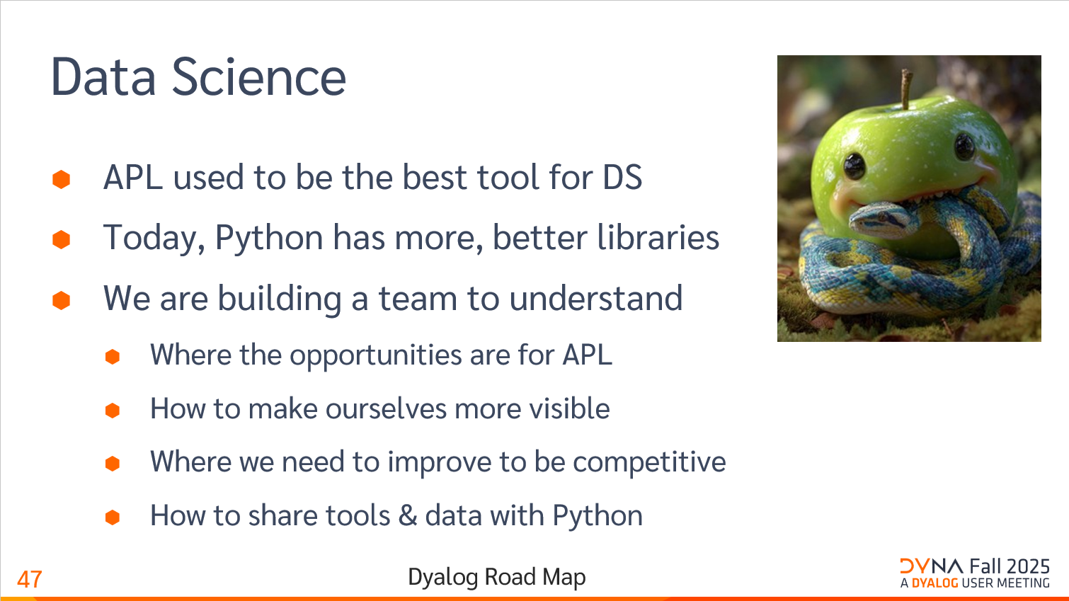

Slide 53
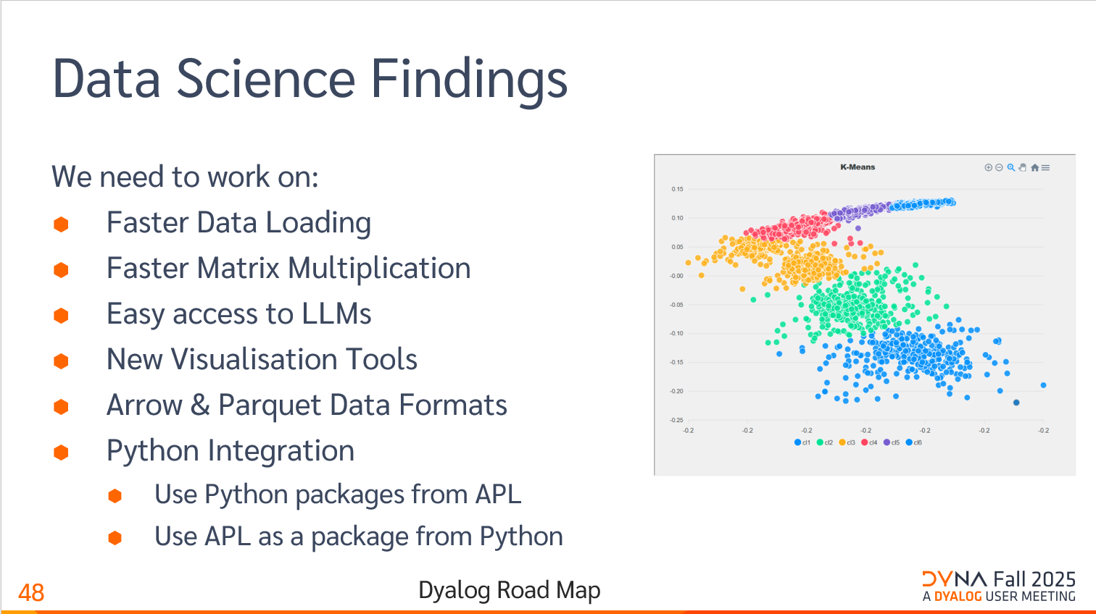
Next
✓
✓

Slide 54
Core Product Directions
Increased focus on speed-ups and other features to improve the "data science experience"
Make APL a better command-line tool
  Not only to please LLMs
Make interfaces Open-Source
  HTMLRenderer, Conga (TCP), Crypto etc
Take full advantage of Array Notation

Slide 55
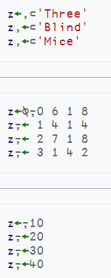
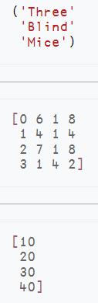
Array Notation
≡
≡
≡

Slide 56
Namespace Notation
⎕VGET and ⎕VSET
people← (name: 'Jack' ⋄ weight:75) (name: 'Jill')
people.name
Jack Jill
people ⎕VGET 'name' ('weight' 50) ⍝ Default weight=50
Jack 75 Jill 50

Slide 57
Array Notation: To come in v22.0
⎕APLAN to format and execute array notation
Enhance system functions to use namespace notation
⎕SIGNAL (EN:11 ⋄ EM:'USER ERROR'
⋄ Message:'problem between screen and chair')
⎕NEW 'Timer' (Active:0 ⋄ Interval:500)

Slide 58

APL Libraries
Add language support for loading modules (⎕IMPORT)
Simplify the package manager for APL (Tatin)
Add a command-line interface to install packages
Write more packages
Find a way to get YOU to write packages

Slide 59


Parallel / Async Operator ∥
Implement a primitive operator ∥ which can invoke functions asynchronously
  A future is immediately returned (as with isolates today)
  The interpreter will block automatically if the value is used and has not materialised.
Multiple architectures will be supported simultaneously
  Isolates (remote processes w/TCP sockets)
  "Green threads" (as the existing & operator)
  Multiple interpreters running on separate O/S threads within the same process
Peter Mikkelsen
John Daintree

Slide 60


Compilation
The ∥ operator will support parallelism using multiple interpreters
Effective use of GPUs
requires a compiler
Enter codfns

