Slide 1
User Interface Testing With Selenium
Morten Kromberg, CXO

Slide 2
Selenium
Selenium is a widely used open-source tool for automating browsers
with growing support from browser vendors
Selenium provides an API that allows you to perform just about any operation that a user could:
click on buttons,
select items from drop-downs,
press keys to enter text,
drag and drop items,
perform exact mouse movements and different types of clicks.

Slide 3
github Dyalog/Selenium
An open-source project with some covers for Selenium to make it easy to drive browsers from Dyalog APL.
Currently requires the Microsoft .NET bindings and can only do the testing from Microsoft Windows.
The web server can be running anywhere, and we hope to add other client platforms in the future.

Slide 4
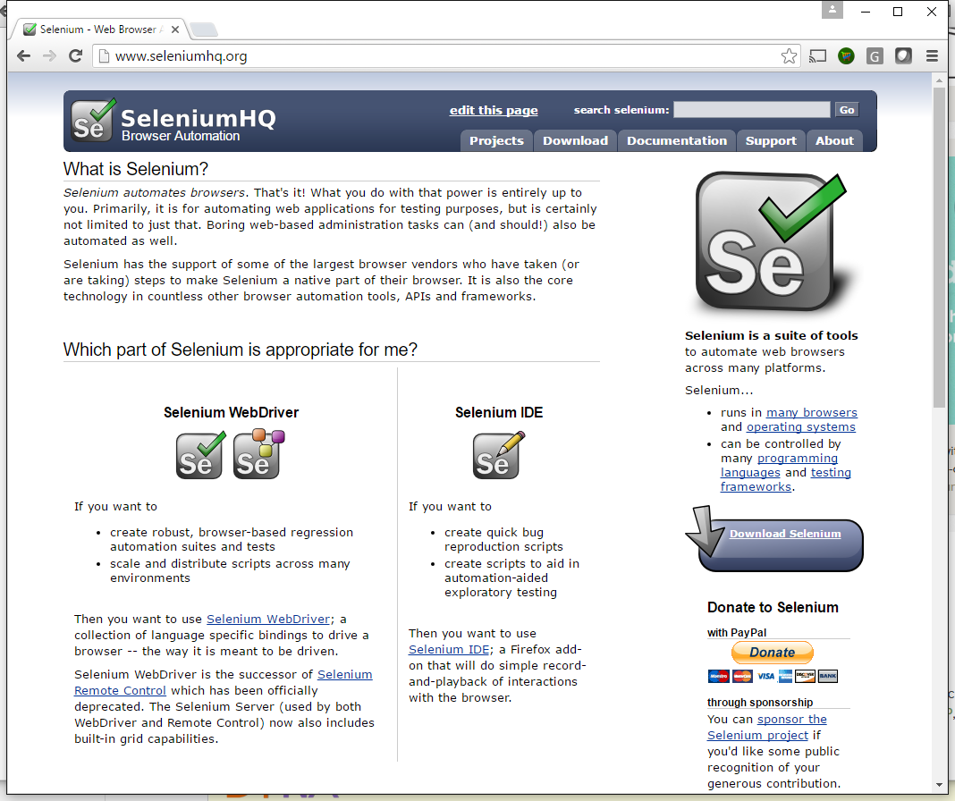
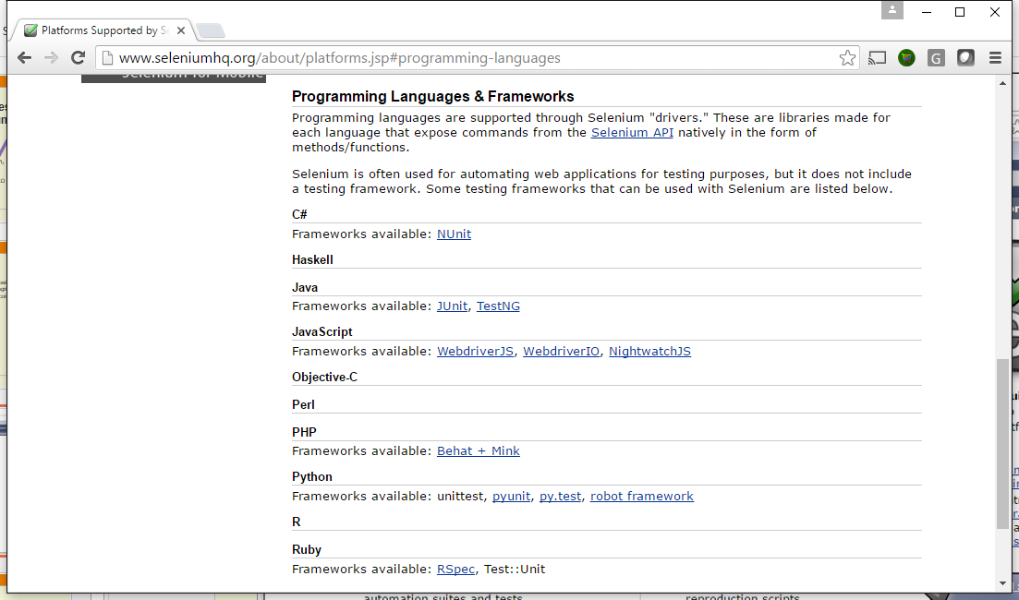

Slide 5
Example
∇ r←TestTryAPL;S;result
⍝ Basic test that TryAPL is working
S←##.Selenium
S.InitBrowser ''
S.GoTo 'http://tryapl.org'
'APLedit' S.SendKeys '1 2 3+4 5 6'
S.('APLedit' SendKeys Keys.Return)
result←'ClassName' S.Find 'result'
r←result S.WaitFor '5 7 9' '1 2 3+4 5 6 failed'
∇

Slide 6
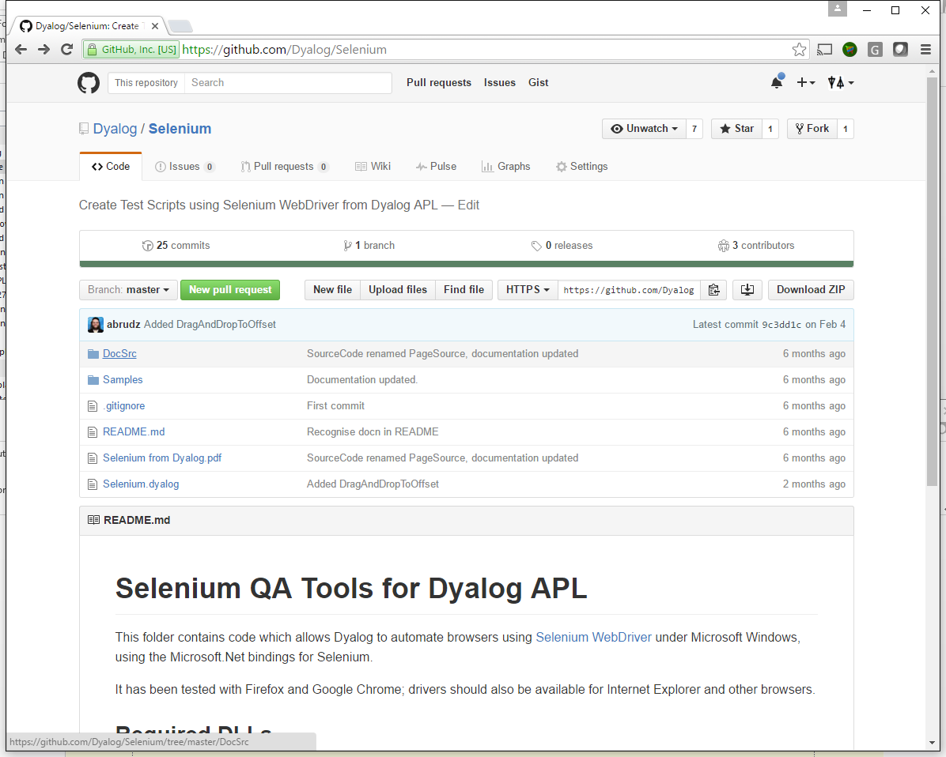
Getting Started

Slide 7
Lots of Examples (MS3 QA)
https://github.com/Dyalog/MiServer/tree/development/MS3/QA/Examples

Slide 8
Summary
Selenium is available from APL!
Windows only until further notice
(The server can be anywhere of course)
Automated testing of HTML5/JS based User Interfaces is realistic!

