Slide 1
Hanging out with APL friends in times of yore
Charles Brenner, Ph.D.
Purveyor of forensic mathematics, DNA∙VIEW®,
Senior Research Fellow at UC Berkeley Human Rights Center
http://dna-view.com c@dna-view.com +1 510 798 7139
Dyalog 2024 Sept

Slide 2
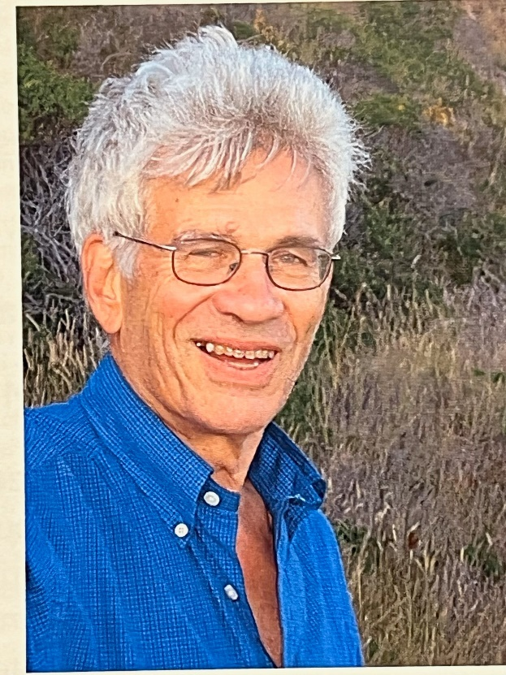
1967 –
right arm in a cast, winding watch.
Truth 40 years later.
Yorktown Heights
Circuit diagrams on the floor
Larry “sonofabitch” Breed
(later photograph)

Slide 3
Larry’s right hand was in a cast
He asked me to wind his watch for him, an unusual way to become acquainted. Anyway, winding a watch isn't difficult so I did, and moreover, noticing that the watch's time was off by about 6 hours I added the extra favor of correcting it, for which Larry was not grateful. He pointed out what I'd noticed but not thought about. His minute hand wasn't synchronized with the hour hand in the usual way but rather Larry had re-positioned by just enough that the two hands would coincide not at the usual 12 o'clock but rather at 6:30. That allowed him, left-handed, to wear the watch upside down on his right wrist, so of course he ignored the numbers on the face and preferred to have both hands pointing up at 12 sharp. I was duly chagrined. Forty years later …

Slide 4
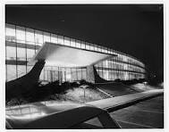
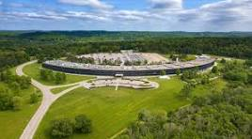
-2004
Eero Saarinen
TJ Watson Research Ctr
1968 Yorktown Hgts
1988 Toronto
1990 San Antonio. OJ
1992 tacit
1999 Palo Alto

Slide 5
Charles
Brenner
Larry
Breed
Eugene
McDonnell
Garth
Foster
Paul
Berry
Joey
Tuttle
Curtis
Jones
?

Slide 6
Much later
I was duly chagrined. However, forty years later, no longer as gullible as at 16, I asked Larry if he'd trapped me intentionally. He confessed. So not for the only time (see Billings) a Breed incident had its denouement decades after.

Slide 7
40 years after Montana incident
Flying off a ramp
A van with a name
What really happened

Slide 8
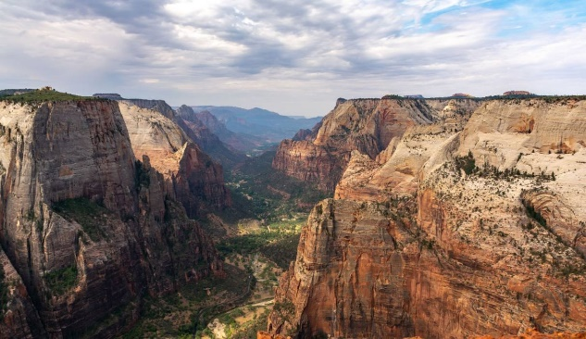
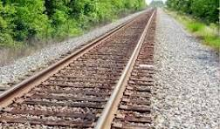
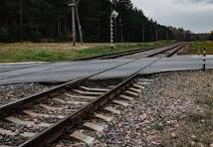
Train crossing in Montana
Palo Alto (later Silicon Valley) to Regina, Saskatchewan, quickly
Zion National Park (Utah)
Need a car
Recessed
train track
near Billings (pop 100K)

Slide 9
c@dna-view.com
+1 510 798 7139

