Slide 1
Deployment of the Dyalog Interpreter as OLE-Server for interactive Use
(Microsoft Windows only)
Jürgen Wiedemann Dyalog ´24 DPC 17. September 2024

Slide 2
Agenda
Introducing DPC and myself
Starting point and Requirements
Implementation
Demo

Slide 3
About DPC (Dittrich & Partner Consulting)
Founded in 1981
Acquired from HBA Consulting in 2023
10 employees, together with HBA 50
Located in Germany, customers in Germany, Austria and Switzerland
Providing consulting services mainly for life insurance companies
Distributing APL Software licences

Slide 4
About me
Working for DPC since 1998
Consultant with focus on APL
Done a lot of APL migrations
Managing director since 2019 (second job)

Slide 5
Starting point and Requirements
Migration of several APL+Win applications (with all the typical challenges)
Requirement:
special functionality referred to as “APL+Win as an ActiveX server”
Possibility to
create an instance of APL
to use any workspace in it without special preparation

Slide 6
Use cases
Regression test for lots of calculations in parallel on several local instances
Integration of APL in other environments, e.g. in Excel (VBA)
Operation in “Developer mode”:
fully functional IDE
visible
debugging and tracing

Slide 7
Challenge
Dyalog does not offer an out-of-the-box solution for these requirements.
You can
export workspaces as Runtime, in- and out-of-process server, .Net assembly
provide namespaces via Jarvis.
But this is more or less tied to a fixed code base.
Full IDE with editor and debugger ?!? However, this was an important requirement.

Slide 8
Solution
OLEServer object
allows visibility and full access to the session
but deploys a specific namespace and only certain functions from it
an OLEServer object is generated from a namespace and the entry points to be provided are defined with its ExportedFns property
Emulation for most of the APL+-Features

Slide 9
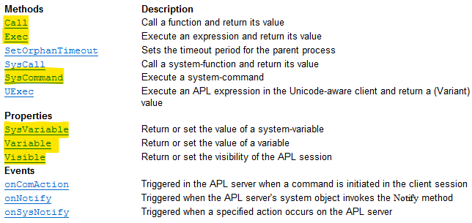
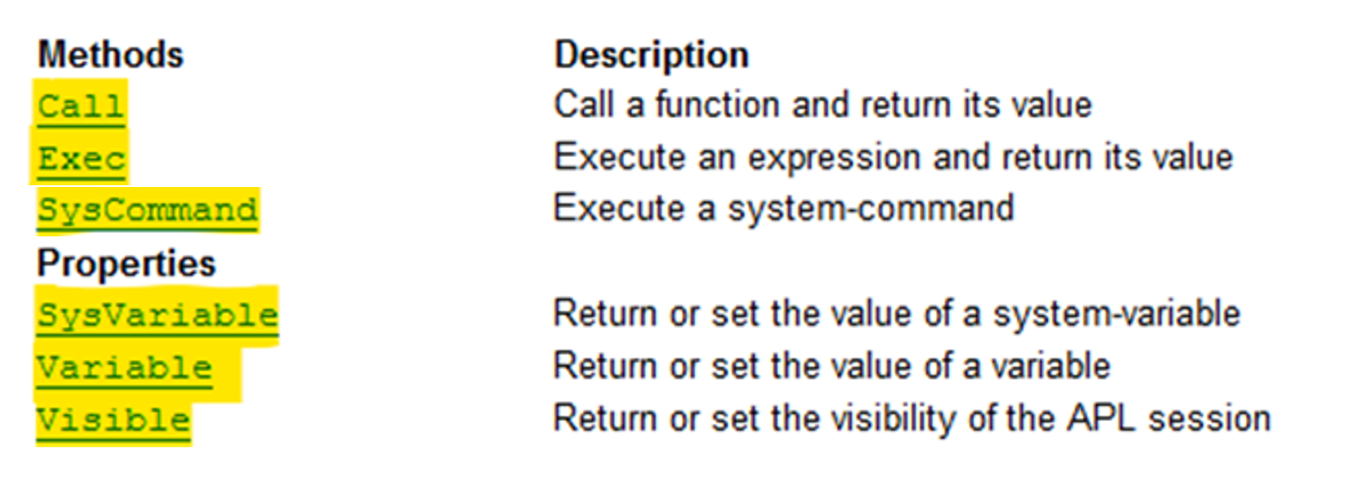
Solution - Template
Overview “APL+Win as an ActiveX server”

Slide 10
dyalog.WSEngine - Essentials
Tiny namespace as an OLEServer
Very few and general methods
To overcome some limitations that apply to an OLEServer
The OLEServer namespace only acts as an intermediate layer for dynamic use of any APL resources.

Slide 11
dyalog.WSEngine - Details

Slide 12
dyalog.WSEngine - Details

Slide 13
Deployment
Registration
with the OLERegister method invoked in ⎕LX
called with a special switch /RegWSEngine
dyalog.exe WSEngine.dws -MAXWS=256M RegWSEngine=1 DYALOG_NOPOPUPS=1
Invocation
VBA Dim objAPL As Object Set objAPL = CreateObject(“dyalog.WSEngine”)
Dyalog 'objAPL‘ ⎕WC 'OLEClient' 'dyalog.WSEngine'

Slide 14
Examples
From APL
'APL'⎕WC'OLEClient' 'dyalog.WSEngine'
APL.setVisible 1 x←APL.SysCommand⊂'LOAD ',ws x←APL.Call⊂'init_appl' x←APL.Call 'do_calc' 123 x←APL.Exec_async⊂'⎕OFF' ⎕EX'APL'
From Excel (VBA)
Set APL = CreateObject("dyalog.WSEngine")
rc = APL.SysCommand(")LOAD " & DWSfile)
rc = APL.SysVariable("PATH", "#.UTILS")
rc = APL.Call("init_appl")
rc = APL.Call("do_calc",123)
APL.Exec_async (apl_quad & "OFF")
Set APL = Nothing

Slide 15
Demo
Excel/VBA
CreateObject("dyalog.WSEngine")

Slide 16
Demo: Excel/VBA ←→ dyalog.WSEngine

Slide 17
Demo: Excel/VBA ←→ dyalog.WSEngine

Slide 18
Demo
Dyalog v19 using WSEngine v18.2:
]demo F:\tmp\WSE

Slide 19
Demo: APL ←→ dyalog.WSEngine

Slide 20
Demo: APL ←→ dyalog.WSEngine

Slide 21
Demo: APL ←→ dyalog.WSEngine

Slide 22
Demo: APL ←→ dyalog.WSEngine

Slide 23
Demo: APL ←→ dyalog.WSEngine

Slide 24
Demo: APL ←→ dyalog.WSEngine

Slide 25
Demo: APL ←→ dyalog.WSEngine

Slide 26
Thank you for listening
Jürgen Wiedemann Dyalog ´24 DPC 17. September 2024

