Slide 1
Problem Solving with APL
Rich Park
Stefan Kruger
Notes:
Workshop, not lecture — interrupt and ask!

Slide 2
Format: For each problem…
Problem statement
Solve the problem
We collect and show solutions
Discussion
(ask if unclear)
(bonus task if you’re fast)
(be brave)
(learning opportunity)
Notes:
Workshop, not lecture — interrupt and ask!

Slide 3
It Is All Right
Write a dfn that takes the length of the legs of a triangle as its left argument, and the length of the hypotenuse as its right argument and returns 1 if the triangle is a right triangle, 0 otherwise.
3 4 YourFunction 5
1
2 3 YourFunction 4
0
Hint: In a right triangle, the square of the hypo-tenuse equals the sum of squares of the legs.
Notes:
{(+/⍺*2)=⍵*2}
=⍥(+.×⍨)
{⍵=|0j1⊥⍺}

Slide 4
Being Whole is Overrated
Write a function which selects the non-integer numbers from a numeric vector.
YourFunction 14.2 9 3 3.1 0 ¯1.1
14.2 3.1 ¯1.1
YourFunction 1 3 5
YourFunction 3.1415 2.71828
3.1415 2.71828
Bonus task:
Keep integers instead
Notes:
⊢~⌊
⊢∩⌊

Slide 5
Zero Nulls
Write a function replaces all ⎕NULLs with 0s in a simple array.
YourFunction 1 2 ⎕NULL 4 5 6
1 2 0 4 5 6
YourFunction 2 2 2⍴'A' ⎕NULL 'B'
A 0
B A
0 B
A 0
Bonus task: Handle nested arrays
Notes:
0@{⎕NULL=⍵}
{r←⍵ ⋄ r[⍸⎕NULL=⍵]←0 ⋄r}
{r←⍵ ⋄ ((⎕NULL=∊r)/∊r)←0 ⋄ r}

Slide 6
Move to the Front
Write a function that, given vector arguments, reorders the right argument so elements in the left argument come first.
'rb' YourFunction 'abracadabra'
brbraacadaa
42 YourFunction ⍬
3 YourFunction ,1
1
Bonus task:
Use the order of the left argument:
rrbbaacadaa
Notes:
∩⍨,~⍨
{⍵[⍒⍵∊⍺]}
{⍵[⍋⍺⍳⍵]}

Slide 7
What Is In a Word
Write a function which returns the number of words in the given character vector. For simplicity’s sake, you can consider the space character ' ' to be the only word separator.
YourFunction 'Testing one, two, three'
4
YourFunction ' many blanks '
2
YourFunction ''
0
Bonus task: Multiple word separators as left argument
Notes:
≢' '∘≠⊆⊢
≢'[^ ]+'⎕S 3
{+/1 0⍷0,⍨' '≠⍵}
{+/2>/0,⍨' '≠⍵}
≢~⍤∊⍨⊆⊢
{+/2</1,⍨⍵∊⍺} ← swapped truth value to avoid ~

Slide 8
Like an Arrow
Write a function that takes a size and creates a corresponding Boolean matrix with the top triangle being 1s.
YourFunction 4
1 1 1 1
0 1 1 0
0 0 0 0
0 0 0 0
YourFunction 5
1 1 1 1 1
0 1 1 1 0
0 0 1 0 0
0 0 0 0 0
0 0 0 0 0
Bonus task:
Left argument (0–3) is arrow direction
Notes:
∧∘⌽⍨∘.≤⍨∘⍳
(≤∧≤∘⌽)⍤0 1⍳
{⍺←0 ⋄ ⌽⍤⍉⍣⍺∧∘⌽⍨∘.≤⍨⍳⍵}
{∧∘⊖⍤(1+2|⍺)⍨∘.≤∘(⌽⍣(0=2|⍺))⍨⍳⍵}

Slide 9
Longest Streak
Write a function that takes a non-empty numeric vector and returns the length of the longest streak of positive growth.
YourFunction 1 2 3 4 5 6 7 8 9 → 8
YourFunction 9 5 4 3 2 6 7 8 → 3
Bonus task: Length of longest streak of consistent growth/stagnation/fall
Notes:
{⌈/≢¨⊆⍨2≤/⍵}
{⌈/¯1-2-/⍸1,1,⍨~2≤/⍵}
{¯1-⌊/2-/⍸1,1,⍨~2≤/⍵}
{⌈/≢¨⊂⍨1,2≠/×2-/⍵}
{⌈/≢¨⊂⍨1,2≠/2(>-<)/⍵}

Slide 10
You’re Unique, Just Like Everyone Else
Write a function that takes a vector as its right argument and returns elements that occur only once in the vector.
YourFunction 1 2 3 4 5 4 3 2 1 2
5
YourFunction 'bye' 'bye' 'hello' 'world'
hello world
Bonus task: Sort by ascending frequency
Notes:
{(1=≢⍤⊢⌸⍵)/∪⍵}
{⍵/⍨(≠⍵)∧⌽≠⌽⍵}
{⍵~⍵/⍨~≠⍵}
{⍵[⍋+/∘.=⍨⍵]}

Slide 11
See (Through) Me
Write a replacement for ⍷ on simple vectors where the left argument is a pair: what to search for and a Boolean mask vector indicating which elements must match.
w ← 5 2 18 5 3 5 4 5 2 18 5
(5 6 5)(1 0 1) YourFunction w
0 0 0 1 0 1 0 0 0 0 0
w←'mississippi'
'issixxi' (1 1 1 1 0 0 1) YourFunction w
0 1 0 0 1 0 0 0 0 0 0
Bonus task: Handle higher ranks
Notes:
{(n m)←⍺ ⋄ (≢⍵)↑((m/n)≡m/⊢)¨⍵,/⍨≢n}
{(n m)←⍺ ⋄ (≢⍵)↑≡⍥(m∘/)∘n¨⍵,/⍨≢n}
{(n m)←⍺ ⋄ (≢⍵)↑n≡⍤1⍥(m∘/)↑⍵,/⍨≢n}
{(n m)←⍺ ⋄ (≢⍵)↑∊{⊂⍺↓n≡⍥(m∘/)⍵}⌺(≢n)⊢⍵}
F←{(n m)←⍺ ⋄ S←⌺(⍴n) ⋄ (b e)←(⊣/,⊢/),⊂⍤⊣S ⍵ ⋄ (⍴↑b↓e↓{n≡⍥(m/⍥,⊢)⍵}S)⍵}
(2 2⍴0 3 3 0)(2 2⍴0 1 1 0) F 5 6⍴3,⍳4

Slide 12
Separation Anxiety
Write a function that takes a right argument character vector and a left argument character scalar separator character. It should then insert the separator after every group of 3 characters from the right, but not at the far left.
',' YourFunction '123456789'
123,456,789
' ' YourFunction 'abcde'
ab cde
Bonus task: Do it fast!
Notes:
{⌽'...(?!$)'⎕R('&'⍺)⌽⍵}
(∊,¨@{0=3|1@1⌽⍳≢⍵})
(⌽⍤⊃(≢⍴3↑1⍨)(⊣,',',⊢)/⍤⊂⌽)
{m←1 0 0⍴⍨≢⍵ ⋄ ⌽1↓∊⍺,¨m⊂⌽⍵}
{c←⌈3÷⍨≢⍵ ⋄ ⌽(c-1-≢⍵)↑,⍺,⍨c 3⍴⌽⍵}
{⌽⍺@{~m}(m←1 1 1 0⍴⍨0⌈¯1+⌈4×3÷⍨≢⍵)\⌽⍵}
{l←0⌈¯1+⌈4×3÷⍨≢⍵ ⋄ m←l⍴0 1 1 1⌽⍨-4|l ⋄ ⍺@{~m}m\⍵}

Slide 13
Chop Chop
A gene has 3×n characters and ends with TAG, TAA, or TGA.
Chop the given character vector into genes.
s←'TAG' 'TAA' 'TGA'
⎕RL←4
⎕←g←∊{⍵≥4:'ACTG'[?3⍴4] ⋄ ⍵⊃s}¨?10⍴8
GTCCTAACCTAATTATGATAACGGCCGTAA
YourFunction g
GTCCTAACCTAA TTATGA TAA CGGCCGTAA
Notes:
{∊¨c⊂⍨¯1⌽'TAG' 'TAA' 'TGA'∊⍨c←↓⍵⍴⍨3,⍨3÷⍨≢⍵}
{⍵⊂⍨¯3⌽(1 0 0⍴⍨≢g)∧∨⌿(3 3⍴'TAGTAATGA')⍷⍤1⊢⍵}
{⍵⊂⍨,¯1⊖∨⌿(3 3⍴'TAGTAATGA')⍷⍤1 2⊢⍵⍴⍨3,⍨3÷⍨≢⍵}
{⍵⊂⍨(1 0 0⍴⍨≢⍵)\¯1⌽3≥(3 3⍴'TAGTAATGA')⍳⍵⍴⍨3,⍨3÷⍨≢⍵}
'(...)*?(TAG|TAA|TGA)'⎕S'&'

Slide 14
Keeping Things In Balance
Write a function which returns a 1 if the opening and closing parentheses in a character vector are balanced, or a zero otherwise.
YourFunction '((2×3)+4)' → 1
YourFunction '' → 1
YourFunction 'hello world!' → 1
YourFunction ')(2×3)+/4(' → 0
YourFunction '(()' → 0
Bonus task: Handle [] too!
Notes:
{0(∧.≤∧=∘⊃∘⌽)+\-⌿'()'∘.=⍵}
Hard: requires state machine

Slide 15
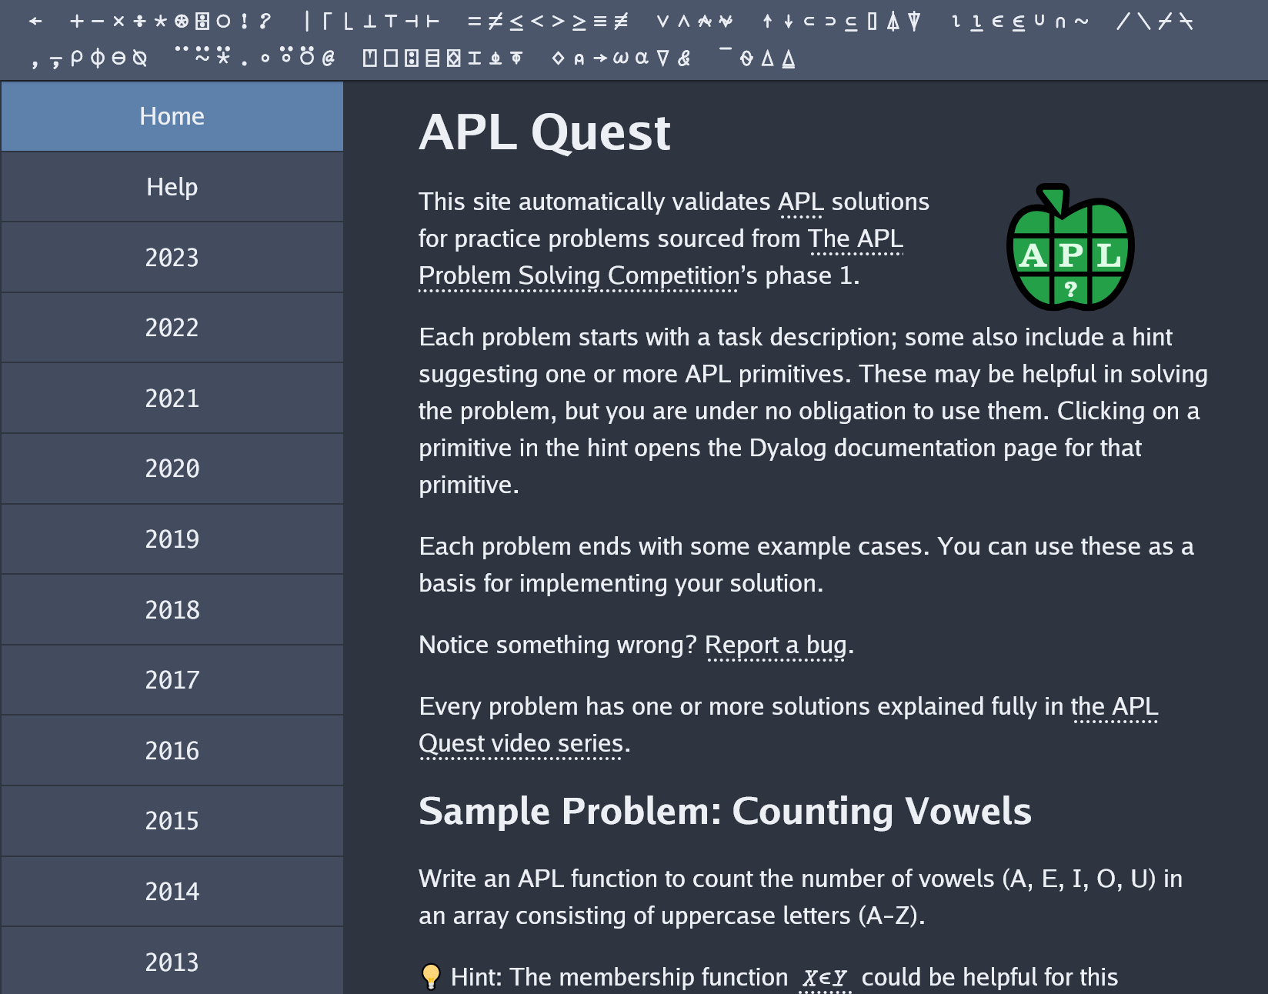
Thank you for playing!
Want more? Visit apl.quest →

