Slide 1
Closing session
Stine Kromberg
Notes:
Thank you for this year
We will keep giving support and continue developing and improving in good order. We are following everything that happens in the technical world.
No UM in 2025.
DYNA + tour in 2025.
UM in 2026.
If anything we do in 2025 works, let us know.
We’ll be visiting and hosting DYNA.
Let us know if you want us to visit you on our tour.

Slide 2
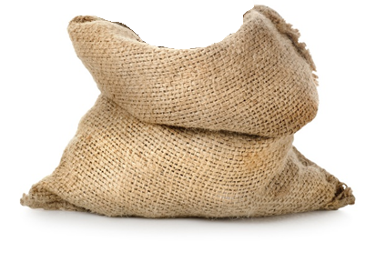
Staying in touch
– in 2025 and 2026
At Dyalog, we travel in packs…
2
Thank you for Dyalog ‘24
Notes:
No UM in 2025.
UM in 2026.
We’ll be visiting and hosting DYNA.
Let us know if you want us to visit you on our tour.

Slide 3
The Challenge and the Forge
– for new and current developers
Notes:
The challenge – for the new.
The forge – for the bold.
We look forward to presenting Holden Hoover, the winner of the Forge, tomorrow.
Both have the same goal: inspire new and current users of APL.

Slide 4
Steady as she goes!
Safe travels to ALL From Team Dyalog!

