Slide 1
New Tatin Packages
Brian Becker

Slide 2
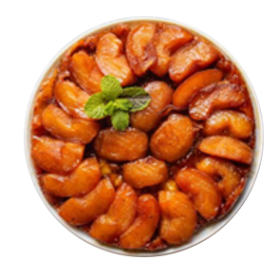
What is a Tatin?
A tasty vegan apple tarte tatin (You're welcome Mark!)
The logo for Tatin, a package manager for tastefully packaged APL code

Slide 3
Quick Survey
How many have used a Tatin package?
How many have written a Tatin package?
How many have some code that might make a good Tatin Package?

Slide 4
https://tatin.dev

Slide 5
Current Tatin Packages
Packager | Number of Packages
APLTeam | 44
Davin Church | 4
Dyalog | 5 (3 new in 2024)

Slide 6
Thank you Kai!
For sharing quality utility libraries for decades.
For developing and hosting Tatin
For everything else you've done for the APL community

Slide 7
At 150% Growth…

Slide 9
New Dyalog Packages
NuGet – makes it easier to use .NET packages from APL
APLProcess – spawn a new APL interpreter in another process
OpenAI – Implements an interface to the OpenAI API

Slide 10
NuGet
A tool to help use NuGet packages from Dyalog APL.

Slide 11
NuGet

Slide 12
NuGet
If you use Cider to manage your APL projects, you can use
]CIDER.AddNuGetDependencies
to add NuGet packages as dependencies in your project.

Slide 13
NuGet
dir←'/tmp/nuget-demo'
NuGet.Setup dir Created project file "/tmp/nuget-demo/_nuget-demo.csproj"
NuGet.Add dir 'Clock/1.0.3' Added/Updated: Clock --version 1.0.3
⎕USING←NuGet.Using dir
Clock.UtcNow 9/16/2024 11:02:04 PM +00:00

Slide 14
APLProcess
APLProcess is a cross-platform utility to start an APL interpreter in a new CPU process.
The isolate workspace uses APLProcess
p←⎕NEW APLProcess 'myWs' 'maxws=4G'
p←APLProcess.New 'myWs' 'maxWs=4G' p.RideInit←22361 ⍝ 'SERVE:*:22361' p.Run

Slide 15
APLProcess RPC Sample
⍝ create and configure the instance of APLProcess
RPC_Process←APLProcess.New''
RPC_Process.Ws←⎕WSID ⍝ workspace to load
RPC_Process.Args←'RPC_Port=',⍕port ⍝ port to use for RPC
RPC_Process.Args,←' RPC_Threaded=',⍕threaded ⍝ run the server in a thread in the child process?
RPC_Process.RunTime←runtime ⍝ use runtime interpreter?
RPC_Process.RideInit←''(port+1)rideable⊃⍨0 1⍸rideable ⍝ RIDE port
RPC_Process.Detach←~detach ⍝ don't kill child proc. when instance goes away ⍝ try to launch the child process :If 0≠⊃(rc msg)←RPC_Process.Run

Slide 16
APLProcess Uses
Distribute processing to other processors (a la isolates)
Offload processing
Spawn a lengthy process
Spawn a "risky" process
Run on other machines via ssh (coming soon)

Slide 17
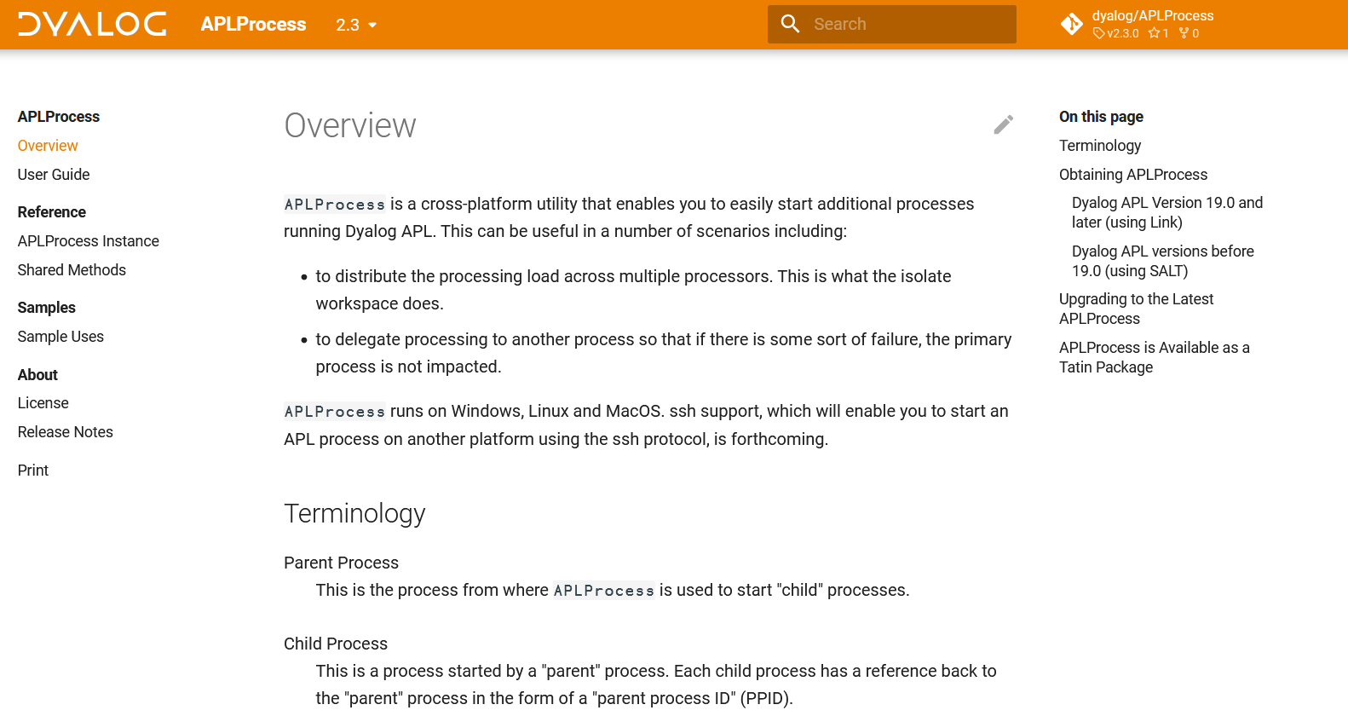
https://dyalog.github.io/APLProcess

Slide 18
OpenAI
Started as a noodle
It's a little like trying to change the oil in a moving car
A subset of endpoints are implemented
More (including Assistants) are coming in October 2024
Good HttpCommand usage model

Slide 19
https://dyalog.github.io/OpenAI

Slide 20
OpenAI Endpoints
Models – return information about available LLMs
Moderations – measure the "harmful" potential of text
Audio – text to speech, transcription and translation
Image – create and modify images based on prompts
Chat – have a conversation with an OpenAI assistant

Slide 21
OpenAI.Models
Returns information about available OpenAI models
m←OpenAI.Models
≢m.Data.data 31 6 2 ⍴ m.Data.data.id tts-1-1106 dall-e-2 gpt-4-1106-preview tts-1 tts-1-hd-1106 tts-1-hd dall-e-3 whisper-1 text-embedding-3-large text-embedding-3-small text-embedding-ada-002 gpt-4-turbo

Slide 22
OpenAI.Moderations.
Moderation - Returns evaluation of "potentially harmful" text
Demo

Slide 23
OpenAI.Audio.
Speech – text to audio
Transcription – audio to native text
Translation – audio to English text

Slide 24
OpenAI.Audio.Speech
Translate text to speech
s←OpenAI.Audio.Speech myText
s.OutFile←'/Dyalog24/NewPackages/speech'
s.Run
[rc: 0 | msg: | HTTP Status: 200 "OK" | 740160 bytes written to c:/Dyalog24/NewPackages/speech.mp3]

Slide 25
OpenAI.Audio.Transcription
Transcribes audio speech to native text
"Welcome to Dyalog24. We hope you have fun and learn something new."
ts←OpenAI.Audio.Transcription inFile outFile
ts.Run

Slide 26
OpenAI.Audio.Transcription
Transcribes audio speech to native text
"Welcome to Dyalog24. We hope you have fun and learn something new."
Danish: "Velkommen til Dialog24. Vi håber I får det sjovt at lære noget nyt."
German: "Willkommen zu Dialog24. Wir hoffen, dass Sie Spaß haben und etwas Neues lernen werden."
Italian: "Benvenuti a Dialog24, vi auguriamo di divertirvi ed imparare qualcosa di nuovo!"

Slide 27
OpenAI.Audio.Translation
Transcribes audio speech to English text
"Welcome to Dyalog24. We hope you have fun and learn something new."
tl←OpenAI.Audio.Translation inFile outFile
tl.Run

Slide 28
OpenAI.Audio.Translation
Transcribes audio speech to English text
"Welcome to Dyalog24. We hope you have fun and learn something new."
Danish: "Welcome to Dialog24. We hope you have fun and learn something new."
German: "Welcome to Dialog24. We hope you will have fun and learn something new."
Italian: "Welcome to Dialog24! We wish you to have fun and learn something new!"

Slide 29
OpenAI.Image.
Create – creates image(s) from prompt
Edit – edit an existing image
Vary – create variation(s) of an existing image
Demo

Slide 30
OpenAI.Chat.
Completion – have a chat with an assistant
Demo

Slide 31
Into the future… Tatin-wise
Dyalog will release additional Tatin packages as we identify good candidates
Please share your priorities!
Please share your own utilities as Tatin packages

Slide 32
Into the future… OpenAI-wise
OpenAI is at version 0.1 and very much experimental
Please provide feedback
We will try to keep up as OpenAI evolves

Slide 33
Thank you!
???

