Slide 1
The Road Ahead
Morten Kromberg

Slide 2
Road Map - 2023

Slide 3
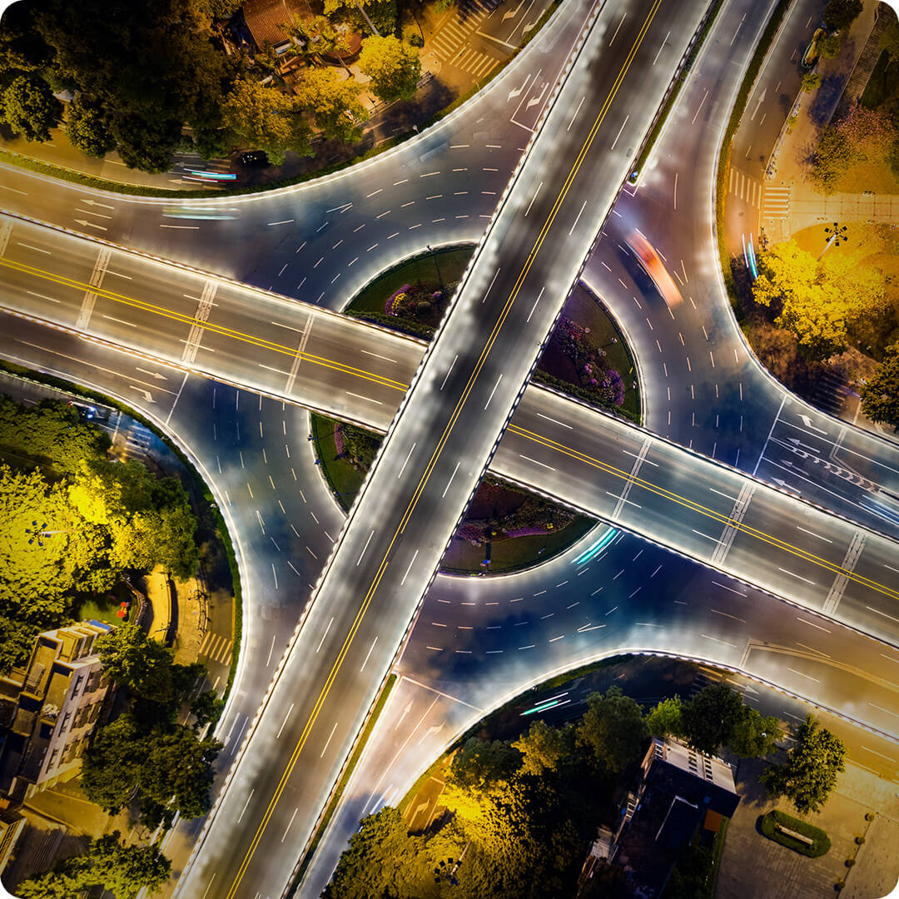
Road Map - 2024

Slide 4
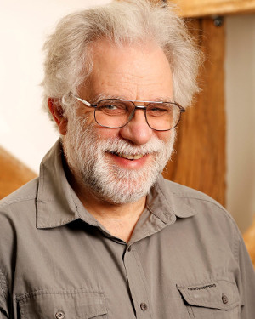
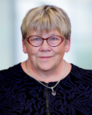
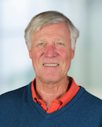
Retirees
Geoff
Gitte
Pete
U17 Weds 15:15: Let's Put the Future Behind Us (Panel Discussion)

Slide 5
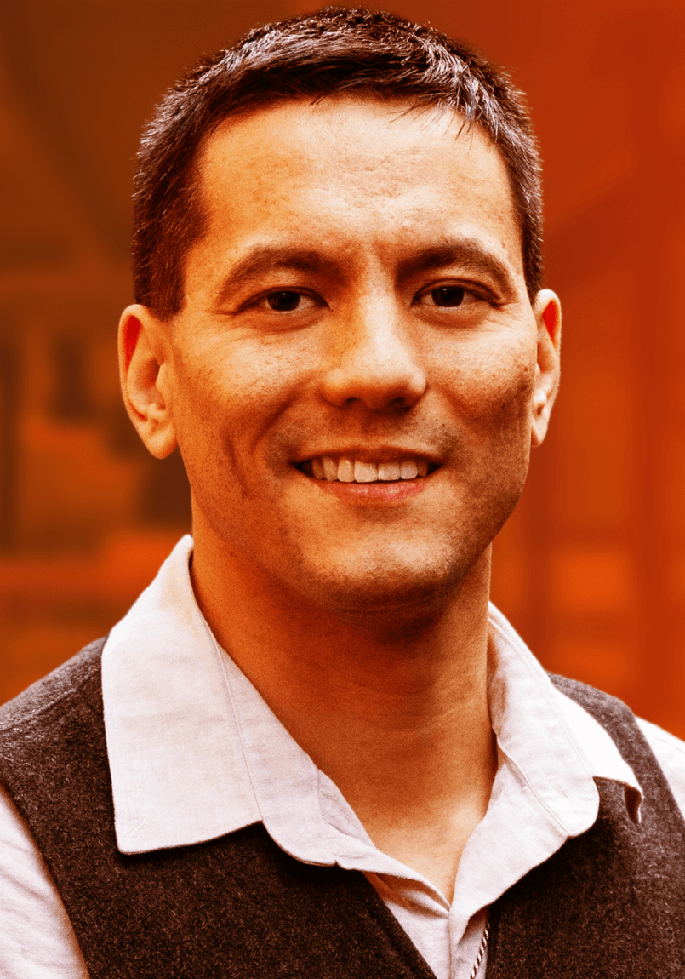
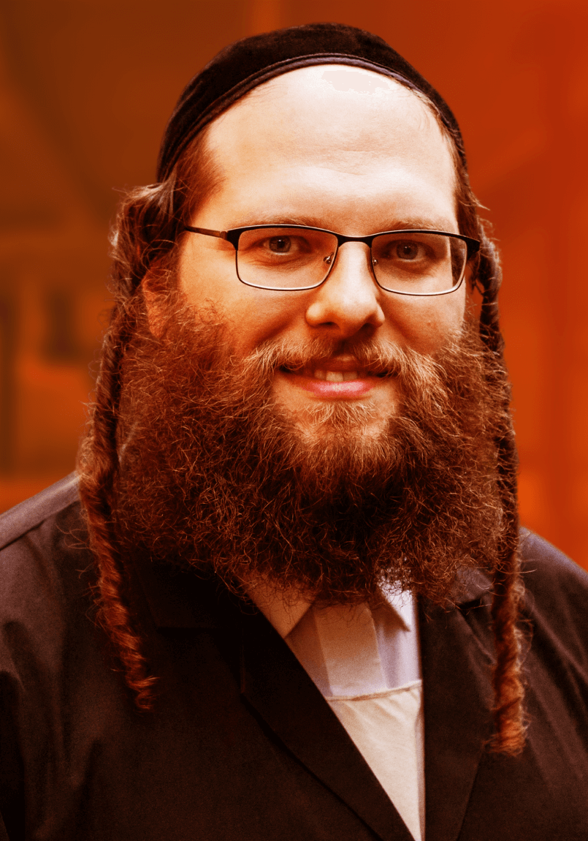
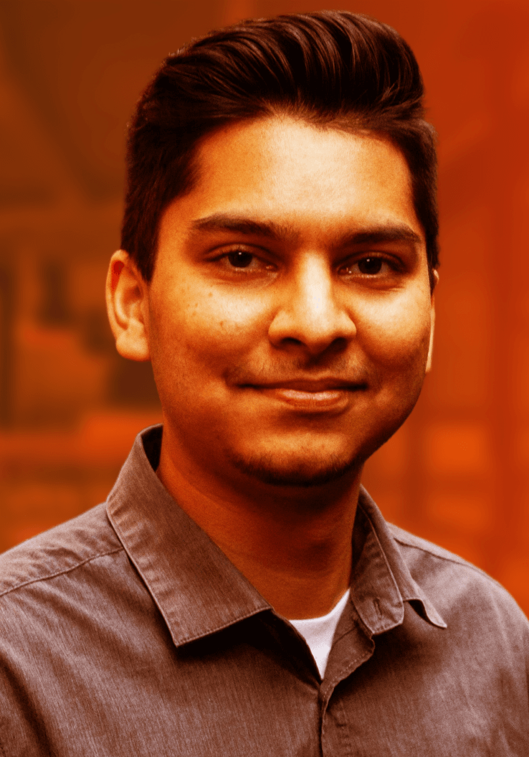
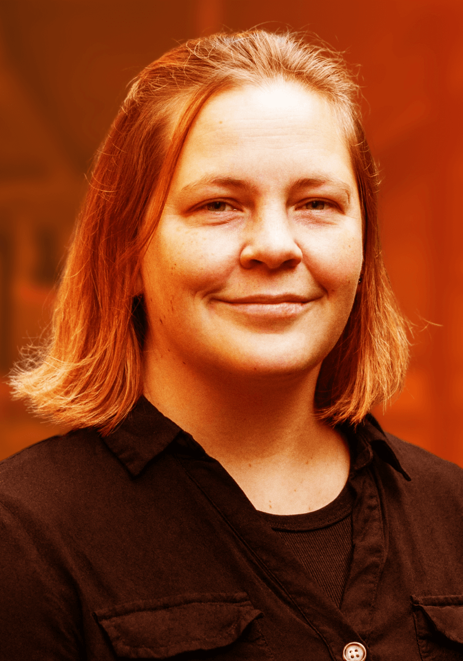
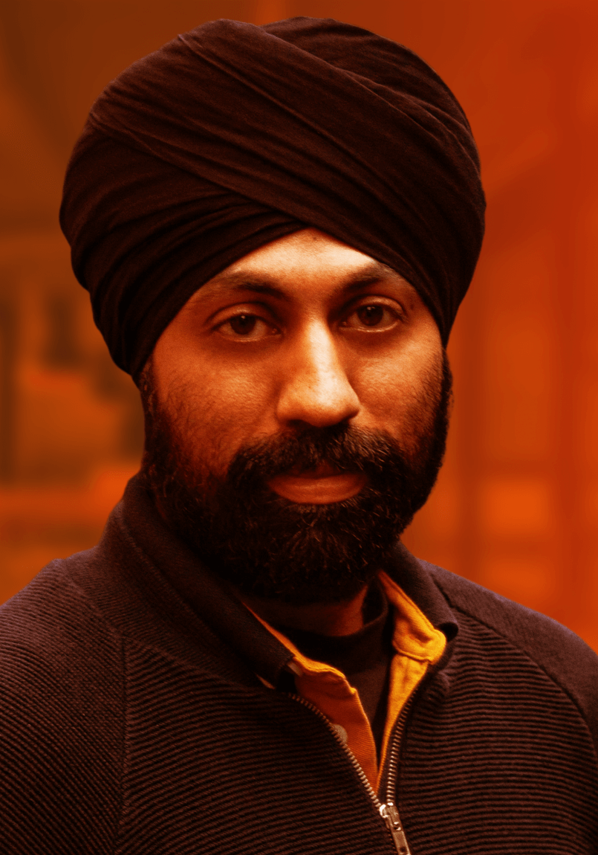
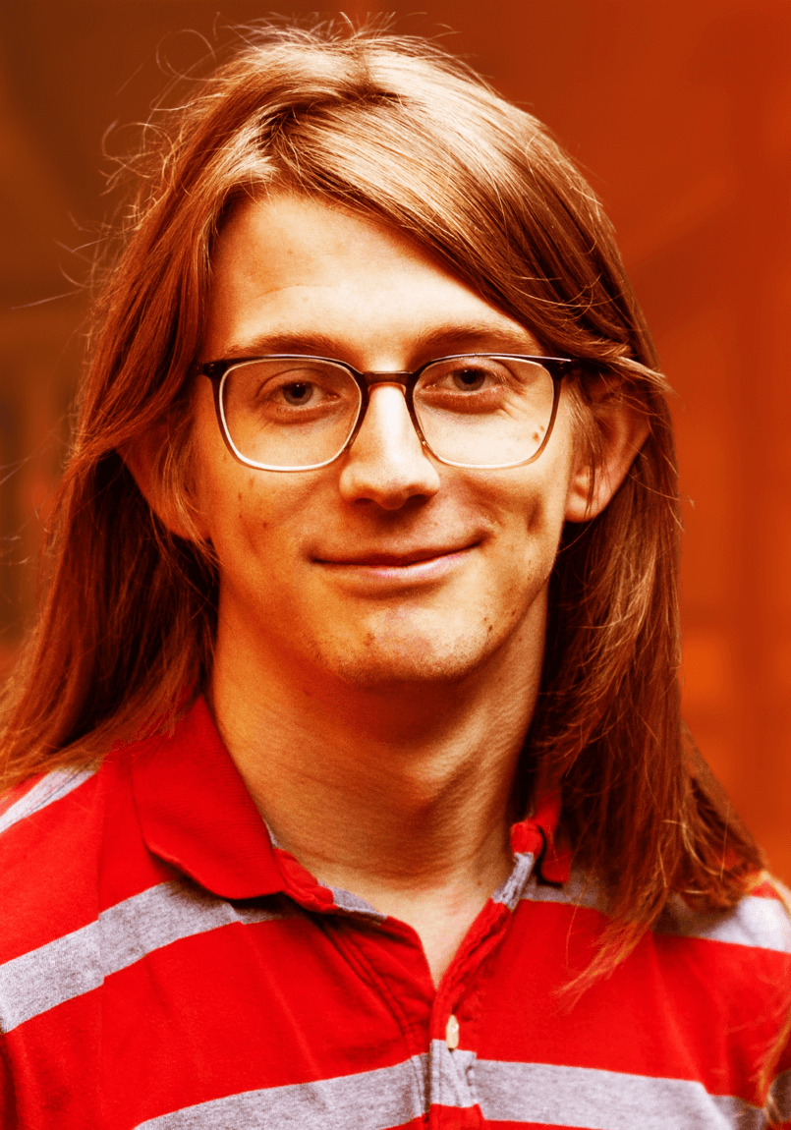
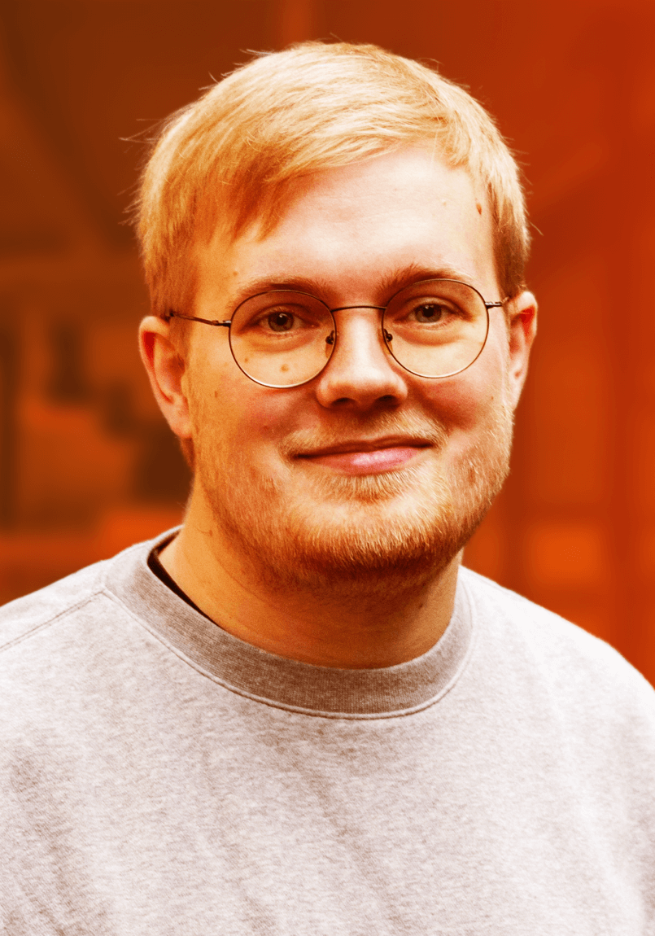
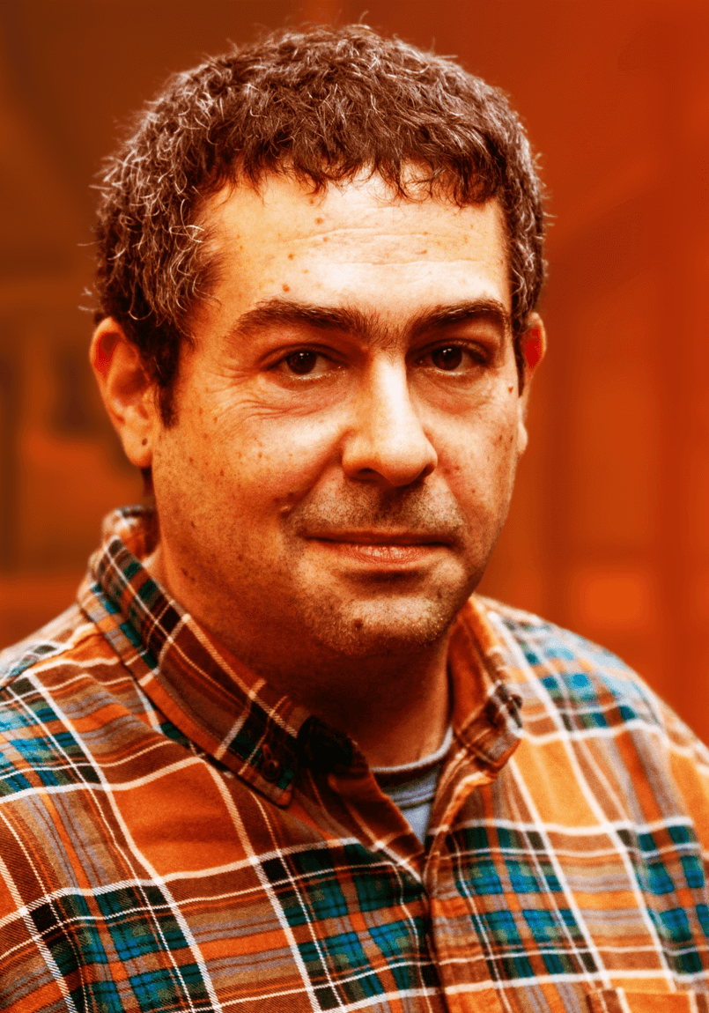
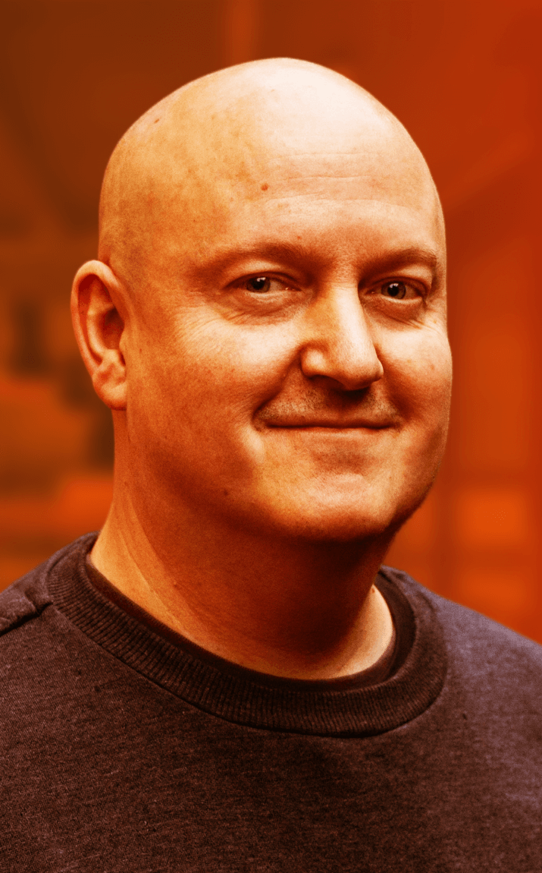
Dyalog – The Next Generation
2010-2021
2022
U18 Weds 15:55: The New Breed Plugs In (Panel Discussion)
2023

Slide 6
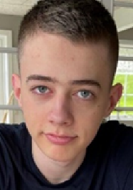
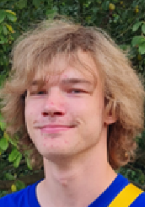
Dyalog – The Next Generation
2024 Summer Interns
U03 Mon 15:15: raylib-apl (Brian Ellingsgaard)
U07 Tue 15:15: Climbing Trees and Catching Bugs (Asher Harvey-Smith)

Slide 7
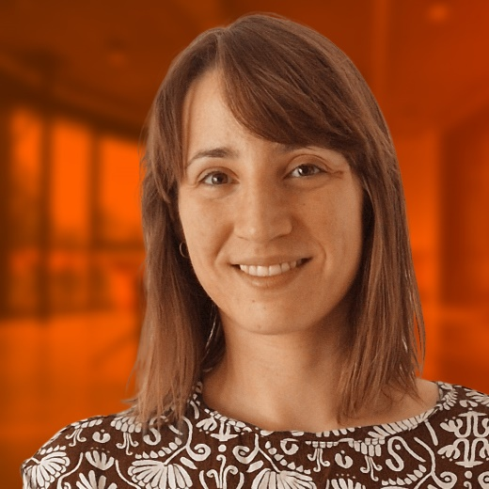

Slide 8
Karl Holt (February, Århus, DK)
Karl is a member of the APL Tools Group and an APL Consultant
Karl is working on the emulator for APL+Win GUI (⎕WI)
D09 Tue 14:25: Migrating APL+Win Applications

Slide 9
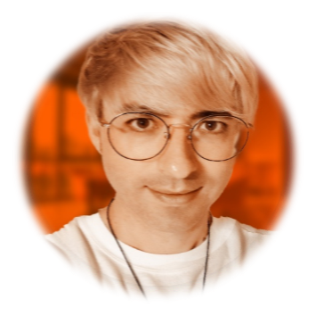
Brandon Wilson (July, 昭和村 / Shōwa, Japan)
Brandon is heading up the Static Analysis project
Working with Aaron Hsu to enhance the co-dfns compiler to support the project
D06 Mon 13:55: Static Analysis of APL in APL
D14 Wed 09:35: Data Parallel Proof Verification in APL

Slide 10
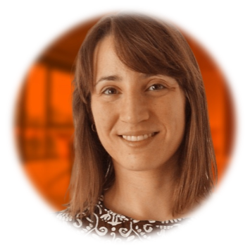
Martina Crippa (August, Copenhagen)
Martina is a member of the APL Tools group and a Consultant
Martina is learning APL and knows C++
Her first project is to build a prototype of a Kafka interface for a client

Slide 11
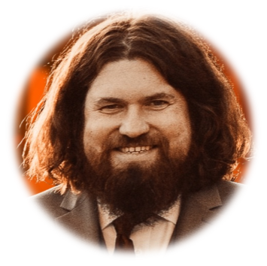
Neil Kirsopp (Gunzenhausen, Bavaria)
Neil is a JavaScript developer (amongst many things)
Also an APL enthusiast, had already signed up for Dyalog’24 before we met
He will work on enhancing EWC, and also take over RIDE development
... and look at a VS Code / Emacs plugin

Slide 12
Highlights of Version 19.0 (Q1'24)
See Last Year's Presentations
Platform Support / Distribution
64-bit ARM support
New Macs
Enhanced .NET Bridge
Framework vs new .NET versions
Bound executables on all platforms
Building Production Systems
Token range reservation
WS FULL handling
⎕NCOPY/⎕NMOVE callbacks
Developer Productivity / IDE
Source "as typed" by default
Multi-line input on by default
HTMLRenderer updates
Link 4.0: Config files, simple text arrays
HttpCommand client, Jarvis web service
Installing & Managing APL
Multiple session files
Health Monitor

Slide 13
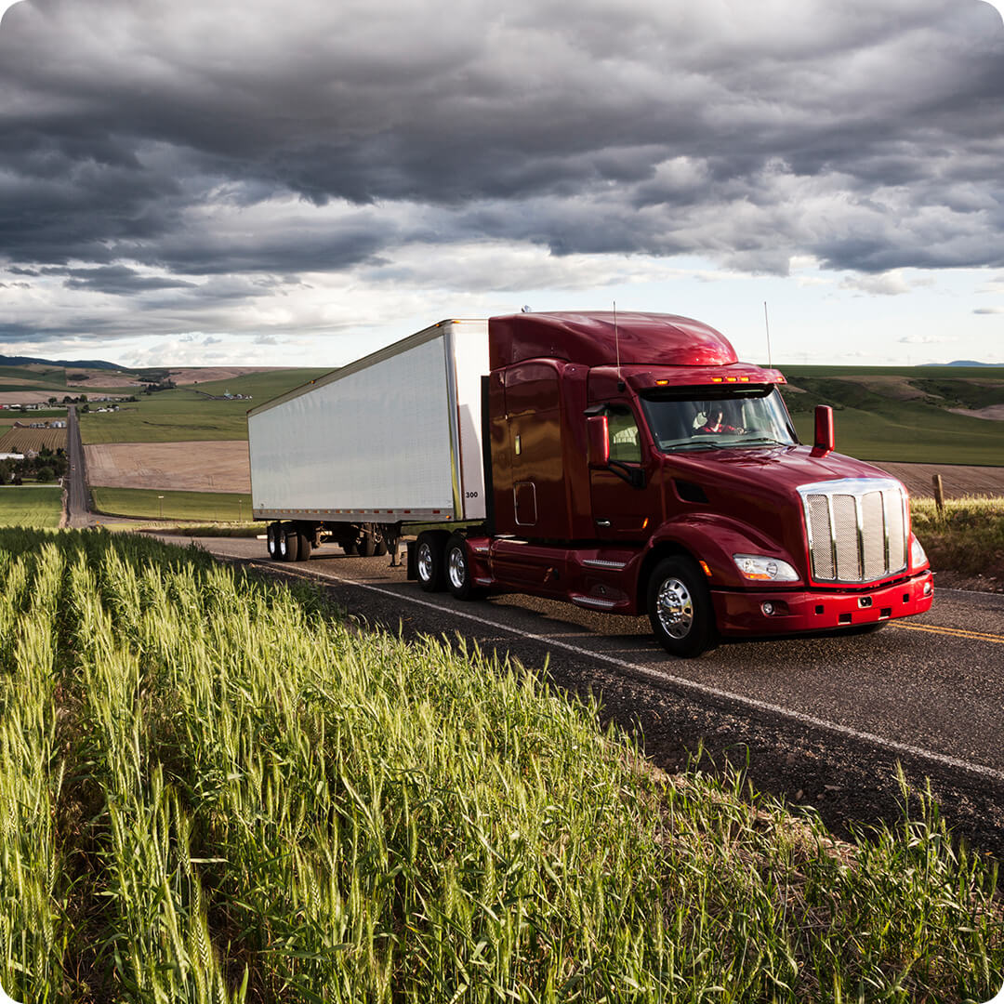
Big Things Heading Your Way
Array Notation
Set & Get Variables
Token-by-Token Debugging
Everywhere WC
Reverse Compose

Slide 14
Array Notation
≡
≡
≡

Slide 15
Namespace Notation
person←(first: 'Max' ⋄ last: 'Mustermann')
person.last,', ',person.first Mustermann, Max
person.(first,' ',last) Max Mustermann
D03 Mon 10:10: Array Notation: A Journey of Discovery (John Daintree)

Slide 16
Set and Get Variables
Get:
[source] ⎕VGET 'Name' ('Height' ¯1) ⍝ Values w/optional defaults
merged←⎕NS defaults inputs ⍝ Merge namespaces Name List with Values:
(names values)←[source] ⎕VGET 2 ⍝ Name Matrix and values
pairs←[source] ⎕VGET ¯2 ⍝ (Name Value) Pairs
Set:
ref←[target] ⎕VSET ('First' 'Lieschen')('Last' 'Müller')
ref←[target] ⎕VSET (2 5⍴'FirstLast ')('Max' 'Munstermann')

Slide 17
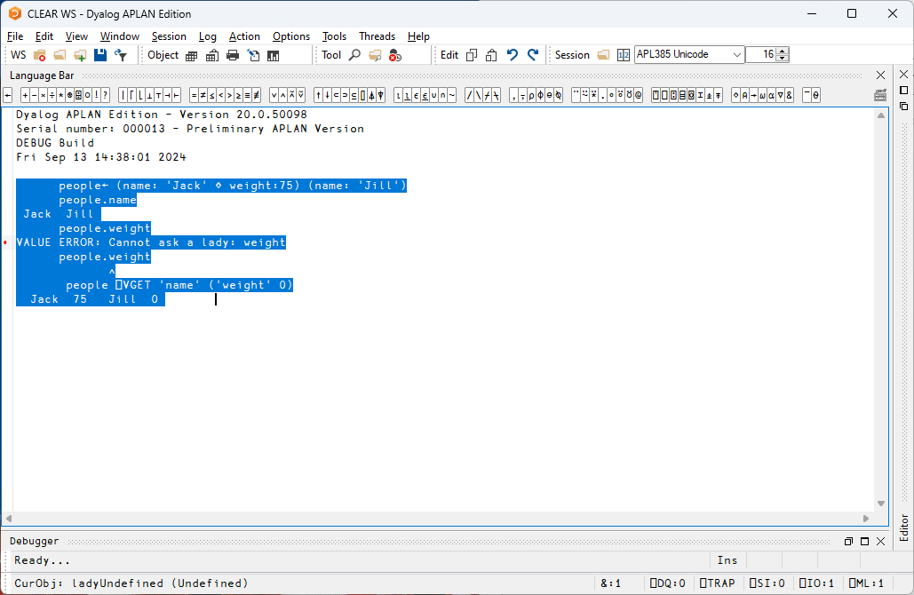
people← (name: 'Jack' ⋄ weight:75) (name: 'Jill')
people.name
Jack Jill people.weight
VALUE ERROR: Undefined name: weight
people.weight
∧
people ⎕VGET 'name' ('weight' 50)
Jack 75 Jill 50
people[1].⎕VGET ¯2
name Jack weight 75
D04 Mon 11:10: Setting and Getting Variables (Adam Brudzewsky)

Slide 18
Token by Token Debugging
Screen shot on next page from Max Sun, (BCA Research)
Max has his own fork of RIDE with VIM bindings and editor extensions: https://github.com/MaxCan-Code/ride/tree/master

Slide 19
Token by Token Debugging
Expression
Right Argument
Left Argument
Previous Result
Function
Previous Left
Previous Right
Previous Function
(this is using the "regular" https://github.com/Dyalog/ride/tree/tbt_support)
See John Daintree's presentation from Dyalog'23

Slide 20
EWC – "Everywhere" WC
A JavaScript emulation of Dyalog's Win32 wrappers (⎕WC, ⎕WG, ⎕WS …)
"Everywhere" means
Windows, Linux, macOS Desktops
Dyalog APL on any platform acting as a Web Server
D07 Mon 15:45: Everywhere WC (Morten Kromberg)

Slide 21
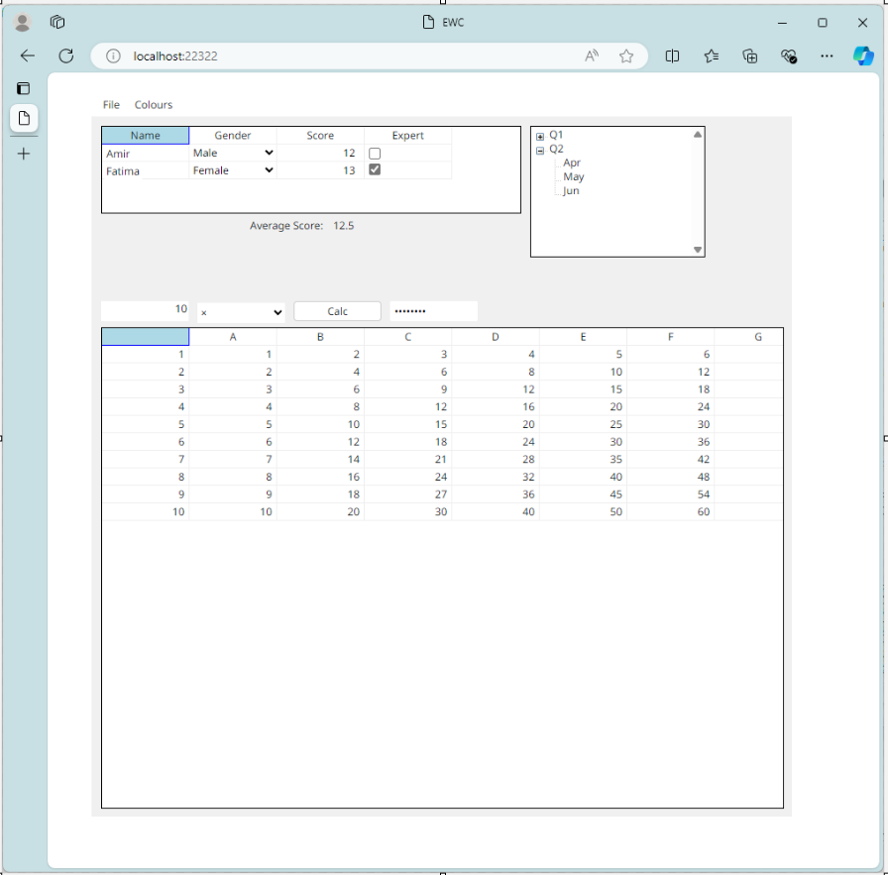
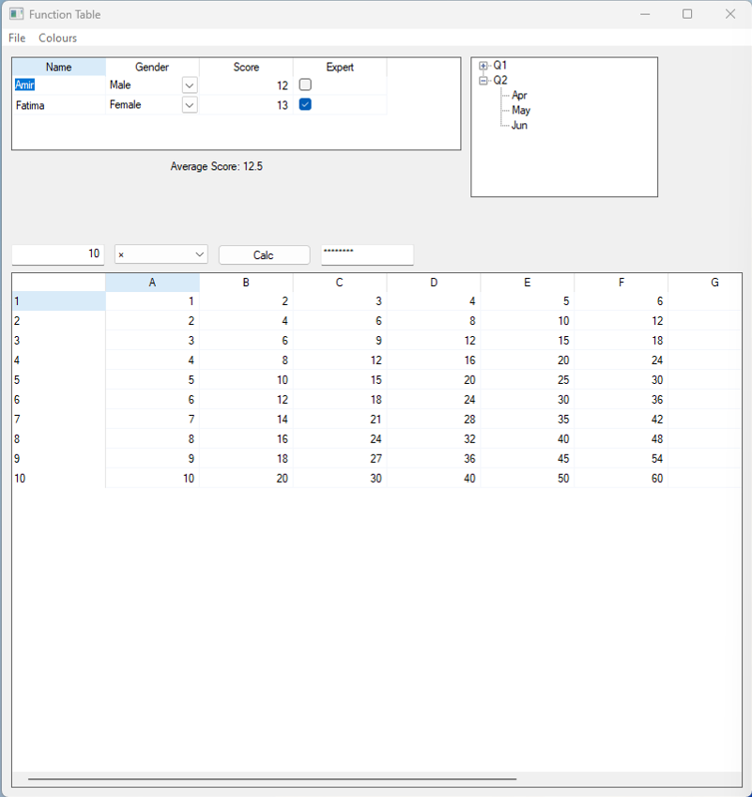
⎕WC↓
EWC→

Slide 22
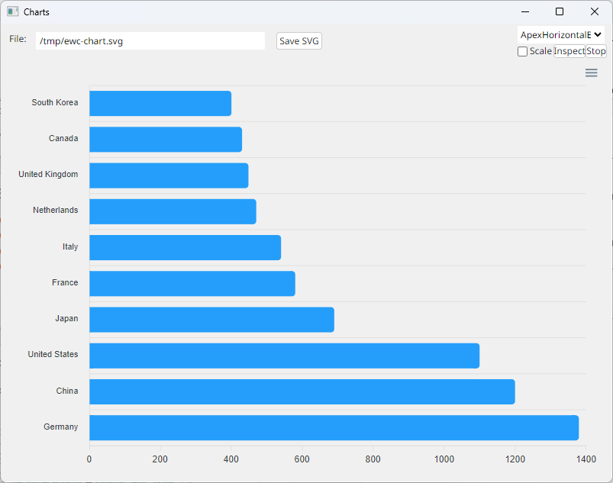
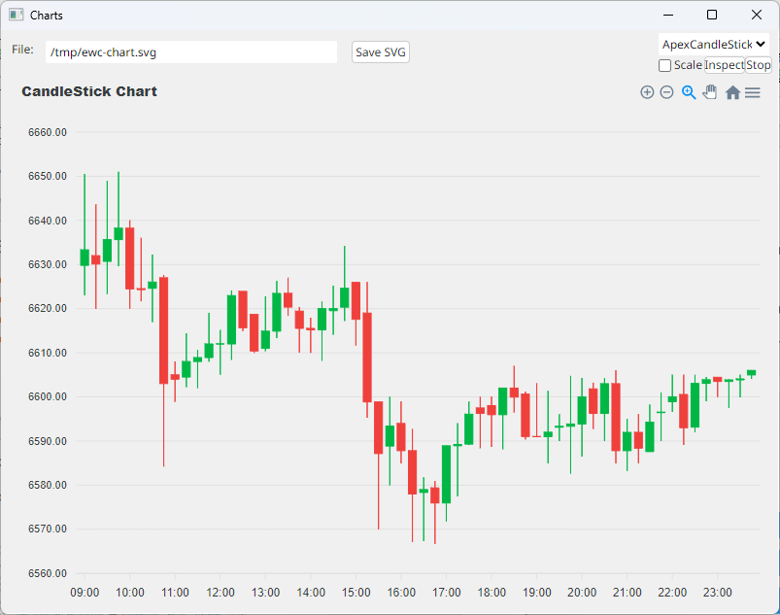
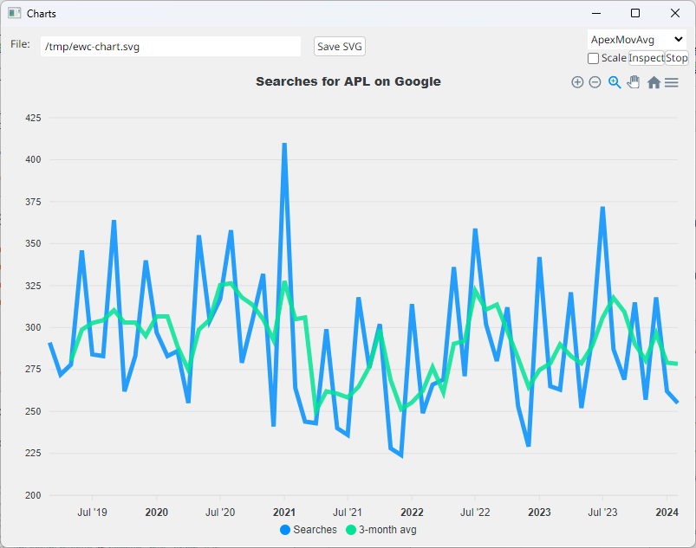
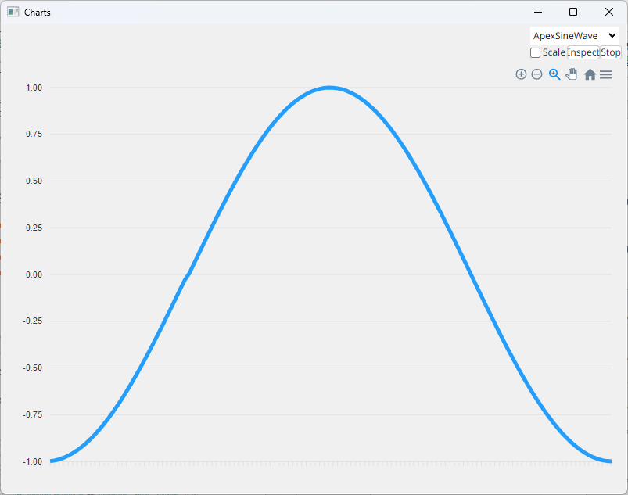
+ ApexCharts

Slide 23
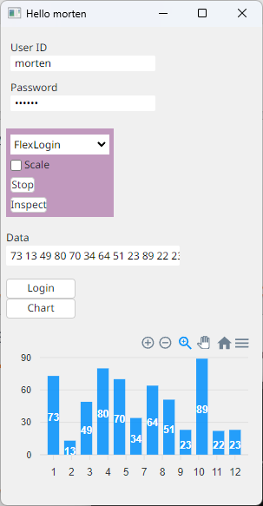
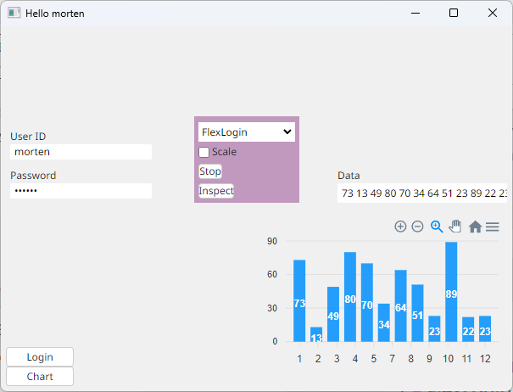
+ Flex Layout

Slide 24
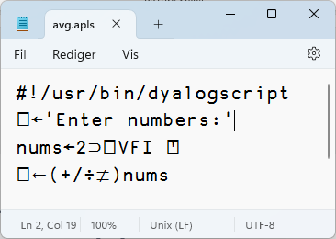
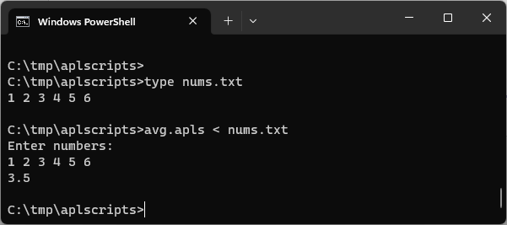
Script Support
#! (hash bang) scripting
Script engine is critical for new users
Makes "Continuous Integration" easier
Still a bit of a prototype in v19.0
Will be improved in v20.0
Need to be able to debug scripts via RIDE

Slide 25
Behind / Reverse Compose
Monadic: f⍛g ⍵ ⬅➔ (f ⍵) g ⍵
From←⊂⍛⌷ ⍝ Enclose behind Index
1 2 2 1 From ⎕A
ABBA
f←5∘< ⍝ Predicate function
f⍛⌿ 2 7 1 8 2 8 ⍝ Filter by f
7 8 8
⌈/⍛= 2 7 1 8 2 8 3 ⍝ Max behind Equal
0 0 0 1 0 1 0

Slide 26
Behind / Reverse Compose
Dyadic: ⍺ f⍛g ⍵ ⬅➔ (f ⍺) g ⍵
10⍳⍛∊2 3 5 8 ⍝ (⍳10)∊2 3 5 8
0 1 1 0 1 0 0 1 0 0
Sort←⊂⍤⍋⍛⌷ ⍝ Universal sorting function
Sort 'mississippi'
iiiimppssss
10 30 20 Sort ↑'Ten' 'Thirty' 'Twenty'
Ten Twenty Thirty

Slide 27
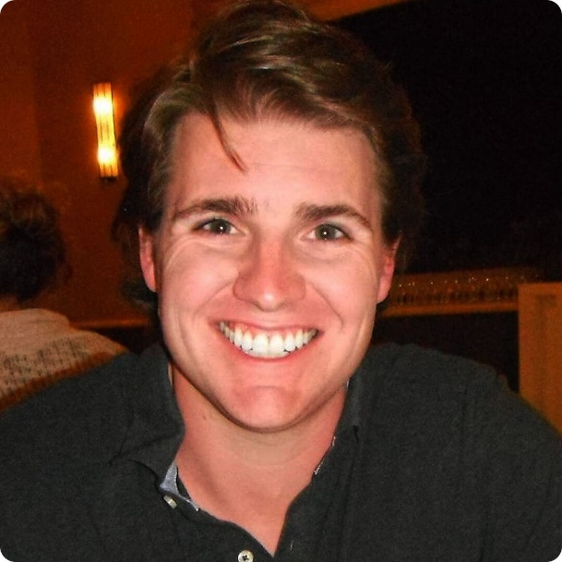
Behind / Reverse Compose
For Conor, with Thanks: Σ & Δ

Slide 28
Tatin
D11 Tue 15:45: New Tatin Packages (Brian Becker)
Package manager for Dyalog APL (A tasty way to package APLs)
2023
2024
]z←tatin.listPackages
{⍺,≢⍵}⌸{(¯1+⍵⍳'-')↑⍵}¨3↓z[;1]
aplteam 42
davin 4
dyalog 2
]z←tatin.listPackages
{⍺,≢⍵}⌸{(¯1+⍵⍳'-')↑⍵}¨3↓z[;1]
aplteam 44
davin 4
dyalog 5 ⍝ 150% growth!
¯2↑z
dyalog-HttpCommand 1
dyalog-Jarvis 1
¯5↑z
dyalog-APLProcess 1
dyalog-HttpCommand 1
dyalog-Jarvis 1
dyalog-NuGet 1 dyalog-OpenAI 1
D10 Tue 15:15: Initialising and Starting from Text Files (Adám Brudzewsky)

Slide 29
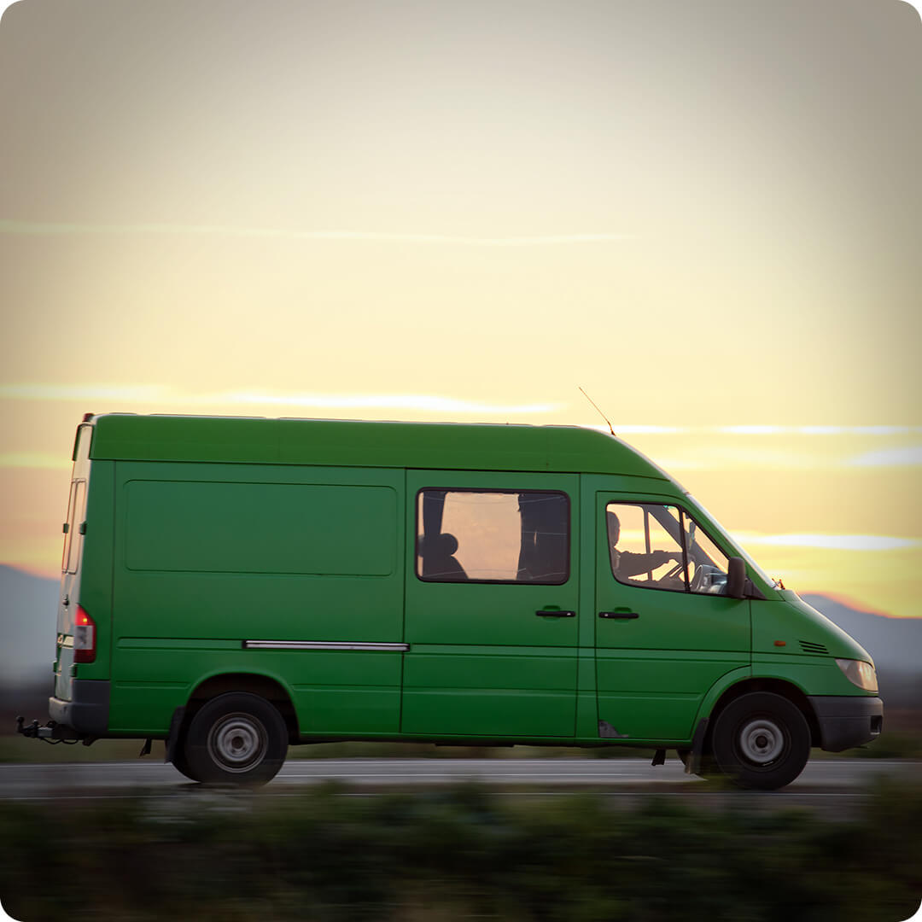
Medium Things on The Way
New Shell System Function
.NET bridge Enhancements
HTMLRenderer Enhancements
Static Analysis of APL Code
Health Monitor
HTMLRenderer Enhancements

Slide 30
⎕SHELL to replace complement ⎕SH
Invoke OS commands from APL
Interruptible
Optionally return data as an asynchronous stream
Manage stdin, stdout & stderr (& other streams) independently
Handle variety of data encodings
D12 Tue 16:15: New Function for Shell Calls (Peter Mikkelsen)

Slide 31
.NET Bridge Enhancements
The v19.0 bridge to .NET 6/7/8 is roughly on par with the Framework bridge
We are developing new features which will ONLY target the new bridge
Generics, Delegates
Async Methods (probably not v20.0)

Slide 32
Static Analysis of APL Code
Static Analysis of application code is seen as a required "best practice" by some corporations
We are building a prototype of a tool which will
Detect vulnerabilities and other bad practices
"Lint" APL Code
This tool will initially be licensed separately
A free "community edition" may follow
D06 Mon 13:55: Static Analysis of APL in APL (Brandon Wilson)
D13 Wed 09:05: Co-dfns Roadmap and Updates (Aaron Hsu)

Slide 33
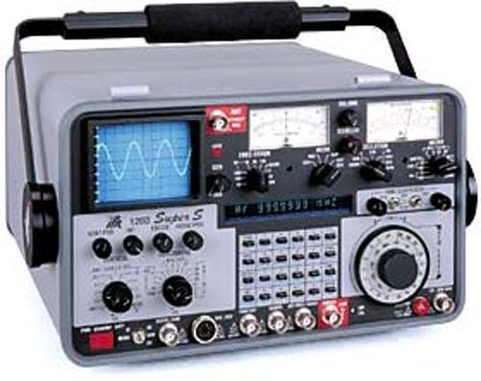
Health Monitor
Version 19.0 contains a prototype. Ideas for v20.0 include:
Complete feature to find last known location of a "hanging" interpreter
Sending signals to interrupt or terminate tasks
Discoverability: allow APL process to broadcast services that it provides
Switch ⎕PROFILE on and off; collect data
Possibly add OpenTelemetry data feed

Slide 34
HTMLRenderer Enhancements
The HTMLRenderer continues to grow in importance
File Upload
Modal HTMLRenderer Windows
More control over "Chrome"
The EWC project will accelerate the evolution of the HTMLRenderer

Slide 35
Small Things
⎕NINFO w/Callbacks
Set File Attributes
Unicode decomposition / normal forms

Slide 36
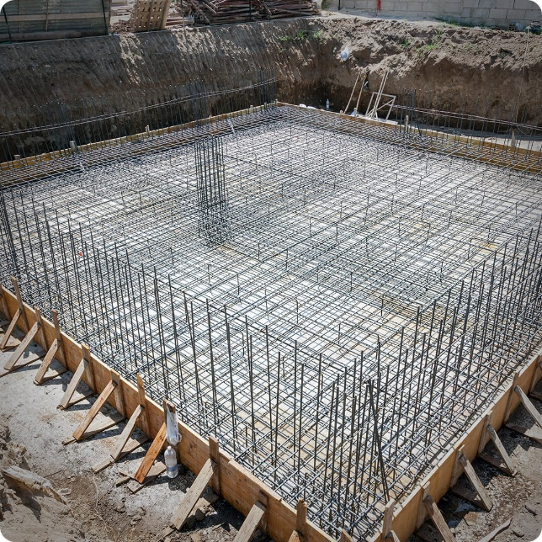
Laying New Foundations
⎕WC Plugin Mechanism
Relax Interpreter Limits
New UCMD mechanism

Slide 37
An Open [Source] Plugin Architecture
A modern replacement for Auxiliary Processors
Uses Direct Workspace Access (DWA) for high performance
Accessible via ⎕WC / ⎕NEW
Make interpreter extensions open source, eg.
HTMLRenderer, Conga (our TCP platform)
Cryptographic Library
Many of these are interfaces to open source components
Dyalog APL
Conga
HTML Renderer
GnuTLS
Chromium Embedded Framework

Slide 38
Plugin Architecture Benefits
Allow users to move faster
Adopt new versions of Chromium or OpenSSL
Make the Dyalog community more inclusive
Allow users to contribute to our eco-system
Users can develop and share new extensions
Makes our encryption tools transparent and verifyable
➔ Easier to comply with FOSS licence constraints
Dyalog APL
Conga
HTML Renderer
GnuTLS
Chromium Embedded Framework
D05 Mon 11:40: WC Plugins (John Daintree)

Slide 39
Relax Interpreter Limits
We plan to relax limitations in the interpreter, like:
Max Rank (15)
Number of tokens in a line (4,095)
Number of token types
(and many more)

Slide 40
Relax Limits – Why Now?
We need more token types for new primitives, new control structures, array notation, …
Migrants have functions with >9,999 lines ☺
Challenge: Structure has not changed for decades
(except new types like Unicode and Complex Numbers)
Must avoid "big bang" data conversion
Different versions of APL must share data
(Restore & use archived component files)
D16 Wed 11:55: Interpreter Limits (John Daintree)

Slide 41
New UCMD Mechanism
The existing User Command mechanism is based on old technology ("SALT")
There are opportunities to make it
Easier to create utilities which provide both a proper API and User Command
Easier to install new User Commands
Faster to start a new APL session
May be provided as an alternative in v20.0, unlikely to immediately replace old system

Slide 42
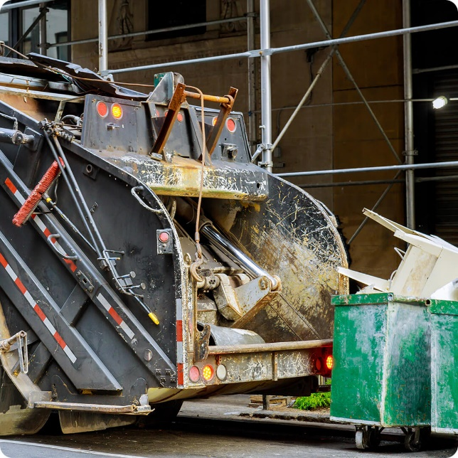
Tidying Up
PCRE 10.x
Documentation Format

Slide 43
Documentation
help.dyalog.com and "core" documentation will be produced using MkDocs on GitHub
Anyone (including you) can raise "issues"
Or even submit "Pull requests"
You CAN still email docs@ or support@
Some tools already use MkDocs…

Slide 45
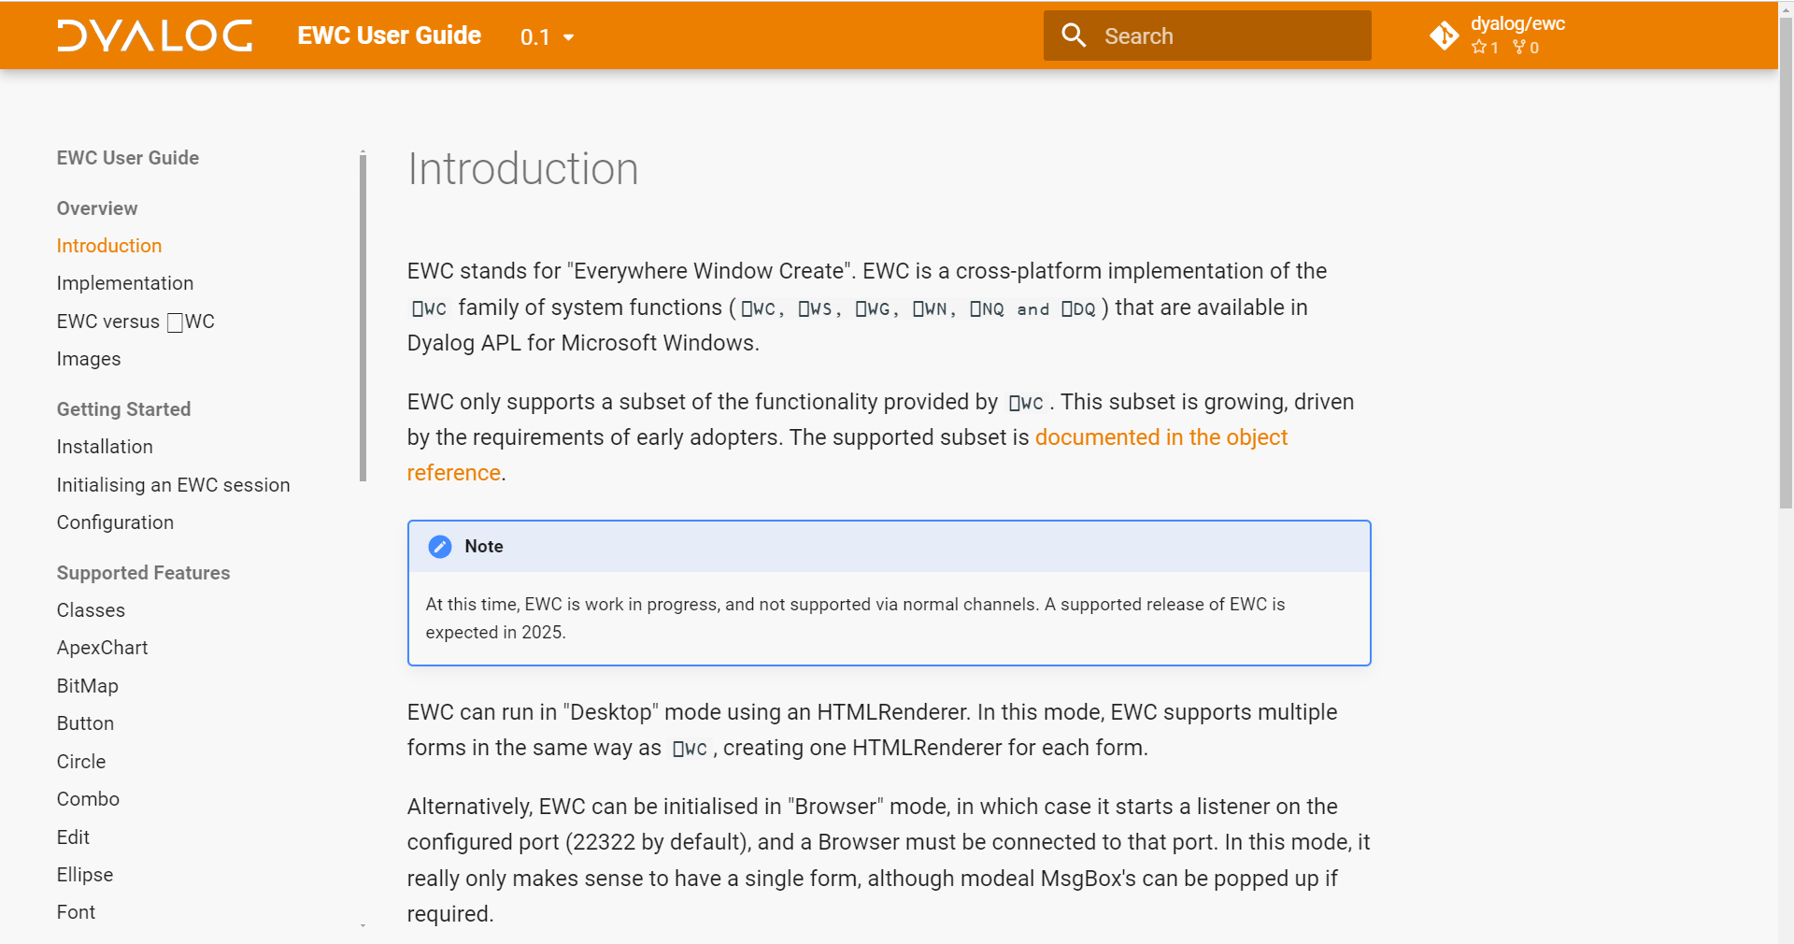
Screenshot of EWC Documentation

Slide 46
Documentation: Why change?
Easier to contribute
Internally and externally (and Pete has retired)
Open formats, platform agnostic tools
Better search
Human-friendly, predictable URLs, like
https://docs.dyalog.com/20.0/object-reference/properties/depth/

Slide 47
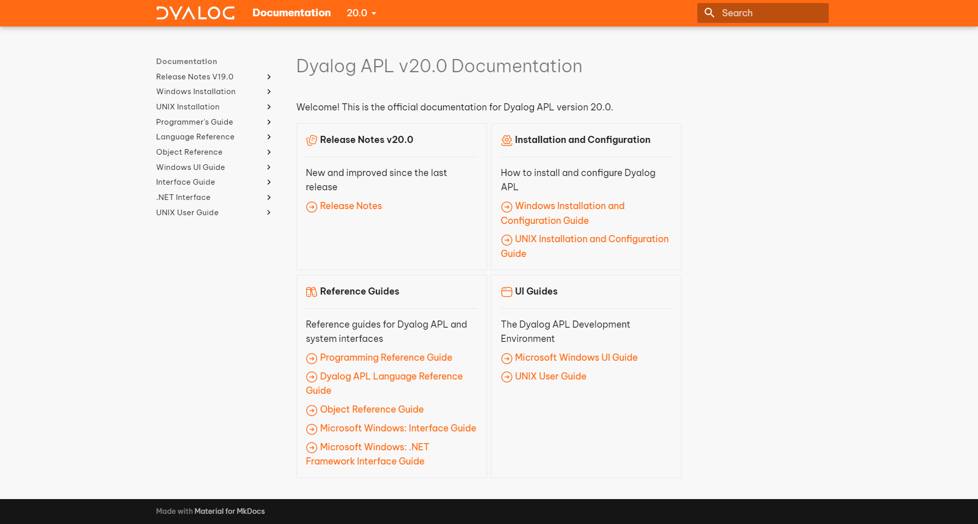

Slide 48
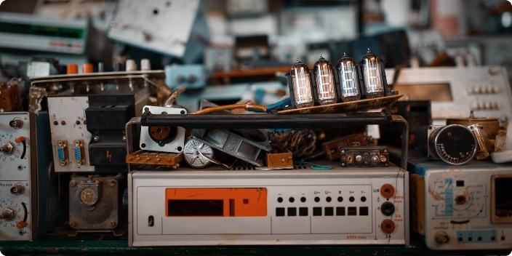
Retiring
Intel-based Mac versions
819⌶ (replaced by ⎕C)
Bundled Syncfusion Libraries
David Liebtag's Array Editor ("replaced" by Array Notation)
32-bit Raspberry Pi

Slide 49
Other Stuff
Link v4.1
Kafka Interface
Telemetry
BSIMM Audit
Isolates connect back to server
(Docker containers)
Performance
Set functions
NSs kept alive by children
Garbage Collector
Exhaustive Primitive Tests
64-bit ARM support
(Pi & AWS Image)
New Mac installer
Directory naming
Keyboard layouts
Platform Features
D15 Wed 10:55: ullu – A Test Framework for Dyalog APL (Aarush Bhat)

Slide 50
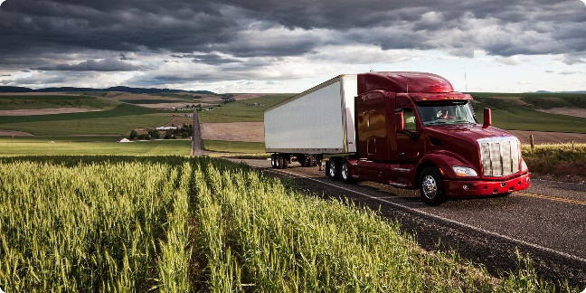
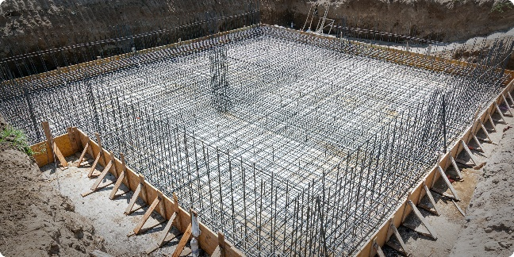
Big Things
Array Notation
Set & Get Variables
Token-by-Token Tracing
Everywhere WC
Script Support
Reverse Compose
New Foundations
⎕WC Plugin Mechanism
Open-source more components
HTMLRenderer, Conga, Crypto Library
Relax Interpreter Limits
New UCMD mechanism

Slide 51
Thank You!

