Slide 1
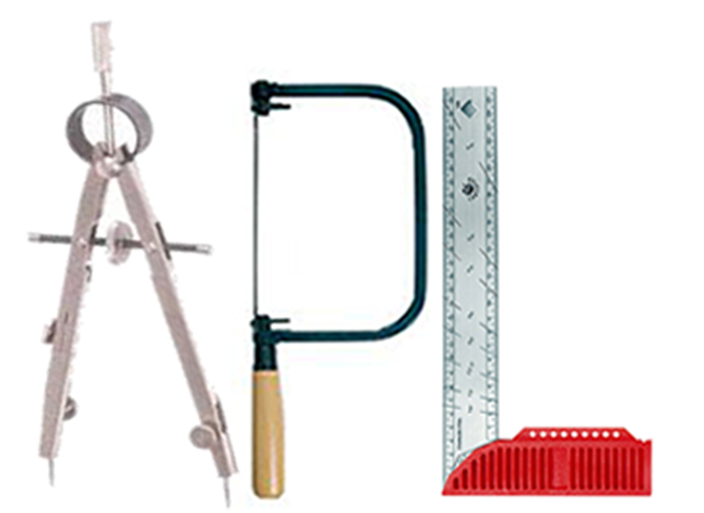
Brian Becker
APL Tools Architect, Dyalog LTD

Slide 2
APL Tools Update
Brian Becker
APL Tools Architect, Dyalog LTD

Slide 3
An APL Tool…
is a software component that the user can:
embed in their APL application
use to develop their APL application
is generally written in APL, but not always
is not an application in and of itself

Slide 4
APL Tools at Dyalog
60+ workspaces delivered with Windows Dyalog
Core utilities, tutorials, games, demonstrations
Built-in
included as user commands or ]LOAD'able
~20 GitHub Repositories
2 Tatin APL Packages (so far)

Slide 5
Web Enabling Tools
Jarvis – JSON and REST web service framework
HttpCommand – send HTTP commands and process server response
DUI/MiServer – HTML web server and content creation
SAWS – SOAP/XML web service framework

Slide 6
Data Tools
loaddata.dws – read and write Excel, csv, XML
newleaf.dws – format and produce PostScript documents
sharpplot.dws – produce high quality SVG or PDF graphs
Math – eigen, domino, Fourier

Slide 7
Interface Tools
conga.dws – TCP/IP toolkit
sqapl.dws – SQL ODBC
aplservice.dws – run as a Windows service
APLProcess – spawn an interpreter in another process
isolate.dws – parallel execution in multiple APL processes
pynapl – Python/APL interface
DUI – cross platform UI

Slide 8
Development/Deployment Aids
Link – map workspace to folder structure
DBuildTest – framework to build and test applications
Cider – project management
Tatin – package management

Slide 9
Tool Availability
To the extent possible, we try to support:
The latest 3 releases of Dyalog APL, plus future releases in the pipeline. Today that means 17.1, 18.0, 18.2, 19.0 and 20.0
All applicable platforms: Windows, Mac, Linux, Pi and AIX
Classic and Unicode
32 and 64 bit
Containerized, headless, scripted
Releases ∘., Platforms ∘., Classic/Unicode ∘., 32/64

Slide 10
2024 Goals
Work with customers to identify tools that will help them succeed
Make it easier to find what tools are available
Website, blogs, forums
Make tools easier to learn
Documentation, webcasts, samples and tutorials
More comprehensive testing
broader test suites
CITA – Continuous Integration Testing in APL

Slide 11
Specific 2024 Goals
HttpCommand – add features per customer needs, webcasts
Jarvis – "industrialize", finish documentation, webcasts
WebSocketServer – come up with a better name, publish version 1
APLProcess – document and publish release
Packages – publish more Dyalog packages on Tatin (you're not retiring that easily Morten ☺)

Slide 12
HttpCommand
Designed with APLers in mind to issue an HTTP request and return the response from the host in a manner useful to the user.
Used for:
Interacting with web services
Downloading files from the web
Scraping web pages
Any HTTP interaction
Demo now - ]demo /dyalog23/httpcommand

Slide 13
HttpCommand
url←'https://api.github.com/orgs/Dyalog/repos' params←('per_page' 5) ('sort' 'pushed') ('direction' 'desc')
⊢ r←HttpCommand.GetJSON 'get' url params [rc: 0 | msg: | HTTP Status: 200 "OK" | ≢Data: 59]
↑r.Data.(name pushed_at) ┌─────────────────────┬────────────────────┐ │HttpCommand │2023-10-14T20:13:50Z│ ├─────────────────────┼────────────────────┤ │Jarvis │2023-10-14T14:47:09Z│ ├─────────────────────┼────────────────────┤ │CITA │2023-10-13T12:44:56Z│ ├─────────────────────┼────────────────────┤ │link │2023-10-12T15:12:02Z│ ├─────────────────────┼────────────────────┤ │dyalog-jupyter-kernel│2023-10-11T15:53:12Z│ └─────────────────────┴────────────────────┘

Slide 14
Jarvis
A few years ago, a customer wanted to make the APL functions their group had written available to other (non-APL) parts of the company.
As often happens, Morten had an idea on how to address their need… (and asked me to make it happen)
Over a weekend, I wrote the JSONServer, and it was well received.
Some time later another customer wanted the capability to deliver a RESTful web service with JSONServer.
JSONServer → Json And Rest serVIce → JARVIS

Slide 15
Jarvis
Jarvis is a framework that makes it easy to expose your APL functionality as a web service.
How easy? Let's see…
Demo time - ]demo /dyalog23/jarvis

Slide 16
Suppose…
You have a web application with a HTML/CSS/JavaScript client.
If you use standard HTTP requests, the only way to get updated information from the server is to ask for it.
Wouldn't it be nice if the server could "push" updated information in real time without the client having to ask for it.
WebSockets can accomplish precisely that (and more)

Slide 17
Sneak Peek at WebSocketServer
WebSocketServer is, well, a WebSocket server.
What's a WebSocket? I'm glad you asked…
WebSocketServer is designed to facilitate different modes of interaction
Publish/Subscribe (PubSub)
Asynchronous Remote Procedure Control (ARPC)
any others we think will be useful and implementable
It may become integrated with Jarvis
Demo time - ]demo /dyalog23/wss

Slide 18
Tools, Tools, and More Tools
There are several other sources of tools in the APL community
Adám Brudzewsky – https://github.com/abrudz
Kai Jeager – https://github.com/aplteam
Tatin – https://tatin.dev
Carlisle Group – https://github.com/the-carlisle-group
Notes:
H

Slide 19
Summary
Our customers are our partners – we're in this together
If you have a need, tell us. Jarvis exists today because a customer communicated a need to Morten...
Many features in our tools are in direct response to feedback from our customers.
Report bugs, suggest features, contribute code

