Slide 1
Rebuilding a production APL environment using Dyalog
Dyalog ’22 – 10/10/2022
Mark I.Wolfson

Slide 2
Summary
Who is BIG and why is it a perfect use-case for APL
Old: Middleware environment with awkward links into the production .Net environment and web application
New: Seamless integration using existing tools and structures.
Notes:
Prequel: What we’re doing with APL and how it has helped us disrupt our industry, increasing collaboration, creating efficiencies and improving overall performance.

Slide 3
Big Business – Disrupting the Jewelry Industry
Prior to BIG - 2005
Independent Jewelers – family-owned businesses
No POS/Inventory Management
Wrong inventory mix
Too much non-performing inventory
Balance to Buy - 2007
Improve performance by using data
Analyze prior consumer behavior
Strategies to reduce aged inventory
Budget/Plan/Buy/Manage
Notes:
Mall stores/free standing stores
Branded stores/ generic stores
Single stores / small chains
$1M stores / 5-10-20-50 M Stores

Slide 4
How to get data from retailers?
Retailers with no technical capabilities
Direct user upload
Emailed reports
Monthly data
Direct POS Integration
Daily transmissions
With and without cooperation from software companies
The Applet – a big ask

Slide 5
Retailer Data – A HOT MESS
Integration with dozens of systems
Varying number of files even for the same system
Different formats
Flavors of CSV
Text files
Excel
XML
JSON
Different content
Variations in content between retailers using the same system
Variations within a retailer depending on who’s entering the data
Changes over time

Slide 6
Retailer
APL Process
Upload Service
Retailer
APL Process
Balance to Buy
Retailer
APL Process
Retailer
APL Process

Slide 7
Building a monster – the APL2 Solution
Integration with dozens of systems
Varying number of files even for the same system
Different formats
Flavors of CSV
Excel
XML
JSON
Different content
Variations in content between retailers using the same system
Variations within a retailer depending on who’s entering the data
Changes over time

Slide 8
APL2 Production Environment
One workspace – 1500 functions
Old, new, unused
100 Launch functions
Check for data, find filenames
Error handling
Notifications
Special-use functions, variations of functions
Multiple versions for variations in data
Mish-mash of workarounds
Reading different file formats
Excel as data converter
Powershell as data converter
Ad-hoc converters
Kludges to communicate with Production DB
Scheduled queries

Slide 9
APL2 Production Environment
Data expected at a certain time
Windows scheduled tasks
.bat files

Slide 10
Dyalog to the RESCUE!
First impulse: Use Dyalog but keep the same execution structure.
Better: create new production environment around all the new tools in Dyalog!

Slide 11
New Production Environment
Windows Service
Code in text files
Restructure data directories
Single unified Launch function
Global file handling
Global error handling

Slide 12
Queue Manager

Slide 13
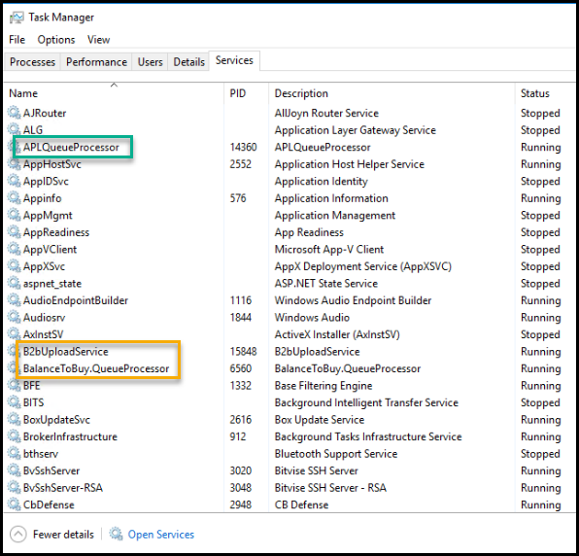

Slide 14
New Production Environment
Windows Service
Spawn APL Session to look for new data to process, then queue task
Look for task
Spawn APL Session to process task
Repeat

Slide 15
APL Queue Processor Service
Queue Tasks
Process Tasks:
Launch Black Box
Upload Service
Task Table

Slide 16
APL Service

Slide 17
New Production Environment
All code in text files, except lean Prod workspace
LX
Initialize SQL
SETPATH – for localized paths
ClosedXML
⎕Path
Check for Prod run
Bring in Utils and PostProcess code
Set RIDE
Set global Error Handling

Slide 18
⎕LX

Slide 19
New Production Environment
Restructure data directories
Incoming data
Pending folder
Processed folder
Single unified Launch function
Check for production run
Look up details of task: retailer, files
Move files to Pending
Set error handling and notifications
Call needed code
Move processed files to Processed

Slide 20
Launch

Slide 21
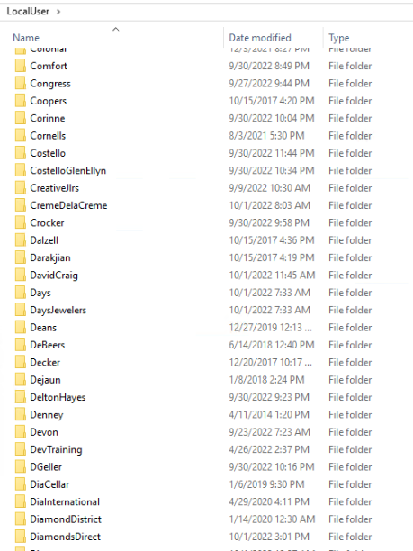
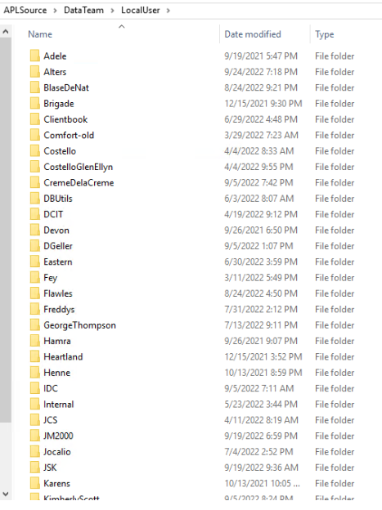

Slide 23
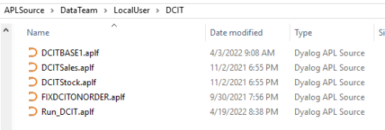

Slide 24
Thank you!
Dyalog ’22 – 10/10/2022
Mark I.Wolfson

