Slide 1
‘16 Problem Solving Competition
Zack Batik

Slide 2
How did I discover APL?

Slide 3
My first APL development
IFS (Index Forecasting System)

Slide 4
The Competition

Slide 5
Phase 1
Mean
{(+/⍵)÷⍴,⍵}
{⍵+.÷⍴,⍵}

Slide 6
Phase 1
The median
{0.5×+/2⍴(2-2|⍴A)↑(¯1+⌈0.5×⍴A)⌽A[⍋A←,⍵]}
Just for fun:
{2≥⍴,⍵:⍵+.÷⍴,⍵ ⋄ ∇ ¯1↓1↓⍵[⍋⍵]}

Slide 7
Phase 2
Three Problems:
Calculating a Forward Rate
Triangular Distribution
Monte Carlo Modeling

Slide 8
Forward Rate
2-/⍵
forward ← { (1⊃⍵),(2-/⍺×⍵)÷2-/⍺}
Where the right argument is a vector of rates
and the left argument a vector of maturities

Slide 9
Probability Density Function

Slide 10
Probability Density Function

Slide 11
Probability Density Function
pdf2←{
a b m←⍺ ⍝ seperate out the left arg
area←⍺∘{
base←|-/⍵ ⍝ the base of the section
trih←|-/points←⍺∘pdf¨⍵ ⍝ height of the triangular tip
rech←⌊/points ⍝ height of the rectangular bit
base×rech+0.5×trih ⍝ the area of the section
}
sections←(⊂a⌈m⌊⍵),⊂b⌊m⌈⍵ ⍝ define the sections of area
+/area¨sections ⍝ calculate probability
}

Slide 12
Probability Density Function
(⊂a⌈m⌊⍵),⊂b⌊m⌈⍵

Slide 13
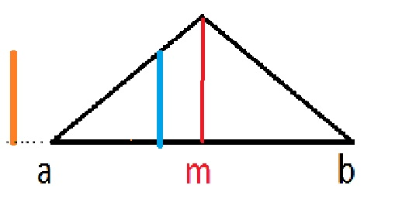
Probability Density Function

Slide 14
The Full Monte

Slide 15
The Full Monte

Slide 16
The Full Monte

Slide 17
The Full Monte

Slide 18
The Full Monte

Slide 19
Some thanks

Slide 20
→0

