Slide 1
Putting Dyalog’s Latest Features to Use
Dan Baronet

Slide 2
Many new features
V14.0 is probably the release of Dyalog with the most new features.
Notes:
⎕ML 1 assumed throughout these slides

Slide 3
New features
performance – idioms, parallel features, compiler and other speed ups
language features – trains, rank and key operators, tally, index of, and others
development environment – new user commands, changes to the IDE, introducing the RIDE
Notes:
We will concentrate on the language enhancements

Slide 4
New features
interfaces – R Project for Statistical Computing, .NET enhancements
tools and utilities – Chart Wizard, JSON, XML, WPF
customer support – new MyDyalog Web site
Notes:
We will concentrate on the language enhancements

Slide 5
Performance improvements
⌊0.5+numArray is a new idiom
Many Boolean Operations are faster

Slide 6
Performance improvements
^.=, +.= (ints)
b⊂[⎕io]x
s⍴x (non pointer)
⍋b (bool or 1 byte items)
+/ (int vectors), ⌈/ (vectors)
x⍳y, y∊x, ∪x (4 bytes major cells)
x (8⌶) y
And many more

Slide 7
Component file system
The performance of reading and writing APL components has been improved
Component files ⎕FREAD can read several components at once, e.g. ⎕FREAD 1 (⍳10) ⍝ atomic & faster
Components can be compressed
Notes:
LZ4 compression method by component

Slide 8
Various IDE enhancements
There are 5 new user commands:
]box to box output and ]rows to limit the output
]findoutput, ]caption and ]copyreg
Skip blank lines/comments when tracing
Allow search to wrap
Chart wizard
Align comments
Notes:
In 14.1 there is also ]findoutput

Slide 9
Language enhancements
Named monadic ops
Right currying for dyadic ops
Variant with ⎕XML
⎕RL true random seed
Roll (?) 0
Mix “upgrade”
Iota extended to higher rank left argument

Slide 10
Misc.
Many user command changes (e.g. grouping, presentation)
External functions tips with syntax
New Ibeams
WPF: data binding
Notes:
See release Notes for details

Slide 11
New Language features
Rank (⍤)
Key (⌸)
Tally (≢)
2 new characters (⍤ and ⌸)

Slide 12
Named monadic ops
Up until now you could not name operators:
spawn ← &
SYNTAX ERROR
spawn ← &
^

Slide 13
Named monadic ops
But now you can name monadic operators
spawn ← & ⋄ each ← ¨
⎕←⎕DL spawn each ⍳7
10 11 12 13 14 15 16
)si
&12
&13
&14
&15
&16

Slide 14
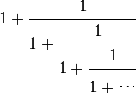
Right currying for dyadic ops
You can also bind a function with a dyadic operator to turn it into a monadic operator:
tilSame ← ⍣=
⍝ Golden number:
+∘÷ / 100⍴1
1.618033988749895
1 +∘÷ tilSame 1
1.618033988749897
Notes:
Why are the answers different? Hint: []CT

Slide 15
Variant with ⎕XML
⎕XML has always been accepting a left argument specifying options Whitespace, Markup or UnknownEntity.
These can now be specified using Variant (⍠) as in
XWS← ⎕XML ⍠ 'Whitespace' 'Strip' instead of
XWS← 'whitespace' 'strip'∘⎕XML

Slide 16
Random seed
Up until now there was no way to set a true random seed.
⎕rl←67890 ⋄ ?1000
279
⎕rl←67890 ⋄ ?1000
279
Now you can:
⎕rl←0 ⋄ ?1000
830
⎕rl←0 ⋄ ?1000
507
⎕rl←0 ⋄ ?1000
154

Slide 17
Roll (?) 0
Up until now ?0 was a DOMAIN error.
It now returns a floating point number in ]0,1[ (between 0 and 1)
E.g.
?0
0.127931
Notes:
⎕rl←0 and ?0 are not related

Slide 18
Roll (?) 0
?0
0.52748508
?0
0.59372336
?0
0.37650812
? 0 10 100
0.31132960 8 42

Slide 19
Tally
Tally simply returns the number of major cells.
The result is a scalar.
Examples:
≢ ⍳8 8 | ≢ 9 1 | ≢ 2 8 ⍴ 5 2

Slide 20
Tally
Tally solves a number of problems Shape was creating.
n ← ⍳3 1 (⍴n) ⍴ 5
DOMERR
1 (≢n) ⍴5
5 5 5
avg←{(+⌿⍵)÷⍴⍵}
avg 7
avg←{(+⌿⍵)÷≢⍵}
avg 7
7
Nothing!

Slide 21
Trains
Trains are a series of 2 (Atop) or 3 functions (Fork).
The general case is
F G H ⍝ fork
Or
G H ⍝ Atop
Where H may be another 3 train function.

Slide 22
Trains
A 3 function train is of the form
F G H
e.g.
+ – x
Which is
(la + ra) – (la x ra)
Used within an expression you must use ()s, e.g.
3 (+ - x) 1
1
Notes:
() are needed just like in other data expressions that need them, e.g. 1 (2 3 4) or 1 (+∘(1∘÷)⍣99) 1

Slide 23
Trains
A 2 function train is of the form
G H
e.g.
– x
Which is
– (la x ra)
Used within an expression you must use ()s, e.g.
3 (- ×) 10
¯30

Slide 24
Trains
Careful!
y F G H z or y G H z
Is not the same as
y (F G H) z or y (G H) z
e.g.
4 + - ÷ 2 ⍝ 4 + ¯0.5
3.5
4 (+ - ÷) 2 ⍝ (4+2) - (4÷2)
4
Notes:
Note that F may be a constant

Slide 25
Trains
NOTE:
operators bind before trains.
+/ ÷ +.×
Really is
(+/) ÷ (+.×)

Slide 26
Mix (↑)
Mix has always padded the individual elements to accommodate the largest one:
⍴⎕← ↑ 9 (1 2)
9 0
1 2
2 2
⍴⎕← ↑ 9 (2 2 ⍴ ⍳4)
9 0
0 0
1 2
3 4
2 2 2
Notes:
Regardless of rank with scalars

Slide 27
Mix (↑)
But Mix always has had a problem with mixing ranks:
↑ (1 2 3) (2 2⍴5)
RANK ERROR
Vector
Matrix

Slide 28
Mix (↑)
In V14.0 Mix no longer has a problem with mixing ranks:
↑ (1 2 3) (2 2⍴5)
1 2 3
0 0 0
5 5 0
5 5 0
Notes:
Vector + matrix = no problem

Slide 29
The Rank Operator (⍤)
It breaks the function calls to “cells” of the argument
A “cell” is a sub array of the original array
In general functions are either scalar (rank 0) or “structural” (rank non 0, often infinite)
For example (+) is a rank 0 function and match (≡) is rank infinite, it applies to the whole argument.
Notes:
The concept of rank was unknown originally

Slide 30
Rank
Sub arrays are sections from the major axes.
For example:
A row is a (major) cell of a matrix
A matrix is a cell in a 4D array
A scalar is always a cell of ANY array
An array is the (only one of that type) cell of itself
Notes:
A major cell is a cell on the leading axis

Slide 31
Rank
Rank reassembles the individual results according to “Mix” rules

Slide 32
Rank
Examples:
Vector of 5 elements.
There are 5 rank 0 (scalars) cells in this rank 1 array.

Slide 33
Rank
Example:
Matrix of 2 rows, 3 columns.
There are 2 rank 1 (vectors)
cells in this rank 2 array.

Slide 34
Rank
Example:
Matrix of 2 rows, 3 columns.
There is 1 rank 2 array (itself)
And there are 6 (2 x 3) rank 0 (scalars)

Slide 35
Rank
Example:
3D array of 2 planes,
3 rows and 4 columns.
It can be seen as 2 planes

Slide 36
Rank
Example:
It can be seen as 6
(2 x 3) rows

Slide 37
Rank
Example:
It can be seen as 24
(2 x 3 x 4) scalars

Slide 38
Rank
Think of rank as
enclose cells / apply each / reassemble.
As in
(foo⍤R) A
Same as
↑ foo¨ ⊂[(-R)↑⍳⍴⍴A] A
Notes:
-R is DROP instead of TAKE

Slide 39
Rank
Same for dyadic case:
B (foo⍤R) A
It is the same as
↑ (⊂[(-1↑R)↑⍳⍴⍴B] B) foo¨ ⊂[(-¯1↑R)↑⍳⍴⍴A] A

Slide 40
Rank Examples
]disp m←2 3⍴1 ';' 3 (⍳3)'sad' 0
┌→────┬───┬─┐
↓1 │; │3│
├~────┼───┼─┤
│1 2 3│sad│0│
└~───→┴──→┴─┘
≡⍤1 ⊢m ⍝ apply ≡ on each row
≡ 1 ';' 3
≡ (⍳3) 'sad' 0
1
¯2
Notes:
We need to separate 1 from m as usual otherwise (1 m) would be treated as a constant, as the right operand to RANK

Slide 41
Rank Examples
≡⍤1 ⊢m ⍝ apply ≡ on each row
Same as
↑≡¨ ⊂[¯1↑⍳⍴⍴m] m
Or
↑≡¨ ⊂[2] m
1
¯2
Notes:
Disclosing a bunch of SIMPLE scalars returns them verbatim

Slide 42
Rank Examples
Some things can be done with the axis operator
im←3 4⍴⍳12 ⍝ add 100×⍳4 to each row
im +[2] 100 200 300 400
101 202 303 404
105 206 307 408
109 210 311 412
im (+⍤1) 100 200 300 400 ⍝ 1 # for both
101 202 303 404
105 206 307 408
109 210 311 412
Notes:
No need to worry about index origin; 3 vectors on the left, 1 on the right, they are conformable

Slide 43
Rank Examples
im←3 4⍴⍳12 ⍝ 3 vectors and 1
im (+⍤1) 100 200 300 400 ⍝ vector
101 202 303 404
1 2 3 4 + 100 200 300 400
1 2 3 4
5 6 7 8
9 10 11 12
105 206 307 408
5 6 7 8 + 100 200 300 400
109 210 311 412
9 10 11 12 + 100 200 300 400
Notes:
3 vectors & 1 vector

Slide 44
Rank Examples
Some things can be done with [brackets]
im←3 4⍴⍳12 ⍝ add 100×⍳3 to each col
im +[1] 100 200 300
101 102 103 104
205 206 207 208
309 310 311 312
im (+⍤1 0) 100 200 300
101 102 103 104
205 206 207 208
309 310 311 312
Notes:
3 vectors, 3 scalars

Slide 45
Rank Examples
im ← 3 4 ⍴ ⍳12 ⍝ 3 vectors and 3
im (+⍤1 0) 3 ⍴ 100 200 300 ⍝ scalars
101 102 103 104
1 2 3 4 + 100
1 2 3 4+100
5 6 7 8+200
9 10 11 12+300
5 6 7 8 + 200
205 206 207 208
9 10 11 12 + 300
309 310 311 312
Notes:
3 vectors on the left, 3 scalars on the right

Slide 46
Rank Examples
ca ← 2 3 4 ⍴ ⎕A
ca (⍪⍤2 1) 2 4 ⍴ 'abcdefgh'
ABCD
EFGH
IJKL
abcd
MNOP
QRST
UVWX
efgh
Same as
ca ,[2] 2 4 ⍴ 'abcdefgh'
Notes:
2 matrices and 2 vectors: good – otherwise we'd get a LENGTH error

Slide 47
Rank Examples
Some things cannot be done with [brackets]
cm ← 3 4 ⍴ ⎕A
⍝ catenate ‘abc’ to each row
cm (,⍤1) 'abc'
ABCDabc
EFGHabc
IJKLabc
cm {⍺,((1↑⍴⍺),⍴⍵)⍴⍵} 'abc'

Slide 48
Rank Examples
ca ← 2 3 4 ⍴ ⎕a
ca (⍪⍤2 1)'abcd'
ABCD
EFGH
IJKL
abcd
MNOP
QRST
UVWX
abcd
ca (⍪⍤2) 'abcd'
ABCD
EFGH
IJKL
abcd
MNOP
QRST
UVWX
abcd
Notes:
No need to use 2 1 since ‘abcd’ is already 1, the lower rank is used between RANK's operand and the real rank of the corresponding argument

Slide 49
Rank Examples
ca ← 2 3 4 ⍴ ⎕A
ca (,⍤2) 'abc'
ABCDa
EFGHb
IJKLc
MNOPa
QRSTb
UVWXc
ca {⍺,((1↑⍴⍺),⍴⍵)⍴⍵}'abc'

Slide 50
Rank Examples
1 2 3 (⍴⍤0) 1 2 3
1 0 0
2 2 0
3 3 3
↑ 1 2 3 ⍴¨ 1 2 3
Notes:
New “mix” behaviour. ⍤0 is like "each" here

Slide 51
Rank Examples
Recreate a structure with same shape
Instead of doing
((¯1↓⍴cm),⍴t)⍴t←'abc'
abc
abc
abc
Do
cm (⊢⍤1) 'abc'
abc
abc
abc

Slide 52
Rank Examples
Matrix inverse is limited to matrices.
⍴ fa←÷ 10 20 ∘.+ iv ∘.+ iv← ⍳4
2 4 4
⌹ fa ⍝ doesn’t work on 2<⍴⍴
RANK ERROR
⍴ r← ↑ ⌹¨ ⊂[2 3] fa
2 4 4
r ≡ (⌹⍤2) fa
1
Notes:
Awkward to use [2 3], this is the matrix in a 3D array – we need to split, apply ⌹ then reassemble

Slide 53
Rank: reassemble results
Like Mix:
↑ (1 2 3) (2 2⍴5)
1 2 3
0 0 0
5 5 0
5 5 0

Slide 54
Rank: reassemble results
Like Mix:
ia ← ↑ (1 2 3) (2 2⍴5)
ia ≡ (⊃⍤0) (1 2 3) (2 2⍴5)
1

Slide 55
Key
Key solves problems related to a common situation.
When we want to apply a function to items of the same nature.
For ex we want to know the indices of each unique names in a group or the sum of their associated scores, etc.

Slide 56
Key
Example:
names ⍝ 12, some repeat
Pete Jay Bob Pete Pete Jay Jim Pete Pete Jim Pete Pete
(∪ names) ∘.≡ names
1 0 0 1 1 0 0 1 1 0 1 1 ⍝ 6 Pete
0 1 0 0 0 1 0 0 0 0 0 0 ⍝ 2 Jay
0 0 1 0 0 0 0 0 0 0 0 0 ⍝ 1 Bob
0 0 0 0 0 0 1 0 0 1 0 0 ⍝ 2 Jim
scores
66 75 71 100 22 10 67 77 55 42 1 78

Slide 57
Key
Example:
b← ↓ (∪ names) ∘.≡ names
]disp b/¨⊂⍳12
┌→──────────────┬───┬─┬────┐
│1 4 5 8 9 11 12│2 6│3│7 10│
└~─────────────→┴~─→┴→┴~──→┘
+/¨b/¨⊂scores
399 85 71 109

Slide 58
Key
Example:
]disp {⊂⍵}⌸ names
┌→──────────────┬───┬─┬────┐
│1 4 5 8 9 11 12│2 6│3│7 10│
└~─────────────→┴~─→┴→┴~──→┘
names {+/⍵}⌸ scores
399 85 71 109

Slide 59
Key
Example:
⍴ ⎕← {⍺ ⍵}⌸ names
Pete 1 4 5 8 9 11 12
Jay 2 6
Bob 3
Jim 7 10
4 2

Slide 60
Key
Example:
avg ← +⌿ ÷ ≢ ⍝ a train
names {avg ⍵}⌸ scores
57 42.5 71 54.5

Slide 61
Key
The monadic definition of key is
array F ⌸ ⍳≢array
This is the same as
F ⌸ array

Slide 62
Optimised cases
{⍺,≢⍵}⌸ (⍺ num)
{⍺ ⍵}⌸
{⍺(≢∪⍵)}⌸
{⊂⍵}⌸
{⍺(≢⍵)}⌸
{⍺}⌸
⊣⌸ (∪⍵)
{≢⍵}⌸ and ⊢∘≢⌸
{≢∪⍵}⌸
⍳∘1 ≥ or 1 ⍳⍨ >

Slide 63
Dyadic iota
It has been modified to work on “higher rank than vector left argument” arrays.
Previously, doing matrix ⍳ anything was a RANK error. Now it is allowed, assuming the LENGTHs match.

Slide 64
Dyadic iota
cm3 ← 4 4 ⍴ 'Jay Bob Jim Pete'
cm3 ⍳ ↑'Dan' 'Bob' 'Pete'
5 2 4

Slide 65
Dyadic iota
X2 ← 2 6 ⍴ ⍳12
⍴ X3 ← 2 10 100 1000 ∘.+ X2
4 2 6
X3 ⍳ 100 1 ∘.+ X2
3 5
⍴⍴ X3 ⍳ X2
0
The result of iota is always an array of the same shape as (-(⍴⍴⍺)-1)↓⍴⍵
Notes:
X2 has the same shape as major cells of X3.

Slide 66
Dyadic iota
Previously finding names in a matrix was done like this:
(↓matrix) ⍳ ↓names
Now it can be simply done like this:
matrix ⍳ names
But the last dimensions MUST agree or a LENGTH error will be reported

Slide 67
Exercises - Choices
Topics
parallel features (isolates)
trains, rank and key operators, tally, index of
new user commands, changes to the IDE, the RIDE
R Project for Statistics, .NET enhancements
Chart Wizard, JSON, XML, WPF
MyDyalog

Slide 68
Parallel features
An Isolate is a namespace where code executes in parallel with the current process.
Code executed within it returns immediately a future, a reference to a result.
They can be handled without blocking as long as no reference is made to the value.

Slide 69
Parallel features
Instructor:
Start APL
]demo C:\APL\training\conf2014\isolates\1

Slide 70
Exercises - Trains
Write functions to
find the average
find the geometric average hint: {(×/⍵) * ÷≢⍵}
add 1÷x to x
find the sum of the product. Hint: {+/⍺×⍵}
ravel and add 15% to its argument
find the square of the SINE. Hint {(1○⍵)*2}
split a list at a specific position
Notes:
; ×/ * 1÷≢ or …÷∘≢ or …⊢÷≢; ÷+⊢; +/x; 1.15x, ; 2 *⍨ 1○⊢ or ×⍨ 1○⊢; see workspace trains for other answers

Slide 71
Exercises - Trains
Find the range (max-min) of a list
Transform Fahrenheit from Celsius (or vice versa)
Sort a list
Perform integer division
Sum all the elements of a nD array
Find the numbers making up a rational fraction, e.g. 2/9
Notes:
⌈/,⌊/ ; 32 + 1.8 x ⊢ ; ⊂∘⍋ ⌷⊢ ; ⌊÷ ; +/, ; (1∧⊢) ÷ 1,⊢

Slide 72
Exercises – Iota
)LOAD trains
Find the position in employees of each row in matrix names
Find which plane (the index) of 3D array cities is matrix P1
Find which planes (the indices) of 3D array cities is 3D array cities2
Notes:
refer to ws supplied for variables

Slide 73
Exercises – Key
Find the position of each unique name in colours
… each enclosed
… with the colour names
… with their number of occurrences
Find the sum of the scores associated with each colour
With each colour
Notes:
⊢⌸colours, (⊂⊢)⌸colours,{⍺,⊂⍵}⌸colours, {⍺,≢⍵}⌸c,c{⍺,+/⍵}⌸scores

Slide 74
UCMDs, IDE, the RIDE
New UCMDS:
Findoutput (14.1)
Caption (14.1)
pivottable
box
boxing
spaceneeded
chart
copyreg (14.1)

Slide 75
UCMDs, IDE, the RIDE
You can now align the comments at the cursor position
Skip comments
Skip blank lines

Slide 76
The RIDE (Remote Integrated Development Environment)
The RIDE is a separate program allowing you to interact with a Dyalog APL (remote) session.
You can download the RIDE from my.dyalog.com, downloads section.

Slide 77
The RIDE
Once installed you can "talk" to sessions that are RIDE enabled.
To make a session RIDE enabled you should start it with the –ride switch as in
$ dyalog –ride
You can then start RIDE and you should be able to connect to it.

Slide 78
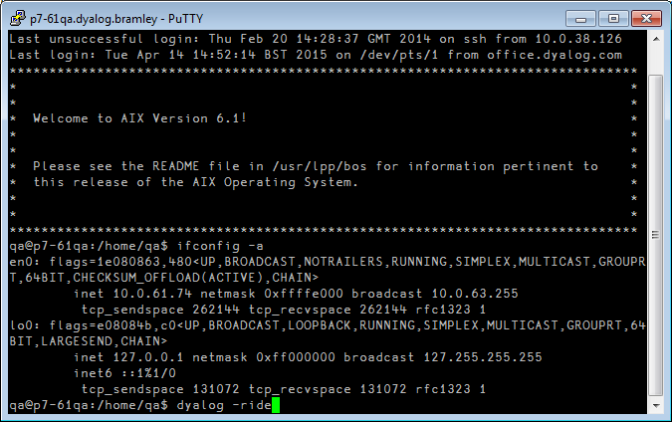
The RIDE - Example

Slide 79
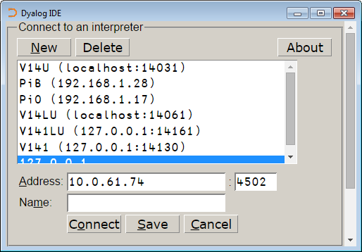
The RIDE - Example

Slide 80
The compiler (experimental)
Works only on dfns
encode←{(⎕A,⎕D)⍳⍵} ⍝ ⎕A,⎕D is evaluated at compile time
No Thread switching will occur between lines of code after a function has been compiled.

Slide 81
The compiler (experimental)
⎕FX 'r←foo y' ... ⍝ define foo
foo 99 ⍝ execute the non compiled code
2 (400⌶) 'foo' ⍝ compile it
foo 99 ⍝ execute the compiled code
Use ]runtime to see CPU usage

Slide 82
R
This assumes you have R installed.
R is supported under Windows and Linux.
R functions can be called directly from within a Dyalog APL session
the contents of APL variables can be transferred to and from equivalent R variables

Slide 83
R
You can get R from the Web. Search for R (http://www.r-project.org/ )
NOTE: you should use the Dyalog APL version matching your R version.
If your R version is 64b you should use Dyalog APL 64b (Unicode).

Slide 84
R
Sample session (r.x executes in R)
⎕←r.x '1+2' ⍝ Add two scalars
⎕←r.x 'c(1,2,3)*c(10,20,30)' ⍝ V1×V2
10 40 90
⎕←r.x 'matrix(1:12,3)' ⍝ ⍉4 3⍴⍳12
1 4 7 10
2 5 8 11
3 6 9 12
Notes:
,byrow=TRUE to get the 4 3⍴⍳12

Slide 85
R
There are many statistical programs for use, e.g. 'rnorm' for normal distributions.
r.p puts a value in R, e.g. 'variable' r.p value
r.g gets a value from R, e.g. r.g 'variable'
See the R interface guide (PDF) in the help folder of Dyalog APL.

Slide 86
R - exercises
)load rconnect
Get a normal distribution for a vector of 1000 elements, with mean=100 and standard dev=10 (use 'rnorm')
Assign it to variable X
Move the data back to R
Apply 'summary' to it.

Slide 87
.Net enhancements
Two new enhancements:
Overloads
Casts

Slide 88
.Net enhancements
Overloads
To force APL to call the double version of function foo() regardless of the type of the argument val:
(foo ⍠('OverloadTypes'Double)) val
or more simply:
(foo ⍠ Double) val
⎕USING←'System' ⋄ Double
(System.Double)

Slide 89
.Net enhancements
Casts
⎕USING←'System' ⍝ make Bool array of 2=⍴
BA←Array.CreateInstance Boolean 2
BA.GetValue 0 ⍝ get the 0th element
0
⍝ attempt to set the 0th element to 1 (AKA true)
BA.SetValue 1 0
EXCEPTION: Cannot widen from source type to target type

Slide 90
.Net enhancements
Casts
To rectify the situation, APL must be told to cast the argument to a Boolean as follows:
(BA.SetValue ⍠ ('CastToTypes' (Boolean Int32))) 1 0
BA.GetValue 0 ⍝ get the 0th element
1

Slide 91
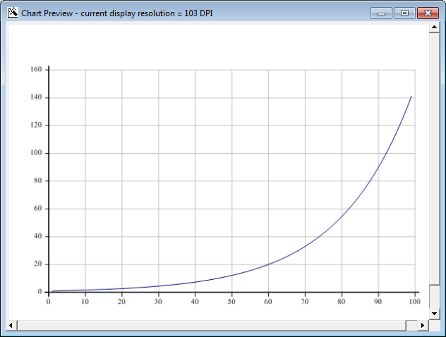
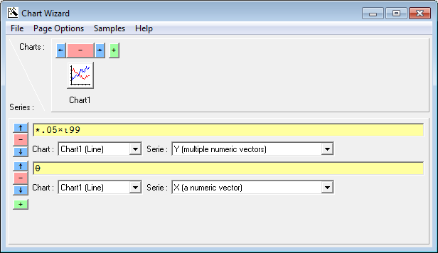
The Chart Wizard
]chart *0.05×⍳99

Slide 92
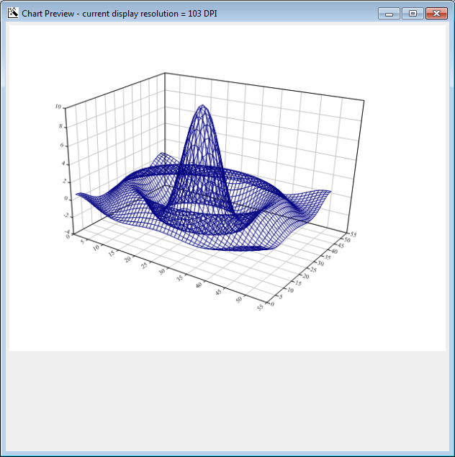
The Chart Wizard
x←¯10 10 {⍺[1]++\0,⍵⍴(|-/⍺)÷⍵} 50
z←x∘.{{10×(1○⍵)÷⍵}((⍺*2)+⍵*2)*.5}x
y←x x z
(put cursor over 'y' and hit this button: )

Slide 93
JSON
]list tools -recursive
Type Name Versions Size Last Update
<DIR> tools\code 2015/04/07 10:45:09
…
tools\code\partScan 4340 2014/05/24 6:44:44
tools\code\textUtils 6758 2014/05/24 6:44:44
<DIR> tools\data 2015/04/07 10:45:09
tools\data\Clock 1339 2014/08/05 20:10:39
tools\data\Person 9958 2014/08/05 20:10:39
tools\data\Tools 11661 2014/05/24 6:44:44
tools\data\names 36318 2014/12/14 15:46:36
<DIR> tools\Inet 2015/04/07 10:45:09
tools\Inet\HTMLdoc 10108 2014/05/24 6:44:44
tools\Inet\JSON 24825 2014/12/09 7:31:34
<DIR> tools\special 2015/04/07 10:45:09
tools\special\asymmetric 8270 2014/12/14 15:47:39
…

Slide 94
JSON
]load tools\Inet\JSON
#.JSON
]box on
Was OFF
⎕←v1←JSON.toAPL '[[1,1],[1,2],[1,3],[2,1],[2,2],[2,3]]'
┌───┬───┬───┬───┬───┬───┐
│1 1│1 2│1 3│2 1│2 2│2 3│
└───┴───┴───┴───┴───┴───┘
JSON.fromAPL v1
[[1,1],[1,2],[1,3],[2,1],[2,2],[2,3]]
JSON.fromAPL ⎕←JSON.toAPL '[null,[]]'
┌──────┬┐
│[Null]││
└──────┴┘
[null,[]]

Slide 95
JSON
⎕←v1←JSON.toAPL '{"z1":"dsa"}'
#.[Namespace]
v1.⎕nl-2
┌──┐
│z1│
└──┘
v1.z1
dsa
JSON.fromAPL v1
{z1:"dsa"}

Slide 96
JSON
]load tools\Inet\JSON
#.JSON
]box on
Was OFF
⎕←v1←JSON.toAPL '[[1,1],[1,2],[1,3],[2,1],[2,2],[2,3]]'
┌───┬───┬───┬───┬───┬───┐
│1 1│1 2│1 3│2 1│2 2│2 3│
└───┴───┴───┴───┴───┴───┘
JSON.fromAPL v1
[[1,1],[1,2],[1,3],[2,1],[2,2],[2,3]]
JSON.fromAPL ⎕←JSON.toAPL '[null,[]]'
┌──────┬┐
│[Null]││
└──────┴┘
[null,[]]

Slide 97
XML
]load tools\Inet\JSON
#.JSON
]box on
Was OFF
JSON.fromXML ⎕← JSON.toXML'{"z1":"dsa","cxz":[1,2,[33,44]]}'
<json type="object"><z1>dsa</z1><cxz type="array"><item type="number">1</item><item type="number">2</item><item type="array"><item type="number">33</item><item type="number">44</item></item></cxz></json>
{z1:"dsa",cxz:[1,2,[33,44]]}

Slide 98
WPF
WPF is a glorified version of .Net Windows forms.
In Dyalog you can bind variables to windows properties.

Slide 99
WPF Applications
Use WPF to create a window displaying stock quotes in a moving text window.
In the workspace stockTicker there is a program, runMarketBG, that will simulate market activity in the background.

Slide 100
WPF Applications
The program also updates regularly a variable, STString, containing the latest stock changes.
You should write a WPF program to display this string in a long panel (a window) updated every once in a while to reflect changes.
You should run runMarketBG before running your program.
Notes:
Using data binding is a bonus

Slide 101
My.Dyalog.com

Slide 102
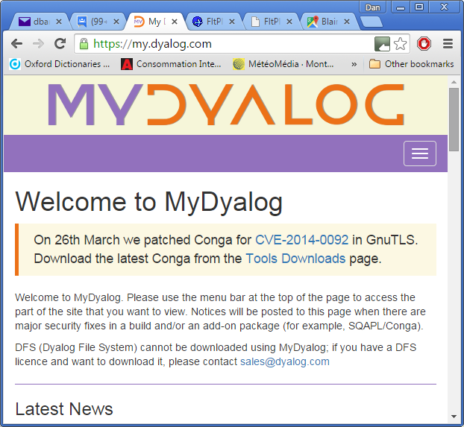
My.Dyalog.com

Slide 103
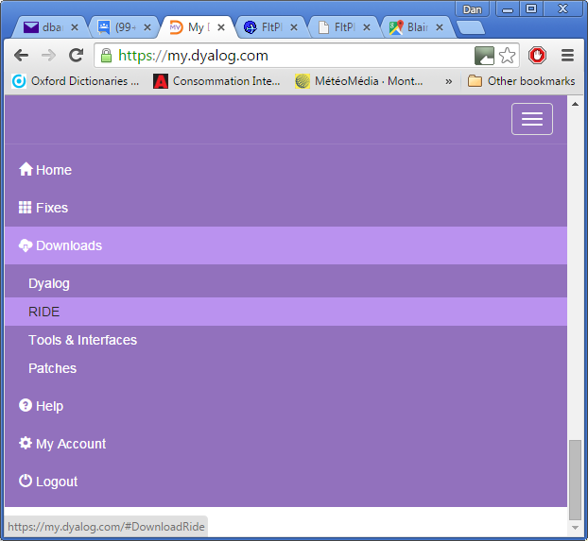
My.Dyalog.com

