Slide 1
Introduction to MiServer 3.0 Brian Becker Applications Tools Group, Dyalog LTD

Slide 2
Agenda
Introductions
The why and what of MiServer
Installing MiServer
Your first MiPage

Slide 3
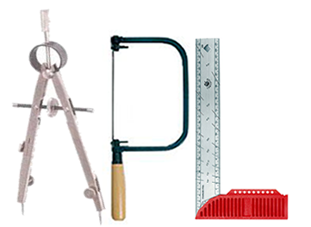
The APpLications Tools Group Our job is to provide tools that help you do your job

Slide 4
MiServer 2.0 in Use
TryAPL
Dyalog'14 Conference Registration
Dyalog File Server Admin Console
DyaBot controller
Optima
Thor8.dk (PiServer)
Jerry Brennan
APLSmith.com

Slide 5
MiServer 3.0 – Why?
Ease of access to your application
All your users need is a browser
Run from any platform
Any OS (that has a browser)
Desktop, Laptop, Tablet, Phablet, Phone...
Customers are always running the latest software
No patches/updates to distribute or download
Ease of deployment of your application
MiServer runs on all platforms supported by Dyalog
Can be configured to run behind a "corporate" web server like IIS, Apache, or WebSphere

Slide 6
MiServer 3.0 – What?
The latest generation of Dyalog's APL-based web server
A framework of tools to make the generation of web content easy from APL
Reduces the need to master other technologies
HTML5, CSS3, JavaScript
use 3rd party "widgets"
Syncfusion (70+ controls for web and mobile)
jQuery / jQueryUI / jQueryMobile
Others as user needs arise
An open source, community, project
Soon to be available on GitHub

Slide 7
MiServer Philosophy
"Anyone who can write an APL function should be able to host it on the Web"
Provide a suite of tools to generate HTML and JavaScript that cover most common use cases
Goal: Make it no more complex to develop rich user interfaces than using ⎕WC
Provide interface(s) to the full functionality of the underlying technologies
Syncfusion, JavaScript, jQuery, jQueryUI, jQueryMobile
Make the framework easy to modify and extend
APL extensions
Adding new plug-ins/widgets/libraries

Slide 8
Some Terminology ...
MiServer
Dyalog's APL-based web server
The name of the workspace that runs MiServer
The primary server class in the miserver workspace
MiSite
a website running under MiServer
MiPage
an APL script file that implements a web page in a MiSite
The class name from which all such web pages are derived
APLJAX
The APL-AJAX interface used to process AJAX calls from within APL

Slide 9
Exercise - Installation
Install MiServer 3…
You can get MiServer3.zip by copying it from workshop memory stick
It will be made available for download from the conference website
Installing MiServer 3
Unzip the file into a directory of your choosing
Notes:
Browse the directory structure after unzipping

Slide 10
MiServer Directory Structure
Config | Server-wide and default configuration settings
Core | contains "core" classes
ErrorPages | overwritable pages used in response to HTTP errors
Extensions | extensions to MiServer
PlugIns | JavaScript libraries
ServerData | Directory for storing server level data
Utils | Utility namespaces used by MiServer
MiServerCGI.exe | used to run MiServer behind IIS and Apache
miserver.dws | the MiServer workspace

Slide 11
MiSite Directory Structure
Code* | MiPage templates*, derived MiServer*
Config* | Configuration files
Data* | Site data (if any)
Logs* | Log file directory (configurable)
Scripts* | Directory for storing server level data
Styles* | Style elements for the site
* denotes optional

Slide 12
Exercise – Testing ⍳3
Start MiServer
)LOAD the mserver workspace
Start 'Empty' ⍝ start the MiSite
Test the Installation
Open your web browser
Navigate to http://localhost:8080

Slide 13
Let's Explore…
Stop MiServer Stop
Load the development environment Load 'ms3'
This loads necessary classes and namespaces to play/explore/develop in the workspace

Slide 14
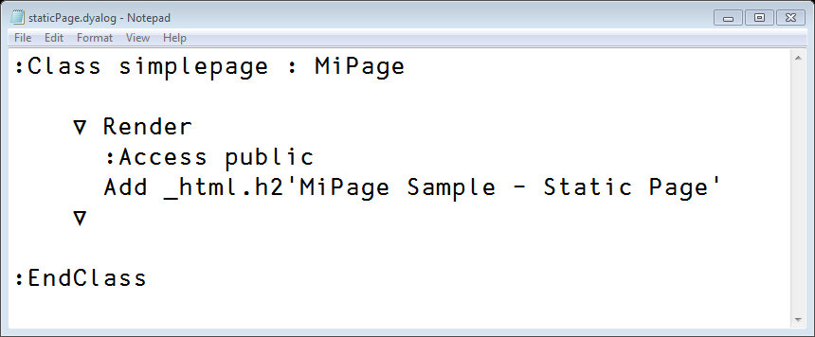
A MiPage
Each page is a class which must eventually derive from MiPage.
:class example : MiPage
:class example : EAWC ⍝ derives from MiPage
It must have a niladic public method called Render
∇Render [1] :access public
Render should do one of the following:
Build HTML content by adding it to the page
Return a file by calling _Request.ReturnFile filename
Signal an HTTP error by calling _Request.Fail HTTPCode

Slide 15
Page Class Hierarchy
Template
Implements custom look and feel
EAWC "Easy As ⎕WC"
MiPage the interface to MiServer
HtmlPage the base page class

Slide 16
Introducing EAWC...
EAWC – Easy As ⎕WC
Class generated at startup
makes it easier to refer to basic and "augmented" HTML elements Add h2 'Hello world!' Add _html.h2 'Hello world!' Add Table (2 2⍴⍳4) Add _HTML.Table (2 2⍴⍳4)

Slide 17
MiPage/HtmlPage Fields/Shortcuts
MiPage and HtmlPage have fields that are references commonly used objects:
_html* "native" HTML5 elements
_HTML * "Augmented" HTML elements
_JQ jQuery/jQueryUI/3rd party jQuery
_JQM jQueryMobile
_SF SyncFusion widgets
_JSS JavaScript "snippets"
_DC Dyalog controls
* denotes the shortcut is not needed in EAWC

Slide 18
native vs augmented HTML
Native HTML elements are found in the _html namespace and all names are lower case
Augmented HTML elements are found in the _HTML based on native elements but have been enhanced to make them easier to use from APL
t←Add table
row←t.Add tr
row.Add td 'cell 1'
row.Add td 'cell 2'
vs.
Add Table 1 2⍴'cell 1' 'cell 2'

Slide 19
HTML Element anatomy
<div id="mydiv">some text</div>
Some tags have no content
<br/>
<meta charset="utf-8"/>
<link rel="icon" href="/i.png"/>
tag (element) name
attributes
opening tag
content
closing tag

Slide 20
HtmlElement class
Every HTML5 element is implemented using the class HtmlElement and contained in the html namespace
Because they're native elements, their names are lowercase
mydiv←⎕NEW _html.div

Slide 21
HtmlElement class
Constructor can accept content and HTML attributes
mydiv←⎕NEW _html.div 'some test' 'id=1'

Slide 22
HtmlElement methods
Add adds to the element's content
mydiv.Add 'some text'
SetAttr sets element attributes
mydiv.SetAttr 'onclick' 'alert("hello")'
Render renders the element's content
mydiv.Render
On sets event handler
mydiv.On 'click' 'callbackfn'

Slide 23
HtmlElement fields/props
Fields defined for common HTML element attributes:
id value name class style title type
mydiv.title←'Hello world'
Content contains the content for the element
Attr is a keyed property for attributes

Slide 24
HtmlElement Setting Attributes
Using Attr
mydiv.Attr['id' 'class']←'foo' 'goo' mydiv.Attr[⊂'title']←⊂'Hello World'
Using SetAttr
mydiv.SetAttr ('id' 'foo') ('class' 'goo')
mydiv.SetAttr 'id' 'foo' 'class' 'goo'
mydiv.SetAttr 'id=foo' 'class=goo'
mydiv.SetAttr 'id=foo class=goo'

Slide 25
HtmlElement Function Chaining
If Add is passed an object, it returns a reference to the object that was added
SetAttr returns a reference to its object
tab←⎕NEW _html.table
((tab.Add _html.tr).SetAttr 'class=hdg').Add _html.td 'cell content'
Notes:
Show Example, Example2⌈

Slide 26
Exercise - HtmlElement
Build an HTML division (div element)
Add 3 paragraphs (p elements) with different text
Give each paragraph a separate id attribute
Render the division

Slide 27
Communicating with the Server
HTML form
POST action
Callbacks using AJAX
APLJax
CallbackFn
Notes:
show datepicker, callback, callbackfn

Slide 28
Data Binding
pre-MiServer 3.0
Public Fields
MiServer 3.0
_PageData
Get 'name'

Slide 29
MiServer 3.0 – When?
Conference Version – now
GitHub – November 2014
Full Documentation – 1st Quarter 2015
Additional widgets – ongoing

Slide 30
QUESTIONS?

