Slide 1
MiServer 3.0 Brian Becker Applications Tools Group, Dyalog LTD

Slide 2
Let's Talk About...
Why?
What?
How?
When?
And then get into questions ☺

Slide 3
What is a Web Server?
A program that listens for HTTP requests for “resources” from clients, which are typically web browsers.
The server attempts to locate the resource (typically an HTML file) and send the contents to the client.
If the resource is a “script”, execute it and generate “dynamic” output.

Slide 4
MiServer in Use Today
TryAPL
Dyalog'14 Conference Registration
Dyalog File Server Admin Console
DyaBot controller
Optima
Thor8.dk (PiServer)
Jerry Brennan
APLSmith.com

Slide 5
MiServer 3.0 – Why?
Because it's easy...
To provide your users access to your application
All they need is a browser
Run from any operating system (that has a browser)
Run from any platform (that has a browser)
Desktop, Laptop, Tablet, Phablet, Phone...
No software or updates to distribute, download, or install
Customers are always running the latest software
To build and deploy applications
"Easy as ⎕WC"
Run server on any platform where Dyalog and Conga run
Windows, Linux, AIX, others coming...

Slide 6
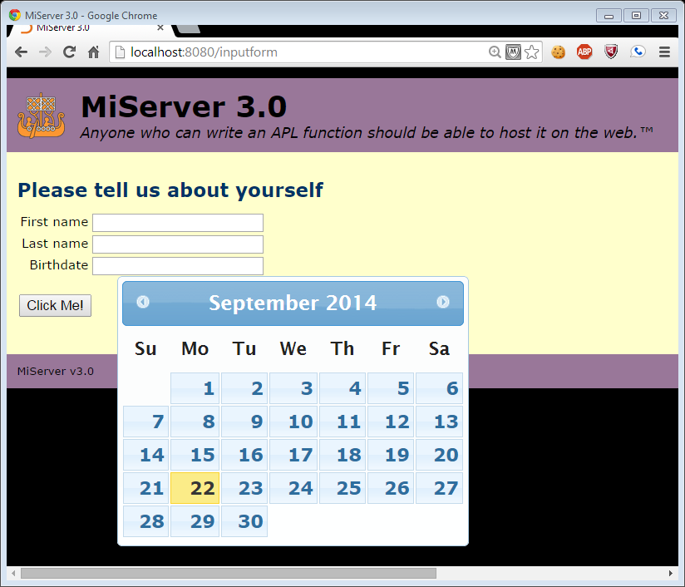
Easy as ⎕WC? Let's see...
Disclaimer:
I love ⎕WC
⎕WC

Slide 7
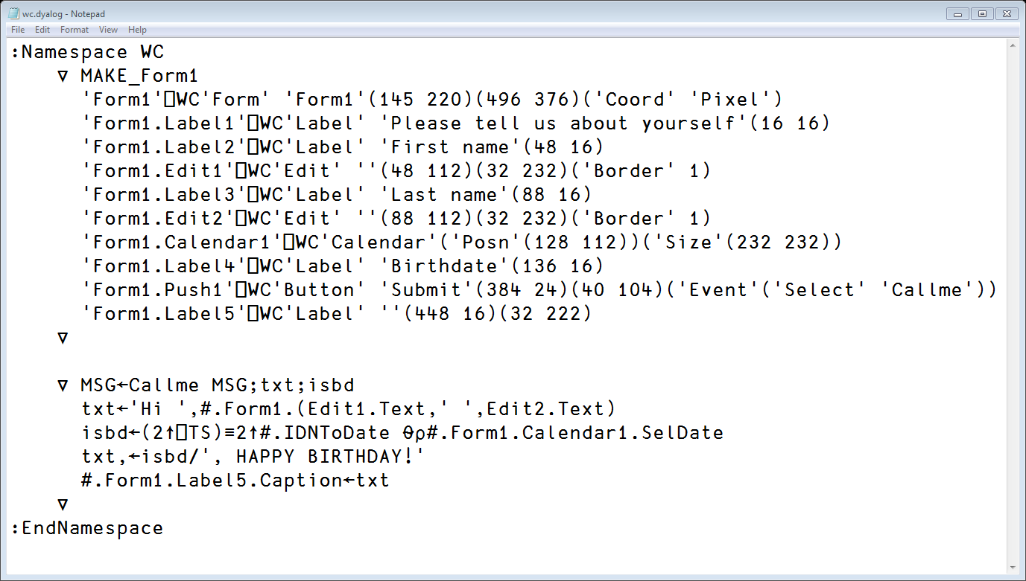
Easy as ⎕WC? Let's see...

Slide 8
Controls...
Notes:
With ⎕WC you need to know about the set of available Win32 GUI controls and objects With MiServer, you need to know about the set of available HTML5 and Javascript controls and widgets

Slide 9
Callbacks
Notes:
With both ⎕WC and MiServer, you can set up event handlers and callback functions

Slide 10
Layout of Controls
Notes:
With ⎕WC you need specify the size and position of controls
With MiServer, the browser handles layout, but you can exercise more control using CSS if you care to

Slide 11
Styling
With ⎕WC/⎕WS
You set properties like FCol, BCol, etc
'form' ⎕WS 'BCol' 124 244 255
With MiServer
You use CSS styles
body { background-color: cyan; }

Slide 12
Available Resources
With ⎕WC/⎕WS
3rd party tools available: .NET, WPF
People who can help: look right and left
With MiServer
3rd party tools available: ≈ bazillion
People who can help: a lot

Slide 13
Platforms
With ⎕WC/⎕WS
Windows running locally
With MiServer
Any platform with a web browser
So basically, all of them ☺
Still want to run locally?
Embedded HTML5 rendering is coming

Slide 14
Samples
Demo time

Slide 15
MiServer 3.0 – What?
A framework of tools to make the generation of web content easy from APL
render HTML
use 3rd party "widgets"
Syncfusion (70+ controls for web and mobile)
jQuery / jQueryUI / jQueryMobile
Others as user needs arise
An open source, community, project
Soon to be available on GitHub

Slide 16
MiServer Philosophy
"Anyone who can write an APL function should be able to host it on the Web"
Provide a suite of tools to generate HTML and JavaScript that cover most common use cases
Goal: Make it no more complex to develop rich user interfaces than using ⎕WC - EAWC
Provide interface(s) to the full functionality of the underlying technologies
Syncfusion, JavaScript, jQuery, jQueryUI, jQueryMobile
Make the framework easy to modify and extend
APL extensions
Adding new plug-ins/widgets/libraries

Slide 17
Need to Know?
Dyalog APL
You need to be able to type: :class MyPage : Template :access public
A basic understanding of web pages
A bit of HTML* – basic elements / concepts
A bit of CSS* – selectors and styling
Little to no JavaScript*
*Need to know increases with the sophistication of the application

Slide 18
Giving MiServer a REST
ful Web Interface
REST – REpresentational State Transfer
gained widespread acceptance across the Web as a simpler alternative to SOAP-based Web services.
Facebook, Google, Twitter, US Government
Uses standard HTTP commands and returns standard MIME types
GET – retrieve a resource
POST – update a resource
PUT – replace or insert a resource
DELETE – delete a resource

Slide 19
REST Examples
US Weather Service http://graphical.weather.gov/xml/sample_products/browser_interface/ndfdBrowserClientByDay.php?zipCodeList=14586&format=24+hourly&numDays=1
Google Maps http://maps.googleapis.com/maps/api/staticmap?center=Eastbourne,UK&size=600x300&zoom=15

Slide 20
RESTful Web Service
Has a base URI
Returns a standard MIME type JSON, XML, images,
Collection http://example.com/cds/
GET list of URIs of the collection's elements
PUT replace the entire collection
POST create a new collection entry
DELETE delete the entire collection
Element http://example.com/cds/cd23
GET retrieve a representation of the element
PUT replace or create an element
POST update the element
DELETE delete the element
Notes:
show HTTPGet

Slide 21
MiServer 3.0 – When?
Conference Version – now
GitHub – November 2014
Full Documentation – 1st Quarter 2015
Additional widgets – ongoing

Slide 22
QUESTIONS?

