Slide 2
Gestures
and
Desktop Scaling in Windows
John Daintree
Chief Architect
Dyalog Ltd

Slide 3
Desktop Scaling in Windows
John Daintree
Chief Architect
Dyalog Ltd

Slide 4
*those were the days…
A 12" 4:3 monitor (diagonal)
about 10" by 7"
at 640x480
About 65 dots per inch (DPI)
probably black and white
if not orange and black
* ©Boris Fomin and Gene Raskin

Slide 5
*those were the days…
A 14" 4:3 monitor (diagonal)
about 11" by 8"
at 1024x768
About 96 dots per inch (DPI)
* ©Boris Fomin and Gene Raskin

Slide 6
*even now
A 24" 16:9 monitor (diagonal)
about 21" by 12"
at 1900x1200
About 96 dots per inch (DPI)
* ©Barry Manilow

Slide 7
*RIGHT now
A 8ft by 6ft screen
about 96"x72"
at 1024x768
About 11 dots per inch (DPI)
* ©Van Halen

Slide 8
*But times, they are a changin'
A 28" 4K 16:9 monitor (diagonal)
about 24" by 13"
at 3840x2160
About 156 dots per inch (DPI)
* ©Bob Dylan

Slide 9
*But times, they are a changin'
A 20" 4K 16:9 monitor (diagonal)
about 17" by 10"
at 3840x2160
About 220 dots per inch (DPI)
* ©Bob Dylan

Slide 10
*But times, they are a changin'
The P50t 15.6" 4K 16:9 Toshiba laptop
about 13" by 7"
at 3840x2160
About 282 dots per inch (DPI)
£1000 ($1400)
* ©Bob Dylan

Slide 11
And I hate to say it
but *"I'm not as young
as I used to be"
* ©Acoustic Ghost

Slide 12
And I hate to say it
but *"I'm not as young
as I used to be"
From the album "It Sucks to be you, and other Love Songs"

Slide 13
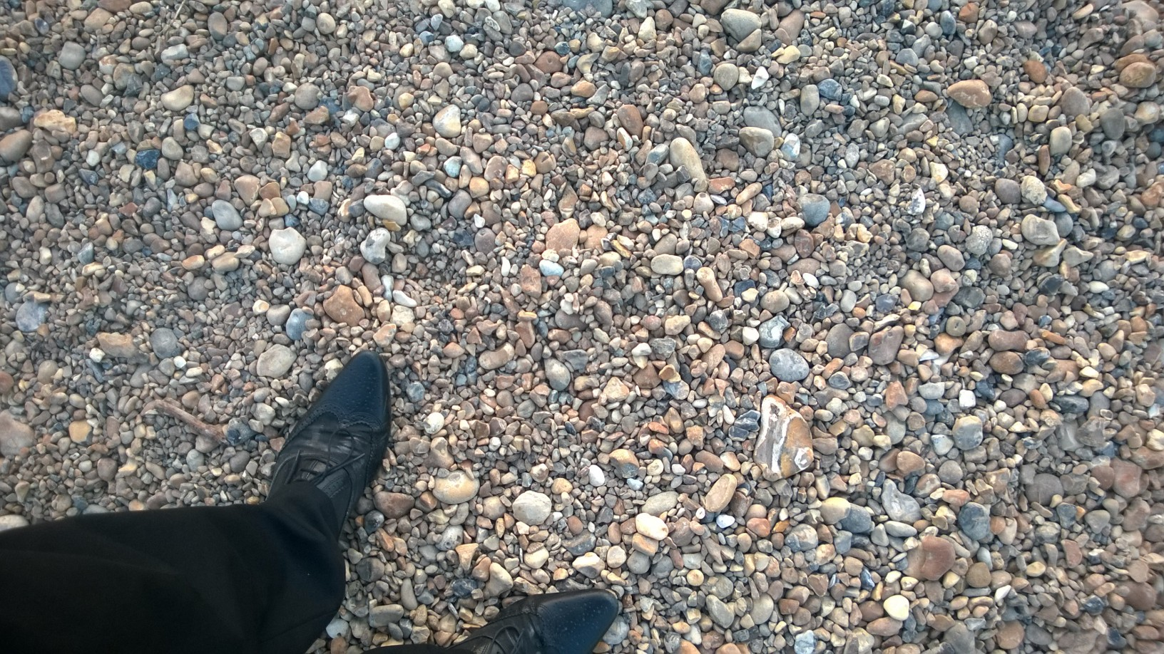

Slide 14
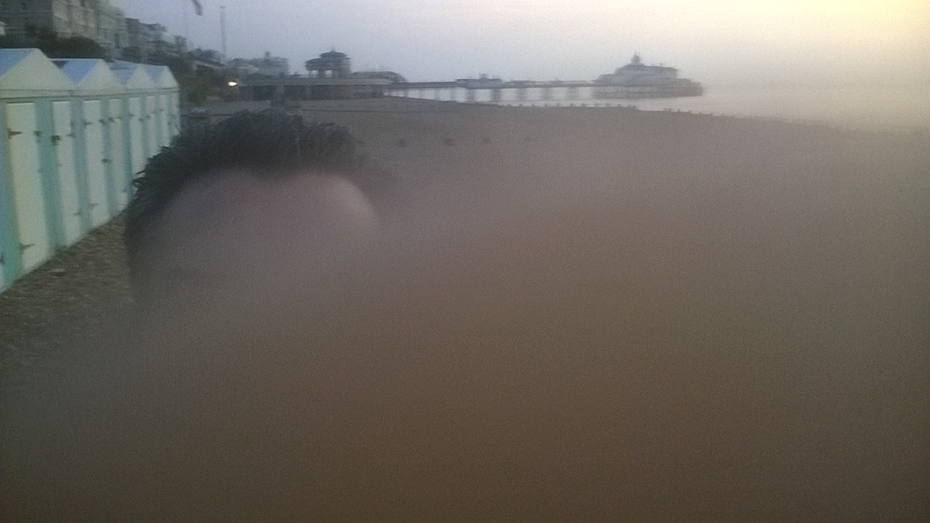

Slide 15
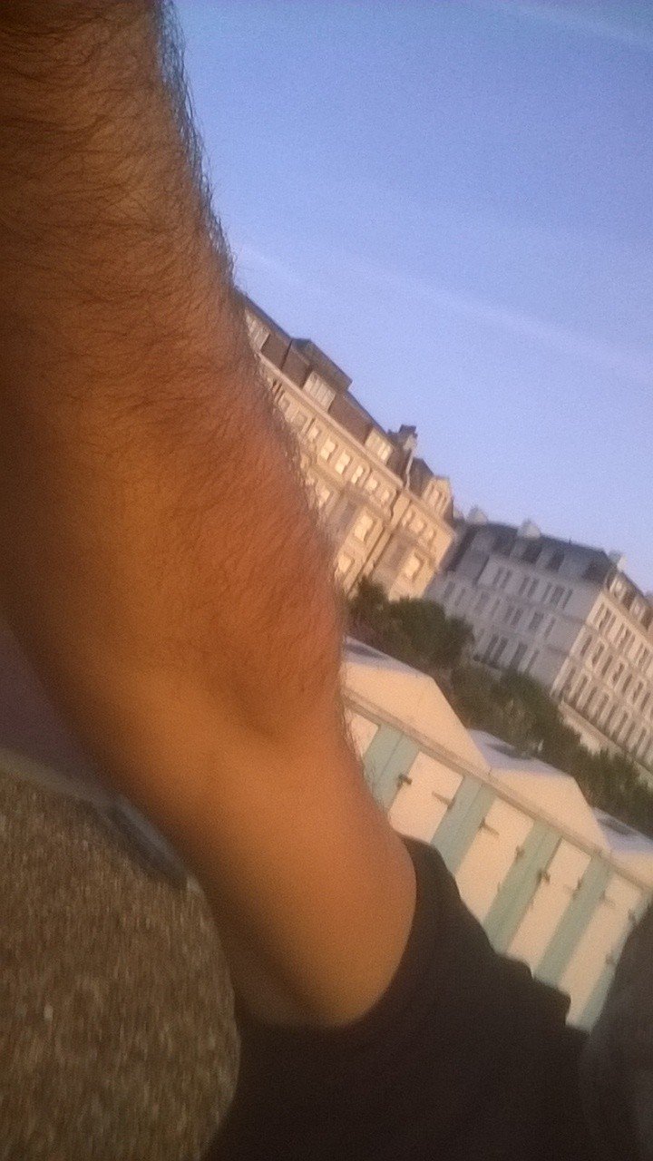

Slide 16
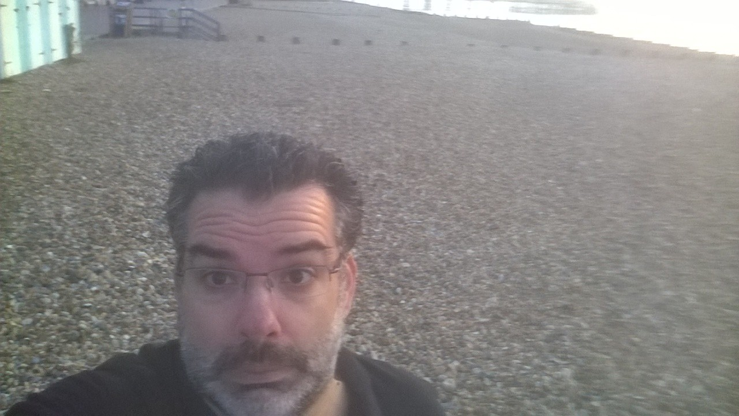

Slide 17
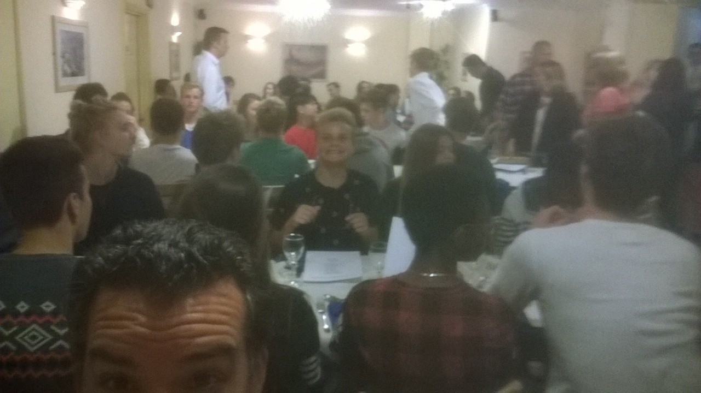

Slide 18
Desktop Scaling
What's the problem?
As screen resolutions get higher, and screens get smaller, a 16 pixel font, or a 32x32 icon might not be suitable for everyone.
And Windows is predominantly pixel based
Stuff needs to get bigger

Slide 19
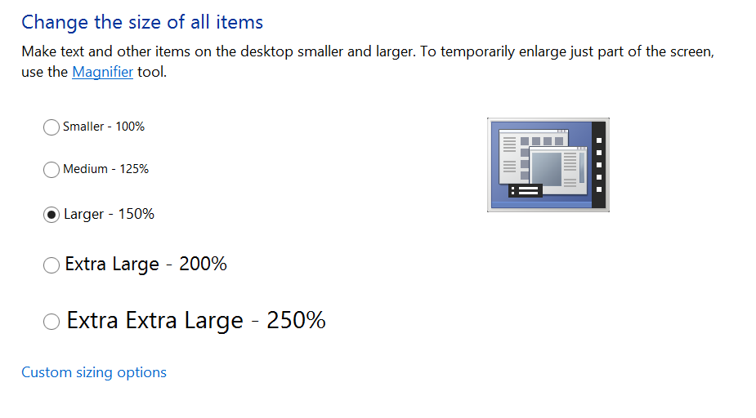
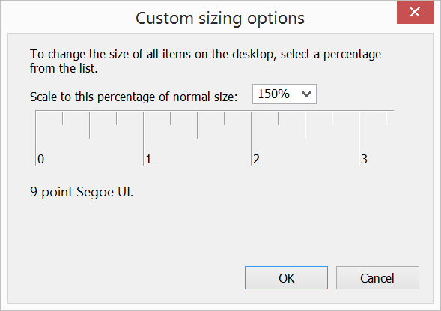
Desktop Scaling
Bill's solution
Windows provides a mechanism for the user to "scale up" the display of their UI elements.
This system is set up for Desktop Scaling of 150%
New systems may be set to >100% by default

Slide 20
And Microsoft suggests that developers
Test with scaling up to 500%
Windows 8.1 update goes up to 250%
http://channel9.msdn.com/Events/Build/2014/2-535
monitors @ 4 minutes
contrast issues @ 9:30 minutes
testing suggestion @ 18 minutes

Slide 21
Desktop Scaling
Bill's solution
Windows provides a mechanism for the user to "scale up" the display of their UI elements.
And an application can determine this "scaling factor" at runtime
And make its UI larger as appropriate
And if doesn't (which by default, yours won't), Windows "helpfully" scales the application "automagically"

Slide 22
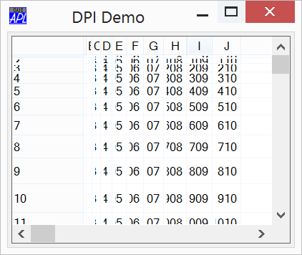
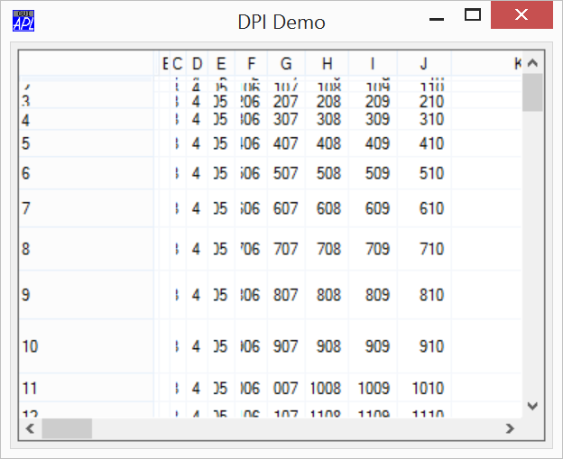
Desktop Scaling
And if doesn't, Windows "helpfully" scales the application "automagically"
It "bitmap" stretches the application's client areas.

Slide 23
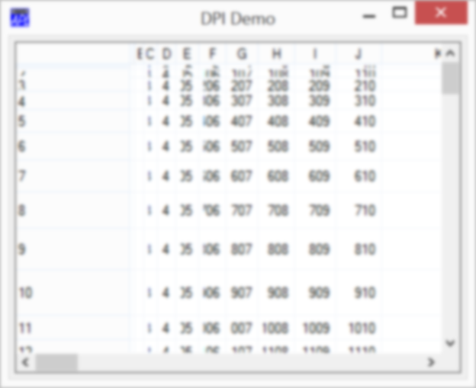
Desktop Scaling
And if doesn't, Windows "helpfully" scales the application "automagically"
It "bitmap" stretches the application's client areas.

Slide 24
Desktop Scaling
And if doesn't, Windows "helpfully" scales the application "automagically"
It "bitmap" stretches the application's client areas.

Slide 25
Desktop Scaling
And if doesn't, Windows "helpfully" scales the application "automagically"
It "bitmap" stretches the application's client areas.
Which isn't always pretty.
And there can be contrast issues for reading.
http://channel9.msdn.com/Events/Build/2014/2-535
contrast issues @ 9:30 minutes

Slide 26
The solution?
Disable the "automagic" and do it all yourself
Which you may decide is to do nothing
Disable the "automagic" and let the interpreter do it for you.
… bit of both.
New in 14.1!!

Slide 27
New coordinate types:
ScaledPixel
RealPixel
An option to map 'Pixel' to one of the above
Defaults to RealPixel

Slide 28
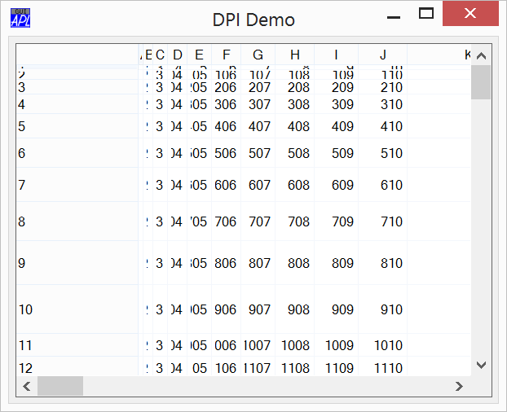
ScaledPixel
The interpreter will scale (most) UI elements according to the DPI of the system
Posn, Size, Points, font sizes, etc etc.
NOT: Bitmaps, Icons, line widths.

Slide 29
ScaledPixel
The interpreter will scale (most) UI elements according to the DPI of the system
Posn, Size, Points, font sizes, etc etc.
NOT: Bitmaps, Icons, line widths.

Slide 30
ScaledPixel
The interpreter will scale (most) UI elements according to the DPI of the system
Posn, Size, Points, font sizes, etc etc.
NOT: Bitmaps, Icons, line widths.
Values returned by properties, and coordinates passed to callbacks are "descaled"

Slide 31
RealPixel
Interpreter does NOT scale any coordinates of this object, or its children.

Slide 32
What's the least I can do?
(and still get scaling)

Slide 33
If you are using Coord 'Proportional'
You may have little to do.
If you are using Coord 'Pixel'
Set DYALOG_PIXEL_TYPE to 'ScaledPixel'
See what "just works"
Change the Coord of those elements that don't "just work" to 'RealPixel' and tweak the layout.
Fix images and other UI elements

Slide 35
Desktop Scaling Demo

Slide 36
Gestures
John Daintree
Chief Architect
Dyalog Ltd

Slide 37
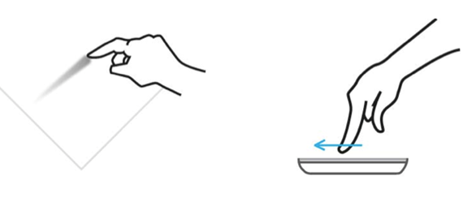
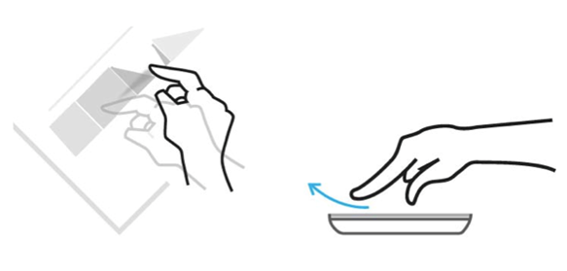
Pans:
1 or 2 finger "swipe"
Or "flick"

Slide 38
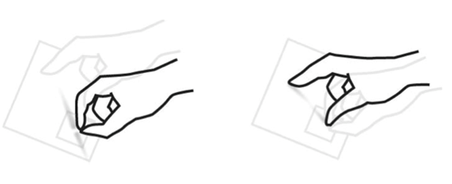
Zoom:
2 finger "stretch"

Slide 39
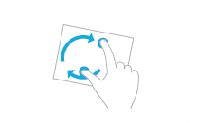
Rotate:
2 finger "twist"

Slide 40
Pan
GesturePan event
Zoom
GestureZoom event
Rotate
GestureRotate event
"Two finger tap"
GestureTwoFingerTap event
"Press and tap"
GesturePressAndTap event

Slide 41
Gestures Demo

