Slide 1

Welcome
Gitte Christensen

Slide 2
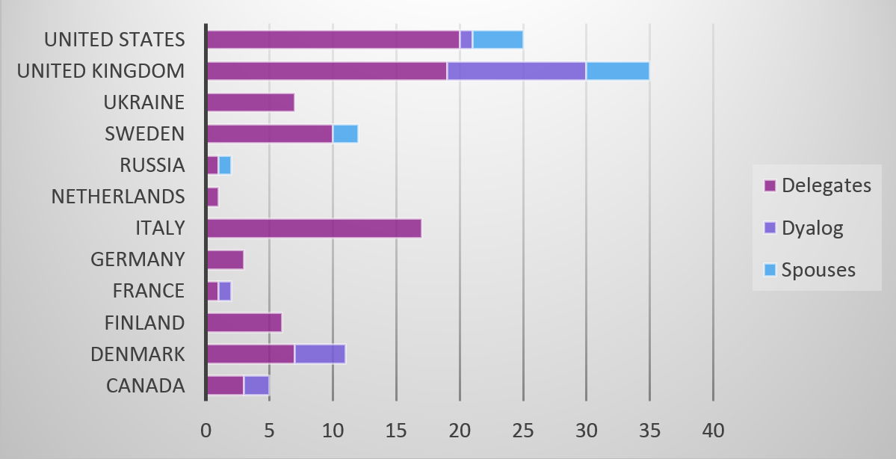
Welcome to record breaking
126 participants

Slide 3
All time Record in numbers
 | 2014 | 2013
Canada | 5 | 4
Denmark | 11 | 6
Finland | 6 | 8
France | 2
Germany | 3
Italy | 17 | 15
Netherlands | 1
Russia | 2 | 2
Sweden | 12 | 5
Ukraine | 7
United Kingdom | 35 | 25
United States | 25 | 28
South Africa |  | 1
TOTAL | 126 | 94

Slide 4
All time Record in numbers
 | 2014 | 2013
Canada | 5 | 4
Denmark | 11 | 6
Finland | 6 | 8
France | 2
Germany | 3
Italy | 17 | 15
Netherlands | 1
Russia | 2 | 2
Sweden | 12 | 5
Ukraine | 7
United Kingdom | 35 | 25
United States | 25 | 28
South Africa |  | 1
TOTAL | 126 | 94

Slide 5
News at the conference
It is no longer a Conference – it is a User Meeting
It is a long story to do with corporate procurement and while we are getting used to it, forgive us if there is a slip of tongue or fingers .....

Slide 6
News at the User Meeting
Speakers meeting each morning
This is for the speakers benefit so we can arrange for your equipment to be set up at the proper time and for the session chairs to meet with you before the session
If you are a speaker please have a look at the time schedule for Speakers Meetings posted next to the registration desk.

Slide 7
News at the User Meeting
From last years questionaire:
”Can we please have the banquet on Monday – I would like to get to know people earlier than the last evening?”
So we introduced a Get-Together party Sunday evening
We hope you found it entertaining and that it served its purpose

Slide 8

New at the User Meeting
Nick Nikolov has joined Dyalog since the last user meeting
Nick had impressed us by writing his own APL in JS with the declared intention of reviving this ”dead” language
We convinced him to join the living

Slide 9
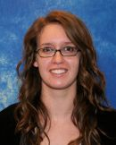
New at the User Meeting
Nadine Paquin joined Dyalog as an intern in January
Nadine now holds a Bachelor in Communications and she impressed us with her knowledge about social media and her insistence on keeping things simple so she is now reviewing our social media efforts

Slide 10
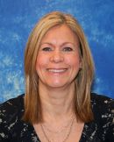
Business as usual
If you are in doubt about anything practical please see Karen
– she knows
The registration desk will be manned every morning and during the coffee breaks
If there is nobody at the desk you can call 2613 to reach the Dyalog
office during the conference

Slide 11
Time flies
This is the 10th Dyalog user meeting since Morten and I joined Dyalog in 2005
Maybe worth a look back ...

Slide 12
Future Direction
Finance
Development
New Services
APL Market

Slide 13
Finance
Ensure that Dyalog Ltd is profitable and financially sound
So far so good – but we would like to grow revenue another 50%
New customers wanted ☺

Slide 14
Development
Dyalog APL will continue to be well integrated with operating systems
Dyalog APL will Support Industry Standard Interfaces
Dyalog APL will continuously improve wrt Performance and Scalability
We will continue to extend the APL language

Slide 15
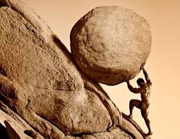
Development
It sounds simple enough
- but here is the truth
Photo Credit: Coconut Headsets

Slide 16
Development
Most of the work we do is creating ways for you to develop applications with the least possible technical challenge
  OO extensions to talk to the environment
  .Net integration to utilize external ressources
  SQAPL to talk to databases
  File system upgrades to compensate for weakening network functionality

Slide 17
Development
  Futures and isolates to make sure you can run faster and utilise all the available machine ressources
  Compilation and precompilation to make sure you can do finer grained parallelisation
  Crypto libraries to make sure you can pass the secirity audits

Slide 18
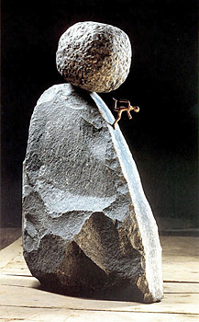
Development
"Sisyfos" by Petr Kavan
RIDE to make sure you can develop on one platform, deploy on another and still debug you code comfortably
- and sometimes we don’t even get to deploy before we have to start all over again
- but we are happy to do so

Slide 19

Development
Because sometimes as in Dyalog v14 we get to enhance Dyalog APL with some cool new language features – and every-body gets excited

Slide 20
New Services
Expand Services based on Insight Systems Key Competences
High Level Consultancy: Platform Migrations, Interfacing, Tuning
”Audits” to help customers use Dyalog more effectively and Dyalog to better understand customer requirement

Slide 21
New Services
Expand Services based on Insight Systems Key Competences
High Level Consultancy: Platform Migrations, Interfacing, Tuning
”Audits” to help customers use Dyalog more effectively and Dyalog to better understand customer requirement

Slide 22
APL Market
Produce new Training and Marketing Materials
  Mastering Dyalog APL, new website, YouTube videos, social media
Build high quality suite of ”APL Patterns” and other Code Libraries
  MiServer, WPF, SALT

Slide 23
APL Market
Produce new Training and Marketing Materials
  Mastering Dyalog APL, new website, You tube videos, social media
Build high quality suite of ”APL Patterns” and other Code Libraries
  MiServer, SALT
Drive co-operation between Array Language Vendors

Slide 24
APL Market
Produce new Training and Marketing Materials
  Mastering Dyalog APL, new website, You tube videos, social media
Build high quality suite of ”APL Patterns” and other Code Libraries
  MiServer, SALT
Make APL easier to learn for new users and significantly grow the market for APL

Slide 25
A warning from 2005:
  20 Years from now we will need a New Generation to take over and we will have to raise them ourselves
It is now 2014 .......

Slide 26
Please assist us where you can
  By supporting us on the social media
  By posting your own material
  By submitting your code examples to the repositories

Slide 27
Welcome
Enjoy your meeting of Dyalog users!

