Slide 2
RIDE
John Daintree
Chief Architect
Dyalog
Andy Shiers
Chief Operations Officer
Dyalog

Slide 3
Dyalog Going Forward
We want to see Dyalog APL everywhere
Desktops
Windows
Unix
Others
Tablets and Phones (Phablets !!!!)
iOS
Android
Surface / Windows Phone
Others
Others?

Slide 4
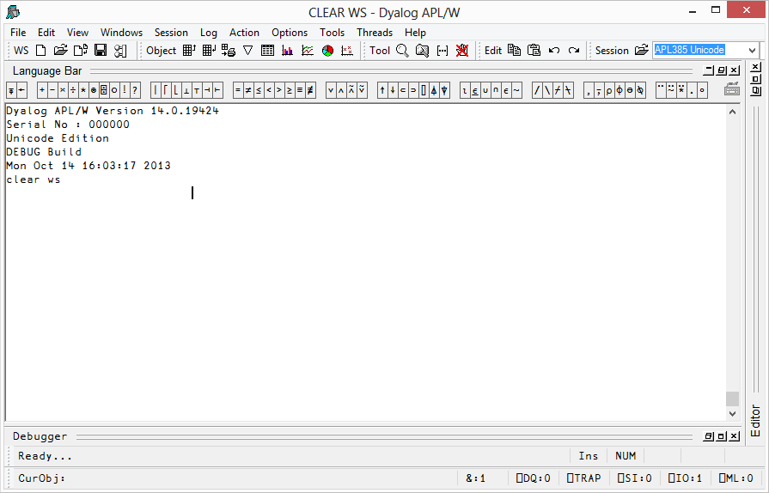
Interpreter
User Interface

Slide 5
Interpreter
User Interface
Mainly ‘C’
“A Good Thing”
Mainly ‘C’ / WIN32
not “A Good Thing”

Slide 6
Interpreter
User Interface
Mainly ‘C’
“A Good Thing”
Mainly ‘C’ / WIN32
not “A Good Thing”

Slide 7
Interpreter
Portable UI core
NEW GUI
C

Slide 8
Interpreter
UI core
NEW GUI
C
C#

Slide 9
RIDE Architecture
C# Core
Platforms specific GUI front ends
WPF on Windows
GTK on Linux (with Mono)
GTK (but could be Cocoa) on Mac OS/X
Appropriate mobile platforms in the future
Android (phones and tablets)
iOS (phones and tablets)
Windows Store Apps (phones and tablets)

Slide 10
Advantages for the User Interface
Gives us a chance to have a “fresh start” on the IDE
Will allow more rapid development of the IDE
Independently of interpreter development
We’ll be able to use platform specific UI features in the IDE

Slide 11
Advantages for the Interpreter
Will ease the process of getting interpreters on to new platforms.
Will allow (over time) simplification of the interpreter
Improve reliability
Should improve performance

Slide 12
Advantages for the user
A GUI for Unix “text only” versions
A way of debugging APL in “interesting places” (e.g. windows services, IIS, other machines)
RIDE
Remote
Integrated
Development
Environment

Slide 13
RIDE is not
An immediate replacement for the existing IDE.
A way for YOU to build GUI applications
although there are some things it can do
Silverlight
No longer constrained to be within a browser.

Slide 14
RIDE Connectivity
Secure socket connection between RIDE and interpreters
Security can be disabled (e.g. for use on a single machine)
Connect to interpreters running in other processes - which may be running APL code
IIS
WPF Applications

Slide 15
RIDE Connectivity
RIDE
Interpreter
Service
machine boundary
IIS
RIDE
Interpreter

Slide 16
A Process Manager

Slide 17
RIDE Connectivity
RIDE
Interpreter
Process Manager
Authentication
Launching Interpreters
Security
Overview
Statistics
Service
IIS
RIDE
Interpreter
BROWSER
SNMP

Slide 18
RIDE Connectivity
Interpreter
Process Manager
Authentication
Launching
Security
Overview
Statistics
RIDE
Service
IIS
Interpreter
machine boundary
BROWSER
Interpreter
Process Manager
Authentication
Launching
Security
Overview
Statistics
Interpreter
SNMP
Interpreter
Interpreter

Slide 19
The Process Manager will
run on the same machine as interpreters.
authenticate connecting RIDE users.
filter which interpreters can be seen by the connected RIDE.
allow for secure and insecure socket connections.
Be able to launch interpreters “on demand” for the RIDE user.

Slide 20
The Process Manager will
act as a switchboard connecting RIDEs to interpreters.
(provide an HTTP interface for monitoring and management).
(provide an SNMP interface to support corporate monitoring systems).
be (is currently) written in APL so the tools group can extend functionality.

Slide 21
The RIDE User Interface
Enhancements over the Silverlight version
Tabbed or overlapped GUI interface with docking.
You can set breakpoints from the UI
Overall a much nicer UI
An “embedded interpreter”
So you can run Dyalog “out of the box”

Slide 22
The RIDE User Interface
An “HTML Viewer”
A corresponding ibeam in the interpreter
Allows the interpreter to send arbitrary HTML to the RIDE to be rendered
postbacks to the interpreter will be supported in the future

Slide 23
RIDE Implementation
C# Core (with Mono on Unix)
Platforms specific GUI front ends
WPF on Windows
GTK on Linux
GTK (but could be Cocoa) on Mac OS/X
Appropriate mobile platforms in the future
Android (phones and tablets)
iOS (phones and tablets)
Windows Store Apps (phones and tablets)

Slide 24
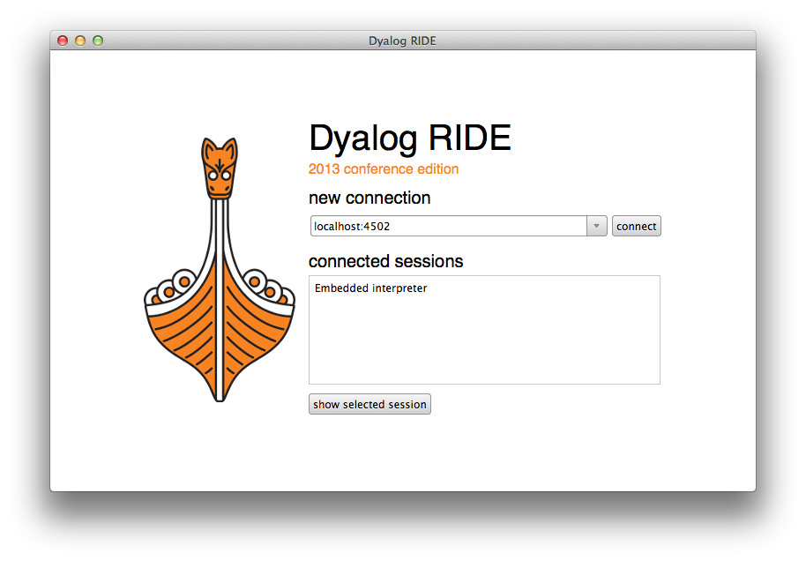
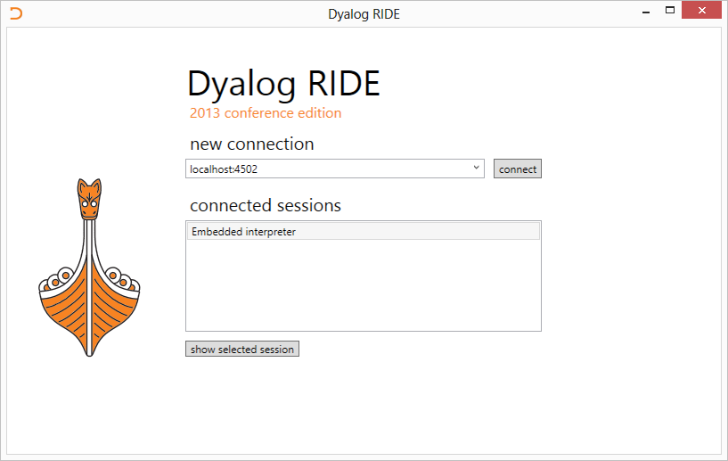
How does it look?

Slide 25
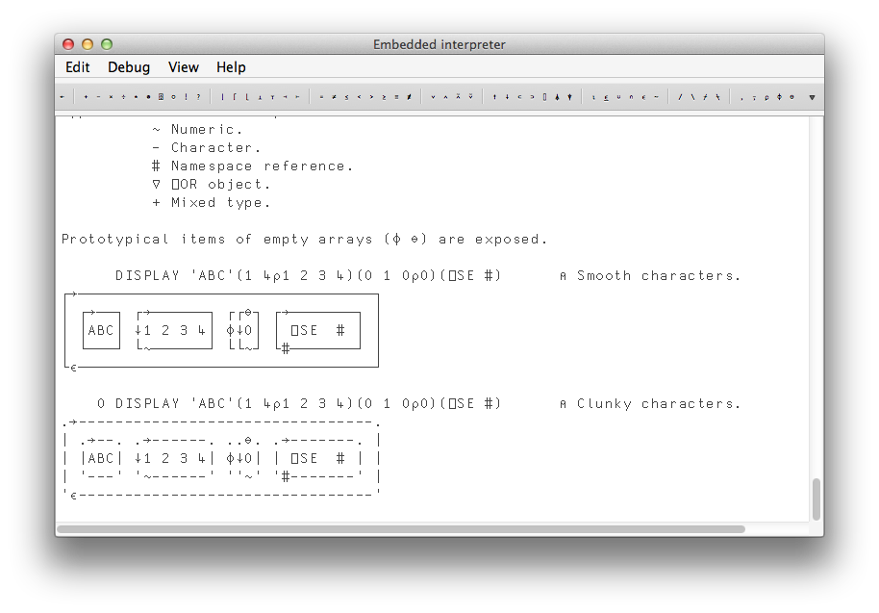
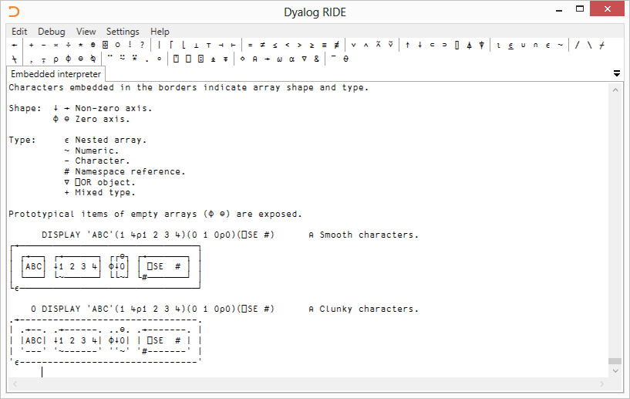
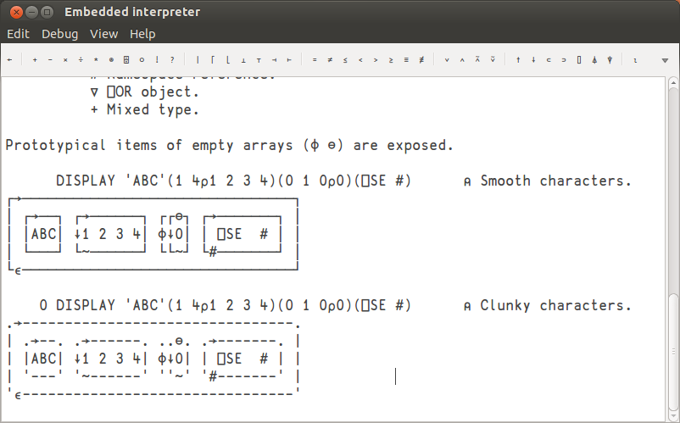

Slide 26
Availability
Windows desktop version available with 14.0
Connect to 14.0 Windows and Unix versions
We’re hoping to allow connectivity to 13.2 interpreters too.
Unix RIDEs to follow
Maybe even the Mac RIDE and a Mac interpreter
Phones and tablets (Phablets, grrr!) later

Slide 27
Demo
Over to Andy Shiers, COO

