Slide 1
Technical Road Map 2012
Morten Kromberg, CTO, Dyalog Ltd.

Slide 2
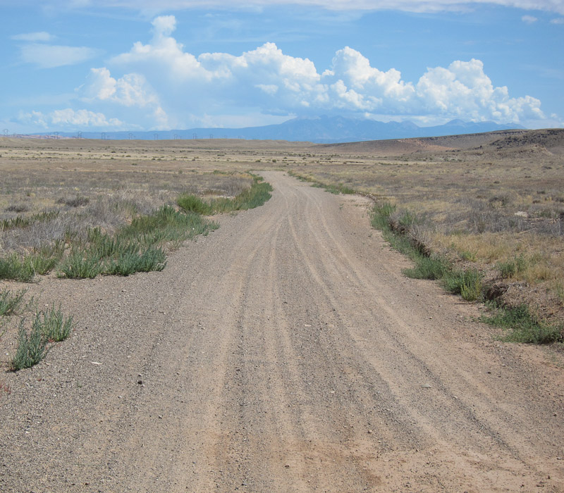
Blue Hills

Slide 3
Trip Report for 2012...
Version 13.1 was shipped mid-April, but also...
Unregistered Version in November 2011 (>700 downloads)
Linux APL Keyboards adopted by x.org
Included in Ubuntu 12.04, openSUSE 12.1 and Fedora 16
http://tryapl.org went live March 1st (5-20 sessions / day)
Final upgrade of Pocket Dyalog (11.0→12.1) for Windows Mobile 6 released in mid-March. (R.I.P.)
MiServer v2.0 in May
Dyalog File Server in August; first production system last week
”Integrated Windows Authentication” support in Conga
Version 13.2 on track for January 31st launch

Slide 4
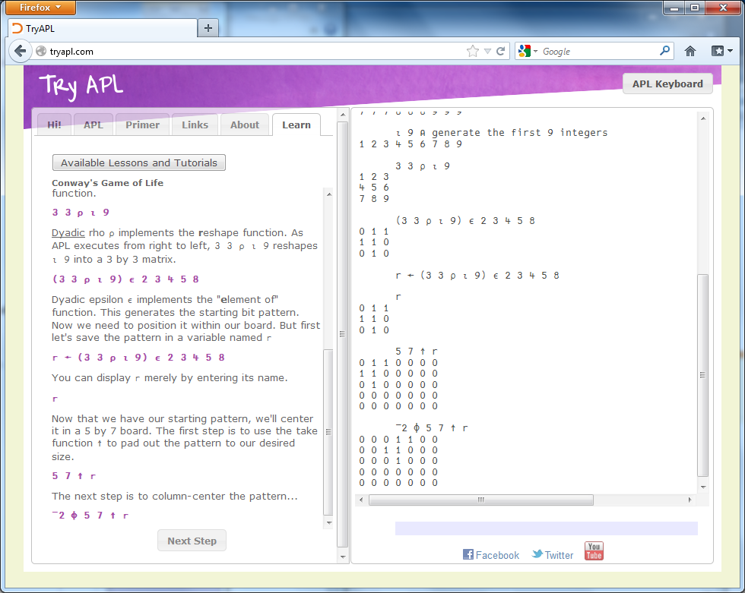
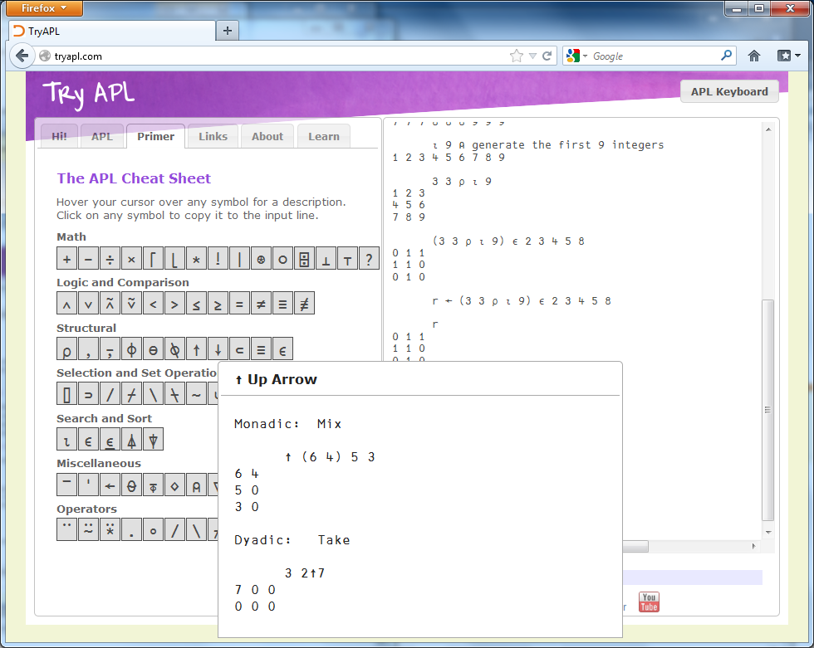

Slide 5
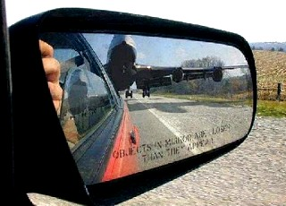
Version 13.1 Recap
Performance enhancements
Dyadic Iota, Take, New idioms
Array & component size limits removed (64-bit)
New random number generator
”Mersenne Twister” + Operating System random numbers
eXtended Diagnostic Message (⎕DMX)
File History Function (⎕FHIST – a la STSC SHAREFILE)
Support for enlist with selective assignment
Component File Journaling Level 1 is now the default
Autocompletion enhancements (mostly .NET related)
http://help.dyalog.com

Slide 6
Quality
Since Dyalog’11, the number of ”open issues” was reduced by ~270, despite steadily improved reporting
Ranging from the Trivial:
Punctuation errors and typos in documentation
Arachnid game failed if ”show stack” is followed by ”game”
Via Bad:
The )COPY of a WS containing a reference to # crashed APL
To Ugly:
”Under extremely rare circumstances”, execution of ⎕FLIB in one task caused ⎕FERASE or ⎕FTIE to fail in another

Slide 7
Version 13.2 Features
Significant GUI Enhancements
“Direct Access” to WS data and callbacks into APL from ⎕NA calls
Speed-ups to scans, summation, and more
Search/Replace performance improvements
Full support for APL2 selective assignment
Improvements (& fixes) to editing scripted objects
David Liebtag's Array Editor (Windows Unicode only)
Enhanced Visual Studio integration
Support for on-line backups for DFS users

Slide 8
Deprecated Features
”Classic Edition” (use Unicode!!!)
⎕XT (use ⎕MAP or Component Files!)
⎕OR (avoid if possible)
DDE (use TCP, COM or .NET)
32-bit (”small span”) Component Files
Auxiliary Processors (build a .dll or .so)

Slide 9
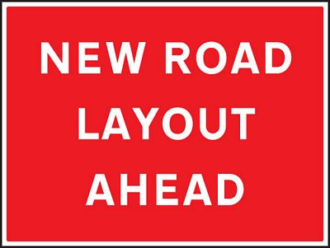
Blue Hills
↑ Beyond v13.2

Slide 10
What We’re Not Talking About at Dyalog’12
Nobody wants browser plugins (on phones & tablets)
Which means…
APL#
Now a “language research project”
The Silverlight “Remote IDE”
Will be replaced by a family of “native” RIDE implementations

Slide 11
The Bad News
We won’t be able to use APL as a client-side scripting language for web pages
Javascript has won that battle for the next 5 years (but not for ever)

Slide 12
The Good News
The important new platforms (“Windows 8”, Android, iOS, Mac OS/X) encourage use of “native” code
“Good Old Dyalog APL” can run there, we don’t need a “new” APL interpreter
RIDE will allow you to develop phone and tablet apps from the comfort of Windows, Mac or Linux
With MiServer, we can build “decent” web pages using server-side APL code
Or use SAWS to build Web Services

Slide 13
Strategy 2012-2015
Performance
Portability
Parallel Computing
Functional Power
Needs of New Users
Application Frameworks
Three documents containing details are on the conference web page in the “Road Map” folder.
A “priority voting” sheet is included in your pack. Please return it to the front desk by Weds lunch.

Slide 14
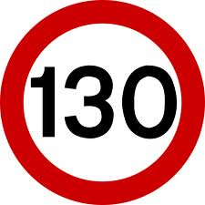
Strategy 2012-2015
Reduce parser overhead
Reduce memory management costs
Adapt to characteristics of modern CPUs
Speed up primitive functions and operators
(This task never ends)
Performance
Portability
Parallel Computing
Functional Power
Needs of New Users
Application Frameworks

Slide 15
Strategy 2012-2015
Implement ”native” RIDEs for Windows Desktop, Apple OS/X & iOS, Windows 8, Java
Produce native Dyalog implementations for Mac OS/X, ”Windows 8”, Android, iOS
Build bridges to Java, WinRT, Cocoa
See detailed document in ”Road Map” folder
Performance
Portability
Parallel Computing
Functional Power
Needs of New Users
Application Frameworks

Slide 16
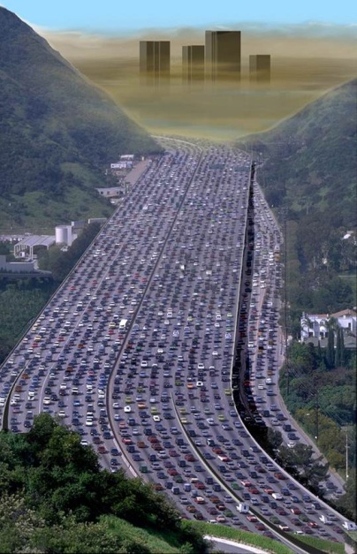
Strategy 2012-2015
Performance
Portability
Asynchronous Namespaces (”Isolates”) and ”Futures” (See document).
Basic research into highly data-parallel computing
”Loop folding” within the interpreter (A+B×C)
Parallel Computing
Functional Power
Needs of New Users
Application Frameworks

Slide 17
Isolates
I3←¤¨3⍴⊂''
I3.X←(1 2 3)(4 5)(6 7)
I3.({+/⍵÷⍴⍵}X)
2 3.5 6.5
X←1 2 3
X←6 7
X←3 4

Slide 18
Strategy 2012-2015
Implement Forks (avg←+/ ÷ ≢)
Implement ”tally” (≢)
Implement Rank (⍤) and Key (⍯)
Research
Closures
Rational Numbers and other ”high precision” representations
Performance
Portability
Parallel Computing
Functional Power
Needs of New Users
Application Frameworks

Slide 19
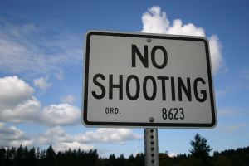
Strategy 2012-2015
Performance
Portability
Integrated Graphics in the session(s)
Interfaces to R, MatLab, LaPack
Also APL-coded Statistical Library(?)
Pay for external ”Usability Study” of the Dyalog APL IDE(s)
Parallel Computing
Functional Power
Needs of New Users
Application Frameworks

Slide 20
Strategy 2012-2015
MiServer and SAWS as fully-fledged development environments for server applications
Templates and Pattern development
Utility libraries
”APL Enterprise Edition” process manager for pool of reusable applets
Performance
Portability
Parallel Computing
Functional Power
Needs of New Users
Application Frameworks

Slide 21
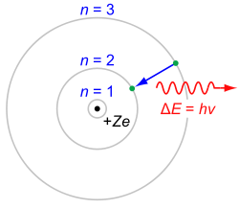
Summary
Dyalog versions 11 & 12 represented a quantum leap in terms of ”modernising” APL
Object Orientation, 64-bit, Unicode Support, Source Code in Text Files
Dyalog versions 13.0 ... 13.2 represent a ”consolidation” phase
We hope to emit new photons from versions 14 & 15

Slide 22
Versions 14 - 15
Dyalog APL on several new platforms: Android, Apple Mac, ARM Linux, perhaps more
MiServer, SAWS, Java Bridge and other ”framework” tools to support the writing of portable applications
Parallel Computing at the Fingertips of the Domain Expert™
Increased emphasis on functional programming
Sustained focus on core performance
New initiatives aimed at making APL attractive for education: Raspberry Pi, Integrated Graphics, etc.
Security / Encryption to become an integrated part of many components (but always optional)

Slide 24
For more Information
Performance
Parallel Computing
Monday 11.30: Andrzej Filinski, Associate Professor, DIKU Segmented Scans and Nested Data Parallelism
Tuesday 15.45: Roger Hui Dyalog APL Benchmarks and Performance Enhancements
Thursday 09.15: Bob Bernecky The Three Beaars

Slide 25
For more Information
Functional Power
Monday 14.15: John Scholes and Roger Hui Proposed Version 14.0 Language Features
Monday 20.30: John Scholes State-free Programming

Slide 26
For more Information
Portability
Wednesday 08.30: Andy Shiers, Chief Operating Officer Enhancements to Dyalog APL for UNIX
Wednesday 09.15: Liam Flanagan Visual Studio Integration
Thursday 11.15: Liam Flanagan & Ensemble APL & Raspberry Pi: At ARM’s Length

Slide 27
For more Information
Needs of New Users
Monday 15.30: David Liebtag, davidliebtag.com (USA) An Array Editor for APL

Slide 28
For more Information
Application Frameworks
Monday 13.30: John Daintree, Chief Architect, Dyalog APL Introducing Version 13.2 (with focus on GUI features)
Monday 16.15: Brian Becker, APL Tools Group Manager Building Web Apps in Dyalog APL
Tuesday 08.30: Dan Baronet, Dyalog Ltd (Canada) New SALT Features and User Commands
Tuesday 09.15: Kai Jäger: APL Team (UK) Fire!
Wednesday 10.30: Morten Kromberg The Dyalog File Server

Slide 29
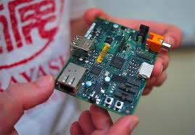

Slide 30
Insert Android Video Here

Slide 31
Strategy 2012-2015
Performance
Portability
Parallel Computing
Functional Power
Needs of New Users
Application Frameworks
Please fill in the “voting form” and return it to the front desk by lunchtime on Wednesday.

