Slide 1
C7: Starting a New Application
Dan Baronet, Morten Kromberg

Slide 2
Agenda
13:30 What kind of applications can we build?
Platform, User Interface (if any), Data Storage, Configuration
(We are going to build an app to display weather forecasts)
14:00 Focus on source code in text files (using SALT) (break at ~ 14:30)
14:45 A closer look at some application components
Configuration Files (Registry, XML, …?)
Logging (errors + usage info)
Running as a Service, Running Slave Processes
Data Storage
15:15 A look at one recent Dyalog application: The MiServer (break at ~ 15:30)
15:45 Exercises (until 16:30)

Slide 3
Types of Applications
Desktop Application
Service (no User Interface)
Web Server (viewed in ”Browser”)
Smartphone or Tablet Application
Single or Multi-Tier – or ”Cloud”?

Slide 4
Desktop Application
Dyalog (⎕WC) GUI
Windows Forms (.NET v1; ”obsolete”)
Windows Presentation Foundation
Hybrid (⎕WC with embedded ActiveX, WPF or WinForms components)
Under UNIX, ⎕SM only for now (text mode), Java Bridge will allow use of Java Widgets.

Slide 5
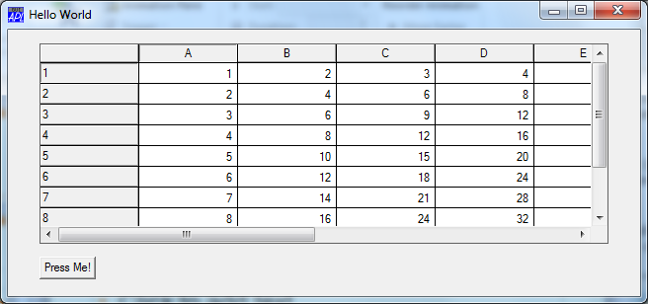
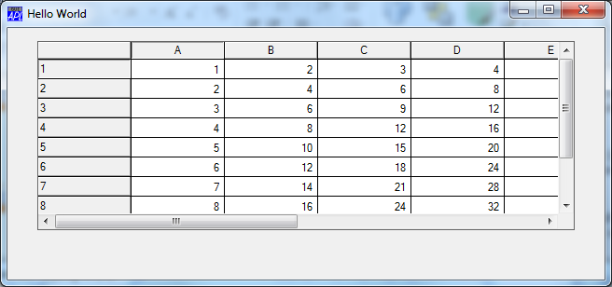
Dyalog GUI
'F' ⎕WC 'Form' 'Hello World'(10 10)(30 40)
'F.G' ⎕WC 'Grid' (∘.×⍨⍳10) (5 5)(75 90)
'F.B'⎕WC'Button' 'Press Me!'(85 5) ('Event' 'Select' 'Foo')

Slide 6
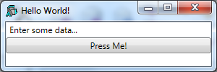
Windows Presentation Foundation
defn←1 4⍴0 'Window' '' (x.xmlns⍪'Title' 'Hello World!')
defn⍪←1 'StackPanel' '' ⍬
defn⍪←2 'TextBox' 'Enter some data...' ('x:Name' 'edit')
defn⍪←2 'Button' 'Press Me!' (2 2⍴'x:Name' 'pressme' 'Click' '∇Rotate')
⎕←xaml←⎕XML defn
<Window xmlns="http://schemas...(blah blah) Title="Hello World!">
<StackPanel>
<TextBox x:Name="edit">Enter some data...</TextBox>
<Button x:Name="pressme" Click="∇Rotate">Press Me!</Button>
</StackPanel>
</Window>
win←WPF.Load xaml
win.(Height Width)←100 300 win.Show

Slide 7
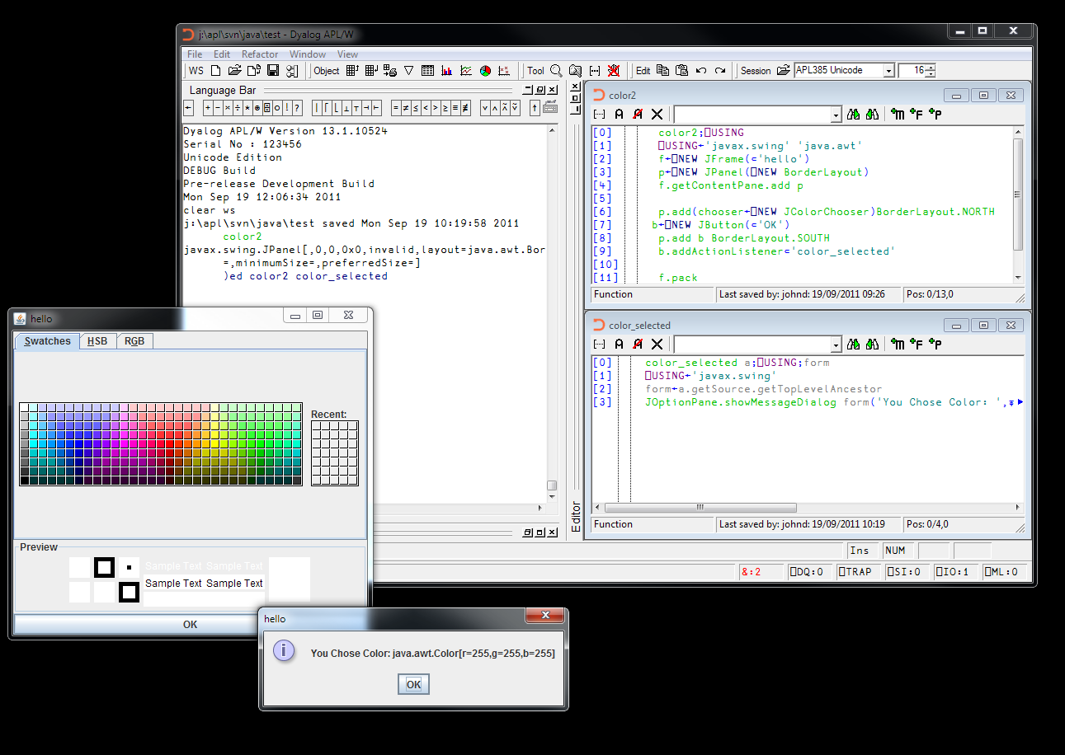
Java Bridge

Slide 8
Implementing Services
Windows DDE (Please do not use)
COM / ActiveX (Still widely used)
Microsoft.NET Assemblies (Growing)
Windows Communication Foundation component
ASP.NET Web Service
Java to come
Stand-Alone Web Service (SAWS)
Dyalog APL as an ODBC Data Source
Roll your own TCP protocol (see ”Samples” in CONGA workspace)

Slide 9
Web Servers
MiServer
Microsoft IIS – ASP.Net
SharePoint WebPart
MiServer CGI support for IIS & Apache (*new*)
Roll your own using raw TCP (if you must - see CONGA samples)

Slide 10
Smartphone or Tablet
APL Interpreters ”to come ☺” meanwhile...
Should you go Native or Generic?
Native
Build an APL Service and write Java, C#, C++ or Objective C using Native libraries on the device
Generic
MiServer with JQueryUI
APL ”Service” + portable GUI toolkit

Slide 11
User Interface Summary
The ⎕WC GUI is still being enhanced
WPF is probably a skill worth learning
Will merge with ”Windows 8 Modern UI”
Java bridge to come in 2013/14
Dyalog hopes to provide ”data binding” support for WPF (.NET) and Java UI
MiServer and SAWS are strategic

Slide 12
Which Platform?
Dyalog APL is available on Microsoft Windows, Linux, IBM AIX and Sun Solaris
It is Dyalog’s goal to make all platforms where APL runs as similar as possible.
More platforms are likely to be added in 2013/2014 (Apple OS/X, Android)
Cross-Platform Tools
APL Language including DECF and Regular Expressions
Conga (TCP), MiServer (HTTP), SAWS (SOAP/JSON), SQAPL (ODBC/SQL)
Future Java Bridge will be cross-platform
C code in the form of Windows DLLs and UNIX Shared Libraries can be made portable and called using ⎕NA
Dyalog File Server will be portable (client and server)
The Built-in GUI (⎕WC) and .NET interface requires Windows

Slide 13
APL ”in the clouds”?
Experimental code to build Amazon Web Service applications is available.
Microsof.NET Assemblies and COM components written in APL can be included in most ”projects”
Students at Copenhagen University (DIKU) running Masters project to use APL under HADOOP
We need customers with real projects to guide out direction - please contact us if you think you want to build a cloud application.

Slide 14
”Running as a Service”
Applications which provide services should ideally (re)start automatically when the operating system boots
This requires registration as a ”Windows Service” or ”UNIX Daemon”.
Under Windows, a very simple solution is to use ”srvany”, a service wrapper which can start any application
Dyalog provides a tool called ”A3S” (APL As A Service), which uses a .NET service wrapper
A3S allows reception of pause/shutdown messages from the system and graceful shutdown, while srvany just kills APL
Under Linux, services are ”installed” by putting a script which should accept parameter start or stop” into /etc/init.d/
Undex AIX: Add the startup script to /etc/inittab

Slide 15
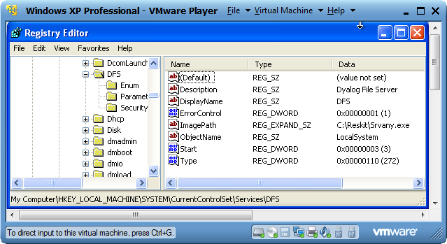
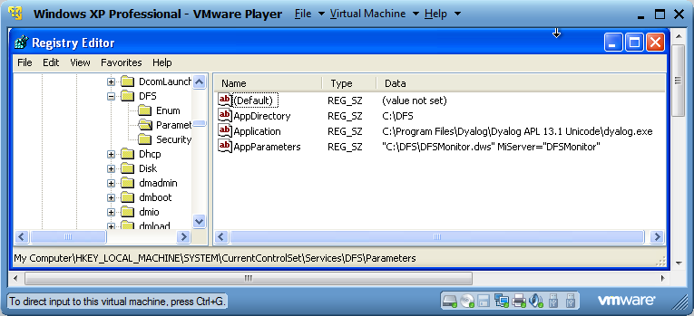
SRVANY
Download from Microsoft
Run command line to install service
(Creates registry settings)
Finally, edit service parameters in registry

Slide 16
APL Slave Processes
Tools refined for PEACH and TryAPL
APLProcess
Start an APL process and kill it when you like!
RPCServer
Uses APLProcess to start a Conga server which will execute ”Remote Procedure Calls”.
Dyalog intends to integrate this functionality into APL – but not before 2014.

Slide 17
Data Storage & Retrieval
Component- and Native File Functions available on all platforms
ODBC interface (SQAPL) is bundled on Windows
SQAPL for ”UNIXODBC” will be available ”soon” – contact Dyalog if interested
SQAPL Server available on a ”project” basis
SAWS and HTTP clients can be used to retrieve data from services
Microsoft.NET also has tools for making WS calls, and serving up Web Services (see .NET User Guide)

Slide 18
SQL vs Component Files?
A hand built data store will nearly always outperform a relational database, IF...
The access paths that it is optimised for actually turn out to be those that are used ☺
Data doesn’t outgrow the design
Modern relational databases *are* competitive in many situations
Most importantly data can be shared with other apps
Downside: DMBS can easily become a bottleneck

Slide 19
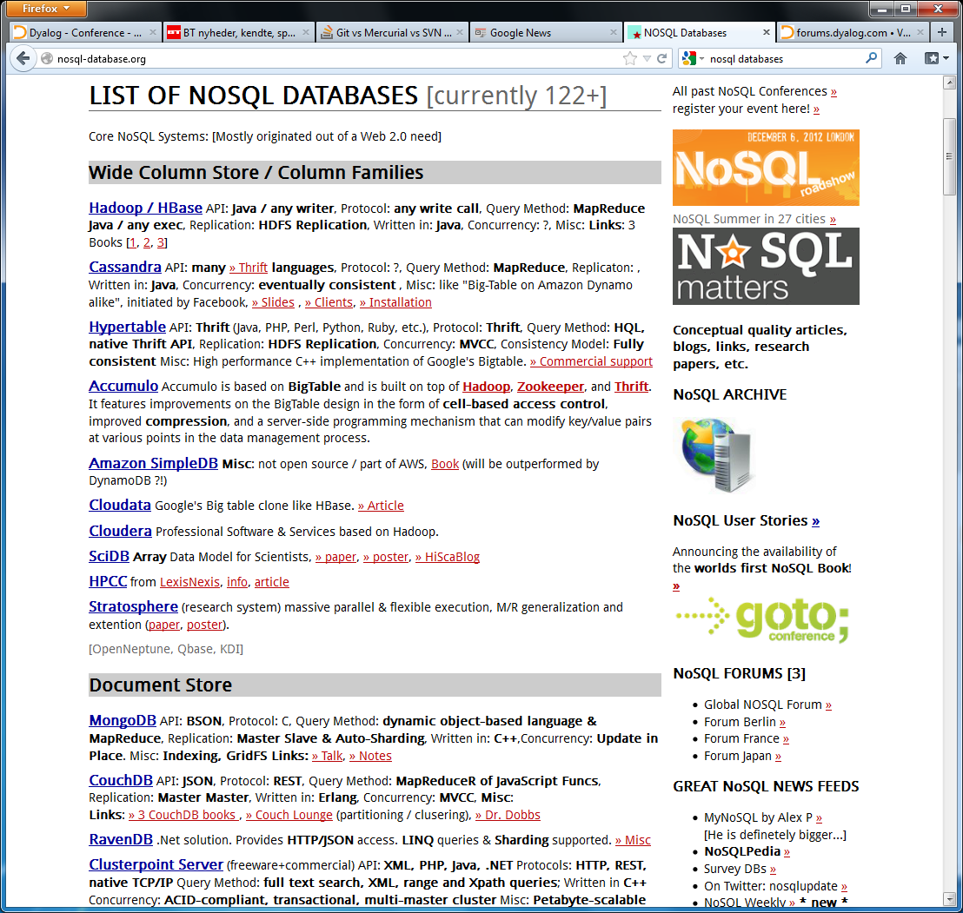
”NoSQL”?
kdb, jdb+, flipdb?
Other custom structures
All have APIs that Dyalog should be able to call
Watch recordings of Gitte Christensen’s workshop after the conference ☺
Contact Dyalog

Slide 20
APL Source Code
Traditional Solutions:
APL Workspaces
Good for ”single user projects
Component Files
Can support multiple users, but are ”black boxes” to non-APL tools

Slide 21
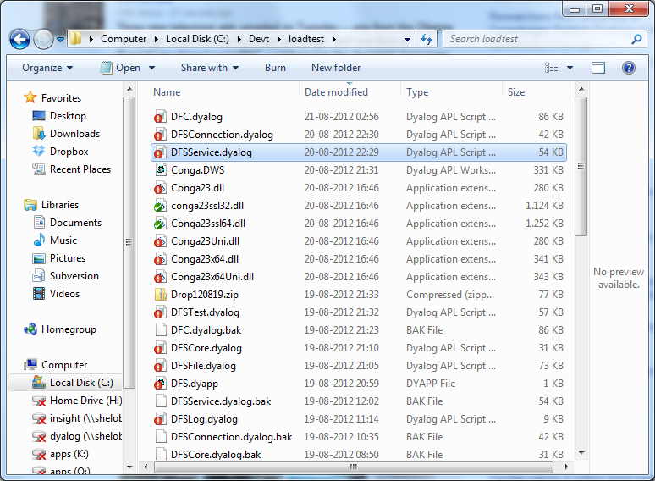
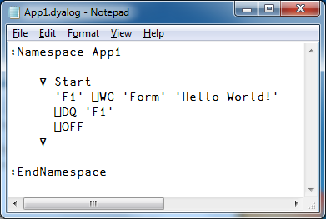
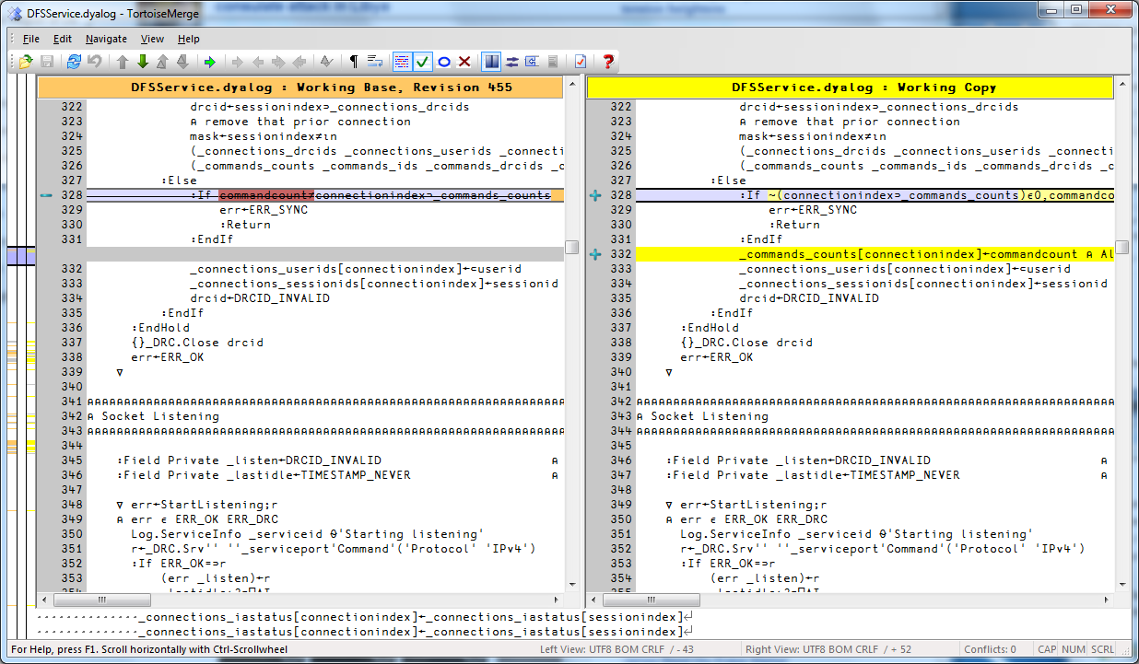
APL Source Code
Recommended Solution:
Use Unicode Text Files (.dyalog)
Allow use of state-of-the-art source code and project management tools
Dyalog is moving towards delivery of all APL source code in this format

Slide 22
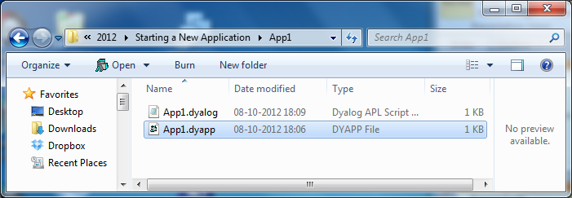
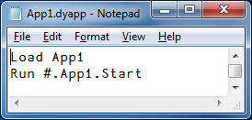
Dyalog Project Files
On installation, Dyalog APL creates an association for the extension .dyapp
.dyapp files define Dyalog Applications
Notes:
Mention the ]EFA user command

Slide 23
Focus on Source Code
Dyalog has developed SALT – the Simple APL Library Toolkit – to manage source code held in Unicode text files
Over to Dan...
Notes:
Load, Save, List
Save classes, namespaces, individual functions (vars?)
”snap”
SALT dependency declarations
How to use simple versioning
Salt functions Load and Boot can be used to initialize an application
Show runtime app booting from .dyapp file (ws with ⎕LX booting App1)
Possile to combine ws with .dyapp

Slide 24
SALT Recap
APL Script files can be used at runtime or loaded into workspace which is distributed.
Using script files doesn’t compromise the APL ”way of life”.
Best thing: You can laugh at syserrs
On every change, source file is updated
Be quick, we are removing them (syserrs)
Notes:
(After the break)

Slide 25
SubVersion, Git, Mercurial?
SubVersion is very widely used, was the first popular open-source system
Today, Git and Mercurial are becoming popular
Use a ”distributed” model (no central repository)
Dyalog uses SVN (SubVersion) for all source code, including C, C#, C++, APL and documentation
”TortoiseSVN” is a Windows GUI frontend for SVN

Slide 26
Part II - Components
Minimum Set?
(Source Code & Deployment Strategy)
Regression Testing Framework
”Front End”
Configuration
TCP Connectivity
Error Handling
Logging

Slide 27
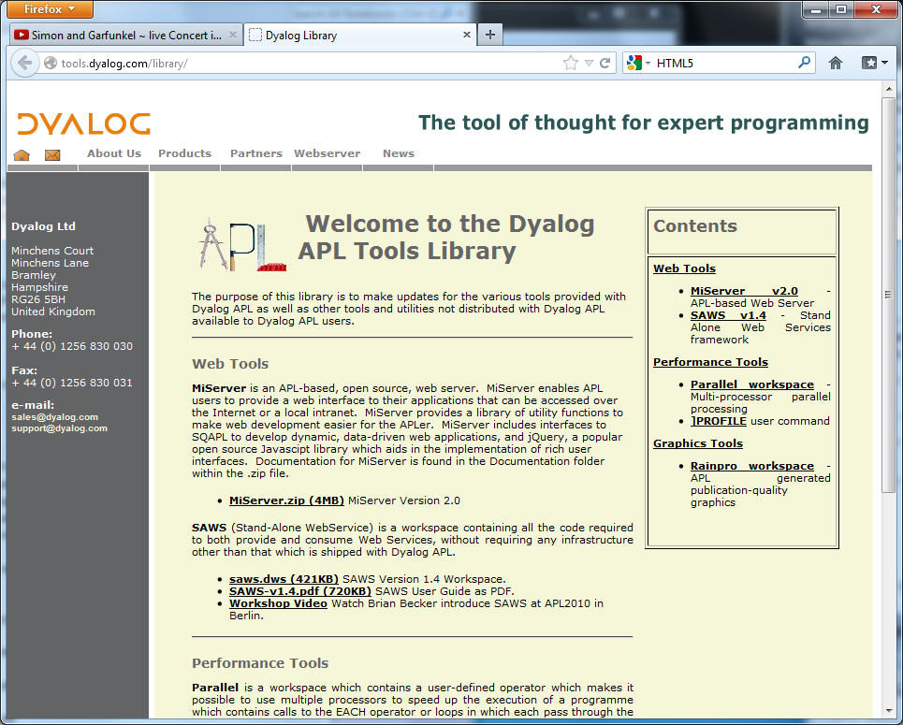
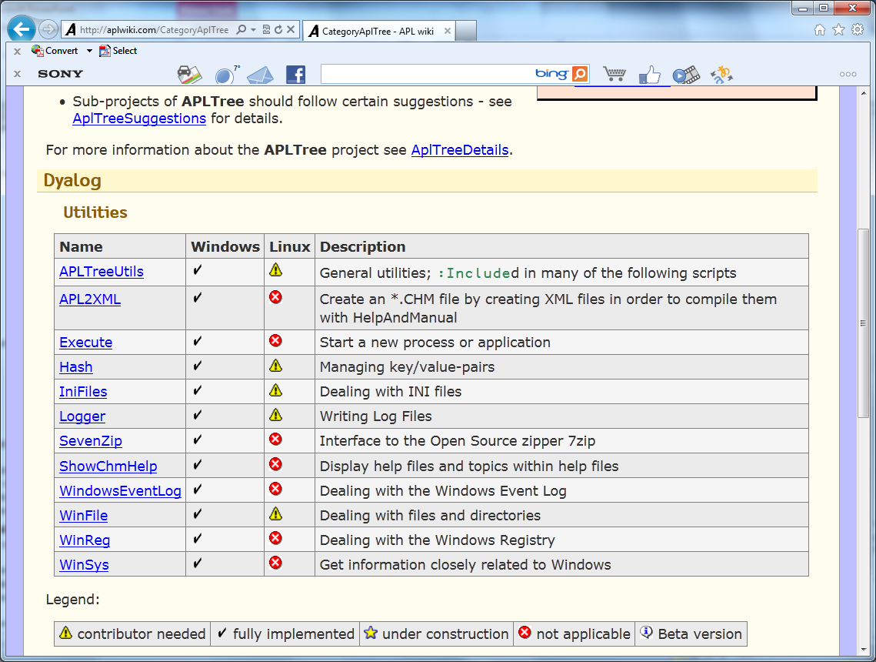
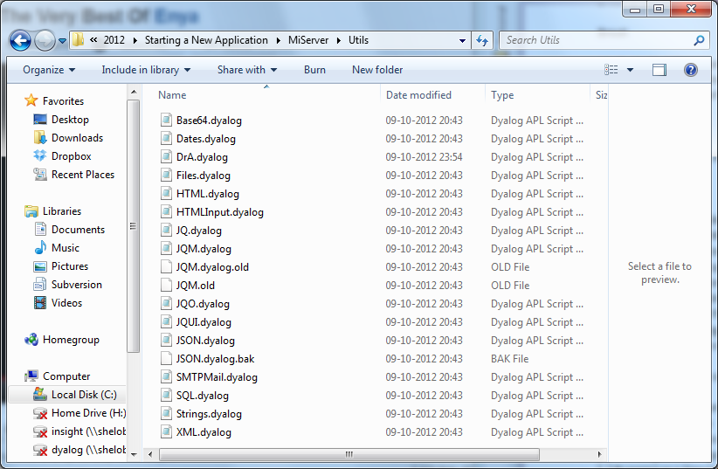
Other Utilities
Strings
Dates
Files, Folders, etc
E-Mail
XML / JSON / Base64 Encoding
Encryption
Recommended sources:
MiServer ”Utils” folder
APLWiki.com
http://tools.dyalog.com/library

Slide 28
Start App1a
We can also start applications from an APL workspace ☺
Let’s take a look...

Slide 29
Loading Utilities
Load utilities first or use SALT dependency features
Beware of un-refreshed references to other spaces: F←#.Files DRC←#.DRC These *must* be refreshed on every application startup, to avoid them keeping old copies of spaces alive – this can be *very* confusing!
Notes:
Discuss strategies for loading/sharing utility code, SVN etc.
References and the dangers of un-initialised DRC in a namespace (demo to show it happening?)

Slide 30
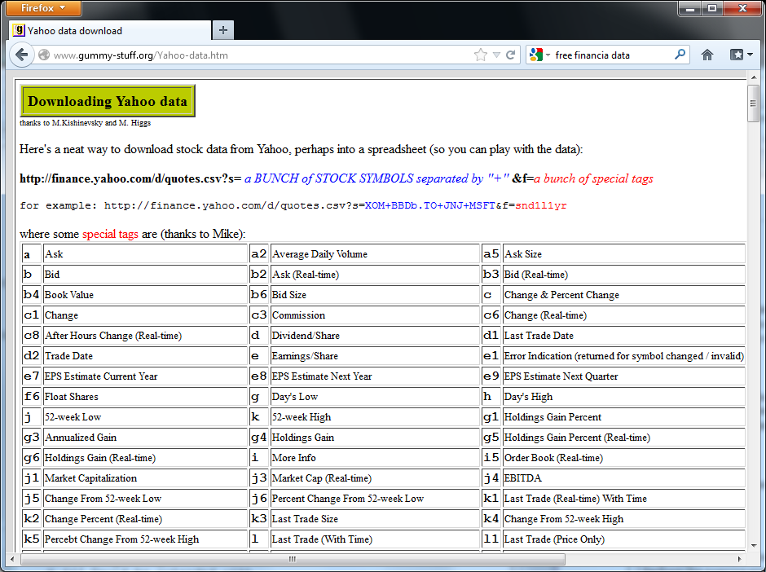
Task 1
Enhance App1a to display stock quotes
A quick search with Google finds http://www.gummy-stuff.org/Yahoo-data.htm
We can use Conga Samples.HTTPGet
Let’s take a look...
Notes:
Google ”Free Financial Data”
http://www.gummy-stuff.org/Yahoo-data.htm

Slide 31
Application Configuration
Alternatives:
Store information in your own database
(Good old) .INI files
Windows Registry
XML config files
INI and XML files have the advantage of being able to reside in your app folder
Easy to make many copies of your app
Notes:
XML is flavour of the day, Registry is old hat. I still prefer INI files

Slide 32
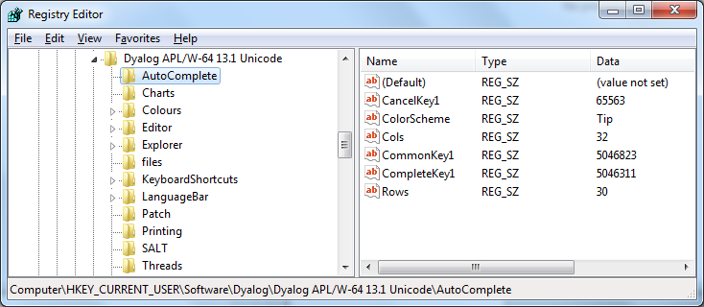
Using the Registry
⎕USING←''
hkcu←Microsoft.Win32.Registry.CurrentUser
subkey←'Software\Dyalog\Dyalog APL/W-64 13.1 Unicode \AutoComplete'
autocomplete←hkcu.OpenSubKey ⊂subkey
autocomplete.GetValueNames ⍬
CancelKey1 ColorScheme Cols CommonKey1 CompleteKey1 Rows
autocomplete.GetValue ⊂'Rows'
30

Slide 33
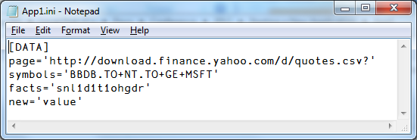
Using INI Files
Kai Jäger has built a very nice INI file class:
]load "C:\...\Starting a New Application\inifiles"
#.IniFiles
ini←⎕NEW IniFiles 'C:\Docs\Conference\2012\Starting a New Application\App1\App1.ini'
ini.Get 'Data' 'page'
http://download.finance.yahoo.com/d/quotes.csv?
ini['Data:symbols' 'Data:facts']
BBDB.TO+NT.TO+GE+MSFT snl1d1t1ohgdr
ini[⊂'Data:new']←⊂'value'
ini.(Save IniFilename)

Slide 34
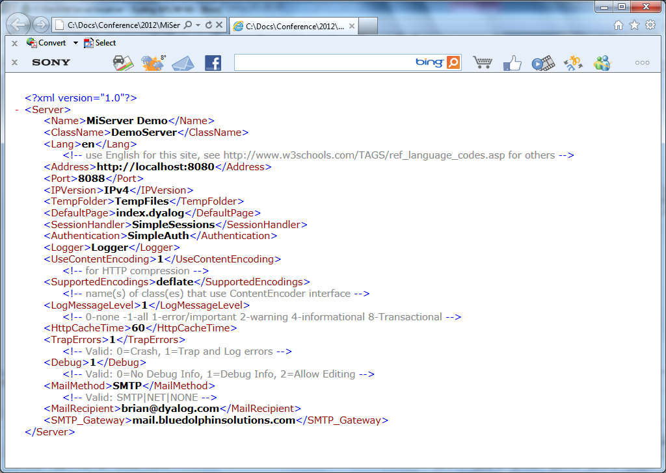
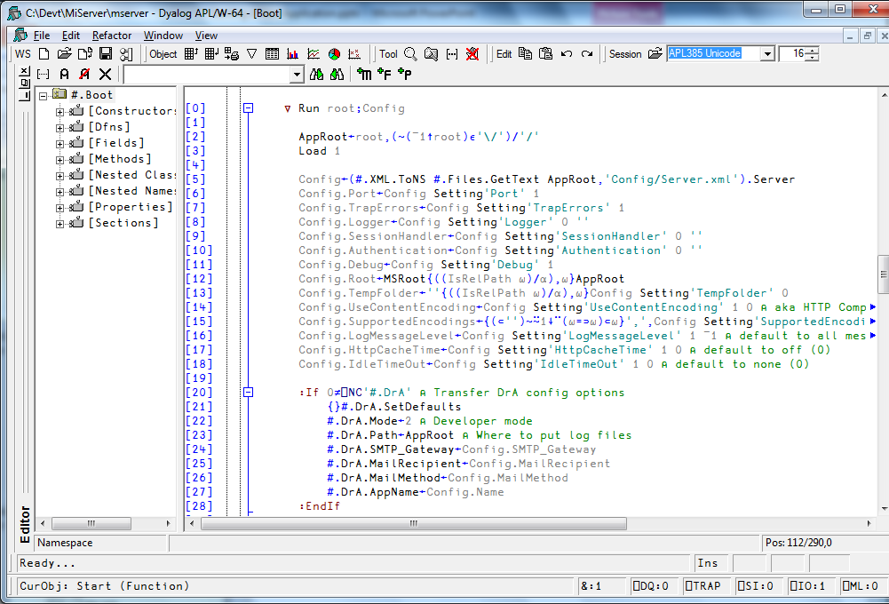
Using XML Files

Slide 35
Task 2
Enhance the application to use an INI file containing configuration:

Slide 36
Error Handling
”DrA” is a general-purpose Error Logging mechanism
Included with MiServer, will soon be ”released” separately
Creates APL component file for each error, containing:
Execution Stack
Definition of the failing function
Values of any variables which were referenced on the line of code which failed. Other vars can be requested.
User can decide whether to resume application
Log file can be e-mailed to system administrator

Slide 37
Logging
LumberJack is a another general-purpose tool included in MiServer (and in the course folder):
lj←⎕NEW Lumberjack ('c:\mylogs' 15 'myApp' 1)
lj.Log 'A log message'
The above will create c:\mylogs\myAppyyyymmdd (and a new one each day), which is updated every 15 seconds (messages are cached)

Slide 38
Task 3
Enhance the application to use DrA for error logging

Slide 39
Other MiServer Utilities
Base64 (encode/decode)
Dates (conversions and formatting)
Files (same as distributes files.dws)
SMTPMail (send e-mail)
Strings (lc, dtb, vtom, etc)
XML (convert XML to/from namespace)

Slide 40
A Look at MiServer
Walk Through MiServer initialization
Dynamic loading of pages – Overview of MiServer Structure

Slide 41
Exercise
Extract the Weather Forecasting application from MiServer and build a minimal ⎕WC GUI application to do the same thing
-------- Or -------
Build anything you like using a selection of the tools mentioned today

Slide 42
RainPro Hint
ch.New 800 400
WindRose
'ff' ⎕wc 'Form' 'My Graph' (200 100)(400 800) ('coord' 'pixel')
'ff' ⎕ws ('Coord' 'User')('Yrange' 400 0) ('Xrange' 0 800)
PostScrp.PS PG '#.ff' 1 PostScrp.∆cmap

Slide 43
References
Links to:
JD’s .NET presentations
SAWS & MiServer presentations
MJH WPF presentations
SQAPL & Conga Documentation
APLWiki

