Slide 1

Welcome to APL
Holden Hoover
holden@dyalog.com
Notes:
Welcome everyone to this array programming language event!

Slide 2

Who am I?
New APLer
Forge
UWaterloo Computer Engineering
Co-Op Student/Intern @ Dyalog Ltd
Notes:
New APLer – 2020-2021 (around 5 years of APL experience)
Forge 2024 Winner
RIS – Airplane Tracking Software written in DyalogAPL
Uni Waterloo First Year
Co-op Student and Intern at Dyalog Ltd. Working on interfaces between Dyalog APL and REST APIs.
How do you relate? Credibility?

Slide 3

Quick Show of Hands
Heard?
Used?

Slide 4

Myth … APL is Unreadable
Not if you learn it!
متوسط
$$\left[\frac{1}{n}\sum_{i=1}^{n}{x_{i}}\right]$$
平
均
평균
+⌿÷≢
Notes:
A common myth with APL is that it’s unreadable.
Language is only unreadable to those who don’t know how to read it.
Some languages use symbols to convey meaning
Some use different characters
Some read from top to bottom
Some read from right to left
And they all mean the same thing. Just because they read differently does not mean they are unreadable.

Slide 5
Myth … APL is Unreadable
Sum ← +⌿
Div ← ÷
Cnt ← ≢
Avg ← Sum Div Cnt
Notes:
Sum
Divide
Count
We get an average.
But wait, the names of the functions are longer than the functions themselves? So, why not just inline them?

Slide 6
Myth … APL is Unreadable
Avg ← (+⌿) (÷) (≢)
Notes:
That’s great, we have our average function on a nice single line.
Something cool to point out is that APL functions a lot like human language. We have our verbs, our adverbs, and our nouns. The sum for instance is a combination of a verb and adverb. The other two are just verbs. We will see nouns in use shortly.
But, we can clean it up further. The function has these extra parenthesis and spaces that we don’t need.

Slide 7
Myth … APL is Unreadable
Avg ← +⌿÷≢
Notes:
And that’s nice but notice how the name of the function is just about as long as the definition of function itself. Names can be ambiguous, whereas there is no ambiguity in the definition of the function.

Slide 8
Myth … APL is Unreadable
(+⌿÷≢)
Notes:
And so, we are left with our ultimate solution

Slide 9
Myth … APL is Unreadable
(+⌿÷≢) 1 2 3 4
2.5
Notes:
Here we can use our function with some data, with a noun.
Here we can use this to find the average and see that the result is 2.5

Slide 10
Myth … APL is Unreadable
(⊢ > +⌿÷≢) 1 2 3 4
Notes:
We add two symbols here to our function. The one on the left is called right tack, and it refers to the right arguments. We say, right tack greater than average.

Slide 11
Myth … APL is Unreadable
(⊢>+⌿÷≢) 1 2 3 4
0 0 1 1
Notes:
And we get the elements that are above the average, 2.5.

Slide 12
Myth … APL is Unreadable
(⊢÷+⌿) 1 2 3 4
0.1 0.2 0.3 0.4
+⌿(⊢÷+⌿) 1 2 3 4
1
Notes:
Here we can say, right tack divided by the sum.
This normalises the sum to 1.

Slide 13
What is APL?
Unreadable
Array-oriented Programming Language
Slide Content: Adám Brudzewsky
Notes:
So, I see APL as quite readable, because I know how to read it.
To We are an array-oriented language that uses concise symbols

Slide 14
What is APL?
Symbolic
Array-oriented Programming Language
for Communicating Algorithms
to Computers
and Humans
Slide Content: Adám Brudzewsky
Notes:
To convey meaning between computers and humans.
One of the oldest languages still in use today
Ken Iverson – Canadian from Alberta. Developed the language while teaching at Harvard for the purposes of teaching linear algebra. IBM liked it and continued the development of APL into a real computer programming language.
“Notation as a Tool of Thought” (K.E. Iverson, Turing Award Lecture)

Slide 15
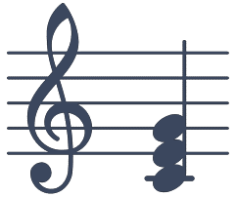
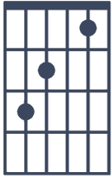




What is APL?
Symbolic
网 田
Slide Content: Adám Brudzewsky
Notes:
Some symbols that APL uses are familiar.
While others might have pictorial meaning. These certainly contain little information on 261.63, 329.63, 392.00 Hz, but that does not mean that musicians don’t know that they mean C E and G.
Just like how some languages use symbols to convey meaning. A very pictoral language here.
And some symbols convey meaning by themselves. Think how these symbols immediately convey the meaning of speech or thought.

Slide 16
Why an APL Project?
Write less, do more
Rapid iteration
Opportunities
Notes:
APL is a good project choice because it makes it extremely easy to use common array algorithms, so, you can express many data-processing ideas in very few lines. That usually means you can prototype and iterate faster and spend more time exploring the idea rather than setting up complex nested loops and indexing.
It can also be efficient: a lot of work happens in vectorized primitives, and there are options for running heavy workloads efficiently in some environments by compiling the APL code to a GPU target. This goes well with Machine Learning. In fact, last years APL Forge Winner, who is a student at York University wrote a GPT-2 autoregressive transformer in pure APL.
Next, I’ll show some interesting opportunities available for APL projects.

Slide 17

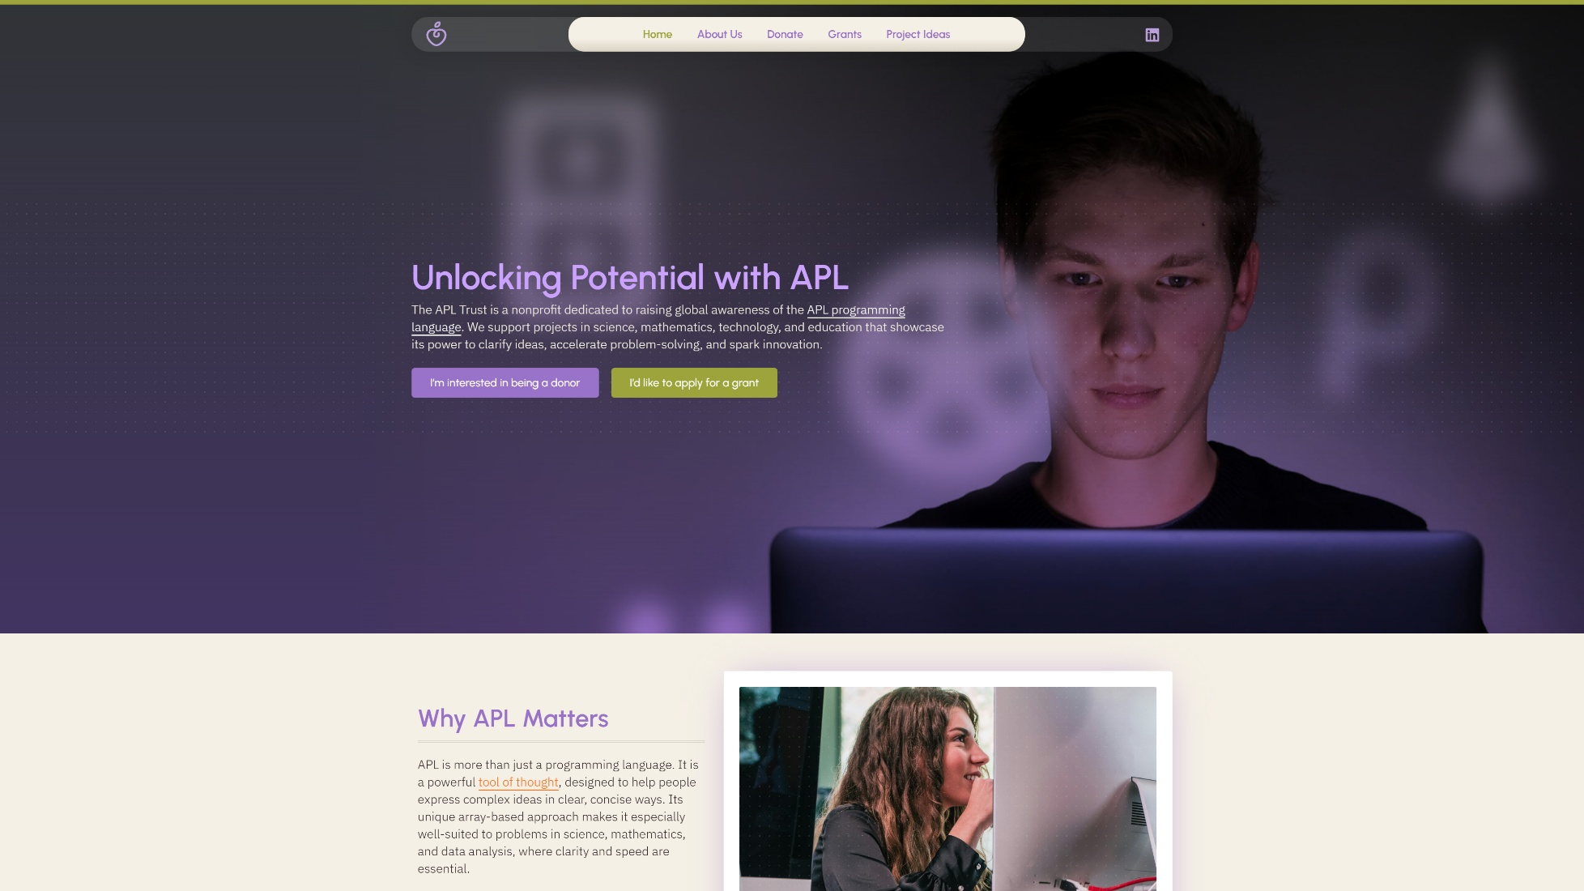
APL Project Opportunities
Notes:
Forge is a project competition with the goal to build something useful and show it working. A prototype or proof of concept is reasonable to submit.
You can win 2500GBP (Almost 5000 CAD, or over 300 large pizzas!) and have an all expenses paid opportunity to present.
Winners also receive support from Dyalog to help turn a prototype into a more polished product (mentoring, guidance, and practical help to move it forward).
This year, you can now submit non‑APL projects, if they improve QoL for APL users (e.g., a book or tutorial, an IDE/editor plugin, tooling, documentation, integrations).
Trust: Nonprofit org in USA dedicated to raising global awareness of APL programming language. They’re looking for project ideas that they can fund, up to 25k US (34k CAD, which is around 2300 large pizzas!). Submit a proposal, reviewed by trust BoD. If approved, you lay out a project to make it happen.

Slide 18
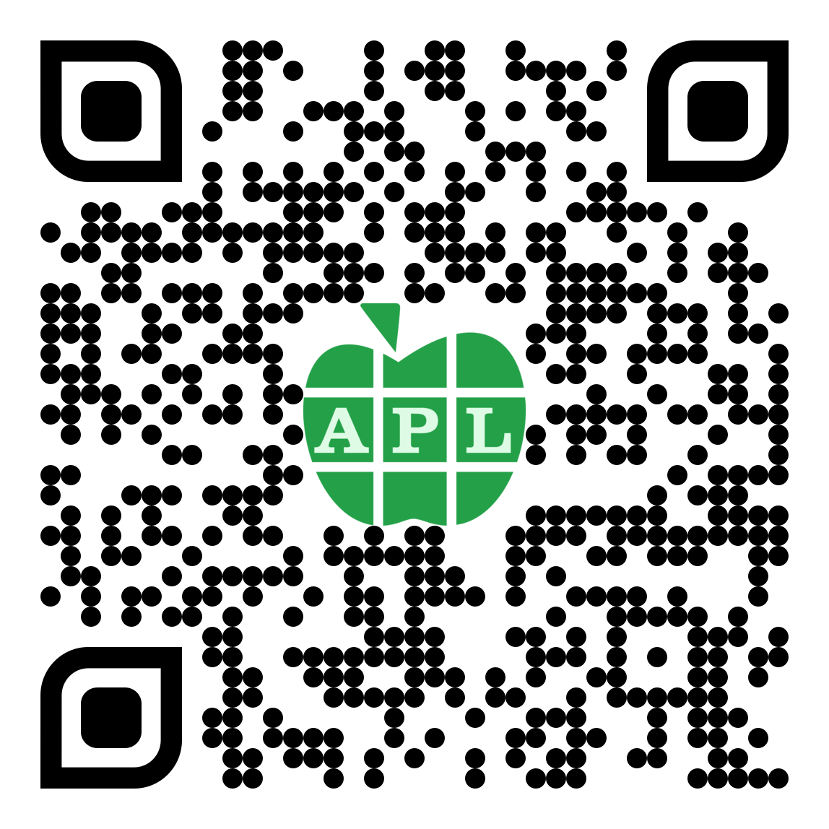
Getting Started
APL Challenge
Dyalog APL Course
Learning APL
Learn APL with Neural Networks
Notes:
There are many resources available to get started with Dyalog APL.
The challenge is not currently available; however, it will be availably shortly. We will announce it on social media when it’s available.
The Dyalog APL Course is a self study course that we have created to teach APL from the ground up.
Learning APL is a great book written by Stefan Kruger, who worked at IBM. It’s a wonderful introduction to APL from the perspective of someone who knows other languages.
Learn APL with NN is a really interesting video series, especially to anyone who might be interested in Neural Networks. You get to learn about Neural Networks AND APL at the same time! Peak efficiency.

Slide 19
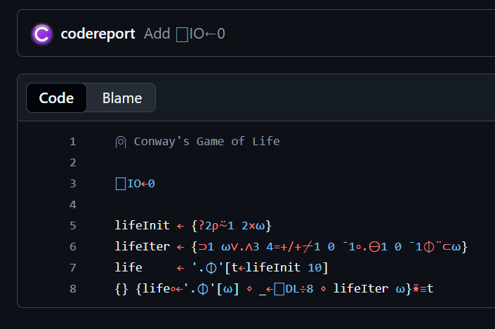
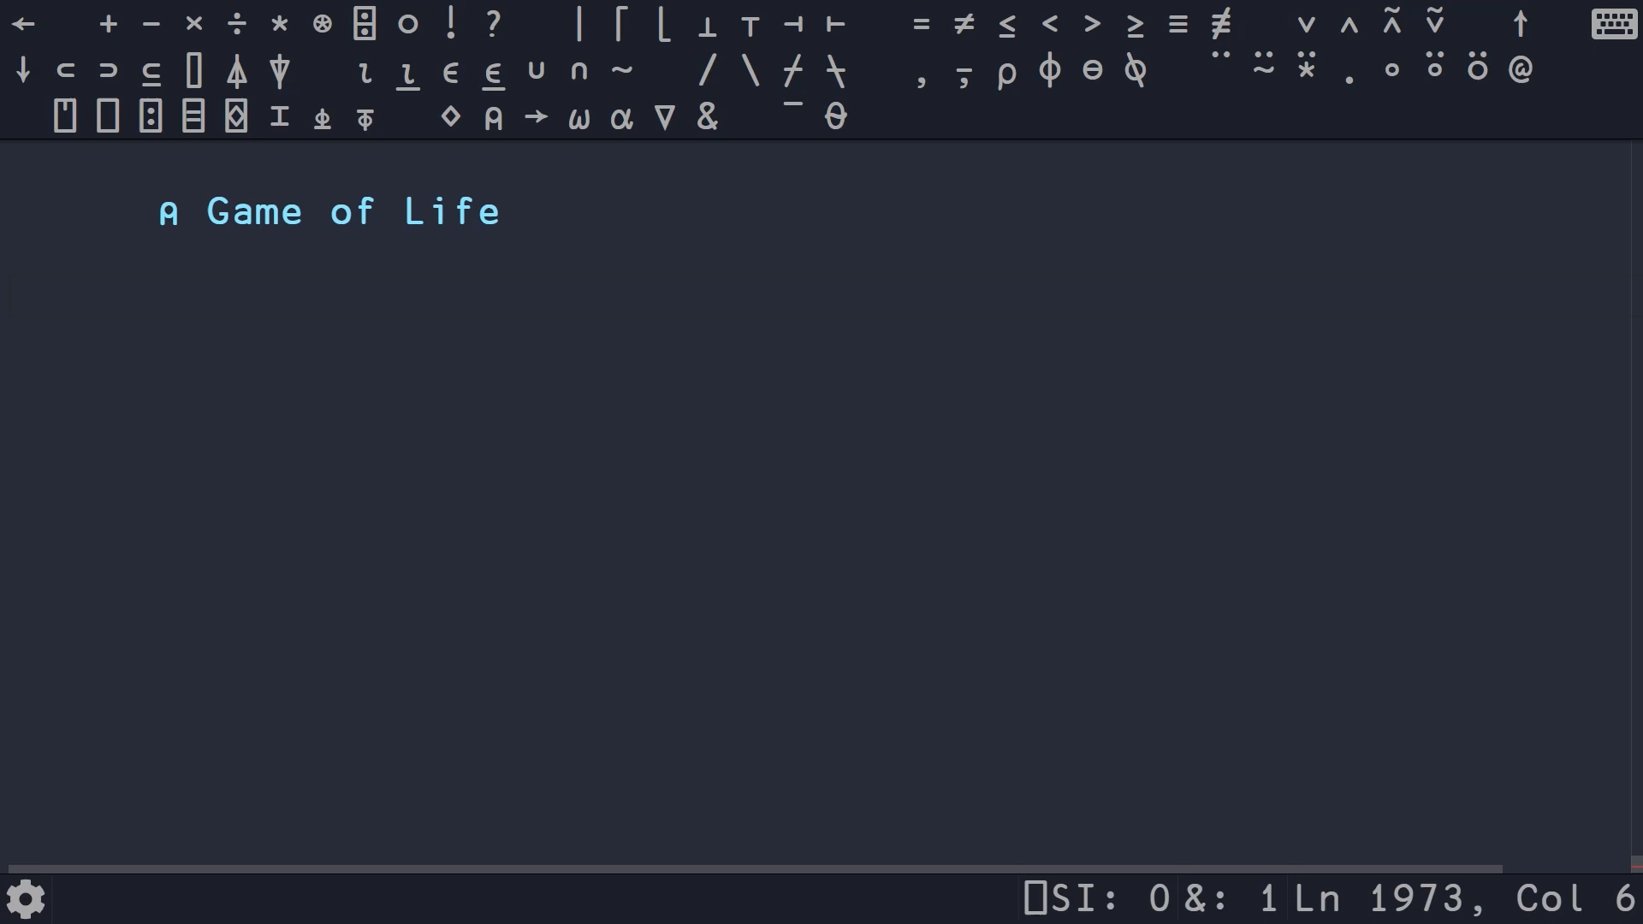
Neat! https://youtu.be/pMslgySQ8nc
Notes:
Before I go, I want to show something cool that Conor demonstrated in a video, a few years ago.
This is the entirety of Conways Game of Life implemented in APL. The implementation was written by John Scholes.

