Slide 1
Link your code
Morten Kromberg
CXO, Dyalog Ltd.

Slide 2
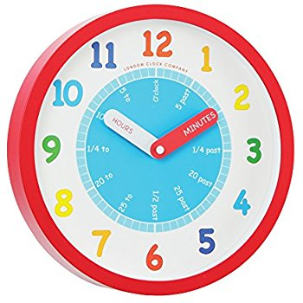
Goals
Tell a few stories about my journey towards building APL systems from source in text files
Warm you up for Gil, so he can put everything in its proper place

Slide 3
Agenda
Why text files?
Converting Python to APL
  Using the "PyCharm" IDE
Look at some User commands:
  ]link: a namepace and a folder
  ]dbuild: bring several namespaces in
  ]dtest: is it still working?

Slide 4
Why text files?
∇ R←A RUN B
[1] →L2B×⍳A>B
[2] ... spaghetti
[....]
[471] L2B:
[472] al ragu ..
∇
The idea of storing APL code in text files is hardly new...

Slide 5
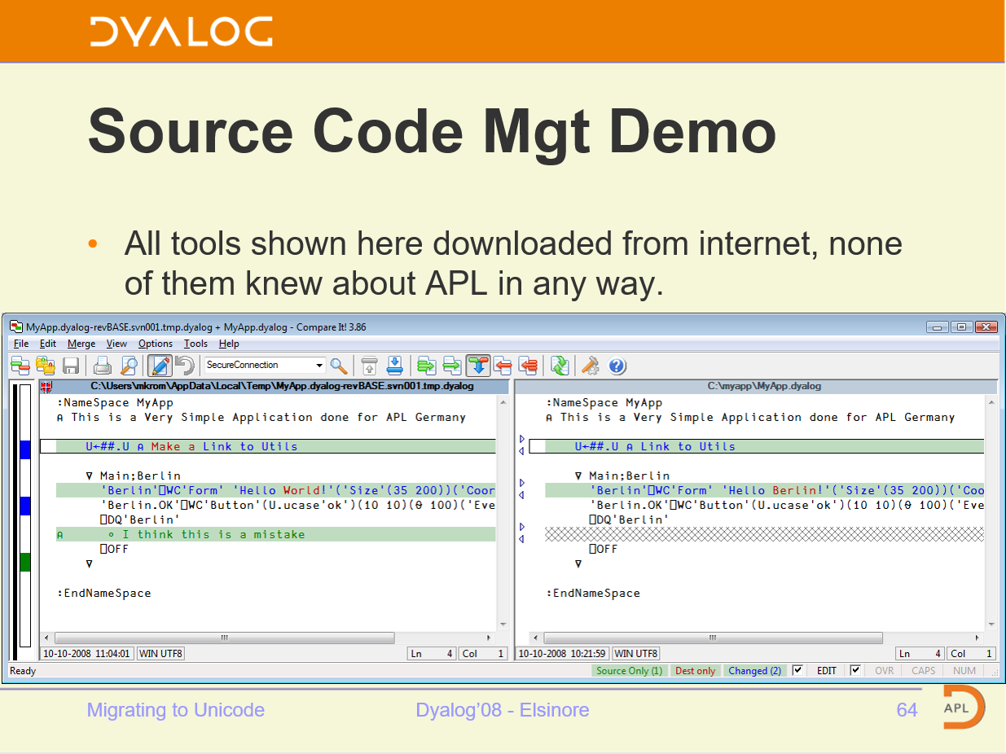

Slide 6
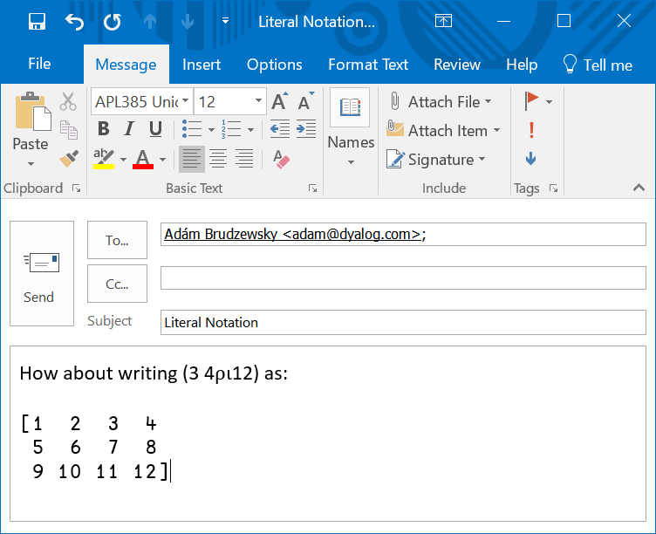
Benefits of Text Source
Use mainstream source code management systems
  SVN, GitHub, Mercurial, CVS, ...
  File "diff" tools etc
Easily share code between APL versions
Read, collaboratively write and exchange APL code without installing an APL IDE
  Most operating systems display readable APL without installing APL fonts
  Recent Linuxes even come with APL keyboard support built in (thanks to Geoff!)
New users expect it
  Not just Software Engineers; anyone who collaborated on software will have used Git[Hub] etc

Slide 7
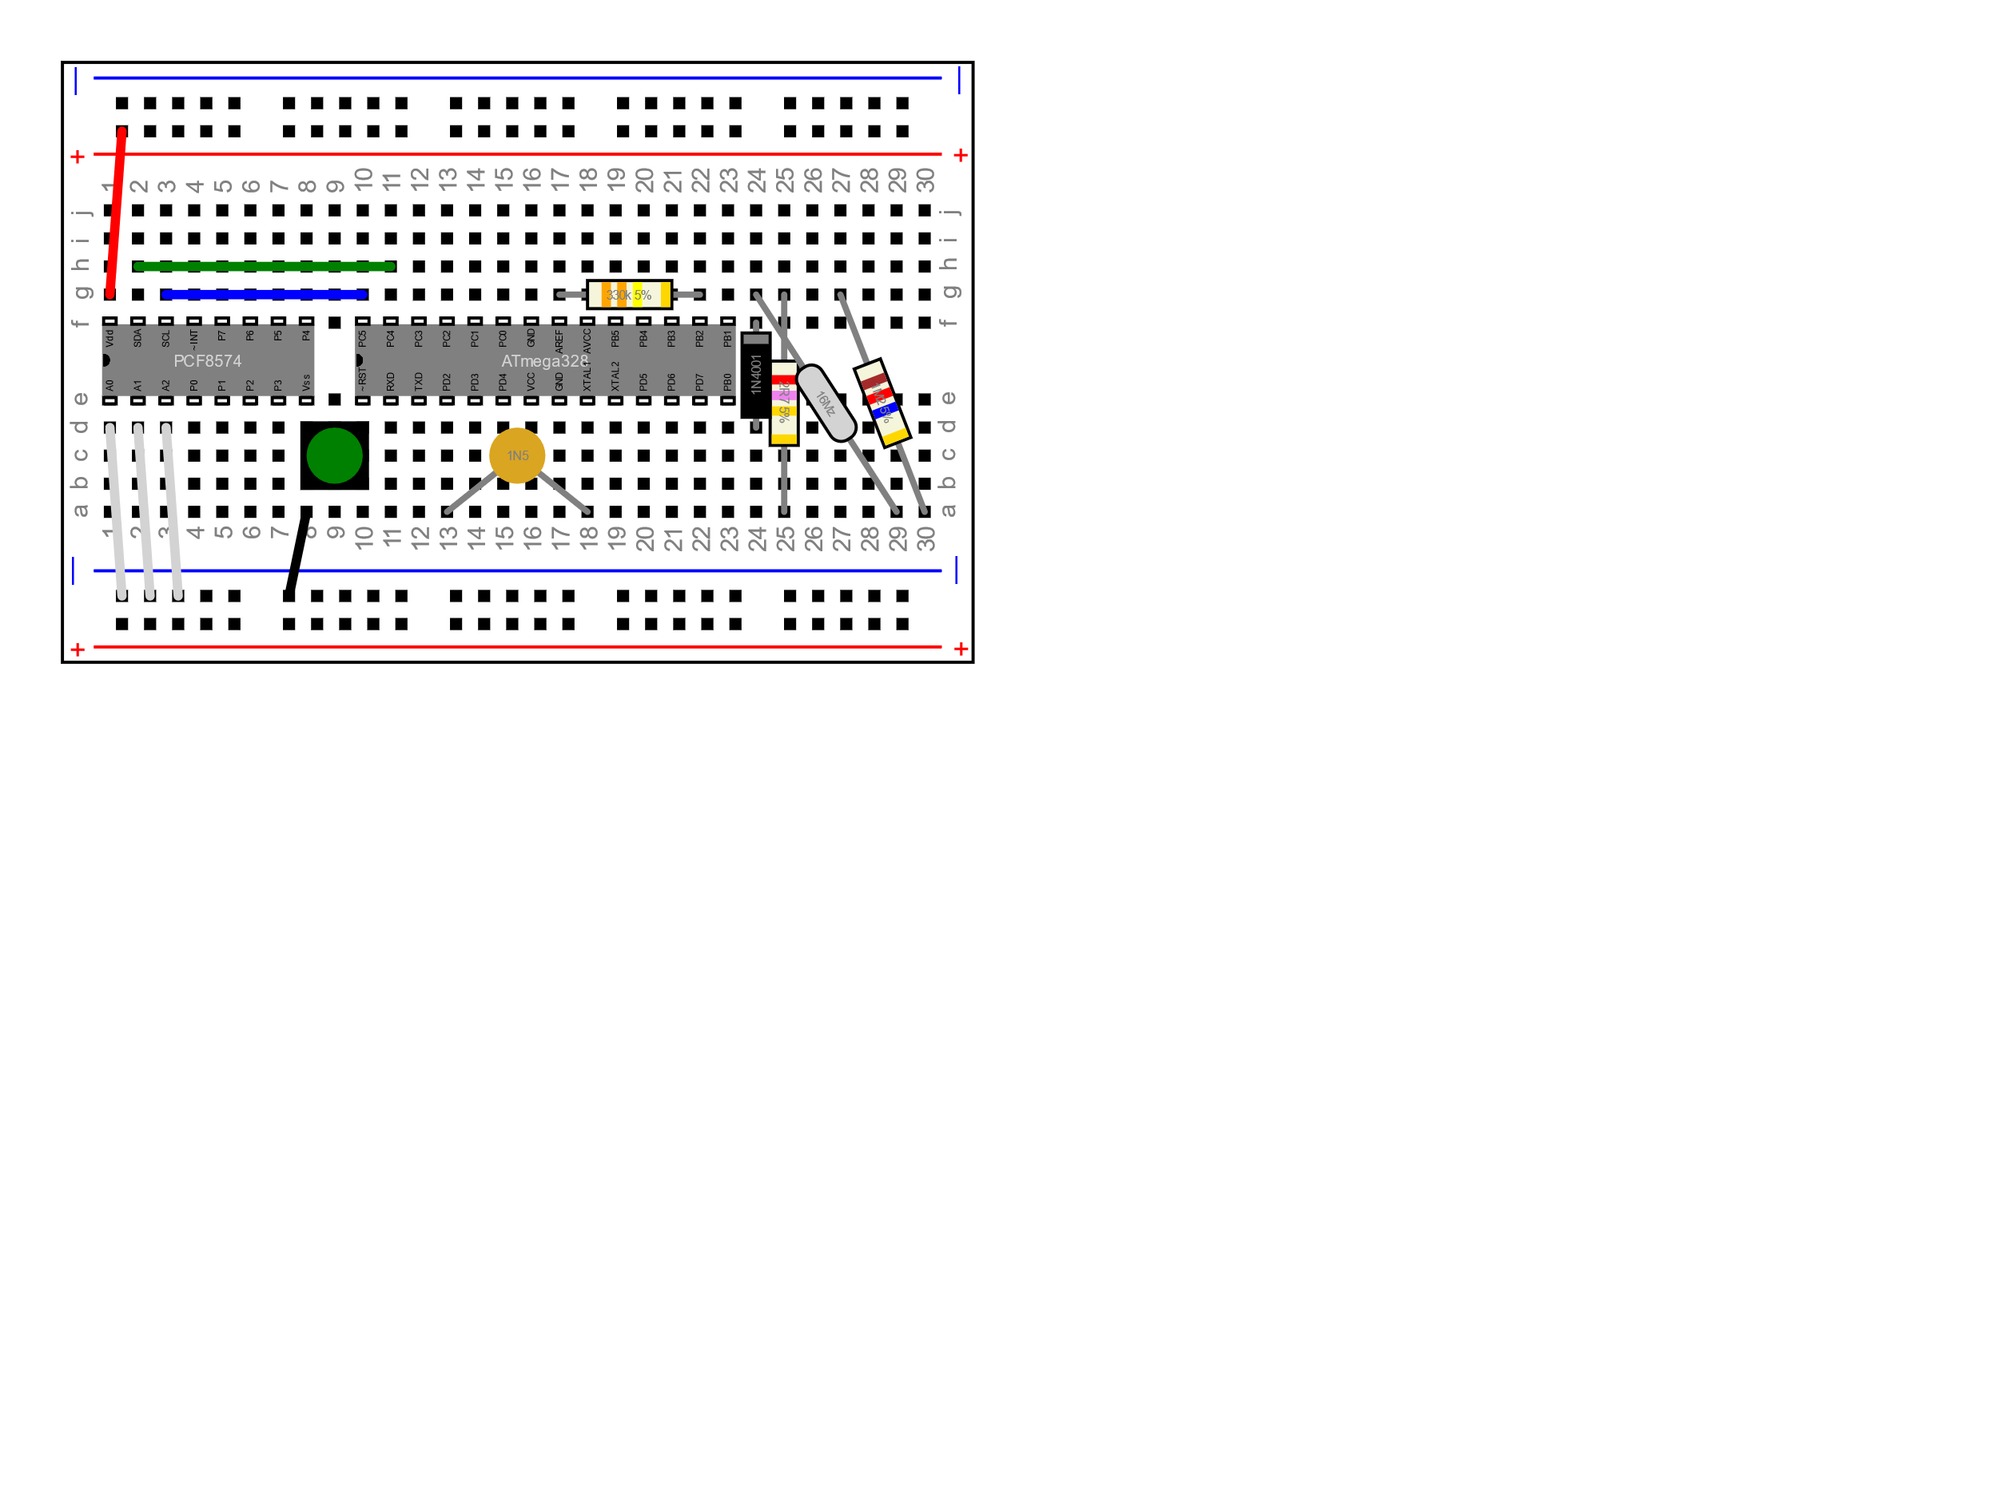
Project to convert Python Project to APL
Learn a little Python
  Know your "enemy"
Learn about the Python IDE
  Any ideas worth st... er, borrowing?
Thanks to Romilly Cocking for providing the example and doing some teaching!

Slide 8
https://github.com/romilly/breadboarder
Romilly is an electonics geek
He is developing a tool to create "breadboard" designs
In Python, on GitHub

Slide 9

Working with Python
PyCharm from JetBrains is a very popular Python IDE
I installed the "Community Edition"
Will probably get the "Professional Edition" any day now ...

Slide 10
Demo 1: Breadboarding

Slide 11
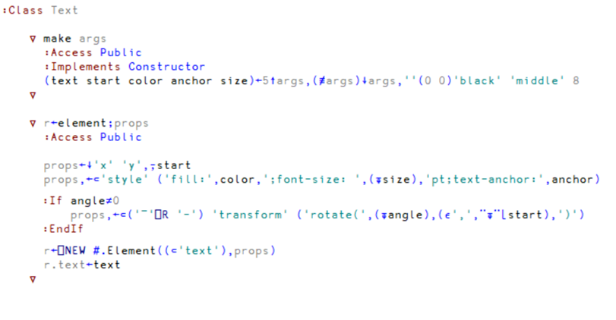
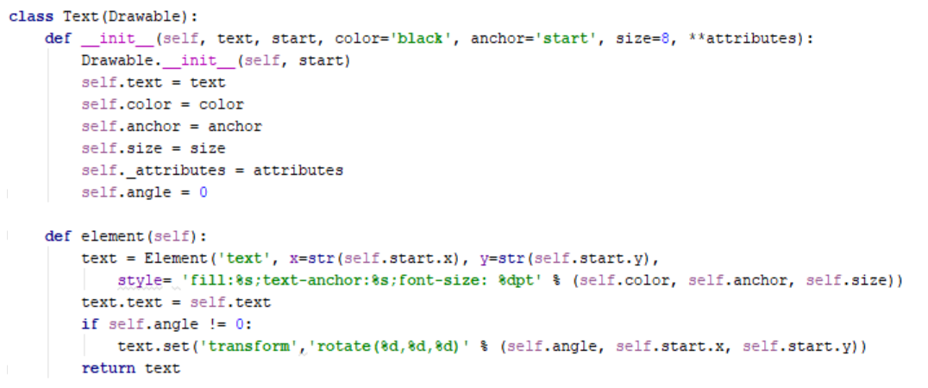
Nice Things
About Python

Slide 12
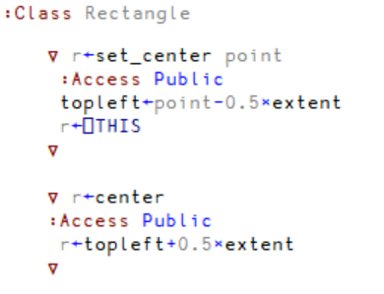
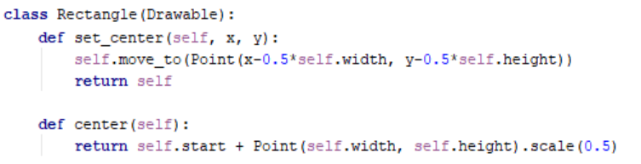
Nice things about APL

Slide 13
Really Nice thing about APL
sortstyles←{
w←⍵[⍋⍵;]
0=≢styles←⍸';'∊¨w[;2]: ⍵
w[styles;2]←{1↓∊';',¨{⍵[⍋⍵]}((~m)×1++\m←⍵=';')⊆⍵}¨w[styles;2]
w
}
fixtrailingzeros←{
0=≢i←⍸(t←⊃¨⎕VFI¨⍵[;2])∊⊂,1: ⍵
w←⍵
w⊣w[i;2]←⍕¨t[i]
}
project←⎕NEW Project
(breadboard←⎕NEW Breadboard).move_to 20 20
project.Add breadboard
svg←project.svg
pysvg←⊃⎕NGET'c:\devt\breadboarder\svg\bb-apl.svg'
(xml pyxml)←⎕XML¨ svg pysvg
xml[;4]←fixtrailingzeros¨sortstyles¨xml[;4]
pyxml[;4]←fixtrailingzeros¨sortstyles¨pyxml[;4]
r←{(≡/⍵),⍵} xml pyxml

Slide 14
Breadboarder Conclusions
Being able to share a single project and data files on GitHub has been a HUGE benefit for this project
The APL code is out there for Romilly's fans to see if they are curious
The ]link user command allowed me to
  Work interactively with APL in my customary fashion
  Have all changes immediately reflected in the code repository
  If Romilly made any changes to the APL code, I could do a "Git Pull" while talking to him, and immediately see his code in my workspace

Slide 15
]link ns dir
"links" a namespace structure to a folder structure:
  Each function, operator, class or scripted namespace corresponds to an external file

Slide 16
Demo 2: ]link

Slide 17
How it works: Changes in the Workspace
Link attaches itself to the EditorFix callback so that it can react to changes made by the user in the editor.
The exact same code can be called under program control:
  ns name [oldname] ⎕SE.Link.Fix src
This allows tools that search and replace or make other changes to source code to report the changes to the link system
src can either be source to use, or empty to ask link to retrieve the source from the workspace itself
Functions to remove objects from the workspace, and to register dfns/tacit functins, will be added

Slide 18
How it works: Changes to Files
Link uses a Microsoft.Net FileSystemWatcher to monitor linked folders
  This is only available under Microsoft Windows; we hope to add cross-platform support in Dyalog 18.0
Under program control, the link system can be made aware of changes, again by calling exactly the same code that handles FSW callbacks:
  ⎕SE.Link.Notify type path [oldpath]
  type is one of created|changed|deleted|renamed
  path and oldpath are file names (the latter only provided if type is "renamed"

Slide 19
The -onRead and -onWrite Hooks
You can specify the names of two functions which will be called before link does it's own processing
This allows you to
  Support file formats not supported natively by link, such as XML, JSON, or acre .charmat and .charvec formats
  Perform additional processing in the workspace if configuration changes
  ...etc...
The hooks can return 1 to allow link to perform default processing, or 0 if the hook has done everything that needs to be done

Slide 20
]link modifiers: Summary
]link ns directory
-source ={ ns|dir|both}
Whether to consider the ns or dir as the source (both will synchronise)
Defaults to "both" except when linking #, when it must be specified
-watch = {none|ns|dir|both} (after initial copying, default=both)
-extn = File extension considered to be APL source code (default=.dyalog)
-flatten Ignore dir hierarchy, loads everything into ns (default=off)
-prompt Prompts user to verify all synchronisation (default=off, not recommended)
-reset Removes an existing link (directory argument not required)
-onRead, -onWrite: hooks to handle files in other formats (xml, json, custom)

Slide 21
Purpose of the Link mechanism
Keep source in the workspace synchronised with files which have a similar structure
Changes on either side are immediately replicated on the other
  Edit a function → file updates
  Add a new function → new file created
  Rename a folder → namespace renamed (except at the top level)
Direction of synchronisation is optional
  outbound, inbound, or bi-directional
  inbound only available with .NET framework in v17.0

Slide 22
Purpose of the Link mechanism
NOT a source code management or project system.
Expects:
  A SCM system "below" to manage the source files (SVN, GitHub, etc)
  A project management "on top" to manage dependecies, building, testing etc
Will be available as a proper API, not just a UCMD – to be called by project mgt systems

Slide 23
]dbuild and ]dtest
Dyalog has used these two user command internally since v16.0
Used to build and test
  conga.dws (in v16.0)
  isolate.dws (from v17.0)
They do not yet use ]link, are still based on SALT ]load
  Outward links only
  No automatic support for adding new functions

Slide 24
Demo 3: ]dbuild and ]dtest

Slide 25
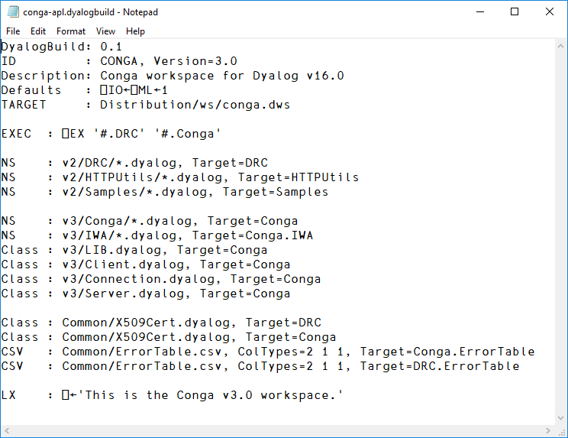
conga

Slide 26
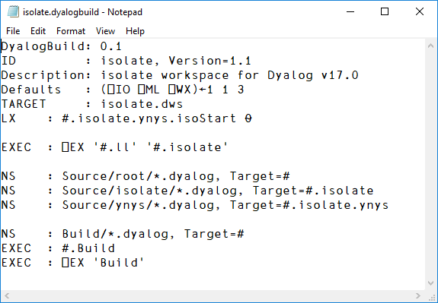
isolate

Slide 27
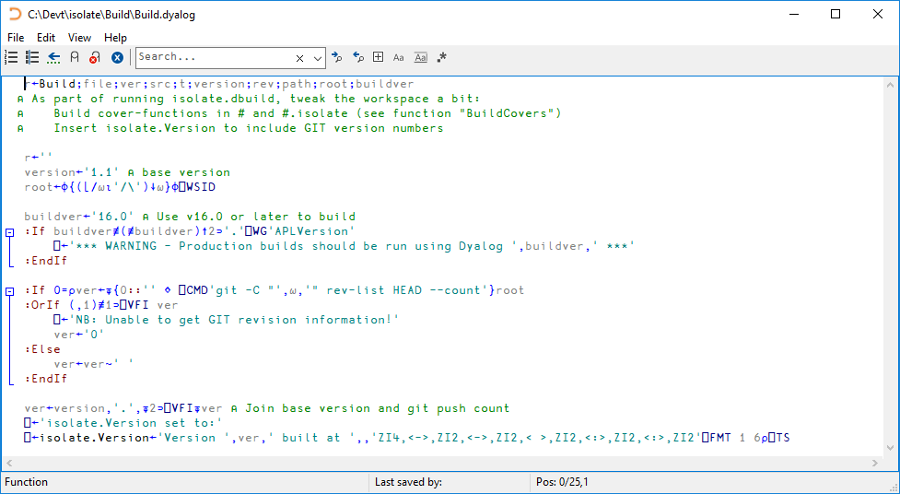

Slide 28
]dbuild "commands"
Command | Use
Id, Description | Metadata
Copy (path, target) | Copy a file or folder
Run | Not yet implemented: Call another build file
NS, Class, APL | Load one or more .dyalog files
Lib | Bring in a standard Dyalog tool
CSV | Load a .CSV file into a matrix
LX, Defaults | Set latent expression, or system variable defaults
EXEC, PROD | Execute expressions (PROD = production builds only)

Slide 29
]dbuild modifiers
-clear[=NCs] expunge all objects,
(optionally of specified name classes only)
-production remove links to source files
-quiet only output actual errors

Slide 30
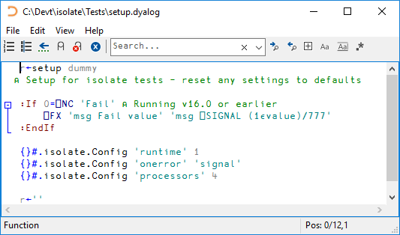
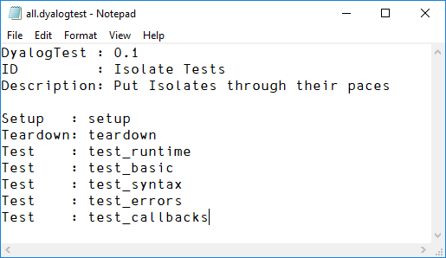
DTest Examples

Slide 31
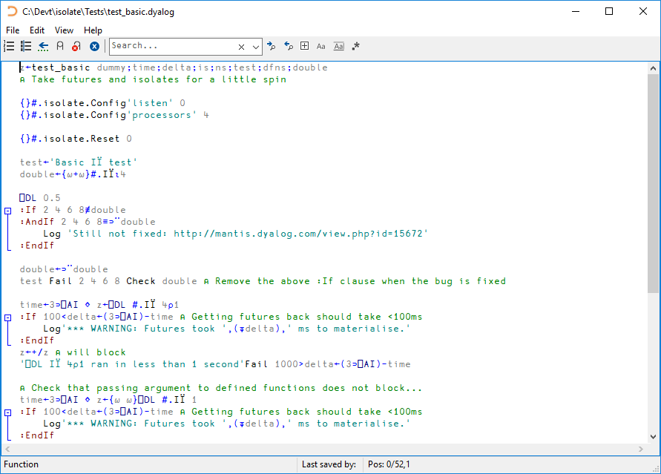

Slide 32
]dtest "commands"
Command | Use
Setup (fnlist) | Listof setups to run (all tests will be repeated for each setup)
Test (fn) | Name of a test function to run
Teardown | Function which performs any final checks and "tears down" what what was set up.

Slide 33
]dtest modifiers
]DTest {ns|file|path} [modifiers]
ns namespace in the current workspace
file .dyalog file containing a namespace
path path to directory containing functions in .dyalog files
Optional modifiers are:
-setup=fn run the function fn before any tests
-teardown=fn run the function fn after all tests
-tests= comma-separated list of tests to run
-filter=string only run functions where string is found in the leading ⍝Test: comment
-repeat=n repeat test n times
-halt halt on error rather than log and continue
-trace set stop on line 1 of each test function
-quiet qa mode: only output actual errors
-verbose display more status messages while running

Slide 34
]dbuild / ]dtest Summary
Implemented fast to solve an urgent problem
Very effective:
  allowing Dyalog to use GitHub to build parts of the distribution
Bit of a mess, refactoring will happen

Slide 35

Selected Dyalog Projects on GitHub
library-core, library-conga, samples-conga (shipped folders)
conga-apl (conga.dws)
isolate (isolate.dws)
link (user command)
aplssh (Run SSH from APL)
pynapl (Python Bridge)
MiServer, MiSites
JSONServer, SAWS
WC2, Selenium
vecdb, MatLab
aplx (conversion tools)

Slide 36
In v17.0 (on track for May/June release)
]link will be included
⎕FIX can handle functions as well as namespaces and classes
Locals outside of line [0] to allow easier merging
Classes will be fix'able with missing dependencies:
:Class MyClass : BaseClass
:Include SomeNamespace
...
:EndClass

Slide 37

The coming year...
Work with Gil and Acre developers/ users to agree on shared guidelines for using text files and packages or "modules"
All Dyalog users *must* be able to share source files, and as many tools as possible, in the 2nd 50 years!

Slide 38
v18.0 Targets
FileSystemWatcher on all platforms
Implement a format for array constants in version 18.0
APL Syntax Colouring "plugins" for GitHub, VS Code, Notepad++(?)

Slide 39

Conclusion
It is time for the community to adopt common platforms for
  How to represent source code
  How to manage dependencies
Not necessarily
  How to manage projects
  How to do testing

Slide 40
Open Source is Key
All the tools that we develop as a community should be open source
Over to Gil

