Slide 1
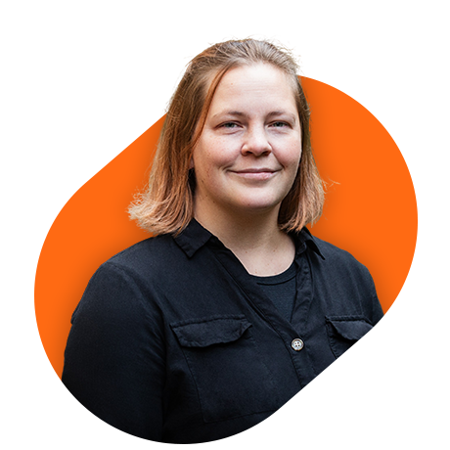
News from Dyalog Ltd.
Stine Kromberg

Slide 2


News from Dyalog
The Challenge and the Forge
New web site
APL Tutor
Going out
Expanding the online community
What can we do for you?!

Slide 3

Dyalog is doing big things
The APL Forge
https://forge.dyalog.com/
Notes:
•The APL Forge is a new initiative launched this year to encourage the organic development of a diverse APL ecosystem.
O Annual competition for innovative open-source libraries, commercial applications and tools.
O Prizes: £2,500 GBP, an expenses-paid opportunity to present at our next user meeting, and a commercial licence valid for one year. We will also help you to take your application into production (if relevant).
O Eligibility: Individuals, groups, or companies can participate if they meet certain conditions – the criteria include being 16 years or older, registered for a free Basic licence for Dyalog, and not an employee, contractor, or otherwise directly associated with Dyalog Ltd.
O The deadline for submissions for the current round of the APL Forge is Monday 23 June 2025 at 12:00 UTC.
O More information on ideas for submissions, judging criteria, and previous winners can be found at the website.

Slide 4

Dyalog is doing big things
The APL Challenge
Do you want it in finnish??
https://challenge.dyalog.com/
Notes:
•The APL Challenge it’s the successor to the annual Student Competition and is a completely different beast than the long running one you may be familiar with.
oThere are four rounds of the APL Challenge each year.
oYou don’t need to participate in an earlier round to participate in the current one.
oEach round has ten problems and runs for three months. The questions start off very easy and get progressively more complex.
oPrizes: three winners awarded $100 (USD), chosen at the discretion of Dyalog
oEligibility: Anyone can win a prize except Dyalog employees and associates.
oThe target audience for this is geared more towards beginner APL’ers, especially young people – the questions are designed to teach the participant APL principles as they go along without needing many resources outside of the problem questions themselves. Especially good opportunity for students so if you have any young family members that you would like to introduce APL to this is a great starting point! We want this competition to be as accessible as possible – which means having more available languages, including Finnish. Fi will explain more at the end.

Slide 5
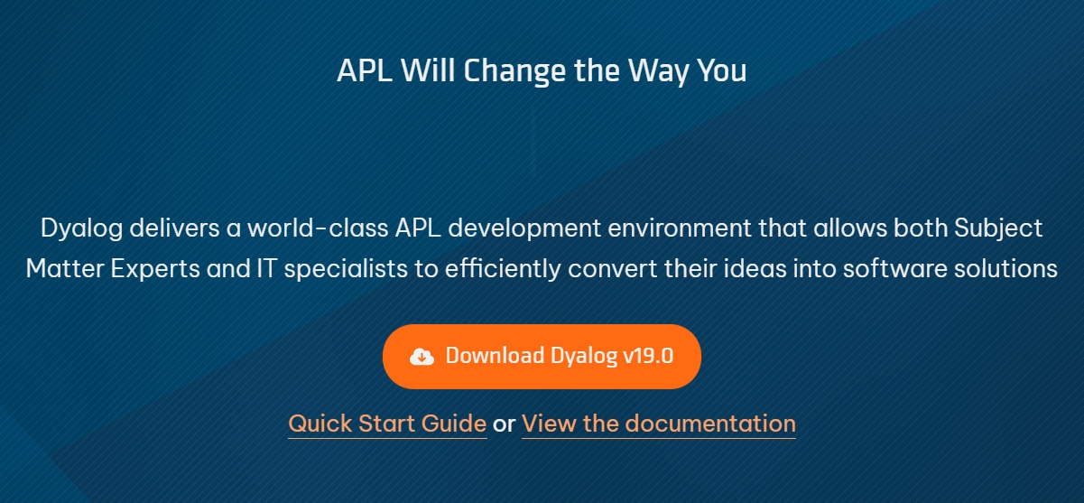
New website
Coming soon!

Slide 6
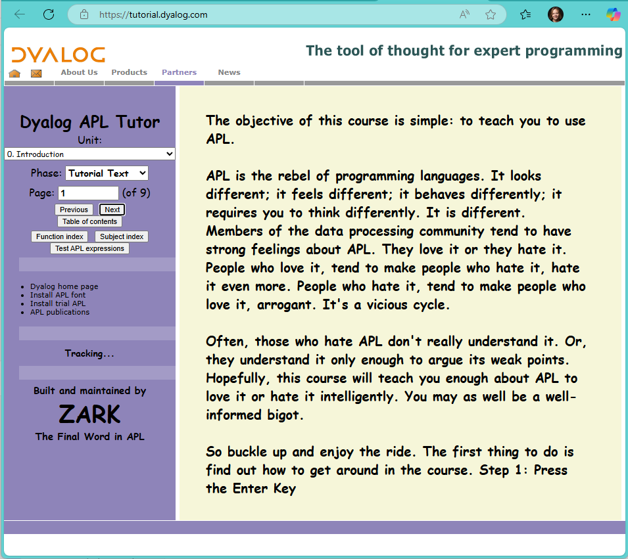
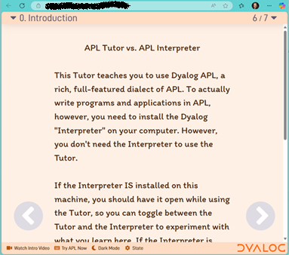
APL Tutor
Same content
New face
Little less snark
Coming soon!

Slide 7
Going out
Functional Conf 2025
APL Germany Spring Meeting
DYNA Spring 2025
Lambda Conf
FinnAPL Spring Meeting
We are going back to Eastbourne for Dyalog 26’
12th - 16th of October 2026
Technical meeting in Milan
Programming Language Standardization and Specification meeting
JSM 2025
DYNA Fall 2025
APL Germany Autumn Meeting?
FinnAPL Autumn Meeting?

Slide 8
Expanding the online community
APL Monday
Array Cast https://www.arraycast.com/
Possibly Exercism https://exercism.org (still need to find out mentoring requirements before committing)
Active chat rooms
- Orchard (apl.chat) https://apl.chat
- Farm (Discord) https://aplwiki.com/wiki/APL_Farm
Forums
- Stack Overflow
- Dyalog Forums https://forums.dyalog.com/

Slide 9
Expanding the online community
Updated branding
Training sessions are being planned
arrayportal.com
Other people are making videos about APL:
- https://www.youtube.com/@arrayaccessor
- https://www.youtube.com/@yernab

Slide 10
What can we do for you?!
I have some questions for you!
Please talk amongst yourselves (in Finnish if you like).
And then we can debate in English.
Does that sound OK to you?

Slide 11
Time for questions
What is the future of FinnAPL?
How can we help?
What do you want to hear about, if you invite us back next time?

Slide 12

Thank you for listing and engaging
Now over to Peter and the interesting stuff.

