Slide 1
Highlights of v19.0
Morten Kromberg

Slide 2
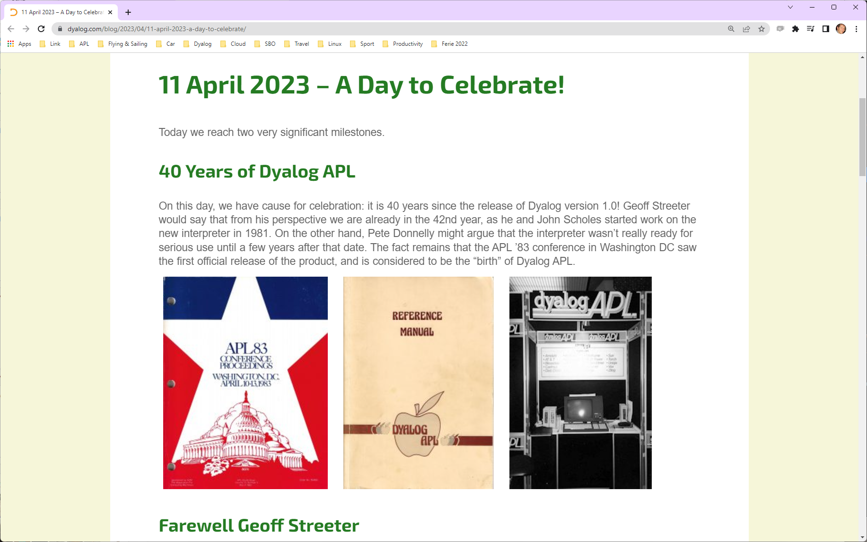

Slide 3
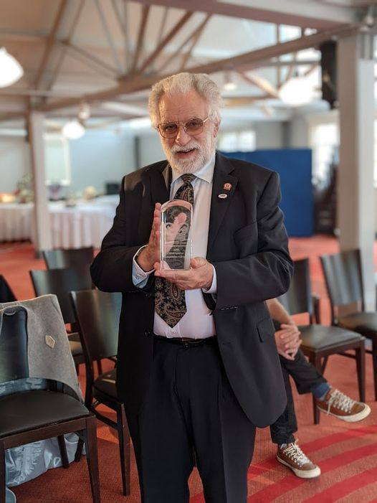
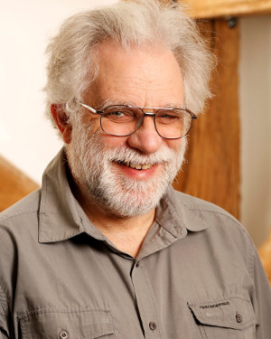
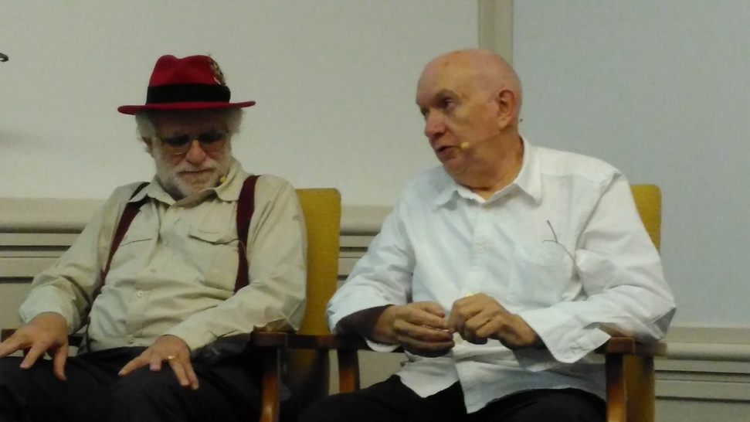

Geoff has Retired (!)
With John Scholes, Geoff Streeter implemented Dyalog APL v1.0 in 1981-1983
We hope to welcome him back for a retrospective talk at Dyalog'24

Slide 4
Recuiting in 2023
Admin person (UK)
  Started April 1st
Developer / Tool Builder / Evangelist (UK)
  Started May 1st
Full Time Tester (UK or India)
  We have a candidate who is being evaluated
1 for the IT Department (UK)
  "Before end of 2023"
Current Head Count ~25 FTE
(from 5 in 2004)

Slide 5












Dyalog … The Next Generation
Legend:
A = APLer
C = C developer
D = Admin
E = Doc/Evangelism
Aaron (ACE)
Adam (AE)
Rich (AE)
Josh (A)
Stine (D)
Karta (C)
Silas (C)
Peter (C)
Jesus (E)
Jada (D)
Stefan (AE)

Slide 6
Highlights of Version 19.0
Structural Operations on Scalars

Slide 7
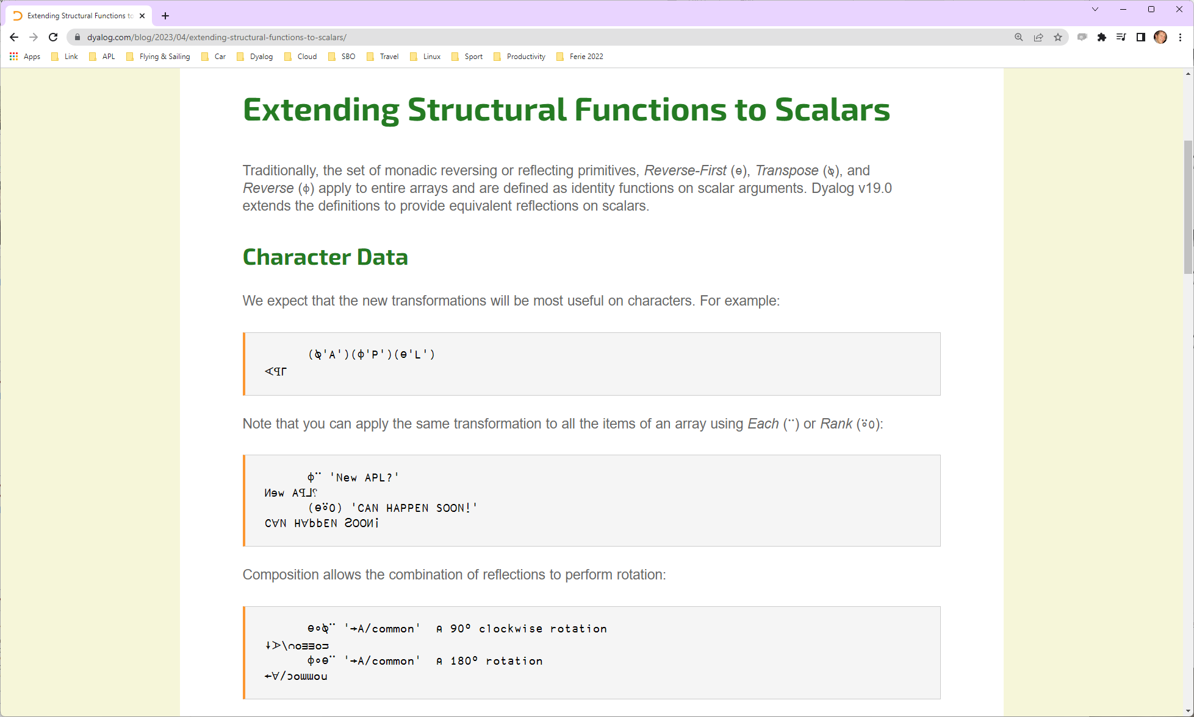

Slide 9
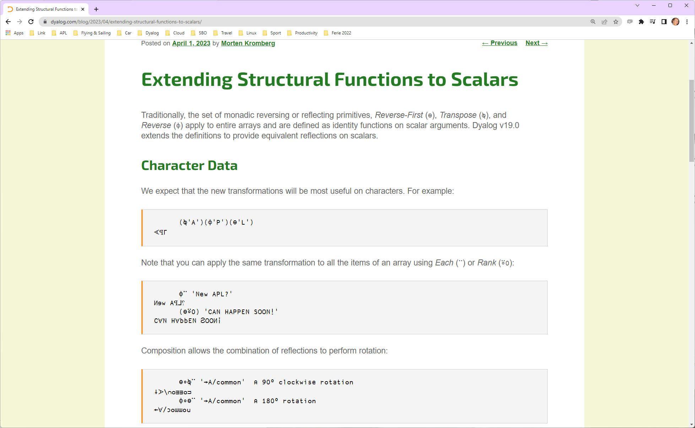

Slide 10
Highlights of Version 19.0
Installing & Managing Your System
  Keyboarding
  Multiple session files
  Health Monitor [demo]
Building Production Systems
  Timeouts
  Token range reservation [demo]
  WS FULL handling [demo]
  NCOPY/NMOVE callbacks
Developer Productivity / IDE
  Source "as typed" by default [demo]
  Multi-line input on by default [demo]
  HTMLRenderer updates
  Link 4.0: Crawler, Support for text data
  Namespace Improvements
Platform Support / Distribution
  64-bit ARM support
  .NET 6/7/8 (6 by default)
  Bound executables on all platforms

Slide 11
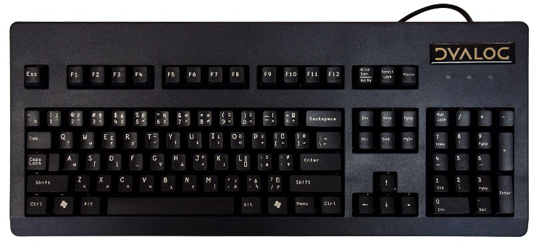
Keyboarding (Mostly for New Users)
Installing &
Managing
Issues:
Dyalog IME does not work with Windows Universal Windows Platform applications
New users report that "ctrl" is undesirable as the APL key
Immediate Solutions (v19.0):
AutoHotkey / Downloadable keyboards for Windows which offer alternative "APL" keys (Alt, AltGr, etc). Thanks to Kimmo Linna!
Backtick-style keyboards for all platforms
Longer Term:
A new IME which offers a similar experience across
supported platforms and works in and out of the IDEs
(this will take a bit longer)

Slide 12
  Multiple session log files
Installing &
Managing
Earlier versions (default behaviour):
All APL sessions read the same log file at startup, and update the same file at shutdown
The last session to be closed overwrites the log file
In rare circumstances, multiple starting or stopping APL interpreters crash due to conflicts reading or writing the log file
Version 19.0 default:
Each APL session locks its log file
Subsequent sessions will generate a new file name (e.g. default-2.dlf)
If you regularly open several simultaneous sessions, they will have separate logs
NB: In all versions, you can set the file name using LOGFILE=
Version 19.0 log files are JSON log files

Slide 13
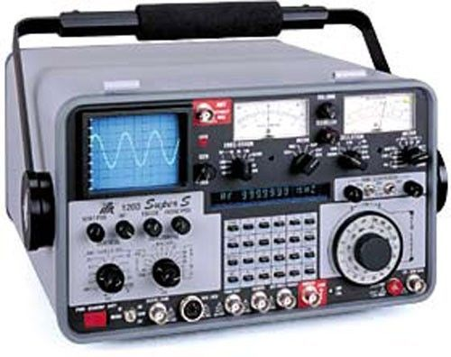
Health Monitor
Installing &
Managing
Experimental TCP-based monitor:
Regular updates on (for example) :
  CPU consumption
  Memory statistics
  Are any threads suspended?
  )SI stack and Error information
Notification on
  untrapped error
  ws compaction
Exact execution location if "breadcrumbs" enabled
Information about whether a RIDE connection is possible

Slide 14
Health Monitor Example
["PollFacts",{"Facts":["AccountInformation","Workspace","ThreadCount"],"Interval":5000,"UID":"1 1"}]
["Facts",
{"Facts": [ {
"ID": 2, "Name": "AccountInformation",
"Value": {
"ComputeTime": 438,
"ConnectTime": 46973,
"KeyingTime": 0,
"UserIdentification": 0
}},{
"ID": 3, "Name": "Workspace",
"Value": {
"Allocation": 33882064,
"AllocationHWM": 33882064,
"Available": 2144207480,
"Compactions": 2,
"FreePockets": 186682,
"GarbageCollections": 0,
"GarbagePockets": 0,
"Sediment": 2120,
"Used": 3276168,
"UsedPockets": 23209,
"WSID": "CLEAR WS"
}},{
"ID": 6, "Name": "ThreadCount",
"Value": {
"Suspended": 1,
"Total": 2
}}
],
"Interval": 5000,
"UID": "1 1"
}]

Slide 15
  Timeouts and Interrupts
Production Systems
⎕FHOLD now takes a left argument which is a timeout in milliseconds.
  1006 TIMEOUT is signalled if the lock cannot be acquired
⎕SIGNAL allows signalling of 1006 TIMEOUT, which was mis-classified as an interrupt (which it is not)

Slide 16
  Token Range Reservation
Production Systems
Independent components which use ⎕TGET/⎕TPUT for synchonisation can interfere with each other if they use the same token ranges.
A new system function ⎕TALLOC allocates token ranges, allowing applications to avoid interference.
⎕TALLOC returns a single integer, granting the right to use floating-point token ids in the range < n , n+1 >
  NB NOT INCLUSIVE – the integers can continue to be used by old style non-collaborating components
Demo will hopefully clarify the design…

Slide 17
WS FULL Handling
Production Systems
If a WS FULL leaves VERY little free space, the interpreter and IDE can malfunction
  For example, a runaway recursion can leave only a few kilobytes of free workspace
  Error trapping may not be possible (system might just stop)
Version 19.0 allocates 1% of MAXWS as a buffer which is released on WS FULL
  Allows WS FULL traps to be safely processed
    (the reservation size is configurable)
    After successful trap handling, space is re-acquired

Slide 18
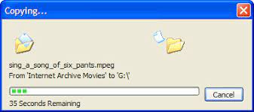
⎕NCOPY / ⎕NMOVE Callbacks
Production Systems
A 'ProgressCallback' variant allows you give the user a progress update
dest (⎕NCOPY ⍠ 'ProgressCallback' ('callbackfn' [larg])) src
callbackfn will be called with a right argument of (Function Event Info)
Function is '⎕NCOPY' or '⎕NMOVE'.
Event is one of Start | Scan | Progress | Done
Info is a namespace, containing
  Progress: A number between 0 and Limit
  Limit: The maximum value of Progress (nb could change)
  Last: A vector of file names processed since the last call.
  Options: See next Page

Slide 19
⎕NCOPY / ⎕NMOVE Callbacks
Production Systems
The callback function can set the following Options:
ScanFirst (default: 1): Should code do a "scan pass" before moving/copying any files (gives "correct" Limit value).
Delay (default: 0): ms to wait before the callback will be called again.
Skip (default: 0): Specifies a number of files to process before the next call.
LastFileCount (default: 1): How many of the latest filenames will be stored in the Last field.
The result of callbackfn should be 1 if processing should
continue, else 0 (signals 1003 interrupt).

Slide 20
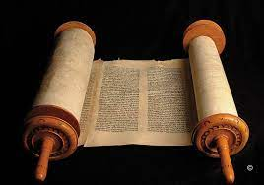
  Source "as typed" by default
Productivity
& IDE
"as typed": Preserve white space, numerical constants (well, everything) exactly as typed by the user.
For several releases, Dyalog APL has preserved source "as typed" if a function or operator was created using ⎕FIX
  Typically by Link, with source kept in a file outside the workspace
  2 ⎕FIX 'file://myapp/foo.aplf'
From version 19.0, the default is to preserve source "as typed" within the workspace for all fns and ops

Slide 21
  Source "as typed" by default
Productivity
& IDE
From version 19.0, the default is to preserve source "as typed" within the workspace for all fns and ops
Also applies to fns/ops with source in an external file
  Allows recovery of source from saved wss with active Links
AutoFormat is ignored in this mode
Configurable: can be turned off if workspace is precious and you have a LOT of code
An I-Beam will discard all source held in the workspace, for example when distributing workspaces

Slide 22

Source "as typed"
Productivity
& IDE
⎕ATX provides access to both canonical and verbatim sources:
2 ⎕FIX'R←DUP X' 'R← X X'
↑60 ⎕ATX 'DUP'
R←DUP X
R← X X
⎕CR 'DUP' ⍝ "Canonical Representation"
R←DUP X
R←X X
(↑61 ⎕ATX 'DUP')≡⎕CR 'DUP'
1

Slide 23
  Multi-line input on by Default
Productivity
& IDE
Multi-line input, which has been an experimental feature for a couple of releases, will be enabled by default
Allows entering multi-line dfns and control structures directly in the session
]demo c:\demos\2023\multiline

Slide 24

  HTMLRenderer updates
Productivity
& IDE
Most important: Find a way to easily upgrade the Chromium Embedded Framework
  In the medium term, turn the HTMLRenderer into an Open Source project to allow community participation
Enhancements in v19.0
  Support Multiple windows that take turns being modal
  Hide title bar, add Handle property, a few more fixes …

Slide 25



Source Code Management
Productivity
& IDE
Link 4.0 will be available with v19.0. Highlights include:
A "Crawler" which will regularly compare the workspace and source files and detect differences
  Will detect changes made using )COPY, assignment, ⎕FX, etc
  Alternative to the DotNet based "File System Watcher"
Support for simple text vectors, vectors of text vectors, and character matrices in simple text files (not ".apla")
The Cider project manager and the Tatin package manager will be bundled with v19.0
More Dyalog-produced packages *will* appear
Link
(source)
Cider
(projects)
Tatin
(packages)

Slide 26

(… many more of Kai's packages skipped …)

Slide 27
Namespace Improvements
Productivity
& IDE
Be more tolerant of errors when fixing namespace scripts
Do not inject references to all sibling namespaces in a nested namespace script
  (continue to do this for classes)
When JSON creates namespaces, provide an option to not create a namespace hierarchy:
data←(¯1 ⎕JSON ⊃⎕NGET 'somefile.json').Data.Records
Drawback: ## does not work within a namespace structure w/no hierarchy

Slide 28
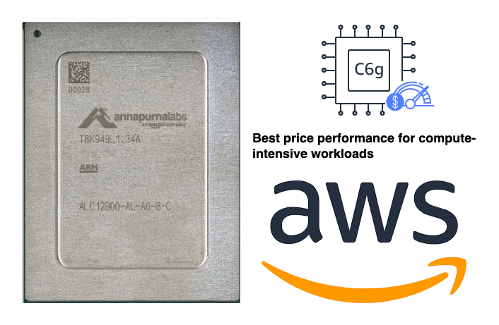
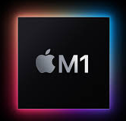

Arm64
Platforms & Distribution
64-bit ARM chips are appearing in
places that Dyalog should support:
M1 & M2 Macs
Raspberry Pi – 64 Bit
Amazon Web Services "Graviton"
ARM64

Slide 29
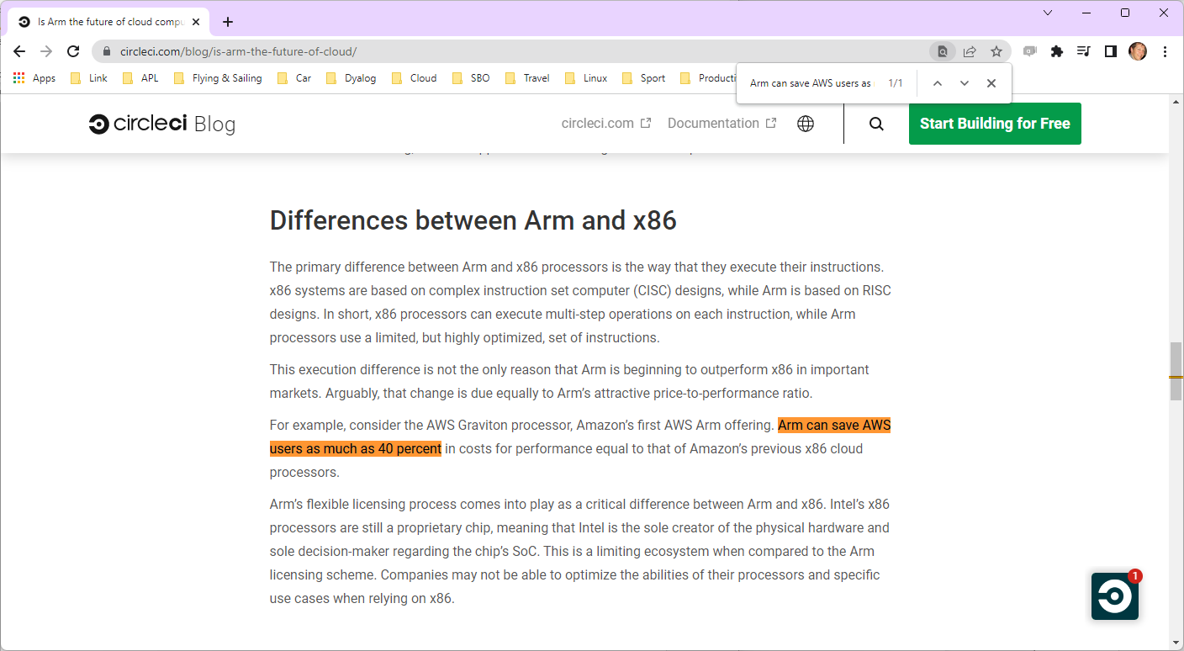

Slide 30
[Microsoft].NET
As .NET celebrates 20 years of existence, Microsoft is pushing everyone to move from proprietary Microsoft.Net Framework to the new open source, cross-platform .NET.
Dyalog v18.0 added a bridge to .NET 3, to complement the 20 year old bridge to the .NET framework.
Name | Platforms | Version Numbers
Microsoft.NET Framework | Windows | 1 2 4
.NET (previously ".NET Core") | Windows Linux macOS | 3 5 6 7 8

Slide 31

v19.0 .NET Bridge
Platforms & Distribution
Add support for .NET 6, 7, 8 …
  Tested with 6 (and 4 – aka ".NET Framework")
  We will test with and support 8 when it is officially released late 2023
Export APL code as .NET assemblies
  (v18 .NET bridge can only *USE* .NET classes)
  Will allow embedding APL code in .NET frameworks like ASP.NET Core, etc
Support for named arguments to .NET methods
Various other tweaks not yet finalised
.NET 6 is the current
Long Term Support
version of .NET

Slide 32
Bound Executables
Platforms & Distribution
A bound executable is a file which combines an interpreter and a workspace into a single .exe file
"Always" been available under Windows
In v19.0, definitely also available for Linux
  Maybe also MacOS (we just hired a Mac expert)
In the longer term, we will look at encrypting and signing application code

Slide 33
Highlights of Version 19.0
Installing & Managing Your System
  Keyboarding
  Multiple session files
  Health Monitor [demo]
Building Production Systems
  Timeouts
  Token range reservation [demo]
  WS FULL handling [demo]
  NCOPY/NMOVE callbacks
Developer Productivity / IDE
  Source "as typed" by default [demo]
  Multi-line input on by default [demo]
  HTMLRenderer updates
  Link 4.0: Crawler, Support for text data
  Namespace Improvements
Platform Support / Distribution
  64-bit ARM support
  .NET 6/7/8 (6 by default)
  Bound executables on all platforms

Slide 34
Demos
WS FULL handling
Token Allocation
Health Monitor
Multiline Input & JSON Log Files
Source as Typed by Default

Slide 35
Highlights of v19.0
Morten Kromberg

