Slide 1
Enhancements in Dyalog v20.0
Asher Harvey-Smith

Slide 2




Enhancements in Dyalog v20.0
Asher Harvey-Smith

Slide 3
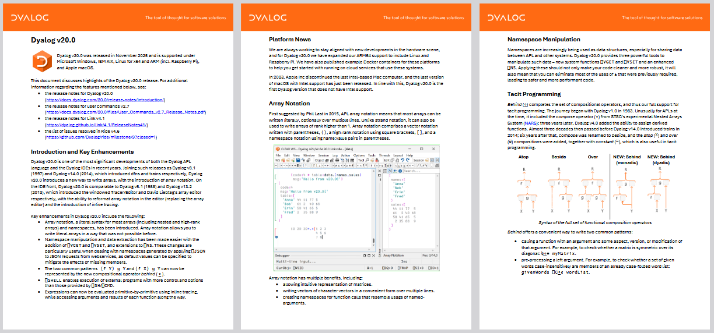
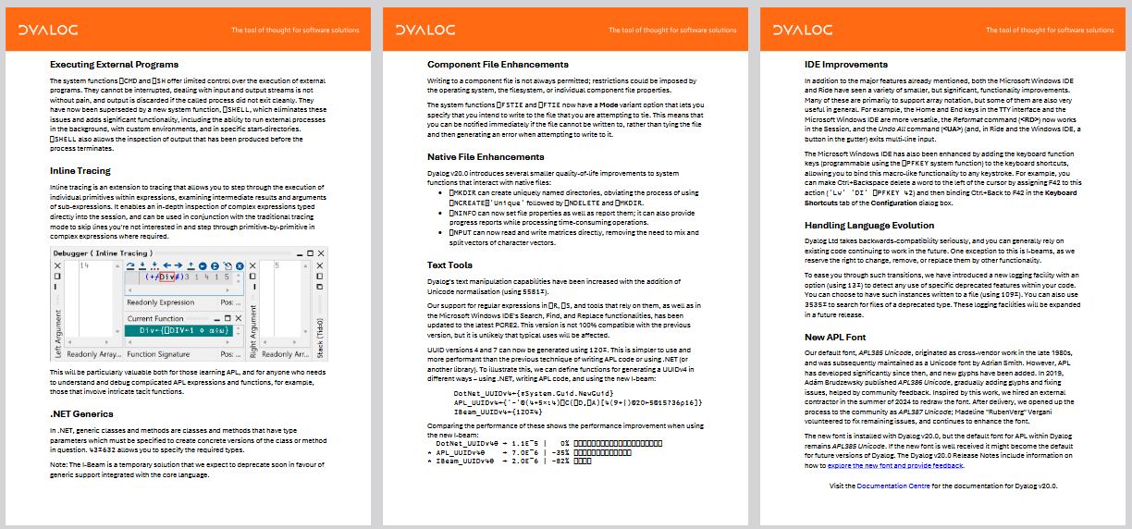
v20.0 has lots of stuff

Slide 4
v20.0 has lots of stuff
Array notation
Inline tracing
Behind (⍛)
⎕VSET and ⎕VGET
⎕SHELL

Slide 5
Writing Big Arrays
v←⍬
v,←⊂'Alice' 12
v,←⊂'Bob' 34
v,←⊂'Claus' 56
m←⍉⍪'Name Age'
m⍪← 'Alice 12 '
m⍪← 'Bob 34 '
m⍪← 'Claus 56 '

Slide 6
Vector Notation
('APL' 'Germany' ⋄ 2025+1)
┌─────────────┬────┐
│┌───┬───────┐│2026│
││APL│Germany││ │
│└───┴───────┘│ │
└─────────────┴────┘

Slide 7
Matrix Notation
[⍳3 ⋄ 4 5 6 ⋄ 7 8 9]
1 2 3
4 5 6
7 8 9

Slide 8
Writing Big Arrays
v←⍬
v,←⊂'Alice' 12
v,←⊂'Bob' 34
v,←⊂'Claus' 56
m←⍉⍪'Name Age'
m⍪← 'Alice 12 '
m⍪← 'Bob 34 '
m⍪← 'Claus 56 '

Slide 9
Writing Big Arrays
v←(
'Alice' 12
'Bob' 34
'Claus' 56
)
v
┌──────────┬────────┬──────────┐
│┌─────┬──┐│┌───┬──┐│┌─────┬──┐│
││Alice│12│││Bob│34│││Claus│56││
│└─────┴──┘│└───┴──┘│└─────┴──┘│
└──────────┴────────┴──────────┘

Slide 10
Writing Big Arrays
m←[
'Name Age'
'Alice 12'
'Bob 34'
'Claus 56'
]
m
Name Age
Alice 12
Bob 34
Claus 56

Slide 11
In the IDE
Notes:
Write some APLAN
Turn on APLAN output
Edit APLAN
Later: () is an empty _namespace_

Slide 12
Writing Namespaces
'ns'⎕NS''
ns.foo←1 2 3
ns.bar←4 5 6
(foo: 1 2 3 ⋄ bar: 4 5 6)
(
foo: 1 2 3
bar: 4 5 6
)
Notes:
Nesting
Text files

Slide 13
v20.0 has lots of stuff
Array notation
Inline tracing
Behind (⍛)
⎕VSET and ⎕VGET
⎕SHELL

Slide 14
Explain this expression
{↑'⎕'/⍨¨⌊0.5+⍵÷(⌈/⍵)÷⍺}
Notes:
Show inline tracing of this expression

Slide 15
v20.0 has lots of stuff
Array notation
Inline tracing
Behind (⍛)
⎕VSET and ⎕VGET
⎕SHELL

Slide 16
Compose (∘)

Slide 17
Compose (∘)
NegRecip ← -∘÷

Slide 18
Compose (∘)
NegRecip ← -∘÷
NegRecip 1 2 3
¯1 ¯0.5 ¯0.3333333333

Slide 19
Compose (∘)
NegRecip ← -∘÷
NegRecip 1 2 3
¯1 ¯0.5 ¯0.3333333333
IsReflection ← ≡∘⌽

Slide 20
Compose (∘)
NegRecip ← -∘÷
NegRecip 1 2 3
¯1 ¯0.5 ¯0.3333333333
IsReflection ← ≡∘⌽
'foo' IsReflection 'oof'
1

Slide 21
Compose (∘)
f∘g y ←→ f g y
x f∘g y ←→ x f g y

Slide 22
Behind (⍛)
f∘g y ←→ f g y
x f∘g y ←→ x f g y
f⍛g y ←→ (f y) g y
x f⍛g y ←→ (f x) g y
Notes:
Dyadic:
Word(s)⊆⍛∊words
x⍴⍛⍴0
Monadic:
⌈/⍛=
>∘0⍛/

Slide 23
v20.0 has lots of stuff
Array notation
Inline tracing
Behind (⍛)
⎕VSET and ⎕VGET
⎕SHELL

Slide 24
⎕VSET and ⎕VGET
To the session!
Notes:
Foobar(!baz) example
Need execute to get name (dangerous!)
Need trap to handle name not existing (ew!)
Name value pairs, and matrix default pair

Slide 25
v20.0 has lots of stuff
Array notation
Inline tracing
Behind (⍛)
⎕VSET and ⎕VGET
⎕SHELL

Slide 26
⎕SH and ⎕CMD
Give a string to the OS
Wait

Slide 27
⎕SHELL
⎕SHELL can…
  use a specified shell (eg cmd vs powershell)
  bypass the shell,
  specify environment variables,
  set a timeout,
  and more!
Notes:
⎕SHELL⍠('Shell' ⋄ 'cmd.exe’ ‘/C')⊢'dir’
F←{⎕SHELL 'tree /F'}
G←{⎕SHELL 'tree.com' '/F’}
⎕SHELL⍠'Env' ['FOO' 'asdf' ⋄ 'BAR' 'qwerty']⊢'echo $Env:FOO $Env:BAR’
⎕SHELL⍠'Timeout' 2000⊢'sleep 10'

Slide 28
v20.0 has lots of stuff
Array notation
Inline tracing
Behind (⍛)
⎕VSET and ⎕VGET
⎕SHELL

