Slide 1
Reinvigorating STARMAP

Slide 2
Who am I?
Neil Kirsopp – just another JS hacker
…sometimes likes to write some APL
Notes:
I’m being a bit facetious here… My role is to write Javascript, but I joined Dyalog because of curiosity for APL.

Slide 3
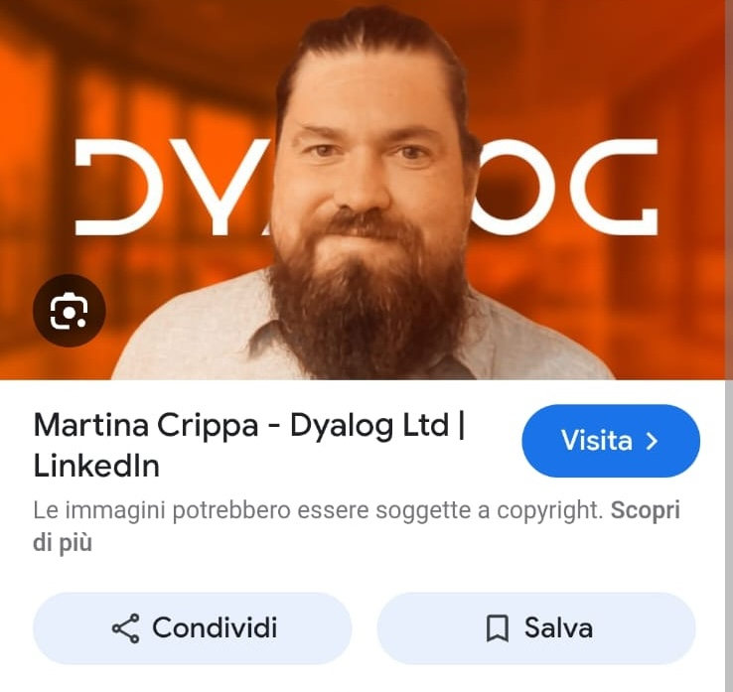
Who am I?
(according to the internet)
Never fully trust the machines
[I am not Martina]
Notes:
I am clearly not my colleague Martina. So when Google can’t even do this simple task correctly…
I’m going to talk about an LLM success for a hobby project, but what I am not trying to do is sell LLMs.

Slide 4
What is STARMAP?
It’s a wonderful little book
Originally written in 1973
  Collaboration with an astronomer
  IBM technical demo
The text I’ve worked from is from 1978
  Published as a book/pamphlet
It uses a plotter!
  We need a new UI
Notes:
As slide plus I really do recommend reading it. I really do think it’s a wonderful demo.

Slide 5
What is STARMAP, the repository?
Transcribed by Stephen Taylor using his physical copy
  He used Claude
  There may have been some transcription issues
    I used Claude to fix those
Notes:
Stephen Taylor mentioned the book to us, and I was immediately intrigued, so I dug in.

Slide 6
What is STARMAP?
The teaching method is wonderful
  I’d recommend anyone to read it
  It teaches both astronomy and APL
    I think this is a sweet spot for APL
But the source originates from IBM APL
  Work required for adapting to Dyalog APL to get calculations working
    Before creating any visualisation
Notes:
Pedagogy is an interesting topic, and in this book we see teaching APL with a purpose. Not a bland ‘learn APL’ tome even though it’s considered to be an exemplar of ‘exploratory’ programming.
There were some adaptations I had to make, but nothing too bad. I shouldn’t admit to the one terrible mistake where I was only rendering in one quadrant of the sky, for some time. The core code was also sound.

Slide 7
The STARMAP book

Slide 8
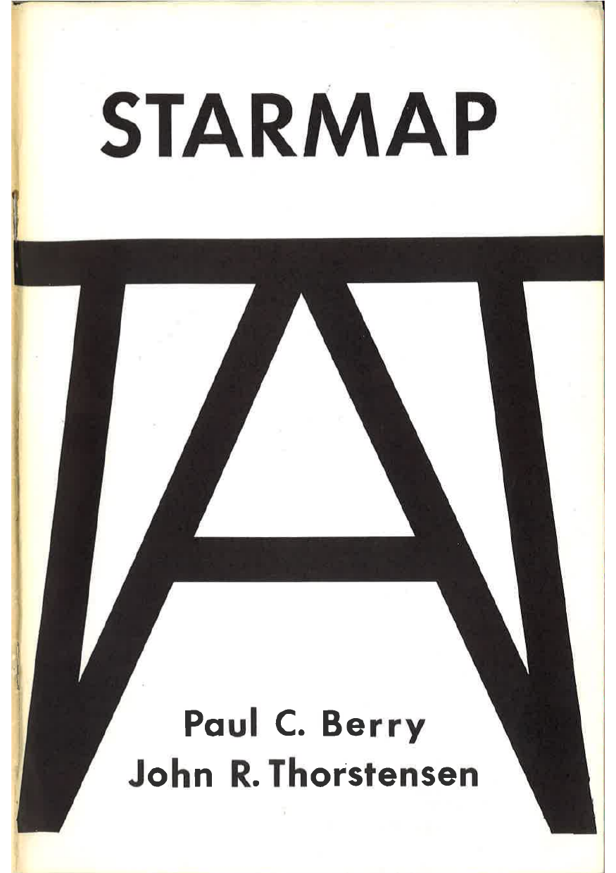
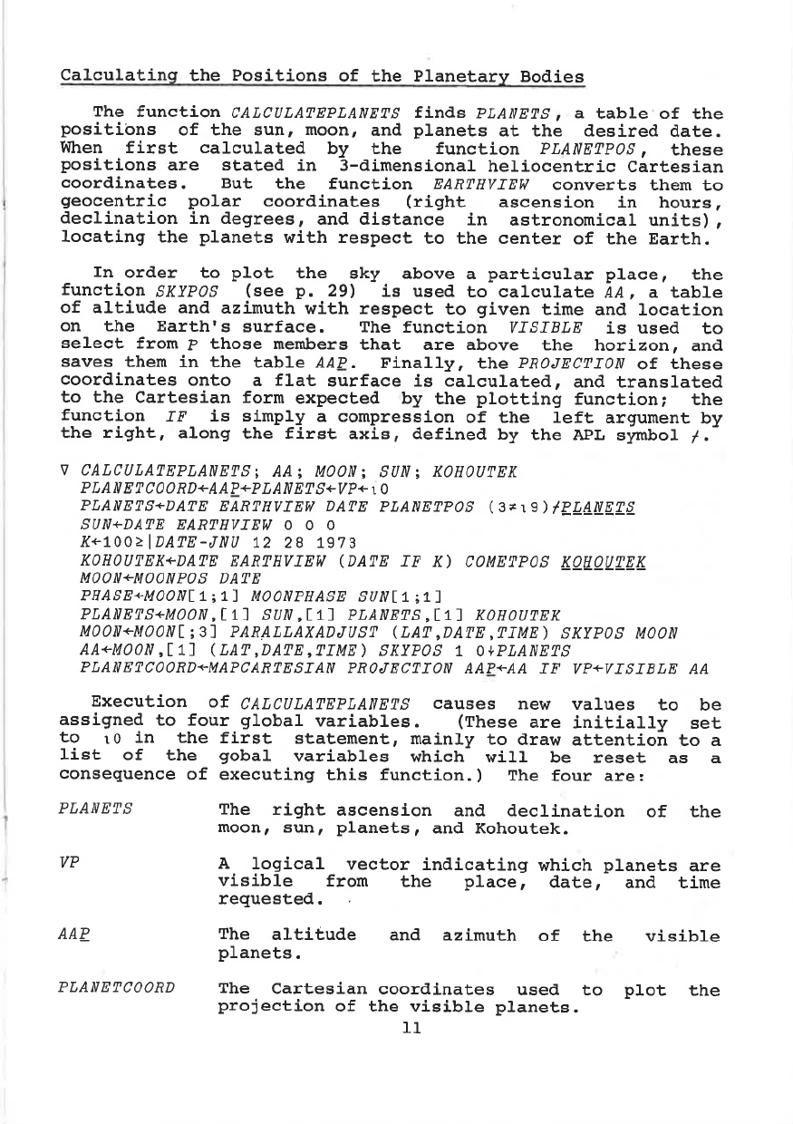
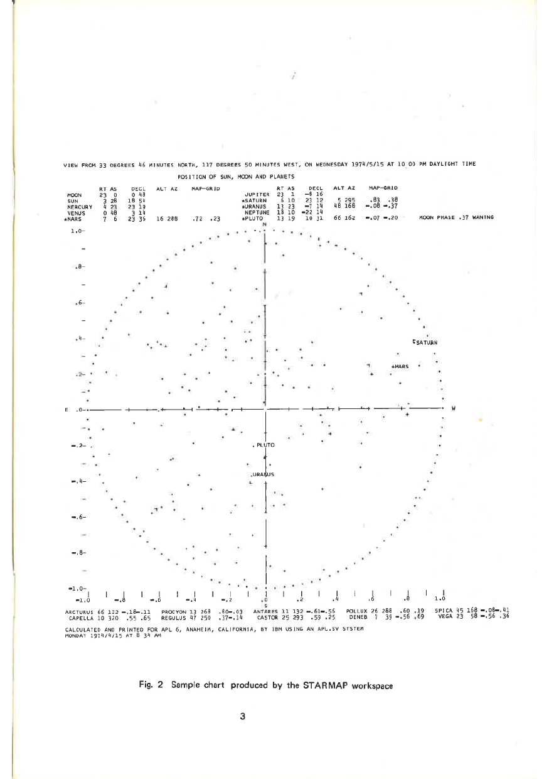
Descriptions of the calculations
The relevant APL
The result of plotting
Notes:
Note: in the actual presentation, I showed all of these full-screen.

Slide 9
What did I do first?
Fixed any errors that seemed to be transcription-based
Notes:
OCR is not perfect: for example, ÷ is easily seen as +. I had to check some sections that didn’t come out perfect. It was almost perfect though.

Slide 10
What did I do first?
Fixed any errors that seemed to be transcription-based
Used Claude to write tests against current star charts
  Seems we were slightly disagreeing with 1973
  Generated tests based on current JPL datasets
    Accepted the JPL data as correct, even when it disagreed with the source
Notes:
Interestingly, I had to change something by 0.<some number of 0s>1 in order to get output that matched the JPL dataset, but I forget what it was.

Slide 11
Working model, so now what?
A pre-recorded demo of a new UI that sits on top of STARMAP follows:
Input via a ‘friendly’ browser form
Now animated over a period of time
Visual confirmation that it seems to work
  Celestial bodies seem to move at likely relative speed – note the moon
Available at https://starmap.kirsopp.me

Slide 12
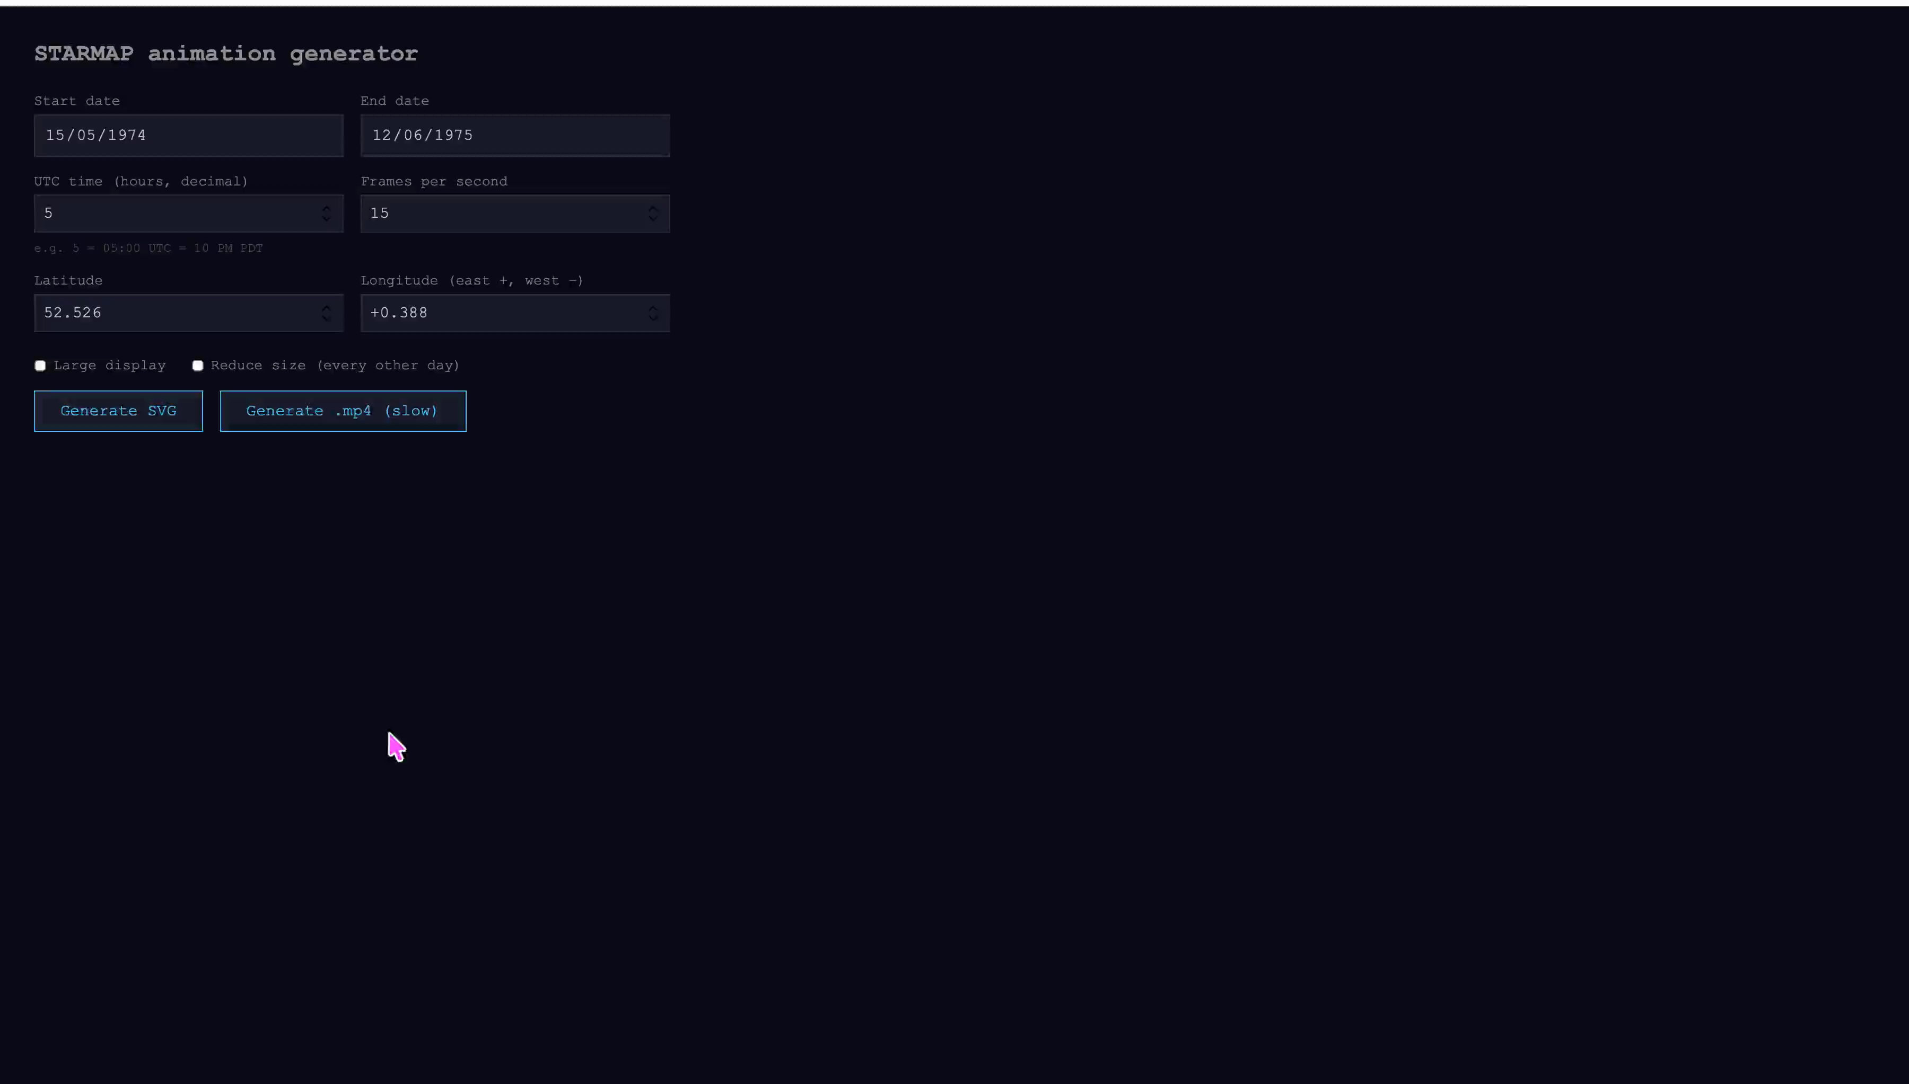

Slide 13
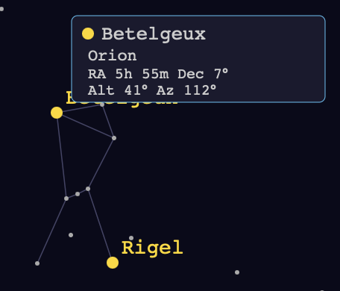
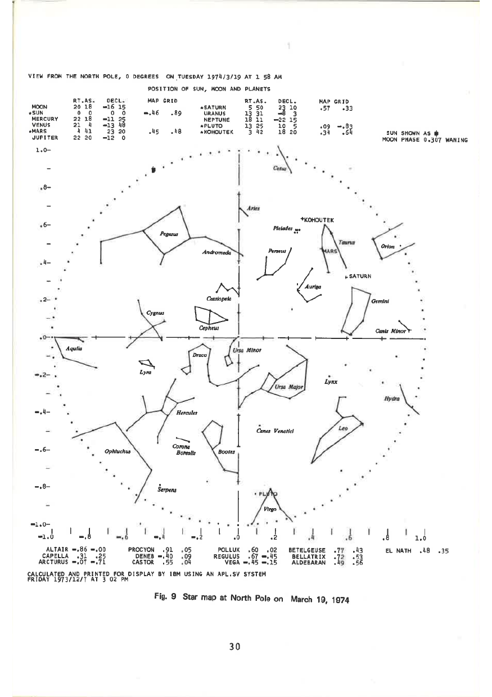
Constellations
”lines linking stars in the same constellation have been drawn in by hand” – STARMAP book
  I used freely available constellation data to automate hovering over a start to show a constellation. I’ve chosen Betelgeux, as I know that is in Orion.

Slide 14
Fin

Slide 15
Fin
Claude is the new ⎕ - Stephen Taylor
Notes:
Not quite the end, but I wanted to note something interesting, and this sentence that was said to me by Stephen Taylor has stuck with me.
The concept is that ⎕ is how you interacted with systems originally. Before ⎕WC etc, that was it. Your interesting code (calculations, business logic…) wasn’t using ⎕. When ⎕WC came along, your interesting code was being enclosed by a ⎕WC application. We, as humans, mostly want to work on the interesting stuff.
Using Claude to do most of the UI work can be powerful; one ends up able to focus on the things you care about/are most important to the project at hand.

Slide 16
More LLM stuff
These slides are reserved in case I finish early…
They are a few examples of other LLM projects I got involved in outside of work

Slide 17
vscode-apl
Based on work by Gilgamesh Athoraya, developed further using LLMs by Martina Crippa
APL debugging from within VS Code
We are seeing more people using VS Code for their APL work
  It is becoming standard tooling for many developers
Short demo…

Slide 18
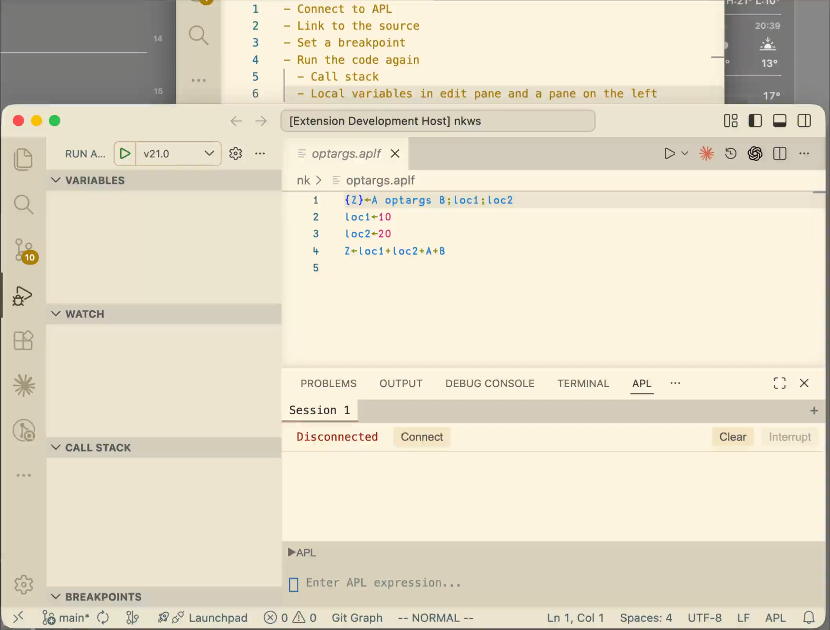

Slide 19
gritt
An implementation of the RIDE protocol, written in Go
An off-shoot of a project for scripting APL
  …but it also grew to be a terminal UI
For LLMs, it is an easily available tool to execute APL code:
A colleague gave me a single line of APL that confused Claude
80+ mins to give me a full explanation through inspection
5 mins to give me a full explanation when enabled to execute expressions

Slide 20
gritt
gritt -l -e EXPRESSION
  Launches Dyalog, runs the expression and closes Dyalog
gritt –addr HOST:PORT -e EXPRESSION
  Connects to a Dyalog process and runs the expression
Easily connecting to a persistent Dyalog instance is where the advantage lies
  LLMs can use this to try experiments and iterate without running full programs
Notes:
I can start a new LLM project and teach it these within a minute – it’s been convenient

