Slide 1
Mortens Favourite
Version 19.0 Features
Morten Kromberg, CTO

Slide 2
Mortens Favourite v19.0 Features
Things that Morten has actually used since release …

Slide 3



Source Code Management
Productivity
& IDE
Link 4.0 was included with v19.0. Highlights include:
  Link a single namespace or class file
  Default to current namespace if no namespace specified
  Configuration files
  Support for simple text vectors, vectors of text vectors, and character matrices in simple text files (rather than using array notation)
The Cider project manager and the Tatin package manager are bundled with v19.0
Dyalog is starting to distribute tools as Tatin packages
Link
(source)
Cider
(projects)
Tatin
(packages)

Slide 4
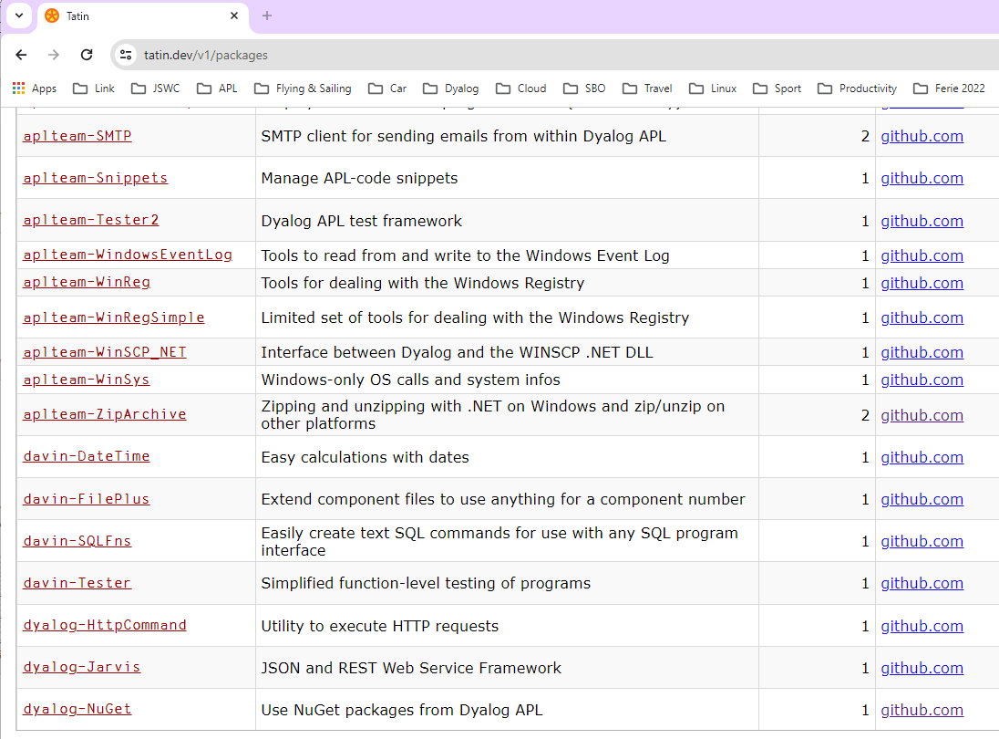


Slide 5
dyalog-APLProcess
Launch and manage processes on all platforms
Coming Soon!

Slide 6
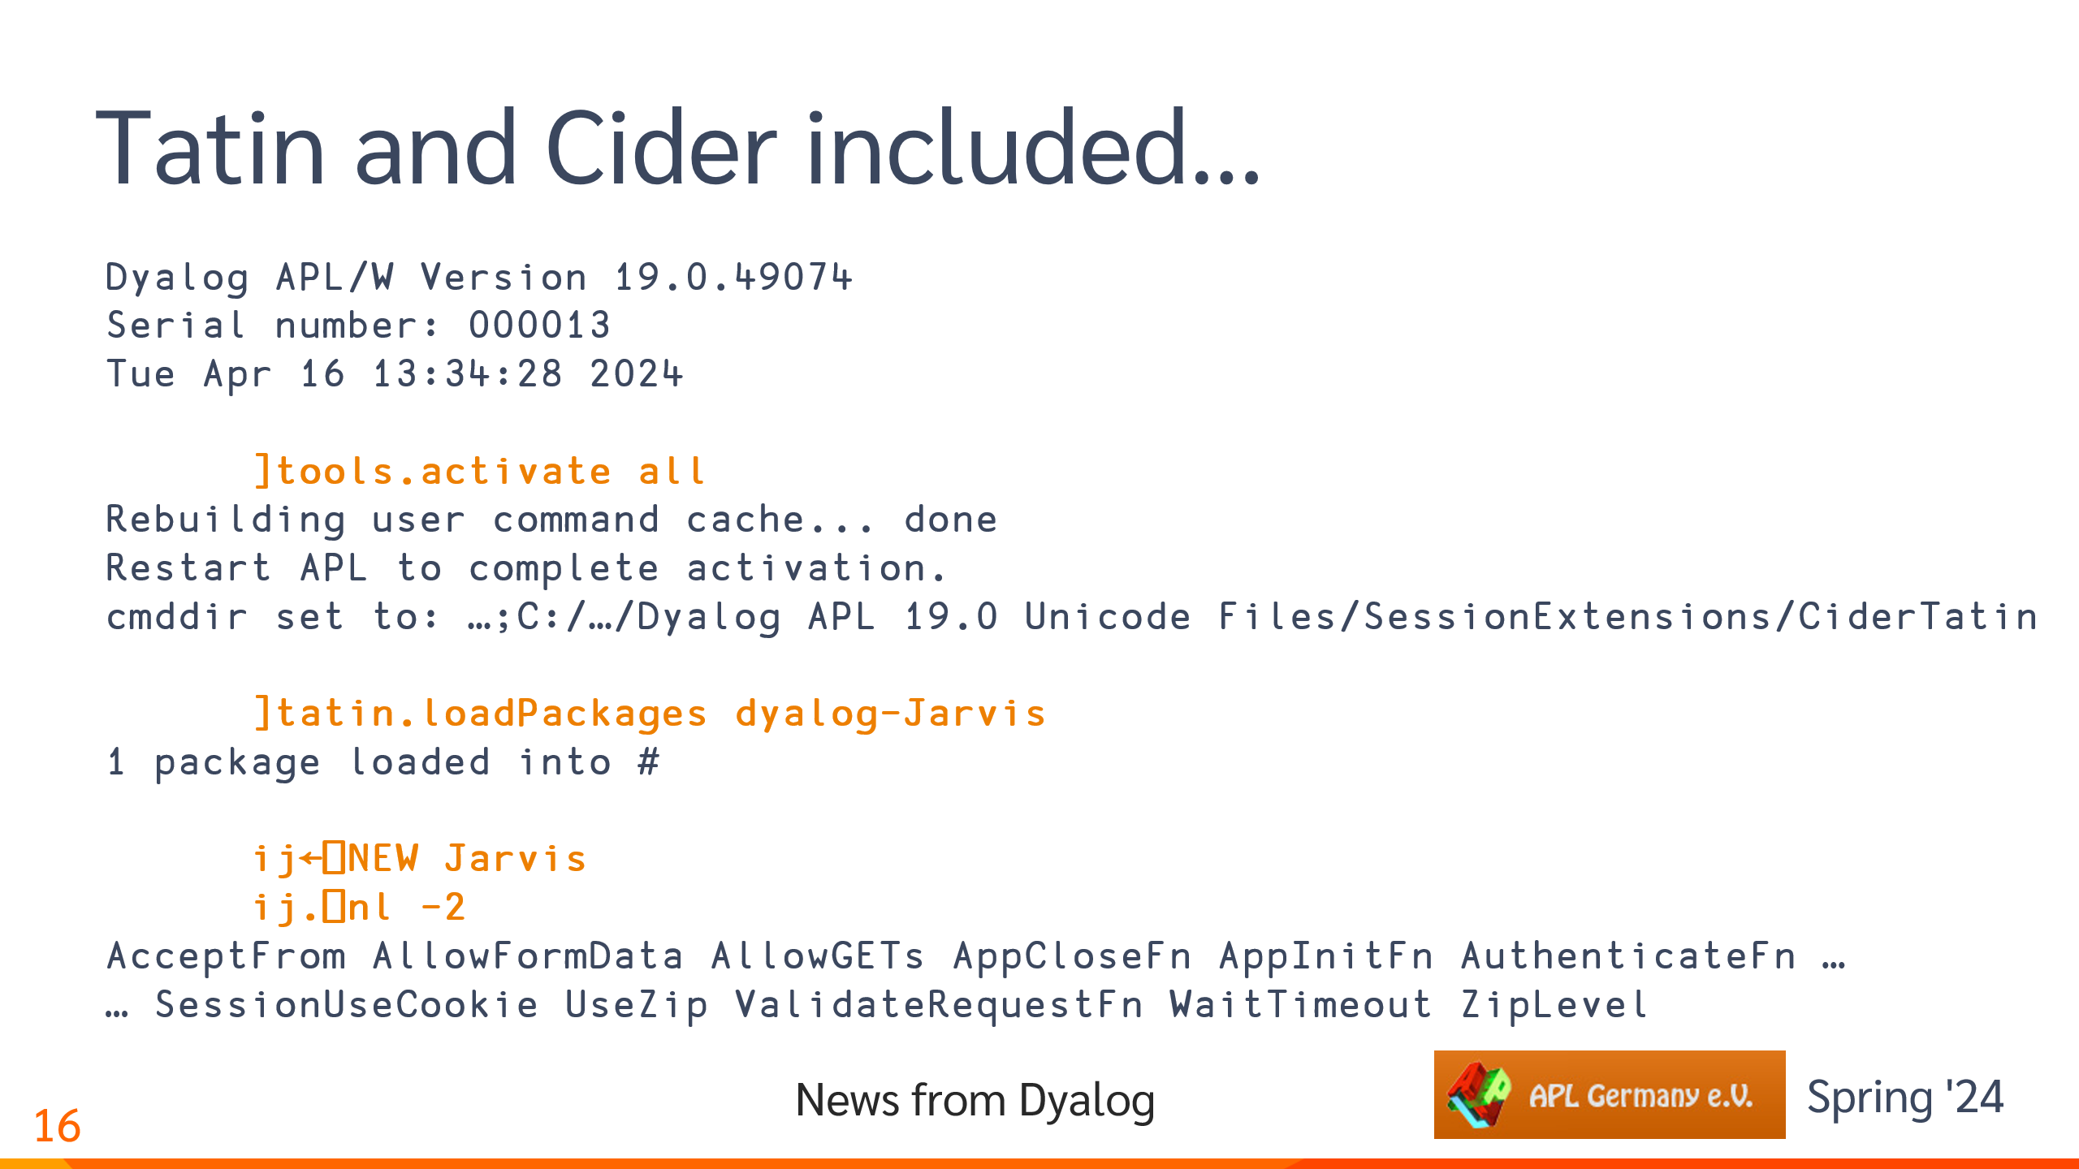

Slide 9
Tatin and Cider included…
Dyalog APL/W Version 19.0.49074
Serial number: 000013
Tue Apr 16 13:34:28 2024
]tools.activate all
Rebuilding user command cache... done
Restart APL to complete activation.
cmddir set to: …;C:/…/Dyalog APL 19.0 Unicode Files/SessionExtensions/CiderTatin
]tatin.loadPackages dyalog-Jarvis
1 package loaded into #
ij←⎕NEW Jarvis
ij.⎕nl -2
AcceptFrom AllowFormData AllowGETs AppCloseFn AppInitFn AuthenticateFn …
… SessionUseCookie UseZip ValidateRequestFn WaitTimeout ZipLevel

Slide 10
The NuGet Tool…
NuGet is the .NET Package Manager.

Slide 11
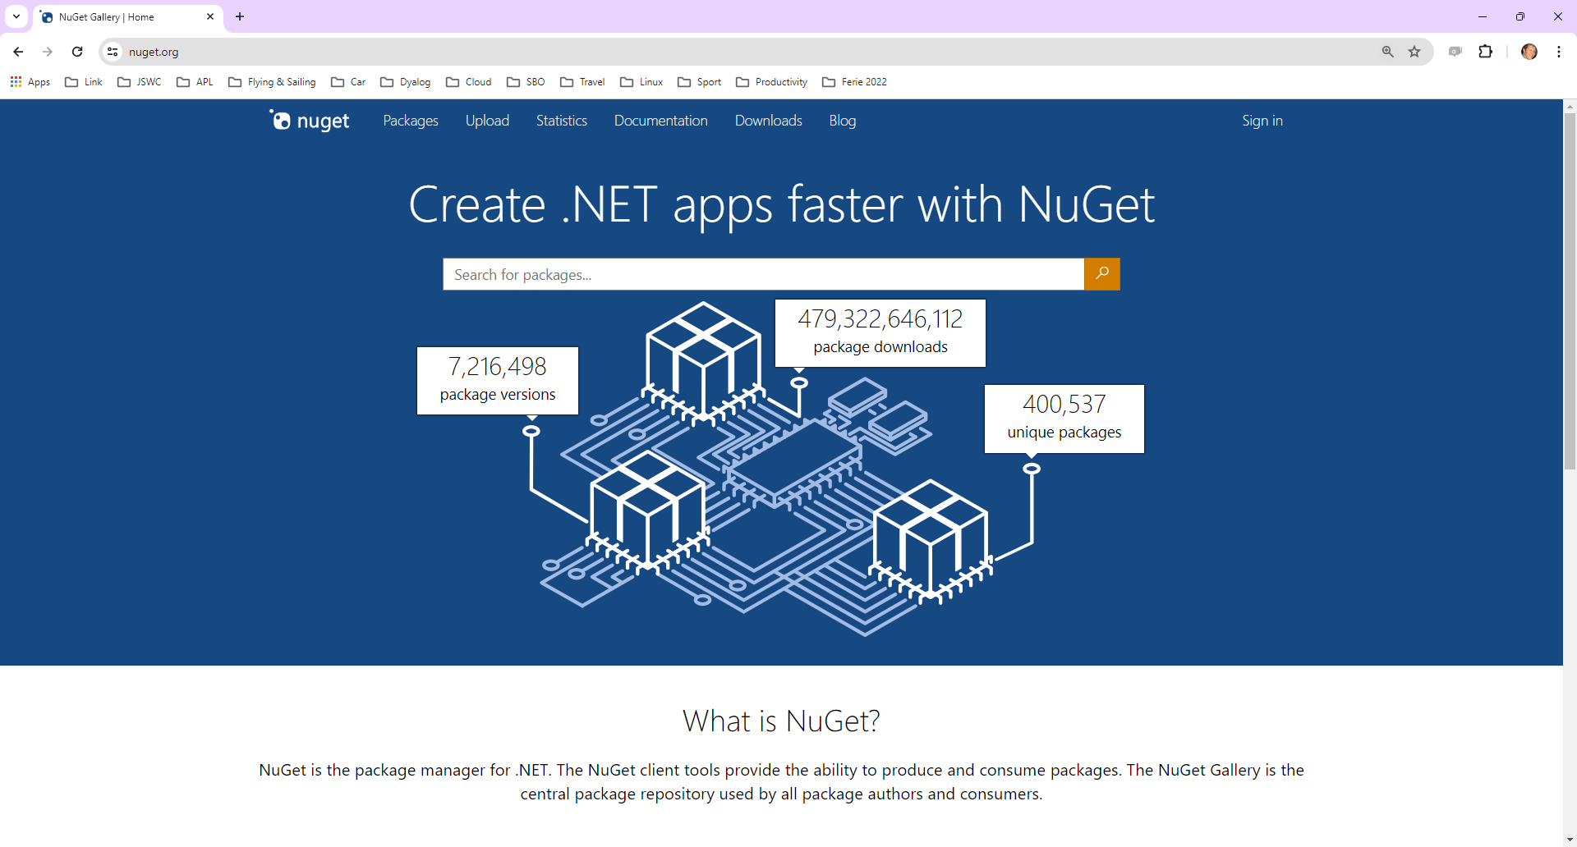

Slide 12
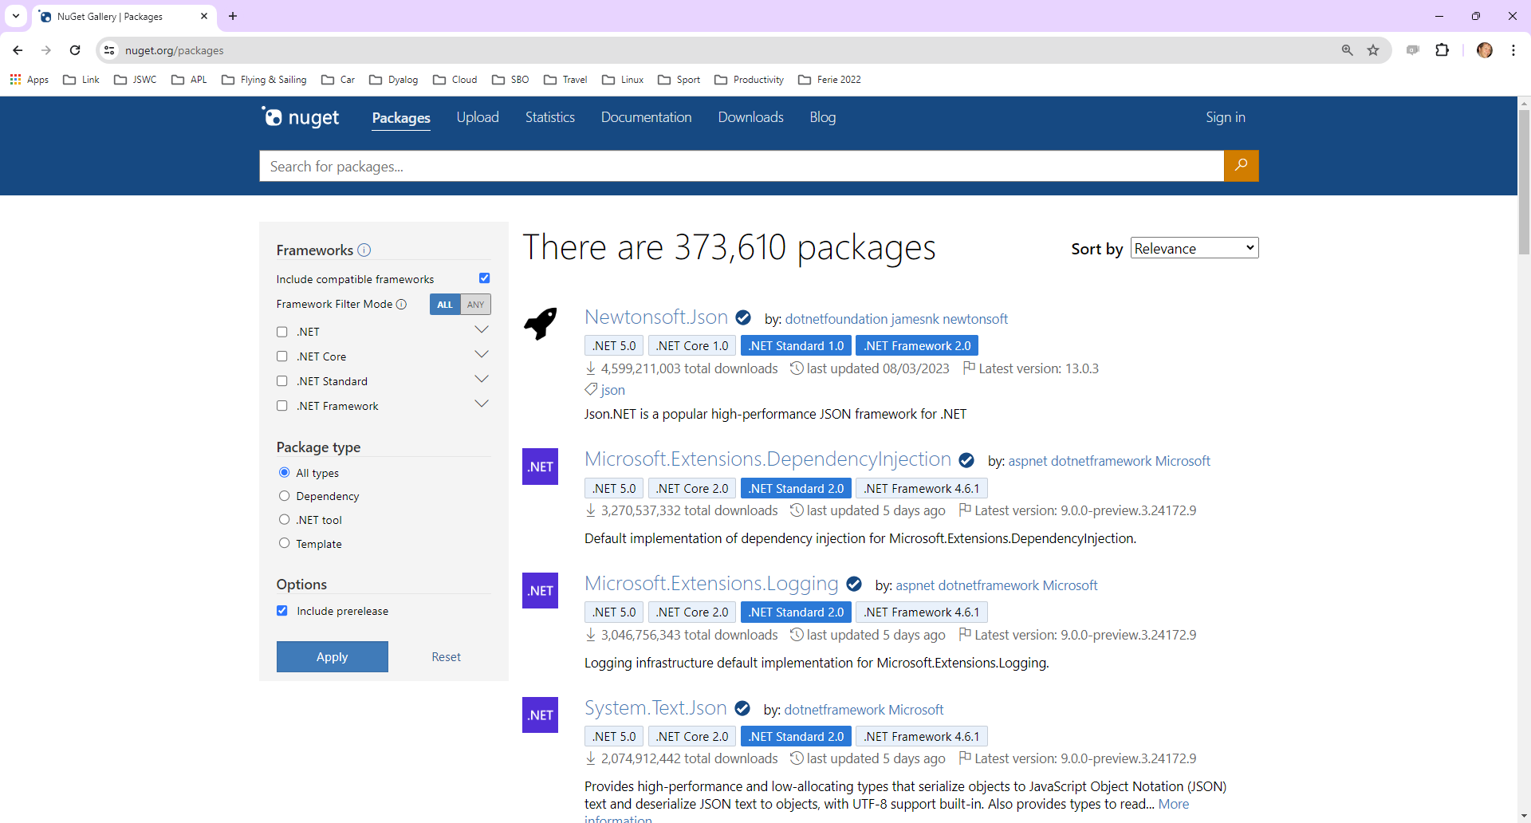

Slide 13
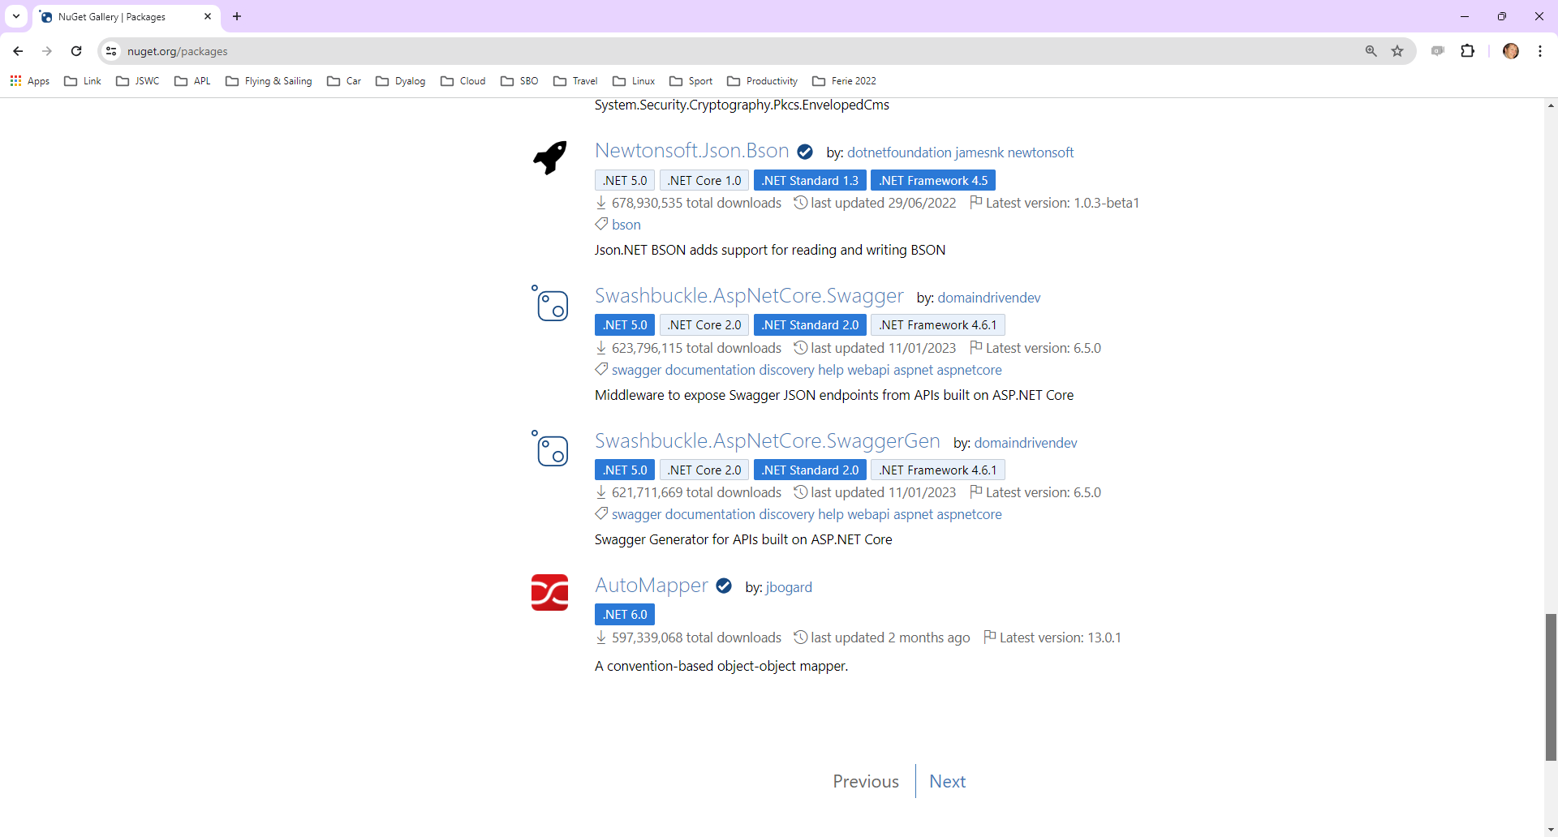

Slide 14
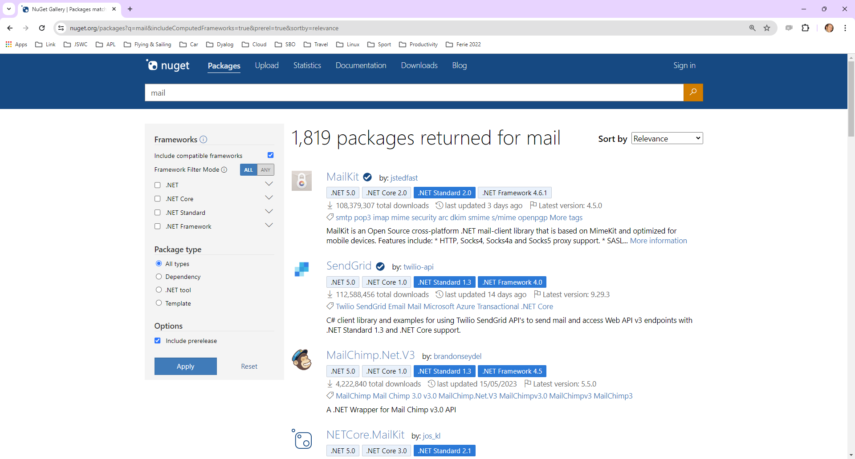

Slide 15
The NuGet Tool…
Let's try MailKit….
]tatin.loadpackages dyalog-nuget
1 package loaded into #
]link.import c:\devt\nuget\APLSource\Tests
Imported: #.Tests ← c:\devt\nuget\APLSource\Tests
Tests.test 'mailkit' ⍝ Trace me

Slide 16
Cider Project Manager
A "project" is effectively
  A folder containing source code, plus
  A list of Tatin or NuGet dependencies
When you open a project…
  Cider uses Link to load the source
  And Tatin or NuGet clients to load the dependencies

Slide 17
Token Allocation
I needed a token for each thread dequeueing messages:
allocateTokens;z;t;i
t←'JSWC Synchronisation'
:Trap 2 ⍝ ⎕TALLOC will SYNTAX ERROR in v18.2
z←↑⎕TALLOC 0 ⍝ List all allocated ranges
:If (≢z)≥i←z[;2]⍳⊂t ⍝ Do we already have a range?
TOKENRANGE←z[i;1] ⍝ Yes: use it
:Else
TOKENRANGE←⎕TALLOC 1 t ⍝ v19.0: Allocate a free range
:EndIf
TOKENSTEP←10*-⌈10⍟MAXSESSIONS+1 ⍝ e.g. step by 0.001 if MAXSESSIONS is 100
(WG_TOKENBASE DQ_TOKENBASE)←TOKENRANGE+0.1 0.2 ⍝ Start at n.101 and n.2.01
:Else ⍝ Version 18.2 or earlier
TOKENSTEP←1 ⍝ Step by 1, and separate the ranges out
(WG_TOKENBASE DQ_TOKENBASE)←(0 1×1+MAXSESSIONS)+30⊥⎕A⍳'EWC' ⍝ v18.2: Think of a number
:EndTrap

Slide 18
Multiple Session Log Files
Before v19.0, the default would be for all Dyalog processes to use the same log file
This sometimes caused loss of useful log file data
In the worst case, rare crashes when two processes tried to update the file at the same time
  (typically when starting or stoppping many processes at once)
Version 19.0 locks the log file and subsequent processes will open or create a new one

Slide 19
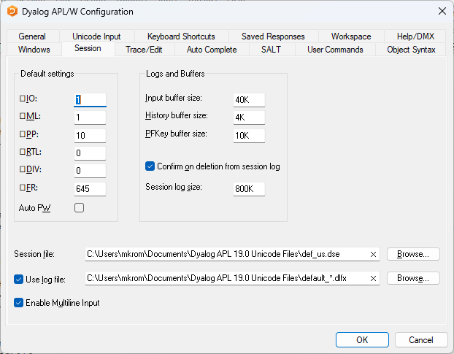
Multiple Session Log Files…

Slide 20
Log Files - Intended Usage Pattern
Users who always start the same set of interpreters at the start of a working session (Markos), for example:
  Development
  Test
  Prod
… will get the same log files each day
Alternatively, create shortcuts without * in the log file name

Slide 21
)ed foo[123]
In v19.0, if you add a line number after the a name, the editor will open on that line

Slide 22
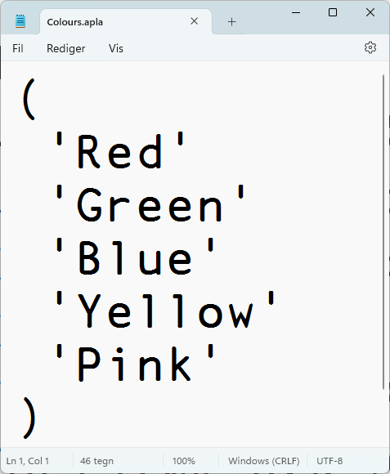
Arrays in "Plain" Text Files
Some character data doesn't map nicely to APL Array Notation:
  Simple character vectors
  Simple character matrices
  Vectors of character vectors
Link v4.0 adds experimental support for storing such arrays in "plain" format

Slide 23
–text=aplan (default)
)ns MyApp
#.MyApp
#.MyApp.Colours←'Red' 'Green' 'Blue' 'Yellow' 'Pink'
]link.create MyApp c:\tmp\myapp -arrays
Linked: #.MyApp ←→ c:\tmp\myapp [directory was created]
]open c:\tmp\myapp\Colours.apla
c:\tmp\myapp\Colours.apla

Slide 24
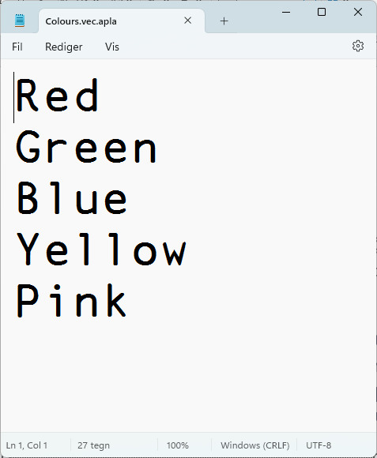
–text=plain
)ns MyApp
#.MyApp
#.MyApp.Colours←'Red' 'Green' 'Blue' 'Yellow' 'Pink'
]link.create MyApp c:\tmp\myapp –arrays –text=plain
Linked: #.MyApp ←→ c:\tmp\myapp [directory was created]
]open c:\tmp\myapp\Colours.apla
c:\tmp\myapp\Colours.apla

Slide 25
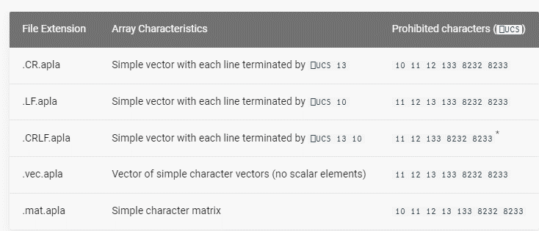
text=plain is experimental
Design may be refined in next release cycle

Slide 26
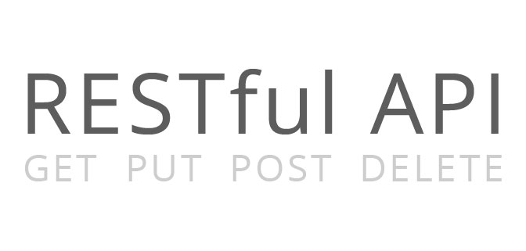

Service Orientation
A rapidly increasing proportion of new APL code is delivered as services
Jarvis wraps APL code as HTTP/JSON or RESTful services on any platform
  https://github.com/dyalog/jarvis
Off-the-shelf docker containers containing Dyalog APL (optionally with Jarvis)
HttpCommand is our HTTP client
HTTP(s) / JSON

