Slide 1
Avoiding Execute
(System functions for getting and setting variable values)
Morten Kromberg, CTO

Slide 2

















Dyalog – The Next Generation
2010-2021
2022
2023
2024
2023 Summer Interns

Slide 3
Dyalog – The Next Generation
2010-2021
2022
2023
2024
2023 Summer Interns

Slide 4

From Adam's Dyalog'23 Slides

Slide 5
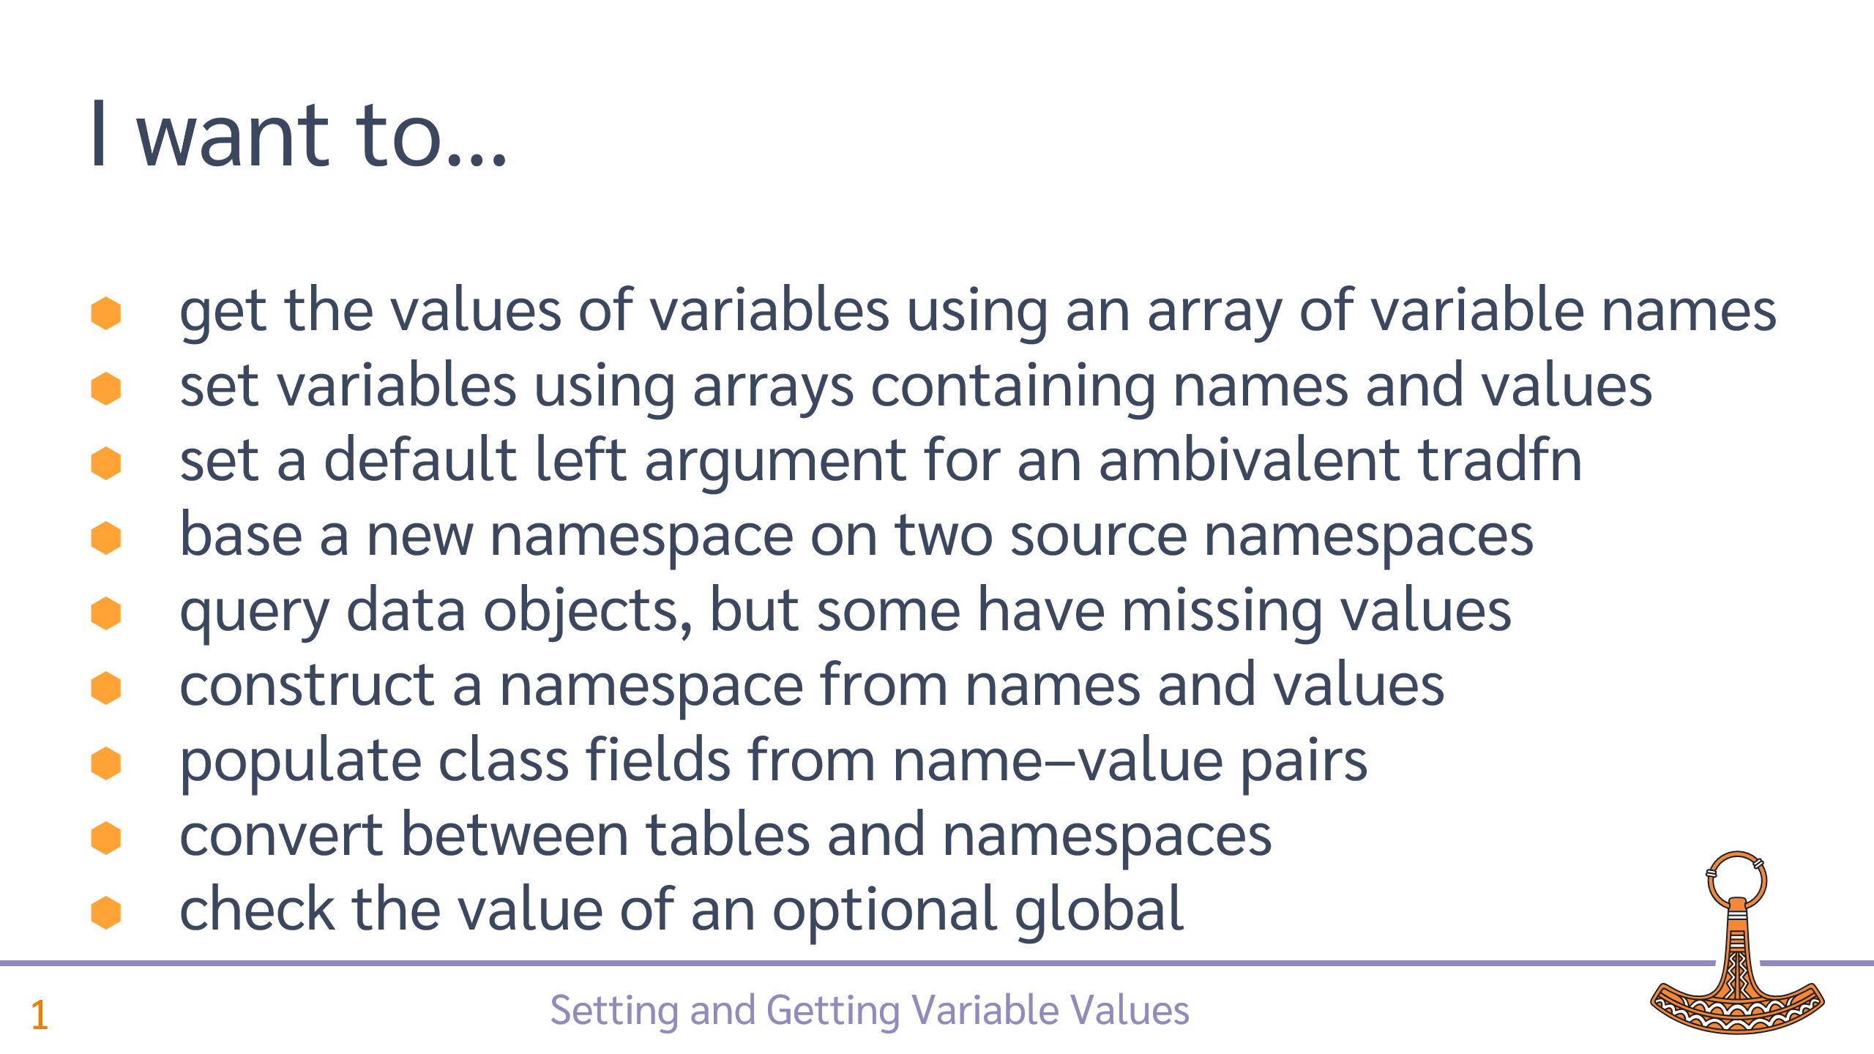

Slide 6
GET values of names w/out ⍎
New function ⎕NG (Name Get) takes a list of names and returns values:
If we have:
(First Last)←'Max' 'Munstermann'
Then:
⍴¨ ⎕NG 'First' 'Last'
3 11
Also allows a single simple name, and a character matrix of names

Slide 7
GET with default values
⎕NG can take name value pairs, the values are returned if the name does not exist:
⎕NG ('First' '')('Last' '')('Height' ¯1)
Max Munstermann ¯1
Not all names need a fallback value:
⎕NG 'First' 'Last' ('Height' ¯1)
Max Munstermann ¯1

Slide 8
GET with an array of namespaces
By default, names are found in the current namespace
The optional left argment of ⎕NG can be one or more namespaces
If records is a vector of spaces representing people:
⊃records ⎕NG 'First' 'Last' ('Height' ¯1)
Max Munstermann 182
Lieschen Müller 167
John Doe ¯1
The ability to provide defaults is particularly useful in this case, for example when processing JSON input with missing values

Slide 9
Default left argument of TRADFN
Finally, a nice(er) way to do this:
∇ r←{left} Foo y
life←⎕NG ⊂'left' 42
…
∇
Nicer than :If 0=⎕NC 'left' …
Not all names need a fallback value:
⎕NG 'First' 'Last' ('Height' ¯1)
Max Munstermann ¯1

Slide 10
Merge Namespaces
Create a merged namespace, where values from input overwrite defaults
merged←input ⎕NG defaults
Merge a hierarchy of value sources (e.g. configuration):
new←⎕NG/namespaces

Slide 11
Get Names AND Values: ⎕NV
Return names and values for given name classes
(names values)←⎕NV 2 ⍝ Positive: Name Matrix
pairs←⎕NV ¯2 ⍝ Negative: Name Value Pairs
pairs←source ⎕NV ¯2

Slide 12
SET names using name/value pairs
The existing function ⎕NS is extended with name/value pairs:
ref←target ⎕NS ('First' 'Max')('Last' 'Munstermann')
⍝ Equivalent to:
target.(First Last)←'Max' 'Munstermann'
NB: if no target is given, a new namespace is created and ref points to it
target can be ⎕THIS or #, of course

Slide 13
SET using vectors of names & values
If you have an array of values, name/value pairs may be inconvenient.
You can use one array of names and one of values:
vars ← 'First' 'Last'
values ← 'Lieschen' 'Müller'
target ⎕NS (↑vars) values
The first element must be a matrix of names to distinguish this from the name/value pair case

Slide 14
Summary Examples
Get:
[source] ⎕NG 'Name' ('Height' ¯1) ⍝ Get values w/defaults
merged←input ⎕NG defaults ⍝ Merge namespaces
List & Get:
(names values)←[source] ⎕NV 2 ⍝ Name Matrix and values
pairs←[source] ⎕NV ¯2 ⍝ (Name Value) Pairs
Set:
ref←[target] ⎕NS ('First' 'Lieschen')('Last' 'Müller')
ref←[target] ⎕NS (2 5⍴'FirstLast ')('Max' 'Munstermann')

Slide 16
Still only a proposal…
As I prepared these slides, it struck me that I would prefer:
⎕VGET for ⎕NG
⎕VSET for ⎕NS
  With no left argument meaning “current space” rather than "create new space"
⎕NLV for ⎕NV (Name List with Values)
… and leave ⎕NS unchanged, for creating NameSpaces and copying names into NameSpaces

Slide 17
We should have done this 20 years ago!

