Slide 1


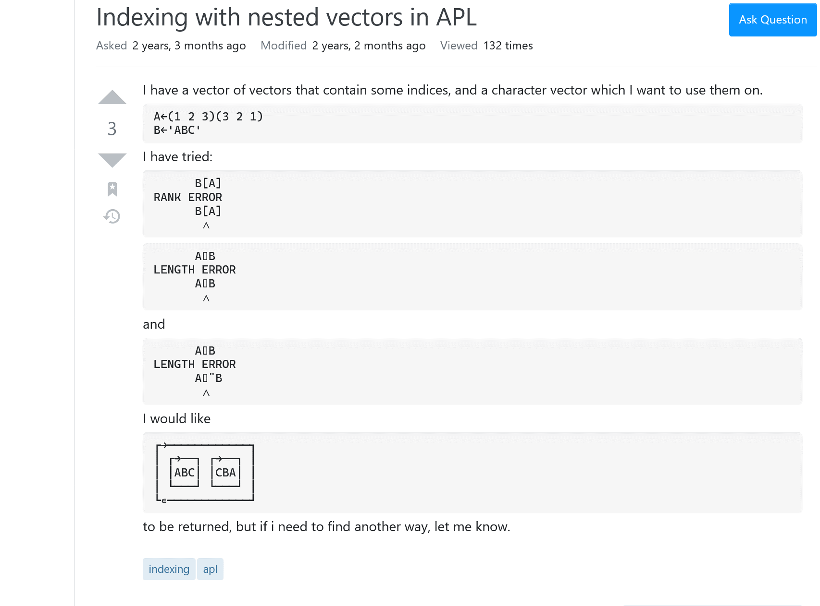
Language Enhancements
Adám Brudzewsky
CC BY-SA: stackoverflow.com/q/62319267

Slide 2
Language Enhancements
Adám Brudzewsky
CC BY-SA: stackoverflow.com/q/62319267

Slide 3
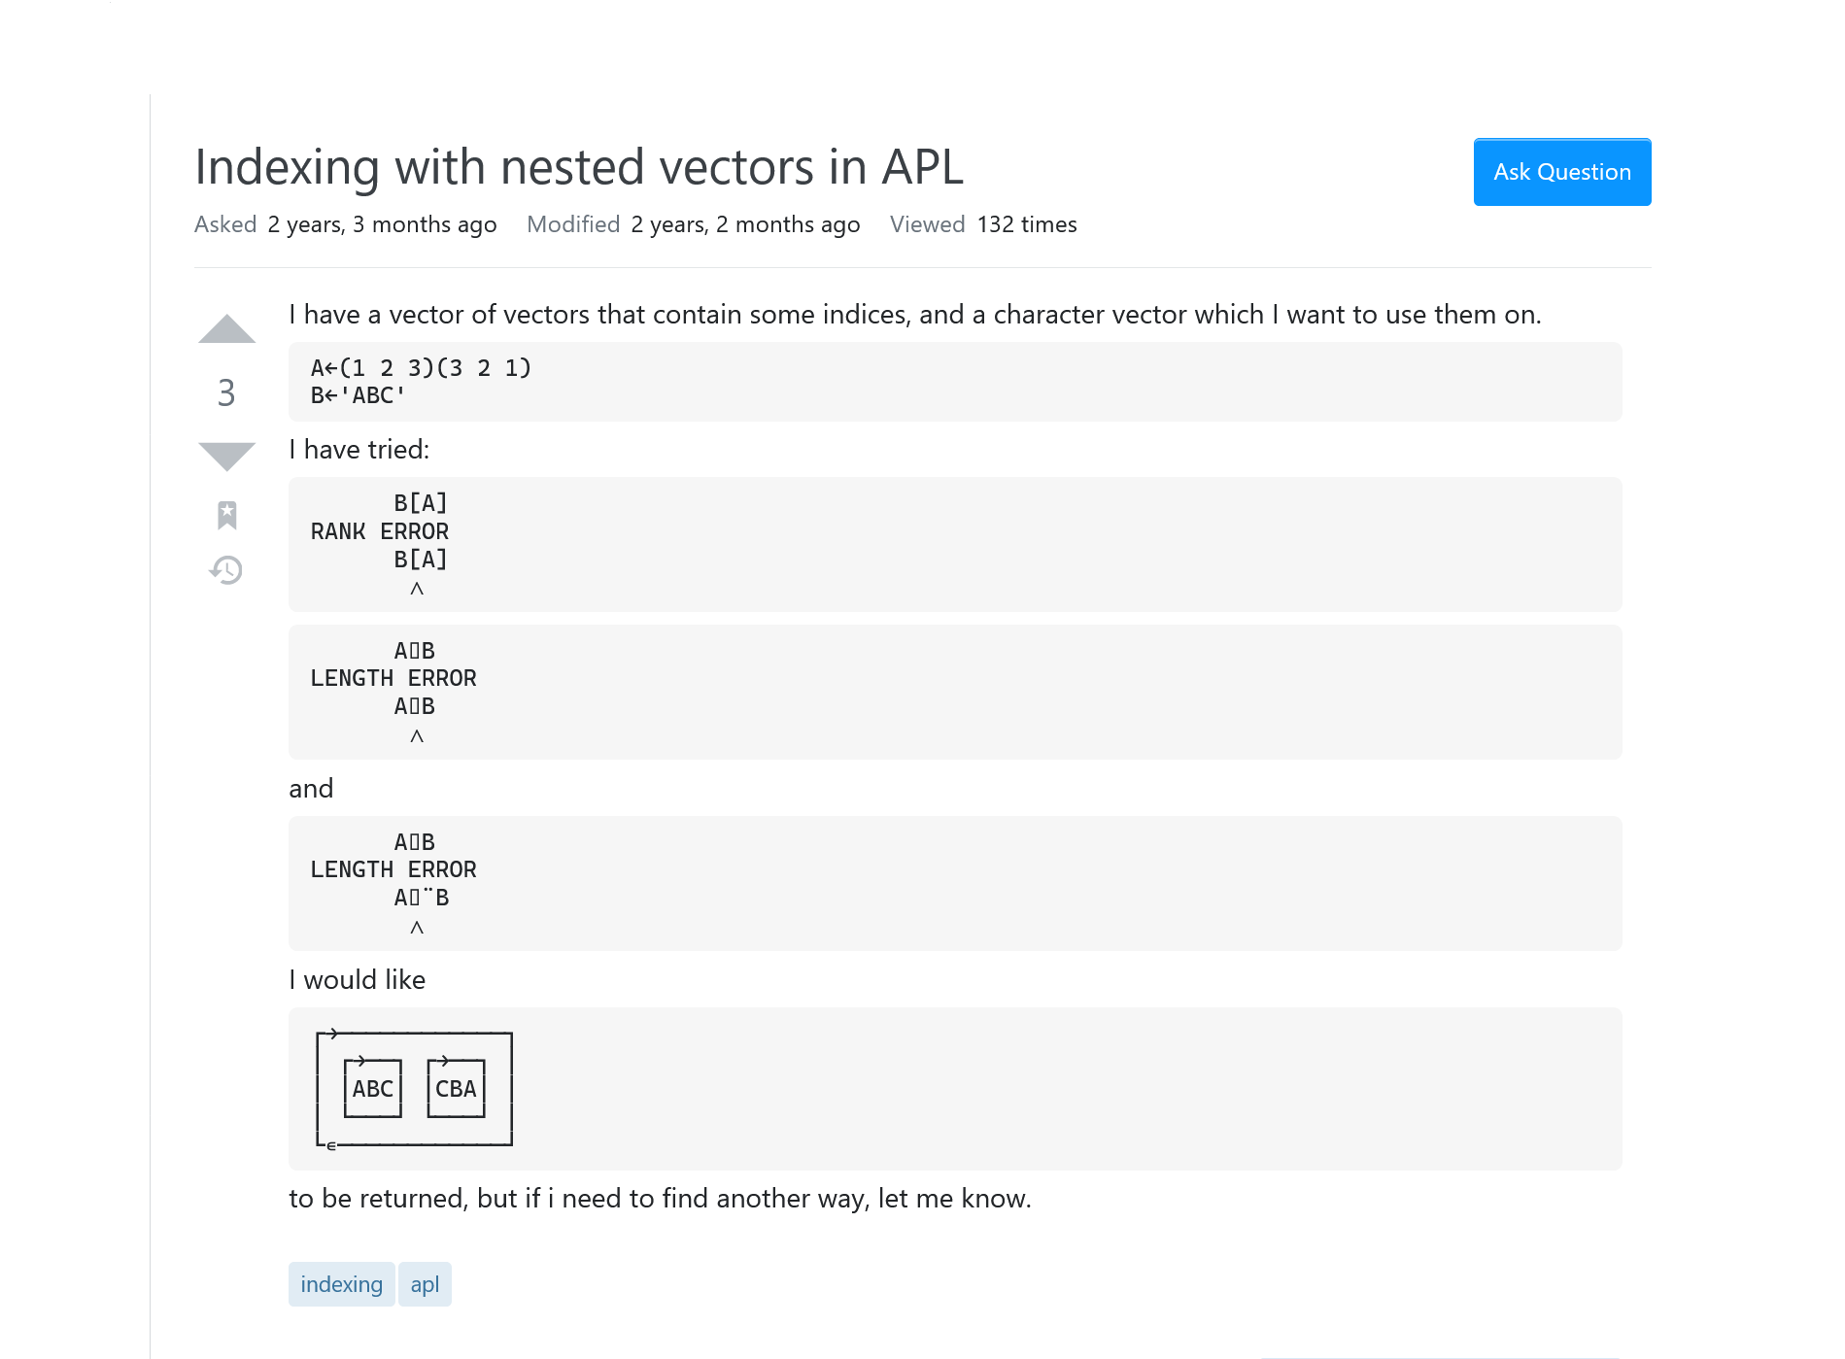
CC BY-SA: stackoverflow.com/q/62319267

Slide 4
CC BY-SA: stackoverflow.com/q/62319267

Slide 5
CC BY-SA: stackoverflow.com/q/62319267

Slide 6
Indexing with Nested Vectors
3 Answers:
(⊂¨A)⌷¨⊂B
{B[⍵]}¨¨A
Don't do that!
Possibilities:
A⌷¨¨⊂⊂B
⌷∘B¨⊂¨A
A⌷⍨∘⊂⍨¨⊂B

Slide 7
Indexing with Nested Vectors
3 Answers:
(⊂¨A)⌷¨⊂B
{B[⍵]}¨¨A
Don't do that!
Possibilities:
A⌷¨¨⊂⊂B
⌷∘B¨⊂¨A
A(⊂⍤⊣⌷⊢)¨⊂B

Slide 8
Language Enhancements

Slide 9
Core Language Enhancements
Data Transformation X×Y ⌽Y X⌷Y
Function Application f⌿ f⍣g f⍤k
Function Composition f⍤g f⍥g f∘g
Axis Manipulation ,Y ⍪Y X⍉Y
⌸ & ⌺

Slide 10
Core Language Enhancements
Data Transformation X×Y ⌽Y X⌷Y
Function Application f⌿ f⍣g f⍤k
Function Composition f⍤g f⍥g f∘g
Axis Manipulation ,Y ⍪Y X⍉Y
⌸ & ⌺

Slide 11
Data Transformation
Simple Indexing
Choose Indexing
Reach Indexing
t←3 8⍴⎕A
t[2;4]
L
2 4⌷t
L
┌→───────┐
↓ABCDEFGH│
│IJKLMNOP│
│QRSTUVWX│
└────────┘

Slide 12
Data Transformation
Simple Indexing
Choose Indexing
Reach Indexing
t←3 8⍴⎕A
t[2 1;4 1 7]
LIO
DAG
(2 1)(4 1 7)⌷t
LIO
DAG
┌→───────┐
↓ABCDEFGH│
│IJKLMNOP│
│QRSTUVWX│
└────────┘

Slide 13
Data Transformation
Simple Indexing
Choose Indexing
Reach Indexing
p←8⍴⎕A
p[2]
B
2⌷p
B
┌→───────┐
│ABCDEFGH│
└────────┘

Slide 14
Data Transformation
Simple Indexing
Choose Indexing
Reach Indexing
p←8⍴⎕A
p[2 1 7]
BAG
2 1 7?p
BAG
┌→───────┐
│ABCDEFGH│
└────────┘

Slide 15
Data Transformation
Simple Indexing
Choose Indexing
Reach Indexing
t←3 8⍴⎕A
t[⊂1 8]
H
1 8⌷t
H
┌→───────┐
↓ABCDEFGH│
│IJKLMNOP│
│QRSTUVWX│
└────────┘

Slide 16
Data Transformation
Simple Indexing
Choose Indexing
Reach Indexing
t←3 8⍴⎕A
t[(1 8)(2 7)]
HO
(1 8)(2 7)?t
HO
┌→───────┐
↓ABCDEFGH│
│IJKLMNOP│
│QRSTUVWX│
└────────┘

Slide 17
Data Transformation
Simple Indexing
Choose Indexing
Reach Indexing
s←'Dad' 'Mom',⍪3 5
s[⊂(2 1)3]
m
(2 1)3⊃s
m
┌→────────┐
↓ ┌→──┐ │
│ │Dad│ 3 │
│ └───┘ │
│ ┌→──┐ │
│ │Mom│ 5 │
│ └───┘ │
└∊────────┘

Slide 18
Data Transformation
Simple Indexing
Choose Indexing
Reach Indexing
s←'Dad' 'Mom',⍪3 5
s[⊂(2 1)3]
m
┌→────────┐
↓ ┌→──┐ │
│ │Dad│ 3 │
│ └───┘ │
│ ┌→──┐ │
│ │Mom│ 5 │
│ └───┘ │
└∊────────┘

Slide 19
Data Transformation
Simple Indexing
Choose Indexing
Reach Indexing
s←'Dad' 'Mom',⍪3 5
s[((2 1)3)((1 1)2)]
ma
((2 1)3)((1 1)2)?s
ma
┌→────────┐
↓ ┌→──┐ │
│ │Dad│ 3 │
│ └───┘ │
│ ┌→──┐ │
│ │Mom│ 5 │
│ └───┘ │
└∊────────┘

Slide 20
Data Transformation
á
?

Slide 21
Data Transformation
Indexing with Nested Vectors
3 Answers:
(⊂¨A)⌷¨⊂B
{B[⍵]}¨¨A
Don't do that!
Possibilities:
A⌷¨¨⊂⊂B
⌷∘B¨⊂¨A
A(⊂⍤⊣⌷⊢)¨⊂B
Select
⊇
X
Y

Slide 22
Indexing with Nested Vectors
Data Transformation
3 Answers:
(⊂¨A)⌷¨⊂B
{B[⍵]}¨¨A
Don't do that!
Possibilities:
A⌷¨¨⊂⊂B
⌷∘B¨⊂¨A
A(⊂⍤⊣⌷⊢)¨⊂B
With Select X⊇Y:
A⊇¨⊂B
⊇∘B¨A

Slide 23
Data Transformation
Indexing with Nested Vectors
X⌷Y Index
Sort ← (⊂⍤⍋⌷⊢)
Sorts ← ⌷⍨∘⊂∘⍋⍨ ⍝ "sort Y by X"
Shuffle ← (⊂⍤?⍨∘≢⌷⊢)
Grade ← ((⊂bounds∘⍸)⌷grades⍨)

Slide 24
Data Transformation
X⊇Y Select
Sort ← (⊂⍤⍋⌷⊢)
Sorts ← ⌷⍨∘⊂∘⍋⍨ ⍝ "sort Y by X"
Shuffle ← (⊂⍤?⍨∘≢⌷⊢)
Grade ← ((⊂bounds∘⍸)⌷grades⍨)

Slide 25
Data Transformation
X⊇Y Select
Sort ← ( ⍋⊇⊢)
Sorts ← ⊇⍨ ∘⍋⍨ ⍝ "sort Y by X"
Shuffle ← ( ?⍨∘≢⊇⊢)
Grade ← ( bounds∘⍸ ⊇grades⍨)

Slide 26
Data Transformation
X⊇Y Select
Sort ← (⍋⊇⊢)
Sorts ← ⊇⍨∘⍋⍨ ⍝ "sort Y by X"
Shuffle ← (?⍨∘≢⊇⊢)
Grade ← (bounds∘⍸⊇grades⍨)

Slide 27
Data Transformation
X⊇Y Select/Permute
Sort ← (⍋⊇⊢)
Sorts ← ⊇⍨∘⍋⍨ ⍝ "sort Y by X"
Shuffle ← (?⍨∘≢⊇⊢)
Grade ← (bounds∘⍸⊇grades⍨)

Slide 28
Indexing with Nested Vectors
I have
A←(1 2 3)(3,2,1) ⋄ B←'ABC'
I would like
┌→────────────┐
│ ┌→──┐ ┌→──┐ │
│ │ABC│ │CBA│ │
│ └───┘ └───┘ │
└∊────────────┘

Slide 29
Indexing with Nested Vectors
I have
A←( )( ) ⋄ B←
I would like
┌→────────────┐
│ ┌→──┐ ┌→──┐ │
│ │ABC│ │CBA│ │
│ └───┘ └───┘ │
└∊────────────┘
1 2 3
3 2 1
ABC

Slide 30
Indexing with Nested Vectors
I have
A← ⋄ B←
I would like
┌→──┐
↓ABC│
│CBA│
└───┘
1 2 3
ABC
3 2 1

Slide 31
Indexing with Nested Vectors
I have
A← ⋄ B←
I would like
┌→──┐ B[A]
↓ABC│
│CBA│
└───┘
1 2 3
ABC
3 2 1

Slide 32
Indexing with Nested Vectors
I have
A← ⋄ B←
I would like
┌→──┐ A ⊇ B
↓ABC│
│CBA│
└───┘
1 2 3
ABC
3 2 1

Slide 33
Indexing with Nested Vectors
I have
A← ⋄ B←
I would like
┌→──┐ A(⊇⍤1)B
↓ABC│
│CBA│
└───┘
1 2 3
ABC
3 2 1

Slide 34
Function Application
I have
A←( )( ) ⋄ B←
I would like
┌→────────────┐ A(⊇?1)B
│ ┌→──┐ ┌→──┐ │
│ │ABC│ │CBA│ │
│ └───┘ └───┘ │
└∊────────────┘
1 2 3
3 2 1
ABC

Slide 35
Function Application
á
?

Slide 36
Function Application
Depth
f
⍥
k

Slide 37
Function Application
⍥
I have
A←( )( ) ⋄ B←
I would like
┌→────────────┐ A(⊇ 1)B
│ ┌→──┐ ┌→──┐ │
│ │ABC│ │CBA│ │
│ └───┘ └───┘ │
└∊────────────┘
1 2 3
3 2 1
ABC

Slide 38
Function Application
I have
A←( )( ) ⋄ B←
I would like
┌→────────────┐ A(⊇¨1)B
│ ┌→──┐ ┌→──┐ │
│ │ABC│ │CBA│ │
│ └───┘ └───┘ │
└∊────────────┘
1 2 3
3 2 1
ABC
Watch this!

Slide 39
Function Application
I have
A← ⋄ B←
I would like
┌→────────────┐ A(⊇¨1)B
│ ┌→──┐ ┌→──┐ │
│ │ABC│ │CBA│ │
│ └───┘ └───┘ │
└∊────────────┘
1 2 3
ABC
3 2 1
Watch this!

Slide 40
Function Application
I have
A←( )( ) ⋄ B←
I would like
┌→────────────┐ A(⊇¨1)B
│ ┌→──┐ ┌→──┐ │
│ │ABC│ │CBA│ │
│ └───┘ └───┘ │
└∊────────────┘
1 2 3
3 2 1
ABC
Watch this!

Slide 41
Function Application
Fp←!
Fp 4 (5 6)
┌──┬───────┐
│24│120 720│
└──┴───────┘
Scalar function!

Slide 42
Function Application
Fd←{×/⍳⍵}
Fd 4 (5 6)
DOMAIN ERROR
Fd[0] Fd←{×/⍳⍵}
∧
Fs←{×/⍳⍵}⍥0
Fs 4 (5 6)
┌──┬───────┐
│24│120 720│
└──┴───────┘
Scalar function!

Slide 43
Function Application
⎕←t1←'hi'
hi

Slide 44
Function Application
⎕←t2←2⍴⊂t1←'hi'
┌──┬──┐
│hi│hi│
└──┴──┘

Slide 45
Function Application
⎕←t3←2⍴⊂t2←2⍴⊂t1←'hi'
┌───────┬───────┐
│┌──┬──┐│┌──┬──┐│
││hi│hi│││hi│hi││
│└──┴──┘│└──┴──┘│
└───────┴───────┘

Slide 46
Function Application
⎕←t4←2⍴⊂t3←2⍴⊂t2←2⍴⊂t1←'hi'
┌─────────────────┬─────────────────┐
│┌───────┬───────┐│┌───────┬───────┐│
││┌──┬──┐│┌──┬──┐│││┌──┬──┐│┌──┬──┐││
│││hi│hi│││hi│hi│││││hi│hi│││hi│hi│││
││└──┴──┘│└──┴──┘│││└──┴──┘│└──┴──┘││
│└───────┴───────┘│└───────┴───────┘│
└─────────────────┴─────────────────┘

Slide 47
Function Application
t4←2⍴⊂t3←2⍴⊂t2←2⍴⊂t1←'hi'
'^.'⎕R'\u&'⊢t1
Hi

Slide 48
Function Application
t4←2⍴⊂t3←2⍴⊂t2←2⍴⊂t1←'hi'
'^.'⎕R'\u&'⊢t2
┌──┬──┐
│Hi│Hi│
└──┴──┘

Slide 49
Function Application
t4←2⍴⊂t3←2⍴⊂t2←2⍴⊂t1←'hi'
'^.'⎕R'\u&'⊢t3
DOMAIN ERROR: Invalid input source
'^.'⎕R'\u&'⊢t3
∧

Slide 50
Function Application
t4←2⍴⊂t3←2⍴⊂t2←2⍴⊂t1←'hi'
'^.'⎕R'\u&'⍥2⊢t3
┌───────┬───────┐
│┌──┬──┐│┌──┬──┐│
││Hi│Hi│││Hi│Hi││
│└──┴──┘│└──┴──┘│
└───────┴───────┘

Slide 51
Function Application
t4←2⍴⊂t3←2⍴⊂t2←2⍴⊂t1←'hi'
'^.'⎕R'\u&'⍥2⊢t4
┌─────────────────┬─────────────────┐
│┌───────┬───────┐│┌───────┬───────┐│
││┌──┬──┐│┌──┬──┐│││┌──┬──┐│┌──┬──┐││
│││Hi│Hi│││Hi│Hi│││││Hi│Hi│││Hi│Hi│││
││└──┴──┘│└──┴──┘│││└──┴──┘│└──┴──┘││
│└───────┴───────┘│└───────┴───────┘│
└─────────────────┴─────────────────┘

Slide 52
Function Application
t4←2⍴⊂t3←2⍴⊂t2←2⍴⊂t1←'hi'
'^.'⎕R'\u&'⍥2⊢t4
{2≤|≡⍵:∇¨⍵ ⋄ '^.'⎕R'\u&'⊢⍵}

Slide 53
Function Application – quiz
,
,
'xy' , ('ab' 'cd')('AB' 'CD')
┌─────────┬─────────┐
│┌───┬───┐│┌───┬───┐│
││xab│ycd│││xAB│yCD││
│└───┴───┘│└───┴───┘│
└─────────┴─────────┘
(⊂'xy') ,¨¨ ('ab' 'cd')('AB' 'CD')
'xy' (,¨⍥1 2) ('ab' 'cd')('AB' 'CD')
,
,

Slide 54
Function Application
,
,
'xy' , ('ab' 'cd')('AB' 'CD')
┌─────────┬─────────┐
│┌───┬───┐│┌───┬───┐│
││xab│ycd│││xAB│yCD││
│└───┴───┘│└───┴───┘│
└─────────┴─────────┘
(⊂'xy') ,¨¨ ('ab' 'cd')('AB' 'CD')
'xy' (,¨⍥2) ('ab' 'cd')('AB' 'CD')
,
,

Slide 55
Function Application
,
,
'xy' , ('ab' 'cd')('AB' 'CD')
┌─────────┬─────────┐
│┌───┬───┐│┌───┬───┐│
││xab│ycd│││xAB│yCD││
│└───┴───┘│└───┴───┘│
└─────────┴─────────┘
(⊂'xy') ,¨¨ ('ab' 'cd')('AB' 'CD')
'xy' ,¨⍥2⊢ ('ab' 'cd')('AB' 'CD')
,
,

Slide 56
Core Language
Data Transformation
Function Application f⍥k
Function Composition

Slide 57
Core Language
Data Transformation X×Y ⌽Y X⌷Y X⊇Y
Function Application f⌿ f⍣g f⍤k f⍥k
Function Composition f⍤g f⍥g f∘g

Slide 58
Core Language
Data Transformation
FunctioniApplication
Function Composition

Slide 59
 | g f g | g f g | g f g
 | f⍤g f∘g f⍥g f g g ⍺ ⍵ ⍺ ⍵
 | f⍤g f g g ⍺ ⍵ ⍺ ⍵
 | f∘g f ⍺ g ⍺ ⍵ ⍺ ⍵ | ⍵ ⍺ ⍺ ⍺ ⍵ | f⍥g f g g ⍺ ⍺ ⍺ ⍵
Function Composition
Data Transformation
FunctioniApplication
f⍨∘g⍨
👈
👉
f
g

Slide 60
 | g f g | g f g | g f g
 | f⍤g f∘g f⍥g f g g ⍺ ⍵ ⍺ ⍵
 | f⍤g f g g ⍺ ⍵ ⍺ ⍵
 | f∘g f ⍺ g ⍺ ⍵ ⍺ ⍵ | ⍵ ⍺ ⍺ ⍺ ⍵ | f⍥g f g g ⍺ ⍺ ⍺ ⍵
Function Composition
Data Transformation
FunctioniApplication
f g
⍨∘⍨?
👉
f
g

Slide 61
 | g f g | g f g | g f g
 | f⍤g f∘g f⍥g f g g ⍺ ⍵ ⍺ ⍵
 | f⍤g f g g ⍺ ⍵ ⍺ ⍵
 | f∘g f ⍺ g ⍺ ⍵ ⍺ ⍵ | ⍵ ⍺ ⍺ ⍺ ⍵ | f⍥g f g g ⍺ ⍺ ⍺ ⍵
Function Composition
f g
?
👉
f
g

Slide 62
 | g f g | g f g | g f g
 | f⍤g f∘g f⍥g f g g ⍺ ⍵ ⍺ ⍵
 | f⍤g f g g ⍺ ⍵ ⍺ ⍵
 | f∘g f ⍺ g ⍺ ⍵ ⍺ ⍵ | ⍵ ⍺ ⍺ ⍺ ⍵ | f⍥g f g g ⍺ ⍺ ⍺ ⍵
Function Composition
f g
?
👉
g
f

Slide 63
Function Composition
á
?

Slide 64
Function Composition
Behind
⍛
f
g

Slide 65
Function Composition
Behind
⍛
X(f⍛g)Y
f
g

Slide 66
Function Composition
Behind
⍛
X(f )g Y
f
g

Slide 67
Function Composition
Behind
⍛
(f X)g Y
f
g

Slide 68
 | g f g | g f g | g f g
 | f⍤g f∘g f⍥g f g g ⍺ ⍵ ⍺ ⍵
 | f⍤g f g g ⍺ ⍵ ⍺ ⍵
 | f∘g f ⍺ g ⍺ ⍵ ⍺ ⍵ | ⍺ ⍺ ⍺ ⍵ | f⍥g f g g ⍺ ⍺ ⍺ ⍵
Function Composition
f g
⍛
g
f ⍵

Slide 69
 | g f g | g f g | g f g
 | f⍤g f∘g f⍥g f g g ⍺ ⍵ ⍺ ⍵
 | f⍤g f g g ⍺ ⍵ ⍺ ⍵
 | f∘g f ⍺ g ⍺ ⍵ ⍺ ⍵ | ⍺ ⍺ ⍺ ⍵ | f⍥g f g g ⍺ ⍺ ⍺ ⍵
Function Composition
f g
⍛
g
f ⍵

Slide 70
 | g f g | g f g | g f g
 | f⍤g f∘g f⍥g f g g ⍺ ⍵ ⍺ ⍵
 | f⍤g f g g ⍺ ⍵ ⍺ ⍵
 | f∘g f ⍺ g ⍺ ⍵ ⍺ ⍵ | ⍺ ⍺ ⍺ ⍵ | f⍥g f g g ⍺ ⍺ ⍺ ⍵
Function Composition
f⍛g ⍵ ⇔ g ⍵
f g
⍛
g
f ⍵

Slide 71
 | g f g | g f g | g f g
 | f⍤g f∘g f⍥g f g g ⍺ ⍵ ⍺ ⍵
 | f⍤g f g g ⍺ ⍵ ⍺ ⍵
 | f∘g f ⍺ g ⍺ ⍵ ⍺ ⍵ | ⍺ ⍺ ⍵ | f⍥g f g g ⍺ ⍺ ⍺ ⍵
Function Composition
f⍛g ⍵ ⇔ f⍛g⍨⍵
f g
⍛
g
f ⍵
⍺

Slide 72
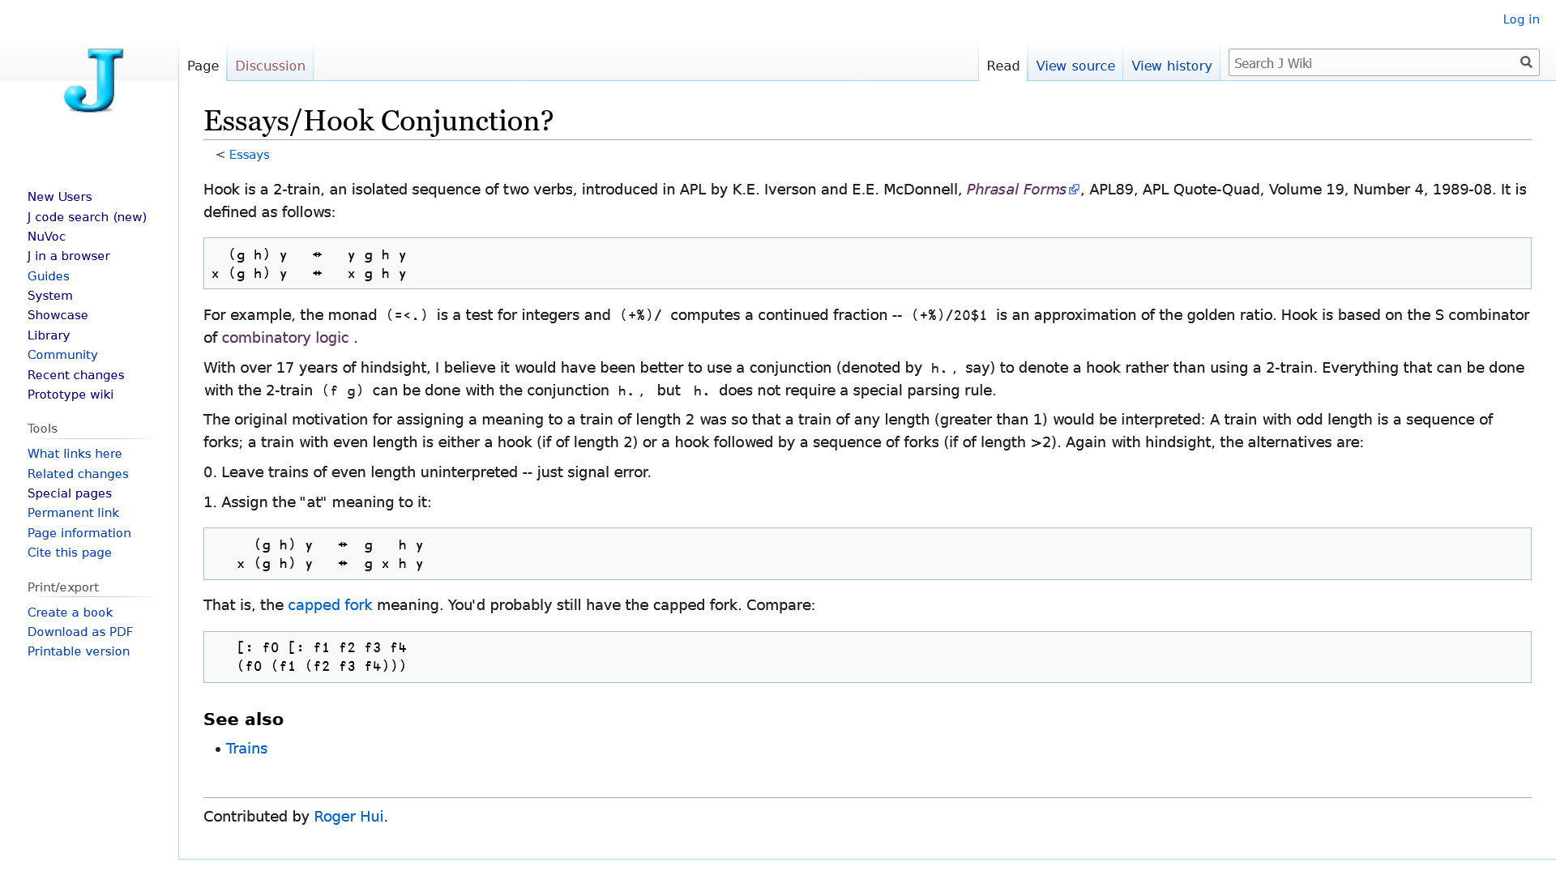

Slide 73
 | g f g | g f g | g f g
 | f⍤g f∘g f⍥g f g g ⍺ ⍵ ⍺ ⍵
 | f⍤g f g g ⍺ ⍵ ⍺ ⍵
 | f∘g f ⍺ g ⍺ ⍵ ⍺ ⍵ | ⍺ ⍺ ⍵ | f⍥g f g g ⍺ ⍺ ⍺ ⍵
Function Composition
f⍛g ⍵ ⇔ f⍛g⍨⍵
f g
⍛
g
f ⍵
⍺

Slide 74
 | g f g | g f g | g f g
 | f⍤g f∘g f⍥g f g g ⍺ ⍵ ⍺ ⍵
 | f⍤g f g g ⍺ ⍵ ⍺ ⍵
 | f∘g f ⍺ g ⍺ ⍵ ⍺ ⍵ | ⍺ ⍺ ⍺ ⍵ | f⍥g f g g ⍺ ⍺ ⍺ ⍵
Function Composition
f g
⍛
g
f
⍵

Slide 75
 | g f g | g f g | g f g
 | f⍤g f∘g f⍥g f g g ⍺ ⍵ ⍺ ⍵
 | f⍤g f g g ⍺ ⍵ ⍺ ⍵
 | f∘g f ⍺ g ⍺ ⍵ ⍺ ⍵ | ⍺ ⍺ ⍺ ⍵ | f⍥g f g g ⍺ ⍺ ⍺ ⍵
pre/postprocess
Function Composition
f g
⍤
postprocess
⍛
preprocess left
g
f
⍵
f g
∘
preprocess right
⍛
⍛
preprocess left
⍥
preprocess both
g
f ⍵

Slide 76
 | g f g | g f g | g f g
 | f⍤g f∘g f⍥g f g g ⍺ ⍵ ⍺ ⍵
 | f g f g g ⍺ ⍵ ⍺ ⍵
 | f g f ⍺ g ⍺ ⍵ ⍺ ⍵ | ⍺ ⍺ ⍺ ⍵ | f g f g g ⍺ ⍺ ⍺ ⍵
pre/postprocess
Function Composition
f g
⍤
postprocess
⍛
preprocess left
g
f
⍵
∘
preprocess right
f g
⍛
preprocess left
⍥
preprocess both
g
f ⍵

Slide 77
Function Composition
⍛
preprocess left
⍥
preprocess both
∘
preprocess right
⍤
postprocess

Slide 78
Function Composition
⍥
preprocess both
⍛
preprocess left
⍢
preprocess both
postprocess
∘
preprocess right
⍤
postprocess

Slide 79
Function Composition
f⍛g Behind with X⊇Y Select/Permute
Sort ← (⍋⊇⊢)

Slide 80
Function Composition
f⍛g Behind with X⊇Y Select/Permute
Sort ← ⍋⍛⊇

Slide 81
Function Composition
f⍛g Behind with X⊇Y Select/Permute
Sort ← ⍋⍛⊇
Sorts ← ⊇⍨∘⍋⍨ ⍝ "sort Y by X"

Slide 82
Function Composition
f⍛g Behind with X⊇Y Select/Permute
Sort ← ⍋⍛⊇
Sorts ← ⍋⍛⊇ ⍝ "sort Y by X"
!

Slide 83
Function Composition
f⍛g Behind with X⊇Y Select/Permute
Sort ← ⍋⍛⊇
Sorts ← ⍋⍛⊇ ⍝ "sort Y by X"
Shuffle ← (?⍨∘≢⊇⊢)

Slide 84
Function Composition
f⍛g Behind with X⊇Y Select/Permute
Sort ← ⍋⍛⊇
Sorts ← ⍋⍛⊇ ⍝ "sort Y by X"
Shuffle ← ?⍨∘≢⍛⊇

Slide 85
Function Composition
f⍛g Behind
SameAsFirst ← ⊃⍛=
HasDuplicates ← ∪⍛≡
Palindrome ← ⌽⍛≡
IsPermutation ← ⍋⍤⍋⍛≡

Slide 86
Function Composition
'/' (≠⊆⊢) 'hi/how/goes'
(⊃⍛≠⊆⊢)'/hi/how/goes'
'/'(⊃⍛≠⊆⊢)'/hi/how/goes'
f⍛g Behind
Integer ← ⌊⍛=
Split ← (⊃⍛≠⊆⊢)
Scale ← ⌈/⍛(÷⍨)
Deviation ← (+⌿÷≢)⍛(-⍨)
{
⍺←⊃⍵
⍵⊆⍨⍺≠⍵
}

Slide 87
Function Composition
f⍛g Behind
Filters ←
>∘5 Filters 2 7 1 8 2 8
7 8 8
⌽⍛≡¨Filters 'racecar' 'racer' 'toot'
racecar toot
⍛⌿
⍛⌿

Slide 88
Function Composition
f⍛g Behind
>∘5 ⍛⌿ 2 7 1 8 2 8
7 8 8
⌽⍛≡¨⍛⌿ 'racecar' 'racer' 'toot'
racecar toot

Slide 89
Function Composition
f⍛g Behind
Whence ← ⍳⍛∊ ⍝ {(⍳⍺)∊⍵}
InPoly ← ⍪⍛⊥ ⍝ {(⍪⍺)⊥⍵}
Shapes ← ⍴⍛⍴ ⍝ {(⍴⍺)⍴⍵}
ToFile ← ⊂⍛⎕NPUT ⍝ {(⊂⍺)⎕NPUT ⍵}

Slide 90
Function Composition
APL\360: 'abc';42;'def'
Dyalog: 'abc',(⍕42),'def'
20.0: 'abc',42⍕⍛,'def'
f⍛g Behind
FCat ← ⍕⍛,
RIndex ← ⊖⍛⍳ ⍝ {(⊖⍺)⍳⍵}
RDrop ← -⍛↓ ⍝ {(-⍺)↓⍵}
RndSfx ← -⍤?⍛↑ ⍝ {(-?⍺)↑⍵}

Slide 91
Function Composition
f⍛g Behind
Split-compose X Y
f⍛g∘h

Slide 92
Function Composition
f⍛g∘h
preprocess both
g
f h
⍺ ⍵

Slide 93
 | g f g | g f g | g f g
 | f⍤g f∘g f⍥g f g g ⍺ ⍵ ⍺ ⍵
 | f g f g g ⍺ ⍵ ⍺ ⍵
 | f g f ⍺ g ⍺ ⍵ ⍺ ⍵ | ⍺ ⍺ ⍺ ⍵ | f g f g g ⍺ ⍺ ⍺ ⍵
pre/postprocess
Function Composition
f g
⍤
postprocess
⍛
f⍛g∘h
preprocess left
preprocess both
g
f
⍵
g
f h
⍺ ⍵
👈
👉
∘
preprocess right
f g
⍛
preprocess left
⍥
preprocess both
g
f ⍵

Slide 94
 | g f g | g f g | g f g
 | f⍤g f∘g f⍥g f g g ⍺ ⍵ ⍺ ⍵
 | f g f g g ⍺ ⍵ ⍺ ⍵
 | f g f ⍺ g ⍺ ⍵ ⍺ ⍵ | ⍺ ⍺ ⍺ ⍵ | f g f g g ⍺ ⍺ ⍺ ⍵
pre/postprocess
Function Composition
f g
⍤
postprocess
⍛
f⍛g∘h
preprocess left
preprocess both
g
f
⍵
g
f h
⍺ ⍵
⍺ g⍛f⍛g ⍵
⇔
⍺ f⍥g ⍵
∘
preprocess right
f g
⍛
preprocess left
⍥
preprocess both
g
f ⍵
👈
👉

Slide 95
Function Composition
f⍛g∘h
preprocess both
g
f h
⍺ ⍵

Slide 96
Function Composition
f⍛g Behind
Split-compose X Y
f⍛g∘h
Pre-18.0: g⍨∘f⍨∘h
18.0: (f⍤⊣ g h⍤⊢)
20.0: f⍛g∘h

Slide 97
Function Composition
f⍛g Behind
Split-compose X Y
f⍛g∘h
Pre-18.0: ((f⊣)g(h⊢))
18.0: (f⍤⊣ g h⍤⊢)
20.0: f⍛g∘h

Slide 98
Function Composition
f⍛g Behind
Split-compose X f⍛g∘h Y
Hybrid mitigation 2∘| ⍛/
Pre-18.0: (2∘|{⍺/⍵}⊢)
18.0: (2∘|⊢⍤/⊢)
20.0: 2∘| ⍛/

Slide 99
Function Composition
f⍛g

Slide 100
Language Enhancements
Data Transformation
FunctioniApplication
Function Composition f⍛g

Slide 101
Language Enhancements
Data Transformation X×Y ⌽Y X⌷Y X⊇Y
FunctioniApplication f⌿ f⍣g f⍤k f⍥k
Function Composition f⍤g f⍥g f∘g f⍛g

Slide 102
Language Enhancements
Data Transformation Select Y[X;;] X⊇Y
FunctioniApplication Depth X f¨¨⊂⊂Y X f⍥k Y
Function Composition Behind (f X)g Y X f⍛g Y
Axis Manipulation
20.0

Slide 103
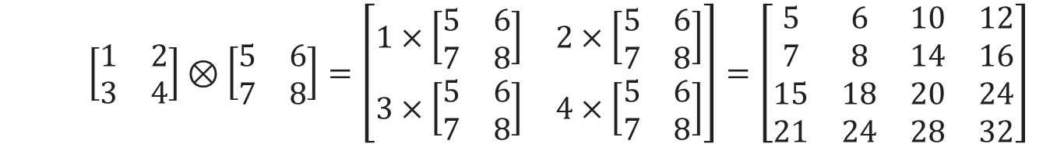
Axis Manipulation
$$\left[\begin{matrix}1 & 2 \\ 3 & 4\end{matrix}\right]⊗\left[\begin{matrix}5 & 6 \\ 7 & 8\end{matrix}\right]=\left[\begin{matrix}1×\left[\begin{matrix}5 & 6 \\ 7 & 8\end{matrix}\right] & 2×\left[\begin{matrix}5 & 6 \\ 7 & 8\end{matrix}\right] \\ 3×\left[\begin{matrix}5 & 6 \\ 7 & 8\end{matrix}\right] & 4×\left[\begin{matrix}5 & 6 \\ 7 & 8\end{matrix}\right]\end{matrix}\right]=\left[\begin{matrix}5 & 6 & 10 & 12 \\ 7 & 8 & 14 & 16 \\ 15 & 18 & 20 & 24 \\ 21 & 24 & 28 & 32\end{matrix}\right]$$
A×⊂B
┌─────┬─────┐
│5 6 │10 12│
│7 8 │14 16│
├─────┼─────┤
│15 18│20 24│
│21 24│28 32│
└─────┴─────┘
⍪⌿A×⊂B
┌─────┬─────┐
│ 5 6│10 12│
│ 7 8│14 16│
│15 18│20 24│
│21 24│28 32│
└─────┴─────┘
,/⍪⌿A×⊂B
┌───────────┐
│ 5 6 10 12│
│ 7 8 14 16│
│15 18 20 24│
│21 24 28 32│
└───────────┘
⊃,/⍪⌿A×⊂B
5 6 10 12
7 8 14 16
15 18 20 24
21 24 28 32

Slide 104
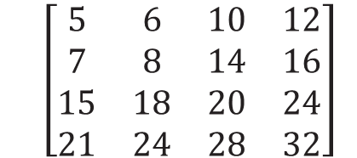
Axis Manipulation
$$\left[\begin{matrix}5 & 6 & 10 & 12 \\ 7 & 8 & 14 & 16 \\ 15 & 18 & 20 & 24 \\ 21 & 24 & 28 & 32\end{matrix}\right]$$
A×∘.⊂B
┌─────┬─────┐
│ │ │
│ │ │
├─────┼─────┤
│ │ │
│ │ │
└─────┴─────┘
5 6
7 8
10 12
14 16
15 18 21 24
20 24 28 32

Slide 105
Axis Manipulation
A⊂∘.×B
$$\left[\begin{matrix}5 & 6 & 10 & 12 \\ 7 & 8 & 14 & 16 \\ 15 & 18 & 20 & 24 \\ 21 & 24 & 28 & 32\end{matrix}\right]$$
5 6
7 8
10 12
14 16
15 18 21 24
20 24 28 32

Slide 106
Axis Manipulation
A⊂∘.×B
$$\left[\begin{matrix}5 & 6 & 10 & 12 \\ 7 & 8 & 14 & 16 \\ 15 & 18 & 20 & 24 \\ 21 & 24 & 28 & 32\end{matrix}\right]$$
5 6
7 8
10 12
14 16
15 18 21 24
20 24 28 32

Slide 107
Axis Manipulation
1 2 3 4⍉A⊂∘.×B
$$\left[\begin{matrix}5 & 6 & 10 & 12 \\ 7 & 8 & 14 & 16 \\ 15 & 18 & 20 & 24 \\ 21 & 24 & 28 & 32\end{matrix}\right]$$
5 6
7 8
10 12
14 16
15 18 21 24
20 2 4 28 32

Slide 108
Axis Manipulation
1 3 2 4⍉A⊂∘.×B
5 6
10 12
7 8
14 16
15 18
20 2 4
21 24
28 32
$$\left[\begin{matrix}5 & 6 & 10 & 12 \\ 7 & 8 & 14 & 16 \\ 15 & 18 & 20 & 24 \\ 21 & 24 & 28 & 32\end{matrix}\right]$$

Slide 109
Axis Manipulation
,[1_2] 1 3 2 4⍉A⊂∘.×B
5 6
10 12
7 8
14 16
15 18
20 2 4
21 24
28 32
$$\left[\begin{matrix}5 & 6 & 10 & 12 \\ 7 & 8 & 14 & 16 \\ 15 & 18 & 20 & 24 \\ 21 & 24 & 28 & 32\end{matrix}\right]$$

Slide 110
Axis Manipulation
,[12_3] ,[1_2] 1 3 2 4⍉A⊂∘.×B_
5 6 10 12
7 8 14 16
15 18 20 2 4
21 24 28 32
$$\left[\begin{matrix}5 & 6 & 10 & 12 \\ 7 & 8 & 14 & 16 \\ 15 & 18 & 20 & 24 \\ 21 & 24 & 28 & 32\end{matrix}\right]$$

Slide 111
Axis Manipulation
,[1 32]⍤¯1 ,[1_2] 1 3 2 4⍉A⊂∘.×B_
5 6 10 12
7 8 14 16
15 18 20 2 4
21 24 28 32
$$\left[\begin{matrix}5 & 6 & 10 & 12 \\ 7 & 8 & 14 & 16 \\ 15 & 18 & 20 & 24 \\ 21 & 24 & 28 & 32\end{matrix}\right]$$

Slide 112
Axis Manipulation
,[31 42]⍤2 ,[1_2] 1 3 2 4⍉A⊂∘.×B_
5 6 10 12
7 8 14 16
15 18 20 2 4
21 24 28 32
$$\left[\begin{matrix}5 & 6 & 10 & 12 \\ 7 & 8 & 14 & 16 \\ 15 & 18 & 20 & 24 \\ 21 & 24 & 28 & 32\end{matrix}\right]$$

Slide 113
Axis Manipulation
,[1 2]?⍤2 ,[1 2]? 1 3 2 4⍉A⊂∘.×B_
5 6 10 12
7 8 14 16
15 18 20 2 4
21 24 28 32
$$\left[\begin{matrix}5 & 6 & 10 & 12 \\ 7 & 8 & 14 & 16 \\ 15 & 18 & 20 & 24 \\ 21 & 24 & 28 & 32\end{matrix}\right]$$

Slide 114
Axis Manipulation
?⍤2 ? 1 3 2 4⍉A⊂∘.×B_
5 6 10 12
7 8 14 16
15 18 20 2 4
21 24 28 32
$$\left[\begin{matrix}5 & 6 & 10 & 12 \\ 7 & 8 & 14 & 16 \\ 15 & 18 & 20 & 24 \\ 21 & 24 & 28 & 32\end{matrix}\right]$$

Slide 115
Axis Manipulation
á
?
á
?

Slide 116
Axis Manipulation
Demote
∨
Y

Slide 117
Axis Manipulation
Promote
Demote
∨
Y

Slide 118
Axis Manipulation
Promote
Demote
∨
Y

Slide 119

Axis Manipulation
'Hallo'
Promote
∧
Y
CC BY-SA 3.0: commons.wikimedia.org/wiki/File:LD_B_22_Stabsunteroffizier.svg

Slide 120
Axis Manipulation
⍴'Hallo'
5
Promote
∧
Y
CC BY-SA 3.0: commons.wikimedia.org/wiki/File:LD_B_22_Stabsunteroffizier.svg

Slide 121
Axis Manipulation
≢⍴'Hallo'
1
Promote
∧
Y
CC BY-SA 3.0: commons.wikimedia.org/wiki/File:LD_B_22_Stabsunteroffizier.svg

Slide 122
Axis Manipulation
≢⍴∧'Hallo'
2
Promote
CC BY-SA 3.0: commons.wikimedia.org/wiki/File:LD_B_22_Stabsunteroffizier.svg

Slide 123
Axis Manipulation
≢⍴∧∧'Hallo'
3
Promote
CC BY-SA 3.0: commons.wikimedia.org/wiki/File:LD_B_22_Stabsunteroffizier.svg

Slide 124
Axis Manipulation
∧'Hallo'
'Hallo'⍪⍥∧'Welt!'
Hallo
Welt!
⍉⍪'Hallo'
↑,⊂'Hallo'
1 5⍴'Hallo'
,[÷2]'Hallo'
,[⎕IO-÷2]'Hallo'
↑'Hallo' 'Welt!'
⎕ML>1: ⊃
⎕ML>1: ⊃

Slide 125
Axis Manipulation
∧'Hallo'
∨ ,[⍳2]
,[f2]
'Hallo'⍪⍥∧'Welt!'
Hallo
Welt!
⍉⍪'Hallo'
↑,⊂'Hallo'
1 5⍴'Hallo'
∧ ,[÷2]'Hallo'
,[⎕IO-÷2]'Hallo'
↑'Hallo' 'Welt!'

Slide 126
Axis Manipulation
∧'Hallo'
∨ ,[⍳2]
,[÷⍳2]
'Hallo'⍪⍥∧'Welt!'
Hallo
Welt!
⍉⍪'Hallo'
↑,⊂'Hallo'
1 5⍴'Hallo'
∧ ,[÷2]'Hallo'
,[⎕IO-÷2]'Hallo'
↑'Hallo' 'Welt!'

Slide 127
Axis Manipulation
∧'Hallo'
∨ ,[⍳2]
,[÷⍳2]
'Hallo'⍪⍥∧'Welt!'
Hallo
Welt!
⍉⍪'Hallo'
↑,⊂'Hallo'
1 5⍴'Hallo'
∧ ,[÷2]'Hallo'
,[⎕IO-÷2]'Hallo'
↑'Hallo' 'Welt!'

Slide 128
Axis Manipulation
(∨\b)∧⌽∨\⌽b←0 1 0 0 1 1 0 0
0 1 1 1 1 1 0 0
▏

Slide 129
Axis Manipulation
(∨\b)∧⌽∨\⌽b←0 1 0 0 1 1 0 0
0 1 1 1 1 1 0 0
(∨\b)∧⌽∨\⌽b←0_1_0_0_1_1_0_0
▏

Slide 130
Axis Manipulation
(∨\b)∧⌽∨\⌽b←0 1 0 0 1 1 0 0
0 1 1 1 1 1 0 0
b (∨\b)∧⌽∨\⌽b←0_1_0_0_1_1_0_0
▏

Slide 131
Axis Manipulation
(∨\b)∧⌽∨\⌽b←0 1 0 0 1 1 0 0
0 1 1 1 1 1 0 0
b ⍪⍥∧ (∨\b)∧⌽∨\⌽b←0_1_0_0_1_1_0_0
▏

Slide 132
Axis Manipulation
(∨\b)∧⌽∨\⌽b←0 1 0 0 1 1 0 0
0 1 1 1 1 1 0 0
b ⍪⍥∧ (∨\b)∧⌽∨\⌽b←0_1_0_0_1_1_0_0
0 1 0 0 1 1 0 0
0 1 1 1 1 1 0 0
(∨\b)∧⌽∨\⌽b←0_1_0_0_1_1_0_0
▏

Slide 133
Axis Manipulation
(∨\b)∧⌽∨\⌽b←0 1 0 0 1 1 0 0
0 1 1 1 1 1 0 0
b ⍪⍥∧ (∨\b)∧⌽∨\⌽b←0_1_0_0_1_1_0_0
0 1 0 0 1 1 0 0
0 1 1 1 1 1 0 0
b (∨\b)∧⌽∨\⌽b←0_1_0_0_1_1_0_0
▏

Slide 134
Axis Manipulation
(∨\b)∧⌽∨\⌽b←0 1 0 0 1 1 0 0
0 1 1 1 1 1 0 0
b ⍪⍥∧ (∨\b)∧⌽∨\⌽b←0_1_0_0_1_1_0_0
0 1 0 0 1 1 0 0
0 1 1 1 1 1 0 0
b ( (∨\b)∧⌽∨\⌽b←0_1_0_0_1_1_0_0
▏

Slide 135
Axis Manipulation
(∨\b)∧⌽∨\⌽b←0 1 0 0 1 1 0 0
0 1 1 1 1 1 0 0
b ⍪⍥∧ (∨\b)∧⌽∨\⌽b←0_1_0_0_1_1_0_0
0 1 0 0 1 1 0 0
0 1 1 1 1 1 0 0
b ( (∨\b)∧⌽∨\⌽b←0_1_0_0_1_1_0_0
▏

Slide 136
Axis Manipulation
(∨\b)∧⌽∨\⌽b←0 1 0 0 1 1 0 0
0 1 1 1 1 1 0 0
b ⍪⍥∧ (∨\b)∧⌽∨\⌽b←0_1_0_0_1_1_0_0
0 1 0 0 1 1 0 0
0 1 1 1 1 1 0 0
b ( (∨\b)∧⌽∨\⌽b←0_1_0_0_1_1_0_0 )
▏

Slide 137
Axis Manipulation
(∨\b)∧⌽∨\⌽b←0 1 0 0 1 1 0 0
0 1 1 1 1 1 0 0
b ⍪⍥∧ (∨\b)∧⌽∨\⌽b←0_1_0_0_1_1_0_0
0 1 0 0 1 1 0 0
0 1 1 1 1 1 0 0
b ( (∨\b)∧⌽∨\⌽b←0_1_0_0_1_1_0_0 )
▏

Slide 138
Axis Manipulation
(∨\b)∧⌽∨\⌽b←0 1 0 0 1 1 0 0
0 1 1 1 1 1 0 0
b ⍪⍥∧ (∨\b)∧⌽∨\⌽b←0_1_0_0_1_1_0_0
0 1 0 0 1 1 0 0
0 1 1 1 1 1 0 0
↑ b ( (∨\b)∧⌽∨\⌽b←0_1_0_0_1_1_0_0 )
▏

Slide 139
Axis Manipulation
(∨\b)∧⌽∨\⌽b←0 1 0 0 1 1 0 0
0 1 1 1 1 1 0 0
b ⍪⍥∧ (∨\b)∧⌽∨\⌽b←0_1_0_0_1_1_0_0
0 1 0 0 1 1 0 0
0 1 1 1 1 1 0 0
↑ b ( (∨\b)∧⌽∨\⌽b←0_1_0_0_1_1_0_0 )
0 1 0 0 1 1 0 0
0 1 1 1 1 1 0 0
▏

Slide 140
Language Enhancements
Data Transformation
FunctioniApplication
Function Composition
Axis Manipulation ∨Y ∧Y

Slide 141
Language Enhancements
Data Transformation Select Y[X;;] X⊇Y
FunctioniApplication Depth X f¨¨⊂⊂Y X f⍥k Y
Function Composition Behind (f X)g Y X f⍛g Y
Axis Manipulation De/Promote ,[÷⍳2]Y ∨Y ∧Y
Questions?

