Slide 1


New User Commands in Dyalog 18.2 and Ideas for the Future
Adám Brudzewsky

Slide 2
Overview
]OUTPUT.View
]TOOLS.APLCart
+ Ideas for the Future
]WS.Names
]OUTPUT.Repr
]EXPERIMENTAL.Get

Slide 3
]OUTPUT.View
]TOOLS.APLCart
+ Ideas for the Future
]WS.Names
]OUTPUT.Repr
]EXPERIMENTAL.Get

Slide 4
]OUTPUT.View
Classic window mode

Slide 5
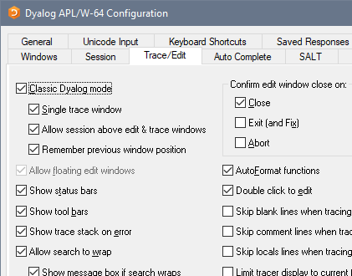
]OUTPUT.View
Classic window mode

Slide 6
]OUTPUT.View
Classic window mode
Inspect long output

Slide 7
]OUTPUT.View
Classic window mode
Inspect long output
]view ⍳⍳5

Slide 8
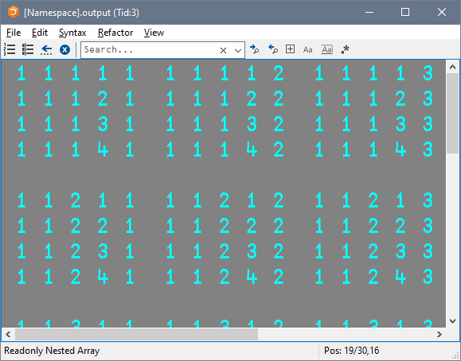
]OUTPUT.View
Classic window mode
Inspect long output
]view ⍳⍳5

Slide 9
]OUTPUT.View
Classic window mode
Inspect long output
Snapshot an APL item

Slide 10
]OUTPUT.View
Classic window mode
Inspect long output
Snapshot an APL item
var←'oldvalue'

Slide 11
]OUTPUT.View
Classic window mode
Inspect long output
Snapshot an APL item
var←'oldvalue'
]view var

Slide 12
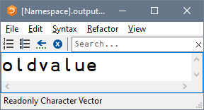
]OUTPUT.View
Classic window mode
Inspect long output
Snapshot an APL item
var←'oldvalue'
]view var

Slide 13
]OUTPUT.View
Classic window mode
Inspect long output
Snapshot an APL item
var←'oldvalue'
]view var
(3↑var)←'new'

Slide 14
]OUTPUT.View
Classic window mode
Inspect long output
Snapshot an APL item
var←'oldvalue'
]view var
(3↑var)←'new'
)ed var

Slide 15
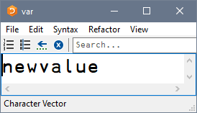
]OUTPUT.View
Classic window mode
Inspect long output
Snapshot an APL item
var←'oldvalue'
]view var
(3↑var)←'new'
)ed var

Slide 16
]OUTPUT.View
Classic window mode
Inspect long output
Snapshot an APL item
Settings: ]Box -view=

Slide 17
]OUTPUT.View
Classic window mode
Inspect long output
Snapshot an APL item
Settings: ]Box -view=
]box on –v=max

Slide 18
]OUTPUT.View
Classic window mode
Inspect long output
Snapshot an APL item
Settings: ]Box -view=
]box on –v=max
Was OFF -view=min

Slide 19
]OUTPUT.View
Classic window mode
Inspect long output
Snapshot an APL item
Settings: ]Box -view=
]box on –v=max
Was OFF -view=min
]view ⍳⍳5

Slide 20
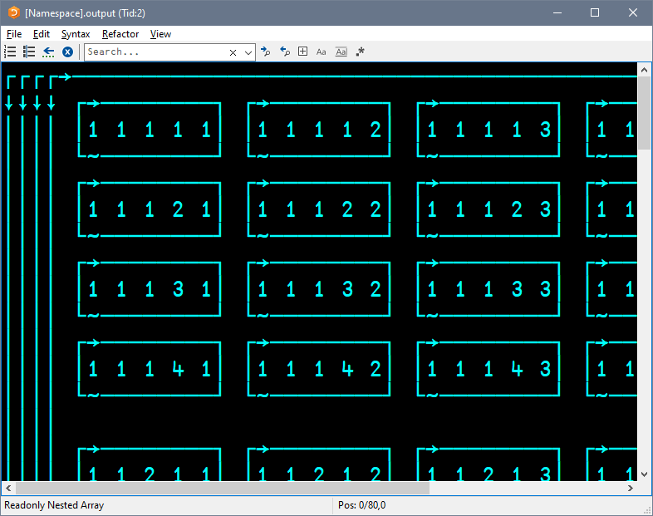
]OUTPUT.View
Classic window mode
Inspect long output
Snapshot an APL item
Settings: ]Box -view=
]box on –v=max
Was OFF -view=min
]view ⍳⍳5
]TOOLS.APLCart
+ Ideas for the Future
]WS.Names
]OUTPUT.Repr
]EXPERIMENTAL.Get

Slide 21
]OUTPUT.View
]TOOLS.APLCart
+ Ideas for the Future
]WS.Names
]OUTPUT.Repr
]EXPERIMENTAL.Get

Slide 22
]TOOLS.APLCart
]OUTPUT.View
Display in session
+ Ideas for the Future
]WS.Names
]OUTPUT.Repr
]EXPERIMENTAL.Get
Notes:
You know what you want, how do I…?

Slide 23
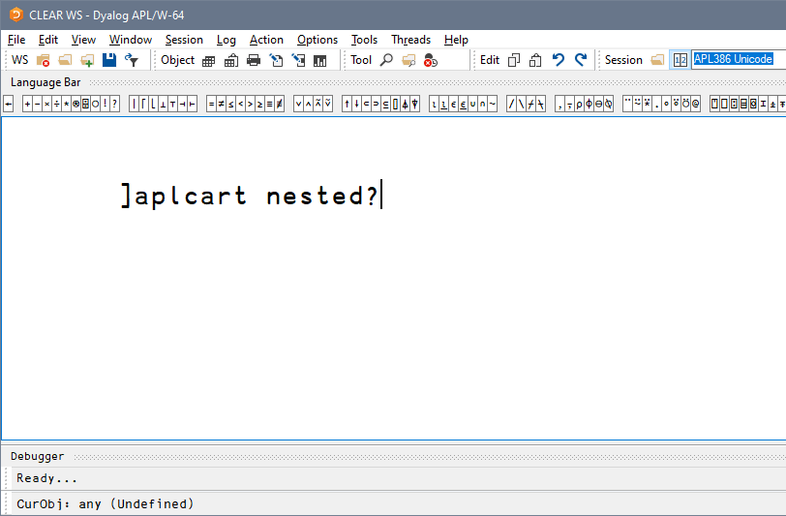
]TOOLS.APLCart
Display in session
Notes:
You know what you want, how do I…?

Slide 24
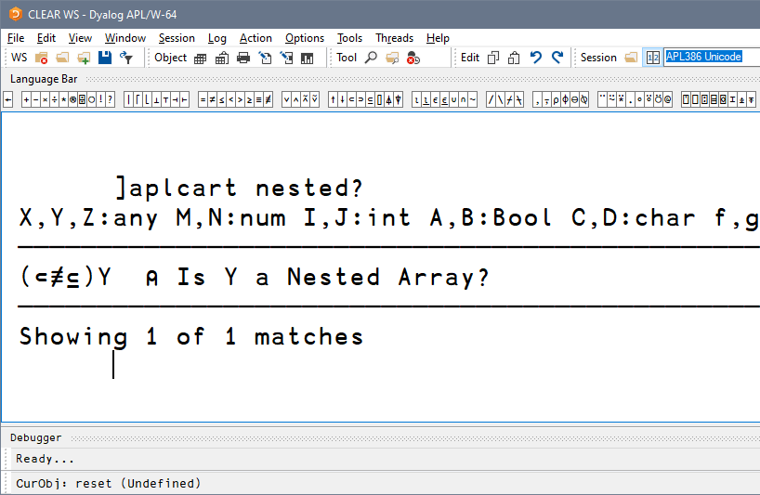
]TOOLS.APLCart
Display in session
Notes:
You know what you want, how do I…?

Slide 25
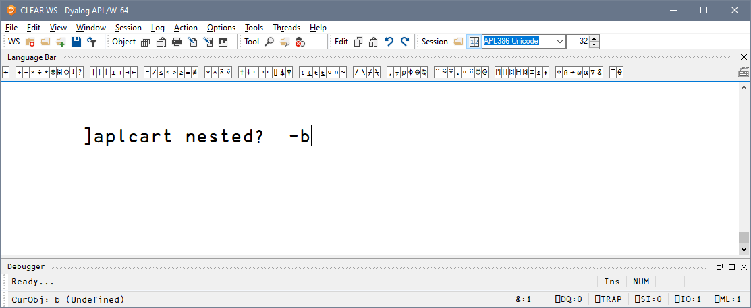
]TOOLS.APLCart
Display in session
Display in browser
Notes:
You know what you want, how do I…?

Slide 26
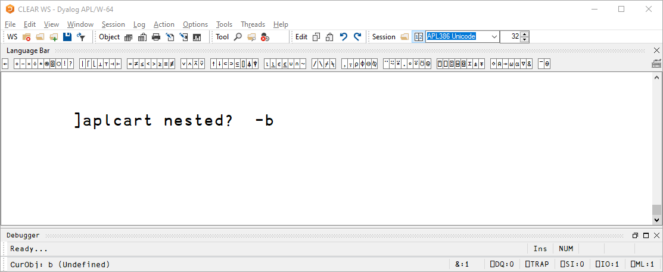
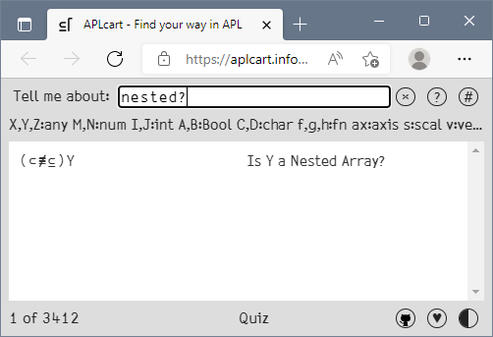
]TOOLS.APLCart
Display in session
Display in browser
Notes:
You know what you want, how do I…?

Slide 27

]TOOLS.APLCart
Display in session
Display in browser
Display in popup
Notes:
You know what you want, how do I…?

Slide 28
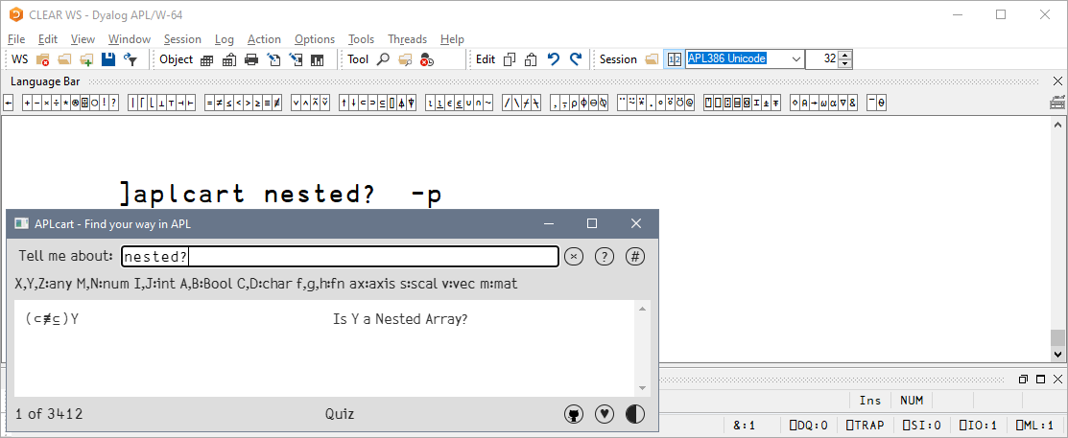
]TOOLS.APLCart
]OUTPUT.View
Display in session
Display in browser
Display in popup
+ Ideas for the Future
]WS.Names
]OUTPUT.Repr
]EXPERIMENTAL.Get
Notes:
You know what you want, how do I…?

Slide 29
]OUTPUT.View
]TOOLS.APLCart
+ Ideas for the Future
]WS.Names
]OUTPUT.Repr
]EXPERIMENTAL.Get

Slide 30
]WS.Names
]OUTPUT.View
]TOOLS.APLCart
+ Ideas for the Future
]OUTPUT.Repr
]EXPERIMENTAL.Get
Notes:
Set PW, Friendly view of namespace content

Slide 31
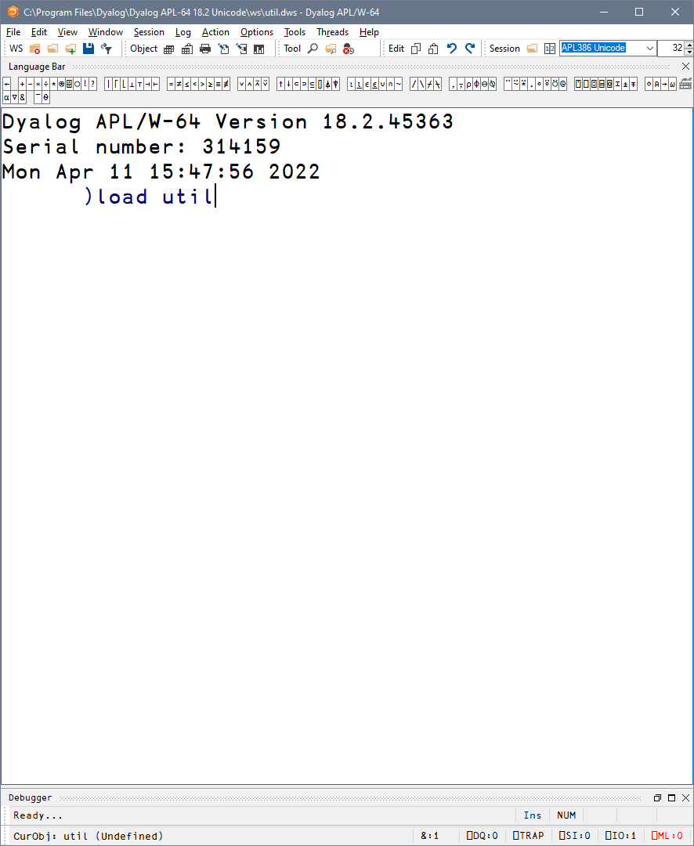
]WS.Names
Notes:
Set PW, Friendly view of namespace content

Slide 32
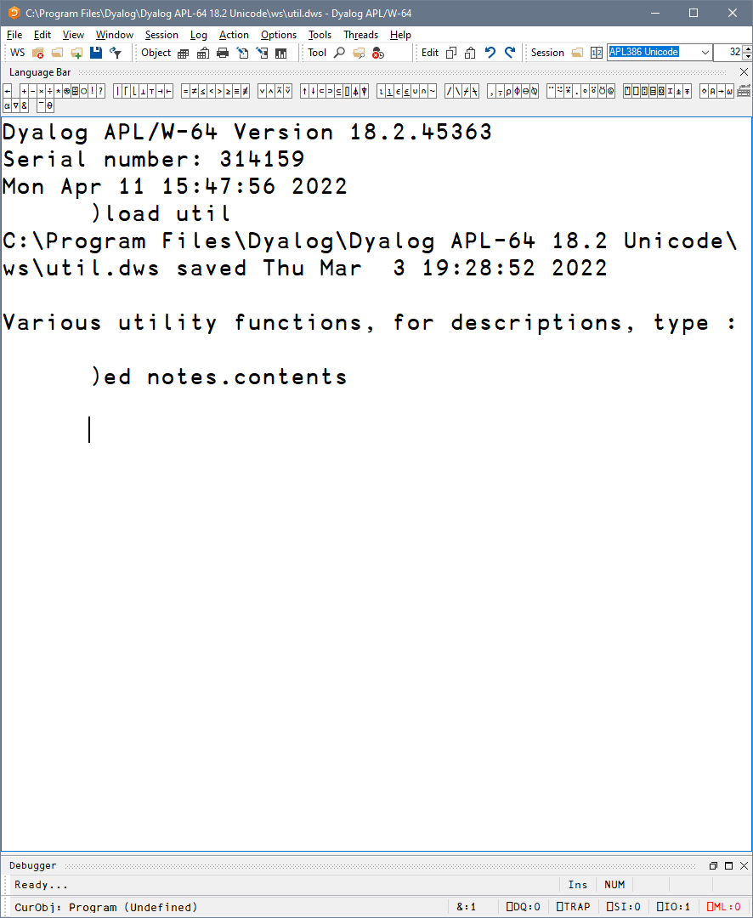
]WS.Names
Notes:
Set PW, Friendly view of namespace content

Slide 33
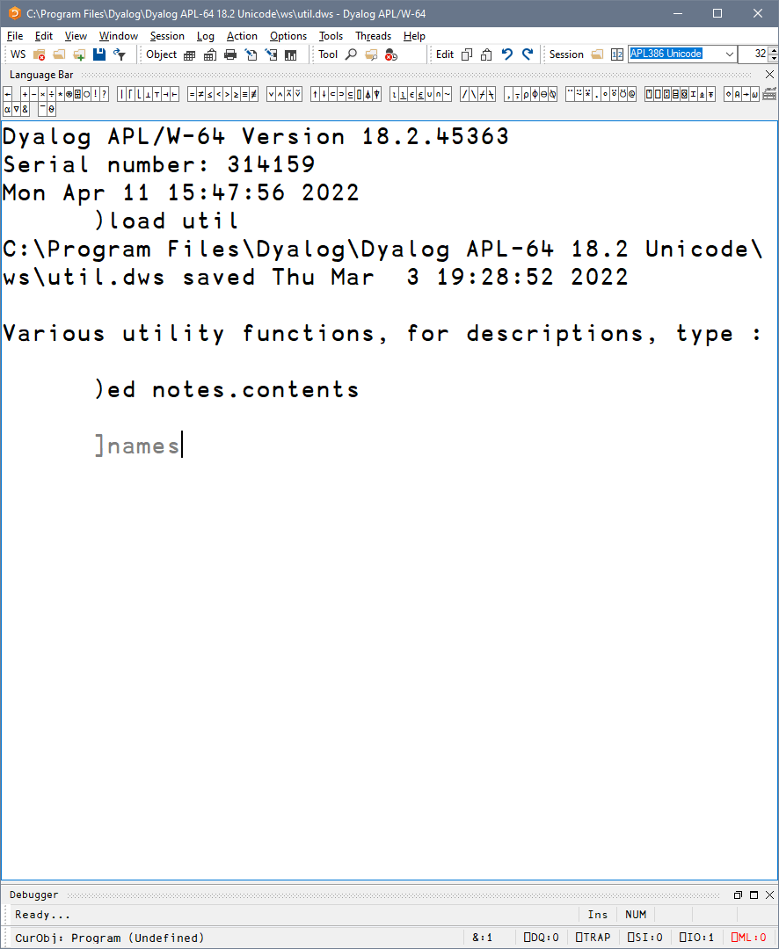
]WS.Names
List all
Notes:
Set PW, Friendly view of namespace content

Slide 34
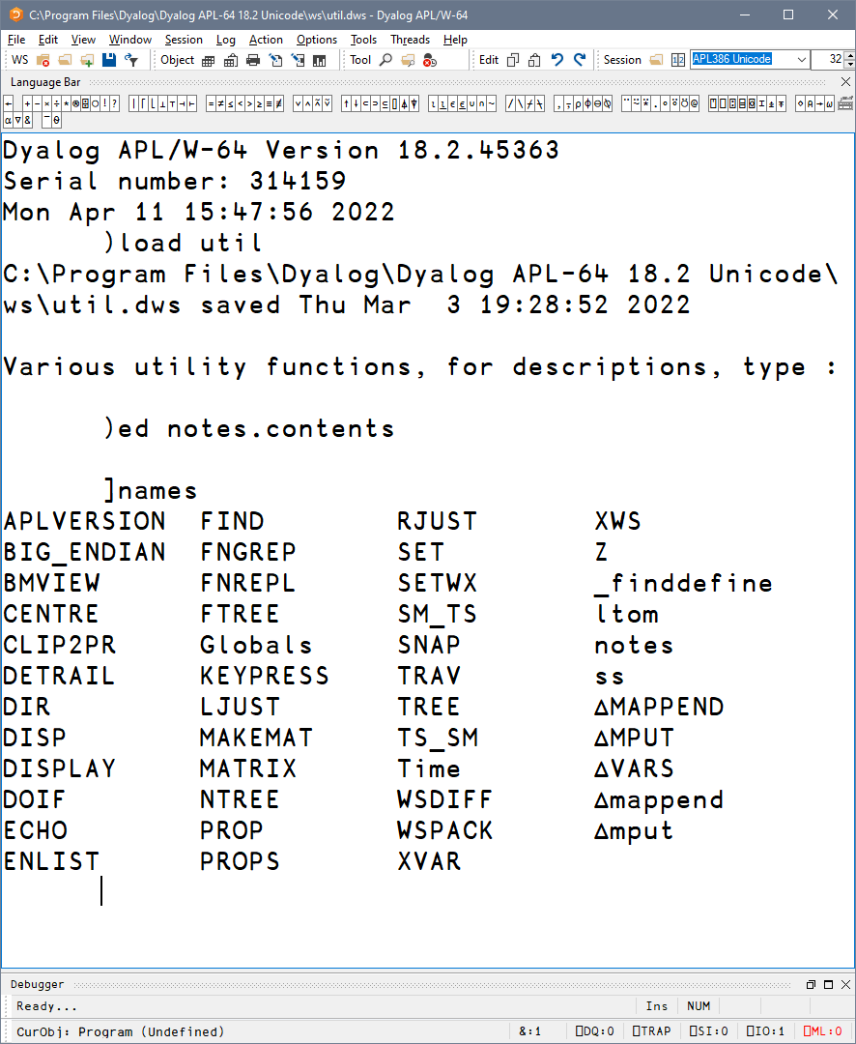
]WS.Names
List all
Notes:
Set PW, Friendly view of namespace content

Slide 35
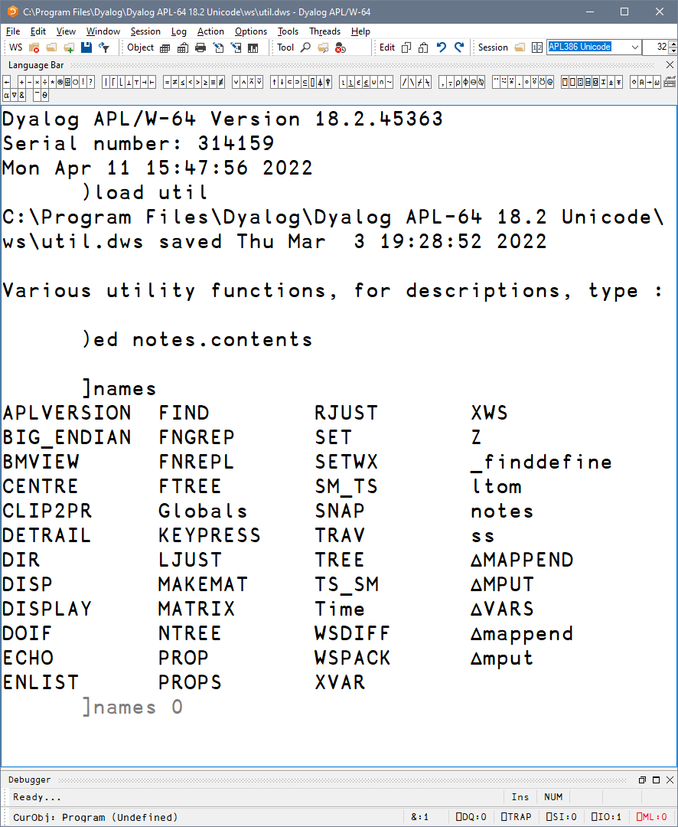
]WS.Names
List all
Group by nameclass
Notes:
Set PW, Friendly view of namespace content

Slide 36
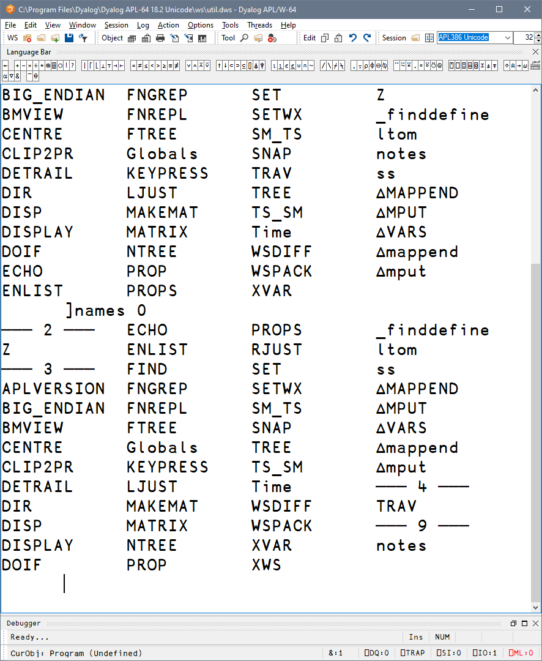
]WS.Names
List all
Group by nameclass
Notes:
Set PW, Friendly view of namespace content

Slide 37
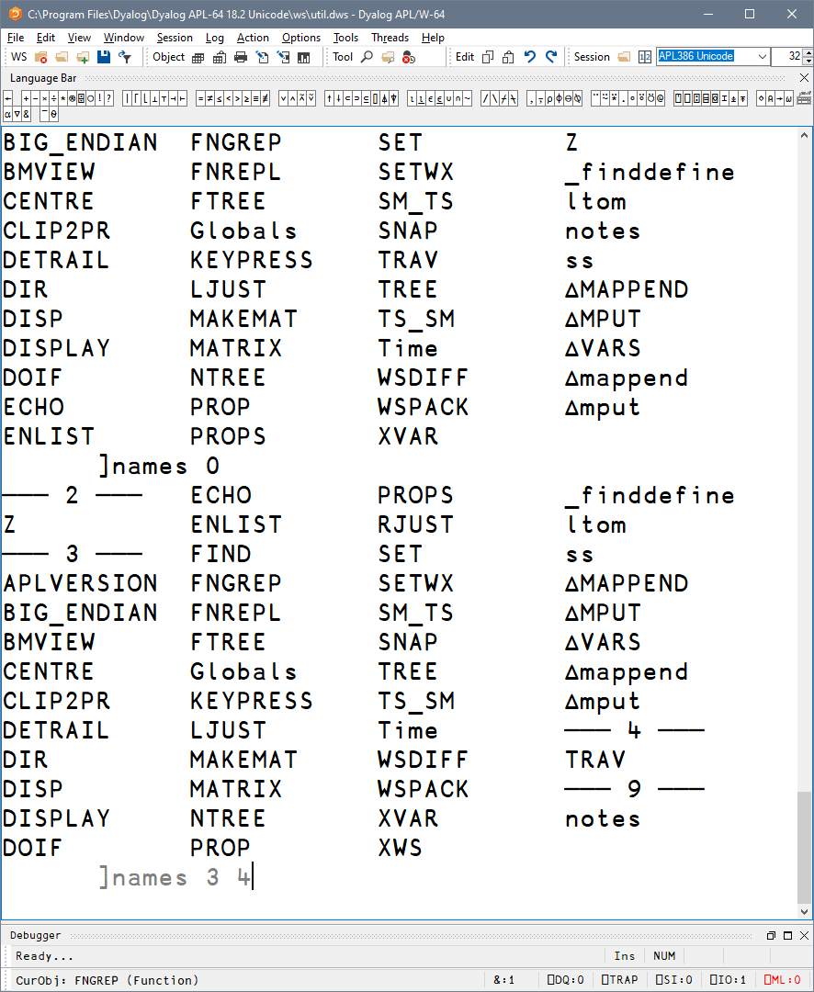
]WS.Names
List all
Group by nameclass
Filter by nameclass
Notes:
Set PW, Friendly view of namespace content

Slide 38
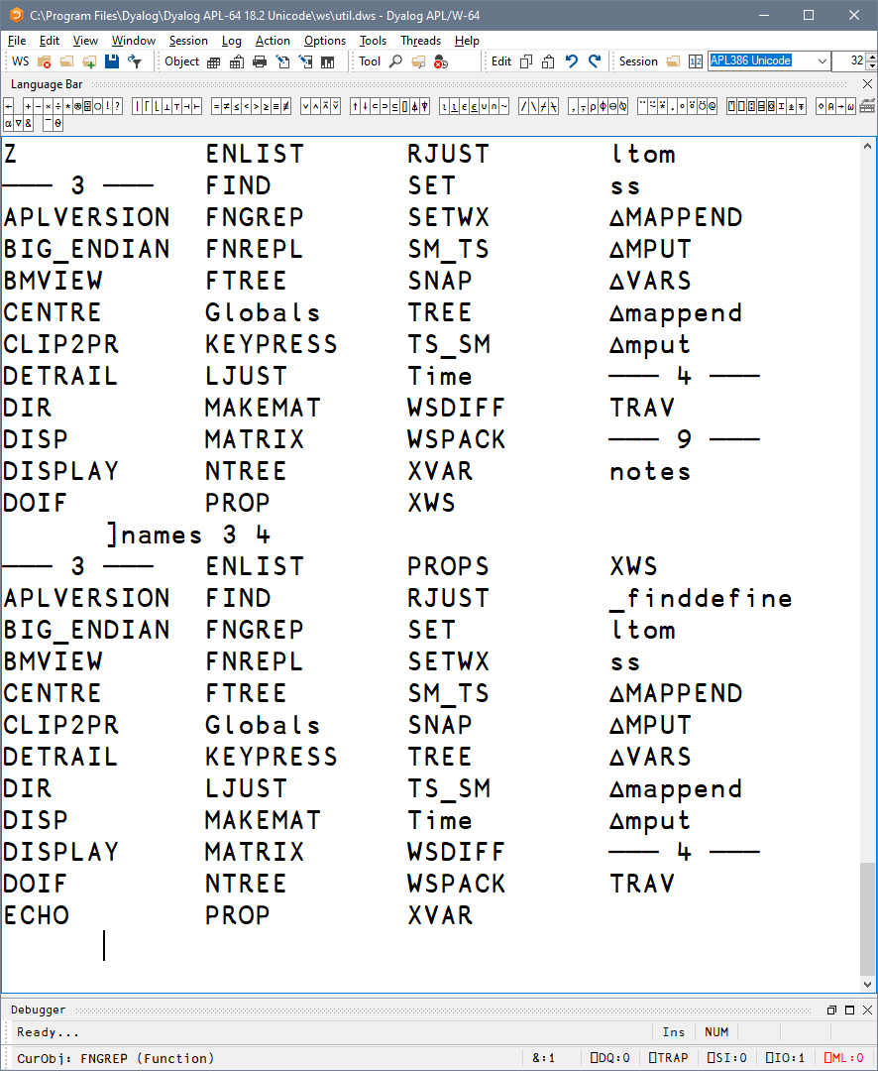
]WS.Names
List all
Group by nameclass
Filter by nameclass
Notes:
Set PW, Friendly view of namespace content

Slide 39
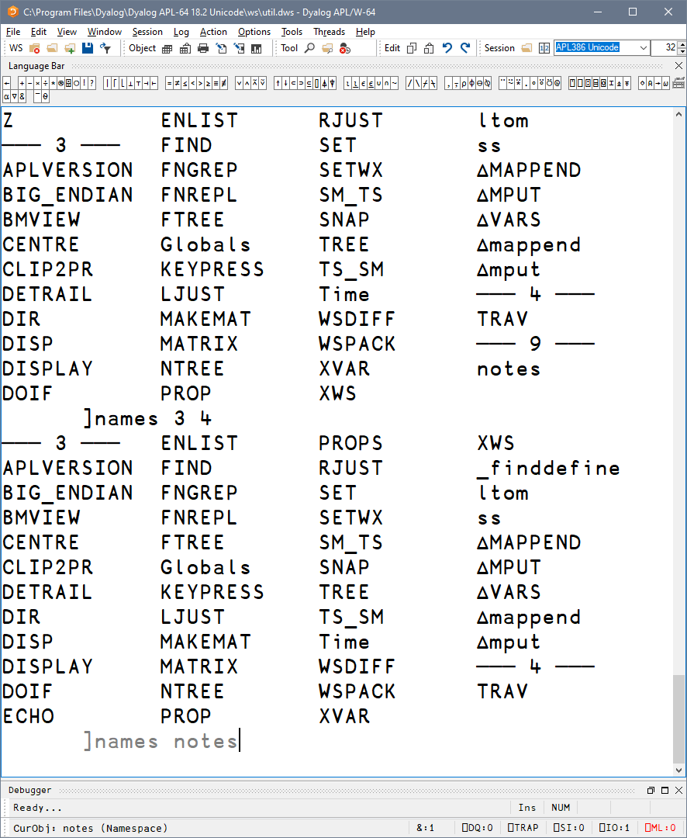
]WS.Names
List all
Group by nameclass
Filter by nameclass
Specific namespace
Notes:
Set PW, Friendly view of namespace content

Slide 40
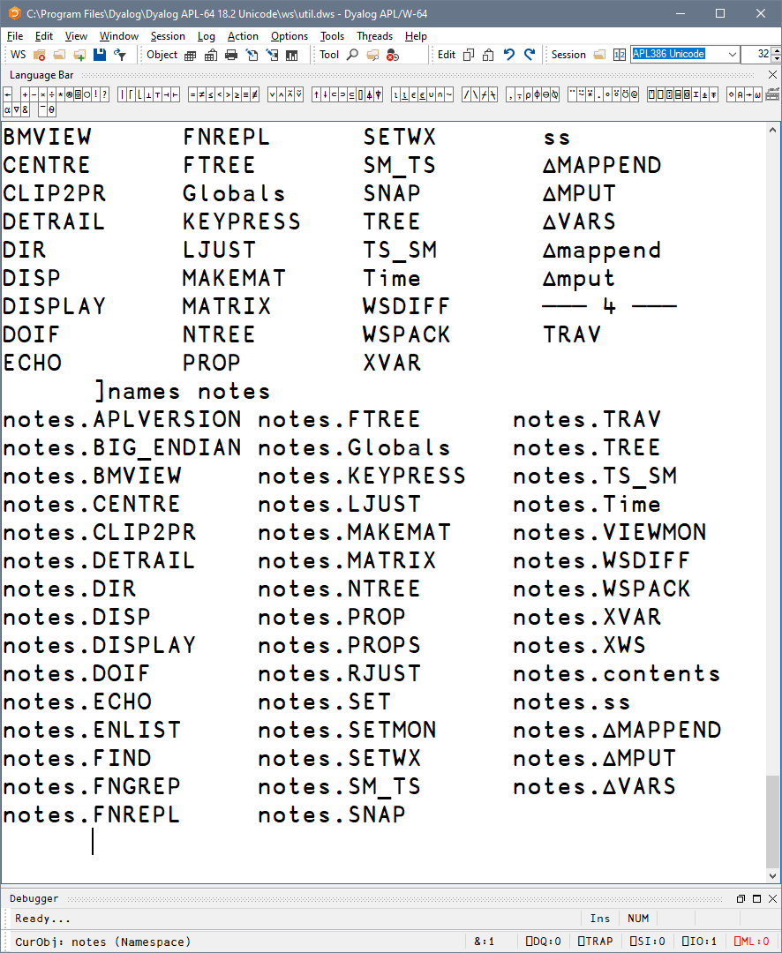
]WS.Names
List all
Group by nameclass
Filter by nameclass
Specific namespace
Notes:
Set PW, Friendly view of namespace content

Slide 41
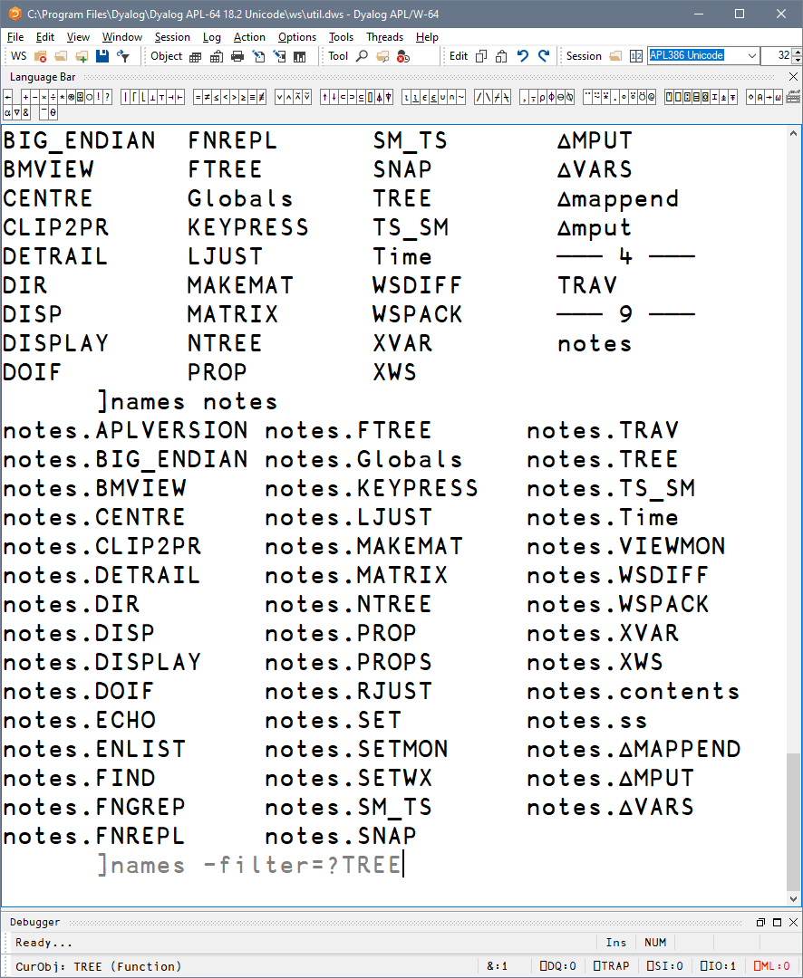
]WS.Names
List all
Group by nameclass
Filter by nameclass
Specific namespace
Filter using wildcards
Notes:
Set PW, Friendly view of namespace content

Slide 42
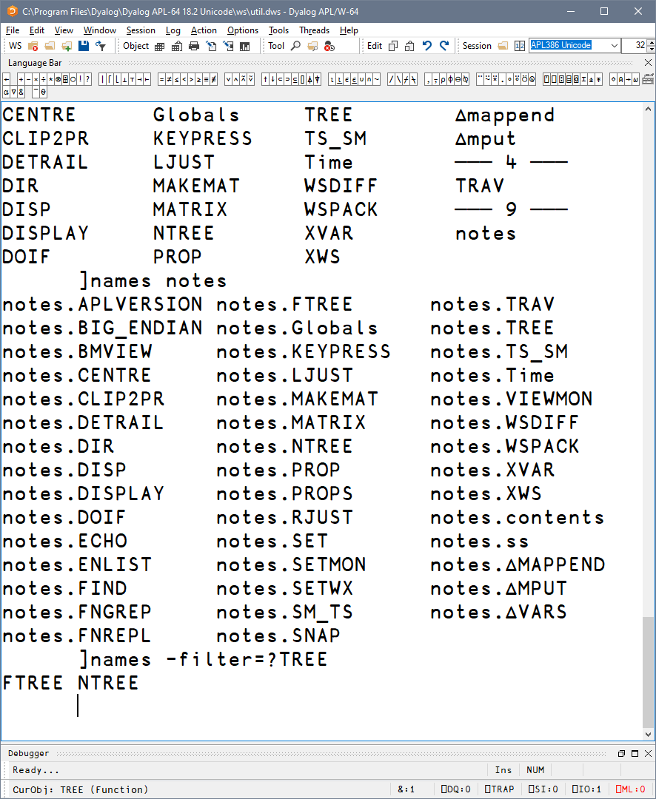
]WS.Names
List all
Group by nameclass
Filter by nameclass
Specific namespace
Filter using wildcards
Notes:
Set PW, Friendly view of namespace content

Slide 43
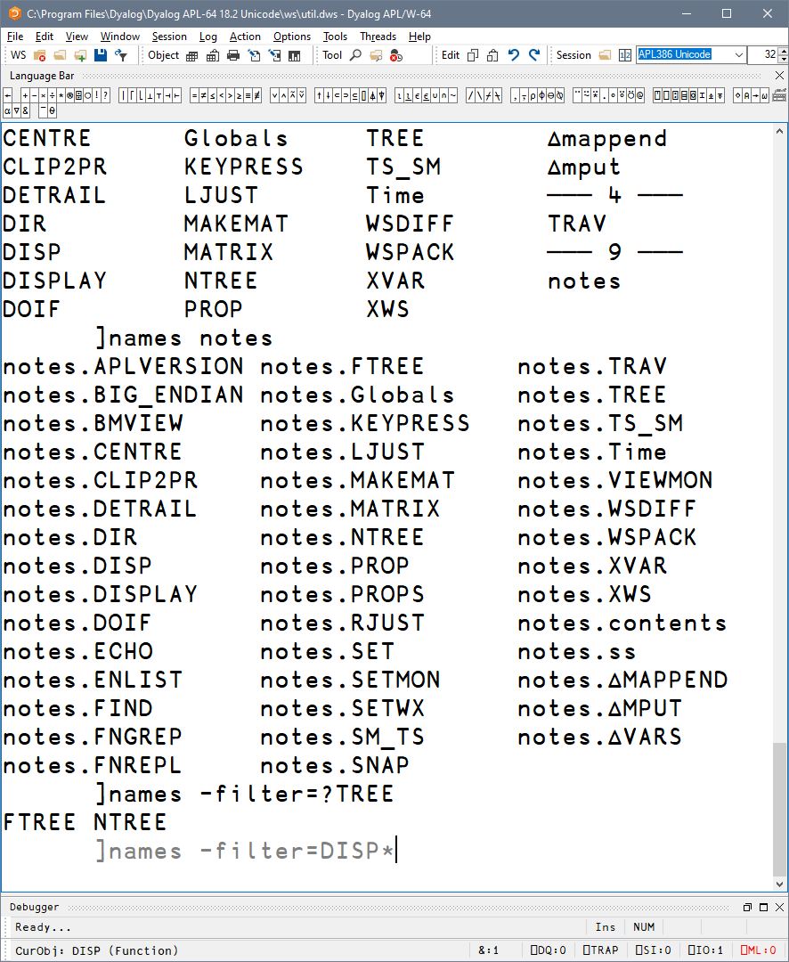
]WS.Names
List all
Group by nameclass
Filter by nameclass
Specific namespace
Filter using wildcards
Notes:
Set PW, Friendly view of namespace content

Slide 44
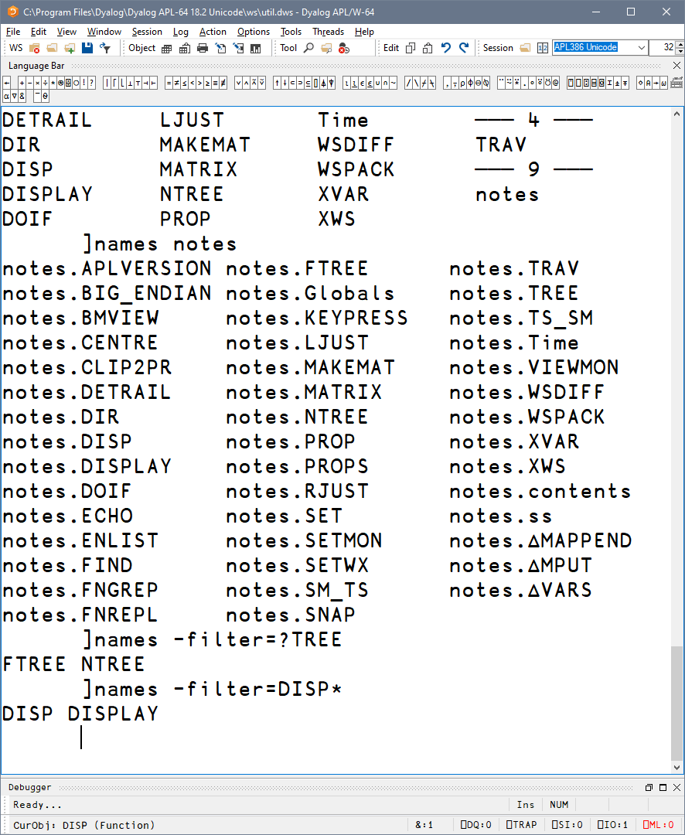
]WS.Names
List all
Group by nameclass
Filter by nameclass
Specific namespace
Filter using wildcards
Notes:
Set PW, Friendly view of namespace content

Slide 45

]WS.Names
List all
Group by nameclass
Filter by nameclass
Specific namespace
Filter using wildcards
Filter using regex
Notes:
Set PW, Friendly view of namespace content

Slide 46
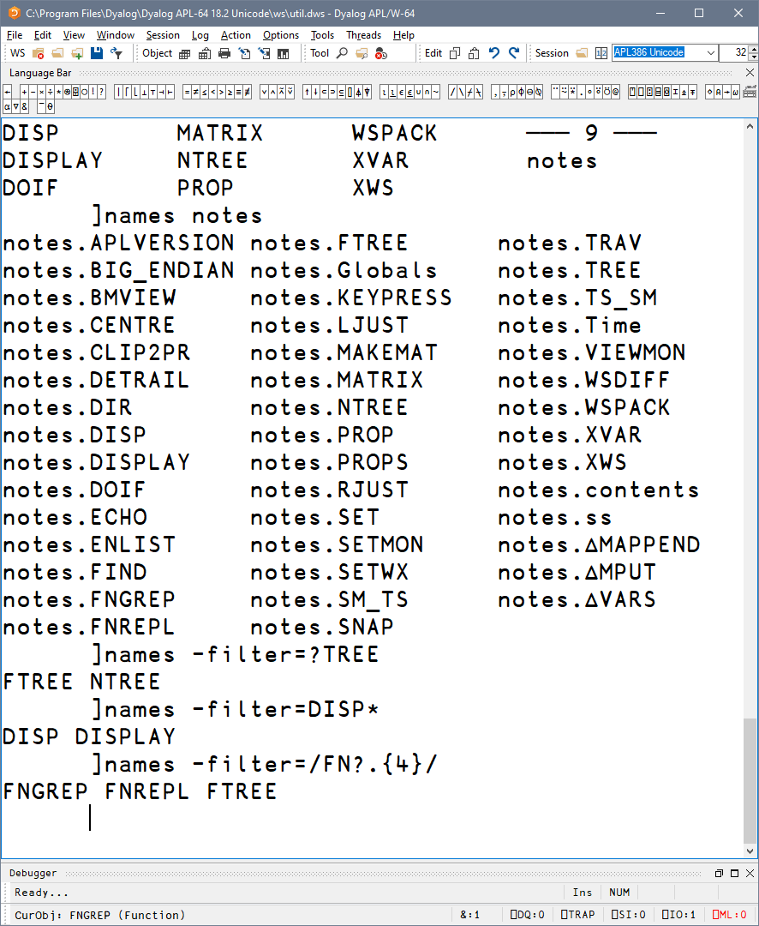
]WS.Names
List all
Group by nameclass
Filter by nameclass
Specific namespace
Filter using wildcards
Filter using regex
Notes:
Set PW, Friendly view of namespace content

Slide 47
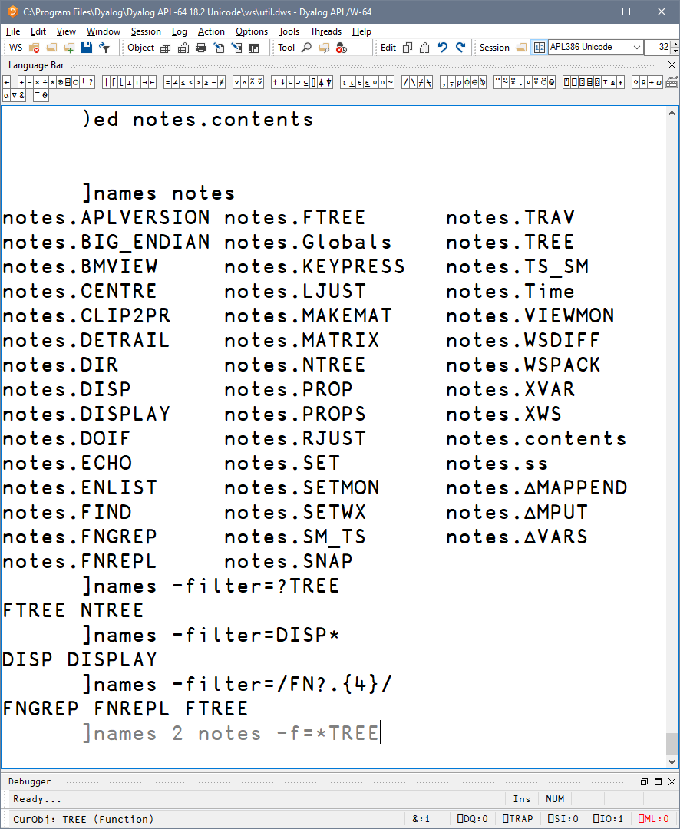
]WS.Names
List all
Group by nameclass
Filter by nameclass
Specific namespace
Filter using wildcards
Filter using regex
Combine all of these!
Notes:
Set PW, Friendly view of namespace content

Slide 48
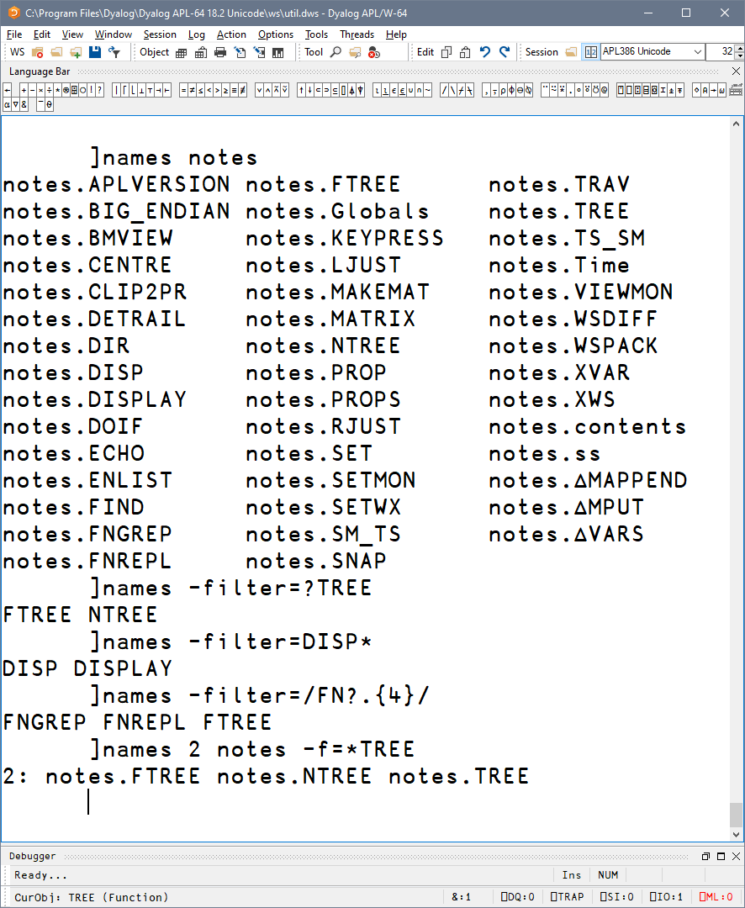
]WS.Names
]OUTPUT.View
List all
Group by nameclass
Filter by nameclass
Specific namespace
Filter using wildcards
Filter using regex
]TOOLS.APLCart
+ Ideas for the Future
Combine all of these!
]OUTPUT.Repr
]EXPERIMENTAL.Get
Notes:
Set PW, Friendly view of namespace content

Slide 49
]OUTPUT.View
]TOOLS.APLCart
+ Ideas for the Future
]WS.Names
]OUTPUT.Repr
]EXPERIMENTAL.Get

Slide 50
]OUTPUT.Repr
]OUTPUT.View
]repr expression
]TOOLS.APLCart
+ Ideas for the Future
]WS.Names
]EXPERIMENTAL.Get

Slide 51
]OUTPUT.Repr
]repr expression -format=
APL ^{single-line APL expression}
APLAN ^{APL Array Notation}
JS JavaScript for inclusion in code
JSON ^{JavaScript Object Notation}
XML ^{Extensible Markup Language}
CSV ^{Comma-Separated Values} ,
SSV ^{Semicolon-Separated Values} ;
PSV ^{Pipe-Separated Values} |
TSV ^{Tab-Separated Values} ⭾

Slide 52
]OUTPUT.Repr
]repr expression -format=format

Slide 53
]OUTPUT.Repr
]repr expression -format=format -outfile=filename

Slide 54
]OUTPUT.Repr
]repr ⍳1 2
(1 2⍴(2⍴1) (1 2))
]repr +⌿÷1⌈≢
(+⌿)÷(1⌈≢)
Merge←⍳⍤≢⍤⊣⌷∘⊃⍤0⌷⍤0 99
]repr Merge
Merge←((⍳⍤≢)⍤⊣)((⌷∘⊃)⍤0)(⌷⍤0 99)

Slide 55
]OUTPUT.Repr
]repr ⍳1 2 –f=aplan
[
(
1 1
1 2
)
]

Slide 56
]OUTPUT.Repr
Hook←{⍺←⍵ ⋄ ⍵ ⍵⍵⍨⍺⍺ ⍵}
]repr Hook
⎕FX(,⊂' Hook←{⍺←⍵ ⋄ ⍵ ⍵⍵⍨⍺⍺ ⍵}')
]repr Hook -f=aplan
Hook←{⍺←⍵ ⋄ ⍵ ⍵⍵⍨⍺⍺ ⍵}

Slide 57
]OUTPUT.Repr
'ns.sub'⎕NS⍬
ns.sub.val←,42
]repr ns -f=aplan
(
sub:(
val:(42⋄)
)
)

Slide 58
]OUTPUT.Repr
'ns.sub'⎕NS⍬
ns.sub.val←,42
]repr ns -f=js
{
sub: {
val: [42],
},
}
]repr ns -f=json
{
"sub": {
"val": [42]
}
}

Slide 59
]OUTPUT.Repr
'ns.sub'⎕NS⍬
ns.sub.val←,42
]repr ns -f=js
{
sub: {
val: [42],
},
}
]repr ns -f=json
{
"sub": {
"val": [42]
}
}

Slide 60
]OUTPUT.Repr
]repr 3 3⍴⍳9 -f=xml
<array>
<shape>3 3</shape>
<list>1 2 3 4 5 6 7 8 9</list>
</array>

Slide 61
]OUTPUT.Repr
]repr 3 3⍴⍳9 -f=csv
1,2,3
4,5,6
7,8,9

Slide 62
]OUTPUT.Repr
]OUTPUT.View
]repr 3 3⍴⍳9 -f=ssv
1;2;3
4;5;6
7;8;9
]TOOLS.APLCart
+ Ideas for the Future
]WS.Names
]EXPERIMENTAL.Get

Slide 63
]OUTPUT.View
]TOOLS.APLCart
+ Ideas for the Future
]WS.Names
]OUTPUT.Repr
]EXPERIMENTAL.Get

Slide 64
]EXPERIMENTAL.Get
]OUTPUT.View
“get pretty much anything from pretty much anywhere”
]TOOLS.APLCart
+ Ideas for the Future
]WS.Names
]OUTPUT.Repr

Slide 65
]EXPERIMENTAL.Get
“get pretty much anything from pretty much anywhere”
One-stop utility for quickly getting bringing resources in.

Slide 66
]EXPERIMENTAL.Get
“get pretty much anything from pretty much anywhere”
One-stop utility for quickly getting bringing resources in.
Do not use at run time, as exact results may vary.

Slide 67
]EXPERIMENTAL.Get
Syntax
]get something

Slide 68
]EXPERIMENTAL.Get
Syntax
]get something
#.something

Slide 69
]EXPERIMENTAL.Get
Plain name heuristics
]get dfns workspace from WS path
#.dfns
]get HttpCommand source file from SALT path
#.HttpCommand
]get tools directory relative to current
#.tools

Slide 70
]EXPERIMENTAL.Get
File extension detection
]get MyFn.aplf Link-type source files
#.MyFn
]get myVar.apla APL Array Notation files
#.myVar
]get text.charmat Acre-type source files
#.text

Slide 71
]EXPERIMENTAL.Get
Data format conversion
]get obj.json JS, JSON, JSON5, config files
#.obj
]get table.csv Comma Separated Values
#.table
]get data.xml eXtensible Markup Language
#.data

Slide 72
]EXPERIMENTAL.Get
Retrieval
]get https://example.com/index.html
#.index
]get https://github.com/abrudz/Kbd
#.Kbd

Slide 73
]EXPERIMENTAL.Get
Protocols
]get https://github.com/abrudz/Kbd
#.Kbd
]get ftp://ftp.software.ibm.com/software
#.foo
]get github.com/abrudz/Kbd
#.Kbd

Slide 74
]EXPERIMENTAL.Get
Unpacking
]get main.zip
#.main
]get github.com/user/repo/tree/main/sub
#.sub

Slide 75
]EXPERIMENTAL.Get
Unpacking
]get dfns -only=dxb,dab
#.dfns
]map
#
· dfns
· · ∇ dab dxb

Slide 76
]EXPERIMENTAL.Get
Unpacking
)clear
clear ws
]get dfns -only=dxb,dab -unpack
#.dxb #.dab
]map
#
· ∇ dab dxb

Slide 77
]EXPERIMENTAL.Get
Options
]get obj.json:txt
#.obj
10↑obj
{"myKey":1
]get thing –target=⎕SE.there
#.SE.there.thing

Slide 78
]EXPERIMENTAL.Get
]OUTPUT.View
Options
]get /tmp/repo –sync
#.repo
]link.status
Namespace Directory Files
#.repo ←→ c:/tmp/repo 14
]TOOLS.APLCart
+ Ideas for the Future
]WS.Names
]OUTPUT.Repr

Slide 79
Overview
]OUTPUT.View
]TOOLS.APLCart
+ Ideas for the Future
]WS.Names
]OUTPUT.Repr
]EXPERIMENTAL.Get

Slide 80
+ Ideas for the Future
]OUTPUT.View
Current issues:
SALT dependency
Performance
Cache file invalidation
Abuse for utility functions
Inflexibility
Old philosophy
]TOOLS.APLCart
]WS.Names
]OUTPUT.Repr
]EXPERIMENTAL.Get

Slide 81
+ Ideas for the Future
My ideas:
Based on SessionStartup
Directories ⇔ namespaces ⇔ groups
Any function can declare
itself as a user command
Standard format
Framework searches ⎕SE
Left argument:
namespace of options
including utilities
Right argument:
argument raw/list

Slide 82
+ Ideas for the Future
]OUTPUT.View
Benefits:
One API function for every user command
Easy to package, distribute, install
Can be part of a larger package
Can co-exist with utilities and dependencies
Stability: Group name required under program control
Customisability: Change group by renaming a directory
]TOOLS.APLCart
]WS.Names
]OUTPUT.Repr
]EXPERIMENTAL.Get

Slide 83
Questions?
]OUTPUT.View
]TOOLS.APLCart
+ Ideas for the Future
]WS.Names
]OUTPUT.Repr
Adám Brudzewsky
adam@dyalog.com
]EXPERIMENTAL.Get

