Slide 1
A Powerful Notation for Problem Solvers
Richard Park

Slide 2
Applied mathematics is largely concerned with the design and analysis of explicit procedures for calculating the exact or approximate values of various functions.
Such explicit procedures are called algorithms or programs.
Because an effective notation for the description of programs exhibits considerable syntactic structure, it is called a programming language.
- Kenneth E. Iverson 1962

Slide 3
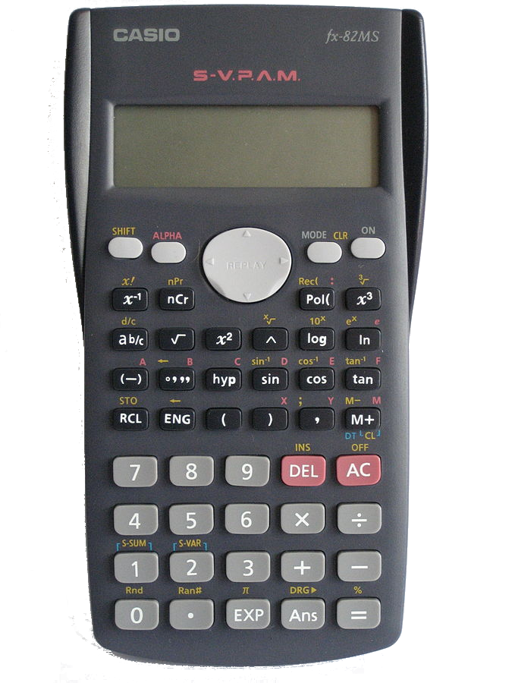
You already know APL
Arithmetic
Comparisons
Sets & Logic
+ - × ÷ !
< ≤ = ≠ > ≥
∩ ∪ ∊ ∧ ∨

Slide 4
Some algorithms
Quadratic equation
Factorial
Fibonacci

Slide 5

Quadratic Equation
$f\left(x\right)=2x^{2}−9x−5$
$$x=\frac{−b ± \sqrt{b^{2}−4ac}}{2a}$$

Slide 6


Factorial
$$F\left(n\right)=1×2×3×…×\left(n−2\right)×\left(n−1\right)×n$$
$$F\left(n\right)=\left\{\begin{aligned}1 \\ n×F(n−1)\end{aligned}\right. {n=1 \atop n>1}$$
$$F\left(n\right)=\prod_{i=1}^{n}{i}$$

Slide 7
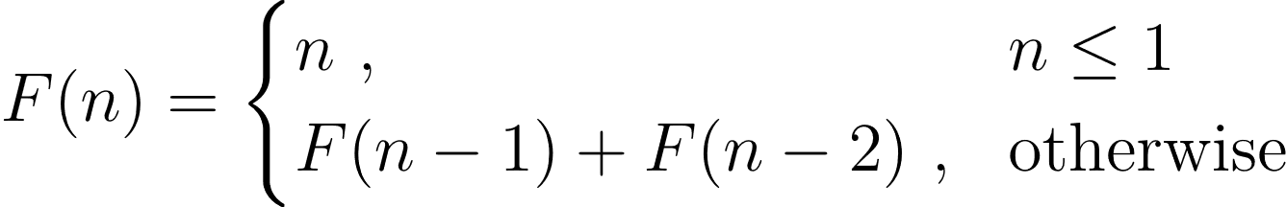
Fibonacci

Slide 8
You already know APL
Arithmetic
Comparisons
Sets & Logic
+ - × ÷ !
< ≤ = ≠ > ≥
∩ ∪ ∊ ∧ ∨

Slide 9
Half of it you can just guess
⌽
⍉
⌈
⌊
≢

Slide 10

Half of it you can just guess
⌽
⍉
⌈
⌊
≢

Slide 11
Half of it you can just guess
⌽
⍉
⌈
⌊
≢

Slide 12


Half of it you can just guess
⌽
⍉
⌈
⌊
≢

Slide 13
Half of it you can just guess
⌽
⍉
⌈
⌊
≢

Slide 14
Half of it you can just guess
⌽
⍉
⌈
⌊
≢
7.3

Slide 15
Half of it you can just guess
⌽
⍉
⌈
⌊
≢
8

Slide 16
Half of it you can just guess
⌽
⍉
⌈
⌊
≢
8
7.3

Slide 17
Half of it you can just guess
⌽
⍉
⌈
⌊
≢
8
7

Slide 18
Half of it you can just guess
⌽
⍉
⌈
⌊
≢
8
7
'tally'

Slide 19
Half of it you can just guess
⌽
⍉
⌈
⌊
≢
8
7
5 =
'tally'

Slide 20
A tool kit that grows
PlusMinus ← + , -
Average ← +/ ÷ ≢

Slide 21
Some disparate notations are unified

Slide 22

Secant Method
$$x_{n}=\frac{x_{n−2}f(x_{n−1})−x_{n−1}f(x_{n−2})}{f\left(x_{n−1}\right)−f(x_{n−2})}$$

Slide 23
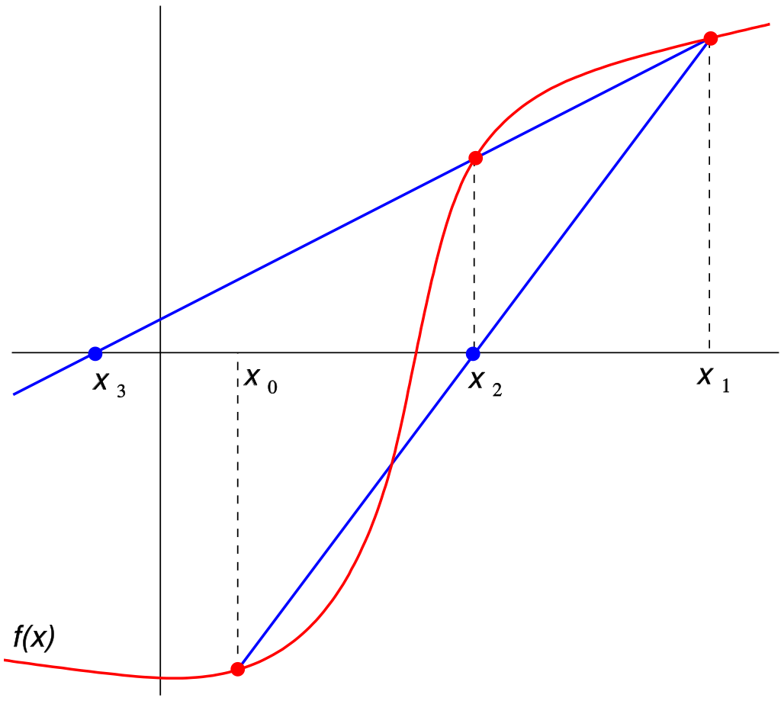
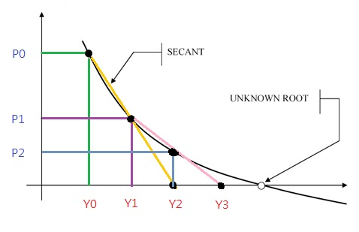
Secant Method

Slide 24
Examples: Today's Problems
Cypher
Nails
Zoo

Slide 25
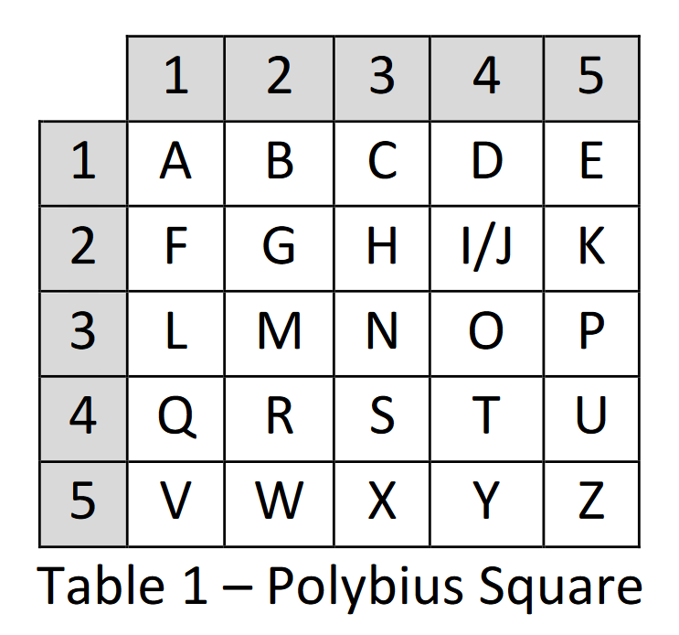
Tap Encoding
TapEnc'APL'
* * *** ***** *** *

Slide 26
Tap Encoding
TapEnc'APL'
* * *** ***** *** *

Slide 27
Tap Encoding
TapEnc'APL'
* * *** ***** *** *

Slide 28
Tap Encoding
TapEnc'APL'
* * *** ***** *** *

Slide 29
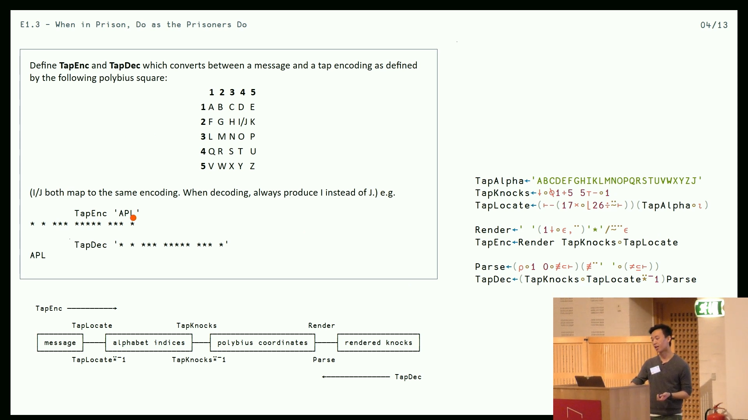

Slide 30
Thinking in rectangles

Slide 31
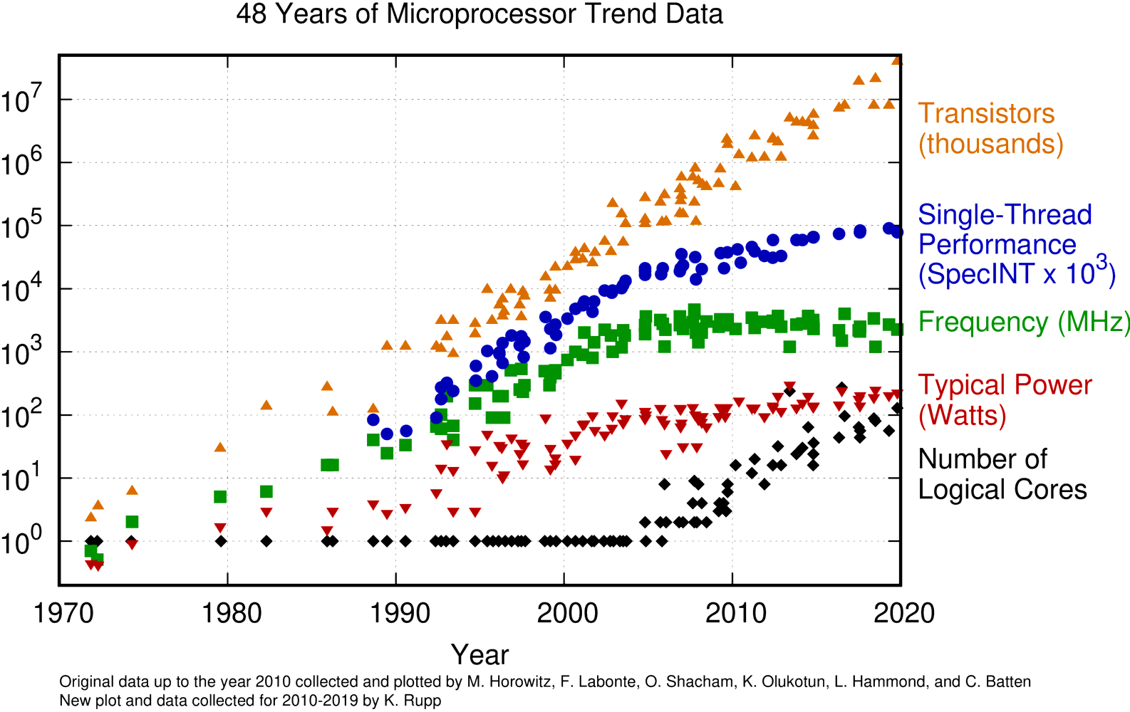
Free lunch om nom nom

Slide 32
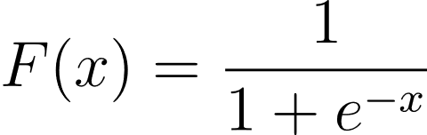
Rectangles are fashionable again
⍝ Sigmoid function
F ← {
÷1+*-⍵
}

Slide 33
BackProp ← {
⍝ Compute the derivatives of the network parameters w.r.t. some network output.
⍝ ⍵: consecutive layer outputs.
⍝ ⍺: expected network output.
dWs ← ⍬
dbs ← ⍬
xs ← 1↓⌽⍵
dxs ← ⊂⍺ LossFn.DLoss⊃⌽⍵
BP ← {
⍝ Auxiliary function.
⍝ The layers and xs are in the reverse natural order of the network,
⍝ while the derivative arrays are in the natural order.
(layers xs dWs dbs dxs) ← ⍵
l ← ⊃layers
x ← l.bias+l.weights+.×⊃xs
db ← (⊃⌽dxs)×l.ActivationFn.DF x
dx ← (⍉l.weights)+.×db
dW ← db+.×⍉⊃xs
(1↓layers) (1↓xs) (dWs,⊂dW) (dbs,⊂db) (dxs,⊂dx)
}
r ← BP⍣(≢layers) ⊢ (⌽layers) xs dWs dbs dxs
(_ _ dWs dbs _) ← r
(⌽dWs) (⌽dbs)
}

Slide 34
BP ← {
⍝ Auxiliary function.
⍝ The layers and xs are in the reverse natural order of the network,
⍝ while the derivative arrays are in the natural order.
(layers xs dWs dbs dxs) ← ⍵
l ← ⊃layers
x ← l.bias+l.weights+.×⊃xs
db ← (⊃⌽dxs)×l.ActivationFn.DF x
dx ← (⍉l.weights)+.×db
dW ← db+.×⍉⊃xs
(1↓layers) (1↓xs) (dWs,⊂dW) (dbs,⊂db) (dxs,⊂dx)
}
r ← BP⍣(≢layers) ⊢ (⌽layers) xs dWs dbs dxs
(_ _ dWs dbs _) ← r
(⌽dWs) (⌽dbs)
}

Slide 35
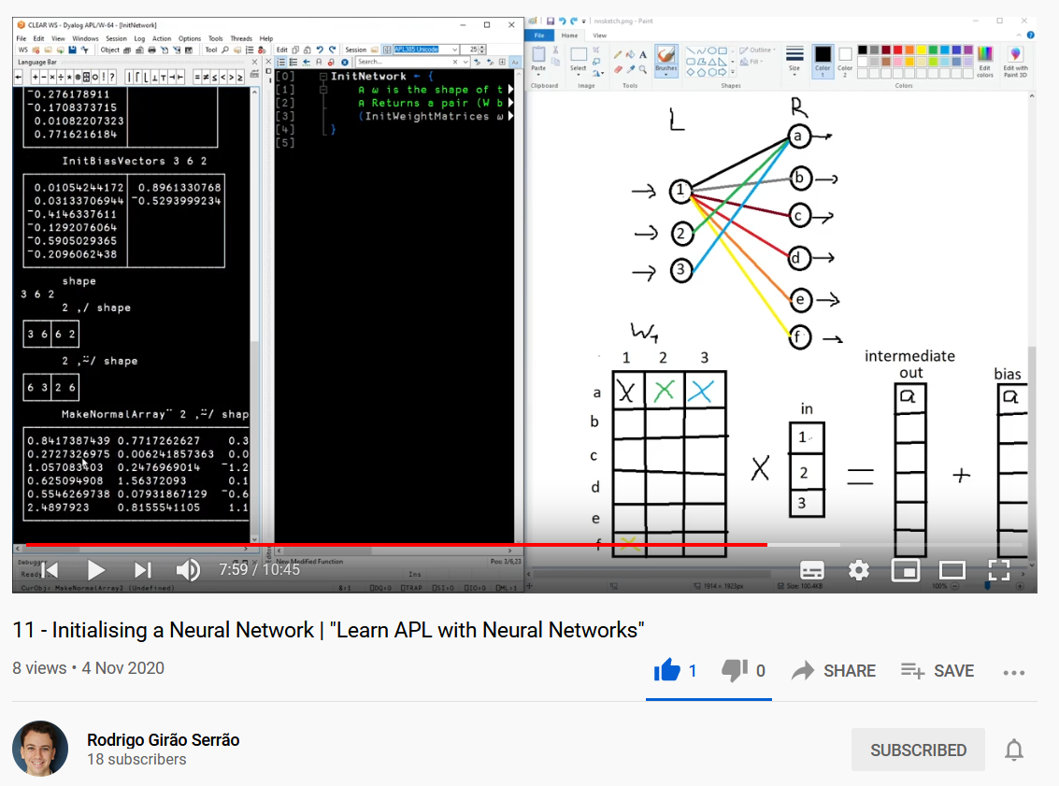

Slide 36
So who's using this anyway?
Business & Finance
Medical Records

Slide 37
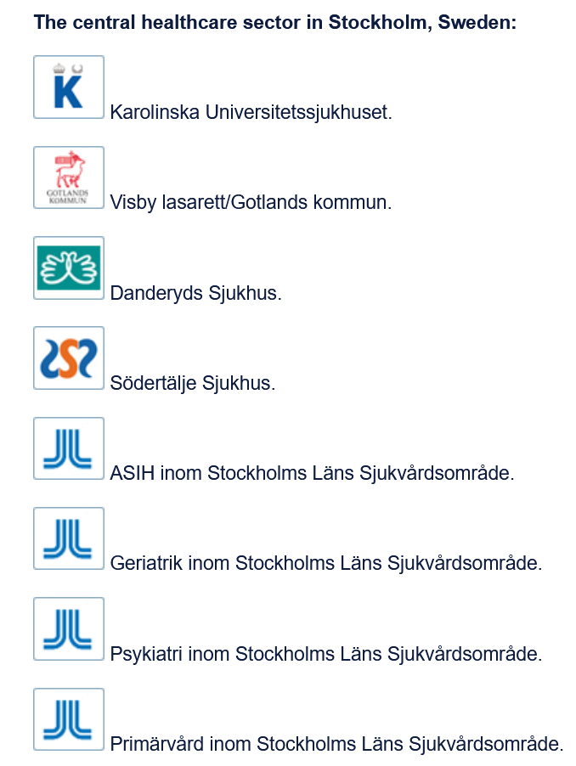
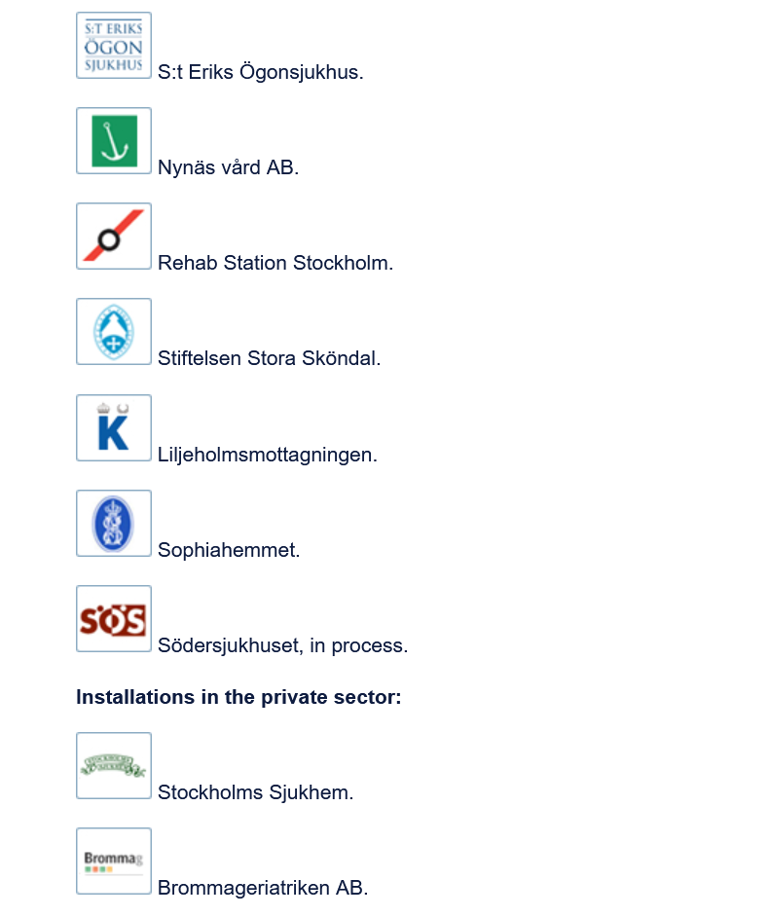

Slide 38
So who's using this anyway?
Business & Finance
Medical Records
Science
DNA Oil refinery NMR
Computer Science
Co-dfns

Slide 39
⍝ A B E F G L M N O P V Z
⍝ 0 1 2 3 4 5 6 7 8 9 10 11
tt←{⍞←'C' ⋄ ((d t k n)exp sym)←⍵ ⋄ I←{(⊂⍵)⌷⍺}
r←I@{t[⍵]≠3}⍣≡⍨p⊣2{p[⍵]←⍺[⍺⍸⍵]}⌿⊢∘⊂⌸d⊣p←⍳≢d ⍝ PV
p,←n[i]←(≢p)+⍳≢i←⍸(t=3)∧p≠⍳≢p ⋄ t k n r,←3 1 0(r[i])⍴⍨¨≢i ⍝ LF
p r I⍨←⊂n[i]@i⊢⍳≢p ⋄ t k(⊣@i⍨)←10 1
i←(⍸(~t∊3 4)∧t[p]=3),{⍵⌿⍨2|⍳≢⍵}⍸t[p]=4 ⋄ p t k n r⌿⍨←⊂m←2@i⊢1⍴⍨≢p ⍝ WX
p r i I⍨←⊂j←(+⍀m)-1 ⋄ n←j I@(0≤⊢)n ⋄ p[i]←j←i-1
k[j]←-(k[r[j]]=0)∨0@({⊃⌽⍵}⌸p[j])⊢(t[j]=1)∨(t[j]=2)∧k[j]=4 ⋄ t[j]←2
p[i]←p[x←¯1+i←{⍵⌿⍨~2|⍳≢⍵}⍸t[p]=4] ⋄ t[i,x]←t[x,i] ⋄ k[i,x]←k[x,i] ⍝ LG
n[x]←n[i] ⋄ p←((x,i)@(i,x)⊢⍳≢p)[p]
n[p⌿⍨(t[p]=2)∧k[p]=3]+←1 ⍝ CI
p[i]←p[x←p I@{~t[p[⍵]]∊3 4}⍣≡i←⍸t∊4,(⍳3),8+⍳3] ⋄ j←(⌽i)[⍋⌽x] ⍝ LX
p t k n r{⍺[⍵]@i⊢⍺}←⊂j ⋄ p←(i@j⊢⍳≢p)[p]
s←¯1,⍨∊⍳¨n[∪x]←⊢∘≢⌸x←0⌷⍉e←∪I∘⍋⍨rn←r[b],⍪n[b←⍸t=1] ⍝ SL
d←(≢p)↑d ⋄ d[i←⍸t=3]←0 ⋄ _←{z⊣d[i]+←⍵≠z←r[⍵]}⍣≡i ⋄ f←d[0⌷⍉e],¯1 ⍝ FR
xn←n⌿⍨(t=1)∧k[r]=0 ⍝ XN
v←⍸(n<¯4)∧(t=10)∨(t=2)∧k=4 ⋄ x←n[y←v,b] ⋄ n[b]←s[e⍳rn] ⋄ i←(≢x)⍴c←≢e ⍝ AV
_←{z/⍨c=i[1⌷z]←e⍳⍉x I@1⊢z←r I@0⊢⍵}⍣≡(v,r[b])⍪⍉⍪⍳≢x
f s←(f s I¨⊂i)⊣@y¨⊂¯1⍴⍨≢r
p t k n f s r d xn sym}

Slide 40
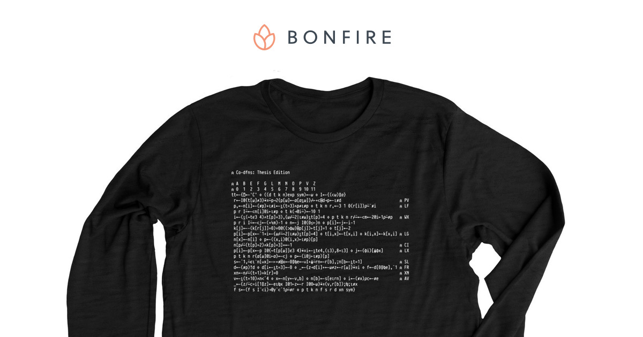

Slide 41
So who's using this anyway?
Business & Finance
Medical Records
Science
DNA Oil refinery NMR
Computer Science
Co-dfns
Simulation: https://stormwind.fi/

Slide 42
Where to find out more?
tryapl.org
apl.wiki
apl.chat
dyalog.tv

Slide 43
Why learn APL?
A tool of thought
Think in rectangles
Kattis

Slide 44
Why should I start learning today?
Annual APL Problem Solving Competition
Launched this week
Compete for $$$
Previous winners learned APL while participating
Referral awards
dyalogaplcompetition.com

