Slide 1

APL Array Notation
Adám Brudzewsky
^{Head of Language Design}
^{Dyalog Ltd.}

Slide 2

A Plan?
History
APL
Problem
Design Iteration
Specification
Implementation
Standardisation?
Take-aways?

Slide 3
History
│
│
│
│
│
│
│
│
│

Slide 4
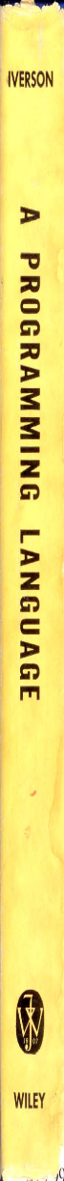

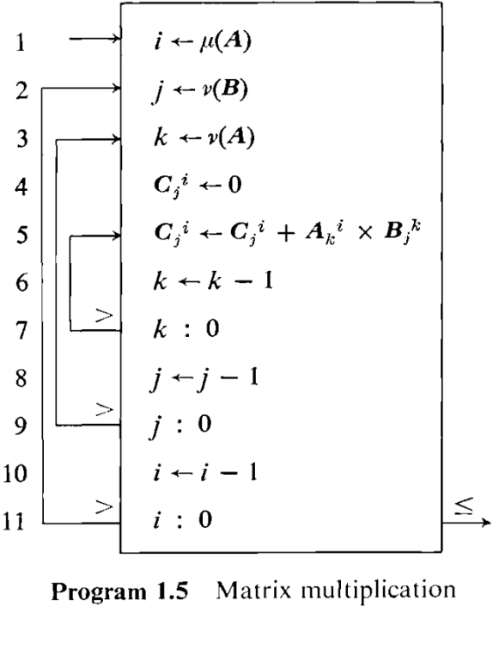
History
├1962:
│
│
│
│
│
│
│
│

Slide 5
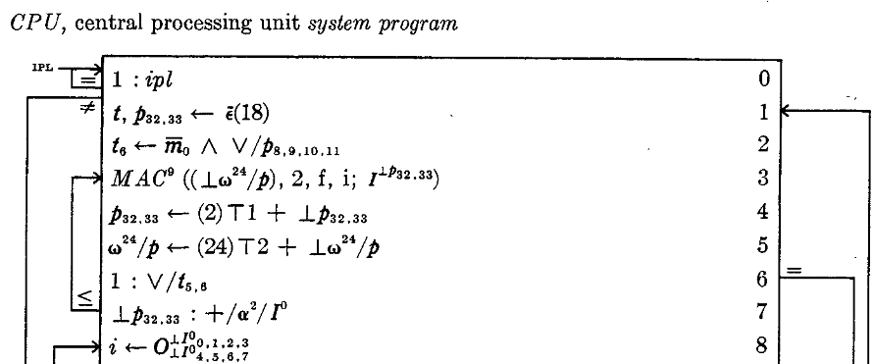
History
│
├1964: IBM System/360 design
│
│
│
│
│
│
│

Slide 6
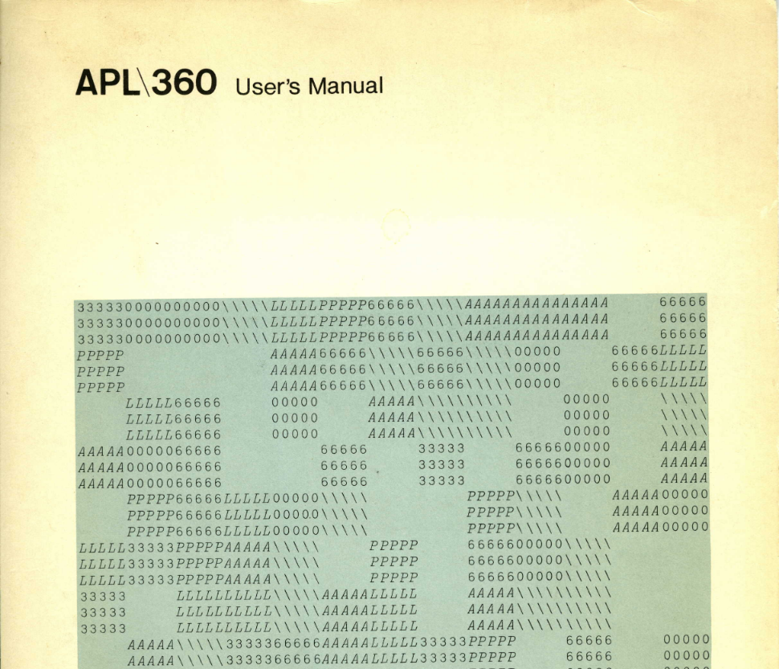
History
│
│
├1966: IBM in-house
│
│
│
│
│
│

Slide 7
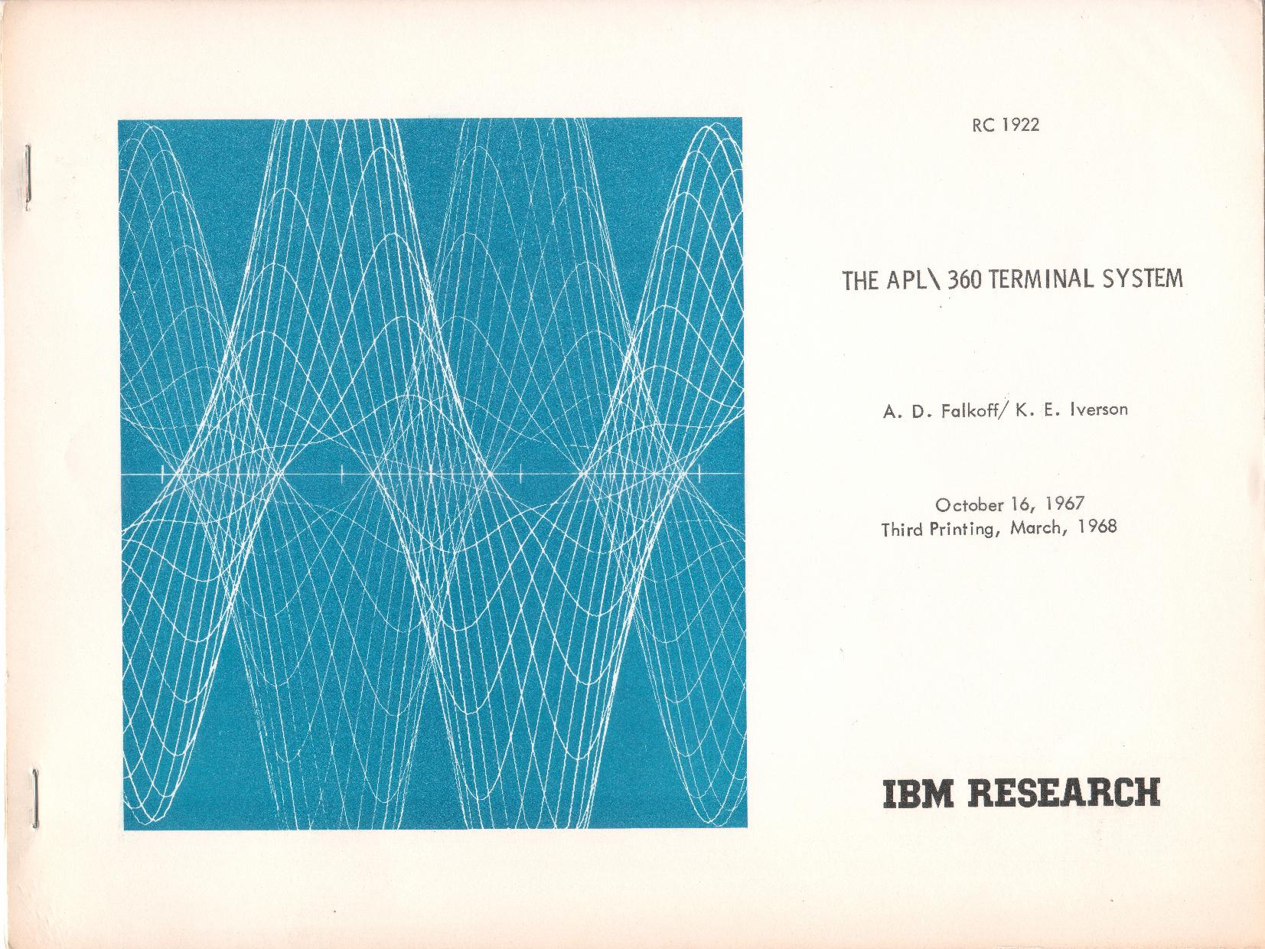
History
│
│
│
├1968: Father
│
│
│
│
│

Slide 8
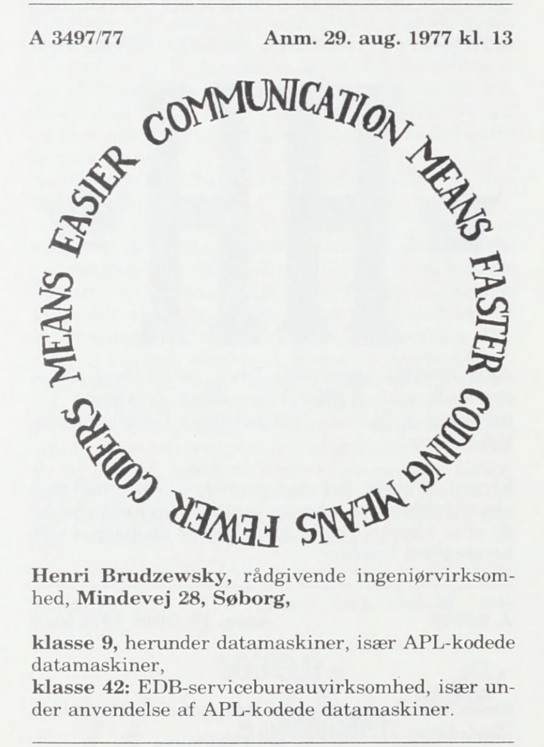
History
│
│
│
│
├1972: Father teaches and consults
│
│
│
│

Slide 9
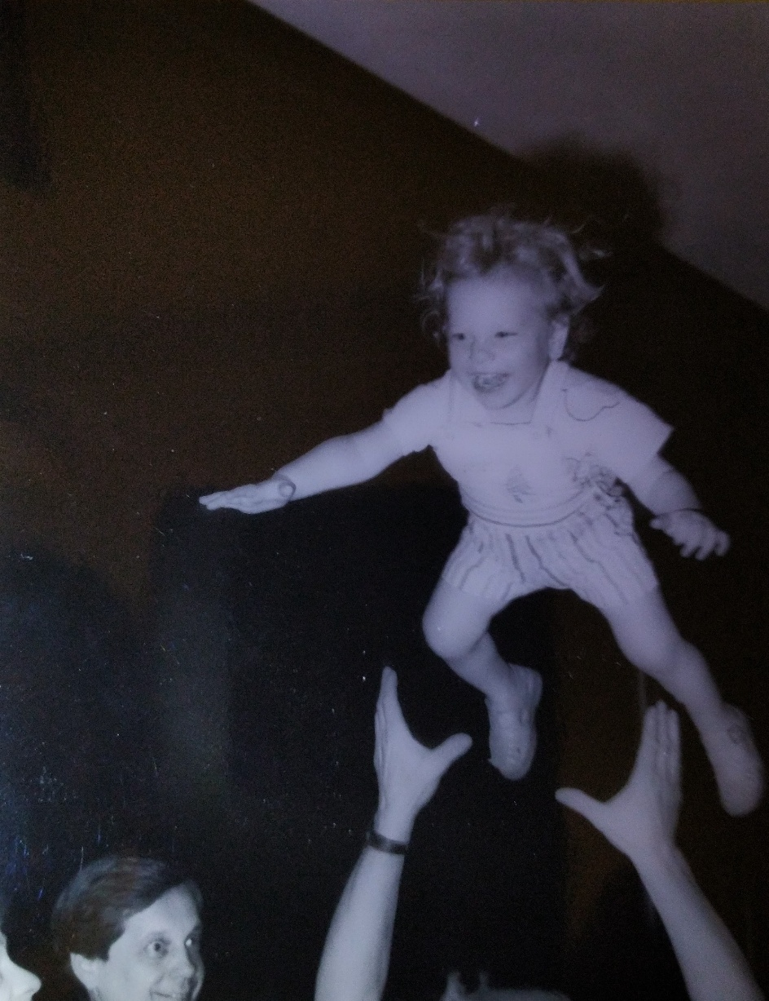
History
│
│
│
│
│
├1986: My first APL conference
│
│
│

Slide 10
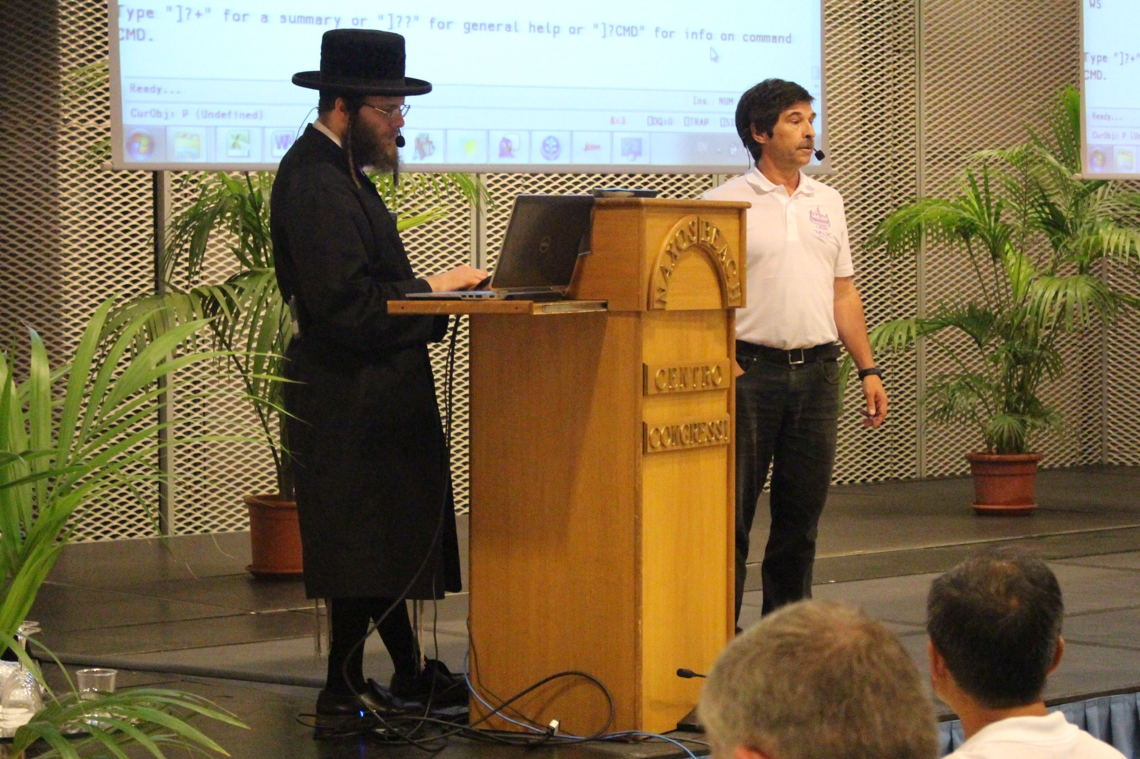
History
│
│
│
│
│
│
├2014: I join Dyalog
│
│

Slide 11
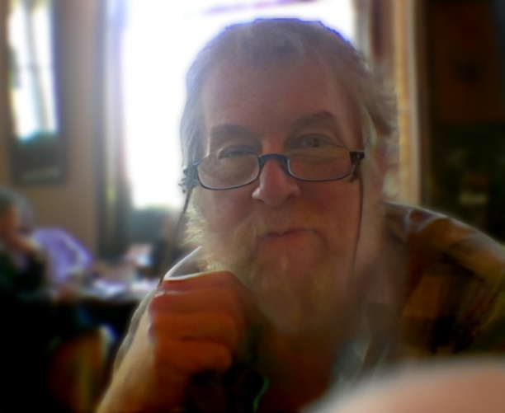
History
youtu.be/9-HAvTMhYao
(…)
'second row of matrix'
'third row of matrix']
(…)
⍝ Doesn't have to be brackets - many reasons why not
⍝ [ ⋄ ] ( ⋄ ) [[ ⋄ ]] ([ ⋄ ]) ⍃ ⋄ ⍄
⍝ Problem with digraphs - human parsing - unicode - many bracketing pairs.
(…)
My hope is that Dyalog and as many as possible of other APL vendors will
consider these proposals and questions and perhaps come to some kind of
agreement to include at least the basic concepts into their products.
Phil Last, <phil.last@4xtra.com> Wiltshire, Wednesday 9 Sept 2015
│
│
│
│
│
│
│
├2015:
│

Slide 12
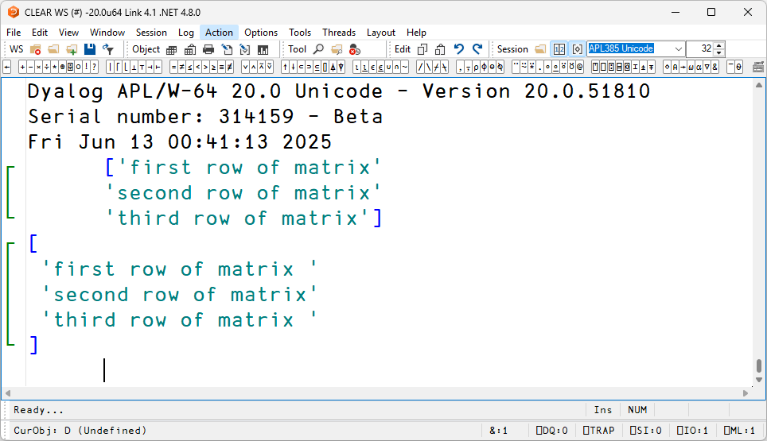
History
│
│
│
│
│
│
│
│
├2025: PLSS

Slide 13
History
├1962: Kenneth E. Iverson, A Programming Language
├1964: IBM System/360 design
├1966: IBM in-house APL\360
├1968: Father joins IBM Research
├1972: Father teaches and consults
├1986: My first APL conference
├2014: I join Dyalog
├2015: Phil Last, APL Array Notation
├2025: PLSS

Slide 14
History
├1962: Kenneth E. Iverson, A Programming Language
├1964: IBM System/360 design
├1966: IBM in-house APL\360
├1968: Father joins IBM Research
├1972: Father teaches and consults
├1986: My first APL conference
├2014: I join Dyalog
├2015: Phil Last, APL Array Notation
├2025: PLSS

Slide 15
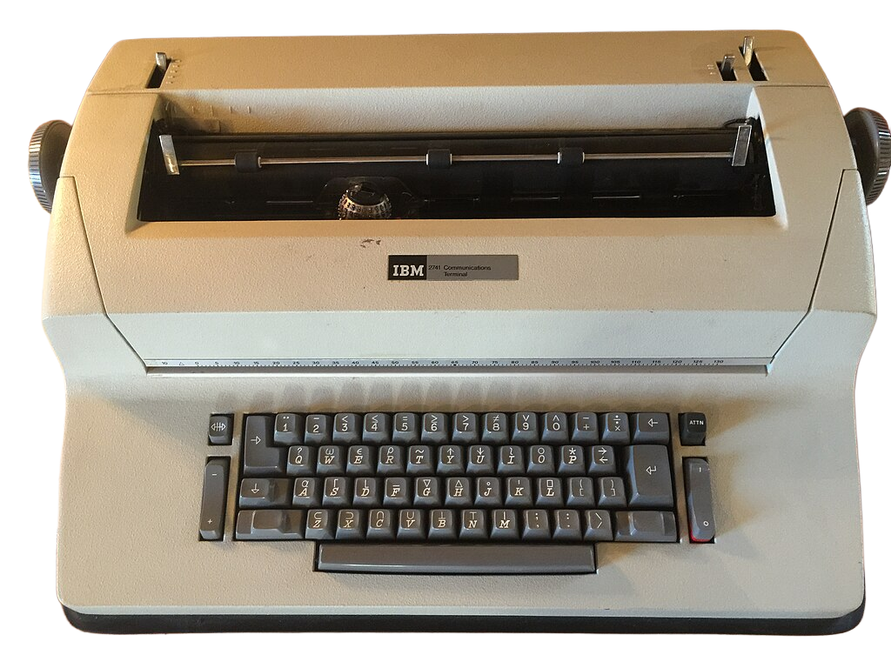
APL
⍳ 6
1 2 3 4 5 6
2 3
2 3
2 3 + 40
42 43
2 3 + 40 50
42 53
2 3 + (40 50) (60 70)
42 52 63 73
CC BY-SA 4.0: w.wiki/EY$n

Slide 16
APL
CC BY-SA 4.0: w.wiki/EY$n
2 3 ⍴ ⍳ 6

Slide 17
APL
2 3 ⍴ (⍳ 6)

Slide 18
APL
2 3 ⍴ ⍳ 6
1 2 3
4 5 6

Slide 19
APL
2 3 ⍴ ⍳ 6 ⋄ 2 3 ⍴ 6 + ⍳ 6
1 2 3
4 5 6
7 8 9
10 11 12

Slide 20
APL
(2 3 ⍴ ⍳ 6) (2 3 ⍴ 6 + ⍳ 6)
1 2 3 7 8 9
4 5 6 10 11 12
X
( 1 2 3 ( 7 8 9
4 5 6) 10 11 12)
The variable X contains a two-item vector, each
of whose items is a two-row, three-column matrix.

Slide 21
APL
(2 3 ⍴ ⍳ 6) (2 3 ⍴ 6 + ⍳ 6)
1 2 3 7 8 9
4 5 6 10 11 12
X
( 1 2 3 ( 7 8 9
4 5 6) 10 11 12)
1 2 3 (2 3 ⍴ 7 8 9 4 5 6) 10 11 12
1 2 3 7 8 9 10 11 12
4 5 6

Slide 22
Problem
(2 3 ⍴ ⍳ 6) (2 3 ⍴ 6 + ⍳ 6)
1 2 3 7 8 9
4 5 6 10 11 12

Slide 23
Problem
(2 3 ⍴ ⍳ 6) (2 3 ⍴ 6 + ⍳ 6)
┌─────┬────────┐
│1 2 3│ 7 8 9│
│4 5 6│10 11 12│
└─────┴────────┘

Slide 24
Problem
(2 3 ⍴ ⍳ 6) (2 3 ⍴ 6 + ⍳ 6)
┌─────┬────────┐
│1 2 3│ 7 8 9│
│4 5 6│10 11 12│
└─────┴────────┘

Slide 25
Problem
(2 3 ⍴ ⍳ 6) (2 3 ⍴ 6 + ⍳ 6)
┌─────┬────────┐
│1 2 3│ 7 8 9│
│4 5 6│10 11 12│
└─────┴────────┘

Slide 26
Problem
Intuitive
Easy to type
Ideally ASCII
Versatile (single/multi-line, Table, nested, object)
Unambiguous — consider:
list[i] table[i;j] (1 2)(3 4) {lambda}

Slide 27
Design Iteration
│
│
│
│
│
│
│
│
│

Slide 28
Design Iteration
├2015 Acre, Mk I
│
│ Table: [1 2 3 ⋄ 4 5 6]
│
│
│
│
│
│

Slide 29
Design Iteration
├2015 Acre, Mk I
│
│ Table: [1 2 3
│ 4 5 6]
│
│
│
│
│

Slide 30
Design Iteration
├2015 Acre, Mk I
│
│ Table: 1 2 3
│ 4 5 6
│
│
│
│
│

Slide 31
Design Iteration
├2015 Acre, Mk I
│
│ Table: [1 2 3 ⋄ 4 5 6]
│
│
│
│
│
│

Slide 32
Design Iteration
├2015 Acre, Mk I
│
│ Table: [1 2 3 ⋄ 4 5 6]
│ List: —
│
│
│
│
│

Slide 33
Design Iteration
├2015 Acre, Mk I
│
│ Table: [1 2 3 ⋄ 4 5 6]
│ List: —
│ Object: [[name1←val1 ⋄ name2←val2]]
│
│
│
│

Slide 34
Design Iteration
├2015 Acre, Mk I
│
│ Table: [1 2 3 ⋄ 4 5 6]
│ List: —
│ Object: [[name1←val1 ⋄ name2←val2]]
│ Value: 6×a←7
│
│
│

Slide 35
Design Iteration
├2015 Acre, Mk I
│
│ Table: [1 2 3 ⋄ 4 5 6]
│ List: —
│ Object: [[name1←val1 ⋄ name2←val2]]
│ Value: 6×a←7
│ Table: [a←7 ⋄ b←8]
│
│

Slide 36
Design Iteration
├2015 Acre, Mk I
│
│ Table: [1 2 3 ⋄ 4 5 6]
│ List: —
│ Object: [[name1←val1 ⋄ name2←val2]]
│ Value: 6×a←7
│ Table: [a←7 ⋄ b←8]
│ Indexing: list[indices]
│

Slide 37
Design Iteration
├2015 Acre, Mk I
│
│ Table: [1 2 3 ⋄ 4 5 6]
│ List: —
│ Object: [[name1←val1 ⋄ name2←val2]]
│ Value: 6×a←7
│ Table: [a←7 ⋄ b←8]
│ Indexing: list[indices]
│ Ambiguous: list [[a←7 ⋄ b←8]]

Slide 38
Design Iteration
├2015 Acre, Mk I
│
│ Table: [1 2 3 ⋄ 4 5 6]
│ List: —
│ Object: [[name1←val1 ⋄ name2←val2]]
│ Value: 6×a←7
│ Table: [a←7 ⋄ b←8]
│ Indexing: list[indices]
│ Ambiguous: list([[a←7 ⋄ b←8]])

Slide 39
Design Iteration
│ Acre, Mk II
│
│ Table: [1 2 3 ⋄ 4 5 6]
├2018 List: —
│ Object: [name1←val1 ⋄ name2←val2]
│
│
│
│

Slide 40
Design Iteration
│ Acre, Mk II
│
│ Table: [1 2 3 ⋄ 4 5 6]
├2018 List: —
│ Object: [name1←val1 ⋄ name2←val2]
│ Empty obj? []
│
│
│

Slide 41
Design Iteration
│ Acre, Mk II
│
│ Table: [1 2 3 ⋄ 4 5 6]
├2018 List: —
│ Object: [name1←val1 ⋄ name2←val2]
│ Empty obj? []
│ All rows: table[;42]
│
│

Slide 42
Design Iteration
│ Acre, Mk II
│
│ Table: [1 2 3 ⋄ 4 5 6]
├2018 List: —
│ Object: [name1←val1 ⋄ name2←val2]
│ Empty obj? []
│ All rows: table[;42]
│ Ambiguous: list []
│

Slide 43
Design Iteration
│ Acre, Mk II
│
│ Table: [1 2 3 ⋄ 4 5 6]
├2018 List: —
│ Object: [name1←val1 ⋄ name2←val2]
│ Empty obj? []
│ All rows: table[;42]
│ Ambiguous: list([])
│

Slide 44
Design Iteration
│ Acre, Mk II
│
│ Table: [1 2 3 ⋄ 4 5 6]
├2018 List: —
│ Object: [name1←val1 ⋄ name2←val2]
│ Empty obj? []
│ All rows: table[;42]
│ Ambiguous: list []
│ Empty obj: [ ← ⋄ ]

Slide 45
Design Iteration
│ Dyalog, Mk I
│
├2017 Table: (1 2 3 ⋄ 4 5 6)
│ List: —
│ Object: (name1:val1 ⋄ name2:val2)
│
│
│
│

Slide 46
Design Iteration
│ Dyalog, Mk I
│
├2017 Table: (1 2 3 ⋄ 4 5 6)
│ List: —
│ Object: (name1:val1 ⋄ name2:val2)
│ List: (1 ⋄ 4 ⋄ 7)
│
│
│

Slide 47
Design Iteration
│ Dyalog, Mk I
│
├2017 Table: (1 2 3 ⋄ 4 5 6)
│ List: —
│ Object: (name1:val1 ⋄ name2:val2)
│ List: (1 ⋄ 4 ⋄ 7)
│ Column: ((1 ⋄) ⋄ (4 ⋄) ⋄ (7 ⋄))
│
│

Slide 48
Design Iteration
│ Dyalog, Mk I
│
├2017 Table: (1 2 3 ⋄ 4 5 6)
│ List: —
│ Object: (name1:val1 ⋄ name2:val2)
│ List: (1 ⋄ 4 ⋄ 7)
│ Column: ((1 ⋄) ⋄ (4 ⋄) ⋄ (7 ⋄))
│ Column? (1 ⋄ 4 ⋄ 7)
│

Slide 49
Design Iteration
│ Dyalog, Mk I
│
├2017 Table: (1 2 3 ⋄ 4 5 6)
│ List: —
│ Object: (name1:val1 ⋄ name2:val2)
│ List: (1 ⋄ 4 ⋄ 7)
│ Column: ((1 ⋄) ⋄ (4 ⋄) ⋄ (7 ⋄))
│ Column? (1 ⋄ 4 ⋄ 7)
│ List? —

Slide 50
Design Iteration
│ Dyalog, Mk III
│
│ Table: [1 2 3 ⋄ 4 5 6]
│ List: (1 2 3 ⋄ 1 2)
├2020 Object: (name1:val1 ⋄ name2:val2)
│
│
│
│

Slide 51
Design Iteration
│ Dyalog, Mk III
│
│ Table: [1 2 3 ⋄ 4 5 6]
│ List: (1 2 3 ⋄ 1 2)
├2020 Object: (name1:val1 ⋄ name2:val2)
│ Column: [1 ⋄ 4 ⋄ 7]
│
│
│

Slide 52
Design Iteration
│ Dyalog, Mk III
│
│ Table: [1 2 3 ⋄ 4 5 6]
│ List: (1 2 3 ⋄ 1 2)
├2020 Object: (name1:val1 ⋄ name2:val2)
│ Column: [1
│ 4
│ 7]
│

Slide 53
Design Iteration
│ Dyalog, Mk III
│
│ Table: [1 2 3 ⋄ 4 5 6]
│ List: (1 2 3 ⋄ 1 2)
├2020 Object: (name1:val1 ⋄ name2:val2)
│ Column: [1
│ 4
│ 7]
│ Empty obj: ()

Slide 54
Design Iteration
├2015: Phil Last, APL Array Notation model
├2016: Acre-3, Mk I APL model; Dyalog, Mk I internal
├2017: Dyalog, Mk II presentation
├2018: Acre-4, Mk II APL model; Dyalog, Mk III presentation
├2020: Dyalog, RC1 presentation
├2021: Dyalog Formal Specification & Community Feedback
├2022: Dyalog, RC1 APL model
├2023: Dyalog, RC1 C prototype
├2025: Dyalog, RC2 implementation

Slide 55
Design Iteration
├2015: Phil Last, APL Array Notation model
├2016: Acre-3, Mk I APL model; Dyalog, Mk I internal
├2017: Dyalog, Mk II presentation
├2018: Acre-4, Mk II APL model; Dyalog, Mk III presentation
├2020: Dyalog, RC1 presentation
├2021: Dyalog Formal Specification & Community Feedback
├2022: Dyalog, RC1 APL model
├2023: Dyalog, RC1 C Prototype
├2025: Dyalog, RC2 Implementation

Slide 56
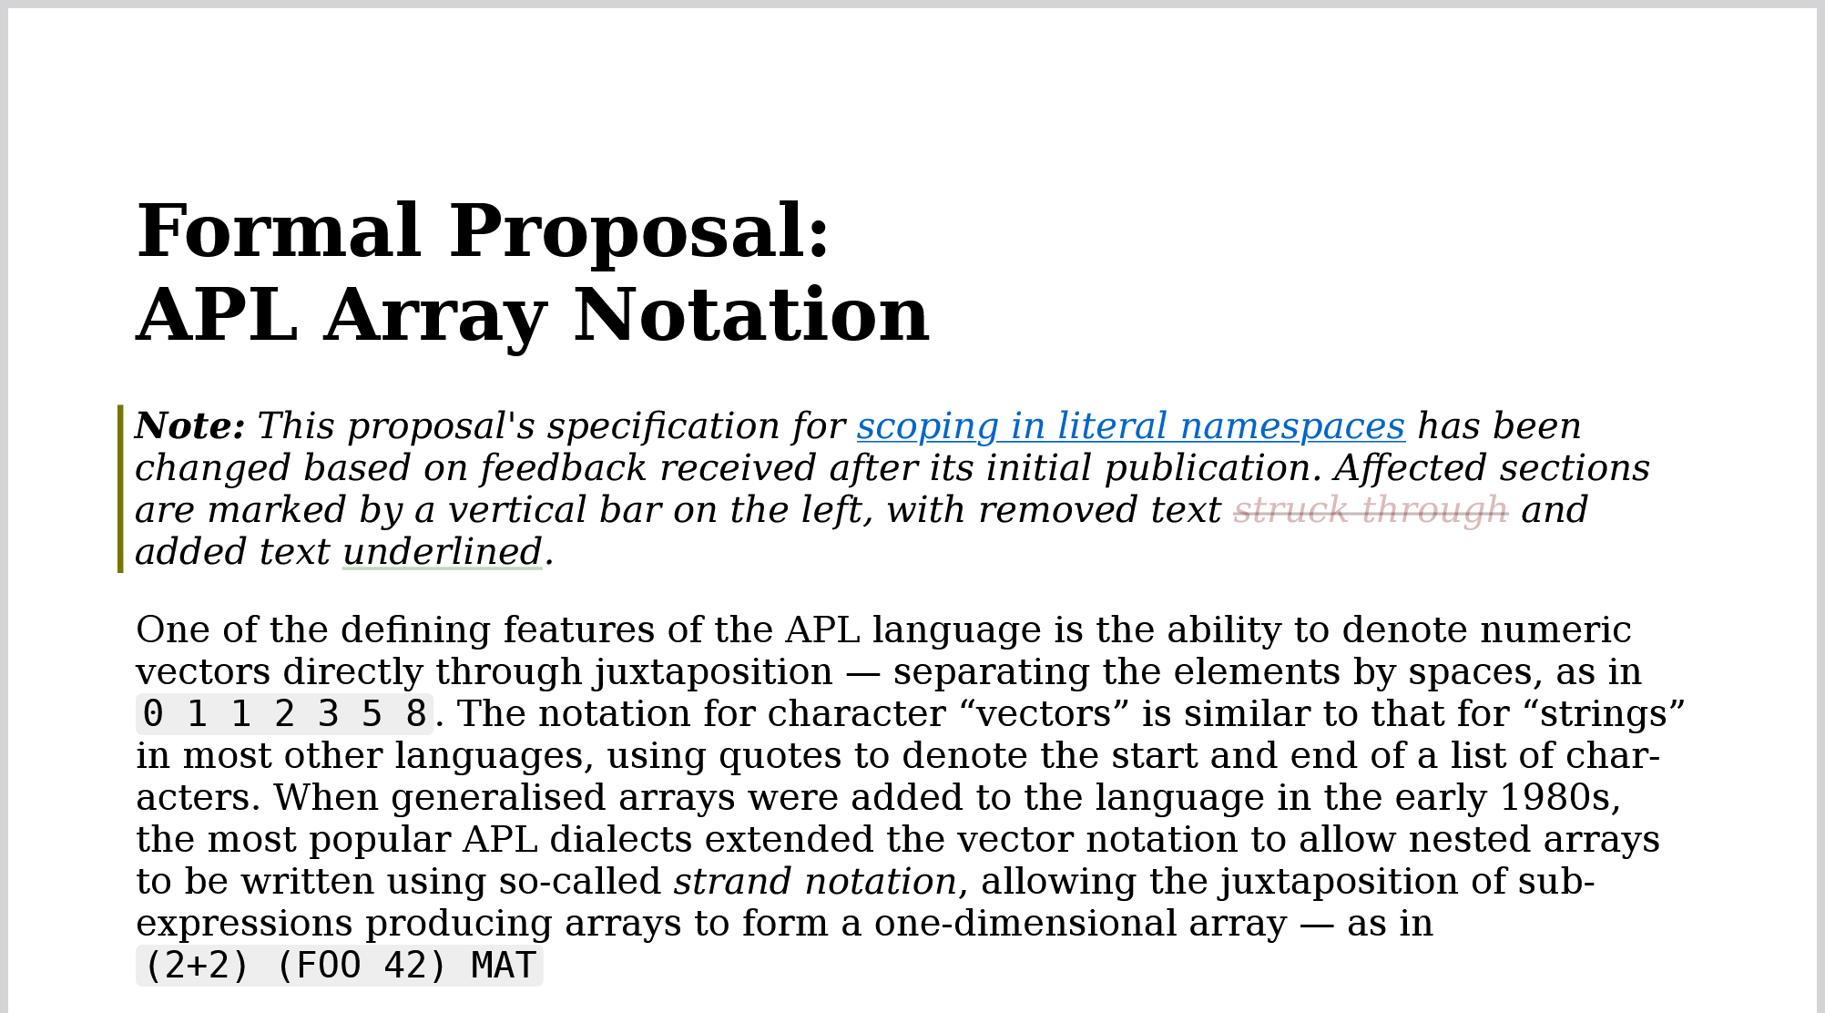
Specification
abrudz.github.io/aplan

Slide 57
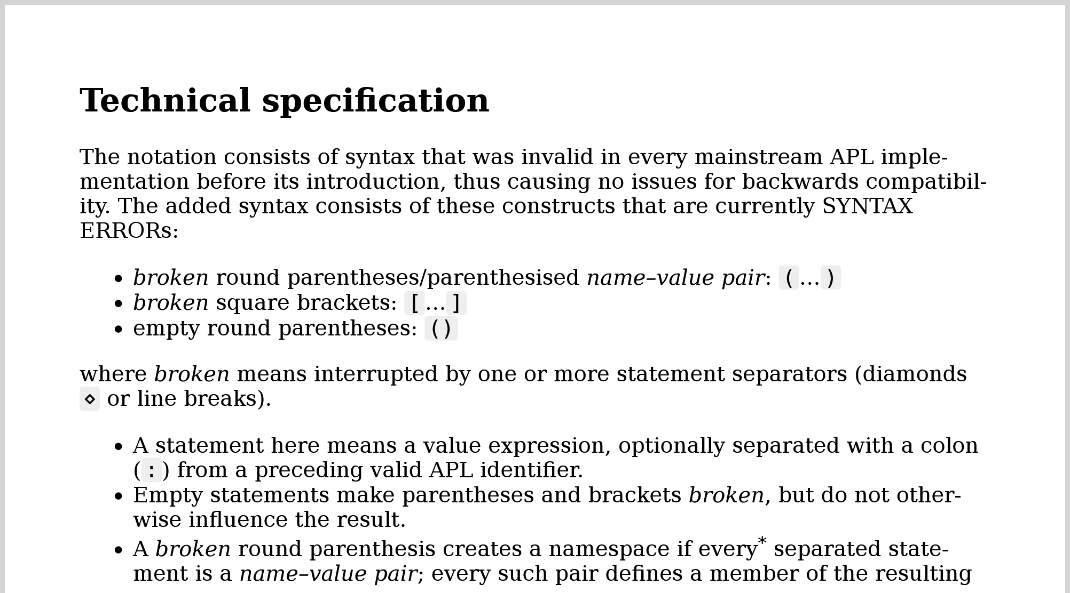
Specification
abrudz.github.io/aplan

Slide 58
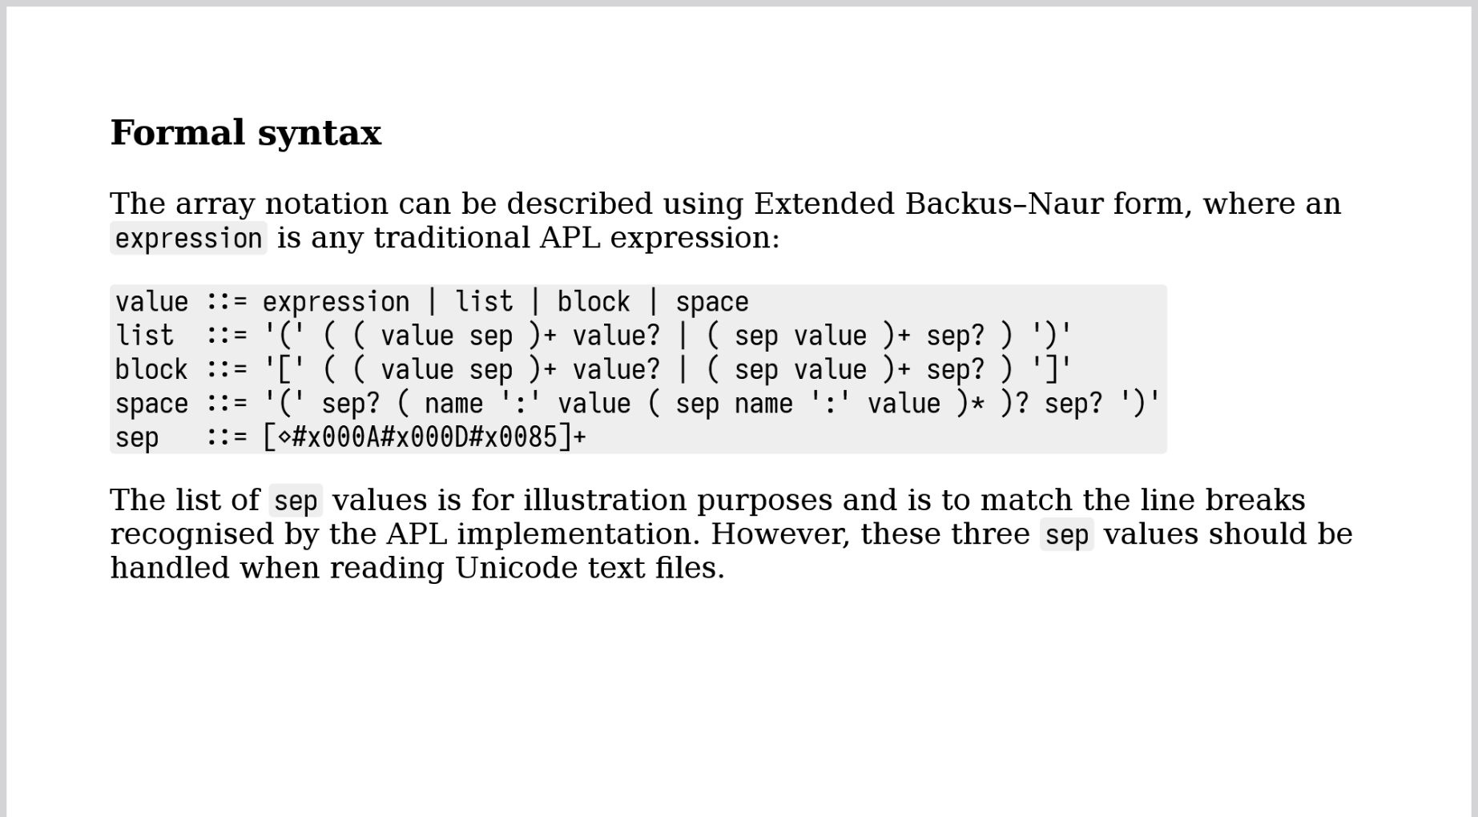
Specification
abrudz.github.io/aplan

Slide 59
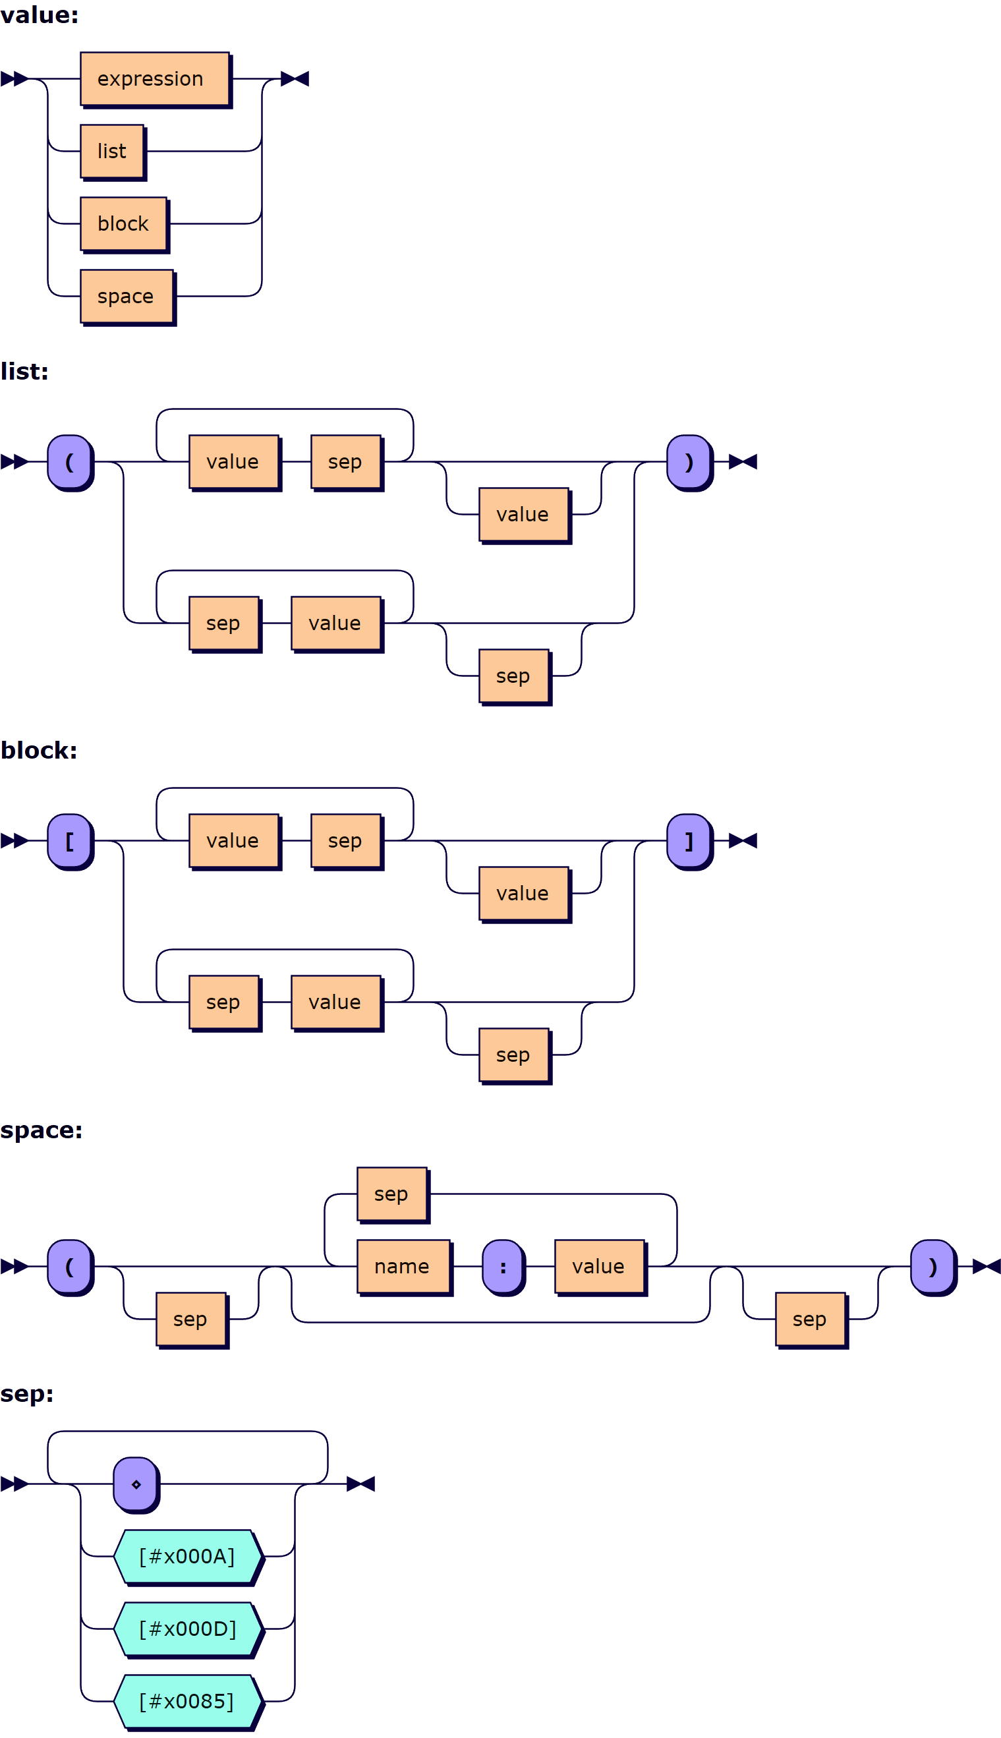
Specification
abrudz.github.io/aplan

Slide 60
Implementation
youtu.be/4cEqsBRMdW0
Parse←{
0=≢⍵:''
bot←0=⍺
(2≤≢⍵)>∨/¯1↓bot:⍺ SubParse ⍵
p←bot×SepMask ⍵
∨/p:∊{1=≢⍵:',⊂',⍵ ⋄ ⍵}⍺(Paren ∇)EachNonempty Over(p Split)⍵
p←2(1,>/∨¯1↓0,</)bot
∨/1↓p:∊(p⊂⍺)∇¨p⊂⍵
⍵
}

Slide 61

Implementation
youtu.be/ToQoJ1Bbpus
parseloop: while (sp) switch(pop()) {
case ST_BEG: {
DEBUG;
// Initial state:
// [ => go to ST_LB
// ( => go to ST_LP
// ANY* => go to ST_EXPR
if (tok.type == TOKLB) { push(ST_LB); break; }
if (tok.type == TOKLP) { push(ST_LP); break; }
if (tok.type == TOKANY || tok.type == TOKSTR || tok.type == TOKID) { push(ST_EXPR); break; }
errorxf(ESYNTAX, DMXAPLAN_UNEXPTOK, tok.offset, tokname(tok.type));
Kamila Szewczyk

Slide 62
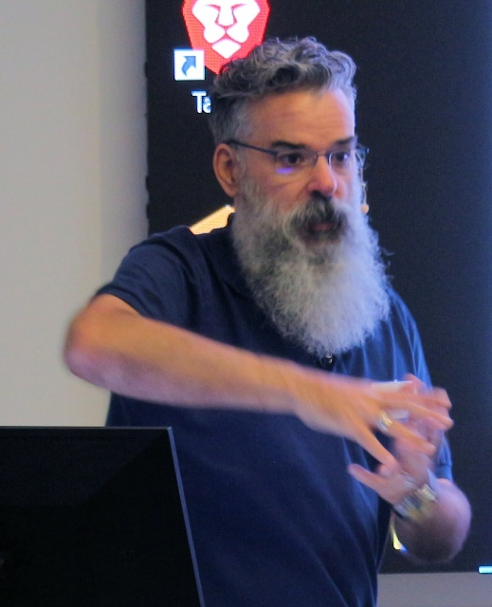
Implementation
youtu.be/bSDStXeKsos
do
{
sp=KwNext(sp);
affirm(sp[1]==KEYWORD);
switch (*sp)
{
case KwANDiamond: count++; break;
case KwANNewLine: count++; break;
case KwANCloseVector: count++; break;
case KwANCloseMix: count++; break;
case KwANAssign: break;
}
} while (sp!=start);
John Daintree

Slide 63
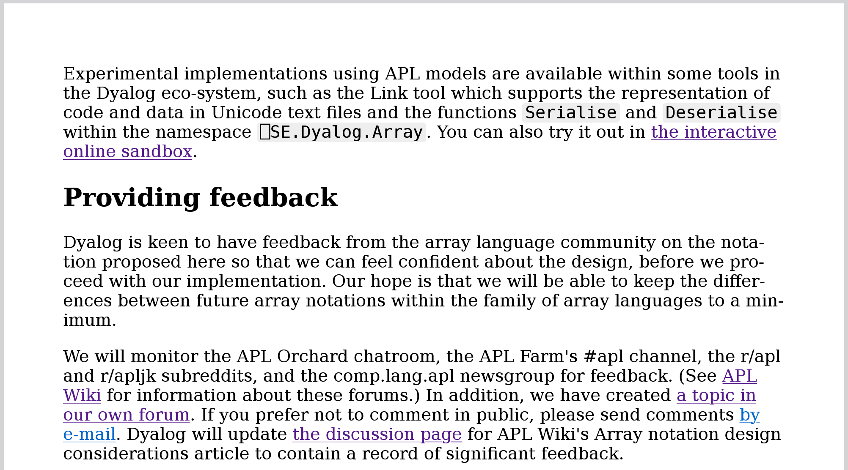
Standardisation?
abrudz.github.io/aplan
Dyalog is keen to have feedback from the array language community on the nota-tion proposed here so that we can feel conﬁdent about the design, before we pro-ceed with our implementation. Our hope is that we will be able to keep the diﬀer-ences between future array notations within the family of array languages to a min-imum.
Dyalog is keen to have feedback from the array language community on the nota-tion proposed here so that we can feel conﬁdent about the design, before we pro-ceed with our implementation. Our hope is that we will be able to keep the diﬀer-ences between future array notations within the family of array languages to a min-imum.
Dyalog is keen to have feedback from the array language community on the nota-tion proposed here so that we can feel conﬁdent about the design, before we pro-ceed with our implementation. Our hope is that we will be able to keep the diﬀer-ences between future array notations within the family of array languages to a min-imum.
Dyalog is keen to have feedback from the array language community on the nota-tion proposed here so that we can feel conﬁdent about the design, before we pro-ceed with our implementation. Our hope is that we will be able to keep the diﬀer-ences between future array notations within the family of array languages to a min-imum.

Slide 64
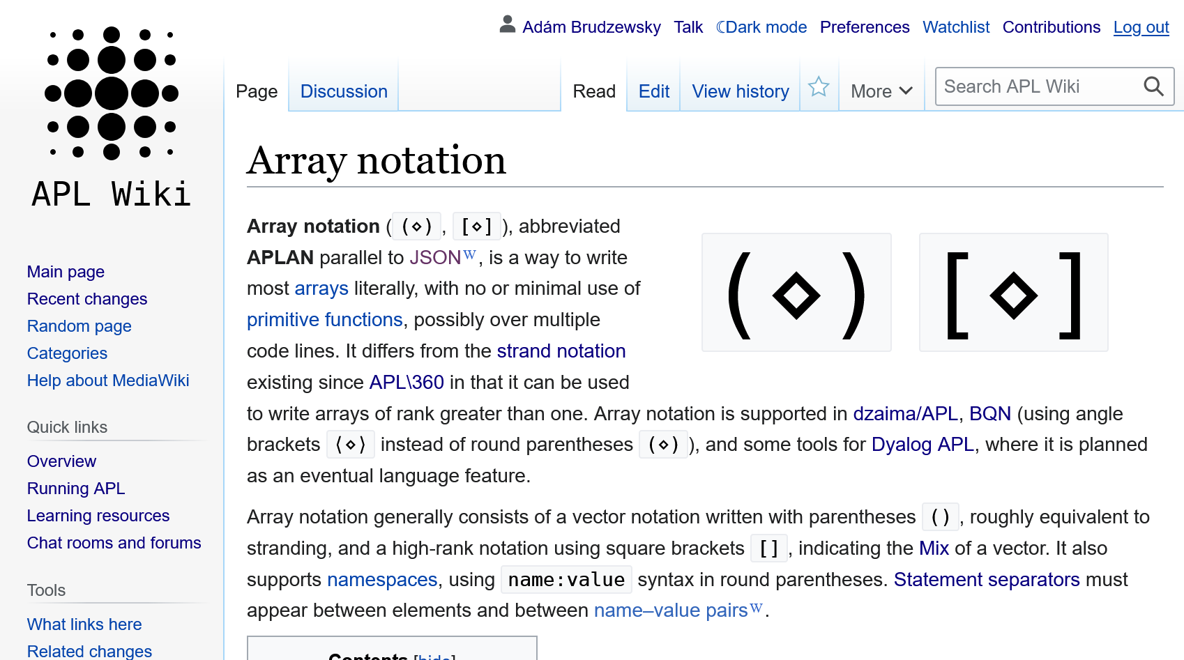
Standardisation?
apl.wiki/aplan

Slide 65
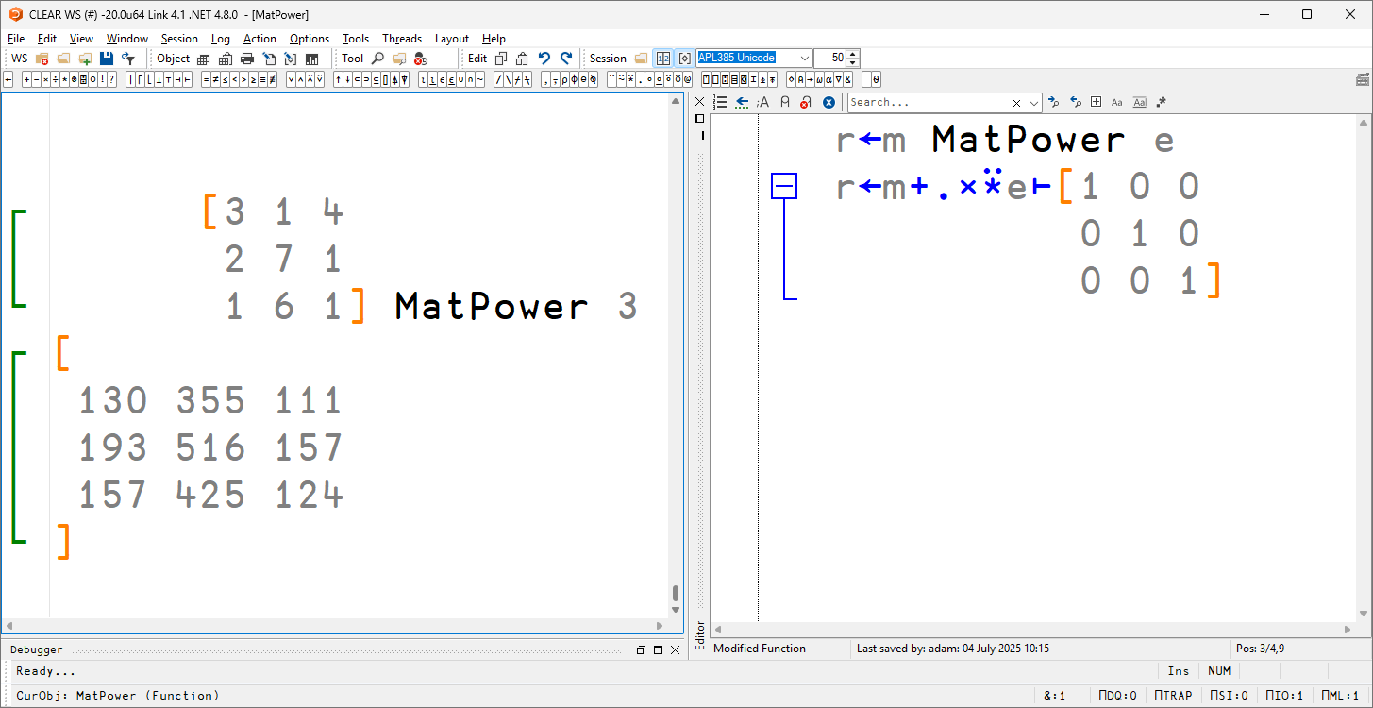

Slide 66
Take-aways?
Good: Lack of standards committee
Bad: Lack of standard for syntax
Ugly: Lack of standardisation for result

Slide 67
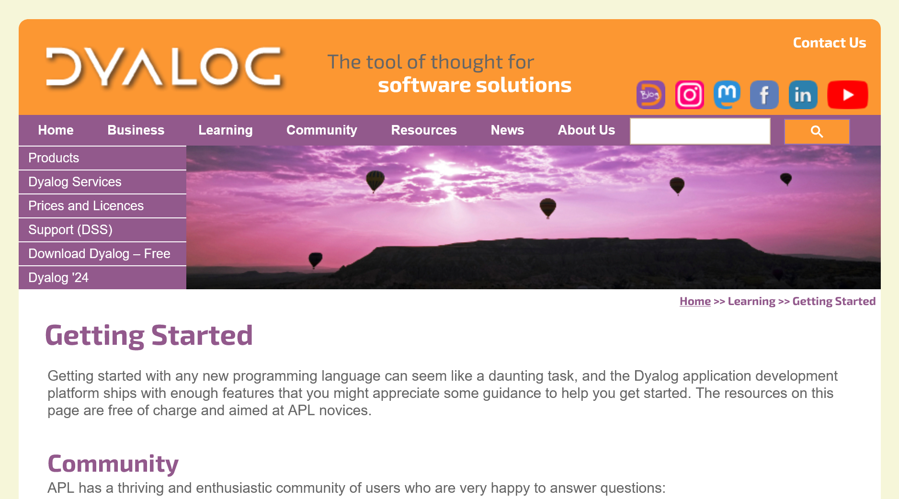
Want more APL?
dyalog.com/getting-started.htm
Cash prizes:
APL Challenge
APL Forge

Slide 68
Recap Resources
History
APL
Problem
Design Iteration
Specification
Implementation
Standardisation?
Take-aways?
apl.wiki
dyalog.tv
abrudz.github.io/aplan
dyalog.com/
getting-started.htm
apl.chat (Stack Exchange)
adam@dyalog.com

