Slide 1
Introducing Dyalog version 18.2
Morten Kromberg

Slide 2
Overview
Release Dates & Patches
Basic Licence
Launching from Text Files:
  Shell Scripts
  Text Source
  LOAD Parameter
Explorer Integration
Docker Support
RIDE v4.4
Developer Productivity:
  JSON tables/datasets
  ⎕ATX metadata one-stop-shop
  Generating random numbers
  New user commands

Slide 3
Release Dates & Windows Patches
18.2 was released to DSS Users on March 10th
  DSS = Dyalog Support Service
Every one else by Weds March 23rd
Updates to be delivered as Microsoft Patch files (MSP) under Windows
  Allows patching ALL components of Dyalog installation including APL code & docn
  (was already the case on all other platforms)

Slide 4
Basic Licence
Intended for
non-commercial use
education
personal projects
experiments
sharing your experience
proof of concepts / trials
participating in programming competitions for cash prizes
fun

Slide 5
Basic Licence
Replaces non-commercial licence
Allows distribution of Dyalog along with your work, under the default royalty licence
  Fee is 2% of gross APL-based revenue
  No fees due if revenue < GBP 5,000 in a calendar year
  Multiple alternative commercial licence schemes are available
For GBP 150 per year, you can subscribe to the Dyalog Support Service (DSS)

Slide 6
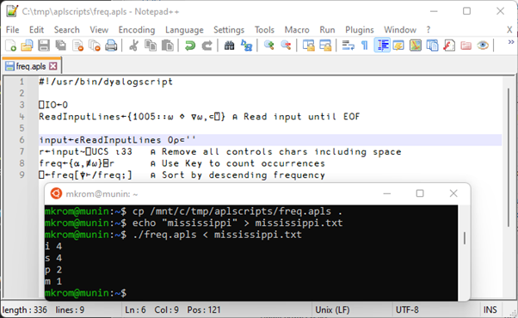
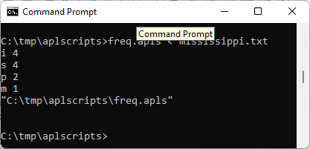
Launching from Text Files:
Shell Scripts
/usr/bin/dyalogscript is the script interpreter
Under Windows, .apls files are associated with dyalogscript

Slide 7
Launching from Text Files:
Text Source – Link 3.0
Completely new documentation
https://dyalog.github.io/link/3.0/
Many small features and bug fixes
https://dyalog.github.io/link/3.0/ChangeHistory/
https://github.com/Dyalog/link/issues?q=is%3Aissue+is%3Aclosed
Most significant new features:
)SAVE workspaces with active links and resynchronise on Load
Support for system variable settings in source files
Cleaner, documented API

Slide 8
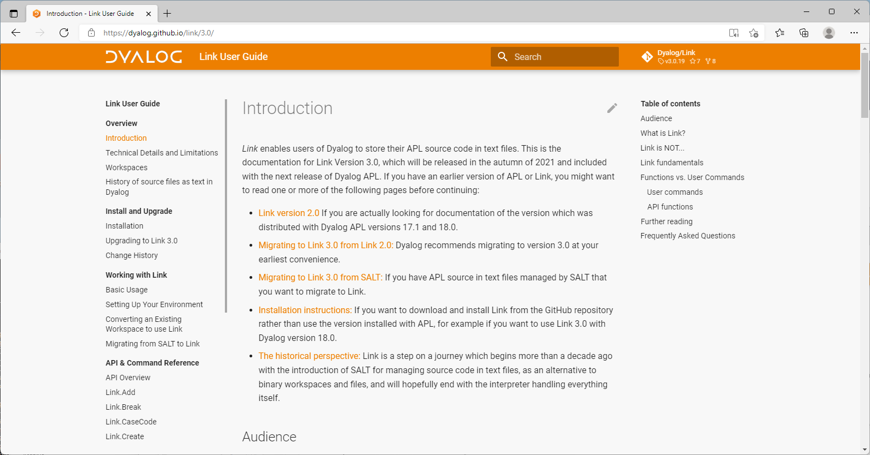

Slide 9
Launching from Text Files:
LOAD Parameter
Supported in 18.0:
Function file
Namespace file
Class file
Windows:
dyalog.exe LOAD=/myapp/foo.aplf
Linux:
LOAD=/myapp/foo.aplf dyalog

Slide 10
Launching from Text Files:
LOAD Parameter
Supported in 18.0:
Function file
Namespace file
Class file
New in 18.2:
Namespace directory
Calls function Run unless –x set
Windows:
dyalog.exe LOAD=/myapp
Linux:
LOAD=/myapp dyalog

Slide 11
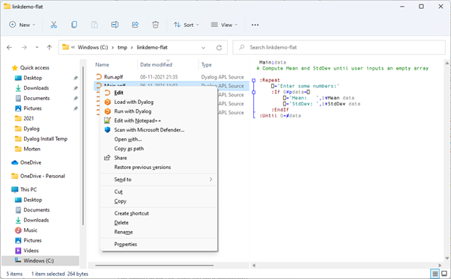
Windows Explorer Integration
Context menu:
Edit
Load with Dyalog
Run with Dyalog
]FileAssociations user command has been
enhanced

Slide 12
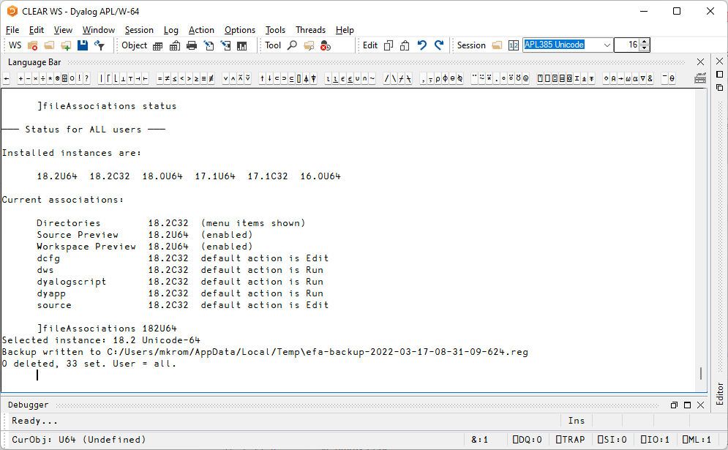
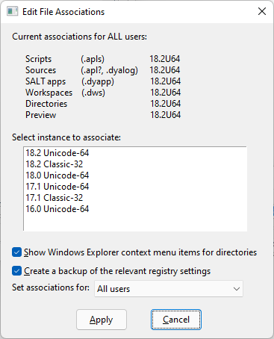

Slide 13
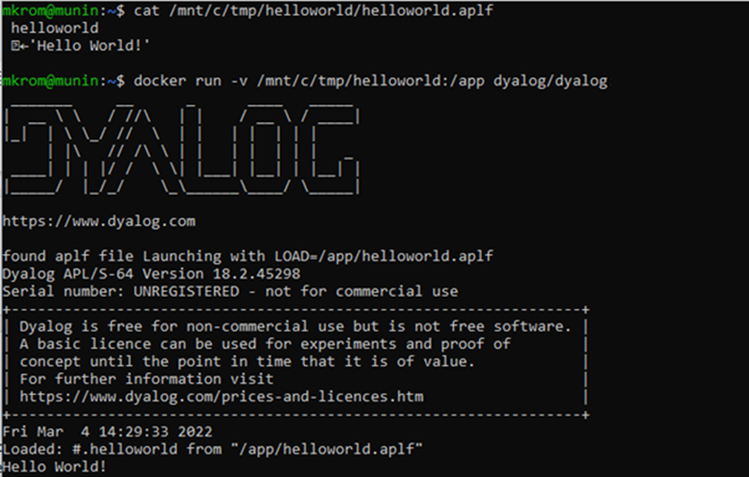
Docker Support
Launch containers on source files
Public containers under Basic Licence:
If you publish containers derived from the public Dyalog containers you MUST include our LICENSE file in a prominent location

Slide 14
RIDE v4.4
Debug multi-threaded applications
Language bar and help adapts to Dyalog version
Save responses to prompts
… and many more tweaks and fixes, see
https://github.com/Dyalog/ride/milestone/4?closed=1

Slide 15
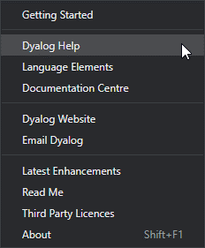
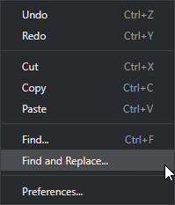
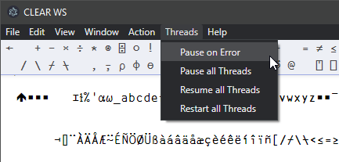
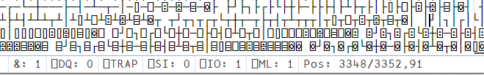
RIDE 4.4 Highlights

Slide 16
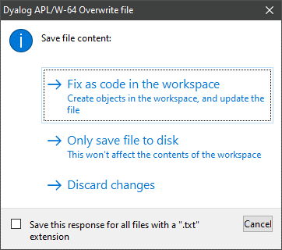
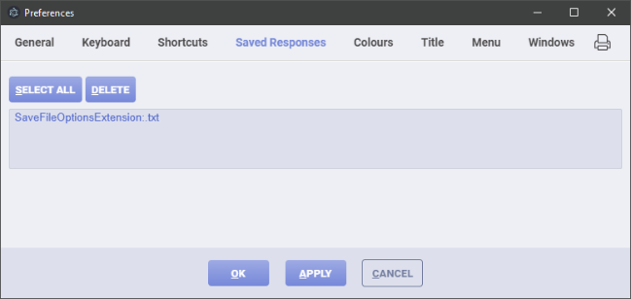
RIDE 4.4 Highlights

Slide 17
Developer Productivity:
JSON tables/datasets
fields ← 'Item' 'Price' 'Qty'
items ← 'Knife' 'Fork'
price ← 3 4
qty ← 23 45
fields⍪⍉↑items price qty
┌─────┬─────┬───┐
│Item │Price│Qty│
├─────┼─────┼───┤
│Knife│3 │23 │
├─────┼─────┼───┤
│Fork │4 │45 │
└─────┴─────┴───┘
cols ← items price qty
table ← ⊂4(cols fields)
(⎕JSON⍠'Compact'0)table
[
{
"Item": "Knife",
"Price": 3,
"Qty": 23
},
{
"Item": "Fork",
"Price": 4,
"Qty": 45
}
]

Slide 18
Developer Productivity:
⎕ATX metadata one-stop-shop
Unifies:
  ⎕SIZE Size of Object
  ⎕NC Name Classification
  ⎕NR Nested Representation
  ⎕SRC Source
  ⎕AT Attributes
  5179⌶ Loaded Object Info
Additional metadata:
  Last edit UTC
  Source "as typed"
  Normalised source
  Best available source
  More to come…

Slide 19
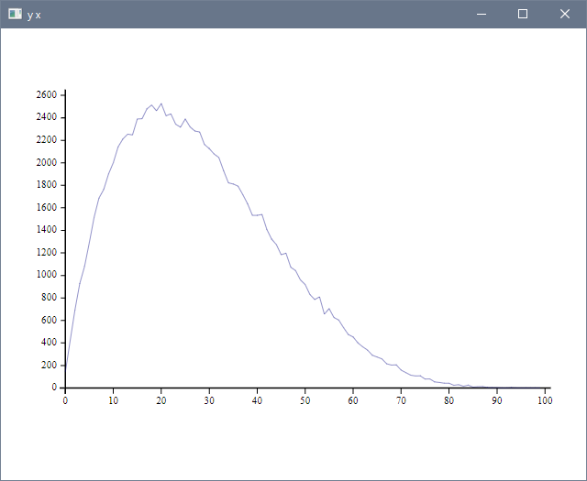
Developer Productivity:
Generating random numbers
Dist ← 16808⌶
val ← 2 5 Dist 'Beta' 1e5
res ← 100
bin ← ⌊res×val
x ← ¯1+⍳res
y ← {≢⍵}⌸x,bin
]plot y x

Slide 20
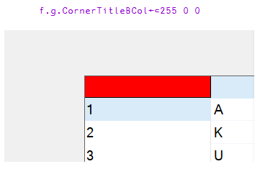
New Win32 GUI (⎕WC) features!!!
CornerTitleBCol on Grid
FireOnce on Timer

Slide 21
Developer Productivity:
New user commands
]get github.com/mkromberg/linkdemo/tree/main/stats

Slide 22
Developer Productivity:
New user commands
]get github.com/mkromberg/linkdemo/tree/main/stats
Working on it…

Slide 23
Developer Productivity:
New user commands
]get https://github.com/mkromberg/linkdemo/tree/main/stats
Working on it……
#.stats
stats.inds←⍳⍳3
]names 0
2: bin res val x y 3: Dist 9: stats
]names stats
stats.Mean stats.Root stats.StdDev

Slide 24
Developer Productivity:
New user commands
]aplcart general mean
X,Y,Z:any M,N:num I,J:int A,B:Bool C,D:char f,g,h:fn ax:axis s:scal v:vec m:mat
───────────────────────────────────────────────────────────────────────────────
Ms(⊣*∘÷⍨1⊥*⍨÷⊢∘≢)N Generalised mean
Ms{(+⌿(⍵*⍺)÷≢⍵)*÷⍺}N Generalised mean
───────────────────────────────────────────────────────────────────────────────
Showing 2 of 2 matches
GM←{(+⌿(⍵*⍺)÷≢⍵)*÷⍺}
1 GM 1 2 3 4 ⍝ Average
2.5
2 GM 1 2 3 4 ⍝ Quadratic Mean
2.738612788
¯1 GM 1 2 3 4 ⍝ Harmonic Mean
1.92

Slide 25
Developer Productivity:
New user commands
]repr (3 4⍴⍳12) -format=json
[[1,2,3,4],
[5,6,7,8],
[9,10,11,12]]
]repr (3 4⍴⍳12) -format=xml
<array>
<shape>3 4</shape>
<list>1 2 3 4 5 6 7 8 9 10 11 12</list>
</array>

Slide 26
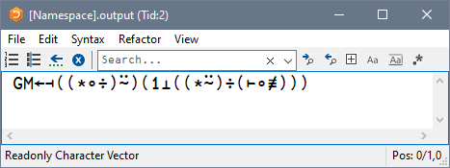
Developer Productivity:
New user commands
]repr (3 4⍴⍳12) -format=apl
(3 4⍴1+⎕io-⍨⍳12)
GM←⊣*∘÷⍨1⊥*⍨÷⊢∘≢
]repr GM
GM←⊣((*∘÷)⍨)(1⊥((*⍨)÷(⊢∘≢)))
]view ]repr GM

Slide 27
Summary
Release Date & Patches
Basic Licence
Launching from Text Files:
  Shell Scripts
  Text Source
  LOAD Parameter
Explorer Integration
Docker Support
RIDE v4.4
Developer Productivity:
  JSON tables/datasets
  ⎕ATX metadata one-stop-shop
  Generating random numbers
  New user commands

