Slide 1
Data Visualisation and Graphics
Rich Park

Slide 2
APL is great for:
Data manipulation & pre-processing
  Cleaning ⍺⌿⍵ ⍺⌷⍵ ⍺↑⍵ ⍺↓⍵
  Reformatting ⌽ ⍉ ⌽ ⎕CSV ⎕JSON
Exploration
  Summaries: +/⍵ ×/⍵ ⌈/ ⌊/
  Grouping: F⌸⍵
  Sort/Lookup: ⍋⍵ ⍺∊⍵ ⍺⍳⍵

Slide 3
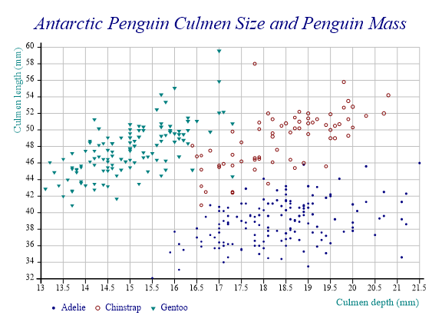
Communicating ideas

Slide 4
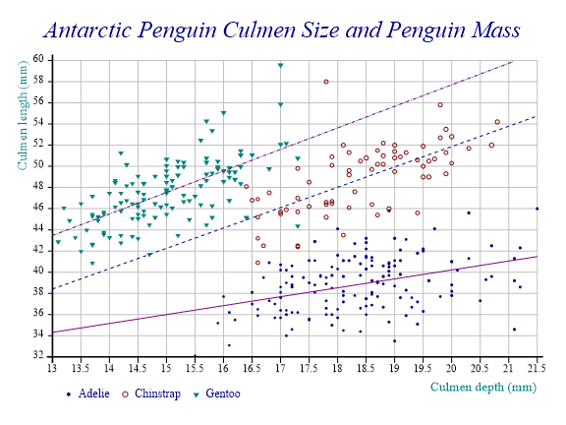
Discovering patterns

Slide 5
Coming Up…
SharpPlot/Vega
HTMLRenderer/⎕WC/Observable
DUI/Abacus
A little bit of speculation

Slide 6
Previously…
2013: The Future of SharpPlot and RainPro:
Nicolas Delcros dyalog.tv/Dyalog13/?v=Xo3vRQMaPxo
2018: Cross-Platform Charting:
Brian Becker dyalog.tv/Webinar/?v=wapJgEXSzvc
2020: APL Cultivations (Orchard chat lessons) 44 and 45
Nicolas Delcros apl.wiki/APL_Cultivation

Slide 7
SharpPlot
Cross platform
Code examples from C#
Argument nesting is fiddly
State machine
'InitCauseway' ⎕CY 'sharpplot' ⋄ InitCauseway⍬
sp←⎕NEW Causeway.SharpPlot
sp.Set<things>
sp.Draw<thing> ⊂data
sp.RenderSvg Causway.SvgMode.FixedAspect

Slide 8
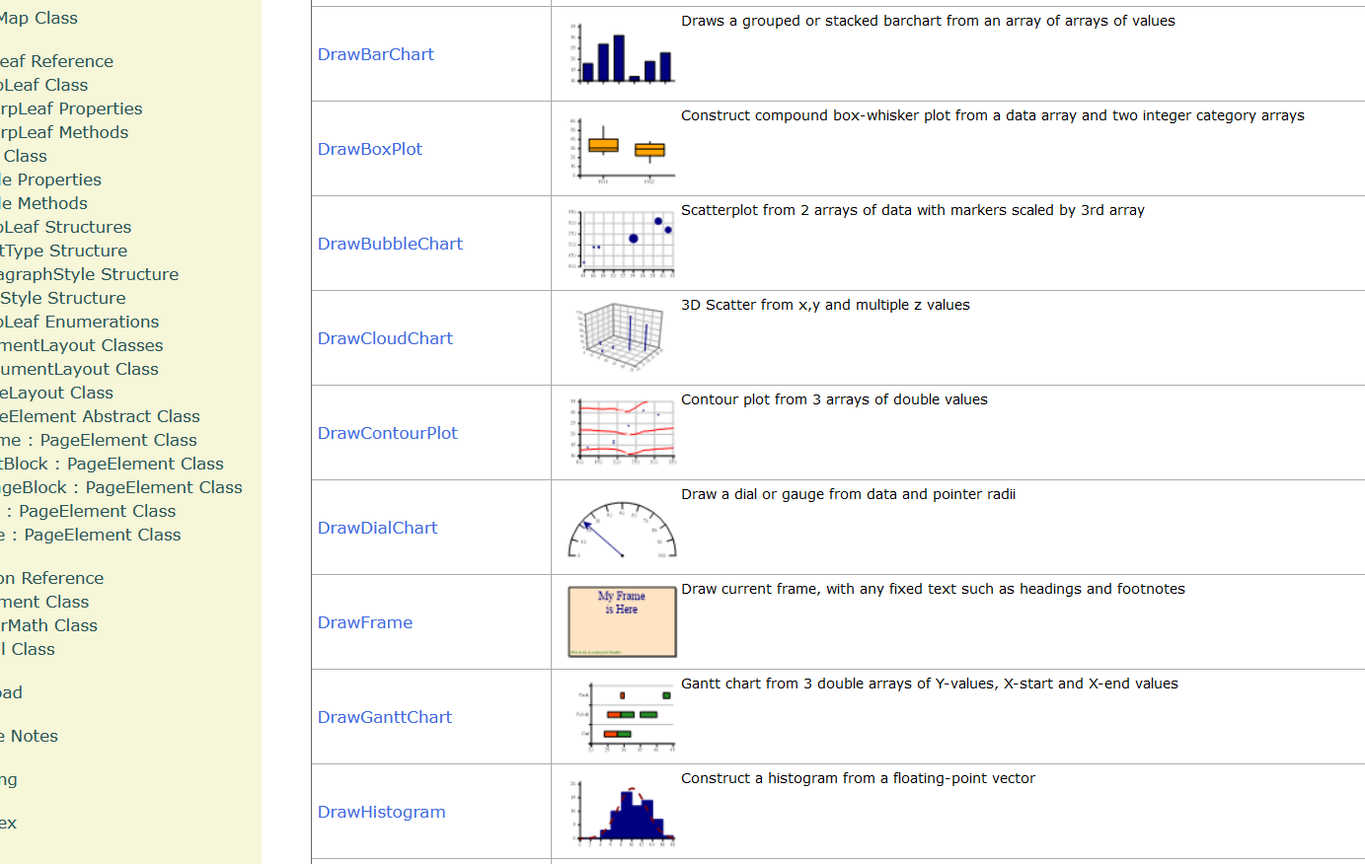
sharpplot.com/SharpPlot-Methods.htm

Slide 9
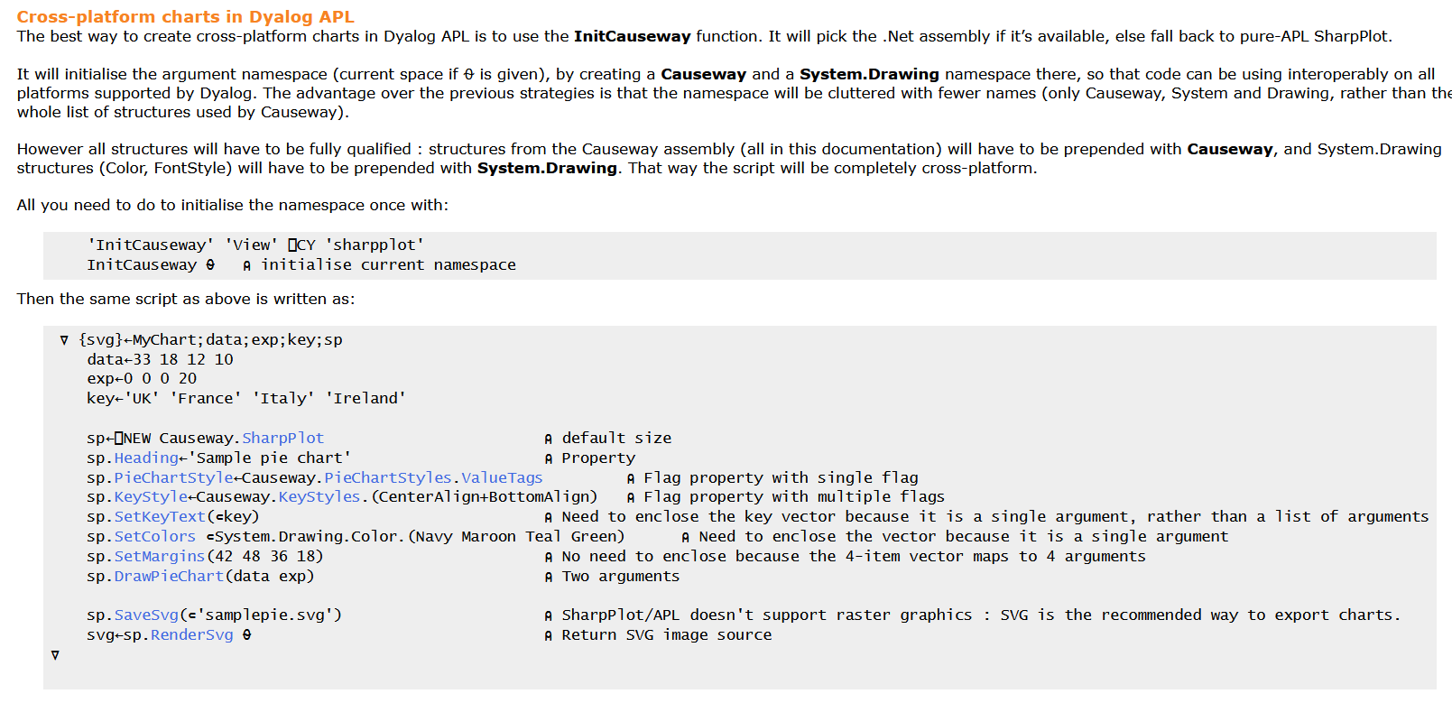
sharpplot.com/Languages.htm

Slide 10
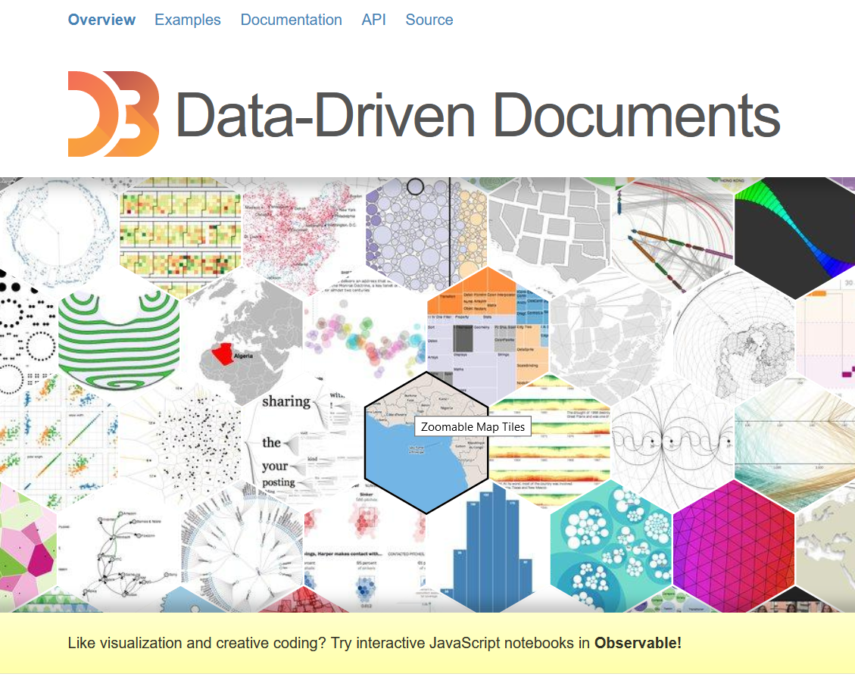
Vega
Based on D3
  A JavaScript library for manipulating HTML, SVG and CSS
Extensible data-driven transformations
  In JavaScript ☹
Vega-lite
  High level description for basic graphics

Slide 11
Vega
{
"config": {
"axis": true
},
"data": {
"values": [
{"count": 161, "item": "5"},
{"count": 166, "item": "3"},
{"count": 166, "item": "2"},
{"count": 157, "item": "1"},
{"count": 171, "item": "6"},
{"count": 179, "item": "4"}
]
},
"encoding": {
"x": { "field": "item", "type": "nominal" },
"y": { "field": "count", "type": "quantitative" }
},
"height": 300, "mark": "bar", "width": 500
}
Define using JSON
  Hand write in an editor
  Programmatically generate using ⎕JSON
vega←⎕JSON'{}'
vega.config←⎕JSON'{}'
vega.config.axis←⊂'true'
data←⎕JSON'{}'
V2J←{j←⎕JSON'{}' ⋄ j.(item count)←⍺ ⍵ ⋄ j}
data.values←⎕JSON'{}'
data.values←V2J⌿⍵
vega.data←data
vega.mark←'bar'
vega.encoding←⎕JSON'{}'
x_enc←'{"field": "item", "type": "nominal"}'
y_enc←'{"field": "count", "type": "quantitative"}'
vega.encoding.x←⎕JSON x_enc
vega.encoding.y←⎕JSON y_enc
vega.width←500
vega.height←300
(⎕JSON⍠'Compact' 0)vega

Slide 12


Slide 13
Publishing and embedding
Print (PDF)
Raster (PNG, BMP, JPG)
SVG
XAML
⎕WC
HTMLRenderer
Browser-based (served)

Slide 14
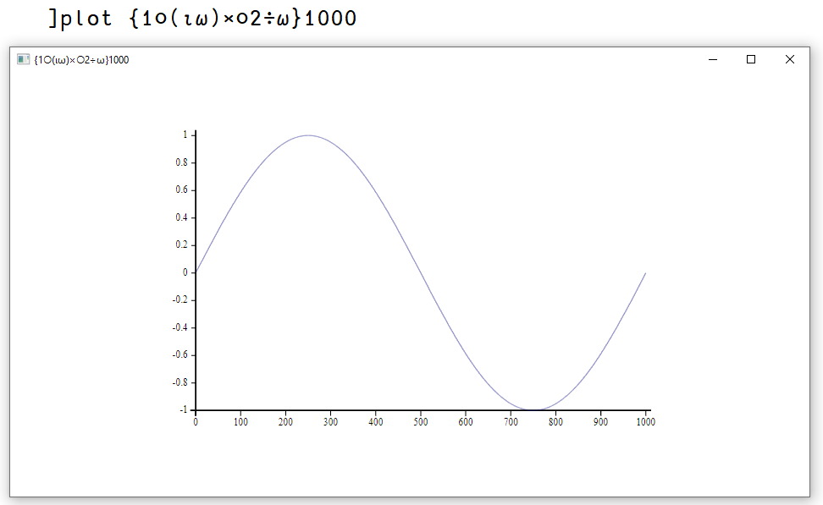
The ]Plot user command

Slide 15
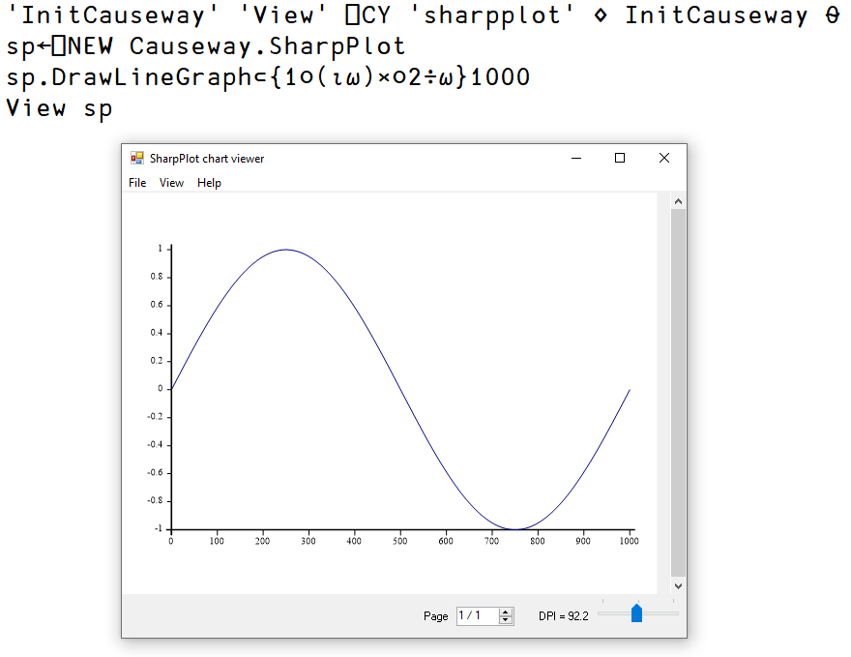
.NET SharpPlot Viewer

Slide 16
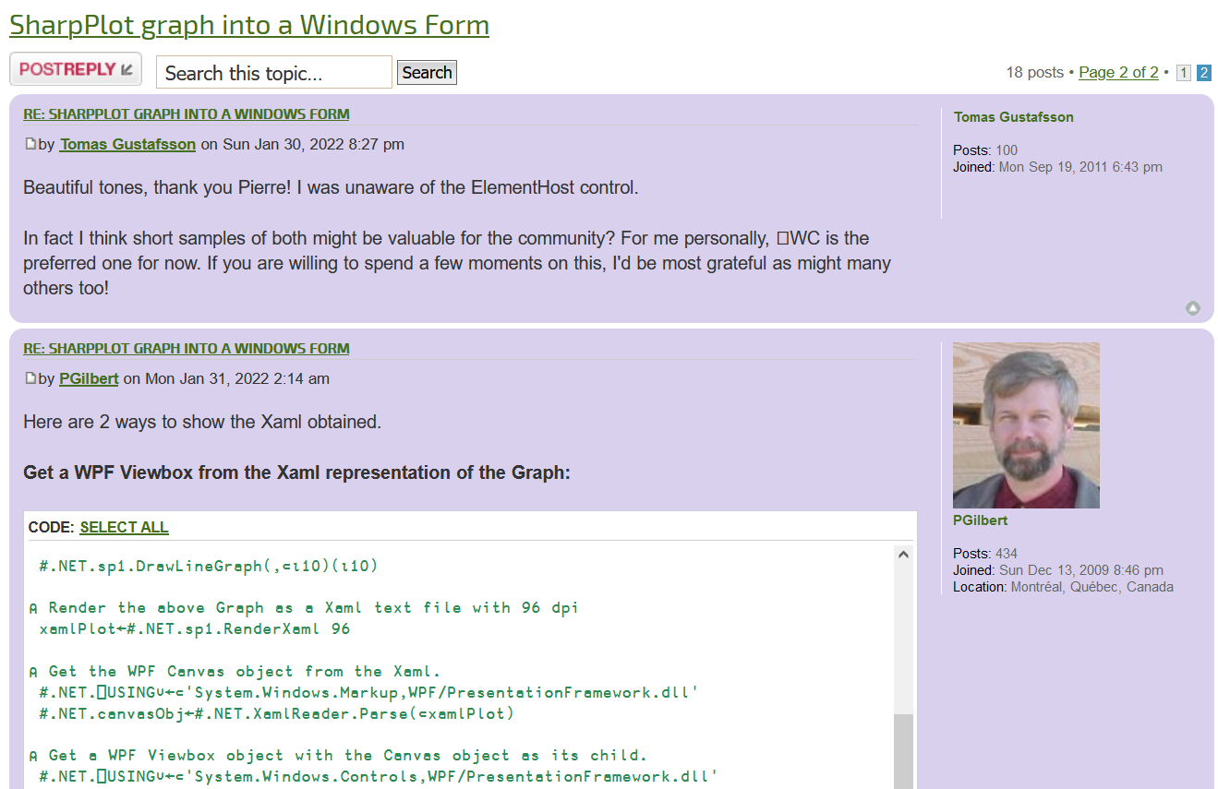
Embed in Windows GUI

Slide 17
HTMLRenderer
Cross platform
Renders SVG
Use web stack (HTML/CSS/JavaScript)
But I don't want to write JS?

Slide 18
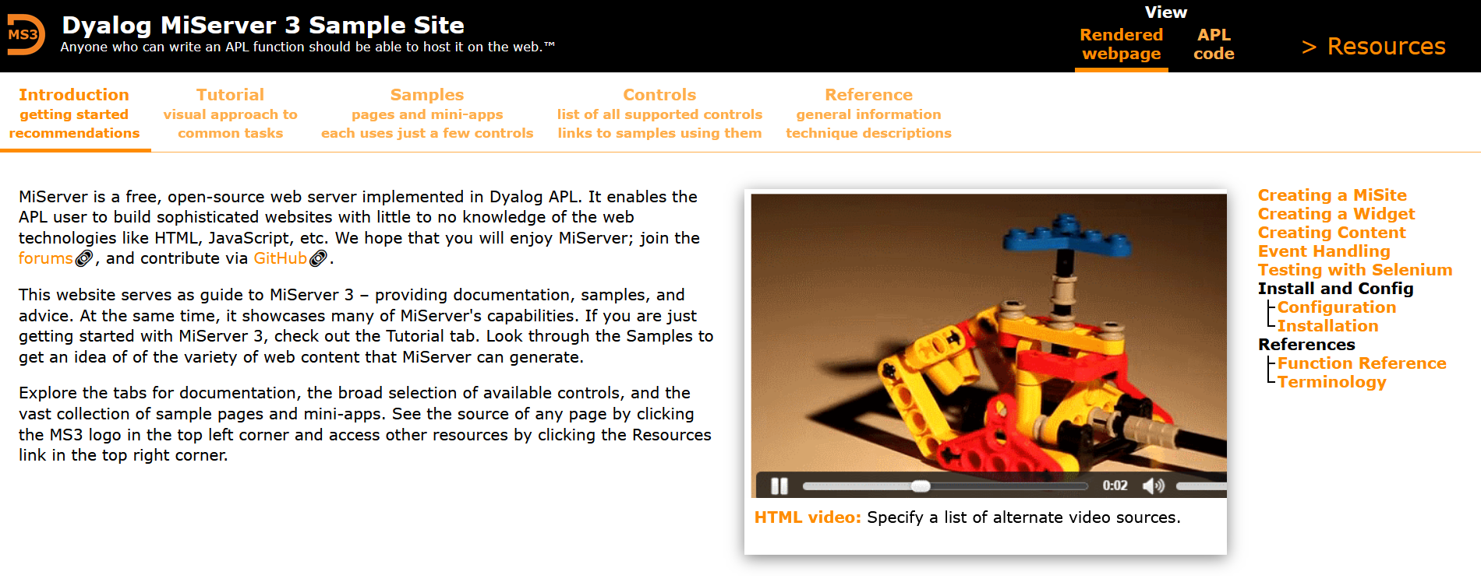
Dyalog User Interface (DUI)

Slide 19
Carlisle Abacus
github.com/the-carlisle-group/Abacus
Manipulate a Document Object Model (DOM) directly in APL
Convert APLDOM ←→ HTML
Serve in HTMLRenderer

Slide 20
Observable
Collaborative data story telling
Easy to insert basic plots
Compatible with Vega/D3

Slide 21
Data Visualisation
Edward Tufte
Keep it simple – less clutter
Present in a digestible format
Jacques Bertin
Semiology of Graphics
Mapping of visual properties to data relations
Lee Wilkinson
Grammar of Graphics
Inspiration: ggplot2 (R) D3 (JavaScript)

Slide 22
Present issues, future possibilities
Read lots of docs
Learn something that "isn't APL"
Translate code examples
Alter your data to fit the framework (easy)

Slide 23
Present issues, future possibilities
WIBNI we had an APL graphic manipulation framework a la D3/ggplot2?
Abacus+ ?
Something else?

Slide 24
APL Media
britishaplassociation.org/webinar-schedule-2022
24th Feb – BAA: Open Session
Dyalog.tv
17th March – Webinar: Link & Sharing Code
(~30th March) – APL Seeds '22

