Slide 1

Error Handling
Adám Brudzewsky
Part 5

Slide 2
Error Handling – Part 1
Number for given message
aplcart.info?q=:: message
Tradfn structure :Trap errnos (0 means all)
Dfn error guard errnos::code
Error Number of last error ⎕EN
Error Message for number ⎕EM

Slide 3
Error Handling – Part 2
Construct error message
aplcart.info?q=dmx 1
Execute there on error ⎕TRAP←errnos 'E' code
Cut back and execute ⎕TRAP←errnos 'C' code
Ext'd Diagnostic Message ⎕DMX

Slide 4
Error Handling – Part 3
Signal an error: ⎕SIGNAL errno
Signal a custom error: ⎕SIGNAL⊂name-value pairs
Assert: aplcart.info?q=assert
Resignal: aplcart.info?q=resignal

Slide 5
Error Handling – Part 4
dyalog.tv
Debugging mode: debug←0
Adjustable trapping: ∊debug↓0(1 22)
Collecting info: error←⎕DMX
Be mindful of dfn error scopes!

Slide 6

Capsules
^{what ⎕SIGNAL leaves}

Slide 7


Slide 8
Tradfn Capsules
^{what ⎕SIGNAL leaves}

Slide 9
Capsules
:Namespace test
∇ inner
:Trap 0
⎕SIGNAL 256
:Else
⎕←'trapped inside!'
:EndTrap
∇
:EndNamespace
test.inner
ERROR 256
test.inner
∧

Slide 10
Capsules
:Namespace test
∇ inner
:Trap 0
⎕SIGNAL 256
:Else
⎕←'trapped inside!'
:EndTrap
∇
:EndNamespace
test.inner
ERROR 256
test.inner
∧

Slide 11
Capsules
:Namespace test
∇ outer
:Trap 0
inner
:Else
⎕←'trapped outside!'
:EndTrap
∇
∇ inner
:Trap 0
⎕SIGNAL 256
:Else
⎕←'trapped inside!'
:EndTrap
∇
:EndNamespace
test.inner
ERROR 256
test.inner
∧
test.outer
trapped outside!

Slide 12

Capsules
:Namespace test
∇ outer
:Trap 0
inner
:Else
⎕←'trapped outside!'
:EndTrap
∇
∇ inner
:Trap 0
⎕SIGNAL 256
:Else
⎕←'trapped inside!'
:EndTrap
∇
:EndNamespace
⎕SIGNAL 256

Slide 13
Capsules
:Namespace test
∇ outer
:Trap 0
inner
:Else
⎕←'trapped outside!'
:EndTrap
∇
∇ inner
:Trap 0
{⎕SIGNAL ⍵}256
:Else
⎕←'trapped inside!'
:EndTrap
∇
:EndNamespace
{⎕SIGNAL ⍵}256

Slide 14
Capsules
:Namespace test
∇ outer
:Trap 0
inner
:Else
⎕←'trapped outside!'
:EndTrap
∇
∇ inner
:Trap 0
{⎕SIGNAL ⍵}256
:Else
⎕←'trapped inside!'
:EndTrap
∇
:EndNamespace
test.inner
trapped inside!

Slide 15
Capsules
:Namespace test
∇ outer
:Trap 0
inner
:Else
⎕←'trapped outside!'
:EndTrap
∇
∇ inner
:Trap 0
{⎕SIGNAL ⍵}256
:Else
⎕←'trapped inside!'
:EndTrap
∇
:EndNamespace
test.inner
trapped inside!
test.outer
trapped inside!

Slide 16
Overview
Special events: errors, interrupts, exceptions
Resetting system constants
Poll: event message to number

Slide 17
Special Events
^{exceptions and interrupts}

Slide 18
Special events
Errors
⎕EN is in range 1…999
Catch all with :Trap 0
Exceptions
⎕EN is 90
Interrupts
⎕EN is in range 1001…1008
Catch all with :Trap 1000

Slide 19
Special events: interrupts
aplcart.info
Interrupts
⎕EN is in range 1001…1008
Catch all with :Trap 1000

Slide 20
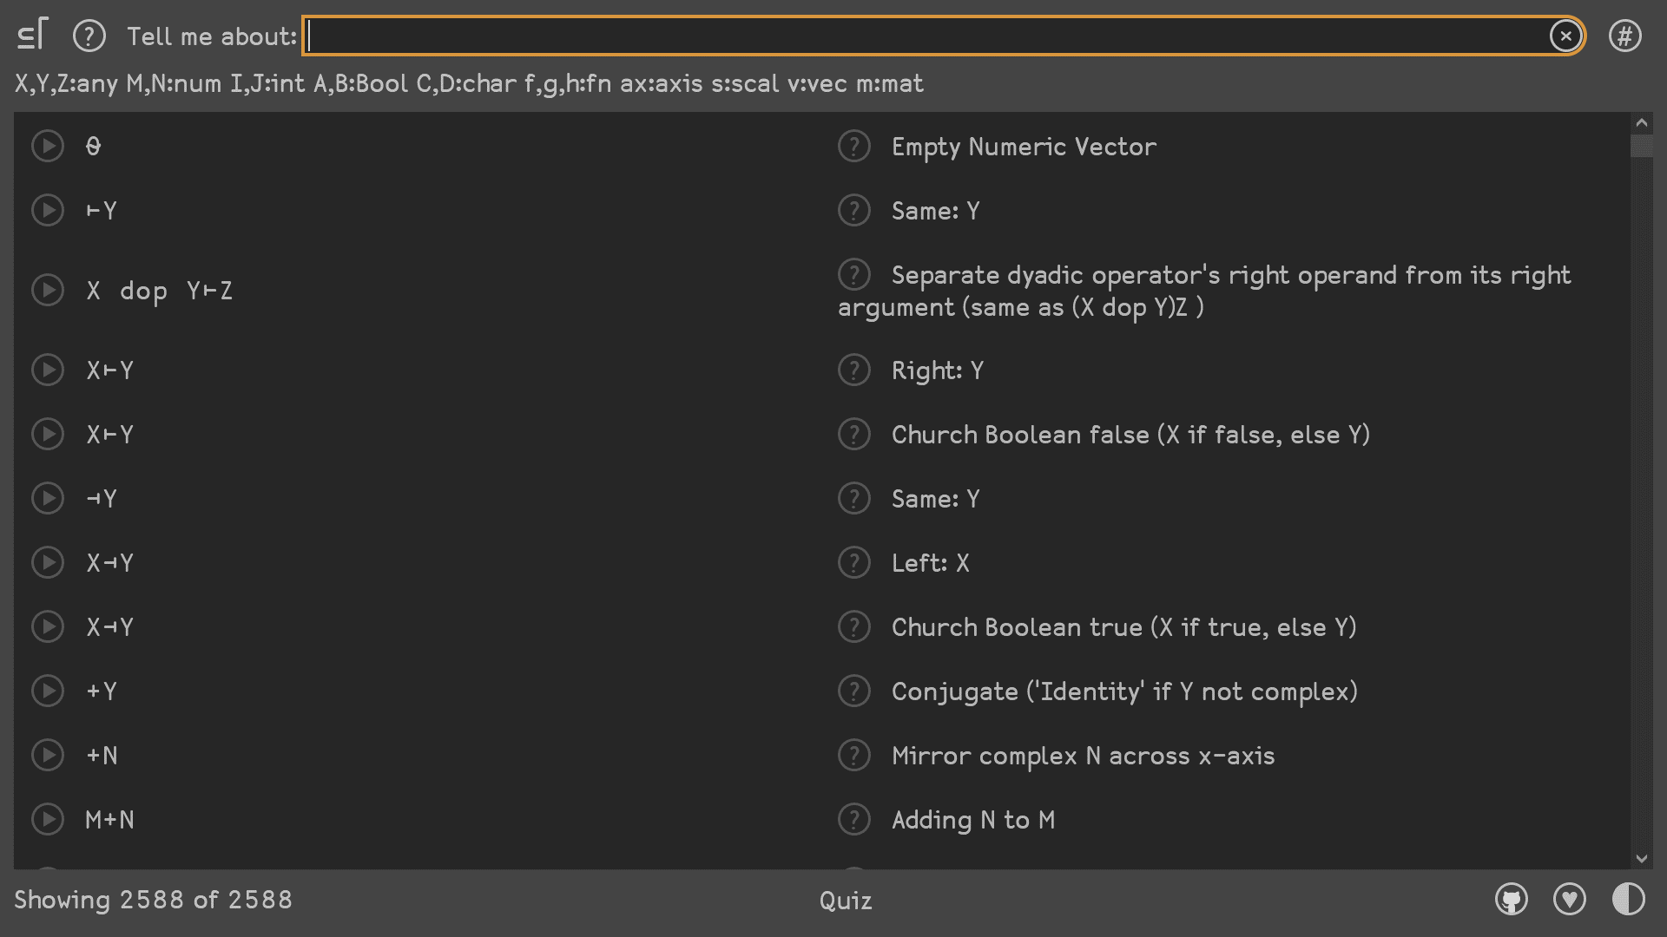

Slide 21
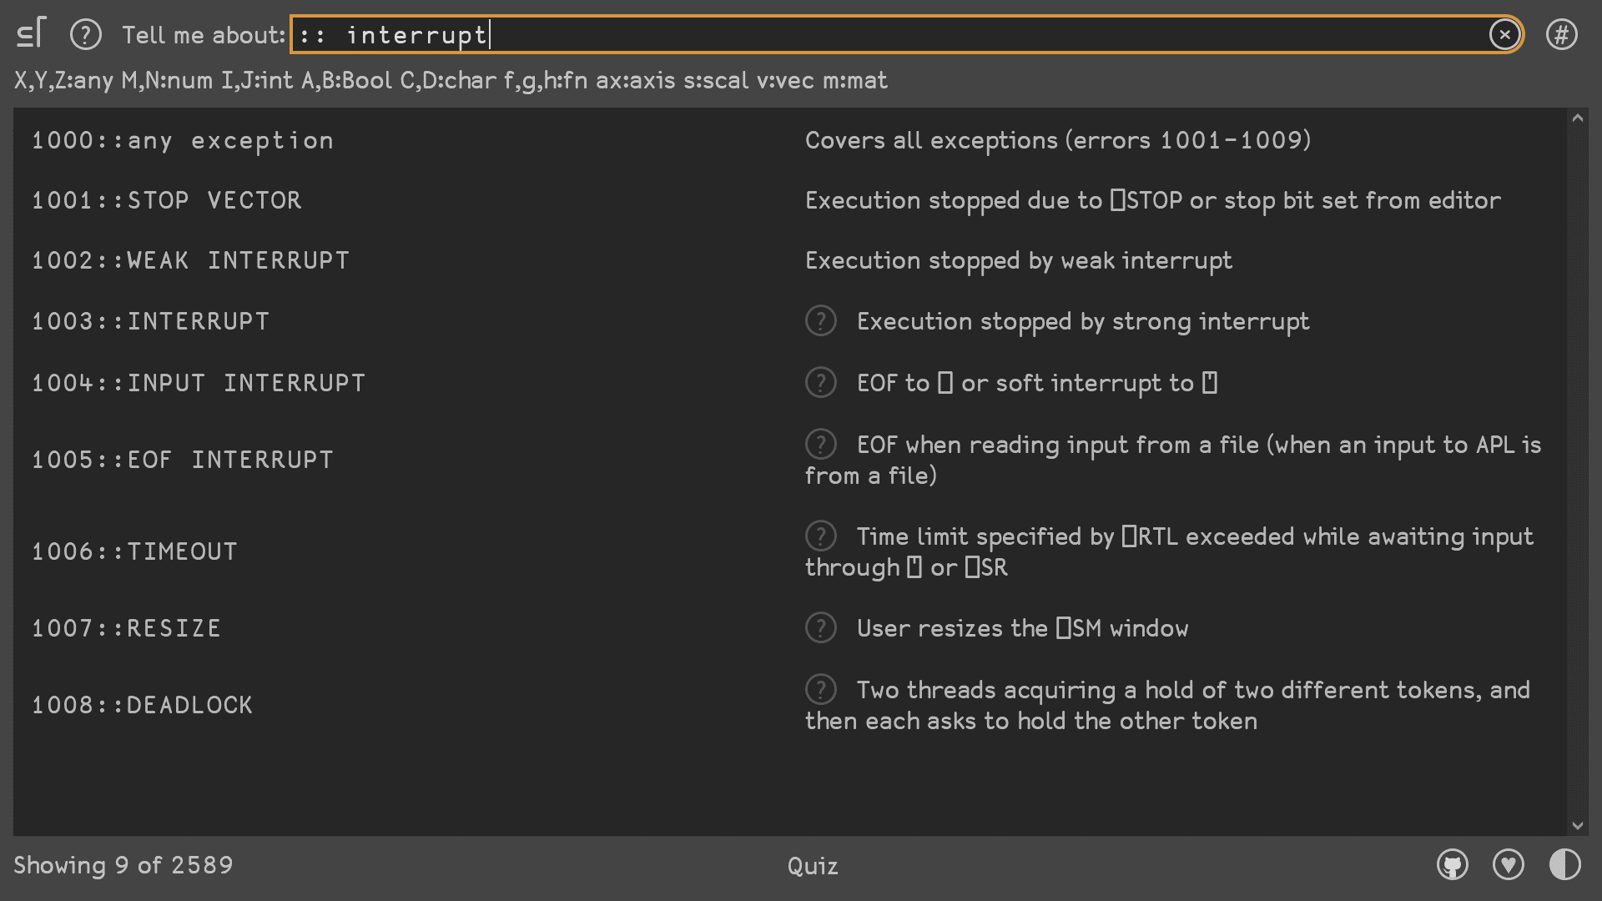

Slide 22
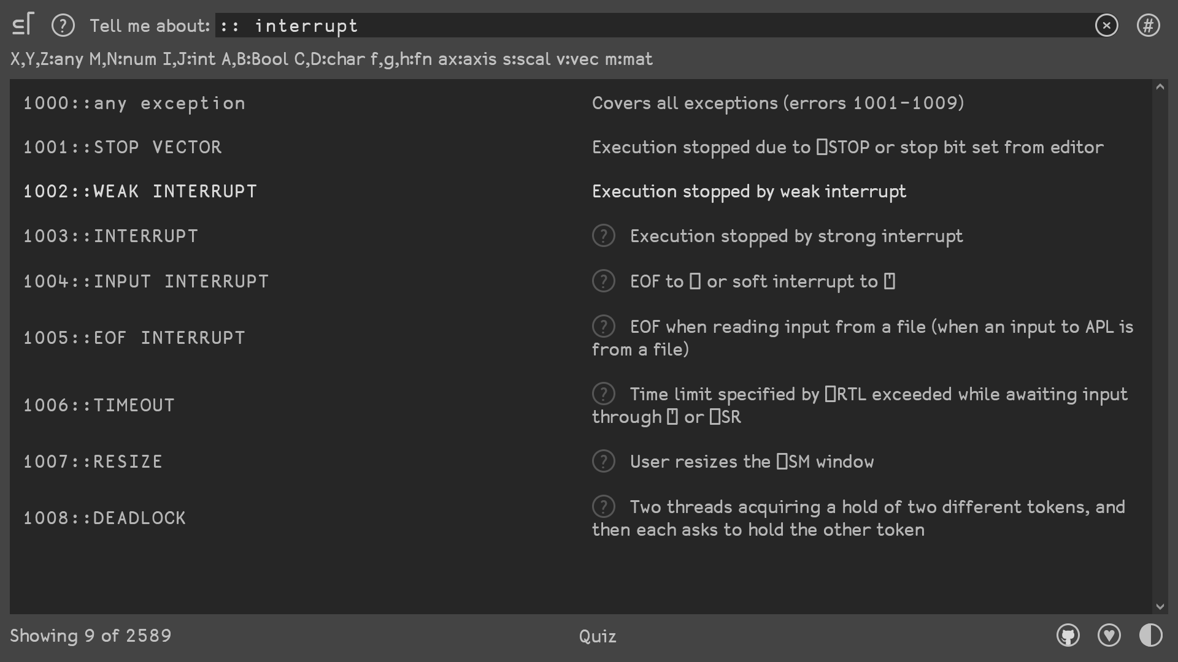
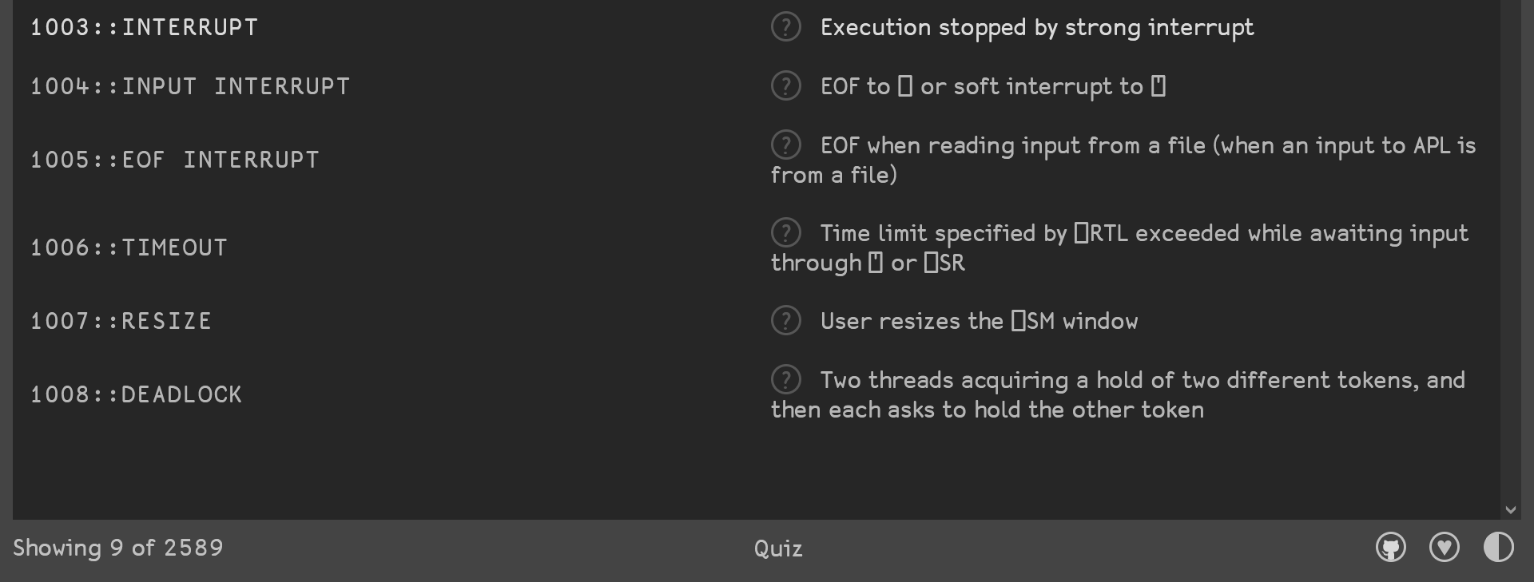

Slide 23
Special events: interrupts
F←{}

Slide 24
Special events: interrupts
F←{⎕DL⊢1}

Slide 25
Special events: interrupts
F←{ ⊣ ⎕DL⊢1}

Slide 26
Special events: interrupts
F←{1+⍵ ⊣ ⎕DL 1}

Slide 27
Special events: interrupts
F←{⎕←1+⍵ ⊣ ⎕DL 1}

Slide 28
Special events: interrupts
F←{∇ ⎕←1+⍵ ⊣ ⎕DL 1}

Slide 29
Special events: interrupts
F←{:: ⋄ ∇ ⎕←1+⍵ ⊣ ⎕DL 1}

Slide 30
Special events: interrupts
F←{1000:: ⋄ ∇ ⎕←1+⍵ ⊣ ⎕DL 1}

Slide 31
Special events: interrupts
F←{1000::'got⊢to',⍵ ⋄ ∇ ⎕←1+⍵ ⊣ ⎕DL 1}

Slide 32
Special events: interrupts
F←{1000::'got⊢to',⍵ ⋄ ∇ ⎕←1+⍵ ⊣ ⎕DL 1}
F 0

Slide 33
Special events: interrupts
F←{1000::'got⊢to',⍵ ⋄ ∇ ⎕←1+⍵ ⊣ ⎕DL 1}
'I⊢',F 0

Slide 34

Special events: interrupts
F←{1000::'got to',⍵ ⋄ ∇ ⎕←1+⍵ ⊣ ⎕DL 1}
'I⊢',F 0
1
2
3
4
5
6
I got to 6
▸Interrupt
Action▸Interrupt
Action▸Interrupt
Action▸Interrupt

Slide 35
Special events: interrupts
Drill 0
17×27?
459
1
Drill←{
⎕←'17×27?'
⍞≡⍕17×27
}

Slide 36
Special events: interrupts
Drill 0
17×27?
459
1
Drill←{
⎕←'17×27?'
⎕RTL←⍵ ⋄ ⍞≡⍕17×27
}

Slide 37
Special events: interrupts
Drill 0
17×27?
459
1
Drill←{
⎕←'17×27?'
1006::'Too slow!'
⎕RTL←⍵ ⋄ ⍞≡⍕17×27
}

Slide 38
Special events: interrupts
Drill 0
17×27?
459
1
Drill 5
17×23?
Too slow!
Drill←{
⎕←'17×27?'
1006::'Too slow!'
⎕RTL←⍵ ⋄ ⍞≡⍕17×27
}

Slide 39
Special events
Errors
⎕EN is in range 1…999
Catch all with :Trap 0
Exceptions
⎕EN is 90
Interrupts
⎕EN is in range 1001…1008
Catch all with :Trap 1000

Slide 40
Special events: exceptions
Exceptions
⎕EN is 90

Slide 41
Special events: exceptions
0⎕DT⊂
Check←{
}

Slide 42
Special events: exceptions
0⎕DT⊂
Check←{
¯1⎕DT⊂⍵
}

Slide 43
Special events: exceptions
Check←{
'Valid'⊣¯1⎕DT⊂⍵
}

Slide 44
Special events: exceptions
Check←{
0::⎕DMX.Message
'Valid'⊣¯1⎕DT⊂⍵
}

Slide 45

Special events: exceptions
Check 2020 2 29
Valid
Check 2021 2 29
Invalid date-time
Check←{
0::⎕DMX.Message
'Valid'⊣ ¯1⎕DT⊂ ⍵
}

Slide 46
Special events: exceptions
Check 2020 2 29
Valid
Check←{
⎕USING←'System'
0::⎕DMX.Message
'Valid'⊣ ¯1⎕DT⊂ ⍵
}

Slide 47
Special events: exceptions
Check 2020 2 29
Valid
Check 2021 2 29
A .NET exception has occurred. Check ⎕EXCE PTION for details
Check←{
⎕USING←'System'
0::⎕DMX.Message
'Valid'⊣ ⎕NEW DateTime ⍵
}

Slide 48
Special events: exceptions
Check 2020 2 29
Valid
Check 2021 2 29
Year, Month, and Day parameters describe an un-representable DateTime.
Check←{
⎕USING←'System'
0::⎕EXCEPTION.Message
'Valid'⊣ ⎕NEW DateTime ⍵
}

Slide 49
Special events: exceptions
⎕EXCEPTION.⎕NL-⍳9
ActualValue Data Equals GetBaseException GetHashCode
GetObjectData GetType HResult HelpLink InnerException
Message ParamName ReferenceEquals Source StackTrace
TargetSite ToString
⎕EXCEPTION.Source
mscorlib
⎕EXCEPTION.TargetSite
Int64 DateToTicks(Int32, Int32, Int32)

Slide 50
Resetting System Constants
^{cleaning up your mess}

Slide 51
Resetting system constants
÷0
DOMAIN ERROR: Divide by zero
÷0
∧
⎕EN,⎕DMX.ENX
11 1
⎕SIGNAL 0
⎕DMX
⎕EN,⎕DMX.ENX
0 0

Slide 52
Poll: Event Message to Number
how would you like this to work?

Slide 53
Messages instead of Numbers
“⎕EM⍣¯1”

Slide 54
Messages instead of Numbers: function
ERROR←(' ERROR'⎕R''⎕EM⍳99)⍳⊆
:Trap ERROR 'RANK' 'LENGTH'

Slide 55
Poll: event message to number
⎕←ems←⎕EM 4 5
RANK ERROR LENGTH ERROR
⎕EM⍣¯1⊢ems
4 5
⎕EM ems
4 5
⎕SOMETHINGELSE ems
4 5
:Trap 'RANK ERROR' 'LENGTH ERROR'
adam@dyalog.com
A
B
C
D

Slide 56
Error Handling – Part 5
Number for given message
aplcart.info?q=:: message
Internal tradfn signal {⎕SIGNAL ⍵}
Interrupts 1000:: or 1001…1008
Exceptions 90::⎕EXCEPTION
Resetting ⎕SIGNAL 0

Slide 57
Upcoming webinars
Oct 7 BAA open session britishaplassociation.org
Oct 21 BAA open session
Nov 8
Nov 9
Nov 18 BAA open session
Dec 2 BAA open session
Dec 16 BAA open session
Jan 20 Dyalog webinar (topic TBA)
Dyalog '21 dyalog.com/user-meetings/dyalog21.htm

