Slide 1
Databases Overview
Richard Park

Slide 2
Databasics
What is a database
Types of databases
Relational databases
Dyalog ⟷ Database

Slide 3
Databasics
A database is a system for storing data
Previously:
Filing Systems
Nowadays:
Databases → Database Management System
(DBMS)

Slide 4
Database Management System
1. A structured arrangement of data
2. Query language
a domain specific language (DSL) for:
∘ reading
∘ writing
∘ manipulating data

Slide 5
Organisation
Relational
Tables
Non-relational (the rest)
Time series
Key-value
Document / Object (e.g. JSON)
Graph
…

Slide 6
Organisation
PCode | Name | Type
P234 | Gruel | Food
P695 | Water | Drink
CID | Address | Name
C4124 | 2 Main St. | Alice
C3156 | 54 Nice Rd. | Bob
RID | Name | Address
SH01 | Shoppz | Shoppz.uk
SH02 | Buyaz | Buyaz.com
Relational
Tables
Non-relational (the rest)
Time series
Key-value
Document / Object (e.g. JSON)
Graph
…
TID | PCode | CID | RID | Price | Qty | DateTime
354 | P234 | C3156 | SH02 | $5.04 | 3 | 2020-05-16
355 | P695 | C4124 | SH01 | $4.95 | 4 | 2020-06-03
356 | P234 | D3156 | SH01 | $2.59 | 2 | 2020-06-04

Slide 7
Let's make a database

Slide 8
Database creation
Efficiency
Integrity

Slide 9
Database creation
Efficiency
Integrity
Reduce redundancy

Slide 10
Example: Entity-Relationship Diagram
Retailers
Customers
Products

Slide 11
Datetime
Quantity
Name
Price
TID
Products
Type
Name
RID
Code
Retailers
Purchase
Address
Customers
CID
Name
Address

Slide 12
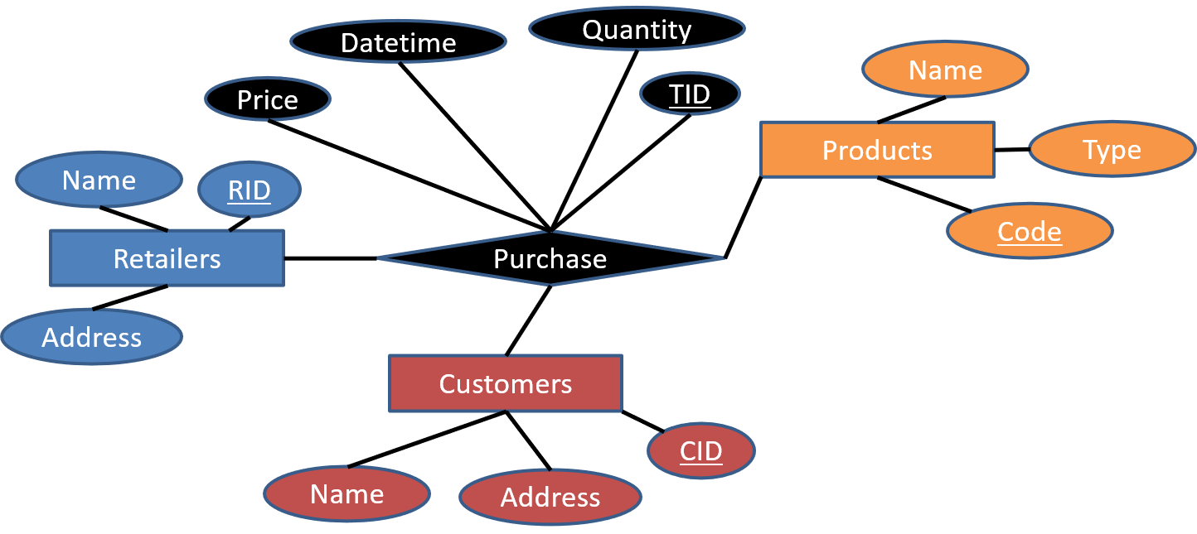

Slide 13
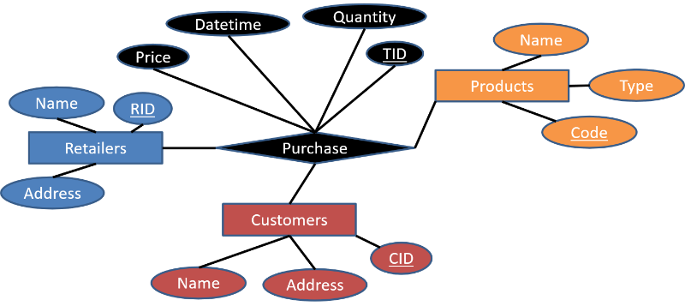

Slide 14
RID | Name | Address
SH01 | Shoppz | Shoppz.uk
SH02 | Buyaz | Buyaz.com
PCode | Name | Type
P234 | Gruel | Food
P695 | Water | Drink
CID | Name | Address
C4124 | Alice | 2 Main St.
C3156 | Bob | 54 Nice Rd.
TID | PCode | CID | RID | Price | Qty | DateTime
354 | P234 | C3156 | SH02 | $5.04 | 3 | 2020-05-16
355 | P695 | C4124 | SH01 | $4.95 | 4 | 2020-06-03
356 | P234 | D3156 | SH01 | $2.59 | 2 | 2020-06-04

Slide 15
Query Language
Relational
Structured Query Language (SQL)
Non-relational AKA NoSQL
GraphQL
RESTful APIs
Also sometimes SQL
(misnomer-ish)

Slide 16
APL Arrays
Data fits in WS
Single-user update
Update from APL

Slide 17
Advantages over "just APL arrays"
Lots o' data
Data integrity
Query optimisers
Multi-user access
Access control / security
Compatibility

Slide 18
Relational Database Paradigms
OLTP (OnLine Transactional Processing)
Inserts, updates, deletes
Simultaneous writes from multiple users
OLAP (OnLine Analytical Processing)
Write less, read more
Better suited for vectorised operations

Slide 19
Options
APL Matrix
APL Inverted Table
Dataframe system
DBMS

Slide 20
Dataframes
Python + Pandas + Py'n'APL
github.com/Dyalog/pynapl
R + data.tables + RSConnect
github.com/kimmolinna/rsconnect

Slide 21
Data locality
Non-APL Programming Languages
Dataframes
DBMS
APL WS
Matrix
⎕MAP
Component files
Inverted Table

Slide 22
Examples
APL
Nested Matrix

Slide 23
Nested Matrix
Query Language: APL
Intuitive
Convenient
Performance suffers with lots of data

Slide 24
Examples
APL
Nested Matrix
Inverted Table

Slide 25
Inverted Table
AKA column-oriented or "columnar database"
Query Language: APL
Slightly more complex DSL (might use 8⌶)
Relatively convenient
Good analytical performance

Slide 26
Inverted Table
Inverted Tables / Roger Hui / Dyalog '18
dyalog.tv/Dyalog18/?v=IOWDkqKbMwk
vecdb
github.com/Dyalog/vecdb
FlipDB
carlislegroup.com/products/flipdb

Slide 27
Examples
APL
Nested Matrix (OLTP)
Inverted Table (OLAP)
Flat Inverted Table (Fast OLAP)
DBMS
MariaDB (OLTP)
ClickHouse (OLAP)

Slide 28
Usage examples
APL Arrays
SQAPL
LOADDATA.dws
SQA.Do
Low level interface

Slide 29
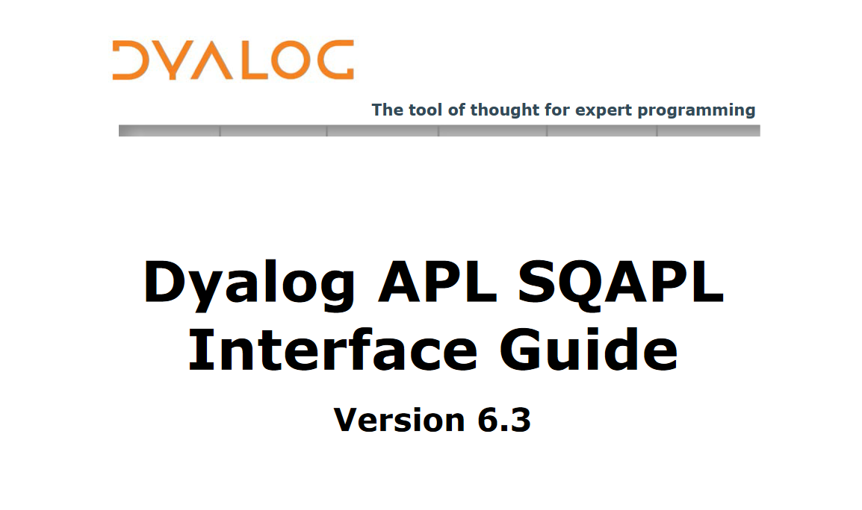

Slide 30
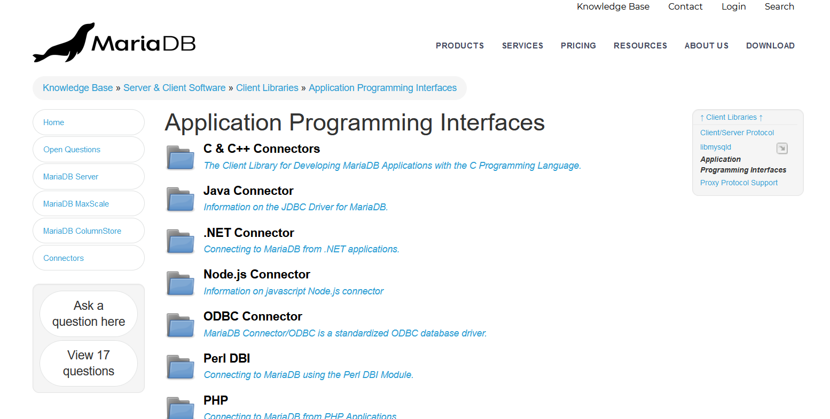

Slide 31
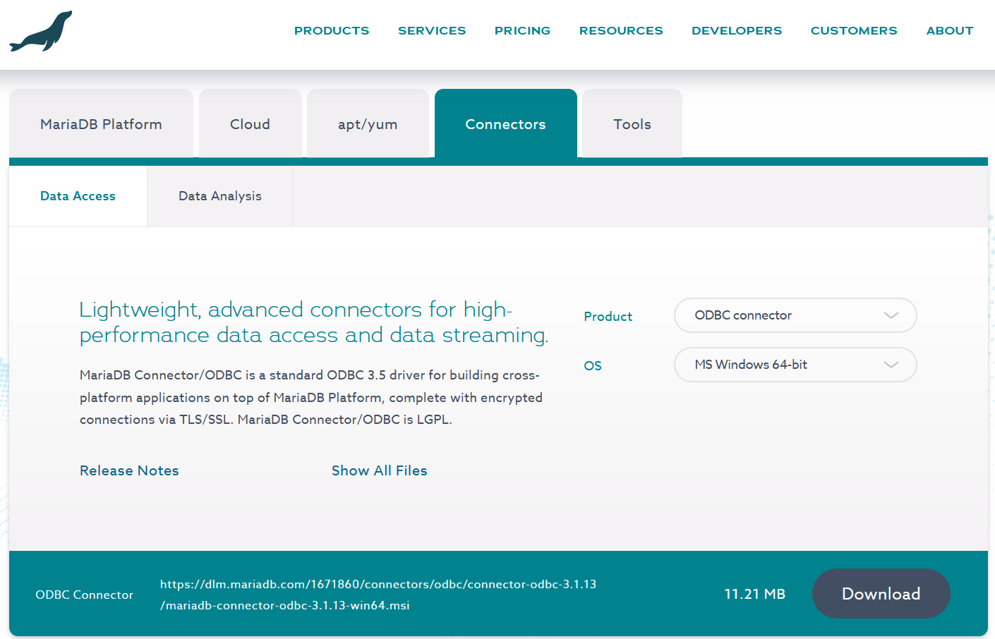

Slide 32
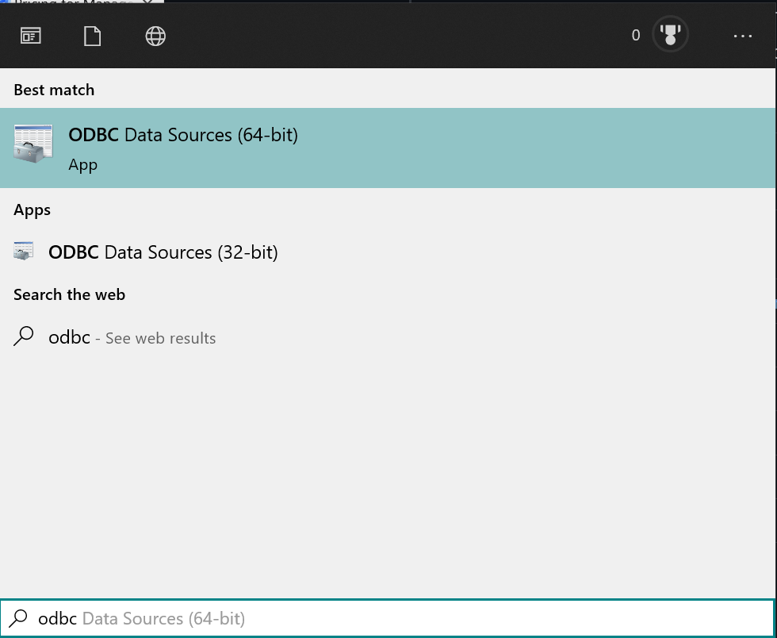

Slide 33
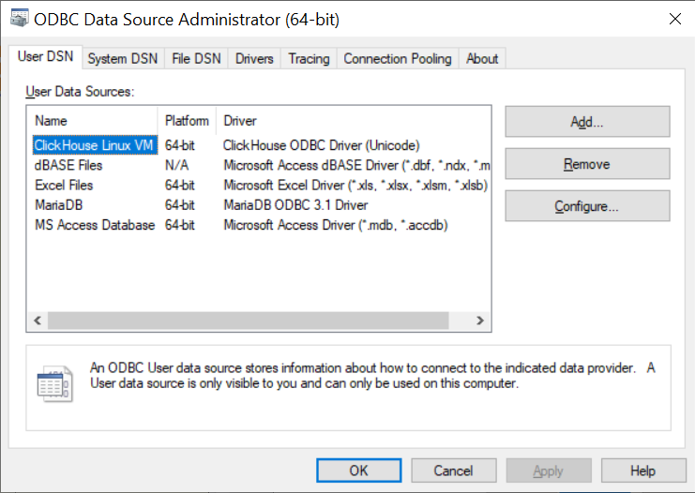
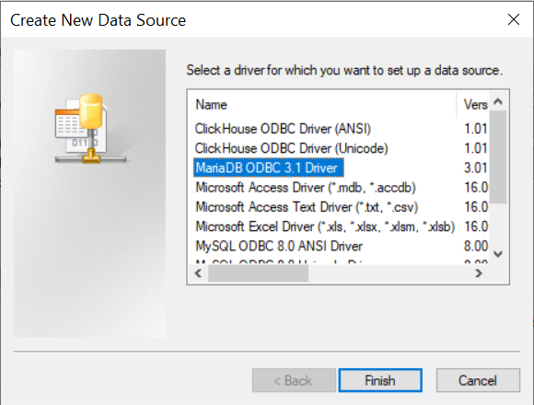
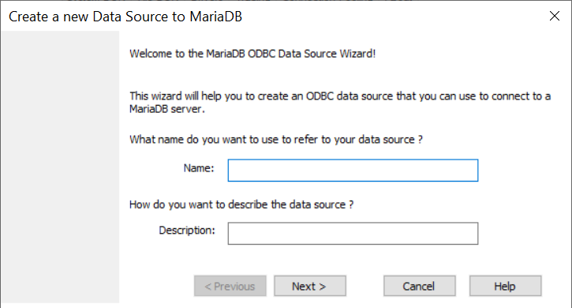

Slide 34
Database
A system of organised data
+
A Query Language

Slide 35
Types
Organisation & Query Language
Relational
Non-relational

Slide 36
Options
APL Matrix
Inverted Tables
Dataframes
DBMS

Slide 37
So much more to cover…
Relational databases
Inverted tables
Permanent storage (component files, memory mapped…)
SQAPL and related tools
Non-relational databases
Time series
Key-value (dictionaries)
Document / Object
Graph
…
Non-ODBC interaction

Slide 38
dyalog.com/dates-for-your-diary.htm
July 15 BAA Open Session
britishaplassociation.org/webinar-schedule-2021
July 30 APL Problem Solving Competition Closes
dyalogaplcompetition.com
August 01 APL Campfire
apl.wiki/campfire
August 05 Error Handling Part 4
dyalog.tv

