Slide 1

Error Handling
Adám Brudzewsky
Part 3

Slide 2
Error Handling – Part 1
Number for given message
aplcart.info?q=:: message
Tradfn structure :Trap errnos (0 means all)
Dfn error guard errnos::code
Error Number of last error ⎕EN
Error Message for number ⎕EM

Slide 3
Error Handling – Part 2
Construct error message
aplcart.info?q=dmx 1
Execute there on error ⎕TRAP←errnos 'E' code
Cut back and execute ⎕TRAP←errnos 'C' code
Ext'd Diagnostic Message ⎕DMX
dyalog.tv

Slide 4
Overview
Signalling an Error
Assertions
Resignalling an Error

Slide 5
Signalling an Event
M←{
(+⌿⍵)÷≢⍵
}
M 3 1 4 1 5
2.8
M ⍬
1

Slide 6
Signalling an Event
M←{
(+⌿⍵)÷≢⍵
}
M 3 1 4 1 5
2.8
M ⍬
DOMAIN ERROR
M ⍬
∧

Slide 7
Signalling an Event
M←{
(+⌿⍵)÷≢⍵
}
M 3 1 4 1 5
2.8
M ⍬
DOMAIN ERROR: Divide by zero
M ⍬
∧

Slide 8
Signalling an Event
M←{
(+⌿⍵)÷≢⍵
}
M 3 1 4 1 5
2.8
M ⍬
MEAN ERROR: Empty 1st axis
M ⍬
∧

Slide 9
Signal Error
^{system function}
⎕SIGNAL

Slide 10
Signal Error
⎕SIGNAL scalar

Slide 11
Signal Error
⎕SIGNAL ┌──── scalar ────┐
errno
⊂name-value pairs

Slide 12
Signal Error
⎕SIGNAL ┌──── scalar ────┐
errno
⊂name-value pairs

Slide 13
Signal Error
M←{
0=≢⍵: ⎕SIGNAL 11
(+⌿⍵)÷≢⍵
}
M 3 1 4 1 5
2.8
M ⍬
DOMAIN ERROR
M ⍬
∧
11::
DOMAIN
ERROR

Slide 14
Signal Error
⎕SIGNAL ┌──── scalar ────┐
errno
⊂name-value pairs

Slide 15
Signal Error
⎕SIGNAL ┌──── scalar ────┐
errno
⊂name-value pairs

Slide 16
Signal Error
name-value pairs

Slide 17
Signal Error
name-value pairs

Slide 18
Extended Diagnostic Message
name-value pairs
⎕JSON⍠'Compact'0⊢⎕DMX
{
"Category": "General",
"DM": [
"DOMAIN ERROR",
" 1÷0",
" ∧"
],
"EM": "DOMAIN ERROR",
"EN": 11,
"ENX": 1,
"HelpURL": "https://help.dyalog.com/dmx/18.0/General/1",

Slide 19
Extended Diagnostic Message
name-value pairs
⎕JSON⍠'Compact'0⊢⎕DMX
{
"Category": "General",
"DM": [
"DOMAIN ERROR",
" 1÷0",
" ∧"
],
"EM": "DOMAIN ERROR",
"EN": 11,
"ENX": 1,
"HelpURL": "https://help.dyalog.com/dmx/18.0/General/1",

Slide 20
Extended Diagnostic Message
name-value pairs
⎕JSON⍠'Compact'0⊢⎕DMX
{
"Category": "General",
"DM": [
"DOMAIN ERROR",
" 1÷0",
" ∧"
],
"EM": "DOMAIN ERROR",
"EN": 11,
"ENX": 1,
"HelpURL": "https://help.dyalog.com/dmx/18.0/General/1",
names values

Slide 21
Signal Error
name-value pairs

Slide 22
Signal Error
name-value pairs

Slide 23
Signal Error
⎕SIGNAL ┌──── scalar ────┐
errno
⊂name-value pairs
'EN' 11
'EM' 'MEAN ERROR'
'Message' 'Empty 1st axis'

Slide 24
Signal Error
⎕SIGNAL
┌──── scalar ────┐
errno
name-value pairs
⊂
'EN'
11
'EM'
'MEAN ERROR'
'Message'
'Empty 1st axis'

Slide 25
Signal Error
⊂
⎕SIGNAL
'EN'
11
'EM'
'MEAN ERROR'
'Message'
'Empty 1st axis'
( )( )(

Slide 26
Signal Error
M←{
0=≢⍵:
(+⌿⍵)÷≢⍵
}
M 3 1 4 1 5
2.8
M ⍬
MEAN ERROR: Empty 1st axis
M ⍬
∧
⎕SIGNAL
'EN'
11
'EM'
'MEAN ERROR'
'Message'
⊂
( )( )(

Slide 27
use-cases
^{for}
⎕SIGNAL

Slide 28
Assert
^{utility function}
{ … ⎕SIGNAL … }
aplcart.info
18.1:
]APLcart

Slide 29
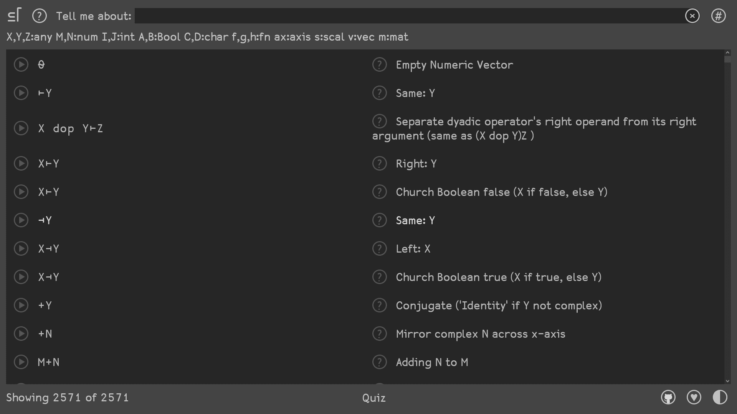

Slide 30
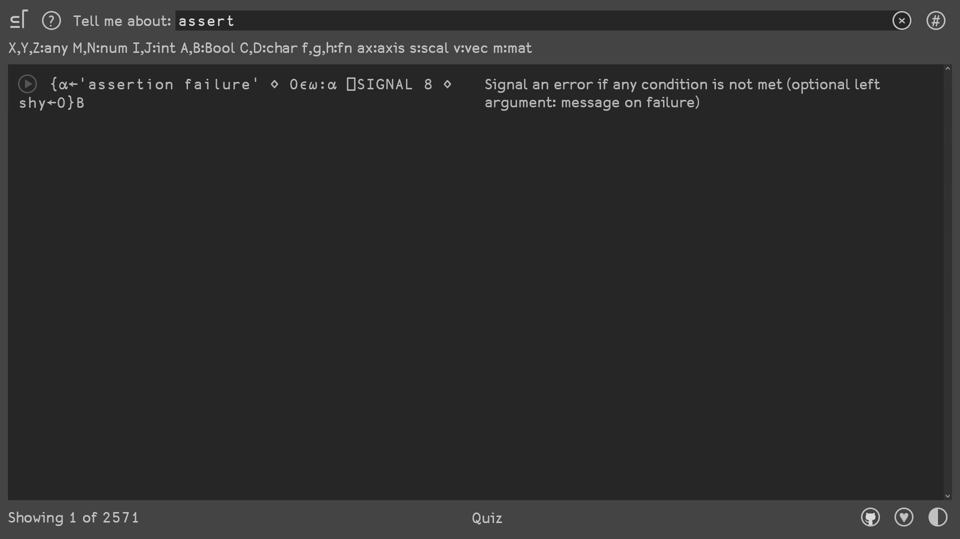

Slide 31
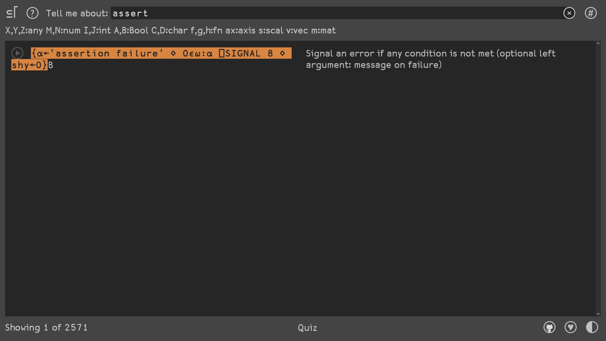

Slide 32
Assert
^{utility function}
{⍺←'assertion failure' ⋄
0∊⍵:⍺ ⎕SIGNAL 8 ⋄
shy←0}

Slide 33
Assert
^{utility function}
{⍺←'assertion failure'
0∊⍵:⍺ ⎕SIGNAL 8
shy←0}
2×{shy←⍵}3
6
2×{shy←⍵ ⋄ }3
VALUE ERROR: No result was provided when the context expected one
2×{shy←⍵ ⋄ }3
∧

Slide 34
Assert
^{utility function}
{⍺←'assertion failure'
0∊⍵:⍺ ⎕SIGNAL 8
shy←0}

Slide 35
Assert
^{utility function}
{⍺←'assertion failure'
0∊⍵:⍺ ⎕SIGNAL 8
shy←0}

Slide 36
⍺ ⎕SIGNAL 8

Slide 37
Signal Error
⍺ ⎕SIGNAL 8
⎕SIGNAL
11
'MEAN ERROR'
⊂('EN' )('EM' )

Slide 38
Signal Error
⍺ ⎕SIGNAL 8
'MEAN ERROR'
⎕SIGNAL
11

Slide 39
Assert
^{utility function}
{⍺←'assertion failure'
0∊⍵:⍺ ⎕SIGNAL 8
shy←0}

Slide 40
Assert
^{utility function}
{⍺←'assertion failure'
0∊⍵:⍺ ⎕SIGNAL 8
shy←0}
2{⍺←10 ⋄ ⍺×⍵}3
6
{⍺←10 ⋄ ⍺×⍵}3
30

Slide 41
Assert
^{utility function}
{⍺←'assertion failure'
0∊⍵:⍺ ⎕SIGNAL 8
shy←0}

Slide 42
Assert
^{utility function}
{⍺←'assertion failure'
0∊⍵:⍺ ⎕SIGNAL 8
shy←0}
{2×⍵}3
6
{r←2×⍵}3
{1+r←2×⍵}3
7
1+{r←2×⍵}3
7

Slide 43
Assert
^{utility function}
{⍺←'assertion failure' ⋄
0∊⍵:⍺ ⎕SIGNAL 8 ⋄
shy←0}

Slide 44
Assert: Use-case
M←{
'MEAN ERROR' Assert 0<≢⍵:
(+⌿⍵)÷≢⍵
}
M 3 1 4 1 5
2.8
M ⍬
MEAN ERROR
M ⍬
∧
{0 ⋄ ⍵}3
0
{0: ⋄ ⍵}3
3
{_←2 ⋄ ⍵}3
3

Slide 45
Assert: Use-case
∇ z←M y
'MEAN ERROR' Assert 0<≢y
(+⌿y)÷≢y
∇
M 3 1 4 1 5
2.8
M ⍬
MEAN ERROR
M ⍬
∧

Slide 46
Assert: Use-case
is.gd/apl2020
SsetTest ← {
Assert 8 = sset 3:
Assert 551872 = sset 857:
Assert 935424 = sset 870:
'Test passed'
}

Slide 47
Resignal Error
^{utility function}
⎕SIGNAL{ … }

Slide 48
Resignal
Lines←{
text←⊃⎕NGET ⍵ 1
≢text
}

Slide 49
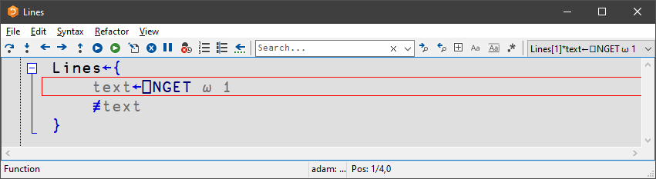
Resignal
Lines '/tmp/my.txt'
42
Lines '/tmp/no.txt'
FILE NAME ERROR: /tmp/no.txt: Unable to open ("T
Lines[1] text←⎕NGET ⍵ 1
∧

Slide 50
Resignal
aplcart.info
Lines←{
0::⎕SIGNAL …
text←⊃⎕NGET ⍵ 1
≢text
}
0::
ALL ERRORS

Slide 52
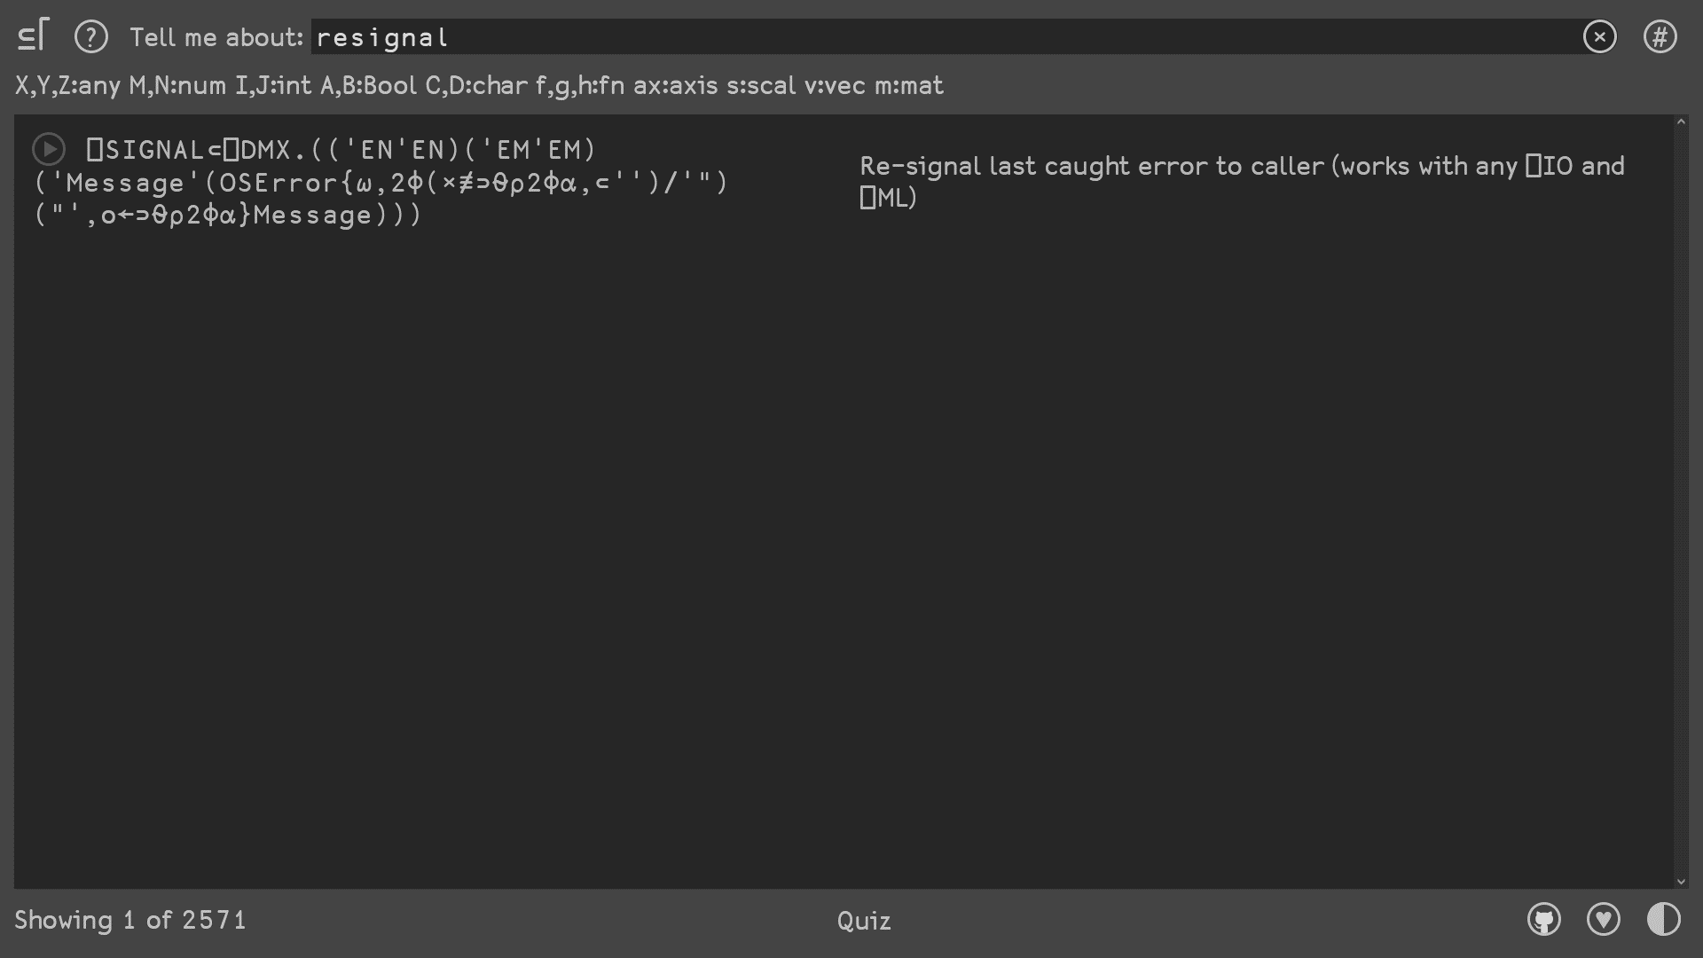

Slide 53
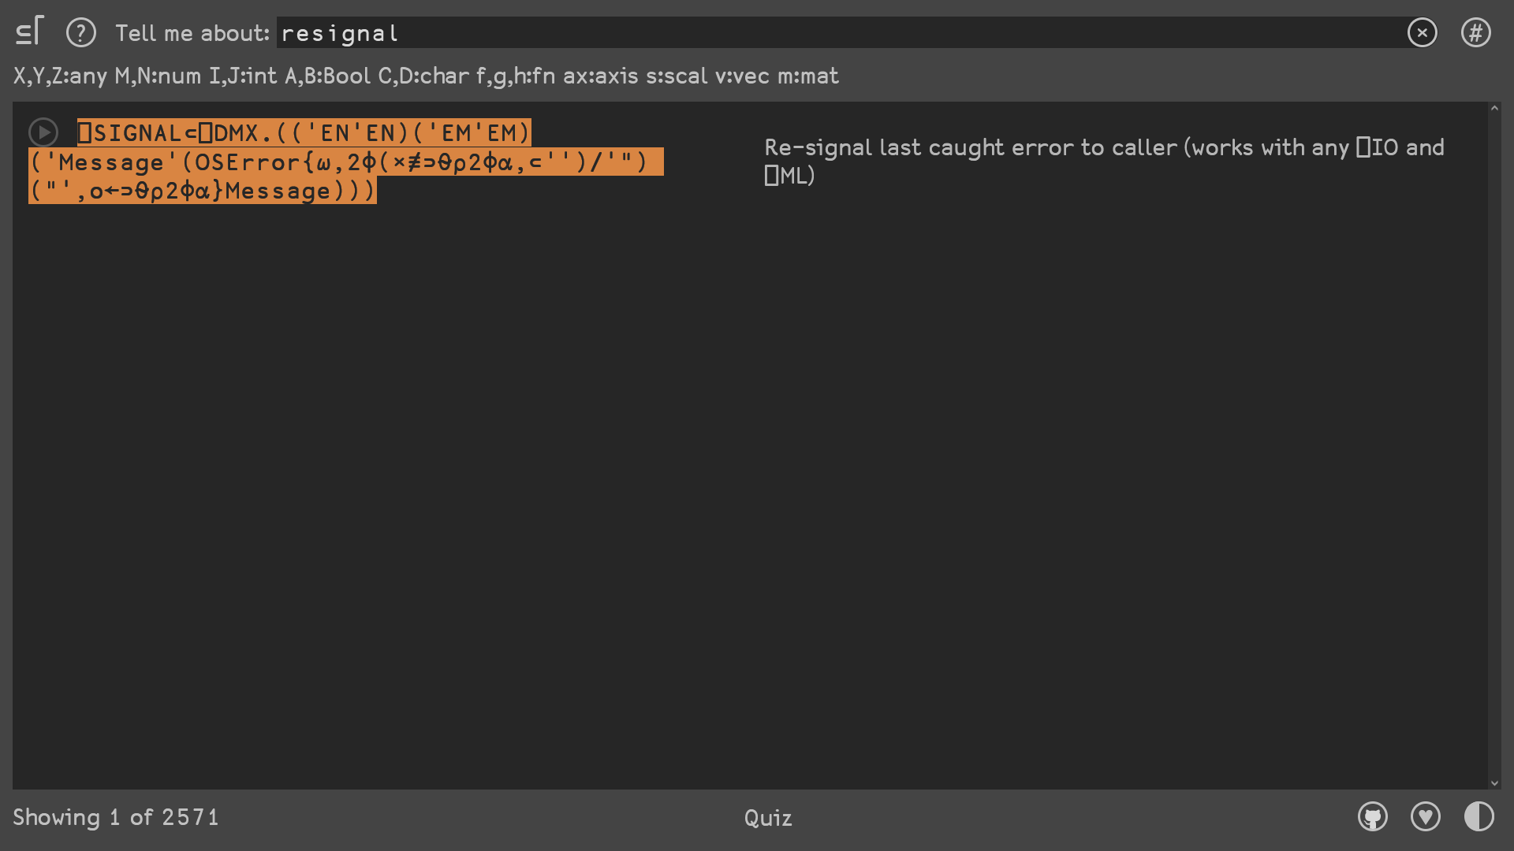

Slide 54
Resignal
Lines←{
0::⎕SIGNAL⊂⎕DMX.(('EN'EN)('EN'EM)('Mes
text←⊃⎕NGET ⍵ 1
≢text
}

Slide 55
Resignal
Lines '/tmp/my.txt'
42
Lines '/tmp/no.txt'
FILE NAME ERROR: /tmp/no.txt: Unable to open fil
Lines'/tmp/no.txt'
∧

Slide 56
Resignal
Lines←{
0::resignal
text←⊃⎕NGET ⍵ 1
≢text
}
∇ resignal
⎕SIGNAL⊂⎕DMX.(('EN'EN)('EM'EM)('e'(OSE
∇

Slide 57
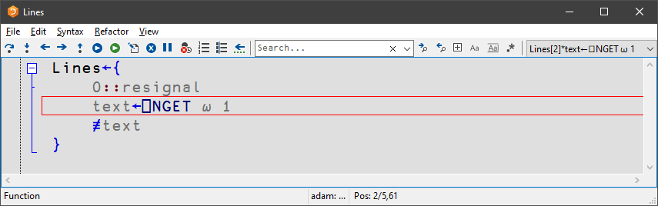
Resignal
Lines '/tmp/my.txt'
42
Lines '/tmp/no.txt'
FILE NAME ERROR: /tmp/no.txt: Unable to open fil
Lines[1] 0::resignal
∧

Slide 58
Resignal
Lines←{
0::resignal
text←⊃⎕NGET ⍵ 1
≢text
}
∇ resignal
⎕SIGNAL⊂⎕DMX.(('EN'EN)('EM'EM)('Me'(OSE
∇

Slide 59
Resignal
Lines←{
0::Resignal ⍬
text←⊃⎕NGET ⍵ 1
≢text
}
Resignal←{⎕SIGNAL⊂⎕DMX.(('EN'EN)

Slide 60
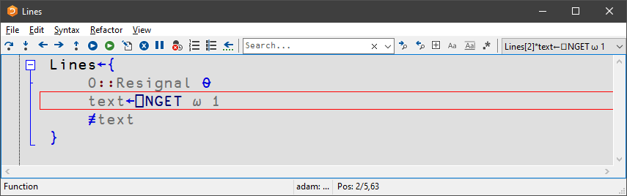
Resignal
Lines '/tmp/my.txt'
42
Lines '/tmp/no.txt'
FILE NAME ERROR: /tmp/no.txt: Unable to open fil
Lines[1] 0::Resignal ⍬
∧

Slide 61
Resignal
Lines←{
0::Resignal ⍬
text←⊃⎕NGET ⍵ 1
≢text
}
Resignal← ⊂⎕DMX.(('EN'EN)
⎕SIGNAL
{

Slide 62
Resignal
Foo←{Goo ⍬}
Goo←{⎕SI}
Foo ⍬
┌───┬───┐
│Goo│Foo│
└───┴───┘
Foo←{Goo ⍬}
Goo←⍎∘'⎕SI'⊢∘#
Foo ⍬
┌───┐
│Foo│
└───┘
Lines←{
0::Resignal ⍬
text←⊃⎕NGET ⍵ 1
≢text
}
Resignal← ⊂⎕DMX.(('EN'EN)
Stack Indicator
⎕SIGNAL
{

Slide 63
Resignal
Lines '/tmp/my.txt'
42
Lines '/tmp/no.txt'
FILE NAME ERROR: /tmp/no.txt: Unable to open fil
Lines'/tmp/no.txt'
∧

Slide 64
Error Handling – Part 3
F1
Press F1 for full docs!
Signal an error: ⎕SIGNAL errno
Signal a custom error: ⎕SIGNAL⊂name-value pairs
Assert: aplcart.info?q=assert
Resignal: aplcart.info?q=resignal

Slide 65
Upcoming webinars
Jun 17 BAA AGM (Annual General Meeting)
Jun 24 - - -
July 1 BAA open session
July 8 Dyalog TBD
July 15 BAA open session
July 22 - - -
July 29 BAA open session
Aug 5 Dyalog Error handling – pt. 4
britishaplassociation.org

