Slide 1

Jupyter Notebooks in Dyalog APL
Adám Brudzewsky

Slide 2
What are notebooks?
A notebook combines the functionality of
  a word processor — handles formatted text
  a "shell" or "kernel" — executes statements in a programming language and includes output inline
  a rendering engine — renders
  HTML in addition to plain text

Slide 3
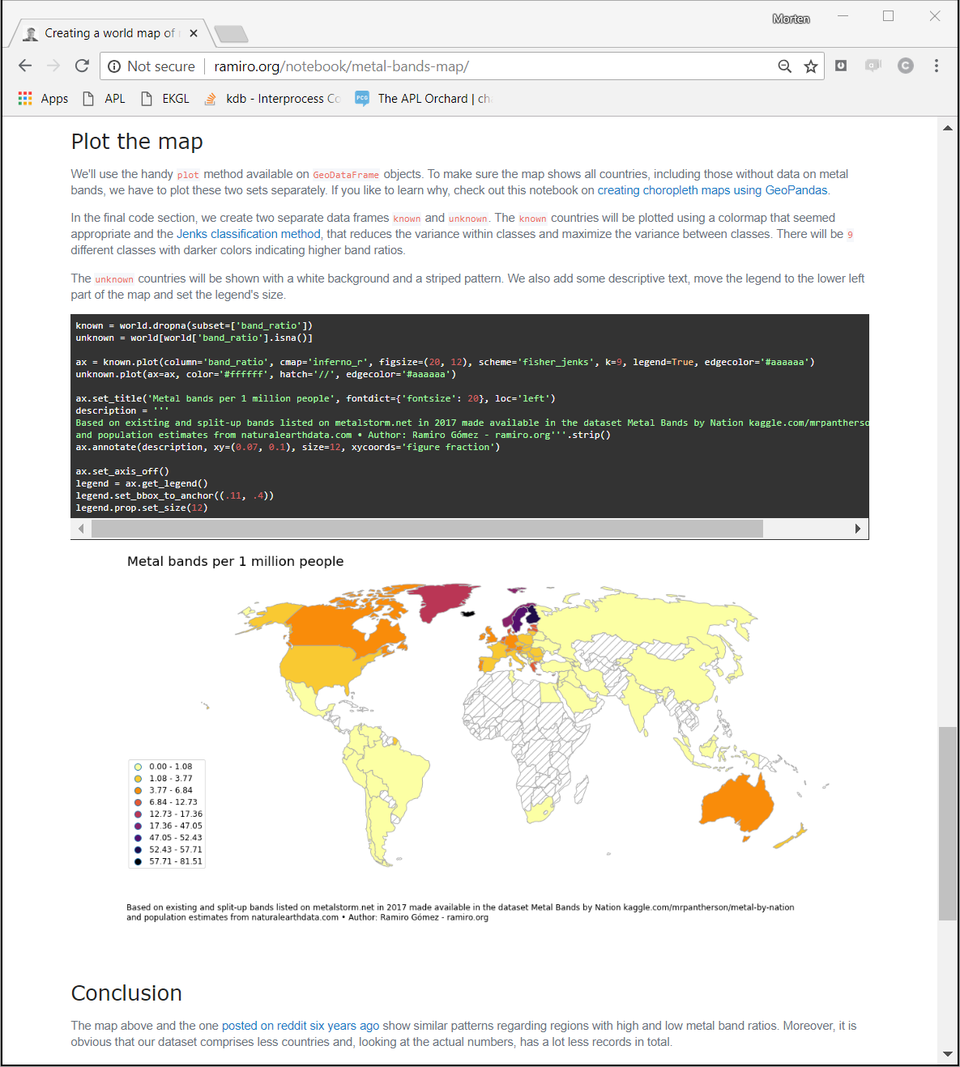
1½
Example notebook
using Python
global density
of metal bands

Slide 4
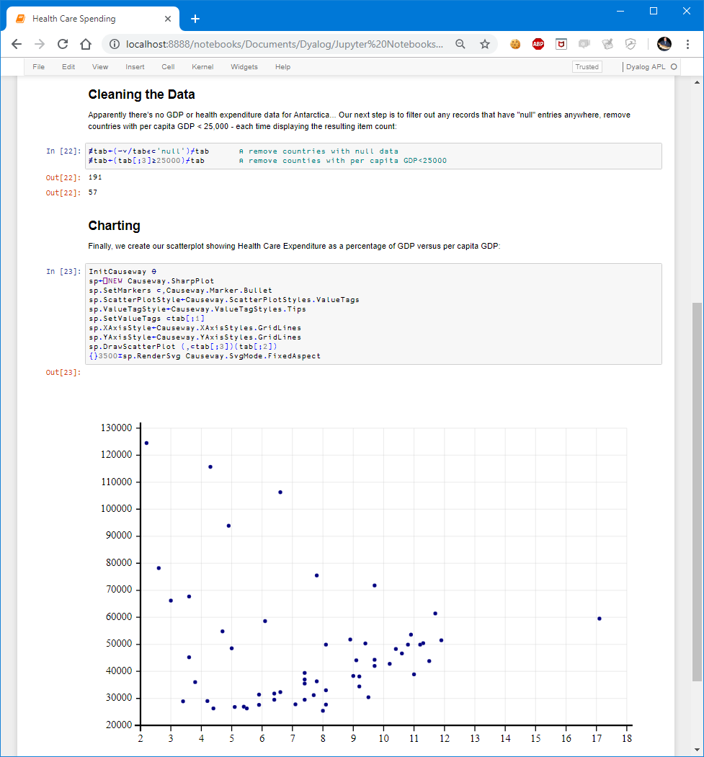
1½
Example notebook
using Dyalog APL
health care expenditure vs GDP per capita

Slide 5
Notebook benefits
A single document that combines explanations with executable code and its output — an ideal way to provide:
  reproducible research results
  documentation of processes
  instructions
  tutorials and training materials of all shapes and sizes
A digital learning environment
for computational thinking

Slide 6

What is Jupyter notebook?
One of the most
significant advances
in the scientific computing arena
University Corporation
for Atmospheric Research
First notebook: Mathematica 1.0 in '88
Jupyter notebook is a part of
Project Jupyter, a nonprofit to
develop open-source software,
standards, and services for
interactive computing across
dozens of programming languages
beginning with Julia, Python, R, and now
over 70 languages, including Dyalog APL

Slide 7
Ways to use Jupyter notebooks
On your own computer after installing a Jupyter notebook server
With an online notebook server like cocalc.com
Save notebook with output and use a notebook viewer
Export to HTML, PDF, L^{A}T_{E}X, etc.

Slide 8
Local notebook server — Python
Anaconda
Python platform
interpreter
Python
notebook server
localhost:8888
web browser
Jupyter kernel
for Python

Slide 9

Local notebook server — APL
Anaconda
Python platform
interpreter
Dyalog APL
notebook server
localhost:8888
web browser
RIDE protocol
Jupyter kernel
for Dyalog APL

Slide 10
Setting up local notebook server
github.com/Dyalog/dyalog-jupyter-kernel/wiki
Install Dyalog ☺
Install Dyalog's Jupyter kernel
Install Anaconda
Launch Jupyter notebook server
  installation instructions

Slide 11
Demo
github.com/Dyalog/dyalog-jupyter-kernel/wiki
Installing Jupyter
Opening a notebook
Modifying content

Slide 12
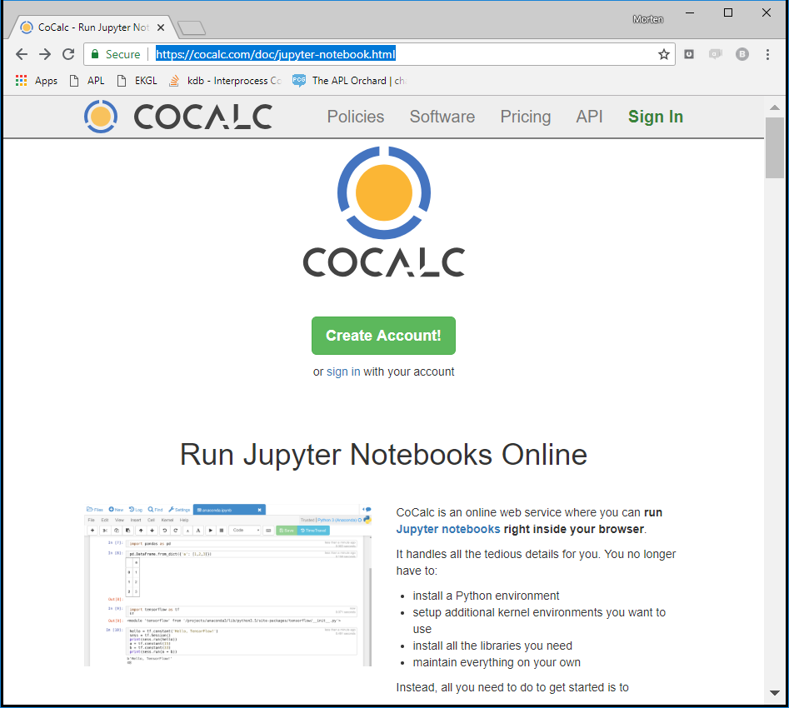
Online notebook servers
There are
online services
for various programming
languages

Slide 13
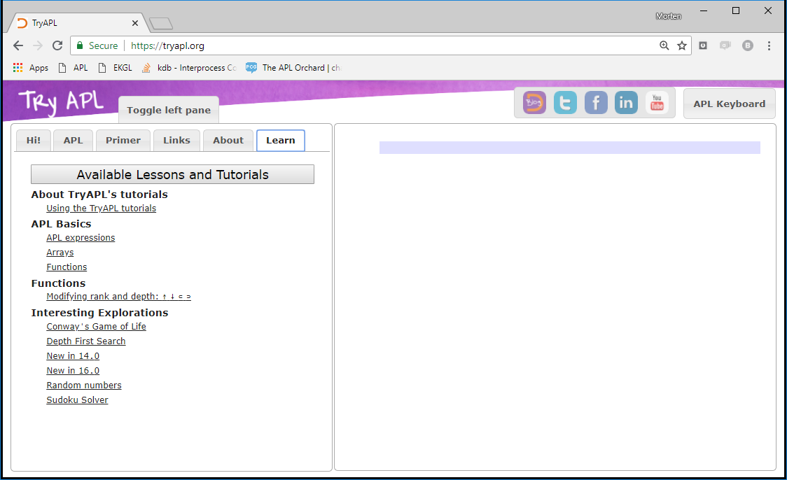
Online notebook servers
TryAPL's
lessons
are now
Jupyter
notebooks
More lessons and features on the way
→ TryAPL presentation
at Dyalog '18 in Belfast

Slide 14
Online notebook servers
Benefit: nothing to install
you may need to sign up for an account
To protect servers, host may place restrictions
or run in a sandbox with limited connectivity
Notebooks can execute any code
all code is run on the host server
same privileges as local execution

Slide 15
Static notebook viewers
Notebooks are stored as .ipynb files
.ipynb files are in JSON format
each code cell may include output from the last execution
You can share an .ipynb file
anyone with a local notebook server can view it
… but of course cannot execute anything new
Many online systems have viewers
GitHub's file previewer
Project Jupyter's nbviewer.jupyter.org

Slide 16
Exported notebooks
Notebooks can be exported to many standard
for example HTML, PDF, and L^{A}T_{E}X
Some formats require 3rd party plug-ins
Exported notebooks are static
expressions cannot be re-executed

Slide 17
Demo
Creating a new notebook document
Generating rich output

Slide 18
Ways to use notebooks — recap
Installing a Jupyter notebook server on your PC
Use an online notebook server like cocalc.com
Store the notebook with output, then open in a notebook viewer
Export to HTML, PDF, L^{A}T_{E}X, …

Slide 19
Ask questions now!
Wiki github.com/Dyalog/dyalog-jupyter-kernel/wiki
Email notebooks@dyalog.com

Slide 20
Ask questions now!
Wiki github.com/Dyalog/dyalog-jupyter-kernel/wiki
Email notebooks@dyalog.com
Thank you
Technology Partnership (tp.rs)
for the prototype APL kernel

Slide 21
Ask questions now!
Wiki github.com/Dyalog/dyalog-jupyter-kernel/wiki
Email notebooks@dyalog.com
Thank you
Will Robertson (our summer intern)
for working on the kernel
and creating many notebooks
Interested in an internship?
Email careers@dyalog.com

Slide 22
Ask questions now!
Wiki github.com/Dyalog/dyalog-jupyter-kernel/wiki
Email notebooks@dyalog.com
Thank you
Gil Athoraya (of Optima Systems)
for implementing syntax colouring

Slide 23
Ask questions now!
Wiki github.com/Dyalog/dyalog-jupyter-kernel/wiki
Email notebooks@dyalog.com
Thank you
for watching

Slide 24


Webinars on Thursdays at 16:00 UTC
Comment and suggest to webinar@dyalog.com or
@Adám in chat.stackexchange.com/rooms/52405
  No webinar in October due to Dyalog '18 in Belfast October 28th–November 1st
  many sessions will be livestreamed
General APL Questions
stackoverflow.com

